Slide 1
Superfun Time!!!!!
Brendan Moriarty

Slide 2
About me
About TPL
About my job
My system
My enlightenments

Slide 4
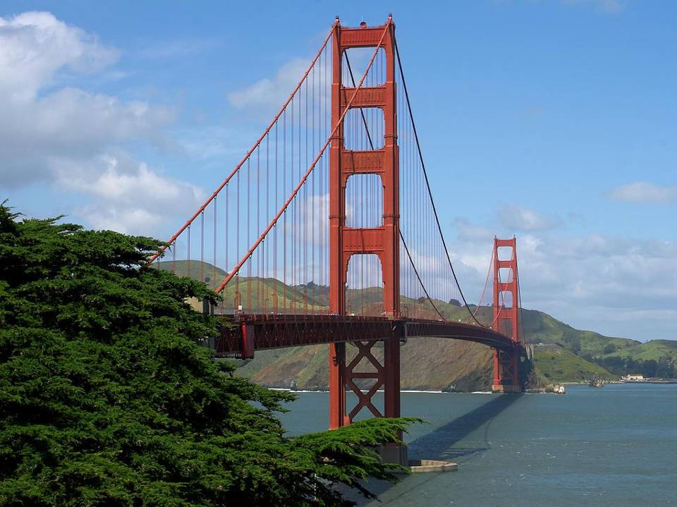
Golden Gate Bridge ~ San Francisco, CA
Photo by TPL File Photo

Slide 5
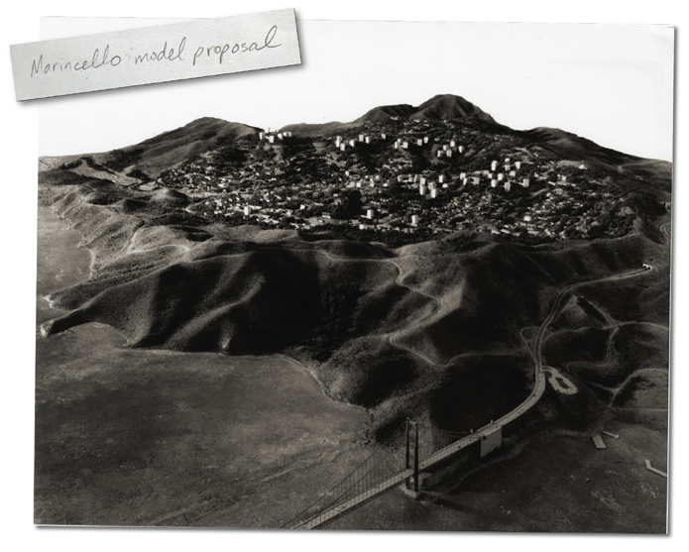
Marincello / Gerbode Valley, GGNRA ~ Marin, CA
http://quietamerican.org/related.html

Slide 6
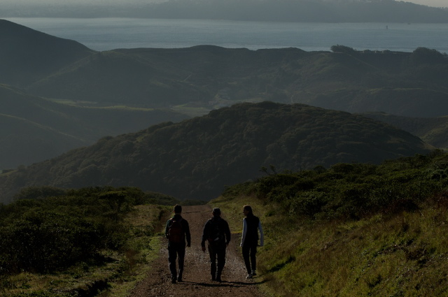
Marincello / Gerbode Valley, GGNRA ~ Marin, CA
Photo by Meliissa Harris

Slide 7
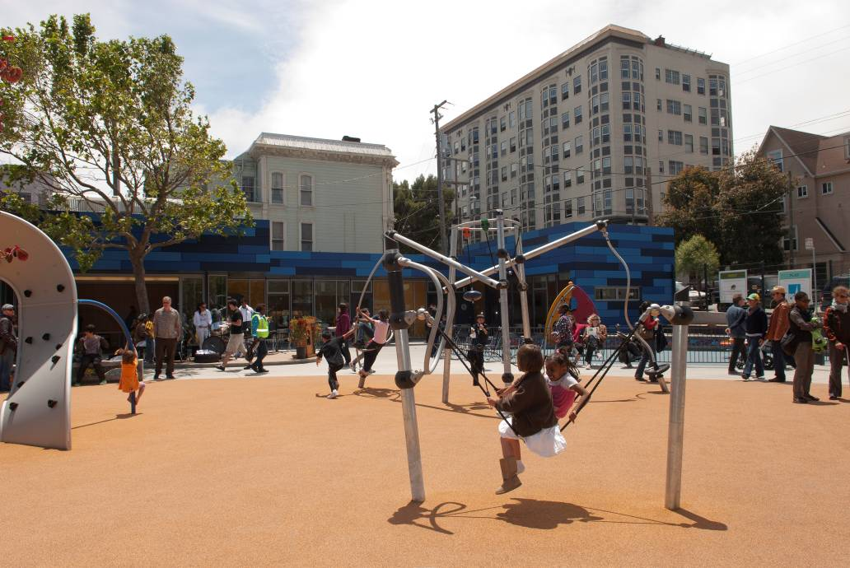
Hayes Valley Playground & Clubhouse ~ San Francisco, CA
Photo by Pat Mazzera
Notes:
Urban parks & community gardens

Slide 8
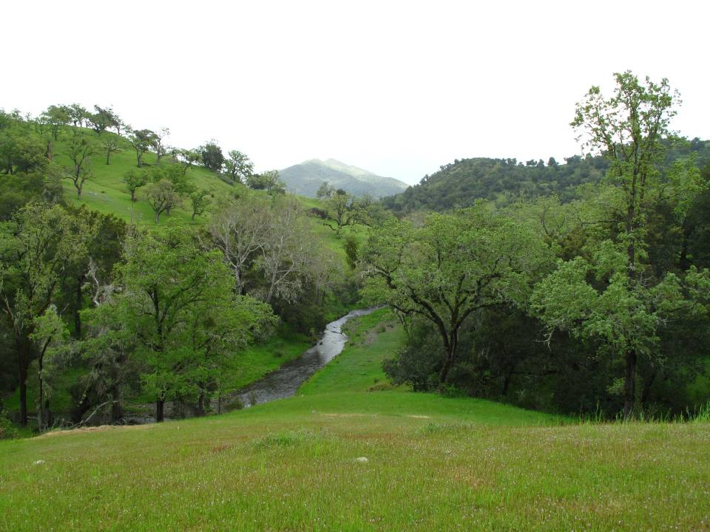
Atascadero Creek ~ Atascadero, CA
Photo by Meliissa Harris
Notes:
Natural lands

Slide 9
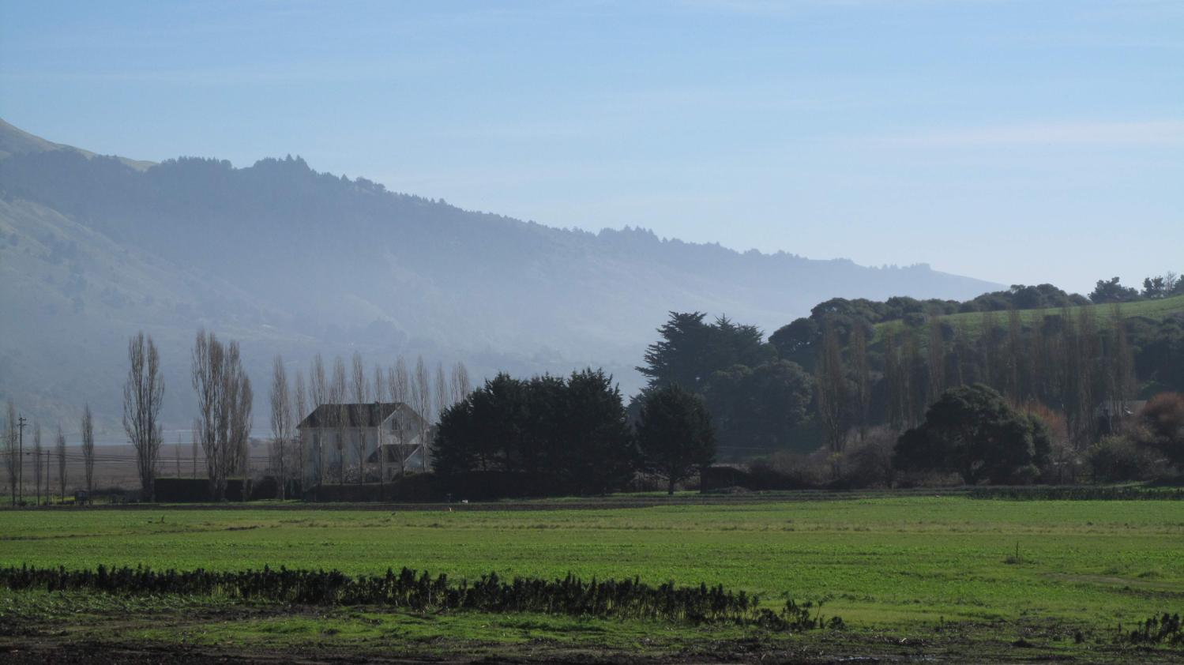
Star Route Farms ~ Bolinas, CA
Photo by Meliissa Harris
Notes:
Natural lands

Slide 12
Launch Day

Slide 13
My system

Slide 14
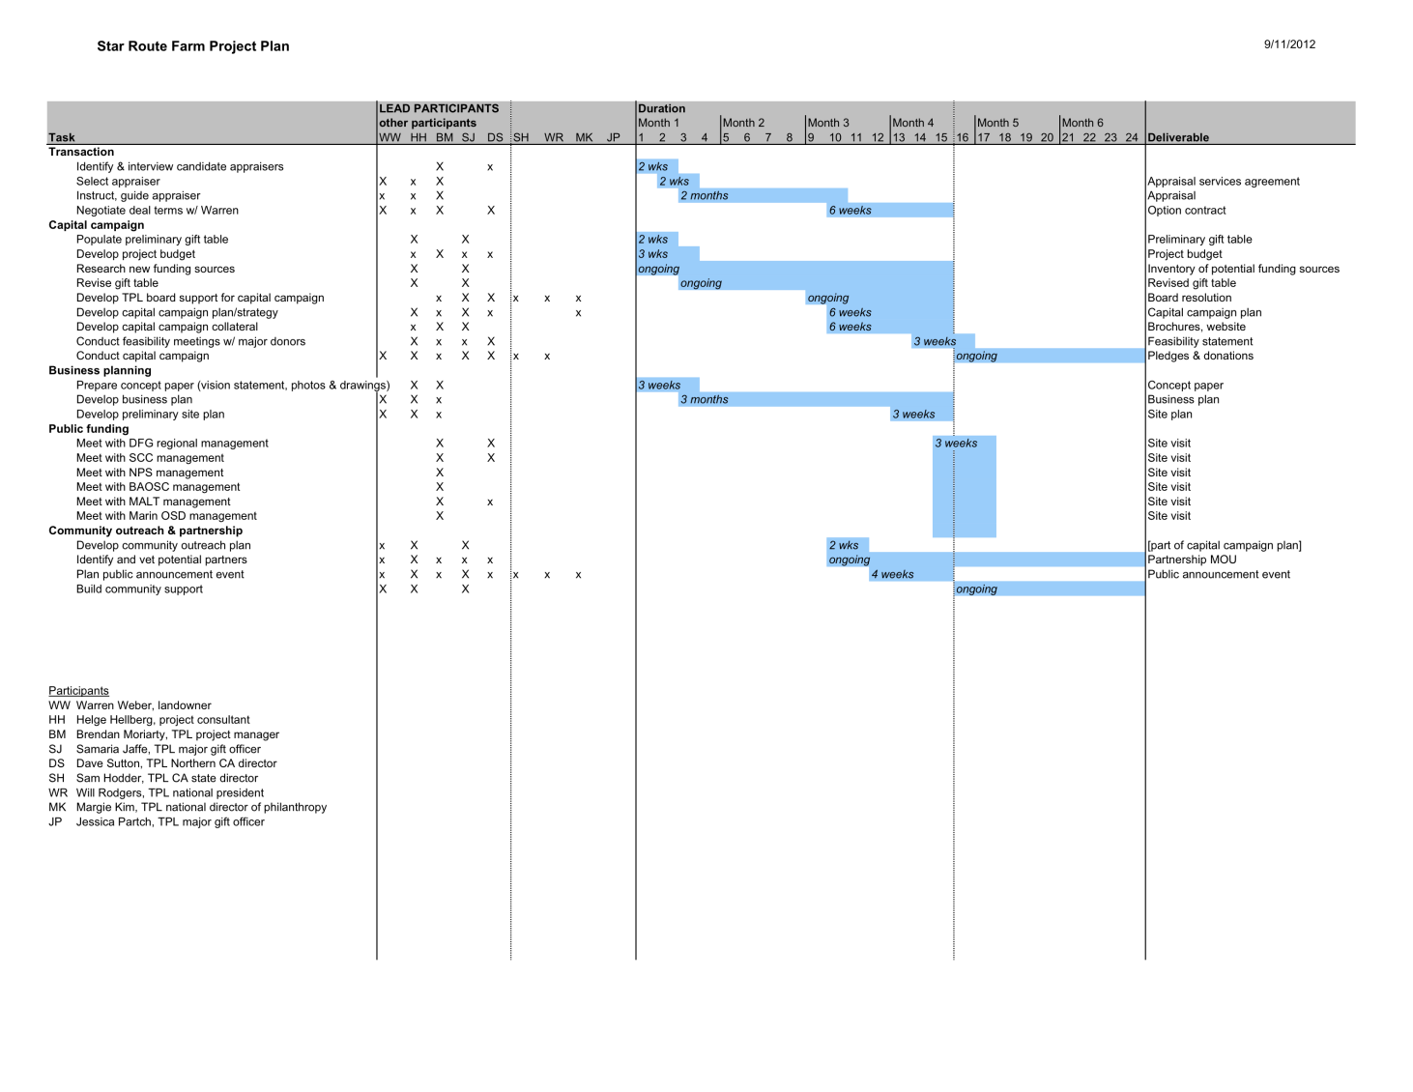

Slide 15
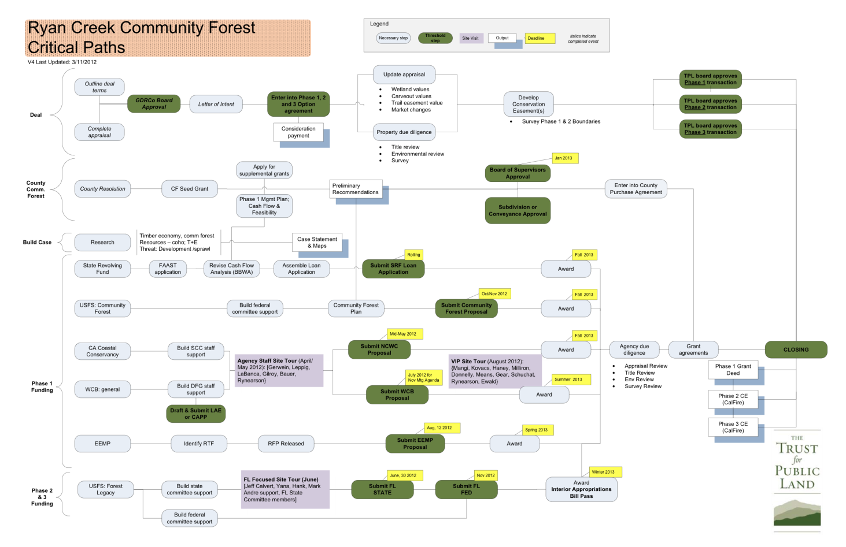

Slide 16
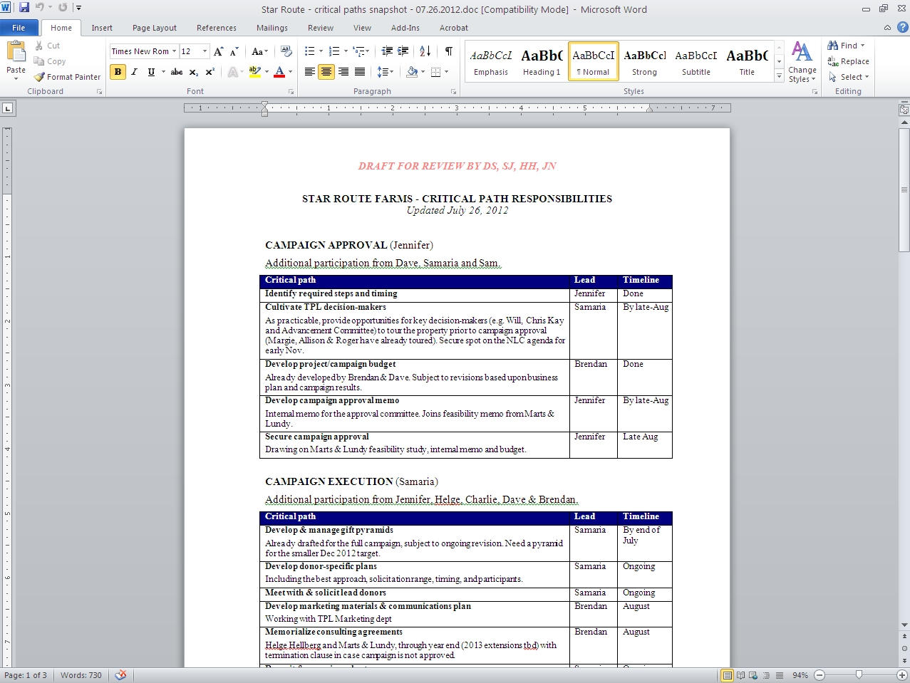

Slide 17
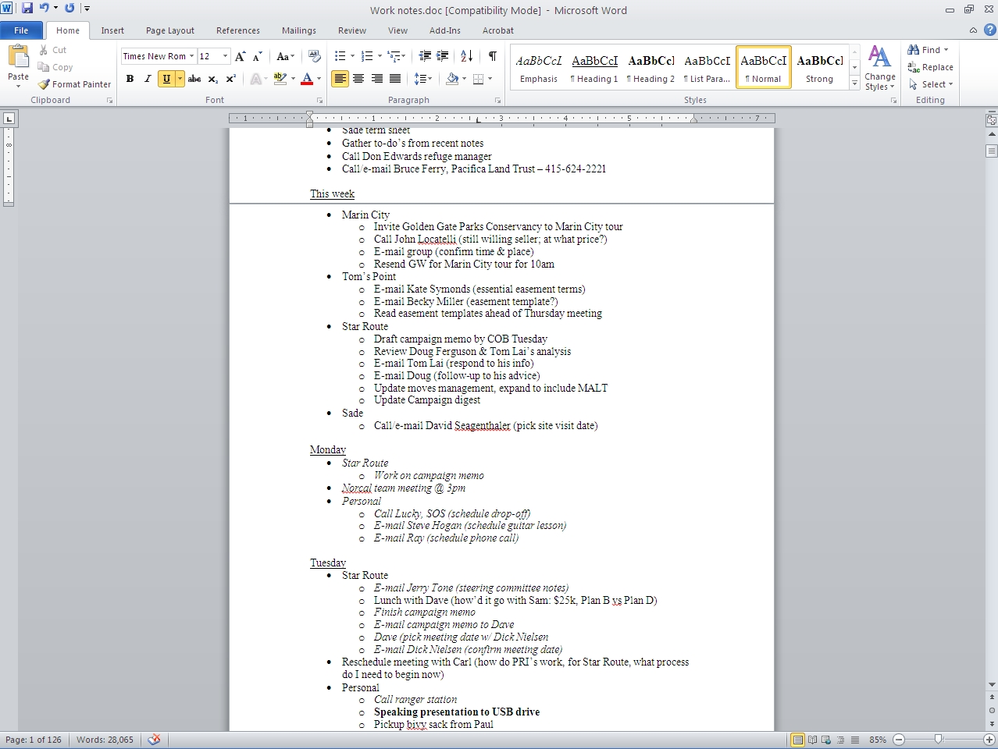
Notes:
Show live file

Slide 18
