Slide 1
Continuous Improvement: Agile, Scrum, Kanban...
PM 290 Nov 0812
Notes:
Me
- Dudley Emmert
Sr Ecommerce Product Manager – Mobile, Esurance
Certified as Scrum Manager, Scrum Product Owner, Scrum Pro
Credentialled for RUP (though it’s been a loooong time...)
Delighted to be here...
Exploring Scrum this evening, but from two directions.
We want to anchor our discussion with your textbook (Wysocki / Effective Project Management) – what Wysocki calls APM or Agile Project Management. (Chapter 11)
We want to look at Scrum within the broader Agile family of methodologies. From my perspective, Scrum is the son of Agile and the brother of Kanban (more about Kanban later) – and we’ll look at the whole family... (And more about Kanban later...)
But let’s start with some brainstorming ---
In a word. What is “Scrum?”
Now – an activity!
~~~~~~~~~~~~ Ball Point Game ~~~~~~~~~~~~~
Chart: Game | Estimate | Actual | Optimizations

Slide 2
Ball Point Game...
The object of the game is to pass as many balls as possible through the team in 3 minutes. The rules:
if you’ve played this game before, please participate silently so you don’t spoil it for others.
you are one big team – you cannot change your team size.
every team member must touch each ball for it to count.
as each ball is passed between team members, it must have air time, i.e. It must not be passed directly from hand to hand.
you cannot pass the ball to the person immediately to your left or right.
if you drop a ball, you cannot pick it up.
there will be a penalty (points deducted) if you break any of the rules.
every ball must end where it started to be counted.
You have 5 minutes to self-organize, plan your approach, and come up with an estimate of how many balls the team can move through the entire process in 3 minutes.
You will then play the game for 3 minutes.
You will then spend 2 minutes discussing how to optimize the process, note what the team has decided on the chart, and make another estimate.
Then play again, and so-forth...
In all, you will do 5 iterations, recording the estimate, actual result, and optimizations each time.
Notes:
We’ll need one person to count...

Slide 3
Agile: Scrum, Kanban
Imagine a continuum of projects that range from situations where almost all of the solution is clearly and completely defined to situations where very little of the solution is clearly and completely defined. This is the range of projects that occupy the APM quadrant...¹
Because there is no known solution, a TPM approach, which requires a complete RBS and WBS, will not work.²
1. Wysocki, Robert K. (2011-02-25). Effective Project Management: Traditional, Agile, Extreme (Kindle Locations 7007-7009). John Wiley and Sons. Kindle Edition.
2. Wysocki, Robert K. (2011-02-25). Effective Project Management: Traditional, Agile, Extreme (Kindle Location 7136). John Wiley and Sons. Kindle Edition.
Notes:
First Statement: This doesn’t take imagination – this is every PM’s experience... This is the way that it is...
Second Statement: Incomplete RBS (Requirements Breakdown Structure) implies incomplete WBS (Work Breakdown Structure) – so a TPM approach would not be adequate...
Aside: Wysocki’s suggestion that we should mix / match project management methodologies to specific project needs is quite compelling – would love to see this occur in an organization...

Slide 4
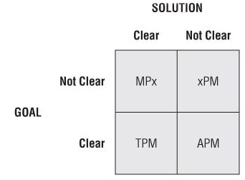
Agile: Scrum, Kanban
Agile
Wysocki, Robert K. (2011-02-25). Effective Project Management: Traditional, Agile, Extreme (Kindle Locations 7007-7009). John Wiley and Sons. Kindle Edition.
Notes:
Wysocki’s Quadrant 1 (lower-left) is traditional product management, then clockwise to APM Agile Product Management, then Extreme, then Emertxe (whatever that means).
Aside: Emertxe is a bit tough to get my head around – no goal and no solution... One obvious application would be in a “lab” setting, like OK Cupid Labs or Heroku Labs, where a highly talented team is brought together with the delightful and daunting assignment to “innovate.”

Slide 5
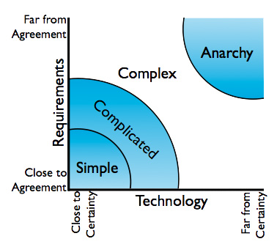
Agile: Scrum, Kanban
Agile
Stacey, Ralph. “Management and Organizational Dynamics”. Agile Software Development with Scrum by Ken Schwaber & Mike Beedle
Notes:
Wysocki defines complexity by goal / solution.
Stacey defines complexity by requirements / technology.
Either way, Agile comes into play as these dimensions move from known to unknown, or even agreement → lack of agreement. (Which is an interesting concept; Agile as a methodology for building consensus...)
We used Scrum (“management team scrum”) as a business process at a startup names Songbird; it worked remarkably well...
As a PM, I found – and you will likely find – that building consensus is a very big part of your job...

Slide 6
Agile: Scrum, Kanban
We are uncovering better ways of developing
software by doing it and helping others do it.
Through this work we have come to value:
Individuals and interactions over processes and tools
Working software over comprehensive documentation
Customer collaboration over contract negotiation
Responding to change over following a plan
That is, while there is value in the items on
the right, we value the items on the left more.
"Manifesto for Agile Software Development". agilemanifesto.org. n.d. Web. 27 Oct 2012. <http://agilemanifesto.org>
Notes:
Read...
Does anyone find any part of this particularly interesting?
Note that this focuses on software – Wysocki mentions this as well.
Note also that the manifesto values the items on the left MORE, but not EXCLUSIVELY.
Thoughts?
So that’s Agile – let’s look at Scrum...

Slide 7
Agile: Scrum, Kanban
Scrum is an iterative and incremental agile software development framework for managing software projects and product or application development... Scrum focuses on project management [scenarios] where it is difficult to plan ahead.¹
Scrum is founded on the principle that bringing people together to self-organize within a loosely-structured way of working will enable them to observe what is happening and to improve it.²
1. “Scrum (development).” Wikipedia, The Free Encyclopedia. Wikimedia Foundation, Inc.. 5 Oct 2012. Web. 11 Oct 2012 . <http://en.wikipedia.org/wiki/Scrum_(development)>
2. “Agile Atlas.” The Scrum Alliance. 14 Oct 2012. Web. 15 Oct 2012 . <http://agileatlas.org/atlas/scrum>
Notes:
Read...
Any surprises here? Anything jump out at you?
For me, the second statement emphasizes continuous improvement – which is somewhat at variance with what Wysocki is emphasizing... (Wysocki’s approach isn’t as team-centric as I’d prefer... And I think that’s where Scrum can really create value...)

Slide 8
Agile: Scrum, Kanban
“The… ‘relay race’ approach to product development… may conflict with the goals of maximum speed and flexibility. Instead a holistic or ‘rugby’ approach – where a team tries to go the distance as a unit, passing the ball back and forth – may better serve today’s competitive requirements.”
Hirotaka Takeuchi and Ikujiro Nonaka, “The New New Product Development Game”, Harvard Business Review, January 1986.
Notes:
The seminal work on Scrum...
Scrum Origins:
Jeff Sutherland
Initial scrums at Easel Corp in 1993
IDX and 500+ people doing Scrum
Ken Schwaber
ADM
Scrum presented at OOPSLA 96 with Sutherland
Author of three books on Scrum
Mike Beedle
Scrum patterns in PLOPD4
Ken Schwaber and Mike Cohn
Co-founded Scrum Alliance in 2002, initially within the Agile Alliance
Cohn, Mike. ”An Introduction to Scrum". Mountain Goat Software, LLC. 6 June, 2012. Web. 27 Oct 2012. <http://www.mountaingoatsoftware.com/presentations/an-introduction-to-scrum>

Slide 9
Agile: Scrum, Kanban
Kanban is a method for managing the creation of products with an emphasis on continual delivery while not overburdening the ... development team. Kanban schedules software development ... so that teams can determine what to produce, when to produce it, and how much to produce...
"Top Kanban Blogs". VersionOne: Agile Made Easier." VersionOne, Inc.. n.d. Web. 12 Oct 2012. <http://blogs.versionone.com/agile_management/2012/07/05/top-kanban-blogs/>
Notes:
We’ll get into the details of Scrum in a moment, but first I want to mention Kanban...
Read...
Kanban is Scrum’s little sister. I mention it because I’m seeing it more and more – particularly around startups... I don’t want you to be caught flat-footed...

Slide 10
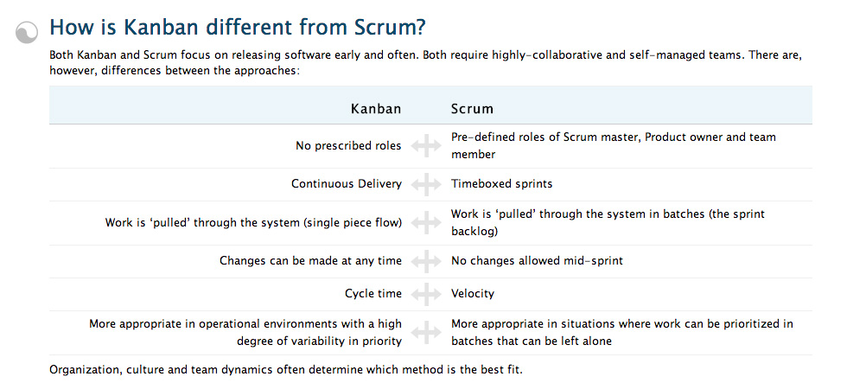
Scrum vs. Kanban
"What is Kanban?". VersionOne: Agile Made Easier. VersionOne, Inc.. n.d. Web. 11 Oct 2012. <http://www.versionone.com/what-is-kanban/>
Notes:
Kanban has many similarities to Scrum, and a few important differentiators...
Biggest differentiator for me is Kanban’s “Continuous Delivery” vs. Scrum’s “Timeboxed Sprints.”
Q: Where would this sit in Wysocki’s 4 quadrants?

Slide 11
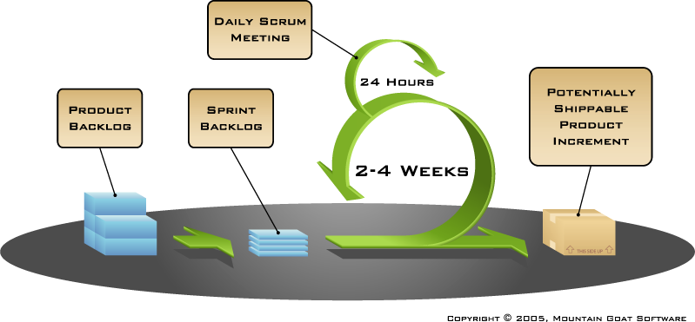
Scrum in a Nutshell...
Notes:
Back to Scrum – and the money shot.
A product backlog looks much like a business requirements repository (RBS, BRD, PRD), but these are stated somewhat differently – as a “Story” that is expressed like this: As a first-time customer, I want to create a user account with an ID and a password so that I can log-in to the system.”
USER → ACTION → SO THAT...
A sprint backlog is a prioritized list of stories that the scrum team has committed to finishing during the sprint.
Note that sprints are suggested to be 2-4 weeks – I prefer 2 weeks... Faster learning...
Daily scrum...
Potentially shippable product increment...
Huge implications – this is where Scrum gained a street reputation for “delivering fast.” But there are also huge QA and quality implications here:
Many would say that Scrum lacks flexibility on the Quality dimension of the scope triangle – everything needs to be high-quality in order to be released... This becomes more relevant when we consider implementation of Scrum on an existing product or systems where technical debt is significant... more on that later...

Slide 12
Scrum teams...
Typically 5-9 people.
Developers, Engineers, DB Admins, QA Testers, UI / UX Designers, Scrum Master, Product Owner...
Optimally, most team members will be allocated 100% to a single scrum.
Optimally, the team will be co-located & is largely self-organizing.
Membership should change only between sprints.
Notes:
One thing I neglected to say here: The team is everything – scrum succeeds or fails based on the team.
Mike Cohn: When a team achieves self-accountability (like a football team or a rugby team or a baseball / cricket team) then you’ve succeeded. Else, failure.

Slide 13
Roles unique to Scrum...
Product Owner
Defines the features of the product and is often responsible for the profitability of the product.
Prioritizes features according to market value, adjusts features and priority for each sprint, and determines release dates and content.
Accepts or rejects work results of each sprint.
Scrum Master
Removes impediments & facilitates efficient collaboration across all roles and functions.
Expresses and champions Scrum values and best practices.
Shields the team from external interferences.
Represents management to the scrum.
Notes:
MASTER is a very unfortunate choice of terms. Scrum Master is not a leader – he works in service of the team (and is not formally considered to be a member of the team).
Scrum Master, in particular, should not encumber the team’s ability to self-organize and self-re-organize, and definitely should not encumber (but should indeed foster) a sense of team accountability to each other.
Experience: Songbird / replacing our QA resource...

Slide 14
Scrum meetings...
activities...
Sprint Review
Sprint Planning
Sprint Planning
Sprint Retrospective
Daily Scrums
Daily ...
2h
15m x 10d = 3.5h
2h
30m
8 hours!

Slide 15
Scrum activities...
Sprint Planning
Team selects the items (“stories”) from the product backlog that they can commit to completing in the sprint – this is the sprint backlog.
Tasks associated with each story are identified and estimated.
Daily Scrums
Daily 15-minute stand-up meeting – optimally first thing in the morning...
What did you do yesterday? What will you do today? Is anything in your way?
This is NOT a status review – it is a commitment in front of peers...

Slide 16
Scrum activities...
Sprint Review
Team presents sprint work results – a live demo of functionality (potentially shippable product increment).
Product Owner either accepts or rejects the output of each sprint, and the whole world is welcome to observe (but not necessarily participate).
Sprint Retrospective
Final activity of every sprint – this is where continuous improvement happens...
What should we start doing? What should we stop doing? What should we continue to do?

Slide 17
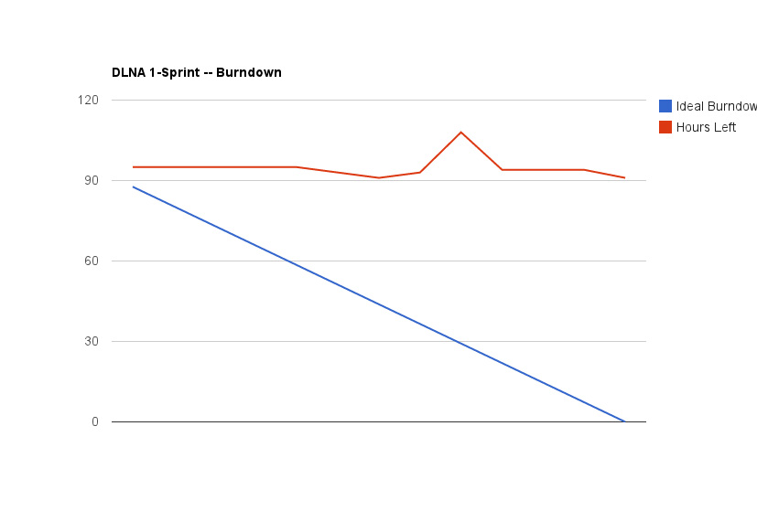
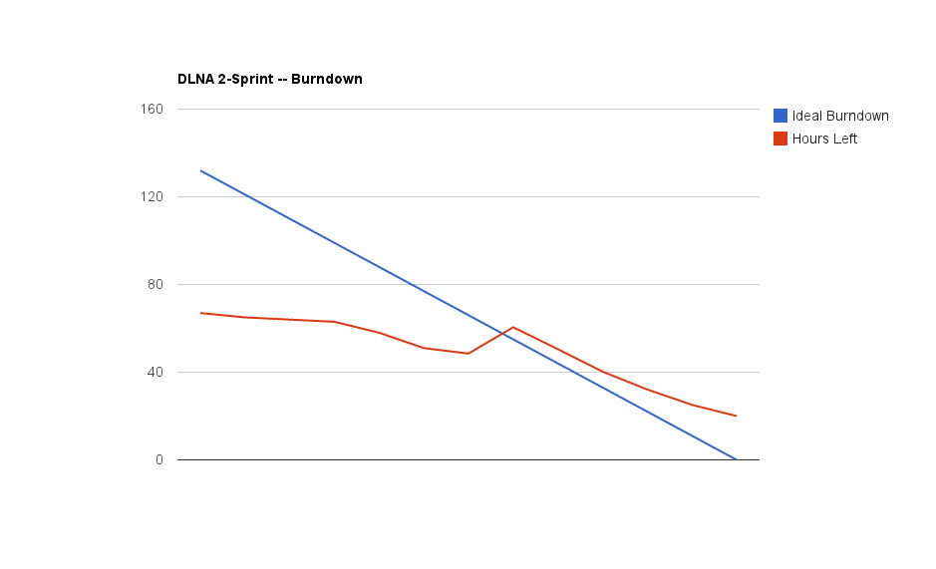
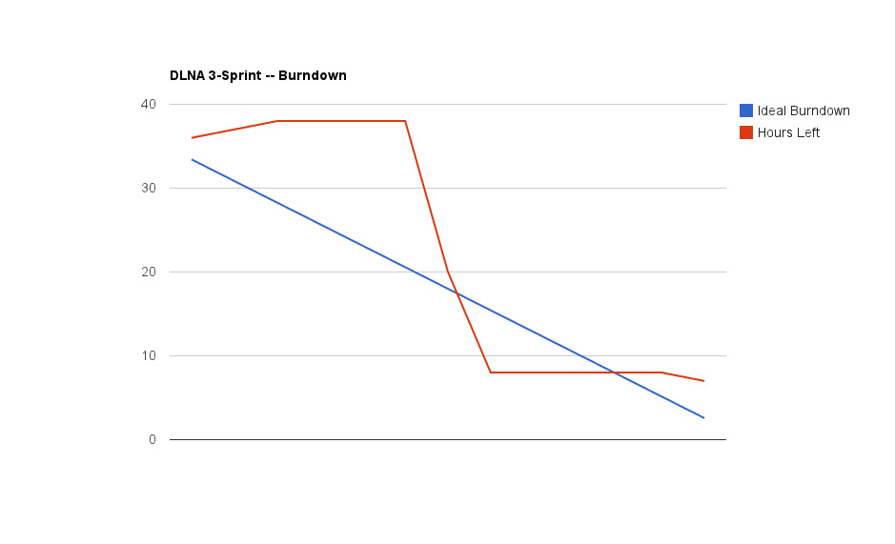
Measuring Progress...

Slide 18
Common Challenges...
Enterprise transitions from traditional to scrum
Slow & Steady vs. Shock & Awe
Choosing the right project
Setting expectations
Scrum with “legacy” products and programs
Technical debt (Quality)
Setting expectations
Working with geographically distributed teams
Daily scrums
Tools that will help...
Regulatory Compliance
Agile Contracts
Scaling

