Slide 1
Getting Your PMP

Slide 2
Certifications Available (1 of 2)
The Certified Associate in Project Management (CAPM)® is a good entry-level certification if you’re new to project management, or still figuring out your career path.
The Project Management Professional (PMP)® is the most important globally-recognized and independently validated credential for project managers, perfect if you have demonstrated experience and competence in leading project teams.
The Program Management Professional (PgMP)® is designed for those who manage multiple, complex projects to achieve strategic and organizational results.

Slide 3
Certifications Available (2 of 2)
The PMI Agile Certified Practitioner (PMI-ACP)® is designed for practitioners who utilize Agile approaches to project management in their projects.
The PMI Risk Management Professional (PMI-RMP)® is a specialty credential that demonstrates competence in assessing project risks, mitigating threats and capitalizing on opportunities.
The PMI Scheduling Professional (PMI-SP)® is a specialty credential for practitioners who want to focus on developing and maintaining project schedules.
The OPM3® Professional Certification recognizes your experience with, and practical knowledge of, organization project management and project management maturity.

Slide 4
Requirements for PMP
Complete an application
Education requirements
Experience requirements
Agree to adhere to a code of professional conduct
Pass a multiple choice exam

Slide 5
Education & Experience Requirements
PMP Requirements
To apply for the PMP, you need to have either:
A four-year degree (bachelor’s or the global equivalent) and at least three years of project management experience, with 4,500 hours leading and directing projects and 35 hours of project management education. OR
A secondary diploma (high school or the global equivalent) with at least five years of project management experience, with 7,500 hours leading and directing projects and 35 hours of project management education.

Slide 6
Eligibility Letter
Comes within 3 weeks
Contact Thomson/Prometric to schedule date to sit for the exam
Don’t wait to schedule the exam until you have studied and you are ready
Good for 12 months

Slide 7
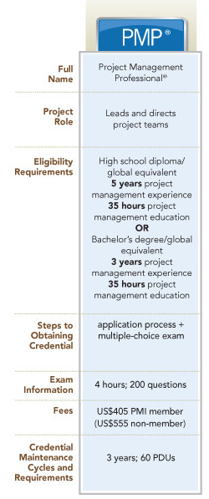
Getting Your PMP
Go to www.pmi.org
Have your updated resume or your PM work outlined
Once you qualify, schedule the exam!

Slide 8
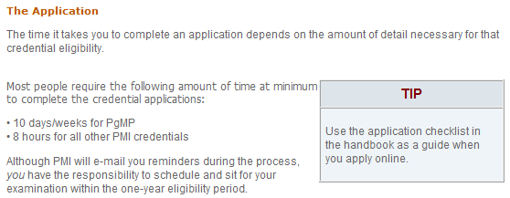
The Application

Slide 9
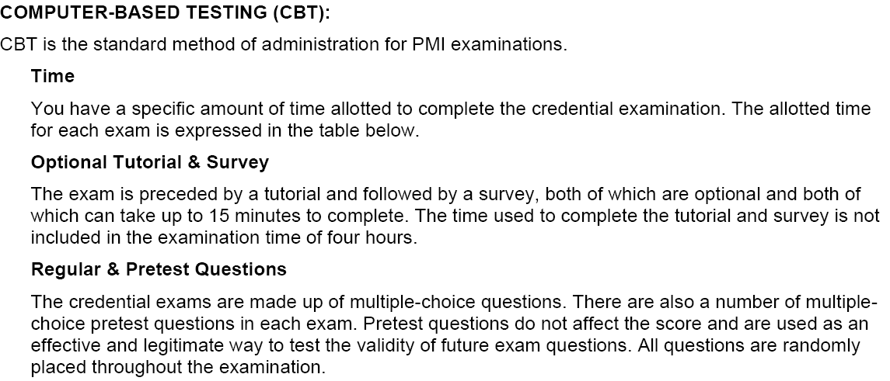
PMI’s Exam Format

Slide 10
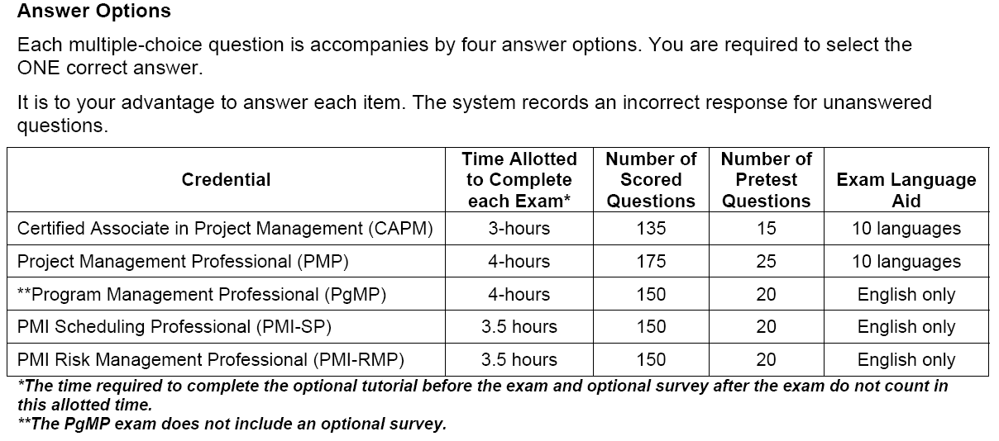
PMI Exam Format (continued)

Slide 11
About the exam
Exam is reviewed and revised annually to satisfy the test specifications
The PMP exam is a computer based exam conducted in the Prometric centers.
200 multiple choice questions each has exactly one correct answer, have 4 hours to complete.
Out of the 200 questions, 25 questions are pretest questions. These are randomly placed through out the exam and are used for research purposes - are not evaluated while computing exam results. You will only be evaluated on the basis of 175 questions.
To pass the PMP examination, you must answer a minimum of 106 of the 175 scored questions correctly.
Unanswered questions are treated as wrong questions.
Exam is preceded by 15-minute computer tutorial on the format of the exam.

Slide 12
Preparing for the exam
Read the PMBOK and know it well (including the glossary). Know the formulas (especially earned value and PERT).
Create charts or tables or whatever you need to know all processes and what inputs, tools & techniques and outputs that apply to each process
Use the free practice exams on the internet
Practice them until you are getting 90%
http://www.preparepm.com/
If you are going to buy study guides, Rita Mulcahy has been identified as the best.
Know where the test center is and how to get there. Get there early, wear comfortable clothing.

