Slide 1
Networked Privacy in the Age of Surveillance, Sousveillance, Coveillance
Lee Rainie (@lrainie)
Director, Internet, Science, and Technology Research
Pew Research Center
1.23.15
Harvard University - “Privacy in a Networked World”
Notes:
Title: Sur-veillance, Sous-veillace and Co-veillance
Abstract: Personal privacy in the networked age is limited by three dimensions of “veillance.” They shape people’s behavior and their anxieties about the future of privacy. Lee Rainie will present the latest survey findings from the Pew Research Center about how people try to navigate this new environment in their relationship with government, commercial enterprises, and each other. He will also discuss how some technologists are trying to respond.

Slide 3
1. Privacy is not binary / context matters

Slide 4
2. Personal control / agency matters

Slide 5
3. Trade-offs are part of the bargain

Slide 6
4. The young are more focused on
networked privacy than their elders

Slide 7
5. Many know they do not
know what is going on

Slide 8
6. People are growing hopeless
and their trust is fading

Slide 9
The balance of forces has shifted in the world of networked information that is persistent, scalable, searchable, spreadable … … created and shared by networked individuals ---- The new reality is that people are “public by default and private by effort”
-- danah boyd
Notes:
http://www.danah.org/papers/talks/2010/SXSW2010.html

Slide 10
On a typical day, how much control do you have over information that is collected about you and how it is used?
47% say “a lot” or “some”
50% say “not much control” or “no control at all”

Slide 11
Surveillance

Slide 12
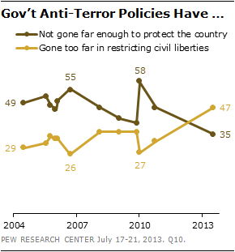

Slide 13
80% of adults “agree” or “strongly agree” that Americans should be concerned about the government’s monitoring of phone calls and internet communications.
54% of adults have become less confident over time that the surveillance programs are serving the public interest.

Slide 14
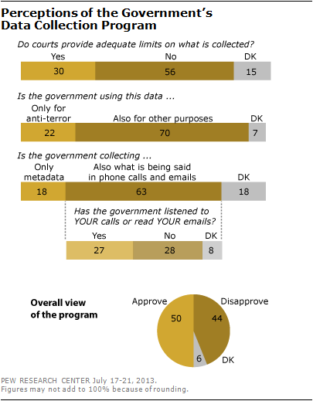

Slide 15
Do you think the courts and judges do a good job balancing the public’s right to privacy and the needs of law enforcement and intelligence agencies to collect information for investigations?
Yes - 48%
No – 49%

Slide 16
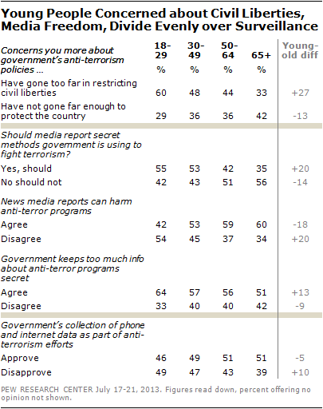
v
v
v
v
v

Slide 17
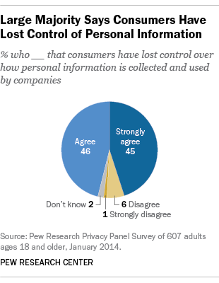

Slide 18
68% of internet users believe current laws are not good enough in protecting people’s privacy online and 24% believe current laws provide reasonable protections.
64% believe the government should do more to regulate advertisers, compared with 34% who think the government should not get more involved.

Slide 19
55% “agree” or “strongly agree” with the statement: “I am willing to share some information about myself with companies in order to use online services for free.”

Slide 20
Knowledge quiz
True or False: When a company posts a privacy policy, it ensures that the company keeps confidential all the information it collects on users.
44% were correct the answer is FALSE
52% were incorrect
4% refused to answer

Slide 21
Privacy strategies that people don’t know about
39% don’t know about anonymity software such as Tor
37% don’t know about using locally-networked communications such as FireChat
31% don’t know about email encryption
31% don’t know about privacy enhancing browser plug-ins such as DoNotTrackMe or Privacy Badger

Slide 22
Sousveillance

Slide 23
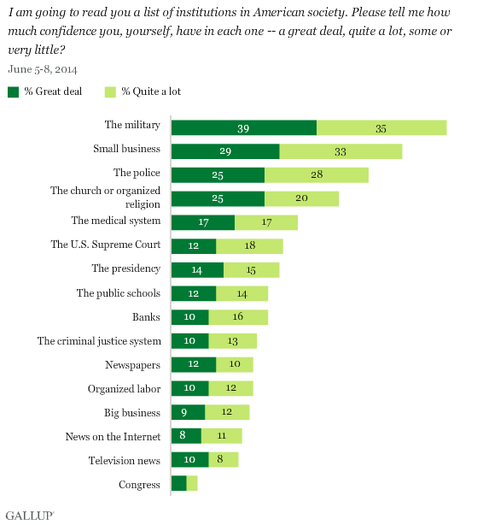

Slide 24
How confident are you that your records at these companies will remain safe and private?

Slide 25
Accessing government data
37% have done this for Federal government information
34% have done this for state government information
32% have done this for local government information
This comes to 67% of adults who used the internet or an app to access government information or data across the three levels of government.

Slide 26
Transparency demands
5% of respondents think the Federal government very effectively shares the data it collects with the general public, with another 39% saying this is done somewhat effectively.
5% of respondents say their state government very effectively shares data with the general public, with another 44% saying their state does this somewhat effectively.
7% of respondents say their local government share data very effectively, with another 45% saying this is done somewhat effectively.

Slide 27
Coveillance

Slide 28
86% of internet users try to be anonymous at least occasionally
59% do not believe it is possible to be completely anonymous online, while 37% of them believe it is possible.

Slide 29
Personal information online % of adult internet users who say this information about them is available online

Slide 30
Who users try to avoid % of adult internet users who say they have used the internet in ways to avoid being observed or seen by …

Slide 31
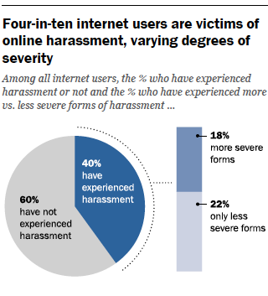

Slide 32
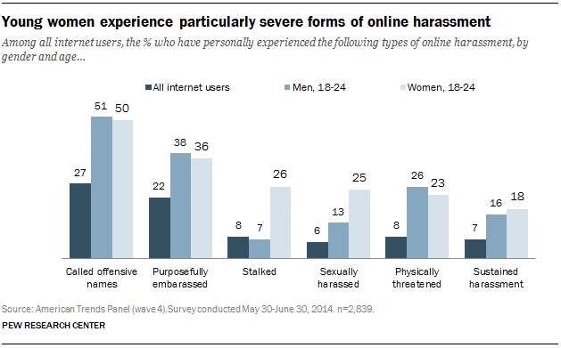

Slide 33
Young adults are the most likely to have had major problems with personal information and identity

Slide 34
62% adults have ever used a search engine to look up their own name or see what information about them is on the internet
47% say they generally assume that people they meet will search for information about them on the internet

Slide 35
When asked if they feel as though their own efforts to protect the privacy of their personal information online are sufficient, 61% say they feel as though they “would like to do more,” while 37% say they “already do enough.”
88% of adults “agree” (49%) or “strongly agree” (39%) that it would be very difficult to remove inaccurate information about them online.

Slide 36
Future public reaction?

Slide 37
Thank you! Lee Rainie lrainie@pewinternet.org @lrainie @pewinternet @pewresearch

