Slide 1
Consumer and Purchaser Use of Healthcare Information
Finding Health in the US: Healthcare and the Information Economy (INFO 290A)
UC Berkeley
September 5, 2014
Purchaser
David Lansky, PhD
President and CEO

Slide 2
























PBGH Members
Apple
Facebook
Google
Hewlett Packard
Microsoft
Oracle
….

Slide 3


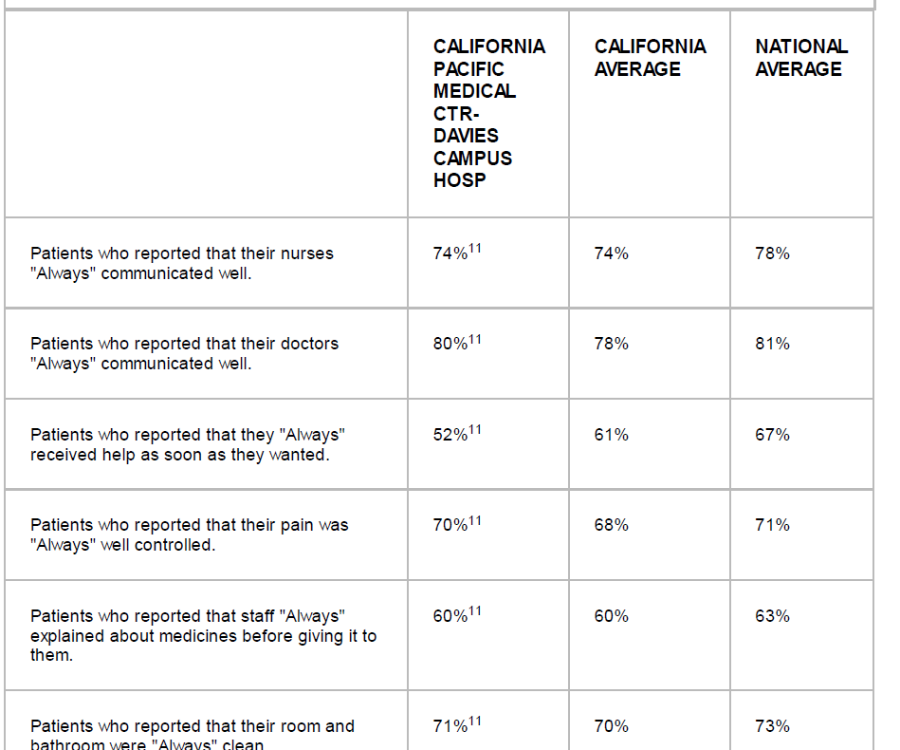
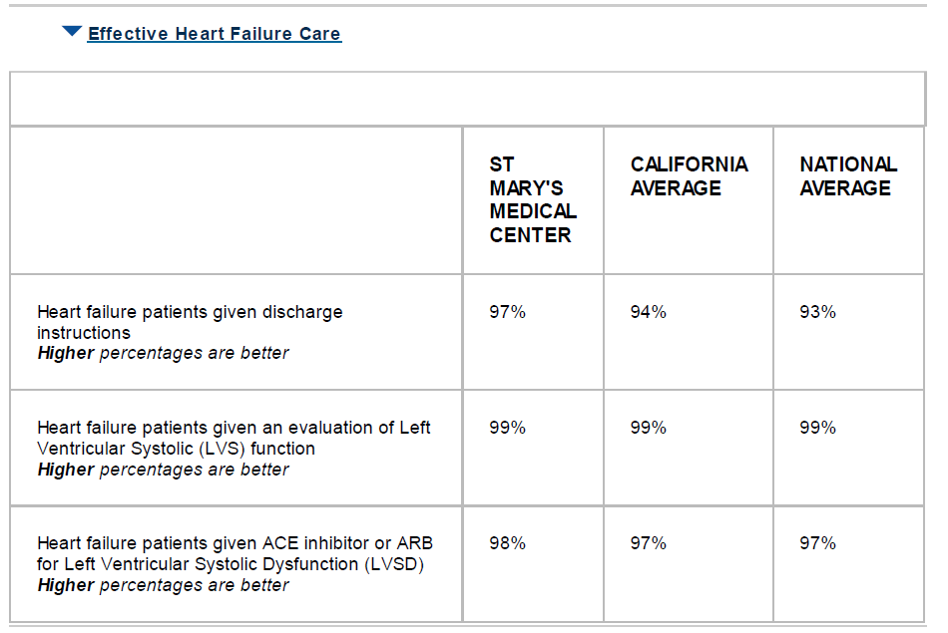
Approaches to Evaluating Quality

Slide 4
Many needs for healthcare information
For Patients (consumers)
  Which health plan to enroll in?
  Which hospital to go to for elective services?
  Which primary care doctor to choose?
  Which specialists to go to?
  Which treatments to undergo?
  (Which health behaviors to follow?)
For Purchasers
  Which health plans to offer my employees?
  Which hospitals and doctors to keep “in-network”?
  Which services to cover?
  The “benefit design” – split between company contribution and employee contribution for each type of service

Slide 5
“Simple” patient use cases
What would you want to know to help you make this decision:
Just learned we’re pregnant. How do I choose an obstetrician and where (which hospital or alternative setting) to have the baby?
Just diagnosed with breast cancer. Which doctor should I go to?
My child has persistent asthma. Which doctor should I take him to?
I need to pick a primary care doctor. Who should I see?

Slide 6
Discussion questions
What types of information are generally needed?
How would purchasers’ requirements differ from patients’?
What would you regard as a reliable source of information to help you make a decision?
What infrastructure is available to supply these data to consumers?
What’s the role of public policy vs. the market in generating these data?
  Standards?
  Mandates?
  Innovation and adaptation?

Slide 7
For more information please visit:
Learn more about the Pacific Business Group on Health and our effort to improve the quality of health care while moderating costs at www.pbgh.org
Learn more about our work to bring employers, consumers and labor organizations together to improve access to publicly reported health care performance information at www.healthcaredisclosure.org
Learn more about our efforts to reform payment at www.catalyzepaymentreform.org

Slide 8
What patients want to know…

Slide 9
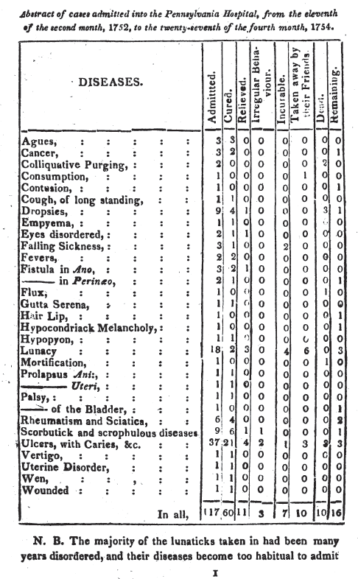


Slide 10
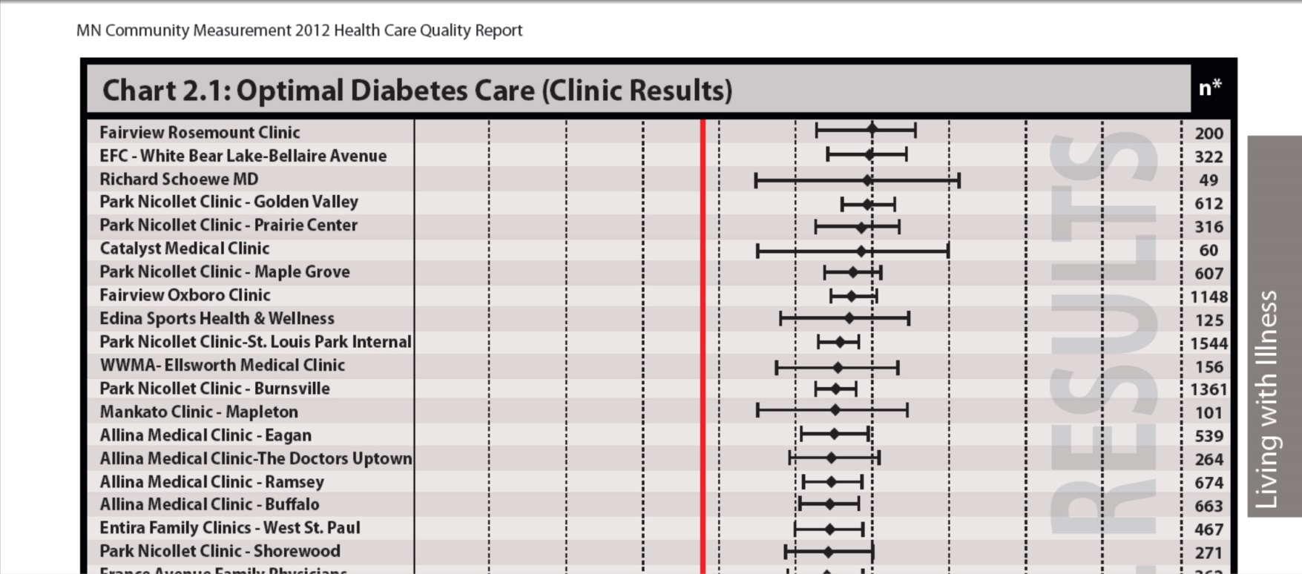
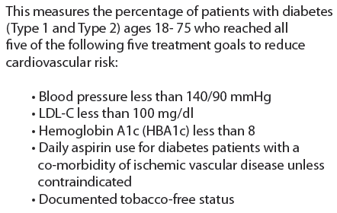

Meaningful measures of chronic care outcomes by provider

Slide 11
New measures of patient outcomes
Case-mix adjusted average health gain after knee replacement – Oxford Knee Score
Max score = 48. Pre-op mean = 18.5 (severe pain)

