Slide 1
Searching for Health: Healthcare and the Information Economy
Scott Young, M.D.
September 6, 2013

Slide 2
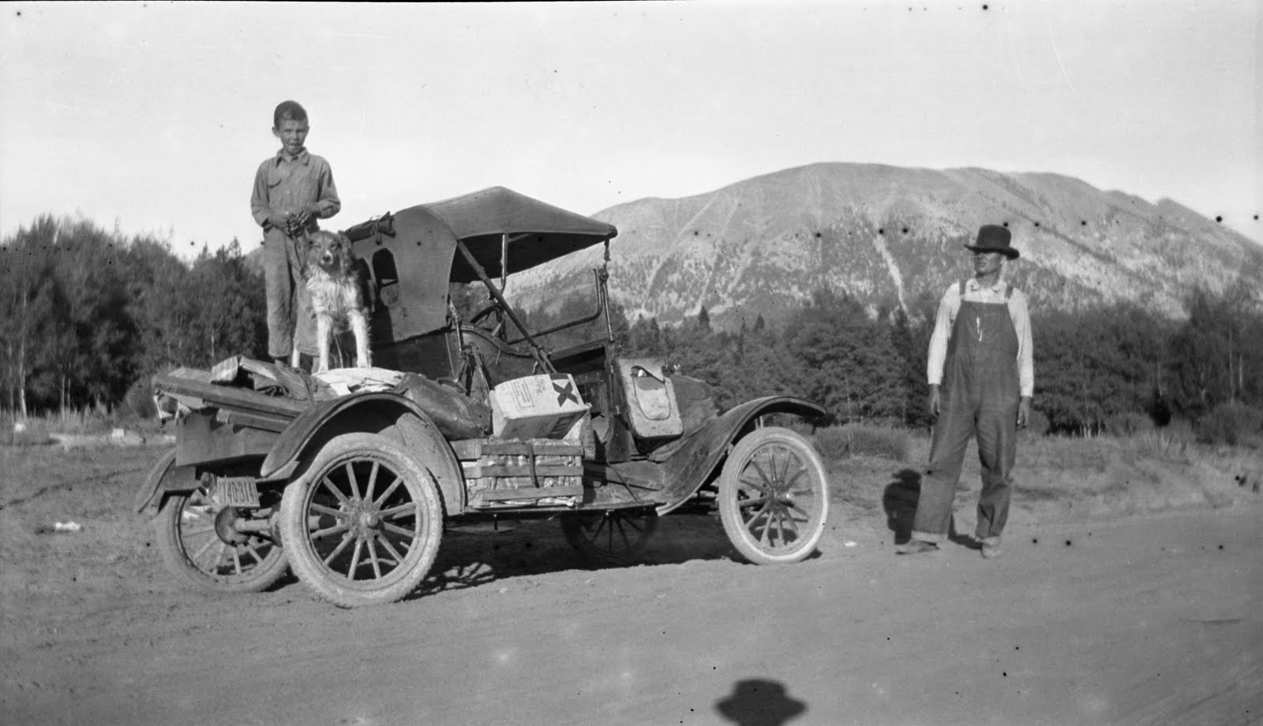
About the Class

Slide 3
What is health?
Health
Care:
10%
Environment: 19%
Lifestyle: 51%
Human Biology: 20%
Source: McGinnis, J. M. and Foege, W.H. (1993). "Actual Causes of Death in the United States," Journal of the American Medical Assocation, Volume 270, Number 18: 2207-221

Slide 4
A national focus on information
“Americans should be able to count on receiving health care that is safe….This requires, first, a commitment by all stakeholders to a culture of safety, and, second, improved information systems.”
Institute of Medicine, 2003

Slide 5
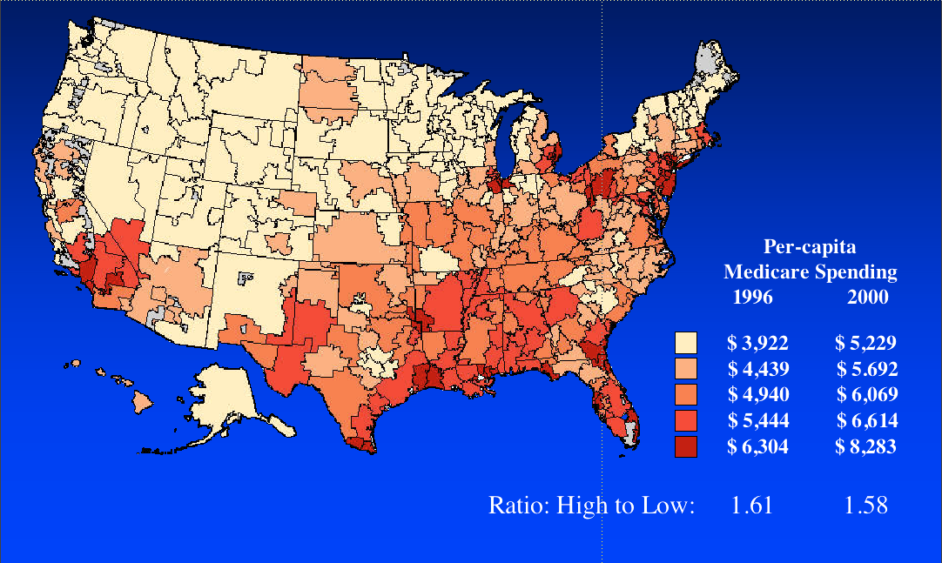
Variations in care
Fisher ES, Wennberg DE, Stukel TA, et al. The implications of regional variations in Medicare spending. Ann Intern Med. 2003;138(4):273-298.
5
5
Fisher ES, Wennberg DE, Stukel TA, et al. The implications of regional variations in
medicare spending. Ann Intern Med. 2003;138(4):273-298.
Notes:
5
5

Slide 6

Continued need for affordability
Changes in health insurance premiums
Source: Kaiser/HRET Survey of Employer-Sponsored Health Benefits, 1999-2011. Bureau of Labor Statistics, Consumer Price Index, U.S. City Average of Annual Inflation (April to April), 1999-2011; Bureau of Labor Statistics, Seasonally Adjusted Data from the Current Employment Statistics Survey, 1999-2011 (April to April).

Slide 7

Average annual insurance premium
$15,073
$13,375
$13,770
Worker Contribution
Employer Contribution
Source: Kaiser/HRET Survey of Employer-Sponsored Health Benefits, 2009-2011.
Notes:
The average annual worker contribution to health insurance premiums for family coverage increased by more than $600 over the past two years.

Slide 8
National Health Expenditure
18.2%
2.7 Trillion

Slide 9
Obesity Trends Among U.S. Adults
(*BMI ≥30, or about 30 lbs. overweight for 5’4” person)
2000
1990
2010
No Data <10% 10%–14% 15%–19% 20%–24% 25%–29% ≥30%

Slide 10







Overall Ranking
Country Rankings
 | 1.00–2.33
 | 2.34–4.66
 | 4.67–7.00
 |  | AUS | CAN | GER | NETH | NZ | UK | US
OVERALL RANKING (2010) |  | 3 | 6 | 4 | 1 | 5 | 2 | 7
Quality Care |  | 4 | 7 | 5 | 2 | 1 | 3 | 6
Effective Care |  | 2 | 7 | 6 | 3 | 5 | 1 | 4
Safe Care |  | 6 | 5 | 3 | 1 | 4 | 2 | 7
Coordinated Care |  | 4 | 5 | 7 | 2 | 1 | 3 | 6
Patient-Centered Care |  | 2 | 5 | 3 | 6 | 1 | 7 | 4
Access |  | 6.5 | 5 | 3 | 1 | 4 | 2 | 6.5
Cost-Related Problem |  | 6 | 3.5 | 3.5 | 2 | 5 | 1 | 7
Timeliness of Care |  | 6 | 7 | 2 | 1 | 3 | 4 | 5
Efficiency |  | 2 | 6 | 5 | 3 | 4 | 1 | 7
Equity |  | 4 | 5 | 3 | 1 | 6 | 2 | 7
Long, Healthy, Productive Lives |  | 1 | 2 | 3 | 4 | 5 | 6 | 7
Health Expenditures/Capita, 2007 |  | $3,357 | $3,895 | $3,588 | $3,837* | $2,454 | $2,992 | $7,290
Note: * Estimate. Expenditures shown in $US PPP (purchasing power parity).
Source: Calculated by The Commonwealth Fund based on 2007 International Health Policy Survey; 2008 International Health Policy Survey of Sicker Adults; 2009 International Health Policy Survey of Primary Care Physicians; Commonwealth Fund Commission on a High Performance Health System National Scorecard; and Organization for Economic Cooperation and Development, OECD Health Data, 2009 (Paris: OECD, Nov. 2009).

Slide 11
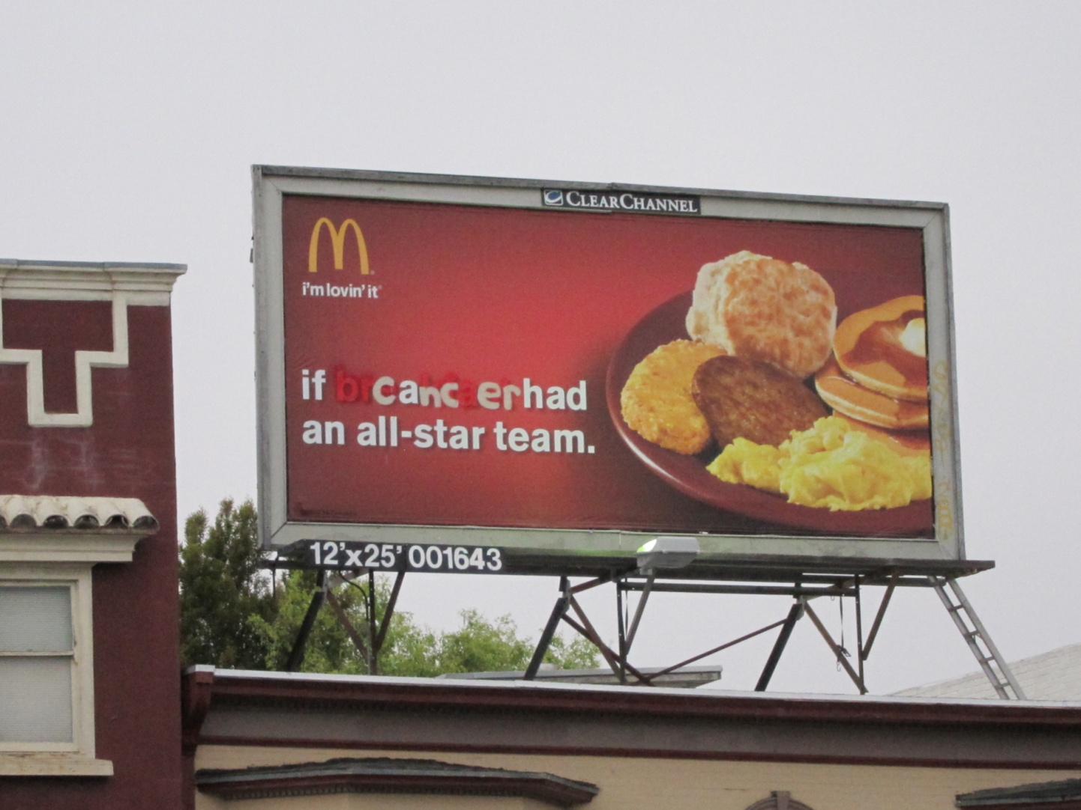
Somebody noticed…….

Slide 12
Reform Arrives
Patient Protection and Affordability Care Act
  Guaranteed Issue
  Expand Medicaid
  Create Exchanges
  Shared Savings Program – Accountable Care Organizations
  Patient Centered Medical Home
  Comparative Effectiveness Research
  The Supremes have spoken
  and much more….
Health Information Technology for Economic and Clinical Health Act
  Grants for Electronic Health Records
  Payment for “meaningful use”

Slide 13
New expectation
Care that is…….
Tailored to keep me healthy
High quality
Safe
When and where I want it
Personalized to my needs
Based on shared decisions
Based on the best information

Slide 14
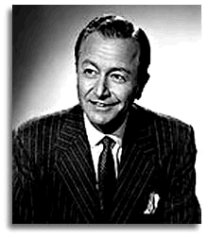
Hey doc…….

Slide 15
Strong Support for Use of Health Information
Technology to Improve Patient Care
Percent reporting it is very important/important for improving patient care
92
88
Note: Subgroups may not sum to total because of rounding.
Source: Commonwealth Fund Survey of Public Views of the U.S. Health Care System, 2011.
Notes:
15

Slide 16
Few Adults Have Internet/E-Mail Access
to Their Records or Doctors; Many Would Like It
Among those with Internet access, percent reporting ability to: | Access your medical records via the Internet | Schedule appointments via e-mail or Internet | Communicate with your doctors via e-mail | Order or refill a prescription using the Internet
Yes | 14 | 22 | 21 | 34
Among those who cannot do any of the above:
Would like to be able to | 50 | 56 | 57 | 55
Would not like to be able to | 48 | 42 | 41 | 43
Source: Commonwealth Fund Survey of Public Views of the U.S. Health Care System, 2011.

Slide 17
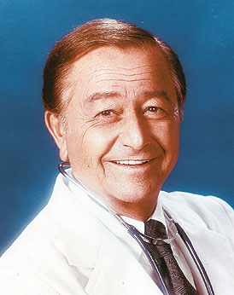

New Roles – New Expectations
Marcus Welby, MD
One patient at a time
Only know about patients who appear in your office
No use of IT
Limited use of “extenders”
Industrial Age Model of Care
“Marcia Welbyte,” MD
Accountability for panel/population
Transparency
Use of EMR, registries, internet
Team care (including patient)
Moving care out of the doctor’s office
Information Age Model of Care

Slide 18
Responding to the new care paradigm
Intermountain Healthcare
Geisinger Health Care
Group Health Cooperative
Kaiser Permanente

Slide 19
Health Care Learning Systems
Knowledge Development
Knowledge Implementation
Innovation
Evaluation
Technology
Decision Support
Measurement

Slide 20
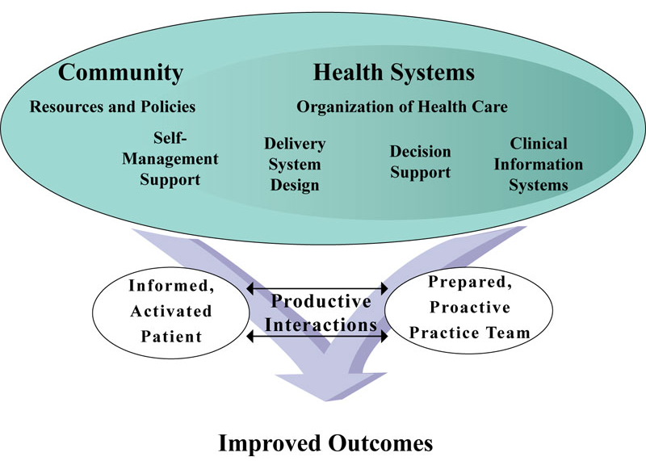
It takes a village……
Source: improvingchroniccare.org
Ed Wagner, MD, MaColl Institute

Slide 21
Call the doctor….or email?

Slide 22
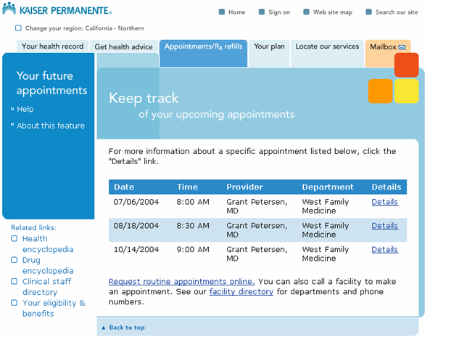
KP.ORG

Slide 23
Expanded online Access for Members
Care Delivery Core
Access medical record
Scope of KP HealthConnect Suite
www.kp.org
Member Web Portal
Outpatient
Inpatient
Send email to doctor
Scheduling
Scheduling
Admission, Discharge
And Transfer
Registration
Access health Information
Clinicals
Pharmacy
Make/change appointments
Clinicals
Emergency
Department
Review eligibility & benefits
Billing
Operating Room
Billing
Account summary
Check lab results

Slide 24
High Quality Care….
SYSTEMS
TOOLS
TEAMS

Slide 25
Care for those with chronic disease
Teams
Dedicated PCP time
Support staff (MA, RN), protected time
Systems
Identifying patients with care gaps and conducting outreach
IT Tool
Internally developed, linked to EMR
Generate list of patients, by care gaps
Prepare clinical data summaries
Review patient status, decide on treatment
Execute orders, communicate
PMA
PMA
Primary Care MD
Nurse
Pharm D
PMA

Slide 26
Panel management relies on an IT tool –
a global registry to view the entire panel

Slide 27
The panel-based registry links immediately to a patient summary

Slide 28
EMR plus
Degree of comprehensive data and integration
Integrated EMR
Inpatient, Outpatient, Lab, Pharmacy.
Quality measurement,
improvement & research
Clinical Decision Support
Improved diagnosis
& disease management
Remote Access
Increased physician
timeliness & efficiency
Medication Order Entry
Reduce prescribing errors
Internet Access
Email Communications,
Online Health Information, etc.
Improved patient access
and convenience
Automated Reminders
(Preventative & Monitoring Tasks)
Improve compliance with
practice guidelines
Charting/Documentation
Improve effectiveness through
access to patient history

Slide 29
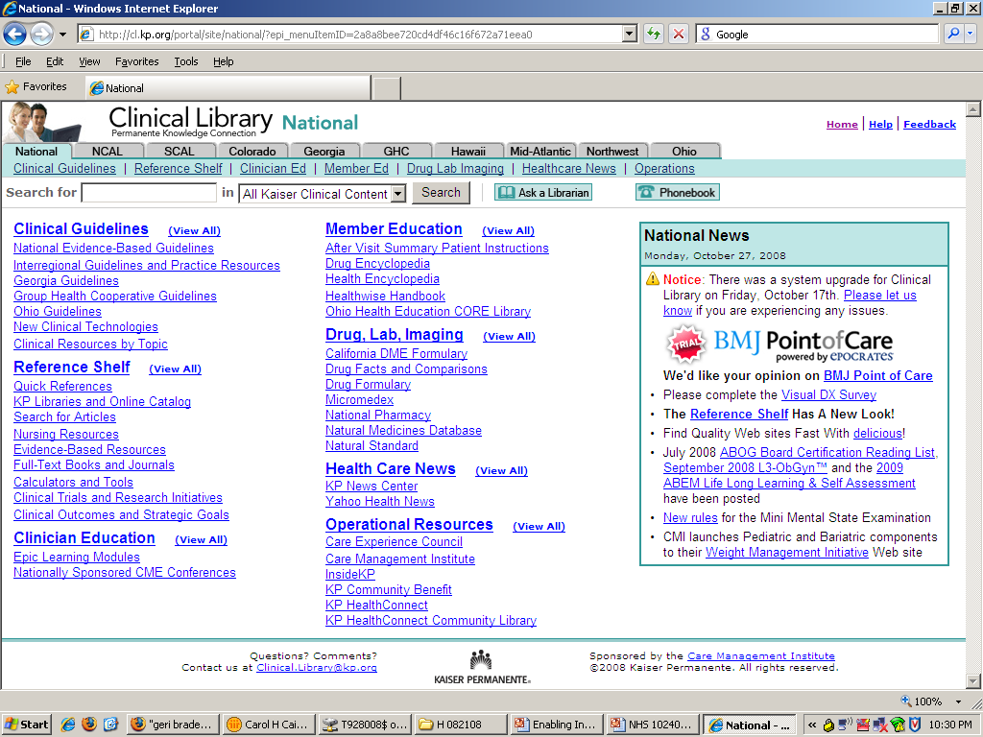
Medical knowledge at the point of care
Notes:
KP wanted basic approaches built-in that would enhance the consistency of care system wide. Because we are so large, we wanted to find ways to coordinate care – and decision making – from region to region.
Chronic disease models take best practices from across the system – and the latest research – to establish protocols not only for chronic diseases, but also for almost any illness, making it all available at our physicians’ fingertips within a patient’s record.
And we wanted our members to be able to learn more about how to improve their health – and stay healthy – easily, at home, at work, wherever. Bottom line: a user friendly computerized medical record supported by the full wealth of medical knowledge available.

Slide 30
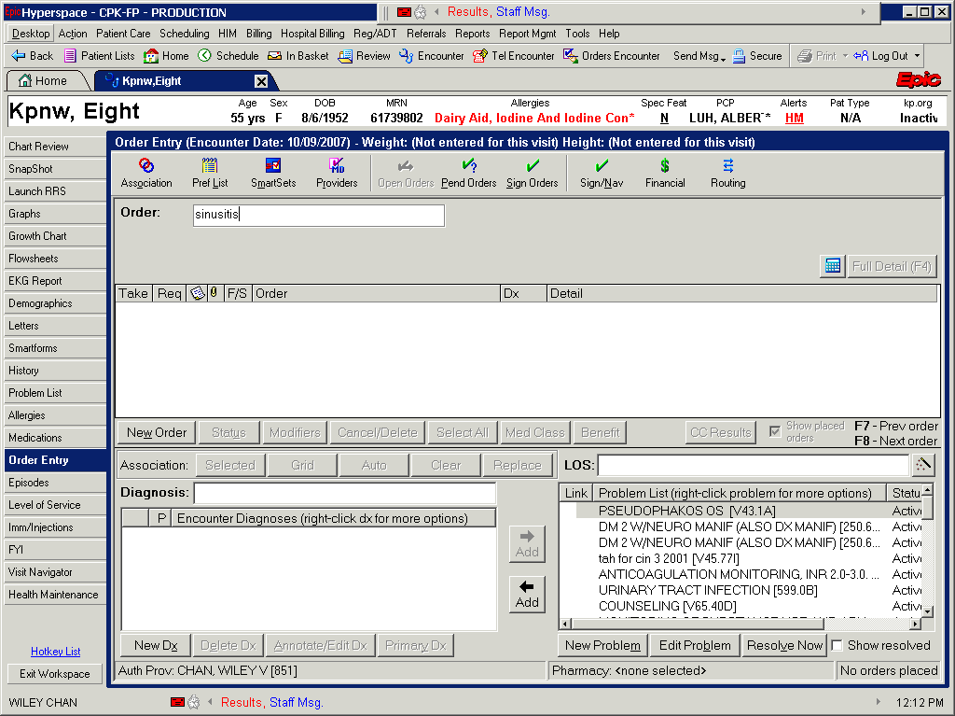
Notes:
Placing guidance within the workflow of clinicians is far more effective than making them look for guidance.
SmartSets can be located by clicking the SmartSet icon and searching by title (including synonyms). SmartSets can also be automatically offered to users, depending on Diagnosis, Problem List and Reason for Visit.

Slide 31
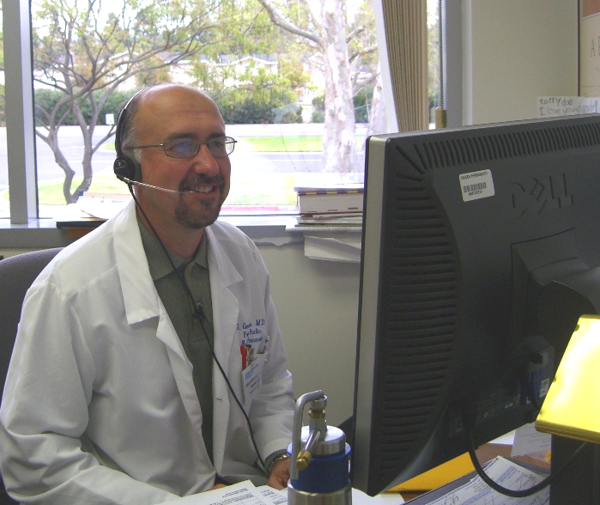
Alternatives to Traditional Office Visits
Telephone Visits
Systematic offering
Rely on the members’ preference and at their convenience
Bridge to building secure messaging experience
Builds capacity in the care team
Other Alternatives
Secure Messaging/eVisits
Group Visits (woman, child)

Slide 32
Future State
Care on your terms
_{Current System}
_{Future}
80
80
70
70
US mail contacts
60
60
RN and HCT
contacts
50
50
Email contacts
40
40
Phone contacts
NUMBER OF DAILY CONTACTS
NUMBER OF DAILY CONTACTS
30
30
Annual health goals
"Fast Track"'s
20
20
Group visits
10
Office visits
10
Office visits
0
0

Slide 33
Future State
Asking New Questions - Meeting New Needs
FROM:
How many patients can you see?
How many patients’ problems can you solve?
How can we encourage and convince patients to get required prevention?
How can we create systems that significantly increase that patients get required prevention?
How often should a physician see a patient to optimally monitor a condition?
What is the best way to optimally monitor a condition?
TO:
FROM:
TO:
FROM:
TO:

Slide 34

Thank you

