Slide 1
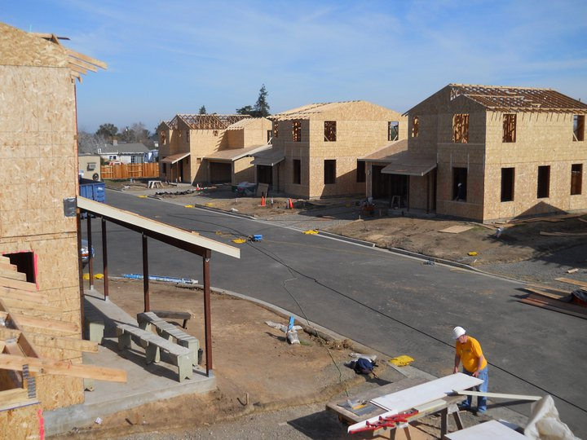
Haibitat Mission Statement:
To create successful homeownership opportunities for families with limited incomes by building sustainable housing and revitalizing neighborhoods.

Slide 2
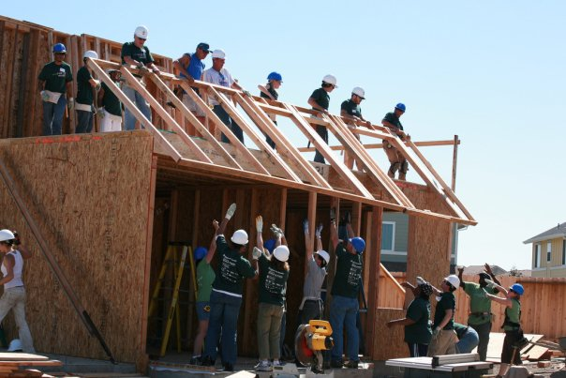
Why is Habitat Different?

Slide 3
Managing the Site
Volunteer Experience
Make manual labor fun.
Anyone can do any task.
“Show the life of the game”
Partner Families
Keep families involved
Ensure their satisfaction w/ home.

Slide 4
Complete Buildings
Maintain Schedule, Budget, Quality, and Mind
Manage Subcontractors
Become peacekeeper between subs and volunteers.

Slide 5
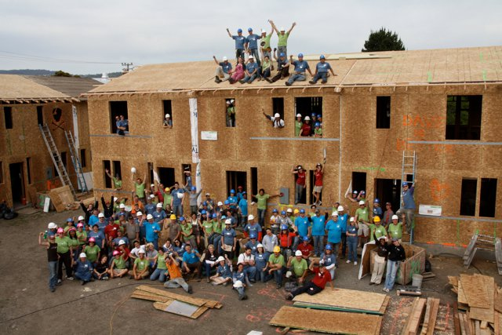
Volunteers
What are the reasons people are volunteering?
Want to help
To learn
To network
Company Day

Slide 6
Assessing Volunteers
Leadership qualities
What do they want out of the day
Volunteer shows up with tool bags

Slide 7
“Cheers” Theory
You want to go where everybody knows your name.
Learn what work they prefer.
Develop Regulars
Match w/ similar crew leaders
Delegate exciting jobs
Create Stories

Slide 8
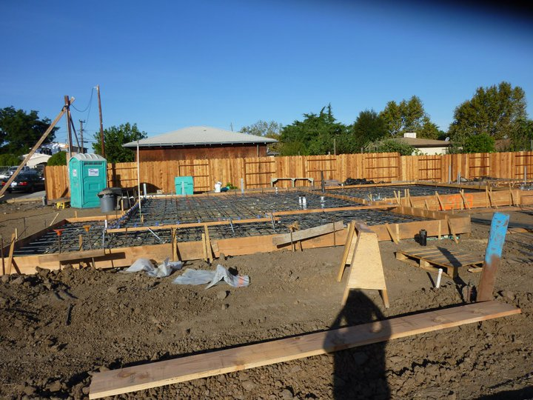
Construction
Preparation
Goals
Training
Planning
Materials

Slide 9
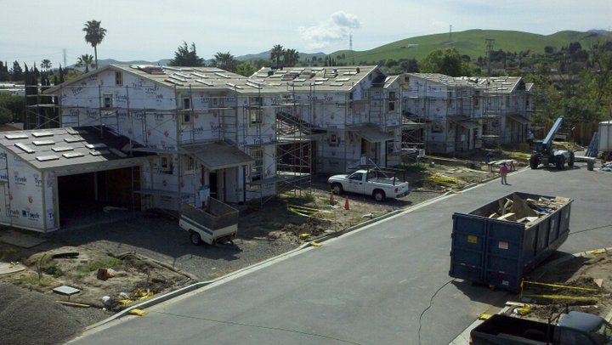
Task completion.
Delegating crew.
Interacting with crew
Back-Pocket jobs.
Improving
Quality Control
Quality - Result of working towards a standard in one’s trade. i.e. durability, appearance, function.

Slide 10
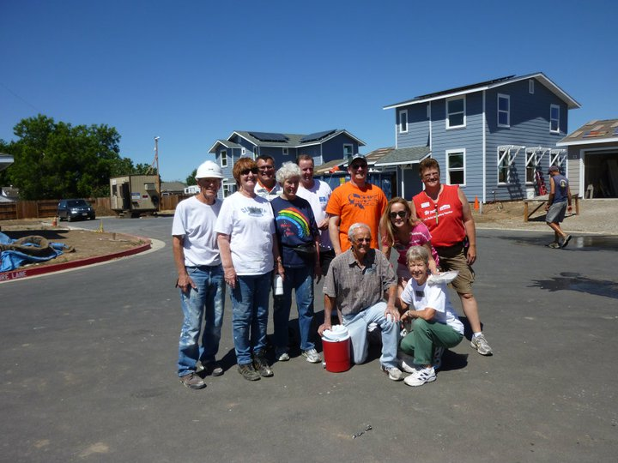

Slide 11
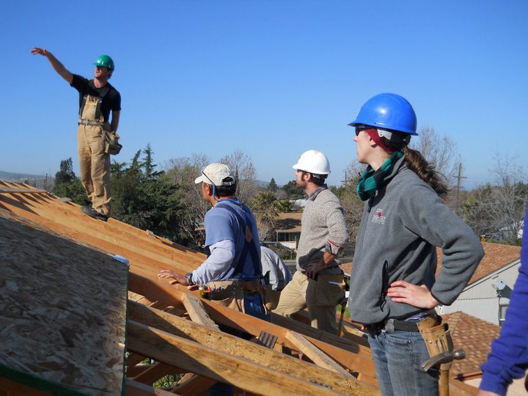
Making it all work
Trust
Team has to believe in leader.
Vision
Know how to build backwards
Understand resources.
Standards
Not a democracy
Study
Plans
Improving efficiency

