Slide 1
Big Data
INFO 272: Qualitative Research Methods

Slide 2
Notes:
http://www.wired.com/science/discoveries/magazine/16-07/pb_theory

Slide 3
Mythology
“Big Data is a tagline for a process that has the potential to transform everything.” – Jon Kleinbeg, CS Prof, Cornell U. – NY Times 8/11/12
“But faced with massive data, this approach to science — hypothesize, model, test — is becoming obsolete.” – Wired mag, 06/23/08
“'Big Data' can change the world” – headline, LA Times, 11/19/12
Notes:
http://www.nytimes.com/2012/08/12/business/how-big-data-became-so-big-unboxed.html
http://www.wired.com/science/discoveries/magazine/16-07/pb_theory
http://www.latimes.com/news/opinion/editorials/la-ed-data-privacy-20121119,0,7387282.story

Slide 4
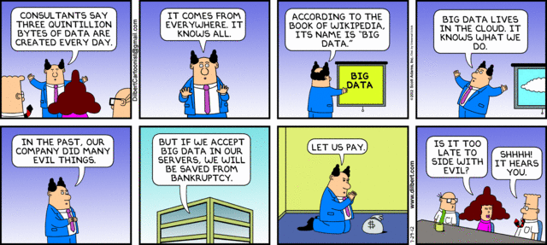
Mythology

Slide 5
What is new?
Type of data – log data, behavioral traces. “as the Internet has matured, the technologies for linking behavior with an identity have increased dramatically” (Lessig)
Quantity of data – terabytes, petabytes, yottabytes - more is better? New skills demanded for processing such data.
Range, Variety, Granularity of data – total enumeration

Slide 6
Type of Data
Logged activities, behavioral traces (online). With the mobile phone, traces of movement tracked through space.
Data captured without conscious awareness of the contributor (research instrument is maximally non-disruptive)…but privacy issues? Informed consent?
Shared approach with ethnographers -- getting close to the phenomenon of interest. “the nearer we get to the conditions in which [the people we are studying] actually do attribute meanings to objects and events, the more accurate our description of those meanings are likely to be” (Becker 1996).

Slide 7
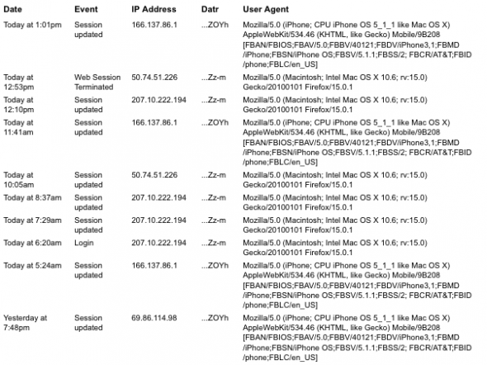

Slide 8
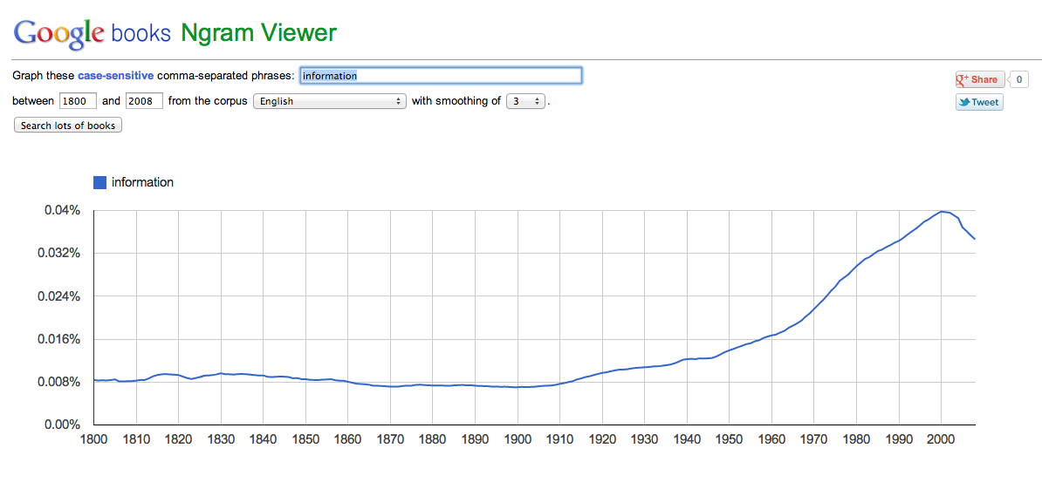
Interpretation
Sameness of Words does not Ensure Stability of Meanings – Suchman and Jordan
Notes:
Polysemy, “sameness of words does not mean stability of meanings”

Slide 9
Interpreting Data: Meaning & Intent
Notes:
http://web.archive.org/web/20110327024741/http://blog.okcupid.com/
“But ‘big data’ is still just as prone to misinterpretation as other kinds of captured data.”
Dubious claim from the piece:
“It seems that generally, people of all races write down to blacks and Latinos and up to Asians and whites. This is a pretty crazy result: proof that race not only affects the quantity of the contacts between people, but the quality as well. For example, the average black person writes at a level almost one full grade-level higher when writing to a white person than when writing to another black person.”

Slide 10
Completeness and Skew
Even the biggest of big data may be skewed, do we understand and are we adequately grappling with this skew?
The privacy aware (Ghostery, Do Not Track Plus, Disconnect, FB Purity)
Data set errors
Shared accounts (non-equivalency between individual user and account), bots!
Notes:
Check impulse to apply findings as general insights about humans (rather than about human patterns in relation to the given tech)

Slide 11
Access
Proprietary data sets
Privacy (US Do Not Track Online Act 2011)

Slide 12
Small Data?
Ethnography as alternate or complement to the ‘big data’ trend?
Small as yielding different kinds of insights – tracking a single vault inspector for a hydroelectric company and the defn of ‘information practices’
Small in terms of feasibility of non-algorithmic analysis (of navigation through and recall of data)
And triangulation – gender and mobile phones in Uganda and Rwanda
Big data as total enumeration permits finding, accounting for, characterizing outliers, extremes (which interests ethnographers)

Slide 13
Applications
To develop models that make better economic predictions, anticipate and track flu outbreaks
Commercial - targeted advertising, placement in time/space of ads

Slide 14
Genetic sequences
Social media interactions
Search terms
Health records
Phone logs
Government records

