Slide 1
Plan for Today’s Lecture(s)
Computational classification
Topic identification
Author identification
Spam detection
Sentiment analysis
Question answering & Watson
1

Slide 2
INFO 202 “Information Organization & Retrieval” Fall 2013
Robert J. Glushko glushko@berkeley.edu
@rjglushko
3 December 2013 Lecture 27.1 – Computational Classification

Slide 3
Computational Classification
Some classification tasks can't be done by people at the needed scale or speed
Some of the tasks can be done by computational approaches like N-gram analysis that are very simple yet very useful
Some tasks are inherently difficult and require techniques of “machine learning”, which are not simple

Slide 4
Text Classification Problems
Classification assigns objects in some domain to one of at least two classes or categories
words - determine part of speech
words - disambiguate polysemy
document retrieval - relevant/not relevant?
author identification - Shakespeare or not?
sentiment classification - positive or negative affect? urgent or not urgent?
language - English, Spanish, whatever?

Slide 5
Computational Classification
CLASSIFICATION assumes a system of categories and some labeled instances so we can train a system to assign new instances to the appropriate categories
In contrast, CLUSTERING techniques don't assume pre-existing categories - they create them (usually to maximize similarity within categories and maximize it between them)

Slide 6
Classifiers
A classifier is a system whose input is a vector of discrete or continuous feature values and whose output is a single discrete value, the name of the class
There are many learning algorithms; the choice among them depends on the domain and the kinds of features that resources in it have
The more complex the domain – the more features it takes to describe each instance – the more examples are needed to train the classifier

Slide 7
The Classification Process
Specify classes
Sounds straightforward, but it isn’t. How many categories?
Label examples
Are the examples representative?
Extract features / Choose a classifier algorithm
These are interdependent. Choose some set of features and run an algorithm; try some other features with the same algorithm; try other algorithms with the same features…

Slide 8
The Classification Process
Train and test
after you've chosen features and an algorithm, you let it "learn" - adjusting the weights it gives to each feature....
(usually better to have a “slow” learner and lots of data than a “smart” one with limited data)
Classify new examples

Slide 9
A Simple Classification Problem

Slide 10
A Classification Solution

Slide 11
Easy Problem: Language Identification
Dr. Ted Mazer is one of the few ear, nose and throat specialists in this region who treat low-income people on Medicaid, so many of his patients travel long distances to see him.
Dr. Ted Mazer ist einer der wenigen Hals-Nasen-Ohrenärzte in dieser Region, die Menschen mit niedrigem Einkommen auf Medicaid zu behandeln, so dass viele seiner Patienten lange Strecken, um ihn zu sehen.

Slide 12
N-Grams
A text can be sliced into a set of overlapping N-grams, an N-character contiguous “slice”
The word “TEXT” can be composed of these N-grams:
Uni-grams: _, T, E, X, T, _
Bi-grams: _T, TE, EX, XT, T_
Tri-grams: _TE, TEX, EXT, XT_, T__
Quad-grams: _TEX, TEXT, EXT_, XT__, T___
(The Google Books “N-gram viewer” enables the “quantitative analysis of culture” via analysis of usage trends for words and grammatical constructions)

Slide 13
N-Gram Frequency (or Probability) Identifies a Language
Most frequent tokens in different European languages (Grefenstette, 1995)

Slide 14
A More Complex Classification Problem

Slide 15
A More Complex Classification Solution

Slide 16
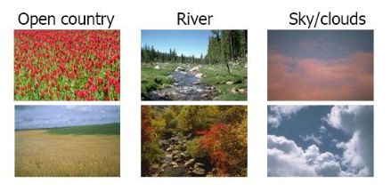
A
A Very Hard Classification Problem: Scenes
Joshi et al, Machine Learning in Computer Vision: A Tutorial

Slide 17
Machine Learning
“Supervised” learning algorithms create classifiers using labeled examples
“Unsupervised” learning algorithms create the categories in a classification system by discovering the correlations between features or properties of the things to be classified (also called “statistical pattern recognition”)
In either case, the goal is to generalize beyond the examples used to train the classifier

Slide 18
Scene Classification Solution
Joshi et al, Machine Learning in Computer Vision: A Tutorial

Slide 19
INFO 202 “Information Organization & Retrieval” Fall 2013
UNIVERSITY OF CALIFORNIA, BERKELEY
SCHOOL OF INFORMATION
Robert J. Glushko glushko@berkeley.edu
@rjglushko
3 December 2013 Lecture 27.2 – Topic Identification and Sentiment Analysis

Slide 20
Features for Text Classification
Linguistic Features (lexical and syntactic)
Words (stems?)
Phrases
Word and character level "N-grams"
Punctuation
Part of speech
Non-linguistic features (structure and formatting)

Slide 21
Topic Categorization in Google News
Google News http://news.google.com/ gathers stories from more than 4,500 English-language news sources worldwide, and automatically arranges by relevance
"Google News has no human editors selecting stories or deciding which ones deserve top placement. Our headlines are selected by computer algorithms…"
"Our grouping technology examines numerous data points for each article including the titles, text and publication time. We then use clustering algorithms to identify closely related articles."

Slide 22
Going Beyond Topic Analysis
Google's news application analyzes the content and (some of) the metadata for news stories to categorize them on the basis of the topic or event
However, news sources and authors have different points of view on the same topic or event
Should these be treated as the "same" story?
Police Arrest Student Protestors, Ending Illegal Occupation of UC's Wheeler Hall
Students Protest Huge Tuition Hikes with Symbolic Occupation on UC Campus

Slide 23
Sentiment Analysis
Sentiment analysis (aka "opinion mining") can be thought of a three-stage classification problem
Entity extraction to locate text of interest
Classifying texts as opinions or facts
Classifying the opinions according to polarity - positive vs. negative (or on some numerical scale)
This is challenging because these classes are really continuaa without sharp boundaries
...and because sarcasm, slang, cliches, and cultural norms obscure the content used to make the classification

Slide 24
Sentiment Analysis in Twitter
Twitter messages are being analyzed to:
Monitor political activity
Assess employee morale or customer sentiment
Track outbreaks of flu or food poisoning
Predict box-office receipts for new movies
Measure "moods" and their fluctuations
Twitter is a good domain to analyze because…
Twitter is a poor domain to analyze because…

Slide 25
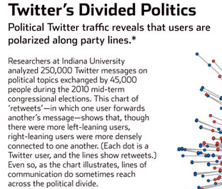
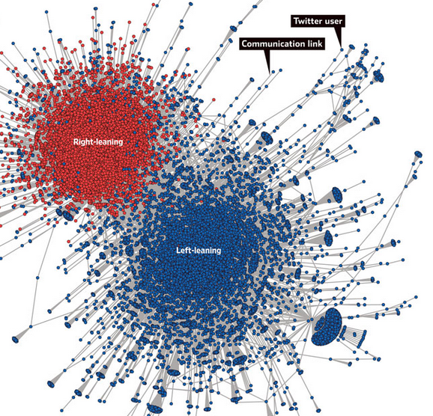
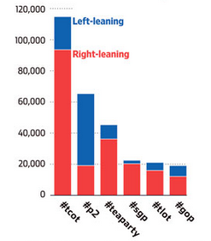
Decoding Our Chatter Wall Street Journal 1 October 2011

Slide 26
The Challenge of Sarcasm

Slide 27
The Challenge of Fake Accounts
The analysis of tweets to measure popularity or sentiment is compromised by the huge proportion or twitter accounts that are fake – “tweetbots”
Tweetbots are programmed to follow people and retweet them, which greatly exaggerates the actual popularity or sentiment about some topic
See “Millions of Fake Accounts Dog Twitter”

Slide 28
INFO 202 “Information Organization & Retrieval” Fall 2013
Robert J. Glushko glushko@berkeley.edu
@rjglushko
3 December 2013 Lecture 27.3 – Author Identification

Slide 29
Motivation and Applications

Slide 30
Authorship Classification Use Cases
Authorship IDENTIFICATION determines the likelihood of a particular author having written a piece of work by examining other works produced by that author
Authorship CHARACTERIZATION is aimed at inferring an author’s background characteristics rather than identity
Similarity detection compares multiple pieces of writing without identifying the author
(related use case: plagiarism detection)

Slide 31
The Authorship Identification NLP Model
Goal is to identify a set of features that remain relatively constant among a number of writings by a particular author
Given n predefined features, each piece of writing can be represented by an n-Dimensional feature vector.
Supervised learning techniques can train and generate a classifier that can to determine the category of a new vector to identify the authorship of an anonymous (or disputed) writing

Slide 32
Authorship Identification
Given:
A text with unknown author
A list of possible authors
A sample of their writing
Can we automatically determine which person wrote the text?

Slide 33
From Fingerprint to “Writeprint”
A writeprint is composed of multiple features, such as vocabulary richness, length of sentence, use of function words, layout of paragraphs, and keywords
These writeprint features can represent an author's writing style, which is usually consistent across his or her writings, and further become the basis of authorship analysis

Slide 34
Features used in Writeprints

Slide 35
How Many Authors?
Who wrote “The Cukoo’s Calling?”

Slide 36
The Disputed Federalist Papers
The Federalist papers were 77 short essays written in 1787-1788 by Hamilton, Jay and Madison to persuade NY to ratify the US Constitution; published under a pseudonym
Historians disputed the authorship of 12 of the papers
Two statisticians (Mosteller and Wallace, 1964) solved the problem by identifying 70 words whose usage patterns distinguished the papers with known authors
Their statistical classifier concluded that the author was Madison

Slide 37
Author Identification for the Federalist Papers

Slide 38
INFO 202 “Information Organization & Retrieval” Fall 2013
Robert J. Glushko glushko@berkeley.edu
@rjglushko
3 December 2013 Lecture 27.4 – Spam Classification

Slide 39
Classifying Spam
Spam can be defined as “unsolicited, unwanted mail that was sent by automated means, directly or indirectly, by a sender having no current relationship with the recipient”
(Fake reviews on Yelp, Trip Advisor, etc can also be viewed as spam, but they are not usually automated)
Classifying email as "spam" or "not spam" using the simple and obvious approach of classifying messages as "spam" when they contain words most often contained in spam messages yields many false positives
But if you are conservative you have too many misses

Slide 40
Classifying Spam
Miss? False positives?
These two kinds of classification mistakes are not equal in costs: what is worse, missing so that something that is spam gets through, or calling something spam that isn't?
Answering these questions requires that we make a slight detour into probability theory and hypothesis testing

Slide 41
Hypothesis Testing [1]
We assume that there is some "true" state or value - called the "null hypothesis" - and we conduct some tests or make some observations to determine whether to believe it or to instead reject it and accept an "alternative hypothesis"
Example null hypotheses - this message isn't spam, the patient doesn't have the disease, the defendant is innocent, the graduation rate for starting football players is 90%
Alternative hypotheses - this message is spam, the patient has the disease, the defendant is guilty, the graduation rate isn't 90%
We conduct experiments / make observations to determine if we should reject the null hypothesis

Slide 42
Hypothesis Testing [2]
No test is perfect
The number of observations we make and their variability gives us more or less confidence about the hypotheses
Our experiments or observations may suggest that the null hypothesis is false - that is, a "positive" test that the patient has the disease, the defendant is guilty, the message is spam, the graduation rate for starting football players isn't 90%
Or the results might be "negative" and not provide enough evidence for the disease, conviction, etc.

Slide 43
Type I and Type II Errors
A Type I error or false positive is the error of rejecting a null hypothesis when it is in fact true; the supposedly positive evidence was observed due to chance (classifying a message as spam when it isn’t)
A Type II error or false negative is the error of not rejecting a null hypothesis when the alternative hypothesis is the true state of nature; the test or observations made weren't powerful enough to detect the evidence that was there (failing to catch spam)
http://www.intuitor.com/statistics/CurveApplet.html shows how differences in power and confidence levels affect the proportions of Type I and Type II errors

Slide 44
Thinking About Probabilities
Most people think of probability using a frequentist approach, which focuses on identifying the "true" probability of some event, defined as the limit of its relative frequency in a large number of trials or samples
In contrast, the Bayesian approach is a more subjective interpretation of probability, defined as a person's degree of belief about some event
This degree of belief, called the prior probability, is then changed by any data or observations - i.e., your opinion can change if you get new information
You updated degree of belief, the posterior probability, is computed using Bayes' Theorem

Slide 45
Bayes’ Theorem
Proposes how a subjective degree of belief should rationally change to account for evidence
For Proposition A and Evidence B:
p(A) is the initial belief or prior probability
P(A|B) is the posterior probability, is the revised belief after accounting for B

Slide 46
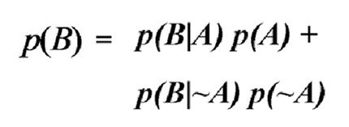
Accounting for “False Positives”
We can rewrite the denominator to make it clear when we calculate that we are considering all the possible outcomes
True Positive: A is true and B happened
False Positive: A is not true and B happened

Slide 47
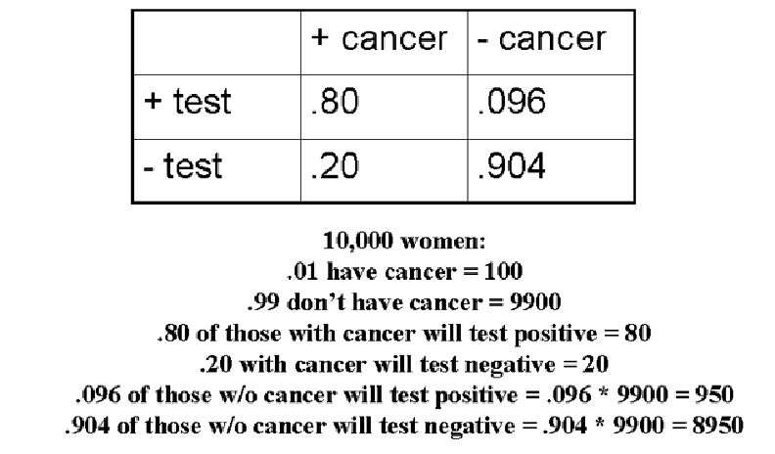
Bayes’ Theorem Example
REALITY
TEST

Slide 48
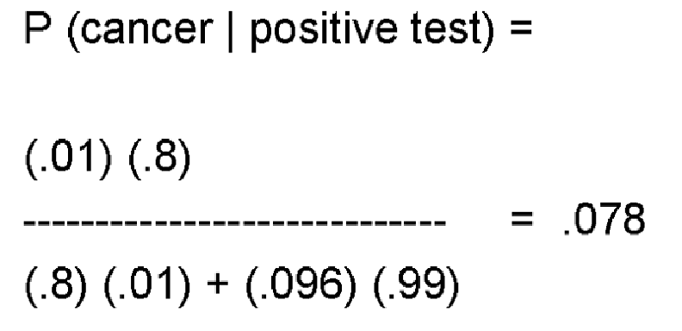
Bayes’ Theorem Example
So even though the test is 80% accurate at detecting cancer, cancer is rare (1%) – which means that a 9.6% false positive rate is a substantial concern

Slide 49
Baysian Spam Classifiers
Bayesian approaches to spam classification assign a "spam probability" to each word, then combines them into a single probability for the email. This combined score considers the good and bad words in an email
This approach evolves with spam as it learns new words and considers their probabilities
Trying to trick a Bayesian filter with misspelled words like "V1AG RA" just trains it to be more reliable because that string has 0 probability in non-spam messages
Very sophisticated spam classifiers use multiple features of messages, not just body content

Slide 50
What to Analyze to Classify Spam?

Slide 51
INFO 202 “Information Organization & Retrieval” Fall 2013
Robert J. Glushko glushko@berkeley.edu
@rjglushko
3 December 2013 Lecture 27.5 – “Answer Machines”

Slide 52
Question Answering Systems
QA systems have been built on both ends of the language vs statistical learning dimension
QA systems use IE techniques to identify the parts of the retrieved documents where the questions are most likely to be answered
Statistical systems rewrite the question into multiple queries in which the keywords occur in different orders
This increases the probability of finding the answers, but is very inefficient, so they use Bayes’ Rule to learn which query rewrites are best and stop doing useless ones

Slide 53
Watson Plays Jeopardy
Watson Beats the Human Champs
Jeopardy uses a broad and open knowledge domain, uses complexly (with puns and abbreviations) worded clues, demands precise answers, and you have to be quick!
A compelling technology (and marketing) demonstration for IBM

Slide 54
Watson – Learning from Reading

Slide 55
Watson- Why Keywords Won’t Work

Slide 56
Watson – Using Deeper Evidence

Slide 57
Reading For Next Lecture
TDO Chapter 10, “The Organizing System Roadmap”

