Slide 1
INFO 202 “Information Organization & Retrieval” Fall 2013
Robert J. Glushko glushko@berkeley.edu
@rjglushko
5 December 2013 Lecture 28.1 – A Roadmap and Retrospective for Organizing Systems

Slide 2
The Organizing System Lifecycle
There is always a lifecycle, but there are times when its phases need to be more explicit and formal:
In institutional contexts
In information-intensive contexts
When traceability and impact analysis are necessary
Better to be more explicit and formal than absolutely necessary than vice versa
2

Slide 3
The Organizing System Lifecycle: 4 Phases
Defining and scoping the domain
Identifying requirements
Design and implementation
Operations and maintenance
These phases are brief and mostly inseparable for some simple organizing systems, more sequential for others, and more systematic and iterative for complex organizing systems
3

Slide 4
A Lifecycle with Inseparable Phases

Slide 5
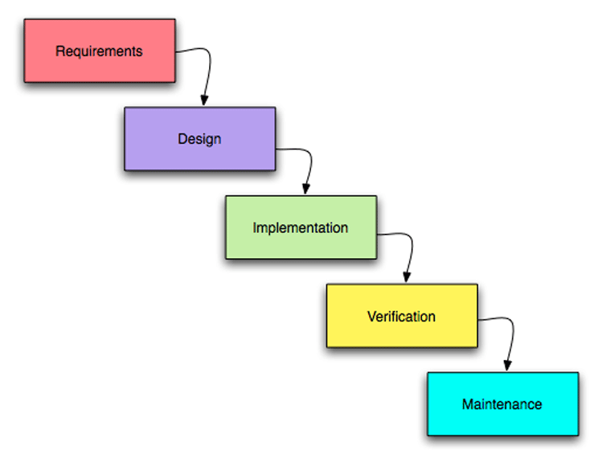
A “Waterfall” or Sequential Lifecycle

Slide 6
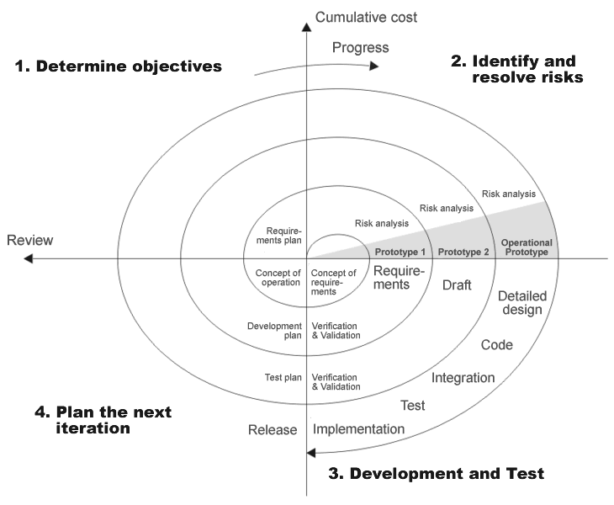
A “Spiral” or Iterative Lifecycle

Slide 7
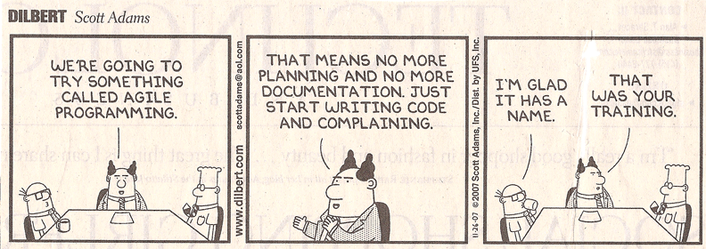
Agile Methods
"Agile“ methods for software development have become very popular and are a specialized form of iterative methods used by small design teams

Slide 8
Defining and Scoping the Domain
Determining scope and scale
Nature and number of users
Expected lifetime
Physical and technological environment
Relationship to other organizing systems
8

Slide 9
Scope and Scale
SCOPE: the breadth and variety of resource types
SCALE: the number of resource instances
Heterogeneity of resources is more important than absolute number (Scope >> Scale)
Handling resource heterogeneity:
Fewer, broader categories
Less description
Automated description and classification
9

Slide 10
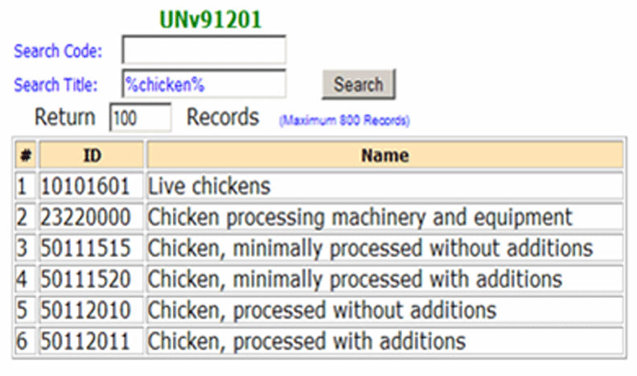
An Organizing System with Global Scope and Scale

Slide 11
An Organizing System with Narrow Scope and Scale

Slide 12
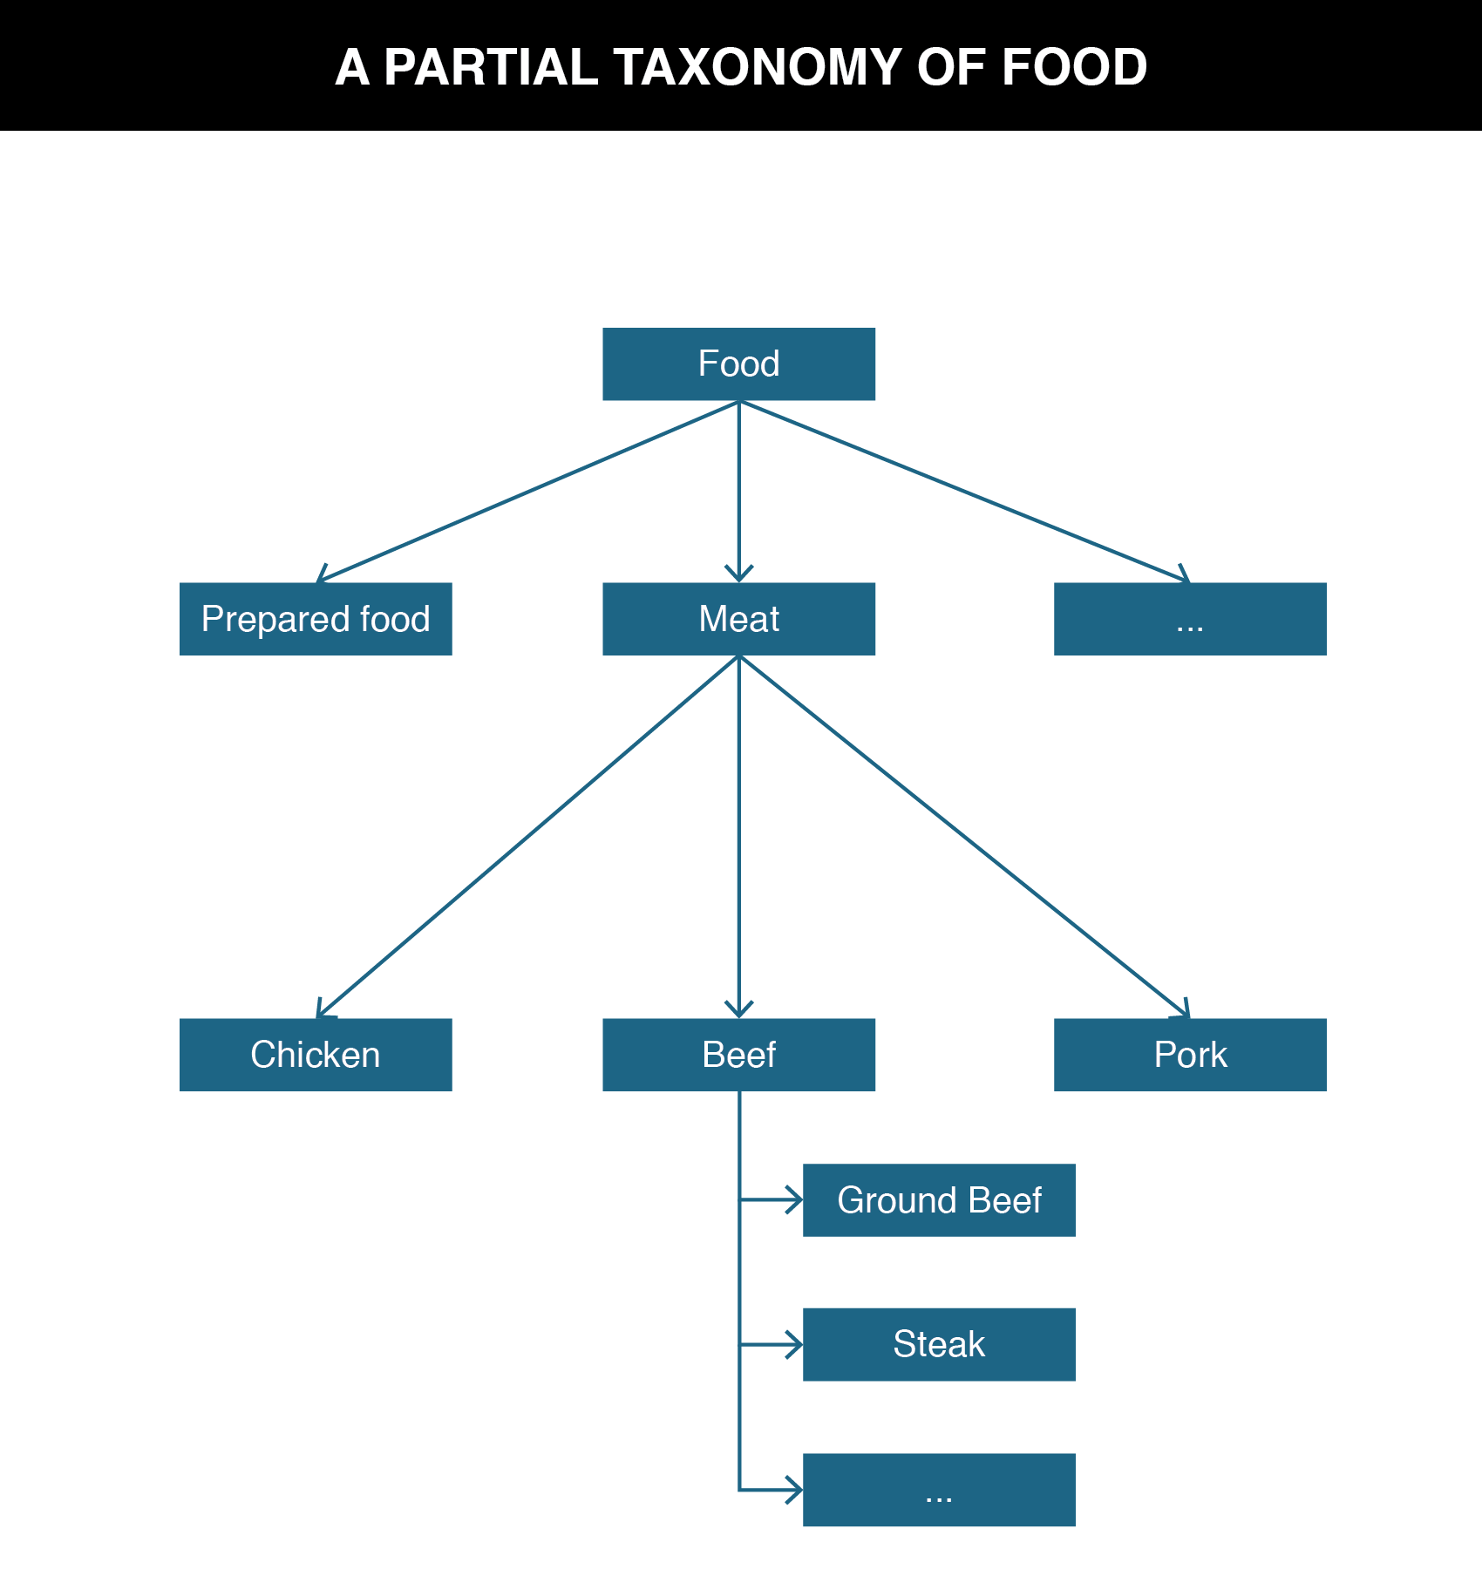
How Broad Should Types Be?
Because of the diversity of resources for a sale in a department store, a broad classification is necessary to accommodate everything in the store. Kitchen goods will be grouped together in a few aisles on a single floor. But a specialty kitchen store or a wholesale kitchen supply store for restaurants would classify much more precisely. An entire section might be dedicated just to knives, organized by knife type, manufacturer, quality of steel, and other categories that are not used in the kitchen section of the department store. (TDO 7.2.1.1).
12

Slide 13
Nature and Number of Users
UNIVERSITY OF CALIFORNIA, BERKELEY
SCHOOL OF INFORMATION
As with resources, the heterogeneity of users is more important than absolute number
Handling user heterogeneity:
More generic interactions
Segment-specific interactions
Multiple organizing principles
Personalization (information-intensive domains where user modeling is feasible)
13

Slide 14
Nature and Number of Users
UNIVERSITY OF CALIFORNIA, BERKELEY
SCHOOL OF INFORMATION
How precisely a collection of resources can be described and organized depends on well user types and requirements are known
In some contexts, user types and individual users can be controlled and identified
In others, types and users aren’t known until the organizing system is in operation
14

Slide 15
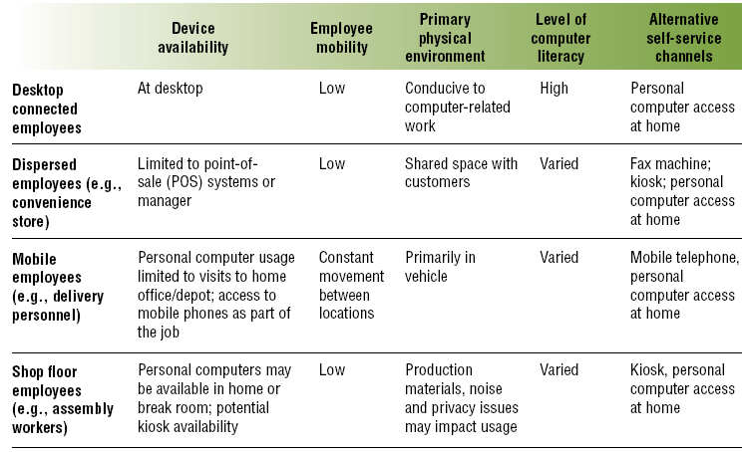
Employee Segmentation & Interactions
15

Slide 16
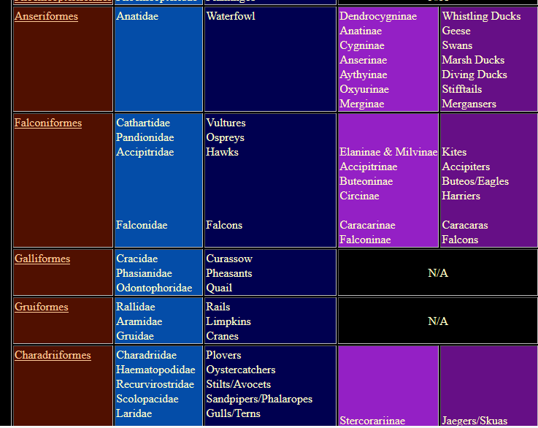
Organizing Birds for Scientists
16

Slide 17
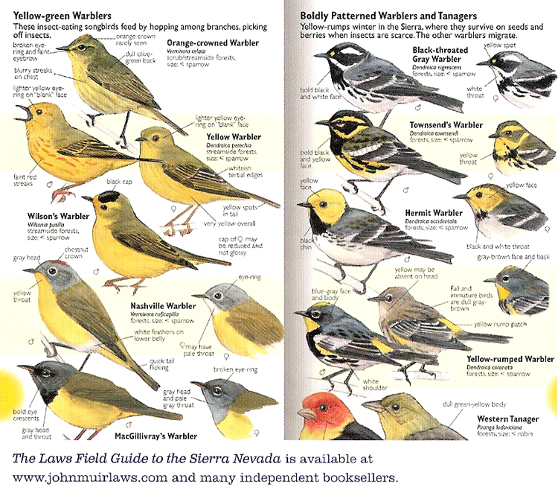
Organizing Birds for Birdwatchers
17

Slide 18
Expected Lifetime
UNIVERSITY OF CALIFORNIA, BERKELEY
SCHOOL OF INFORMATION
Usually correlated with number of users and resources; small collections with single users are often ad hoc and don’t outlive the specific tasks for which they were created
Think architecturally to enable more robustness and flexibility wrt changes in technology or business contexts
18

Slide 19
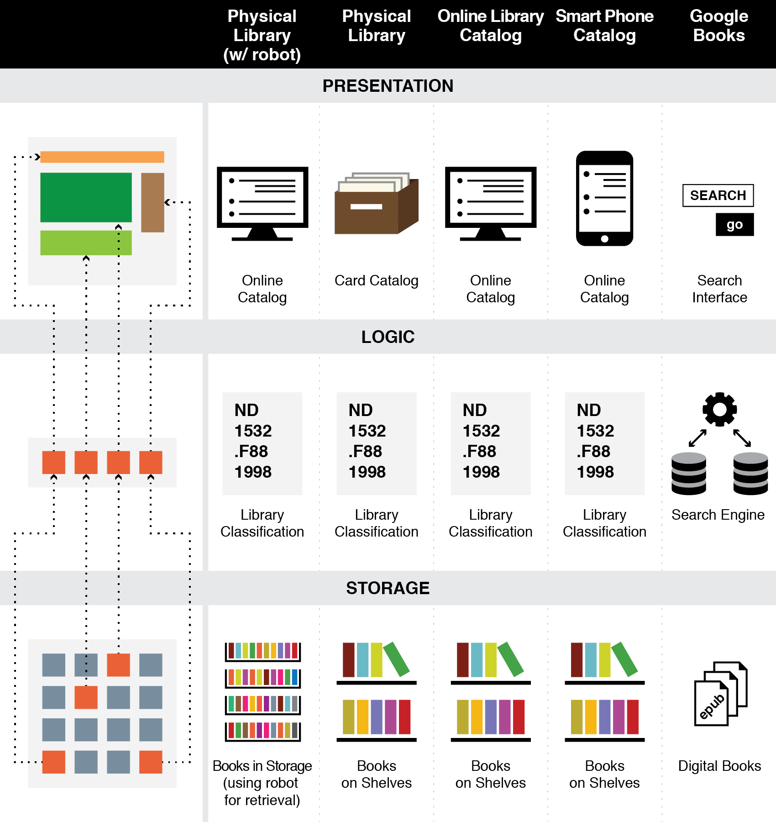
Think Architecturally
19

Slide 20
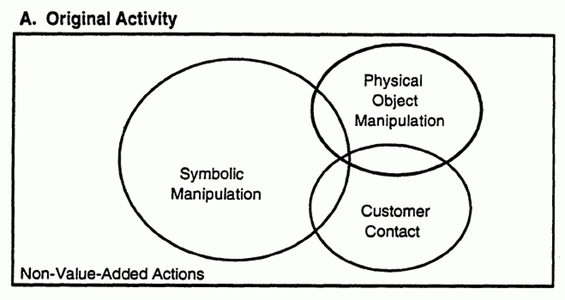
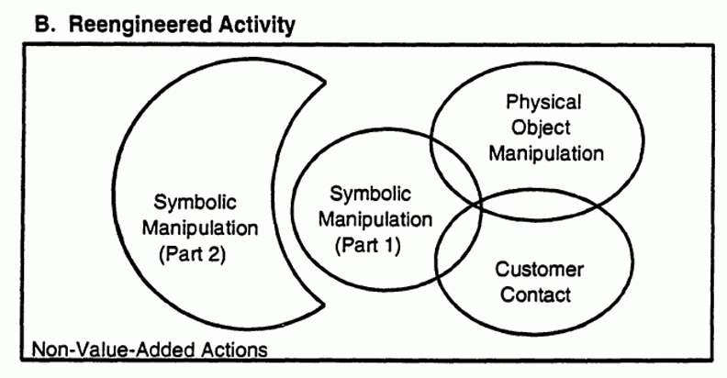
Think Architecturally
20

Slide 21
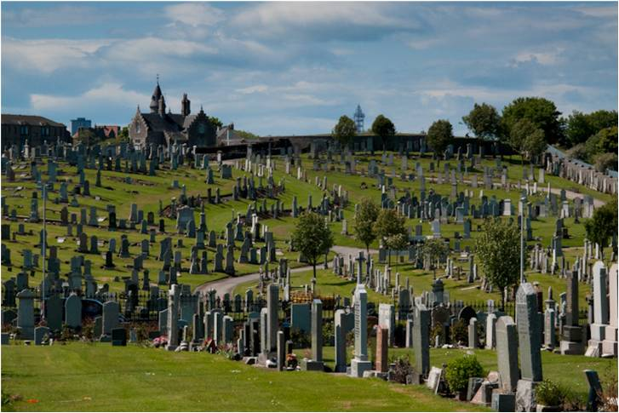
Don’t Confuse Lifetime of Resources with that of the Organizing System
21

Slide 22
Physical or Technological Environment
UNIVERSITY OF CALIFORNIA, BERKELEY
SCHOOL OF INFORMATION
There might be affordances that create possibilities
But there might be constraints that limit them
Estimating the ultimate size of a collection at the beginning of an organizing system’s lifecycle can reduce scaling issues related to storage space for the resources or for their descriptions (flashback to “warrant” goes here)
22

Slide 23
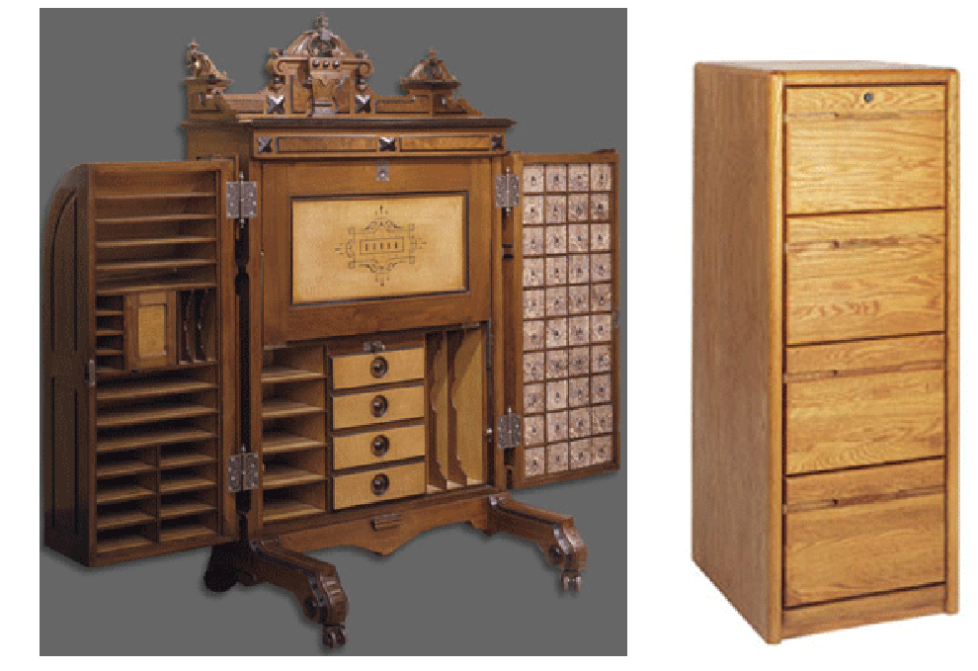
Affordances or Constraints?
23

Slide 24
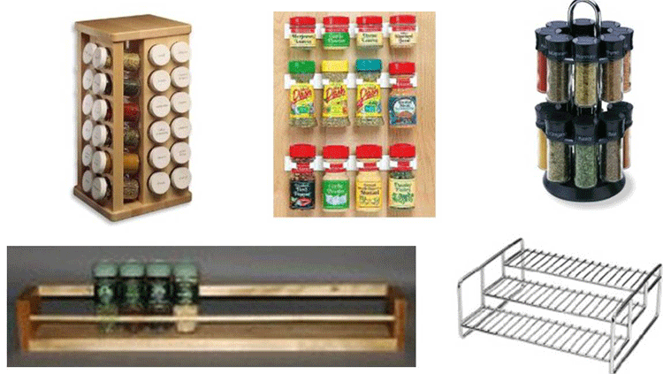
Affordances or Constraints?
24

Slide 25
Relationships with Other Organizing Systems
UNIVERSITY OF CALIFORNIA, BERKELEY
SCHOOL OF INFORMATION
No organizing system exists in isolation
There are always overlapping and adjacent systems from the user’s perspective
Sometimes it is possible to design these to work together to achieve integration and interoperability, or standards / ecosystem can emerge
At very least, try not to make this difficult
25

Slide 26
Overlapping Categories
26

Slide 27
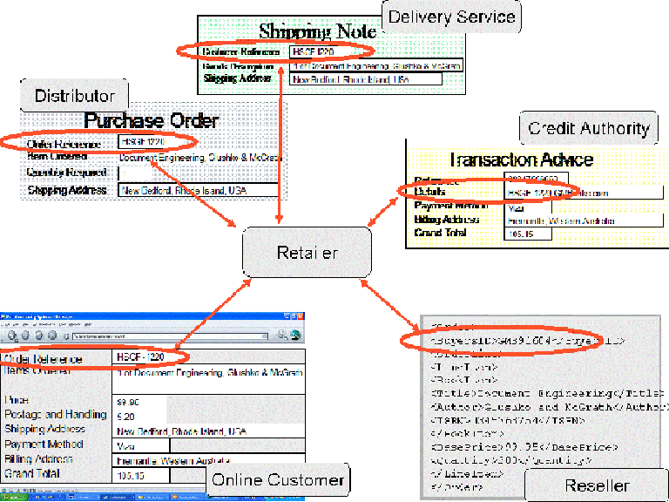
“Drop Shipment” Business Model Enabled by Overlapping Data Models
27

Slide 28
Requirements for Interactions
UNIVERSITY OF CALIFORNIA, BERKELEY
SCHOOL OF INFORMATION
All organizing systems have some common interactions, but most of the time we want to pay attention to the more resource-specific interactions that create the most value
The priorities of different interactions are often determined by decisions about intended users
An essential requirement is ensuring that the supported interactions can be discovered and invoked by their intended users
28

Slide 29
"Information Architecture" and Organizing Systems
An architecture describes a system's components (or "building blocks") and their relationships with each other
"IA is designing an abstract and effective organization of information and then exposing that organization to facilitate navigation and information use"
29

Slide 30
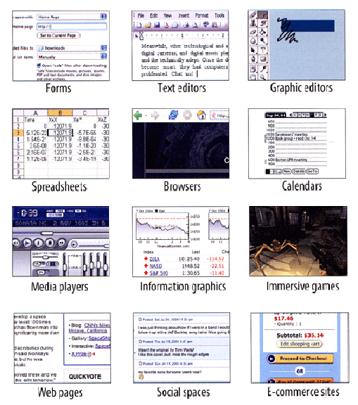
User Interface Design Idioms
Tidwell, Jenifer.
Designing Interfaces: Patterns for Effective Interaction Design
www.amazon.com/dp/1449379702
30

Slide 31
Requirements for Interactions
UNIVERSITY OF CALIFORNIA, BERKELEY
SCHOOL OF INFORMATION
For most organizing systems other than personal ones, the set of interactions that are implemented in an organizing system is strongly determined by business model considerations, funding levels, or other economic factors
Businesses differentiate themselves by the number and quality of the interactions they support with their resources
31

Slide 32
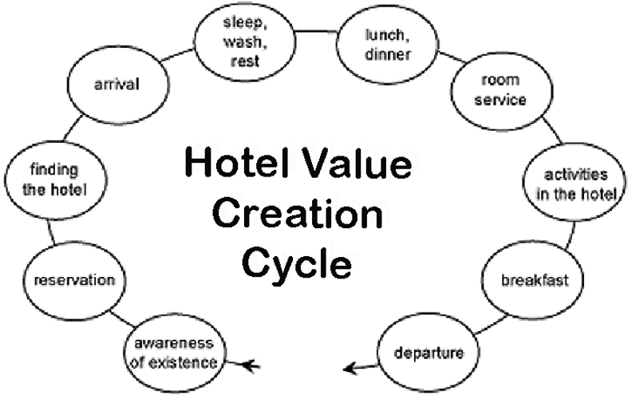
A “Generic” Hotel as a Design Pattern
32

Slide 33
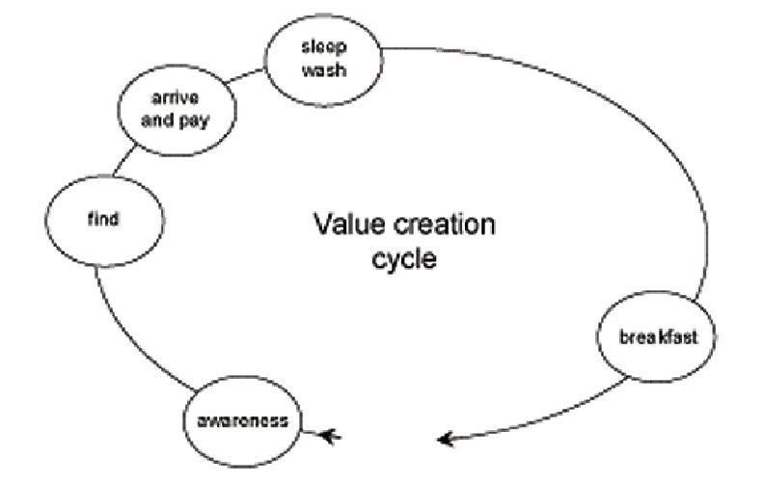
A “Budget” Hotel with Fewer Interactions
33

Slide 34
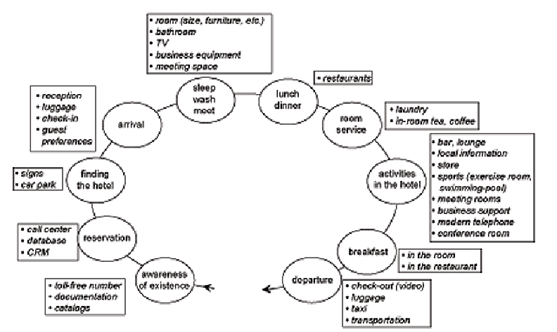
A “Luxury” Hotel with More Interactions
34

Slide 35
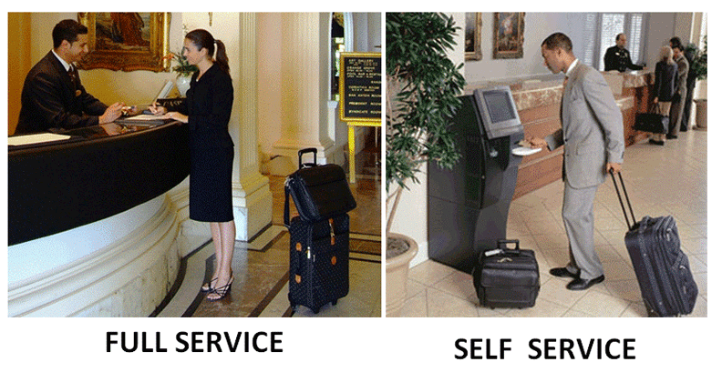
Interaction Alternatives Accommodate User Preferences
35

Slide 36
Requirements about Resource Description
UNIVERSITY OF CALIFORNIA, BERKELEY
SCHOOL OF INFORMATION
The most generic interactions use descriptions that can be associated with almost any type of resource, such as the name, creator, and date
Different types of resources must have differentiating properties, otherwise there would be no reason to distinguish them
36

Slide 37
Requirements about Resource Description
UNIVERSITY OF CALIFORNIA, BERKELEY
SCHOOL OF INFORMATION
Business strategy and economics strongly influence the extent of resource description and the use of technology for automatic description
The tradeoffs imposed by the extent and timing of resource description arise throughout the lifecycle, with the tradeoff between recall and precision being the most salient
37

Slide 38
Tradeoffs involving Description
UNIVERSITY OF CALIFORNIA, BERKELEY
SCHOOL OF INFORMATION
Someone designs or selects a structure for the description... or not
Someone determines the content of the description .. or not
How much structure or how detailed a description?
38

Slide 39
Tradeoffs involving Description
UNIVERSITY OF CALIFORNIA, BERKELEY
SCHOOL OF INFORMATION
Is it easier to create structured or unstructured descriptions?
If we want to combine information from many different authors or sources, what are the implications for description and organizing decisions?
Is it easier to combine information from different authors or sources if it is structured or unstructured?
39

Slide 40
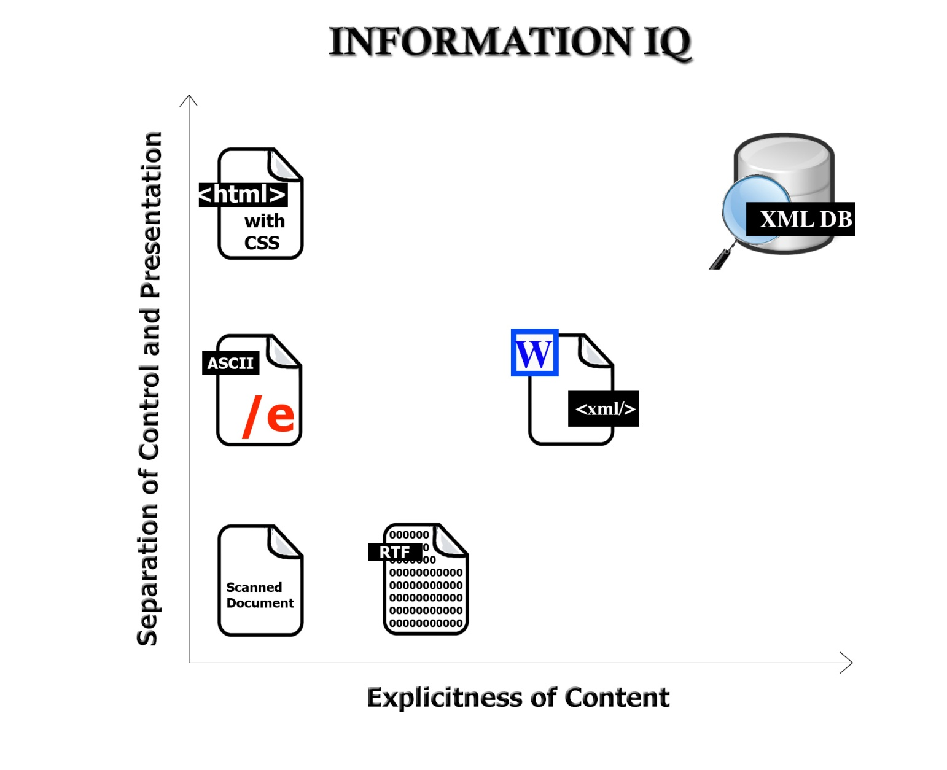
Two Dimensions of “Information IQ”
40

Slide 41
The Fundamental Tradeoff in an Organizing System
UNIVERSITY OF CALIFORNIA, BERKELEY
SCHOOL OF INFORMATION
There is a tradeoff between the amount of work that goes into describing and organizing a collection of resources and the amount of work required to find and use them
The more effort we put into describing and organizing resources, the more effectively they can support interactions
The more effort we put into retrieving resources, the less they need to be organized first
41

Slide 42
The Fundamental Tradeoff in an Organizing System
UNIVERSITY OF CALIFORNIA, BERKELEY
SCHOOL OF INFORMATION
We need to think in terms of investment, allocation of costs and benefits between the describer/organizer and user
The allocation differs according to the relationship between them; who does the work and who gets the benefit?
42

Slide 43
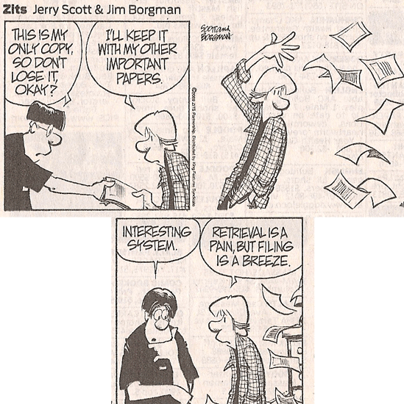
Even Comic Strips Know The Tradeoff

Slide 44
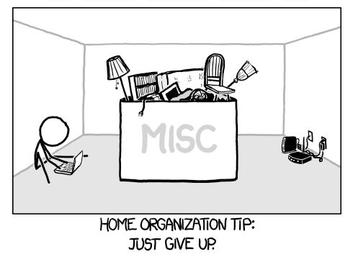
Even Comic Strips Know The Tradeoff

Slide 45
Requirements about Intentional Arrangement
UNIVERSITY OF CALIFORNIA, BERKELEY
SCHOOL OF INFORMATION
Specifying requirements for the intentional arrangement of resources is analogous to specifying why and how resource categories can be created
There is a continuum of category formation that ranges from minimal use of resource properties to more rigorous use of multiple properties, and finally to statistical or composite use of multiple properties
45

Slide 46
Principles for Creating Categories
UNIVERSITY OF CALIFORNIA, BERKELEY
SCHOOL OF INFORMATION
Enumeration
Single Properties
Multiple Properties
Family Resemblance
Similarity
Theory-Based
Goal-Derived
46

Slide 47
The Choice of Properties Matters!
UNIVERSITY OF CALIFORNIA, BERKELEY
SCHOOL OF INFORMATION
Organization using behavior or preferences can make interactions highly efficient for some users and the opposite for those who act differently
When multiple properties are used to organize resources, their order determines the arrangement and the ease of interactions
This implies the need to prioritize user and interaction types
47

Slide 48
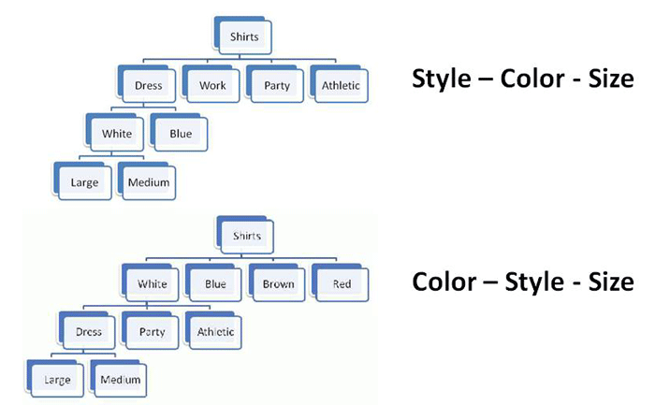
Multiple Properties in Different Order
48

Slide 49
Operating and Maintaining an Organizing System
UNIVERSITY OF CALIFORNIA, BERKELEY
SCHOOL OF INFORMATION
It is critical to determine an appropriate mix of methods for creating and maintaining resource descriptions, because their cost, quality, consistency, completeness, and semantic richness depends on which human or computational agents do the work
49

Slide 50
Small Changes to Organizing Systems
UNIVERSITY OF CALIFORNIA, BERKELEY
SCHOOL OF INFORMATION
Incremental changes in description vocabularies and classification schemes needed when new instances or contexts require additional properties
Subdivision and extension to create new subcategories
Technology upgrades to improve capacity or performance that don’t change any interactions
50

Slide 51
Larger Changes to Organizing Systems
UNIVERSITY OF CALIFORNIA, BERKELEY
SCHOOL OF INFORMATION
Changes in resource description and classifications mandated by new laws or regulations
“All at once” changes to the principles for arranging resources along with changes in the implementing technology because incremental change is infeasible
51

Slide 52
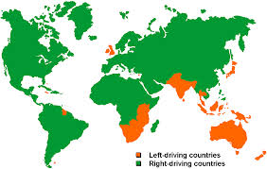
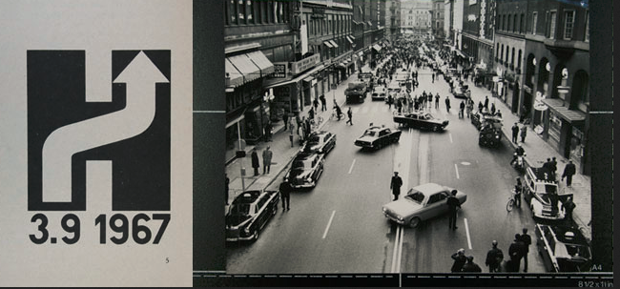
Which Side to Drive On?

Slide 53
The Road Ahead
UNIVERSITY OF CALIFORNIA, BERKELEY
SCHOOL OF INFORMATION
Tuesday December 10 – Alumni Day
Thursday December 12 – Review for Final Exam
Tuesday December 17, 9-1 – Early Final (Sign up!)
Wednesday December 18, 9-1 – FINAL EXAM
53

