Slide 1
Plan for Today’s Lecture(s)
Motivating NLP
Information Extraction
Machine Translation
Speech Recognition and Synthesis
1

Slide 2
INFO 202 “Information Organization & Retrieval” Fall 2013
Robert J. Glushko glushko@berkeley.edu
@rjglushko
26 November 2013 Lecture 26.1 – Introducing Natural Language Processing

Slide 3
Imagining Natural Language Processing in 1968 – “2001: A Space Odyssey”
Dave and Frank think HAL is malfunctioning, so they plan to disconnect it. But HAL reads their lips when they think they are avoiding his speech recognition…

Slide 4
Natural Language Processing
NLP has the goal of creating computers and machines that can use natural language as their inputs and outputs
The field is broad, and involves computer science, linguistics, cognitive psychology, statistics
4

Slide 5
Natural Language Processing
Every NLP application needs to identify and classify the words, phrases, structures, documents in some context or domain
The earliest NLP applications were very narrow in scope, relying on “hand crafted” rules to implement the required knowledge
Today much NLP uses dictionaries, stemmers, grammars, and other language knowledge
But the statistics of co-occurrence / conditional probability yield many practical techniques for analyzing and generating language that make no use of “languageness”
5

Slide 6
Real World NLP Applications
Information extraction
Summarization
Auto-journalism (story generation)
Machine translation
Speech recognition and synthesis
Computational classification
Topic identification
Author identification
Spam detection
Sentiment analysis
Question answering, automated customer service, recommendations…
6

Slide 7
INFO 202 “Information Organization & Retrieval” Fall 2013
Robert J. Glushko glushko@berkeley.edu
@rjglushko
26 November 2013 Lecture 26.2 – Information Extraction

Slide 8
Understanding Information Extraction
What type of structure is being extracted?
What is the unstructured source input?
What resources are available to guide the extraction?
What extraction techniques are employed?
What is the format of the extracted information?
(IE typically starts after tokenization, part-of-speech tagging, and phrase identification steps of text processing)

Slide 9
"Named Entity" Recognition
People, organizations, locations, dates, etc. can be identified with high accuracy in most kinds of documents using a combination of dictionaries, directories, gazetteers and rules – many are domain-specific
Named entity recognition is essential for machine translation because if multi-word names are missed, translating them word-for-word will cause errors (e.g., Golden Gate Park, Walnut Creek)
Important entities are likely to be mentioned many times in a text, but are often described by different noun phrases each time, requiring co-reference resolution

Slide 10
Application Areas for IE
Sales intelligence and lead generation (customers)
Market intelligence (competitors, pricing)
Business intelligence (aggregating information)
"Central Intelligence" and Homeland Security

Slide 11
Extraction Rules
Capitalized-word + “Corp.” → finds company names
“Mr.” capitalized-word+ → finds person names
Capitalized-word+ “,” number-below-100 “,” → finds person names
Mark Zuckerberg, 29, …
“Mark Zuckerberg” and “Mr. Zuckerberg” are probably the same entity if these two phrases occur near each other
But “Golden Gate Park” and “Mr. Park” aren’t …
Examples from Grishman, Ralph. "Information extraction." The Handbook of Computational Linguistics and Natural Language Processing (2003): 515-530.

Slide 12
Extracting Dataypes and Patterns: Closed Sets

Slide 13
Extracting Dataypes and Patterns: Regular Expressions

Slide 14
Extracting Dataypes and Patterns: Canonical Order

Slide 15
Extracting Multi-Way Relationships
Often called "record extraction"
Some N-way extractions are easy because of conventional ordering of the entities in the unstructured input (e.g., creating structured address records)
But the goal of most N-way extractions is to populate schemas involving causal relations and dependencies (e.g., for "events" like disease outbreaks, news about company reorganizations and employee promotions)

Slide 16
Record Extraction

Slide 17
Domain Specific Entities and Relationships
See DARPA Message Understanding Conference

Slide 18
“Open” Information Extraction
The earliest information extraction applications were designed to identify a pre-specified set of entities and relationships (e.g., terrorism events)
But these hand-crafting techniques can’t possibly scale to the web or more open-ended environments
More recent efforts exploit the fact that most relationships follow a very small set of patterns
Alchemy Demo

Slide 19
Binary Entity Relationships
Two relationship types account for 60% of them and 8 relationship types account for 95% of them
Etzioni, Oren, et al. "Open information extraction from the web." Communications of the ACM 51.12 (2008): 68-74)

Slide 20
Identifying Hyponyms
Hearst, Marti A. "Automatic acquisition of hyponyms from large text corpora." In Proceedings of the 14th conference on Computational linguistics-Volume 2, pp. 539-545. Association for Computational Linguistics, 1992.

Slide 21
Identifying Hyponyms

Slide 22
Text Summarization
A summary is a text produced from one or more texts that conveys their important information(to people) using significantly fewer words
Summarization requires EXTRACTION to identify important content, ABSTRACTION to regenerate it in more concise form, FUSION to combine the extracted parts, and COMPRESSION to eliminate unimportant content
The "important content" is identified via a combination of features and heuristics

Slide 23
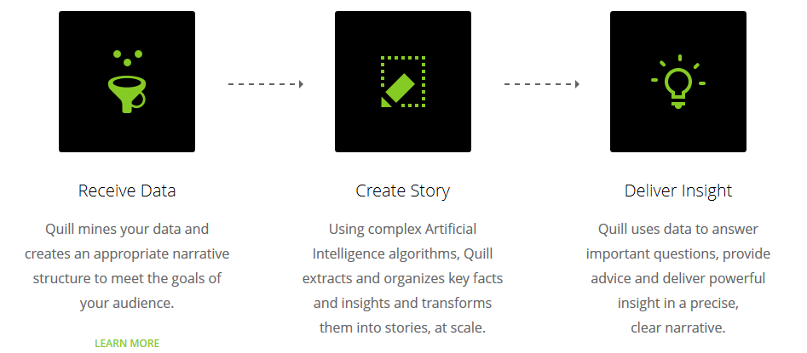
Robo-Journalism
Domains in which the most important information is inherently highly structured can do the inverse of information extraction
Narrative science pioneered this idea to generate sports and finance stories, which follow templates and grammars

Slide 24
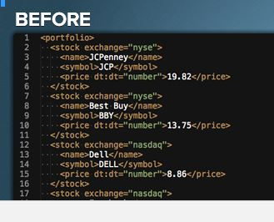
“Automated Insights”
“Our patented artificial intelligence platform sifts through large data sets and identifies key patterns and trends, then describes those insights in plain English with the tone, personality and variability of a human writer”

Slide 25
Story Templates and Grammars
Some document types have a regular "discourse" or "frame" structure that makes it easier to find information that fills the key "slots“
What are the slots in a generic sports story? What if the sports are subdivided?
Election story? “Weather event” story? Etc….
Once Narrative Science had mastered the art of telling sports and finance stories, the company realized that it could produce much more than journalism. Indeed, anyone who needed to translate and explain large sets of data could benefit from its services…

Slide 26
INFO 202 “Information Organization & Retrieval” Fall 2013
Robert J. Glushko glushko@berkeley.edu
@rjglushko
26 November 2013 Lecture 26.3 – Machine Translation

Slide 27
Machine Translation: An Apocryphal but Important Example
A story often told about the early days of machine translation research (1950s) is that the English sentence:
The spirit is willing, but the flesh is weak
when translated into Russian, and then back to English became:
The vodka is strong but the meat is rotten
27

Slide 28
Machine Translation: A Brief History [1]
Initial optimism in the 1950s was followed by extreme pessimism
In 1966 the Automatic Language Processing Advisory Committee (ALPAC) concluded "there is no immediate or predictable prospect of useful machine translation" and recommended the development of computer aids for human translators
Fortunately, ALPAC also recommended continued support of basic research in computational linguistics
28

Slide 29
Machine Translation: A Brief History [2]
In the 1970s and 1980s MT systems continued to develop; the dominant technical strategy relied on hand-crafted syntactic parsers, morphological analyzers, and dictionaries - intensely semantic and rule-based approaches.
The 1990s were a major turning point. IBM research developed the Candide system that relied purely on statistical analysis and "example-based" methods for phrase matching and translation
29

Slide 30
Machine Translation: A Brief History [3]
Candide used a very large corpus of English and French documents that had extremely reliable bi-directional translations
This bilingual corpus contained enough examples to estimate the substitutability or semantic equivalence of words between English and French
30

Slide 31
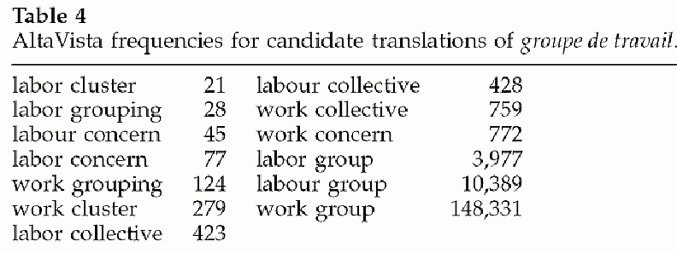
Using Statistics to Improve Translation
Word selection in translation:
French phrase groupe de travail
groupe translates to cluster, group, grouping, concern, collective
travail translates to work, labor, labour
31

Slide 32
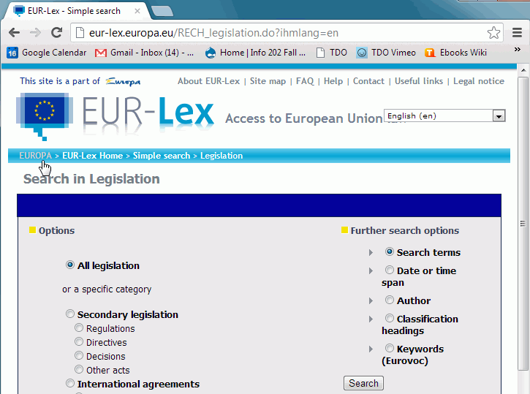
Authoritative Multi-Language Corpus
The European Union keeps official documents from all EU institutions, including minutes of parliament hearings, all European Commission documents, regulations in every language
32

Slide 33
Authoritative Multi-Language Translation
Today the largest corpus of authoritative multi-language translations is at the European Parliament, where there are 23 "official languages“ and realtime translation is often necessary but not always possible
How many pairwise translations might need to be done?
Is this an effective method of translation? Why or why not?
33

Slide 34
Text Corpora
Computational linguists, computer scientists, experimental psychologists and others rely on text corpora for their research
Prominent pre-web examples include the Brown corpus (Kucera and Francis, 1967) that includes a million words of contemporary American English
The web dwarfs any other (possible?) corpus -- Google probably indexes a few trillion words, making it orders of magnitude larger than any other text collection (with the possible exception of Microsoft's)
34

Slide 35
Pre-Nominal Adjective Ordering
In translation and text generation we need to arrange nouns and adjectives to "sound right" and create the intended meaning:
Big brown dog is grammatical
Brown big dog is not
This is a challenging problem for ESL people, and especially when their native language does it very differently
35

Slide 36
Getting Adjective Order Right
Some NLP approaches attempt this using rules (e.g., size adjectives precede color ones)
But it can also be done using data-intensive approaches; compare frequency of {a, b} with {b, a}
Generate all the possible strings and choose the one that occurs most frequently
"smart beautiful woman" 5.5 x more frequent than "beautiful smart woman" (Google search on 29 November 2010)
36

Slide 37
How Good is Machine Translation?
Microsoft's release of its Xbox 360 video-games console begins a new phase in the battle to remove Sony's PlayStation from the top spot. If it succeeds, the software giant may be tempted to make more incursions into the competitive market for home-entertainment hardware.
37

Slide 38
How Good is Machine Translation – “Google Translate” Roundtripping (German)
(Nov 2005) Release Microsofts of its video game console Xbox 360 begins a new phase in the battle for removing from PlayStation Sonys from the upper point. If it follows, the software giant can be provoked, in order to form more ideas into the free market for house maintenance small articles.
(Nov 2013) Microsoft's release of the Xbox 360 video game console begins a new phase in the struggle for Sony's PlayStation remove from the top. If it is successful, the software giant may be tempted to make more inroads in the competitive market for home entertainment hardware.
38

Slide 39
How Good is Machine Translation – “Google Translate” Roundtripping (Chinese)
(Nov 2005) Its Xbox 360 video-games control bench Microsoft. The s release starts one new stage removes Sony in this battle; s PlayStation from this top spot. If it succeeds, perhaps the software giant does invades into the competitive market for the family entertainment hardware
(Nov 2013) Its Xbox360 video game console, Microsoft released the beginning of a new phase in the battle of Sony's PlayStation deleted from the top spot. If successful, the software giant might be tempted to make more broke into a competitive market, home entertainment hardware.
39

Slide 40
Is Machine Translation Good Enough? Compared to What?
Is "round tripping" a fair test of machine translation? What exactly is it testing?
English is (one of) the most widely spoken and written languages, and is the language most widely learned as a second or third one
How well would speakers and readers of second languages compare to automated language translation?
Automated translation is clearly more accurate than some large portion of them would be
40

Slide 41
INFO 202 “Information Organization & Retrieval” Fall 2013
Robert J. Glushko glushko@berkeley.edu
@rjglushko
26 November 2013 Lecture 26.4 – Speech Recognition and Synthesis

Slide 42
Speech Recognition
As we saw in the 2001: A Space Odyssey example speech recognition has great potential to enhance how people interact with machines
Like machine translation, speech recognition has a long history in NLP, but it raises many additional technical challenges because of the acoustical and signal processing challenges
And like machine translation, speech processing had a rule-based phase but it is now much more statistical in character

Slide 43
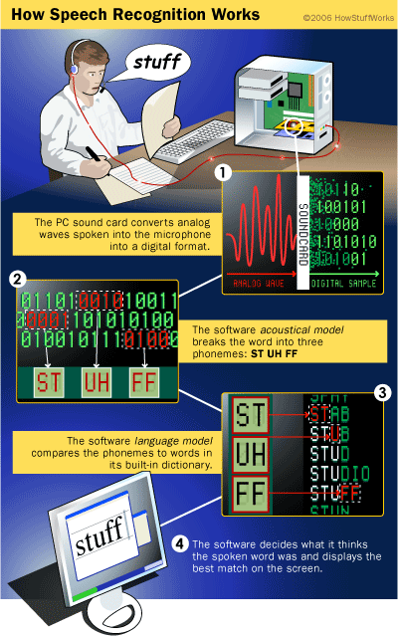
Speech Recognition - Simplified Process (about 2008)
43

Slide 44
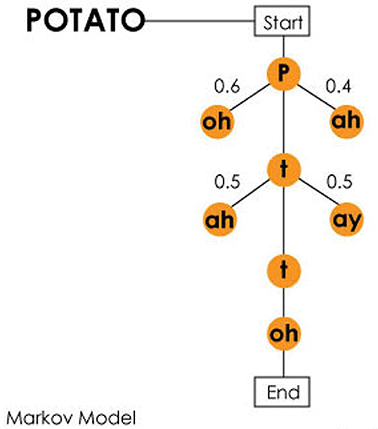
Speech Recognition – Using Transition Probabilities
44

Slide 45
Speech Recognition – for “Consumers”
Continuous speech recognition systems for dictation can be extremely accurate if the system has been trained to recognize the speaker's voice, but even untrained systems are getting really good (e.g., Dragon from Nuance)
SIRI does its speech recognition “in the cloud” and emphasizes entity and phrase recognition rather than sentence and intent understanding

Slide 46
Speech Synthesis (Text-to-Speech)
TTS seems like the reverse of speech recognition, but there is limited technology overlap and neither involves much language understanding
Being able to synthesize speech from computer-readable text is useful in applications that require spontaneous interaction ...
... or where reading isn't practical, like when you're driving and need directions.
Speech synthesis enables accessibility for people who are sight- or voice-impaired
When TTS is aimed at the general public, "naturalness" is essential to acceptance; this makes dialect critical
(UK male; India female)

Slide 47
Speech Recognition, Translation, and Synthesis Combined
47

Slide 48
INFO 202 “Information Organization & Retrieval” Fall 2013
Robert J. Glushko glushko@berkeley.edu
@rjglushko
26 November 2013 Lecture 26.4 – Assignment

Slide 49
Your Assignment: Enjoy Thanksgiving

