Slide 1
Plan for Today’s Lecture(s)
Dimensionality Reduction and LSA (runover from 11/12)
History of web search
Web crawling
Using links to determine relevance
1

Slide 2
INFO 202 “Information Organization & Retrieval” Fall 2013
UNIVERSITY OF CALIFORNIA, BERKELEY
SCHOOL OF INFORMATION
Robert J. Glushko glushko@berkeley.edu
@rjglushko
12 November 2013 Lecture 22.5 – Dimensionality Reduction in the Vector Model

Slide 3
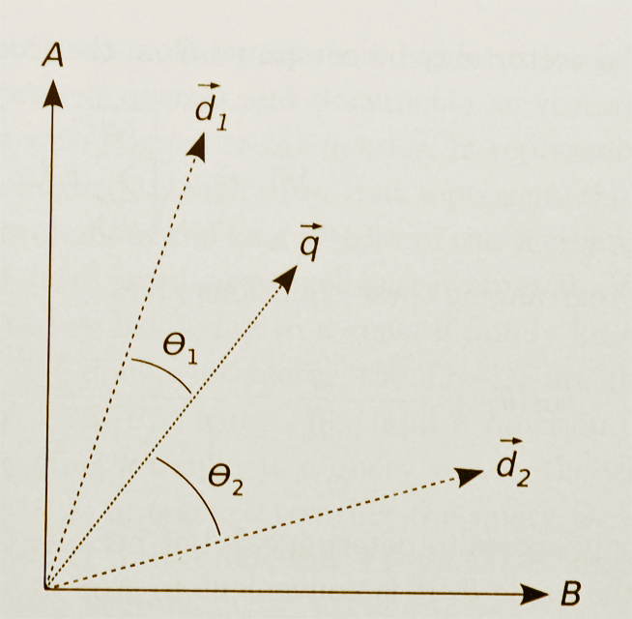
Similarity in Vector Models (Graphical Depiction)
3

Slide 4
Vector Model with Polysemy
Because the vector model doesn't recognize that "BANK as in river" and "BANK as in money" are different senses, all occurrences of the term BANK are treated the same instead of being distinguished as separate dimensions in the space
This overestimates the similarity of documents containing BANK
4

Slide 5
Vector Model with Synonymy
The vector model can't recognize that "AUTO" and "CAR" are synonyms, and thus assigns them separate dimensions instead of counting them as additional occurrences of the same "semantic term”
This underestimates the similarity of documents containing AUTO and CAR
5

Slide 6
Dimensionality Reduction - A Very Informal Motivation
Reducing the number of dimensions in a description to the "principle" ones is a common goal in psychology or marketing
For example, if you have lots of people answer the questions on a personality test, you want to reduce the "person x question" matrix to a "person x PersonalityDimension" one
6

Slide 7
Dimensionality Reduction - A Very Informal Motivation
If every resource described as “big” is also described as “red,” and every “small” resource is also “green,” this correlation between color and size means that either of these properties is sufficient
With thousands of properties or descriptive terms, we need clever statistical analysis to choose the optimal descriptive terms
We can synthesize new “logical terms” based on the correlations
7

Slide 8
From Terms to Topics
The dimensionality of the space in the simple vector model is the number of different terms in it
But the "semantic dimensionality" of the space is the number of distinct topics represented in it
The number of topics is much lower than the number of terms
Documents can be similar in the topics they contain even if they have no words in common
8

Slide 9
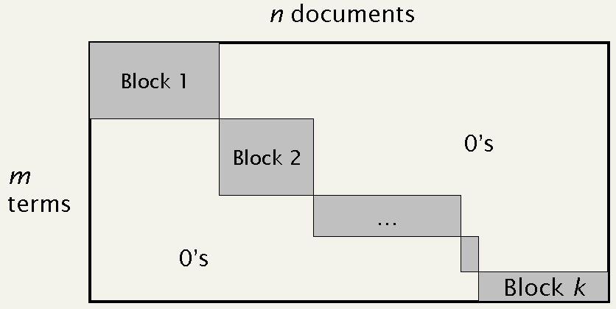
An Intuitive Explanation for Dimensionality Reduction Techniques
9

Slide 10
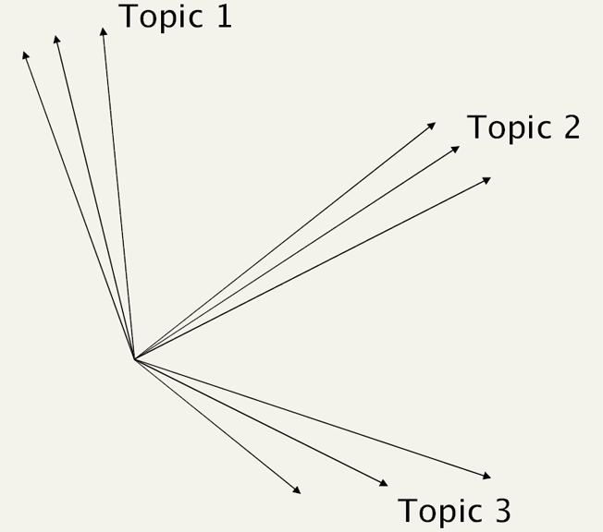
"Topic Space," Not "Term Space"
10

Slide 11
Dimensionality Reduction with "Latent Semantic Analysis"
The vectors in this reduced dimensionality space aren't directly identifiable, but they are "latently" semantic in that relationships between vectors in this lower dimensional space reflect semantic associations
This dimensionality reduction is completely automatable
11

Slide 12
LSA as an IR Model
Reducing the dimensionality of the Term x Document matrix might suggest that retrieval precision would suffer
But we're not just discarding terms -- we are replacing sets of co-occurring (e.g., associated) terms with "superterms" or "topics" that represent meaning as a kind of average of all the terms that tend to occur in the same contexts
We can compute document similarity based on the inner product / cosines in this latent semantic space just as we do with other vector models
12

Slide 13
LSA Applications
LSA has been shown to be a practical technique for estimating the substitutability or semantic equivalence of words in larger text segments
...which makes it effective in IR, text categorization, and other NLP applications like question answering
EXAMPLE: LSA to grade essay exams
13

Slide 14
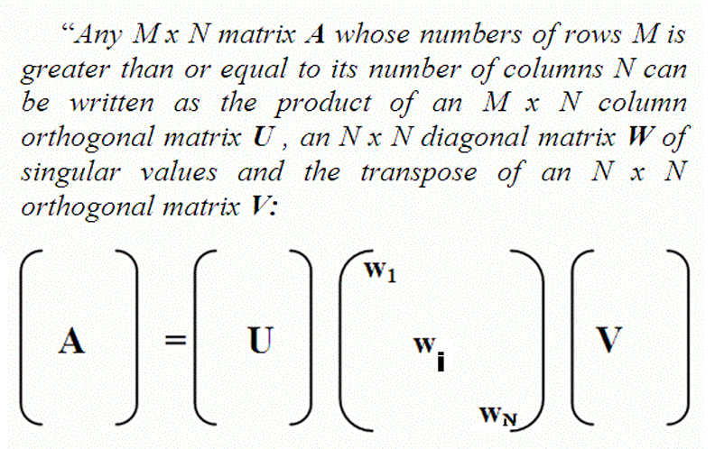
Singular Value Decomposition (formal)
14

Slide 15
Singular Value Decomposition (less formal)
The original matrix is decomposed here into three matrices whose product exactly reproduces the original one
... which by itself doesn't help us
...but the rows and columns are now "orthogonal" or "independent" vectors
15

Slide 16
Singular Value Decomposition (less formal)
... and the "matrix in the middle" (the "singular values") is a diagonal matrix (all values other than the diagonal ones are 0) that is a set of "scaling" values for those new dimensions
... ordered in size so we can approximate our original matrix even if we toss out most of the new vectors because they don't explain much of the data
16

Slide 17
Dimensionality Reduction with "Latent Semantic Analysis"
UNIVERSITY OF CALIFORNIA, BERKELEY
SCHOOL OF INFORMATION
Once we have factored the original term x document matrix using SVD, we can then find a much smaller matrix that approximates it
(...more or less by deleting coefficients from the diagonal matrix, starting with the smallest)
These techniques in effect "squeeze down" the matrix to lower rank (typically 100-200) by bringing together terms that have similar co-occurrence patterns
17

Slide 18
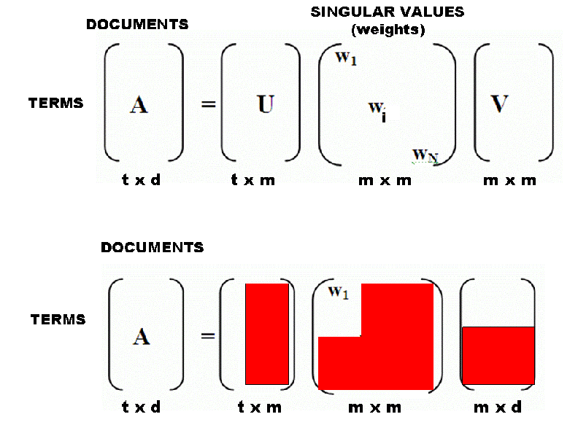
Singular Value Decomposition Approximation
18

Slide 19
INFO 202 “Information Organization & Retrieval” Fall 2013
Robert J. Glushko glushko@berkeley.edu
@rjglushko
19 November 2013 Lecture 24.1 – History of Web Search

Slide 20
History of Web Search
Infographic showing the long and incremental evolution of systems for searching Internet resources, beginning around 1990 with Archie
The earliest search engines indexed only the title of Internet resources
TB-L created the Web to consolidate the diverse formats and protocols for Internet file exchange
TB-L anticipated a web of academic and research institutions that knew each other, so search and site discovery were not top priorities
20

Slide 21
Listing, Indexing, Crawling
When there were few web sites, each new one was announced on the NCSA “What’s New” page
After NCSA’s Mosaic graphical browser was released in 1993, the number of sites grew rapidly, and NCSA’s list became inadequate
Web Wanderer in 1993 was first to create an index of URLs
Web Crawler in 1994 was first to create an index of web page content
21

Slide 22
The Index
When we talked about Boolean model the index was the words and their locations in the document
But more generally the index is “anything we know about the document” – its content, its metadata, its links, its access frequency, etc.
22

Slide 23
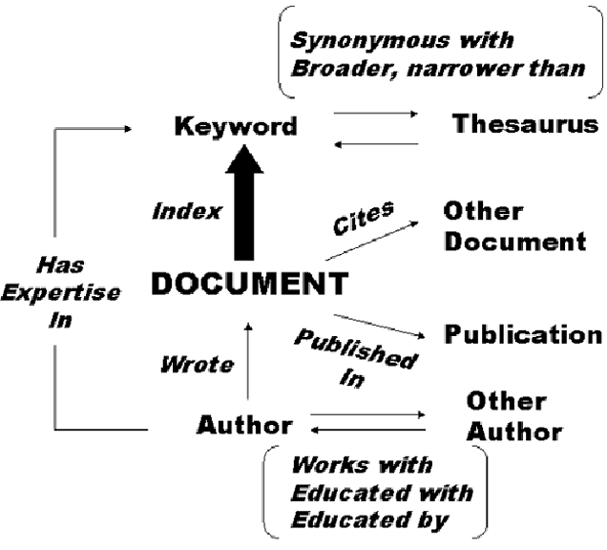
THE INDEX IN CONTEXT

Slide 24
Directories and Portals
In 1994 two Stanford grad students (Yang and Filo) created a hierarchical directory that organized sites by category
Searching this human-created organizing system was an effective and popular way to find relevant web sites
Yahoo! went public in 1996 and became the leading “portal” site that aggregated web sites, games, news, email, and other interactions
24

Slide 25
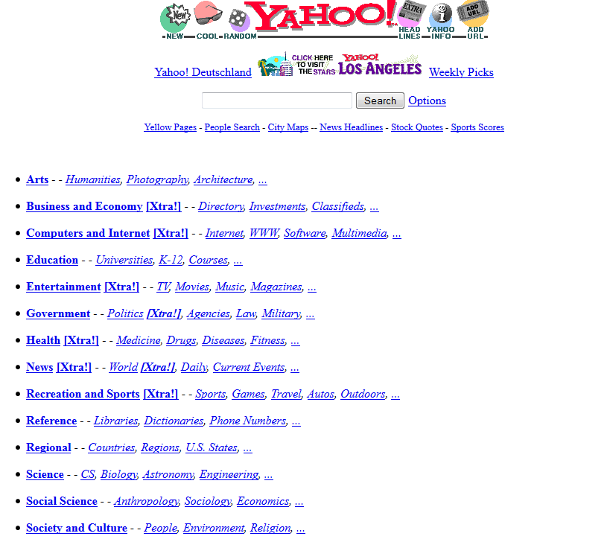
Yahoo! Directory in 1996

Slide 26
Commercialization
In the mid-90s the web drew commercial interest, leading to substantial debate about whether this was an acceptable use... and the commercial interests won
Commercial use of the web grew so fast that the directory sites couldn’t keep up, and Altavista, Excite, Infoseek, Inktomi, and Lycos emerged as keyword-based search engines
The uncontrolled essence of the web enabled the emergence of spam by the mid-1990s
26

Slide 27
Fighting Spam with Authoritative Relevance
Vector IR models that worked well in controlled collections were not effective against spam
Page & Brin at Stanford developed BackRub, used incoming links to estimate “authoritative” relevance
This “Page Rank” method was substantially better than vector IR models at eliminating spam sites from search results
Google was founded in 1998 with goal of licensing Page Rank to other search engines, but this strategy wasn’t successful
27

Slide 28
Advertising
GoTo (soon renamed Overture) was founded in 1998 and invented paid search results placement using keyword auctions; no "organic" results
Page & Brin were adamantly opposed to this
advertising funded search engines will be inherently biased towards the advertisers and away from the needs of the consumers… it is crucial to have a competitive search engine that is transparent and in the academic realm.
28

Slide 29
Ads Pay for It!
But their advisors and investors convinced Page and Brin to change their minds, and Google added paid search results, segregating them from the results produced by their search engine
Ad revenue pays for investment in search engine infrastructure, which makes the web more useful, which incents the creation of more web sites, which makes search more necessary…
29

Slide 30
INFO 202 “Information Organization & Retrieval” Fall 2013
Robert J. Glushko glushko@berkeley.edu
@rjglushko
19 November 2013 Lecture 24.2 – Web Crawling

Slide 31
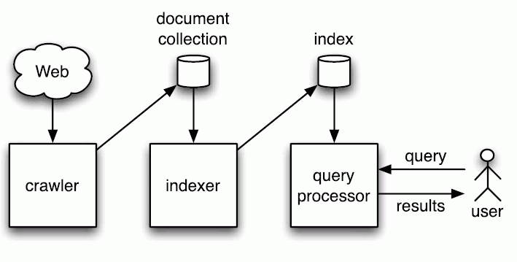
Simplified View of Web Search Engine

Slide 32
Web Crawling: Simplistic View
How do search engines find web pages to index?
“Crawling” is the conventional name for this activity but it is misleading
It suggests that some program that is moving around the web… rather than “staying at home” and sending queries to web sites
32

Slide 33
Web Crawling: Simplistic View
Start with known sites
Record information for these sites
Follow the links from each site
Record information from sites found by following links
Repeat
(Put "to be processed" pages in a queue)
33

Slide 34
Web Crawling: Complications
"Individual" web pages are often highly complex structures with menus, images, advertising, and lots of dynamically generated content
Some sites are linked to by many pages, and we don't want to process them whenever we find them
Some sites change a lot, some rarely change
Duplicate pages
A great deal of the web is "deep" or "hidden" and not directly accessible to crawlers
34

Slide 35
Web Crawling: Complications
Link loops (A links to B, B links to C, C links to A)
Invalid HTML
Some sites don't want to be indexed
Some sites don't deserve to be indexed because they are "link farms" - these just impose useless work on the crawler
35

Slide 36
The "Deep Web"
Much of the dynamic web is also the "deep" or "hidden" or "invisible" web whose pages are generated in response to queries submitted to an underlying database or repository
Using overlap analysis between pairs of search engines, it was estimated in that 43,000–96,000 “deep Web sites” and an informal estimate of 7,500 terabytes of data exist - 500 times larger than the surface Web
He, Patel, Zhang, and Chang. "The Deep Web," Communications of the ACM, May 2007
36

Slide 37
INFO 202 “Information Organization & Retrieval” Fall 2013
Robert J. Glushko glushko@berkeley.edu
@rjglushko
19 November 2013 Lecture 24.3 – Using Links to Determine Relevance

Slide 38
The Need for Web Citation Analysis
The primary reason for using web links is because relying only on the content of web pages just doesn't work well enough
The typical short queries (1 or 2 words) create short query vectors that would bias toward the retrieval of short documents
Unlike documents in controlled collections, the metadata associated with web pages is often missing or misleading
38

Slide 39
Adapting Citation Analysis to the Web
The concepts and techniques of citation analysis seem applicable to the web since we can view it as a network of interlinked articles
But not everything applies because the web is different in numerous ways
Google’s Page Rank is the exemplar of how citation analysis influences relevance ranking
39

Slide 40
Google Page Rank
Google is extremely secretive about how it computes relevance, and it uses hundreds of “signals” to select and rank web sites in response to a query
But the basic ideas about exploiting link structure to estimate relevance have probably not changed much
40

Slide 41
Using Links to Assess Relevance
Using links to assess the relevance of a web site seems intuitively sensible
Sites that are the "official" or "authoritative" or "gateway" site for an enterprise or organization will attract links from the Es & Os that have relationships with them -> we should value incoming links
Sites that these sites then link to are being endorsed by them -> we should value outgoing links from high relevance sites
41

Slide 42
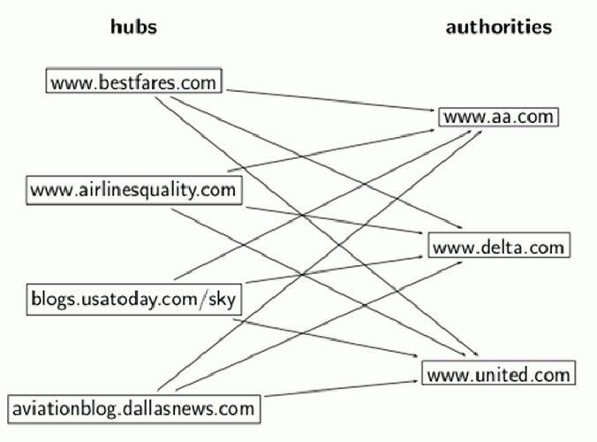
Hubs and Authorities

Slide 43
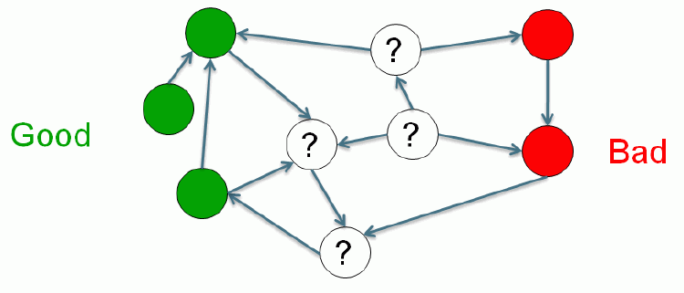
Evaluating Incoming and Outgoing Links
A "good" site only points to other "good" sites, endorsing them...what about the other types?

Slide 44
Evaluating Incoming and Outgoing Links
If you point to a known bad site, you are either bad or showing poor judgment; either way we should lower our evaluation of you
If a known bad site points to a known bad site, maybe they are cooperating
If a known bad site points to a known good site, it isn't the good site's fault
Should the number of outgoing links a site has influence how we value each link?
44

Slide 45
The Page Rank "Voting" Calculation
A site doesn't lose any of its own Page Rank by linking - it is just voting, as in a company shareholders meeting where you get as many votes as you have shares of stock
The vote for the "linked to" site is divided by the number of outgoing links from the "voting" site
So it is better for a site's Page Rank if it gets a vote from a site that only has a few of them than from a site that has a lot of them
45

Slide 46
Page Rank and Relevancy
Page Rank measures the static structure of each web page, and there is no concept of relevancy in the mathematical description of Page Rank, so it is not dependent on any aspect of a query
Page Rank comes into play only after some set of relevant documents has been identified by other retrieval models that more directly use the search terms
The simplest approach would be to order the results by descending Page Rank
46

Slide 47
Manipulating Page Rank
There are issues with web links that are analogous to concerns in scientific citation that self-citation and citations to classics distort the "true" link structure and relevance measures
"Search engine optimization" techniques claim to increase a page or site's page rank
The simpler the IR model, the easier it is to manipulate
47

Slide 48
"Good" SEO Techniques
CONTENT IS KING; good content deserves a higher relevance ranking
Design your site with a clear hierarchy that is implemented using static text links
Validate the HTML and make sure that links aren't broken
Choose informative page titles and section headings that accurately describe the content
48

Slide 49
"Good" SEO Techniques
Recognize the vocabulary problem and use the same words as your target customers (http://adwords.google.com)
Avoid jargon or scientific terms if you aren't aiming for scientists
BUT BECAUSE EVERYONE COMPETES FOR THE SAME "GOOD" KEYWORDS, GOOGLE GETS RICH SELLING THEM
49

Slide 50
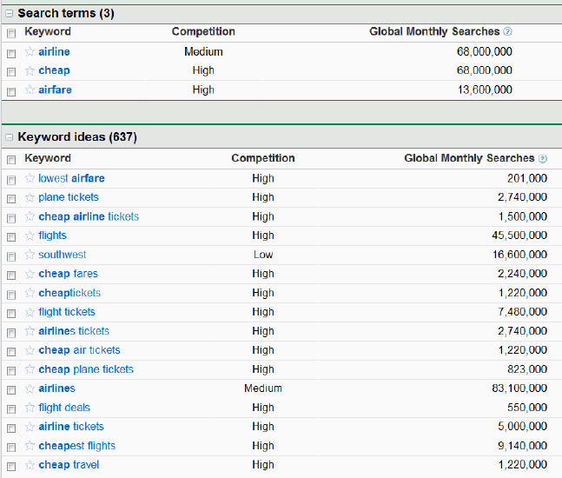
Keyword Analysis: Google Adwords

Slide 51
"Good" Linking Techniques
Provide links to "Resources" that visitors to your site might find useful
Don't link to sites, or ask for links from sites, that are "bad actors" or not credible
51

Slide 52
"Good" Linking Techniques
Use informative link anchor text; it is often a better description of a page than its own title!
Participate meaningfully in social or professional communities where reciprocal linking is a side effect
52

Slide 53
"Bad" SEO Techniques
Some techniques are not intuitive and aren't as related to the IR model; most of these are easily detected by search engines
Link farms, especially those created by automated techniques - essentially a form of spam directed toward search engines
Submitting a site to a directory service is rarely a good idea since most of them are little better than link farms in terms of content quality
53

Slide 54
The Relevance "Arms Race"
In response to "bad" SEO techniques, search engines adapt their relevance algorithms to ignore or penalize sites that use those strategies
But Google makes most of its money from selling ads to companies that want to manipulate relevance...
and these sites then that take up some of the space on the results page that might have gone to the truly relevant and deserving pages that didn't have the money to pay to get seen
54

Slide 55
Sociopolitical Criticism of Page Rank and Google Relevance Heuristics [1]
Google says Page Rank relies on the uniquely democratic nature of the web by using its vast link structure
The Page Rank algorithm favors older pages because a new page, regardless of its quality or relevance, will not have many incoming links
Diaz, Alejandro. "Through the Google goggles: Sociopolitical bias in search engine design."
55

Slide 56
Sociopolitical Criticism of Page Rank and Google Relevance Heuristics [2]
Put another way, Page Rank treats popularity as a substitute for relevance
Similarly, pages from "big company" domains, with short URLs, and whose URLs contain the search terms are treated as more relevant
So "conventional" authority is favored
Google also seems to vastly overweight Wikipedia articles
56

Slide 57
Sociopolitical Criticism of Page Rank and Google Relevance Heuristics [3]
Does Page Rank systematically disfavor or suppress new, underrepresented, or other voices that are critical of the "mainstream" point of view?
57

Slide 58
Readings for Next Lecture
Geller, Tom. “Talking to machines.” Communications of the ACM 55, no. 4 (2012): 14-16.
Knees, Peter, Tim Pohle, Markus Schedl, and Gerhard Widmer. “A music search engine built upon audio-based and web-based similarity measures.”
Schmitz, Patrick and Black, Michael – “The Delphi Toolkit: Enabling Semantic Search for Museum Collections”
58

