Slide 1
Plan for Today’s Lecture(s)
Motivating The Vector Model
The Vector Model
Term Weighting
Similarity Calculation
Limitations of the Vector Model
1

Slide 2
INFO 202 “Information Organization & Retrieval” Fall 2013
Robert J. Glushko glushko@berkeley.edu
@rjglushko
12 November 2013 Lecture 22.1 – Motivating the Vector Model

Slide 3
The Boolean Model
The Boolean model of IR represents documents and queries as sets of index terms
Term frequency is not represented in any way; terms are either present or absent
This enables comparisons between queries and document collections using set theory operations with Boolean algebra, making relevance a binary decision
3

Slide 4
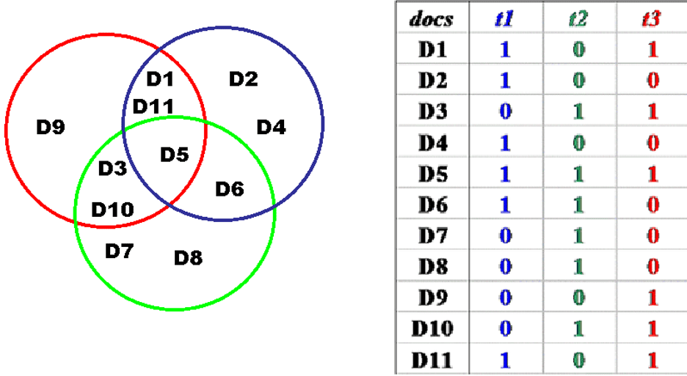
Example of Boolean Representation
4

Slide 5
Relevance in the Boolean Model
Synonymy and polysemy mean that the presence or absence of any specific term is an inadequate measure of relevance
Synonymy means that relevant documents are missed
Polysemy means that irrelevant documents are considered relevant
5

Slide 6
Relevance in the Boolean Model
Because terms are either present or absent, a document is either relevant or not relevant
Retrieved documents might be ordered (chronologically?) but not by relevance because there is logically no way to calculate it
But this is clearly flawed -- if a query is "a and b" the Boolean model retrieves only those documents that contain both of them, and treats documents that contain only a or only b as equally irrelevant
6

Slide 7
Relevance in other IR Models
Other IR models rank the retrieved documents in terms of their relevance to the query
This requires more refined methods of representing what documents are about
This enables more continuous methods of assessing relevance rather than all or none
7

Slide 8
Motivating Term Weighting
The Boolean model represents documents as a set of index terms that are either present or absent
This binary notion doesn't fit our intuition that terms differ in how much they suggest what the document is about
We will capture this notion by assigning weights to each term in the index
8

Slide 9
INFO 202 “Information Organization & Retrieval” Fall 2013
Robert J. Glushko glushko@berkeley.edu
@rjglushko
12 November 2013 Lecture 22.2 – The Vector Model

Slide 10
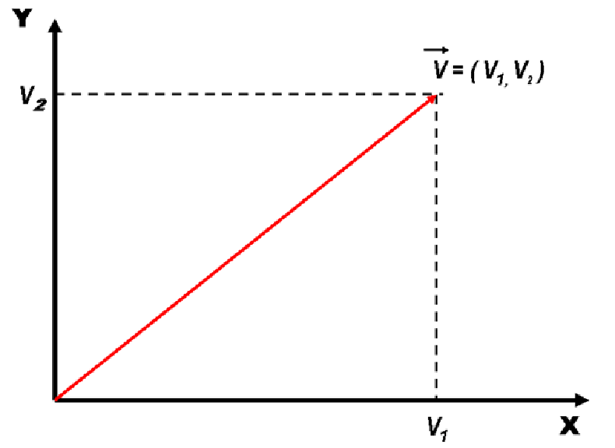
Vectors
10

Slide 11
Vectors
Vectors are an abstract way to think about a list of numbers
Any point in a vector space can be represented as a list of numbers called "coordinates" which represent values on the "axes" or "basis vectors" of the space
11

Slide 12
Vectors
UNIVERSITY OF CALIFORNIA, BERKELEY
SCHOOL OF INFORMATION
Adding and multiplying vectors gives us a way to represent a continuous space in any number of dimensions
We can multiply a coordinate value in a vector to "scale" its length on a particular basic vector to "weight" that value (or axis)
12

Slide 13
Overview of Vector Model
UNIVERSITY OF CALIFORNIA, BERKELEY
SCHOOL OF INFORMATION
Documents and queries are represented in the same way as word or term vectors
Each dimension is the count of occurrences for a term
Term weights can capture term counts within a document or the importance of the term in discriminating the document in the collection
13

Slide 14
Overview of Vector Model
Vector algebra provides a model for computing similarity between queries and documents and between documents because of assumption that "closeness in space" means "closeness in meaning"
There is no representation of word order (sentence structure) in the vector - it is just a BAG OF WORDS
14

Slide 15
An Important Note on Terminology
WARNING: A lot of IR literature uses Frequency to mean Count
Term Frequency is defined to mean "the number of occurrences of a term in a document"
... even though to actually make it a frequency the count should be divided by some measure of the document's length
15

Slide 16
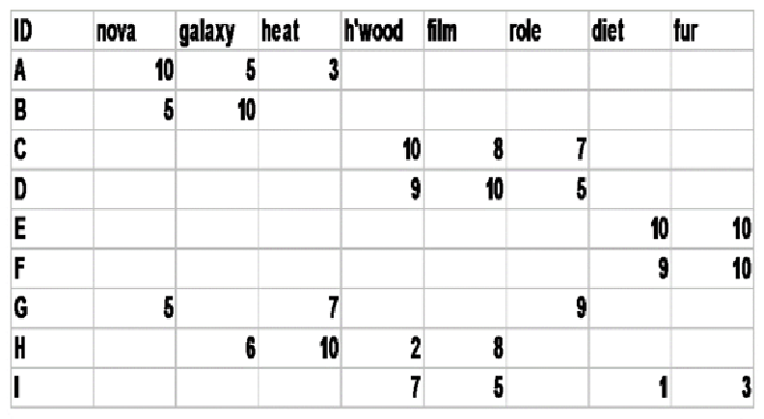
Document x Term Matrix
We can represent for each document the frequency of the words (or terms created by stemming morphologically related words) that it contains
16

Slide 17
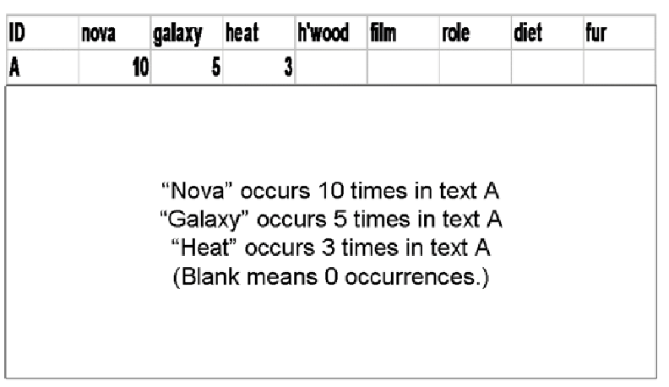
Document Vector
17

Slide 18
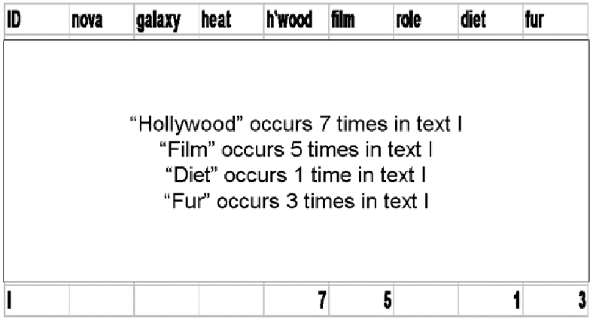
Document Vector
18

Slide 19
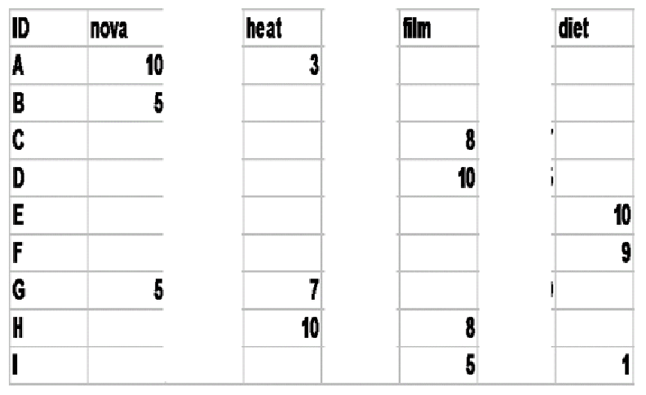
Word (or Term) Vectors
We can use this same matrix to represent a word / term as a vector whose coordinates measure how much it indicates the concept or context of a document
19

Slide 20
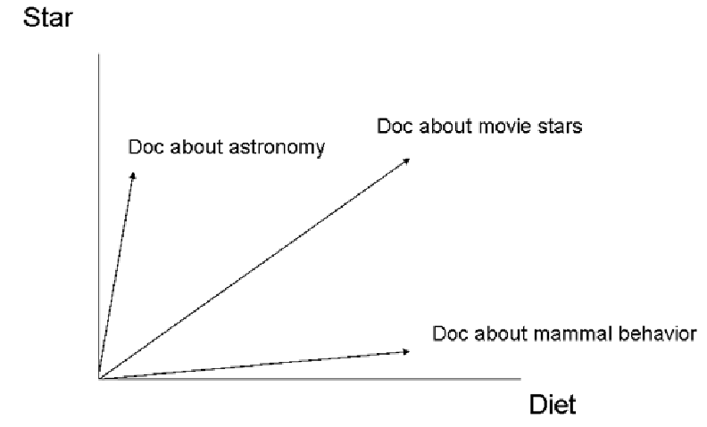
Documents in Term Space – 2D
20

Slide 21
INFO 202 “Information Organization & Retrieval” Fall 2013
Robert J. Glushko glushko@berkeley.edu
@rjglushko
12 November 2013 Lecture 22.3 – Term Weighting

Slide 22
The Zipf Distribution
In any natural language, we can observe that:
A few items occur very frequently
A medium number of elements have medium frequency
Very many elements occur very infrequently (the "long tail“)
22

Slide 23
The Zipf Distribution
An approximate model of this distribution is the Zipf Distribution, which says that the frequency of the i-th most frequent word is 1/(i^a) times that of the most frequent word
Because of the huge range in frequency and the long tail, the distribution is often drawn on a log-log scale
23

Slide 24
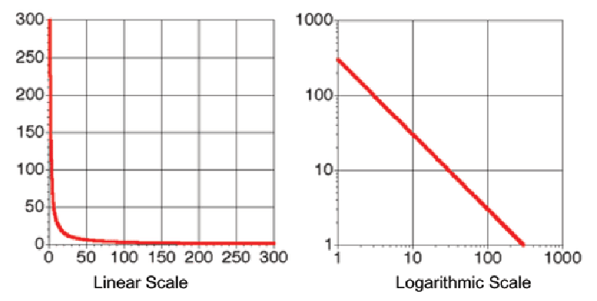
Zipf Distribution – Linear vs. Log Plotting
24

Slide 25
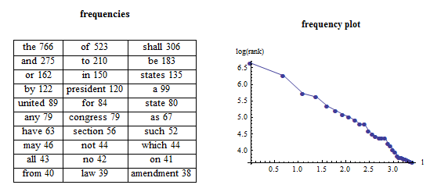
Zipf Distribution – US Constitution
http://demonstrations.wolfram.com/ZipfsLawAppliedToWordAndLetterFrequencies/
25

Slide 26
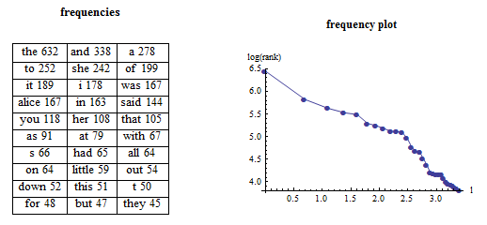
Zipf Distribution – Alice in Wonderland
26

Slide 27
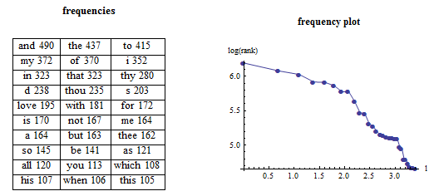
Zipf Distribution – Shakespeare’s Sonnets
27

Slide 28
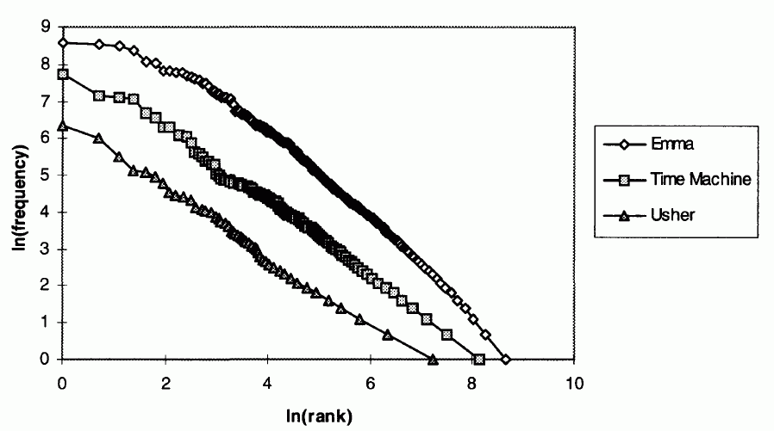
Zipf for 3 Novels on Same Plot
28

Slide 29
Resolving Power
The term distribution lets us categorize terms on the basis of how well they discriminate between the documents in the collection.
The value of a term varies inversely with the number of documents in which it occurs
The most informative words are those that occur infrequently but when they occur they occur in clusters
29

Slide 30
Resolving Power and Term Weighting
Terms that appear in every document have no resolving power because including them retrieves every document
Terms that appear very infrequently have great resolving power, but don’t turn out to be very useful because they so rare that most people will never use in queries
30

Slide 31
Resolving Power and Term Weighting
So the most useful terms are those that are of intermediate frequency but which tend to occur in clusters, so most of their occurrences are in a small number of documents in the collection
31

Slide 32
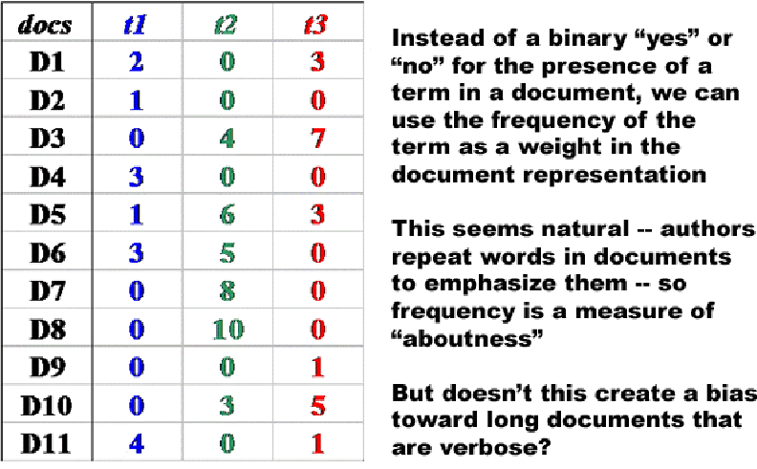
Weighting Using Term Frequency
32

Slide 33
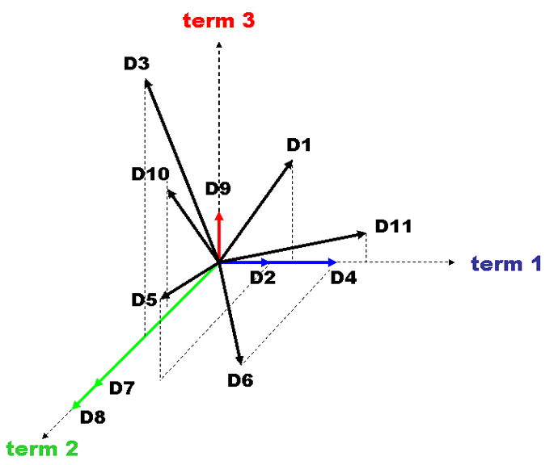
Term Frequency Weighted Vectors
33

Slide 34
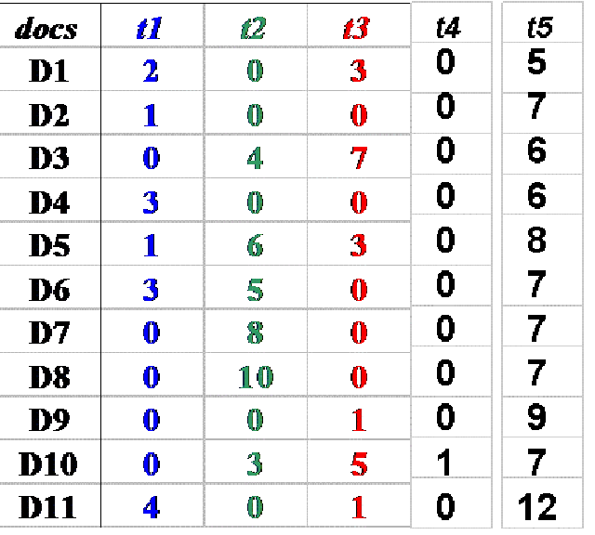
Term Resolving Power
34

Slide 35
Inverse Document Frequency
We need a way to penalize the words that are too frequent so they don't get in the way of the terms that have greater resolving power
We will replace the actual term frequency in the vector with one that we calculate using some weighting function
“Inverse document frequency” is the weighting function that “penalizes” the too frequent words
35

Slide 36
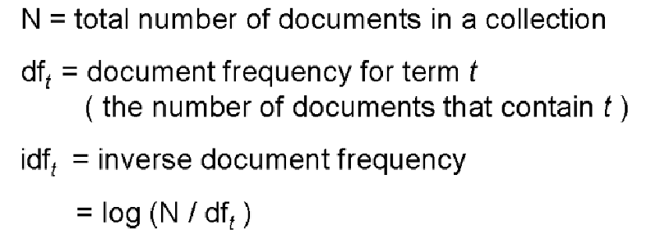
Inverse Document Frequency
36

Slide 37
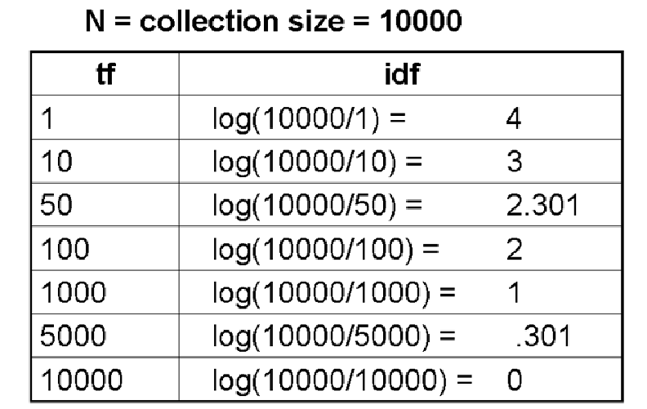
IDF Examples
37

Slide 38
Rationale for TF x IDF
The IDF calculation gives us a measure of how important the term overall is in the collection
But we need to do another calculation to get at the "clustering" intuition that the terms that do the best job finding relevant documents are those that occur in clumps to indicate the aboutness of a document
So we will multiply IDF by TF (i.e. the count) within each document to compute the term weights
38

Slide 39
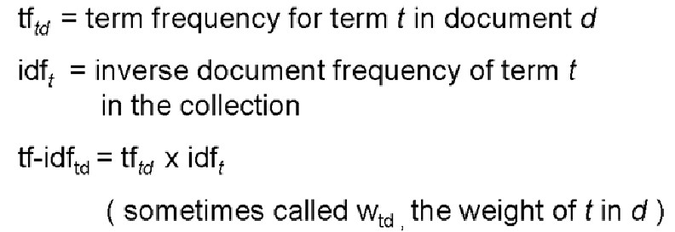
Calculating Term Weights
39

Slide 40
Calculated Term Weights for TF x IDF
Term weights are highest for terms that occur many times within a small number of documents (high IDF)
They are lower when the term occurs fewer times in a document (low TF), or occurs in many documents (low IDF)
They are lowest when the term occurs in virtually all documents (almost 0 IDF)
40

Slide 41
INFO 202 “Information Organization & Retrieval” Fall 2013
Robert J. Glushko glushko@berkeley.edu
@rjglushko
12 November 2013 Lecture 22.4 – Similarity and Relevance in the Vector Model

Slide 42
Calculating Similarity in Vector Models
The similarity between a query and a document, or between two documents, is defined as the "inner product" of their vectors
The inner product of two vectors is the sum of the products of their overlapping terms (so similarity increases when they have more terms in common)
v1 = (3, 8, 4) v2 = (2, 3, 1)
(3, 8, 4) x (2, 3, 1) = (3 x 2) + (8 x 3) + (4 x 1) = 34
42

Slide 43
Calculating Similarity in Vector Models
Qualitatively or intuitively this means that documents are more likely to be about the same topics when they use the same terms in the same proportions
When vectors are normalized (to length 1) compensate for different lengths, the inner product calculation is the cosine between the vectors
43

Slide 44
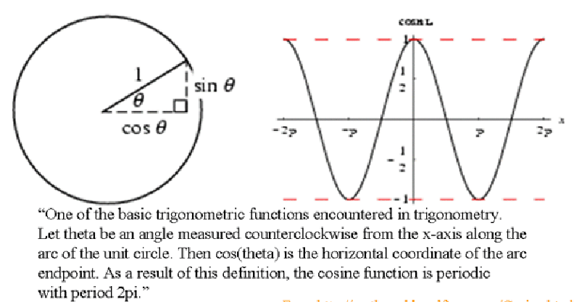
Cosines
Cosine of 0 degrees = 1; Cosine of 90 degrees = 0
44

Slide 45
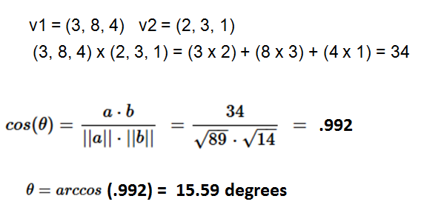
Cosine Calculation – Normalized Vectors
45

Slide 46
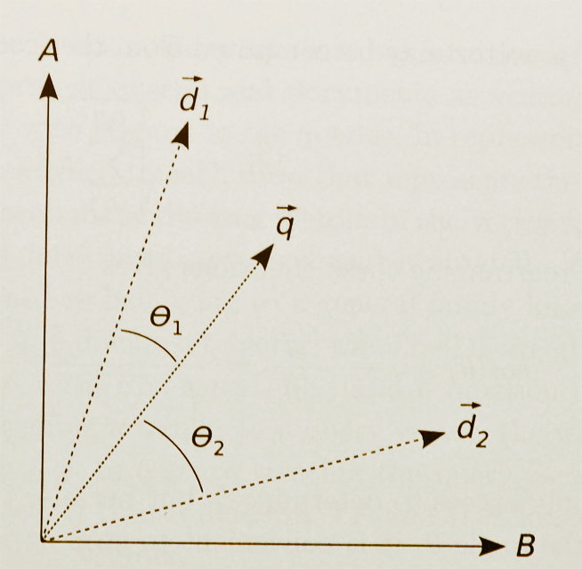
Similarity in Vector Models (Graphical Depiction)
46

Slide 47
Vector Model Retrieval and Ranking
Vector models treat documents in a collection as "bags of words" so there is no representation of the order in which the terms occur in the document
Not caring about word order lets us embody all the information about term occurrence in the term weights
Likewise, vector queries are just "bags of words“
47

Slide 48
Vector Model Retrieval and Ranking
So vector queries are fundamentally a form of "evidence accumulation" where the presence of more query terms in a document adds to its "score"
This score is not an exact measure of relevance with respect to the query, but it is vastly better than the all or none Boolean model!
48

Slide 49
Vector Model: Advantages
Index terms can be selected automatically
Term weighting to improve retrieval performance
Partial matching of queries and documents when no document contains all search terms
Relevance ranking according to similarity
49

Slide 50
Vector Model: Limitations
The calculations used by simple vector models are about the frequency of words and word forms (e.g., stemmed) in texts
This means that they are measuring the "surface" usage of words as patterns of letters
Polysemy leads to overestimates of similarity
Synonymy leads to underestimates
50

Slide 51
Readings for Next Lecture
Hearst, Marti – “Search User Interfaces” (Preface and Ch. 1)
Hearst, Marti A. “‘Natural’search user interfaces.” Communications of the ACM 54, no. 11 (2011): 60-67. dl.acm.org/citation.cfm?id=2018414
51

