Slide 1
Plan for Today’s Lecture(s)
UNIVERSITY OF CALIFORNIA, BERKELEY
SCHOOL OF INFORMATION
Knowledge management
Content management
Enterprise Data Management
Integration and Interoperability
Supply Chains and Inter-Enterprise Information Exchange
1

Slide 2
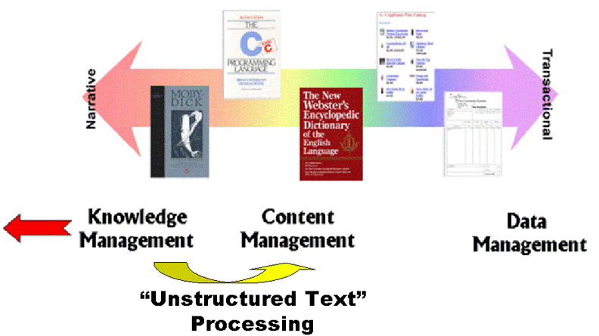
Information Management and the DTS
2

Slide 3
INFO 202 “Information Organization & Retrieval” Fall 2013
UNIVERSITY OF CALIFORNIA, BERKELEY
SCHOOL OF INFORMATION
Robert J. Glushko glushko@berkeley.edu
@rjglushko
31 October 2013 Lecture 19.1 – Knowledge & Content Management

Slide 4
Knowledge Management
UNIVERSITY OF CALIFORNIA, BERKELEY
SCHOOL OF INFORMATION
Much collective knowledge is embodied in a firm's people, systems, management techniques, history of strategy and design decisions, customer relationships, and intellectual property like patents, copyrights, trademarks, brands, etc.
Some of this knowledge is EXPLICIT, tangible, and traceable in the form of documents, databases, organization charts, policy and procedure manuals
But much of it is TACIT: informal, not systematized in tangible form because it is held in the minds and experiences of people; a synonym is "KNOW-HOW”
4

Slide 5
Knowledge Management
UNIVERSITY OF CALIFORNIA, BERKELEY
SCHOOL OF INFORMATION
The goals of KM can be viewed as getting the tacit parts of this "intellectual capital" to be explicit
"Knowing how to get things done" or "knowing how things work" includes what a person knows how to do, but also who they know
So identifying and analyzing the "social network" or "knowledge network" of employees is a key part of knowledge management
5

Slide 6
Knowledge Management Goals
UNIVERSITY OF CALIFORNIA, BERKELEY
SCHOOL OF INFORMATION
Sharing solutions to customer problems
Facilitating collaboration
Locating people with relevant skills
Managing unstructured content
Providing greater access to existing information
Improving traceability and justification for strategic (and controversial) decisions
Recording the rationale for business process and information models
6

Slide 7
Knowledge Management Issues
UNIVERSITY OF CALIFORNIA, BERKELEY
SCHOOL OF INFORMATION
Many technologies have been used for KM -- Lotus Notes, Intranets, Wikis, Blogs...
But at best, knowledge management techniques can only capture knowledge that is codifiable and transferable, and not all knowledge is
And furthermore, employees have complex motivations for complying with or not complying with KM goals
Enlightened firms and management try to align personal and corporate goals for knowledge management
7

Slide 8
Content Management
UNIVERSITY OF CALIFORNIA, BERKELEY
SCHOOL OF INFORMATION
"Content Management" narrowly defined involves the management of semi-structured content in a logical repository, usually in a multi-user collaborative context
But "content management" necessarily involves authoring and delivery or there would be nothing to manage or no purpose in managing it
8

Slide 9
Content Authoring
UNIVERSITY OF CALIFORNIA, BERKELEY
SCHOOL OF INFORMATION
Authoring can be broadly defined as creating reusable "information assets" from different sources
Reusable information sometimes means XML, but more generally means information resources with metadata
Reusable information assets can be created by adding structure and metadata to existing information
Non-text information assets can be described using XML text metadata
9

Slide 10
Content Management (narrow sense)
UNIVERSITY OF CALIFORNIA, BERKELEY
SCHOOL OF INFORMATION
Reliable storage and retrieval of components, documents, schemas, transforms, stylesheets...
Componentizing a document by separating it into its constituent elements using user-defined names as boundaries
Risk management functions like backup and archiving
10

Slide 11
Component Granularity
UNIVERSITY OF CALIFORNIA, BERKELEY
SCHOOL OF INFORMATION
Document level granularity
Module level granularity
Content unit level granularity
Word level granularity
11

Slide 12
Content Delivery
UNIVERSITY OF CALIFORNIA, BERKELEY
SCHOOL OF INFORMATION
Content delivery usually begins when some set of components is retrieved from the repository and assembled to meet some specific requirement
Assembly may involve both the assembly of a document type model and then the assembly of an instance that conforms to it
The retrieved or assembled instance may need to be transformed to conform to different models for various contexts, users, or devices
12

Slide 13
“Flavors” of Content Management
UNIVERSITY OF CALIFORNIA, BERKELEY
SCHOOL OF INFORMATION
Document management
Often just searchable metadata and content with workflow support
Web content management
More multimedia types than doc mgmt, more real-time workflow
Digital asset management
Movies and audio
13

Slide 14
“Flavors” of Content Management
UNIVERSITY OF CALIFORNIA, BERKELEY
SCHOOL OF INFORMATION
E-mail management
Records management
Report management
14

Slide 15
A Single-Source Strategy
UNIVERSITY OF CALIFORNIA, BERKELEY
SCHOOL OF INFORMATION
Informal defintion:
Write once, reuse many times
Revise once, update everywhere
Transform many times for delivery
Rigorous definition:
Enforce normalization techniques to prevent anomalies with duplicate content
Use transformations to convert content from one structure or context to another,
15

Slide 16
A Single-Source Strategy
UNIVERSITY OF CALIFORNIA, BERKELEY
SCHOOL OF INFORMATION
Single-sourcing is NOT a property of any content management system, only a goal to be achieved by one
CASE STUDY: XML-Centric Workflow in Scholarly Publishing
16

Slide 17
AGU Case Study
UNIVERSITY OF CALIFORNIA, BERKELEY
SCHOOL OF INFORMATION
How American Geophysical Union redesigned its publishing processes and technology
Substantially increased productivity in producing existing publications
Enabled many new kinds of publications
Valid XML single source is the foundation for all the automated publishing and post-publication processes
17

Slide 18
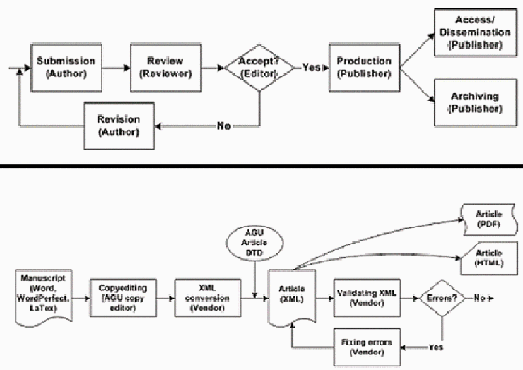
AGU Authoring – Before and After
18

Slide 19
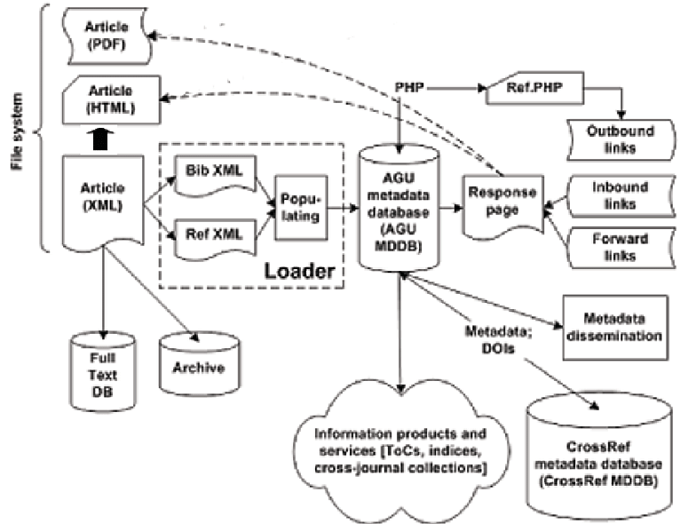
AGU Publishing System
19

Slide 20
INFO 202 “Information Organization & Retrieval” Fall 2013
UNIVERSITY OF CALIFORNIA, BERKELEY
SCHOOL OF INFORMATION
Robert J. Glushko glushko@berkeley.edu
@rjglushko
31 October 2013 Lecture 19.2 – Enterprise Data Management

Slide 21
The Data that Enterprises Manage
UNIVERSITY OF CALIFORNIA, BERKELEY
SCHOOL OF INFORMATION
In addition to the "end-to-end" processes of authoring, management, and delivery for content many enterprises have end-to-end data or transactional processes
Some of these data processes are separable from the content processes and others are intertwined (especially in e-commerce processes)
These internal processes also extend to other enterprises in supply and demand chains or distribution channels
21

Slide 22
Enterprise Data Management Challenges
UNIVERSITY OF CALIFORNIA, BERKELEY
SCHOOL OF INFORMATION
Many business processes span multiple departments (or companies) or multiple business applications (run by separate departments)
These "silos" or "stovepipes" are narrowly-focused, may have been created over time, and not have been designed to share information with each other
Stovepipe applications naturally occur when engineering, manufacturing, sales, marketing, etc. are separated into different departments with limited interactions except when they hand off "finished work" to each other
22

Slide 23
Enterprise Data Management Challenges
UNIVERSITY OF CALIFORNIA, BERKELEY
SCHOOL OF INFORMATION
Each of these systems has a specific purpose and a data model customized for that purpose - so these models may be incomplete or incompatible with respect to each other
In the worst case. manual re-entry of information between stovepipe systems is required
Many of these problems are also occur between enterprises; the primary difference is whether they can be attacked unilaterally
23

Slide 24
Sarbanes-Oxley
UNIVERSITY OF CALIFORNIA, BERKELEY
SCHOOL OF INFORMATION
The Sarbanes-Oxley Act of 2002 was enacted to curb corrupt business activities and fraudulent accounting practices
SOX (aka Sarbox) requires firms to implement adequate internal control structures and procedures and attest to their effectiveness.
SOX requires sufficient auditing and traceability to relate the IT systems that carry out internal controls and the financial reporting process to the firm's financial statements
24

Slide 25
Ken Lay Does the “Perp Walk”
25

Slide 26
Sarbanes-Oxley
UNIVERSITY OF CALIFORNIA, BERKELEY
SCHOOL OF INFORMATION
SOX also requires that firms disclose "material" information about their operations and financial situation in a timely and predictable manner that trigger disclosure
26

Slide 27
XBRL
UNIVERSITY OF CALIFORNIA, BERKELEY
SCHOOL OF INFORMATION
Standardization of "Extensible Business Reporting Language (http://www.xbrl.org/WhatIsXBRL/) and standard models for the auditing document types and their interrelationships
Excellent XBRL resource: http://xbrl.squarespace.com/
Some people argue that effective internal controls should be viewed as a strategic investment, not just a defensive move
27

Slide 28
"Electronic Health Records: Just Around the Corner? Or over the Cliff?”
UNIVERSITY OF CALIFORNIA, BERKELEY
SCHOOL OF INFORMATION
A case study of the adoption of an electronic health record system by a small (4 physicians) medical office... discusses several interconnected organizing systems
What are the resources being organized?
What were the primary motivations for installing the system?
28

Slide 29
"Electronic Health Records: Just Around the Corner? Or over the Cliff?”
UNIVERSITY OF CALIFORNIA, BERKELEY
SCHOOL OF INFORMATION
Was the system they selected able to implement the organizing system(s) effectively?
Were their expectations about installation, training, and operation reasonable?
Of the problems they encountered, which were preventable, and which ones weren't?
29

Slide 30
INFO 202 “Information Organization & Retrieval” Fall 2013
UNIVERSITY OF CALIFORNIA, BERKELEY
SCHOOL OF INFORMATION
Robert J. Glushko glushko@berkeley.edu
@rjglushko
31 October 2013 Lecture 19.3 – Integration and Interoperability

Slide 31
Integration
UNIVERSITY OF CALIFORNIA, BERKELEY
SCHOOL OF INFORMATION
Integration is the "controlled sharing of information" between two (or more) business systems, applications, or services within or between firms
Integration means that one application can extract or obtain information from another one
It doesn't mean that the information will work "as is" in the target application
"Enterprise integration" - making different applications share information - has long been a substantial portion of the IT activities in many companies
31

Slide 32
Inter-Enterprise Data Integration
UNIVERSITY OF CALIFORNIA, BERKELEY
SCHOOL OF INFORMATION
Data integration between companies so they can do business with each other is also a huge IT challenge
Suppose you publish your web service interface description; this says "my ordering service requires a purchase order that conforms to this schema"
This says "send me MY purchase order" not "send me YOUR purchase order"
Will the purchase orders being used by other firms meet your interface requirement, either directly or after being transformed?
32

Slide 33
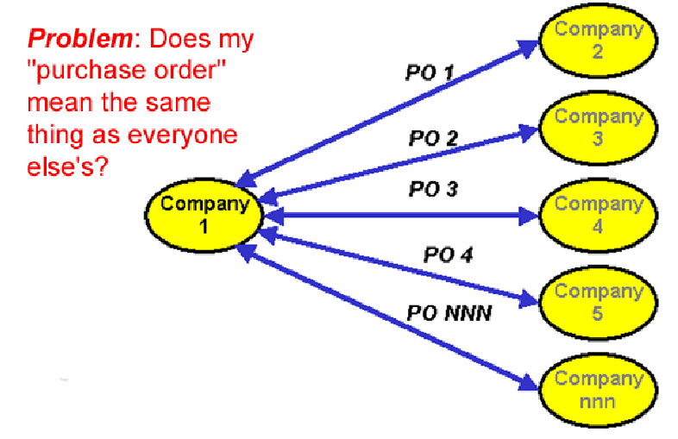
To Interoperate, or not to Interoperate?
33

Slide 34
Syntactic, Structural, & Semantic Interoperability
UNIVERSITY OF CALIFORNIA, BERKELEY
SCHOOL OF INFORMATION
SYNTACTIC interoperability is just the ability to exchange information
STRUCTURAL interoperability means that all of the expected information components are present with the same arrangement and granularity
SEMANTIC interoperability requires that the content of the message be understood by the recipient application or process
Semantic integration is the process by which this common semantic model is created
34

Slide 35
Interoperability isn't All or None
UNIVERSITY OF CALIFORNIA, BERKELEY
SCHOOL OF INFORMATION
Some interoperability problems can be detected and resolved by completely automated means
Other problems can be detected and resolved with some human intervention
Other problems can be detected but not resolved
Some problems can go undetected
35

Slide 36
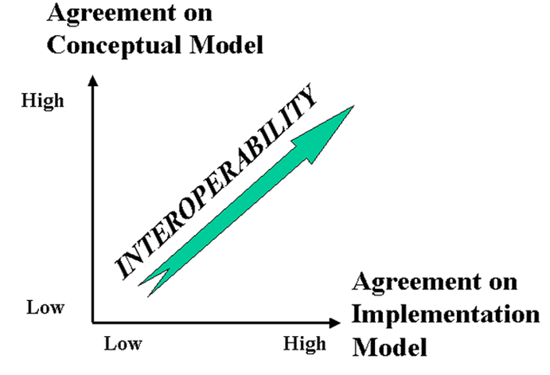
The Dimensions of Interoperability
36

Slide 37
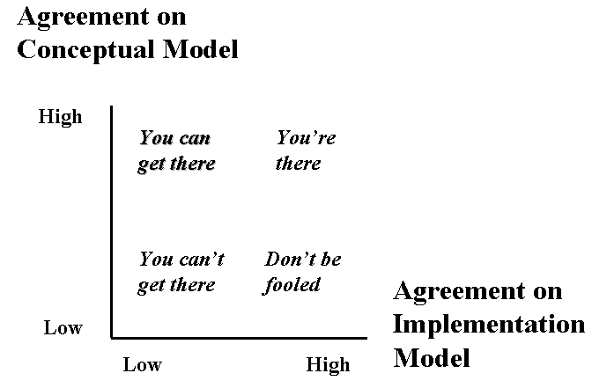
The Dimensions of Interoperability
37

Slide 38
Ways NOT to Interoperate
UNIVERSITY OF CALIFORNIA, BERKELEY
SCHOOL OF INFORMATION
Elements with the same meaning can have different names ("IssueDate" vs "OrderIssueDate")
Elements with the same meaning can have different names or different formats even when they have the same name (September 11, 2001, 9/11/2001 and 9-11-01; 11/09/01 in Europe)
Same meaning, but encoded differently: in XML using attributes instead of elements
38

Slide 39
Ways NOT to Interoperate
UNIVERSITY OF CALIFORNIA, BERKELEY
SCHOOL OF INFORMATION
Differences in granularity ("Name" vs "LastName" "FirstName", "Address" vs "Street" "City" "PostalCode“)
Overlapping coverage, different assemblies (Separate "Order" and "Customer" documents)
Implied values embedded in forms or software
39

Slide 40
INFO 202 “Information Organization & Retrieval” Fall 2013
UNIVERSITY OF CALIFORNIA, BERKELEY
SCHOOL OF INFORMATION
Robert J. Glushko glushko@berkeley.edu
@rjglushko
31 October 2013 Lecture 19.4 – Supply Chains and Inter-Enterprise Information Exchange

Slide 41
The Supply Chain Pattern
UNIVERSITY OF CALIFORNIA, BERKELEY
SCHOOL OF INFORMATION
A supply chain is an organizing system that defines the end-to-end view of the buy-side and sell-side relationships of an enterprise
A supply chain is the network of facilities and distribution capabilities an enterprise uses to:
"Source" (or "procure") raw materials (chemicals, ores, grains, ...) or components
Transform the materials or assemble the components into products
Deliver the products to customers (indirectly through distributors or stores or directly to the purchaser)
41

Slide 42
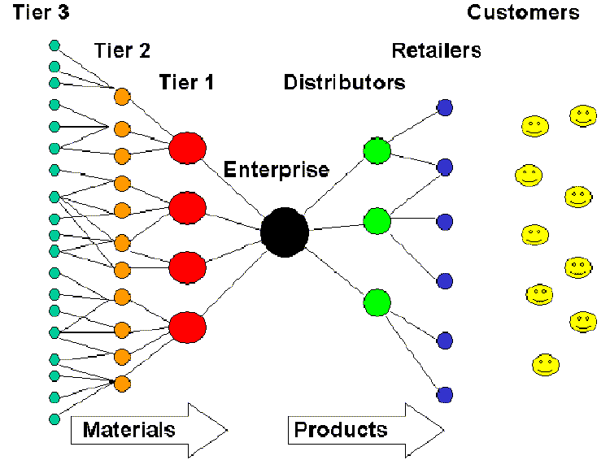
Conceptual Model of a Supply Chain
42

Slide 43
The Information Supply Chain
UNIVERSITY OF CALIFORNIA, BERKELEY
SCHOOL OF INFORMATION
The flow of materials and goods in a supply chain is accompanied by information about it
But information about supply chain activities and processes is increasingly separated from the physical flow of materials and goods, and for information-based services there are no physical resources to move
(recall “Global Disaggregation of Information-Intensive Services” in previous lecture)
43

Slide 44
The Information Supply Chain
UNIVERSITY OF CALIFORNIA, BERKELEY
SCHOOL OF INFORMATION
Information also flows in the opposite direction from the customer, retailers, and distributors back into the supply chain – this is also called the DEMAND CHAIN
The information supply chain has become especially important because increased global competition and better informed customers are forcing forms to shift from forecast to demand (i.e. customer) driven business models
44

Slide 45
Design Issues for the Information Supply Chain
UNIVERSITY OF CALIFORNIA, BERKELEY
SCHOOL OF INFORMATION
What information is exchanged?
Which entities in the supply chain are able to exchange information?
What is the frequency of this information exchange?
45

Slide 46
"Interoperability Costs in the US Auto Supply Chain"
UNIVERSITY OF CALIFORNIA, BERKELEY
SCHOOL OF INFORMATION
Excellent case study about how a concurrent engineering business model escalates the information exchanges and interoperability problems in the organizing system centered around automobile manufacturers
Analyzes various alternatives for data transfer, and finds that the choices made are not the optimal ones
46

Slide 47
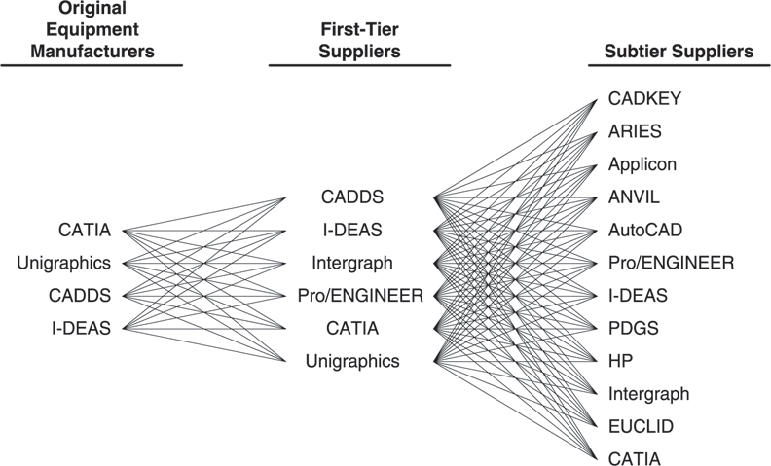
CAD/CAM Systems Proliferation
47

Slide 48
Juran's "Quality Costs" Framework
UNIVERSITY OF CALIFORNIA, BERKELEY
SCHOOL OF INFORMATION
Joseph Juran's "Quality Control Handbook" (1951) -- "cost of quality" framework determines how much to spend on quality at any point in the "quality system"
The costs of preventing and finding quality problems (avoidance) ...
... must be balanced against the costs associated with those quality problems (mitigation)
48

Slide 49
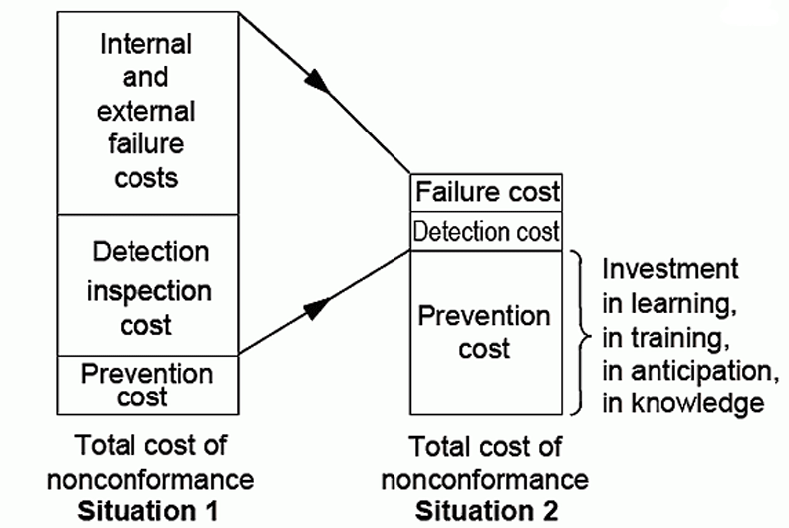
The Case for Investing in Avoidance
49

Slide 50
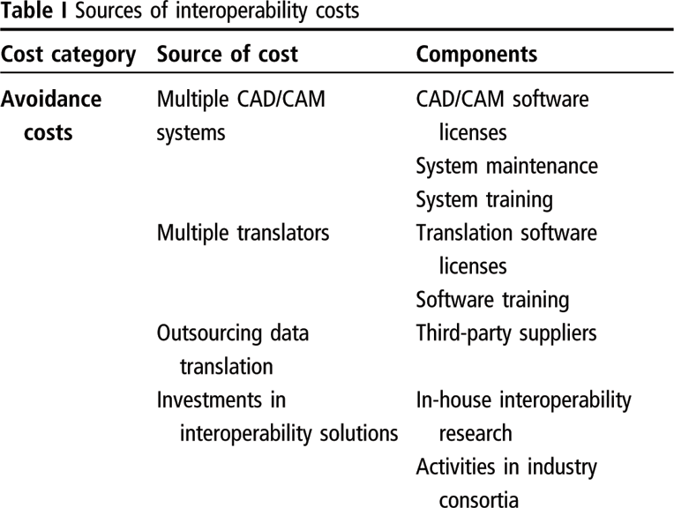
Interoperability Avoidance Costs
50

Slide 51
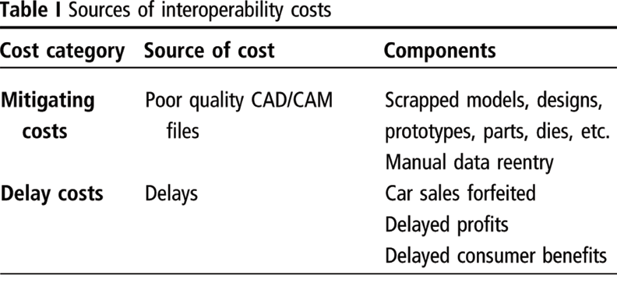
Interoperability Mitigation and Delay Costs
51

Slide 52
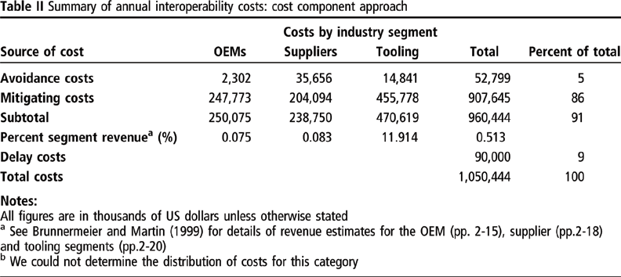
Estimated Interoperability Costs
52

Slide 53
Next Week
UNIVERSITY OF CALIFORNIA, BERKELEY
SCHOOL OF INFORMATION
Tuesday November 5 is midterm review
View video recording before Tuesday Nov 12
Submit review questions to glushko@berkeley.edu by noon Monday Nov 4
Thursday November 7 is midterm
4 multi-part question; 1 is required, choose 3 of other 6
open book, open notes
Write on your computer, submit online and in print
53

