Slide 1
Plan for Today’s Lecture(s)
UNIVERSITY OF CALIFORNIA, BERKELEY
SCHOOL OF INFORMATION
Introduction to Classification
Classification is Purposeful, Principled, and Biased
Classification and Standardization
1

Slide 2
INFO 202 “Information Organization & Retrieval” Fall 2013
UNIVERSITY OF CALIFORNIA, BERKELEY
SCHOOL OF INFORMATION
Robert J. Glushko glushko@berkeley.edu
@rjglushko
22 October 2013 Lecture 16.1 – Introduction to Classification

Slide 3
What is Classification?
UNIVERSITY OF CALIFORNIA, BERKELEY
SCHOOL OF INFORMATION
"Classification is a higher order thinking skill requiring the fusion of the naturalist's eye for relationships...
...with the logician's desire for structured order...
...the mathematician's compulsion to achieve consistent, predictable results...
...and the linguist's interest in explicit and tacit expressions of meaning“
-- Louise Gruenberg, "Faceted Classification, Facet Analysis and the Web“
3

Slide 4
Distinguishing Categorization and Classification (1)
UNIVERSITY OF CALIFORNIA, BERKELEY
SCHOOL OF INFORMATION
Categories are EQUIVALENCE CLASSES - sets of resources, processes, and events that we treat the same
A Classification (noun) is a SYSTEM OF CATEGORIES, ordered according to a PRE-DETERMINED SET OF PRINCIPLES and used to organize a collection of resources
Classification (verb) is the process of systematically assigning resources to intentional (often institutional) categories in a classification system
4

Slide 5
Distinguishing Categorization and Classification (2)
UNIVERSITY OF CALIFORNIA, BERKELEY
SCHOOL OF INFORMATION
The contrasts among cultural, individual, and institutional categories” yield a precise definition of classification:
The systematic assignment of resources to a system of intentional categories, often institutional ones
This definition highlights the intentionality behind the system of categories, the systematic processes for using them, and implies the greater requirements for governance and maintenance that are absent for cultural categories and most individual ones.
5

Slide 6
Classification vs. Resource Arrangement
UNIVERSITY OF CALIFORNIA, BERKELEY
SCHOOL OF INFORMATION
With physical resources the end result of classification is their arrangement in some physical location
In libraries these two activities are strongly associated
We often describe the physical location using the category name
But the physical location is often arbitrary and it is better to think of classification in purely logical terms, unless the categories are explicitly designed in terms of co-location (as they are in taskonomies...)
6

Slide 7
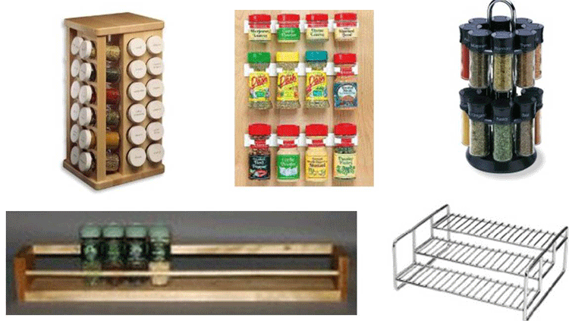
Separating the Organizing Principle From Physical Arrangement
7

Slide 8
Classification Schemes (1)
UNIVERSITY OF CALIFORNIA, BERKELEY
SCHOOL OF INFORMATION
A CLASSIFICATION SCHEME is a realization of one or more organizing principles
An ENUMERATIVE scheme itemizes all possible categories to which resources can be assigned (into one and only one of the categories)
Alphabetic or chronological ordering creates an implicit or latent scheme that arranges resources in a predictable place without the need to create the categories in advance
8

Slide 9
Classification Schemes
UNIVERSITY OF CALIFORNIA, BERKELEY
SCHOOL OF INFORMATION
A HIERARCHICAL or TAXONOMIC scheme emerges when multiple resource properties are used by organizing principles; each property creates another level
A scheme can be both HIERARCHICAL and ENUMERATIVE at the lowest level where resources are categorized
A FACETED classification scheme uses multiple resource properties, but does not require every resource to have a value for every property and allows the properties to be considered in any order
9

Slide 10
INFO 202 “Information Organization & Retrieval” Fall 2013
UNIVERSITY OF CALIFORNIA, BERKELEY
SCHOOL OF INFORMATION
Robert J. Glushko glushko@berkeley.edu
@rjglushko
22 October 2013 Lecture 16.2 – Classification is Purposeful, Principled, and Biased

Slide 11
Classification Is Purposeful
UNIVERSITY OF CALIFORNIA, BERKELEY
SCHOOL OF INFORMATION
Classifications arrange resources to provide structure for and increase the precision of interactions in organizing systems
Classifications are essential in useful work
They serve as a reference model (a semantic road map) to individual domains and the relationships among them to help people understand the concepts and relationships
They improve learning and communication
11

Slide 12
Classification and Interactions
UNIVERSITY OF CALIFORNIA, BERKELEY
SCHOOL OF INFORMATION
With physical resources, activity-based classification makes co-location more useful
Effective user interfaces to physical or digital systems present and reinforce the logical classifications embodied in the system
… while poor user interfaces don’t
Standard classifications for products and business services make it easier to discover suitable resources and integrate them into your own processes
12

Slide 13
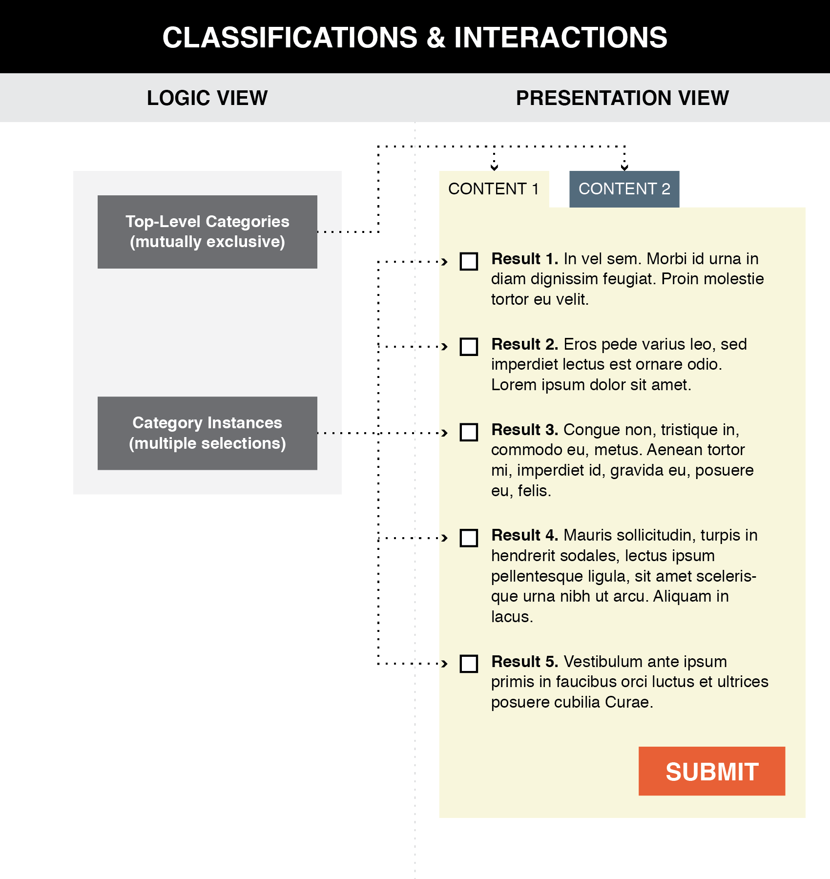
Good user interface design creates a clear mapping between a classification scheme and the arrangements and interactions that users see (TDO, Figure 7.1)
13

Slide 14
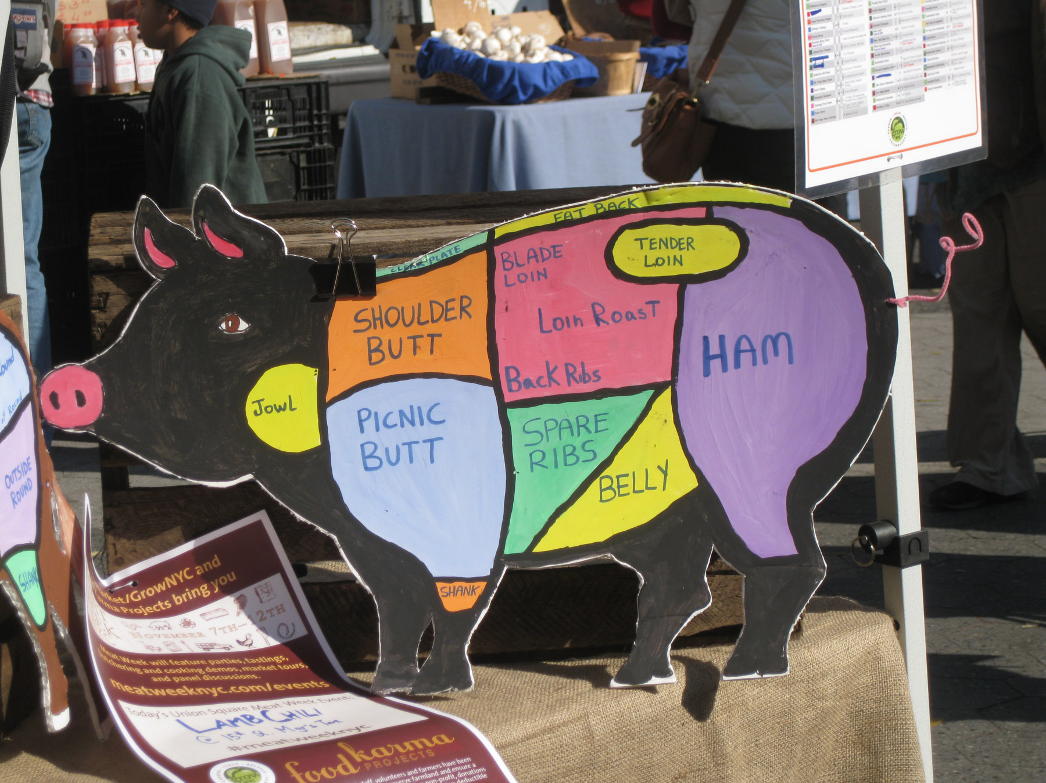
Clear Communication of a Classification Scheme
Photo taken by Bob Glushko at Union Square Greenmarket, NYC

Slide 15
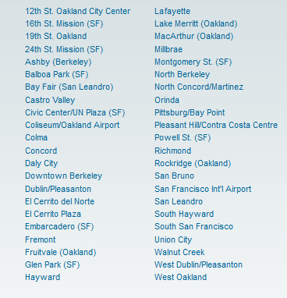
Poor Communication of a Classification Scheme
BART Station List
Better Might Be Something Like…
San Francisco
Embarcadero
Montgomery
Powell
Civic Center
…
Oakland
West Oakland
12 Street
19 Street
MacArthur
Rockridge
…
Berkeley
Ashby
Berkeley Downtown
Berkeley North

Slide 16
Classification is “Principled”
UNIVERSITY OF CALIFORNIA, BERKELEY
SCHOOL OF INFORMATION
The principles for defining categories (enumeration, properties, similarity, family resemblance, etc.) are embodied in the classifications that use these principles
But the emergent classification system follows other principles about its purposes, scope, scale, intended lifetime, extensibility, and other considerations
Being "principled" means that these design choices are made they should be consistently followed
16

Slide 17
Principles Embodied in the Classification Scheme
UNIVERSITY OF CALIFORNIA, BERKELEY
SCHOOL OF INFORMATION
Warrant: What is the justification for the choice of categories and their names?
Literary Warrant: Classify only the resources we have?
Scientific Warrant: Use expert categories and names
Use Warrant: Use categories and names from “ordinary” people
Breadth and depth of classification hierarchy
Degree of enumerativeness
17

Slide 18
Principles for Assigning Resources to Categories
UNIVERSITY OF CALIFORNIA, BERKELEY
SCHOOL OF INFORMATION
Hierarchy
Uniqueness
18

Slide 19
Hierarchy and Uniqueness Principles
UNIVERSITY OF CALIFORNIA, BERKELEY
SCHOOL OF INFORMATION
Deeply engrained in our intellectual and physical worlds
Each category is successively divided into smaller subdivisions
Every level of the hierarchy is divided according to a "feature" or "character of division"
Every resource is classified in only one subdivision
19

Slide 20
The "One and Only One Place" Rule
UNIVERSITY OF CALIFORNIA, BERKELEY
SCHOOL OF INFORMATION
If each resource goes in one and only one category it won't always be easy to decide what metadata or property determines the categorization
For example, a book's title is often a clue to the subject, but should never be the only thing analyzed
Who Moved My Cheese? is a work on coping with change, not a work related to the culinary arts
Should Leaves of Grass be assigned to the "Gardening" category?
Needless to say, the rules for categorizing books take a long time to learn and are not always easy to apply
20

Slide 21
Principles for Maintaining the Classification
UNIVERSITY OF CALIFORNIA, BERKELEY
SCHOOL OF INFORMATION
Lifetime management
Category integrity: Classify once and for all, or change categories and assignments as we learn?
Flexibility / extensibility / hospitality
21

Slide 22
"Principled" Maybe ... But Every Classification is "Biased"
UNIVERSITY OF CALIFORNIA, BERKELEY
SCHOOL OF INFORMATION
Every classification is arbitrary to some extent because the criteria used to establish the categories reflect a point of view or perspective on the domain that intentionally excludes all other perspectives
There is no "one true way" about how things go together
Every classification system implicitly or explicitly distinguishes between "good" or "standard" and "bad" or "nonstandard" ways of understanding things
Borges: “there is no classification of the Universe that is not arbitrary and full of conjectures”
22

Slide 23
Classification Biases
UNIVERSITY OF CALIFORNIA, BERKELEY
SCHOOL OF INFORMATION
Natural vs. man-made disaster?
Welfare vs. entitlement?
Taxes vs. government investments?
Illegal vs. undocumented immigrants?
23

Slide 24
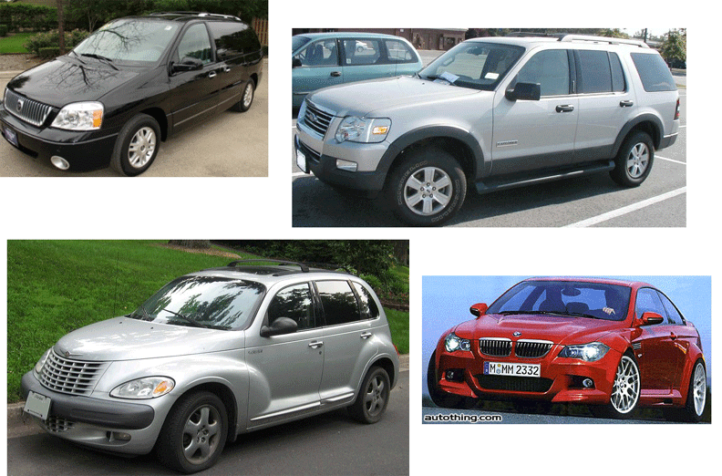
CAFE Categories: Find the Truck(s)
24

Slide 25
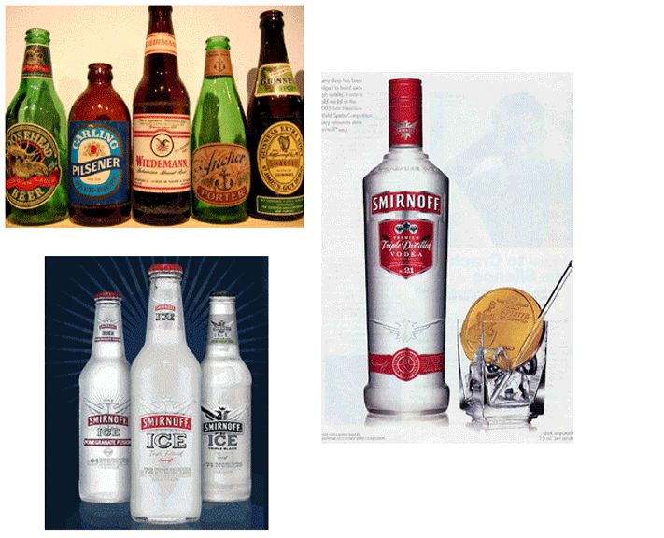
Beverage Categories: Find the Beer
25

Slide 26
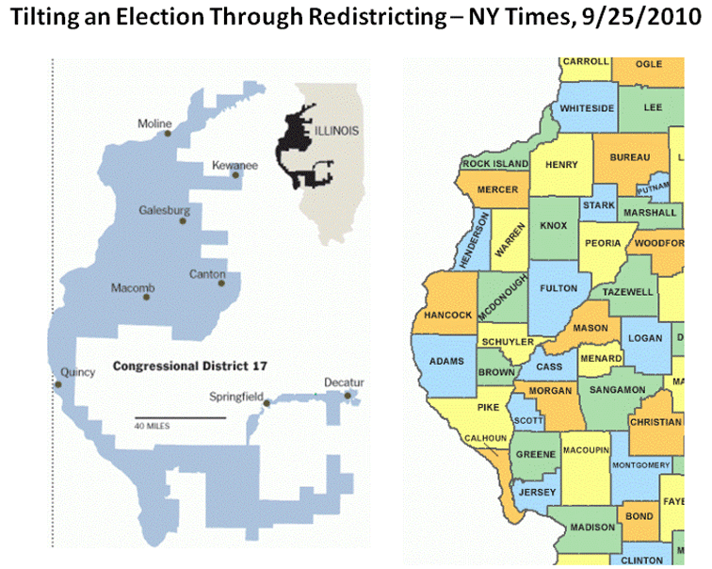
Gerrymandering: Find the Democrats
Illinois is famous for its corrupt politicians….
26

Slide 27
Classification Biases
UNIVERSITY OF CALIFORNIA, BERKELEY
SCHOOL OF INFORMATION
Minority, underrepresented minority
Coup or regime change?
Dietary supplement vs. beverage?
Employee vs. contractor, full vs. part time?
Unemployed
27

Slide 28
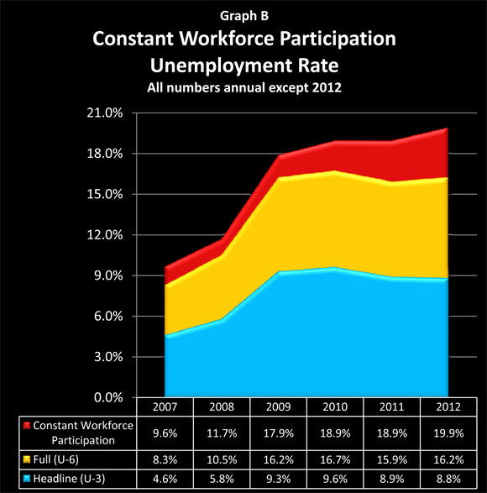
Making 9 Million Jobless People Vanish
When you give up looking for a job, you’re not unemployed
28

Slide 29
Some More Examples…
UNIVERSITY OF CALIFORNIA, BERKELEY
SCHOOL OF INFORMATION
How do airlines and transit authorities define “on time” and “late” with respect to their scheduled times?
Utilities report the number of “customers” affected by power failures… but a “customer” is a bill payer, not a person
If a season ticketholder doesn’t show up, are they still counted in the “paid attendance” category?
"Response time" to a fire is the time it takes for the first emergency vehicle to arrive, even if it isn’t a fire truck
29

Slide 30
How Psychiatry Went Crazy
UNIVERSITY OF CALIFORNIA, BERKELEY
SCHOOL OF INFORMATION
Tavris, Carol. How Psychiatry Went Crazy. Wall Street Journal, 17 May 2013
DSM 1 in 1952 had 11 categories; new one has several hundred
Why has the number of categories increased so much?
How are the categories used? Are the categories “good ones” that can be used reliably?
Why the hurry to revise?
30

Slide 31
INFO 202 “Information Organization & Retrieval” Fall 2013
UNIVERSITY OF CALIFORNIA, BERKELEY
SCHOOL OF INFORMATION
Robert J. Glushko glushko@berkeley.edu
@rjglushko
22 October 2013 Lecture 16.3 – Classification and Standardization

Slide 32
Classification and Standardization (1)
UNIVERSITY OF CALIFORNIA, BERKELEY
SCHOOL OF INFORMATION
Classifications and standards both impose order on resources
They both distinguish, explicitly or implicitly, between standard / appropriate / effective and nonstandard / inappropriate / ineffective ways of creating organizing, and using resources
But this does not imply that a standard is a good one or that the best one will win a "standards war"
32

Slide 33
Classification and Standardization (2)
UNIVERSITY OF CALIFORNIA, BERKELEY
SCHOOL OF INFORMATION
Some classifications become standards
Every successful standard imposes a classification system
Standards and classification systems can have significant inertia, becoming part of the "installed base" or "infrastructure" and difficult to change
33

Slide 34
"Specifications"
UNIVERSITY OF CALIFORNIA, BERKELEY
SCHOOL OF INFORMATION
A specification is an explicit and detailed description about how something (a product, system, service, or practice) works that might include:
the definitions of the key concepts or terms used in the description
the materials from which it is made
the components (tangible or intangible) that are arranged or assembled to make it work
the methods or processes by which it operates
the inputs and outputs for each method or process
34

Slide 35
"Standards"
UNIVERSITY OF CALIFORNIA, BERKELEY
SCHOOL OF INFORMATION
A standard is a published specification that is developed and maintained by consensus of all the relevant stakeholders in some domain
following a defined and transparent process
usually under the auspices of a dedicated organization with the authority to create standards
The rigor and transparency of the process by which a standard is created is essential to its legitimacy
Some governments or other large procurers or products of systems require that they be based on these "de jure" standards
35

Slide 36
Why Standards Exist (1)
UNIVERSITY OF CALIFORNIA, BERKELEY
SCHOOL OF INFORMATION
Standards serve as a coordinating mechanism whenever there are alternative ways of doing or making something that might be incompatible or that otherwise wouldn't be possible
Standards can also serve as a regulating mechanism to restrict behavior or operation that might be unsafe, unfair, or otherwise "harmful“
36

Slide 37
Why Standards Exist (2)
UNIVERSITY OF CALIFORNIA, BERKELEY
SCHOOL OF INFORMATION
Many standards define technical specifications and procedures to ensure a "common design" or "interoperability"-- TDO calls these "institutional semantics"
Standards define institutional categories about models, behaviors, or processes - TDO calls these "institutional taxonomies" (like the UNSPSC)
37

Slide 38
Who Sets Standards? (1)
UNIVERSITY OF CALIFORNIA, BERKELEY
SCHOOL OF INFORMATION
Some technical standards are set by governments in order to protect the public interest
Other standards are set by organizations created precisely for the purpose of setting standards
Other standards are set by groups of companies who may or may not establish an ongoing organization and governance procedures to maintain and extend a standards "family" around the initial standard
38

Slide 39
Who Sets Standards? (2)
UNIVERSITY OF CALIFORNIA, BERKELEY
SCHOOL OF INFORMATION
Other "standards" begin as proprietary vendor specifications that will become "de facto" standards if they are widely adopted and achieve market dominance
Often "de facto" standards are submitted to a standards organization with the goal of "rubber stamping" them as "de jure" ones
39

Slide 40
Specifications {and,or,vs} Standards
UNIVERSITY OF CALIFORNIA, BERKELEY
SCHOOL OF INFORMATION
"All standards are specifications, but not all specifications are standards"
Any person, firm, or ad hoc group can create a specification and then use it themselves, try to get others to use it, or prevent others from using it
In contrast, standards are sometimes created by people or groups who aren't themselves planning to use them, but standards are generally made available for anyone's use at no cost or under "reasonable and non-discriminatory" terms
But the widespread adoption (or "traction") of a specification is often more important than whether or not is was created by a "standards" organization
40

Slide 41
Standards and Metcalfe's Law
UNIVERSITY OF CALIFORNIA, BERKELEY
SCHOOL OF INFORMATION
Standards are especially important in industries or domains that have significant "network effects" where the value of a product or service depends on the number of interoperable or compatible
These contexts are sometimes called "winner take all" markets, which is why standards wars take place - because of the economic implications
How do you encourage and enable others to conform to a standard?
41

Slide 42
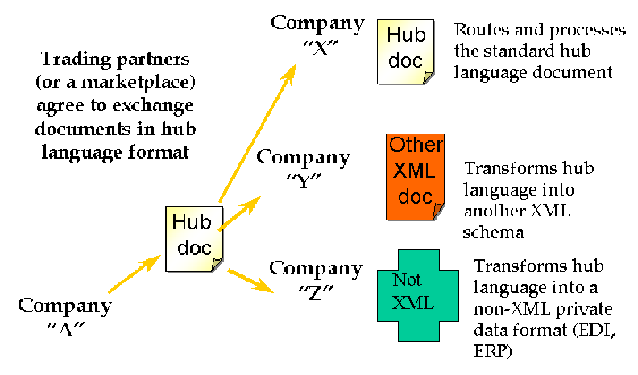
Interchange / Hub Languages
42

Slide 43
Mapping in and out of Hub Language
UNIVERSITY OF CALIFORNIA, BERKELEY
SCHOOL OF INFORMATION
If all parties/applications/services rely on a hub language for their external interfaces, an exponential interoperability challenge becomes a linear one
Mapping tools for transforming instances from an internal information model to another one are ubiquitous as standalone tools and as parts of application servers
EXAMPLE: Altova MapForce
43

Slide 44
Using Standards in Your Information Organization Efforts
UNIVERSITY OF CALIFORNIA, BERKELEY
SCHOOL OF INFORMATION
You may be required by the government, by your customers, or by "business partners" to conform to some standards for information organization
But to the extent that standards embody best practices, it is a good idea to follow them anyway
Nevertheless, this is "mother and apple pie” advice because of the proliferation of standards, their sometimes competitive and sometimes complementary character
44

Slide 45
Standards for Document Description in Organizing Systems (1)
UNIVERSITY OF CALIFORNIA, BERKELEY
SCHOOL OF INFORMATION
For specific vocabularies or "domain-specific languages" (e.g., HTML, UBL, SPL, DocBook, DITA, EPUB, SVG)
For schema languages that formally define the domain-specific languages (e.g., XSD)
For "profiles" that suggest modeling practices like degree of abstraction and granularity, or constrain the possible values for some descriptor
For the metalanguages used to encode the DSLs and schema languages (e.g., XML, SGML)
45

Slide 46
Standards for Document Description in Organizing Systems (2)
UNIVERSITY OF CALIFORNIA, BERKELEY
SCHOOL OF INFORMATION
For the construction of file and document names
For identifying resources and namespaces
For specifying versions, stages or revisions of documents or other resources
46

Slide 47
Other Standards for Organizing Systems
UNIVERSITY OF CALIFORNIA, BERKELEY
SCHOOL OF INFORMATION
Metadata standards (MARC, Dublin Core, EAD, METS, RDF, OWL)
Standards for classification (LoC, DD, BISAC)
Standards for thesaurus construction
Standards for processes (WS-*)
Standards for communication protocols
47

Slide 48
Readings for Next Lecture
UNIVERSITY OF CALIFORNIA, BERKELEY
SCHOOL OF INFORMATION
TDO rest of chapter 7
48

