Slide 1
Plan for Today’s Lecture(s)
UNIVERSITY OF CALIFORNIA, BERKELEY
SCHOOL OF INFORMATION
The What and Why of Categories
Cultural, Individual, and Institutional categories
Principles for creating categories
Classical categories... NOT
1

Slide 2
INFO 202 “Information Organization & Retrieval” Fall 2013
UNIVERSITY OF CALIFORNIA, BERKELEY
SCHOOL OF INFORMATION
Robert J. Glushko glushko@berkeley.edu
@rjglushko
17 October 2013 Lecture 15.1 – The What and Why of Categories

Slide 3
How Do We Understand Each Other?
UNIVERSITY OF CALIFORNIA, BERKELEY
SCHOOL OF INFORMATION
It sometimes seems amazing that people can communicate because they organize and name the world in such different ways
People establish a shared context through negotiated and iterative interactions and by providing assistance when possible
People apply the recall / precision tradeoff, using more general categories to establish context and more specific ones when precise identification is required
3
Notes:
If I say "think of a building on campus" vs "think of a campanile on campus"; the campanile is a building but that equivalence class has many members and the campanile class has only 1
this is the RECALL vs PRECISION tradeoff. A more general term creates a larger category, but might have a lot of heterogeneous instances in it. A very precise term is either going to find what you want or you'll realize that it doesn't match any instances.
We will also see this principle applied in the weighting of index terms ..what words make the best index terms to describe documents? Terms that don't appear very often in a document collection and when they occur they occur in a cluster are the best discriminators of what documents are about

Slide 4
Categories are “Equivalence Classes”
UNIVERSITY OF CALIFORNIA, BERKELEY
SCHOOL OF INFORMATION
Categories are sets or groups of resources or abstract entities that are treated the same
This almost never means that every instance of the category is identical
It only means that for some purpose we treat them in the same way
4

Slide 5
Categories are Essential
UNIVERSITY OF CALIFORNIA, BERKELEY
SCHOOL OF INFORMATION
Categories are involved whenever we perceive, communicate, analyze, predict, classify – or otherwise attempt to make sense of our experiences
All human languages and cultures divide the physical and experiential “worlds” into categories
Some of this “sense-making” is discovering categories and some is creating them, but these aspects are often interconnected
5
Notes:
if you are interested in these issues, there are about 500 words of endnotes 1-5 to get you pointed in the right direction... my intellectual roots as a cognitive scientist are showing through pretty clearly there

Slide 6
Categories are Created
UNIVERSITY OF CALIFORNIA, BERKELEY
SCHOOL OF INFORMATION
Categories can be created in many different ways according to many different types of principles
The equivalence classes that are created depend on which aspects or roles or meanings of the category members are treated as relevant
6

Slide 7
Categories are Models
UNIVERSITY OF CALIFORNIA, BERKELEY
SCHOOL OF INFORMATION
Defining categories as equivalence classes in this way should remind you of this definition:
Models are simplified descriptions of a subject that abstract from its complexity to emphasize some features or characteristics while intentionally de-emphasizing others
Categories are COGNITIVE and LINGUISTIC MODELS for applying prior knowledge
7

Slide 8
INFO 202 “Information Organization & Retrieval” Fall 2013
UNIVERSITY OF CALIFORNIA, BERKELEY
SCHOOL OF INFORMATION
Robert J. Glushko glushko@berkeley.edu
@rjglushko
17 October 2013 Lecture 15.2 – Category Categories, or Contexts for Categorization

Slide 9
Category Categories
UNIVERSITY OF CALIFORNIA, BERKELEY
SCHOOL OF INFORMATION
Cultural Categorization
Individual Categorization
Institutional Categorization
9
Notes:
different kinds of categorization and classification activities or systems lie in a continuous multidimensional space where we can identify three important regions
this is a classification I came up with

Slide 10
Cultural Categories
UNIVERSITY OF CALIFORNIA, BERKELEY
SCHOOL OF INFORMATION
Embodied in culture and language, developing slowly and typically changing slowly
Many have a perceptual or sensorimotor origin based on natural boundaries or discontinuities in perception and experience
Learned implicitly through development via parent-child interactions, language, and experience
Informal and contextual acquisition makes cultural categories flexible, creative, generative, and biased
10
Notes:
Competent adults understand tens of thousands of different categories even if they don’t have words for them, and then can readily understand new categories like the “what do you take from a burning building”

Slide 11
Cultural Categories
UNIVERSITY OF CALIFORNIA, BERKELEY
SCHOOL OF INFORMATION
When properties or behaviors co-occur in predictable ways, it is useful to have category words that name them => emergence of language
Formal education can teach cultural categories but the non-formal mechanisms often dominate or interfere
Thinking and research about categorization is primarily about cultural categories
11
Notes:
Competent adults understand tens of thousands of different categories even if they don’t have words for them, and then can readily understand new categories like the “what do you take from a burning building”

Slide 12
Linguistic Relativity
UNIVERSITY OF CALIFORNIA, BERKELEY
SCHOOL OF INFORMATION
Languages differ a great deal in the words they contain (which concepts are lexicalized)
They also differ in more fundamental ways by requiring speakers or writers to attend to details about the world or aspects of experience that another language allows them to ignore
But this doesn't mean that people can't understand concepts that are not lexicalized
12

Slide 13
Linguistic Relativity in Reykjavík
13

Slide 14
The Whorfian Hypothesis
UNIVERSITY OF CALIFORNIA, BERKELEY
SCHOOL OF INFORMATION
Benjamin Whorf (mid 20th century) is widely credited and miscredited with the hypothesis that "language shapes thought" - that the categories embodied in languages shape or even constrain how people perceive and understand the world
Cognitive science professor Lera Boraditsky has done some ingenious experimental tests of the Whorfian hypothesis - see http://www-psych.stanford.edu/~lera/papers/wsj.pdf for a very readable summary...
14
Notes:
for example. she studied an aboriginal language that doesn't use left or right, instead they use absolute cardinal directions. So instead of saying "Please raise your right hand" you'd say "please raise your north hand"

Slide 15
Cultural Categories Don’t Have Precise Boundaries
… often causing ambiguity or the “vocabulary problem”
15
Notes:
it isn't that the person who runs this martial arts place doesn't think that women are adults, but they didn't express it very well
Do you know that Berkeley has both a faculty club and a women’s faculty club? Why would that be? (faculty club was created when there were no women faculty, and women were explicitly barred from going there)

Slide 16
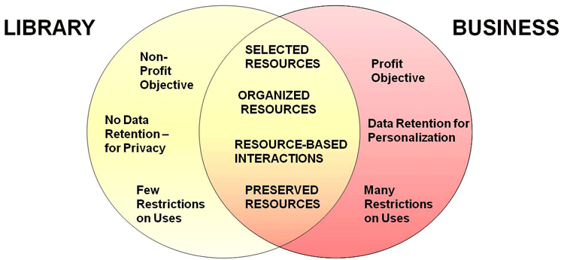
Cultural Category Boundaries Can Be Contentious
Is Google Books a Library or a Business?
16

Slide 17
Individual Categories
UNIVERSITY OF CALIFORNIA, BERKELEY
SCHOOL OF INFORMATION
Created to satisfy ad hoc requirements that emerge from an individual’s unique experiences, preferences, and resource collections
Created intentionally in response to specific organizing requirements
Can have an imaginative or metaphorical basis that distorts or misinterpret cultural categories
Collection hobbies often embody peculiar individual categories. Chacun son goût…
17
Notes:
Might be short term in response to a speciific task – get organizied for an IRS audit –

Slide 18
Individual Categories
UNIVERSITY OF CALIFORNIA, BERKELEY
SCHOOL OF INFORMATION
Often have short lifetimes because they are designed to support specific tasks
When physical resources are involved, individual categories are rarely visible to or shared with others
With digital resources, increasingly common for individual categories to be intentionally or accidentally revealed
“Personal information management” is a subfield that focuses on individual organizing systems
18
Notes:
Might be short term in response to a speciific task – get organizied for an IRS audit –

Slide 19
Borges' Categorization of Animals
UNIVERSITY OF CALIFORNIA, BERKELEY
SCHOOL OF INFORMATION
In a certain Chinese encyclopedia "it is written that 'animals are divided into:
(a) belonging to the Emperor, (b) embalmed, (c) tame, (d) suckling pigs, (e) sirens, (f) fabulous, (g) stray dogs, (h) included in the present classification, (i) frenzied, (j) innumerable, (k) drawn with a very fine camelhair brush, (l) et cetera, (m) having just broken the water pitcher, (n) that from a long way off look like flies.'“
19
Notes:
(In a 1952 short story titled "The Analytical Language of John Wilkins" Borges writes:)
John Wilkins was the founder and first head of the British Royal Society, roughly equivalent to the National Academy of Sciences in the US, and proposed a new taxonomy of knowledge and a universal language to be used by all the world's philosophers
Borges is commenting on the feasibility of Wilkins' efforts by saying it reminds him of this encyclopedia (which of course is made up, like the rest of stuff in Borges like the Library you read about last week)
What is he saying to us today about Wilkins plan?
all classifications are arbitrary and if this one seems inconsistent to you (like the self-referential stuff) maybe the ones you create look just as strange to others
overlapping categories, inconsistent granularity, items can be in different places, and can change places
That's a little stronger than my position - there are certainly principles we can follow in the design of names and classifications - but I agree with a weaker interpretation that every classification is embedded in a context, practice, or point of view

Slide 20
Institutional Categorization
UNIVERSITY OF CALIFORNIA, BERKELEY
SCHOOL OF INFORMATION
Explicit construction of a semantic model of a domain to enable more control, robustness, and interoperability than is possible with just the cultural system
Essential in abstract, information-intensive domains where semantic precision is essential for processes and transactions (especially automated ones)
Often the collaborative artifact of many individuals who represent different organizational or business perspectives
20
Notes:
for example. she studied an aboriginal language that doesn't use left or right, instead they use absolute cardinal directions. So instead of saying "Please raise your right hand" you'd say "please raise your north hand"

Slide 21
Institutional Categorization
UNIVERSITY OF CALIFORNIA, BERKELEY
SCHOOL OF INFORMATION
Usually developed via rigorous and formal processes (e.g., in standards organizations or legislative bodies)
Laws, regulations, and standards often define institutional categories and the rules for working with them
Require ongoing governance and maintenance because of continuous changes taking place in related cultural and individual systems
21
Notes:
Heavyweight modeling

Slide 22
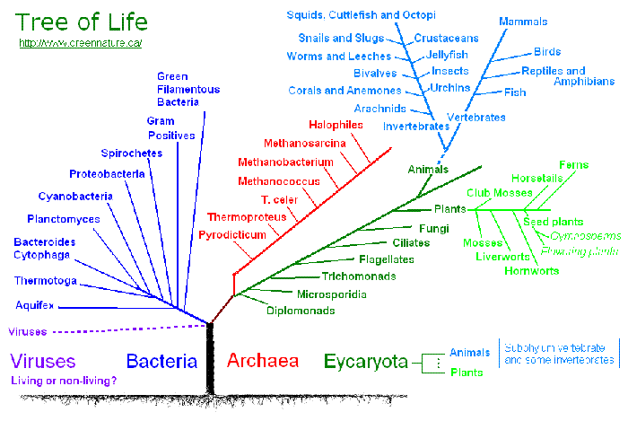
Institutional Categorization of Animals (Sorry Borges)
22
Notes:
The Tree of Life Project http://www.tolweb.org/tree/

Slide 23
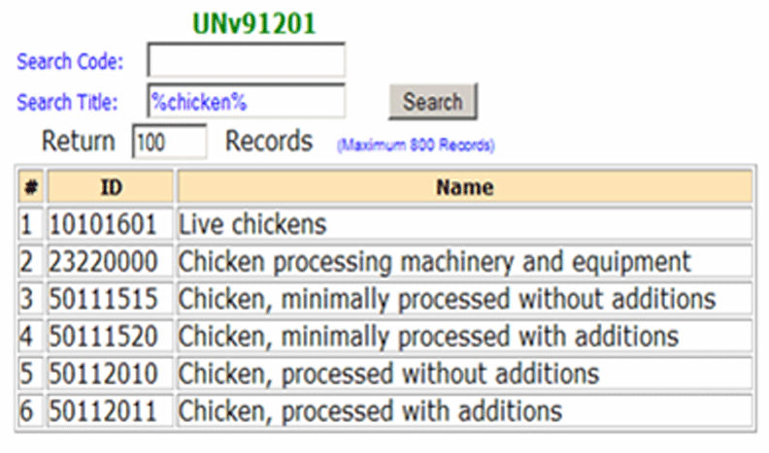
UN Standard Products and Services Codes for "Chicken"
23
Notes:
The UNSPSC (unspsc.org) provides an open, global multi-sector standard for efficient, accurate classification of products and services
So why do we need this formal a classification system for "chicken" or anything else?
look for lettuce at unspsc.org
commerce, statistics, economic policy

Slide 24
Institutional != Unbiased
UNIVERSITY OF CALIFORNIA, BERKELEY
SCHOOL OF INFORMATION
Creating institutional categories by more systematic processes than cultural or individual categories does not prevent them from being biased
Indeed, the goal of institutional categories is often to impose or incentivize biases in interpretation or behavior
24
Notes:
categories define "good and bad" behavior, try to regulate it with precise definitions that classify a company or activity into some particular category so it can be objectively dealt with
this is sensible - you want to know if and how some law applies.
so imagine some regulation of chemical storage tanks: if a tank is less than 500 gallons, mo law applied. If 501-5000, this law applies, if bigger than that, some other provision applies. and you'd think that tanks are of some size so a compamy just has to comply.
but suppos a company has a 6000 gallon tank. Maybe replace it wtih 2 3000 gallon tanks, avoid the regulation...

Slide 25
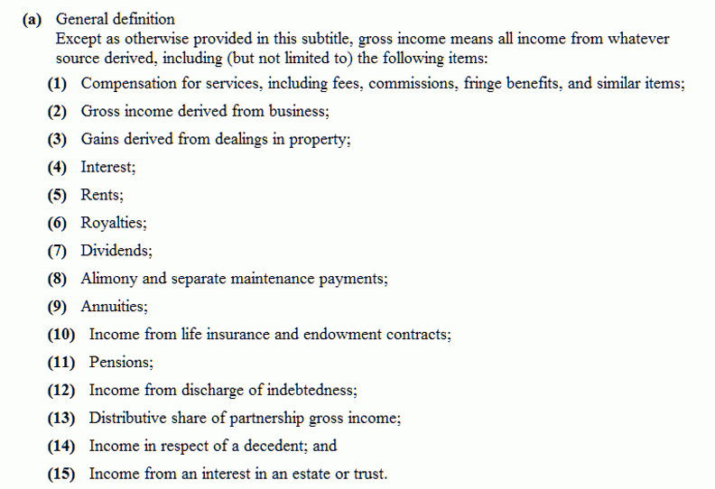
"Gross Income" Tax Code Categories
Should dividends be taxable income?
25
Notes:
categories embodied in laws... classify wrong, go to jail
standard fraud is to buy something from someone at inflated prices, they buy something from you at inflated prices, you increase your sales
Should dividends be income? Dividends are already taxed twice: corporations pay taxes on their profits, and when they distribute dividends to investors, the investors also pay taxes on the dividends. Many countries adjust for this double taxation by keeping individual dividend taxes low.
A home mortgage interest deduction allows taxpayers who own their homes to reduce their taxable income by the amount of interest paid on the loan which is secured by their principal residence (or, sometimes, a second home). Most developed countries do not allow a deduction for interest on personal loans, so countries that allow a home mortgage interest deduction have created an exception to those rules. The Netherlands, Switzerland, and the United States each allow the deduction. In Belgium, Ireland and Sweden, only a minor part of mortgage interest is deductible.

Slide 26
Dimensions of Variation Across “Categorization Contexts”
UNIVERSITY OF CALIFORNIA, BERKELEY
SCHOOL OF INFORMATION
Explicitness – how much awareness is required to use the categorization system
Effort – how much effort is required
Precision – “statistical” or formal specification
Goals – whose purposes are served; individuals, informal groups, formal groups
26

Slide 27
Dimensions of Variation Across “Categorization Contexts”
UNIVERSITY OF CALIFORNIA, BERKELEY
SCHOOL OF INFORMATION
Interoperability – none, between people, between systems
Reuse – from none to a great deal
Change – slow, fast, unmanaged, managed
Feedback – implications for misuse of the categories
27

Slide 28
INFO 202 “Information Organization & Retrieval” Fall 2013
UNIVERSITY OF CALIFORNIA, BERKELEY
SCHOOL OF INFORMATION
Robert J. Glushko glushko@berkeley.edu
@rjglushko
17 October 2013 Lecture 15.3 – Principles for Creating Categories

Slide 29
Principles for Creating Categories
UNIVERSITY OF CALIFORNIA, BERKELEY
SCHOOL OF INFORMATION
Enumeration
Single Properties
Multiple Properties
Family Resemblance
Similarity
Theory-Based
Goal-Derived
29
Notes:
not a sharp boundary obviously since individuals are members of a language and cultural community - but in this context we're emphasizing what they're doing "on their own"

Slide 30
Defining Categories by Enumeration
UNIVERSITY OF CALIFORNIA, BERKELEY
SCHOOL OF INFORMATION
Simplest way to define a category is by enumerating (listing) its members
This principle is also called EXTENSIONAL definition; the members of the set are called the EXTENSION
This principle is easy to understand and implement; the meaning of a category or concept is the specific set of resources associated with it
30

Slide 31
Defining Categories by Enumeration
UNIVERSITY OF CALIFORNIA, BERKELEY
SCHOOL OF INFORMATION
We understand something like "states of the US" as a category by listing all 50 of them
Enumerative categories enable membership to be unambiguously determined, but at some scale they become impractical or inefficient, and the category either must be sub-divided or be given a definition based on principles other than enumeration
31

Slide 32
Frege's "Correspondence" Philosophy of Language
UNIVERSITY OF CALIFORNIA, BERKELEY
SCHOOL OF INFORMATION
Gottlob Frege (1848-1925), father of modern logic, investigated the idea of equivalence – how can you tell that two things are the same – in "Uber Sinn und Bedeuting"
"Sinn" or "sense" (or "intension") – the inner concept that people understand; words have intensions
"Bedeuting" or "reference" (or "extension") – the thing being referred to; the set of all objects in the world that can be described by the concept; intensions belong to extensions
But if "meaning" was just based on reference would we need all that complicated ontology and common sense?
32
Notes:
You can tell that "Bob Glushko" and "Deirdre Mulligan" mean different things because the people who answer to the names are different
"Bob" and "Professor Glushko" must mean the same thing because I respond to both of these names

Slide 33
If Names Mean What They Refer To...
UNIVERSITY OF CALIFORNIA, BERKELEY
SCHOOL OF INFORMATION
Prune == Dried Plum
Chinese Gooseberry == Kiwi Fruit
Patagonian Toothfish == Antarctic Cod == Chilean Sea Bass
Sectarian Conflict == Civil War
Terrorists == Insurgents == Resistance == Freedom Fighters
33
Notes:
Prunes were promoted as a dietary supplement that people (especially old ones) need to "maintain regularity" - sales declined steadily until the name change -- but only in the US. Other parts of the world don't think that only old people eat prunes
Gooseberry didn't sell well with first name
Name change so successful that fish is now endangered

Slide 34
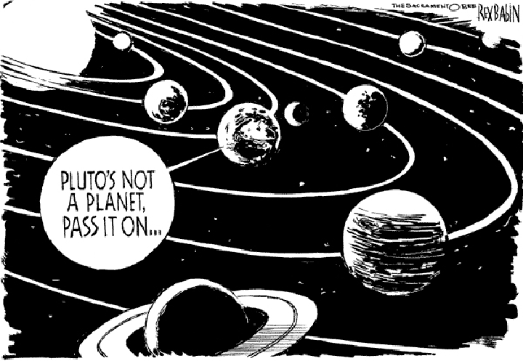
Sorry, Pluto
34
Notes:
You might remember the uproar a couple of years ago when the International Astronomical Union proposed a formal definition of "planet" for the first time.
when we only knew about planets in our own solar system, we could count them, as every kid learns to do in school. But when we start discovering bodies that revolve around other stars we can't possibly define by enumeration.

Slide 35
Categories Defined by Single Properties
UNIVERSITY OF CALIFORNIA, BERKELEY
SCHOOL OF INFORMATION
Simple category systems can be created using the values of any intrinsic static property, especially when the possible values are discrete and not very numerous
But you can always define ranges for continuous value properties: low, moderate, high cost
It is important to use properties that are psychologically or pragmatically relevant for the resource domain
35
Notes:
but you always define ranges for continuous value properties: low cost, moderate cost, high cost
Bill Gates is a billionaire, he's smart, he's powerful, he's ruthless; generous people, visionary, programmer, which single characteristic is most useful to understanding Bill Gates
if we categorize by wealth, gates and zuckerberg are in the same category, by age they are not

Slide 36
Categories Defined by Single Properties
UNIVERSITY OF CALIFORNIA, BERKELEY
SCHOOL OF INFORMATION
Whenever a single property is used to define categories, the choice of property is critical (Gates and Zuckerberg example)
A single-property category with a large numbers of items in it will lack coherence because differences on other properties will be too apparent
36
Notes:
but you always define ranges for continuous value properties: low cost, moderate cost, high cost
Bill Gates is a billionaire, he's smart, he's powerful, he's ruthless; generous people, visionary, programmer, which single characteristic is most useful to understanding Bill Gates
if we categorize by wealth, gates and zuckerberg are in the same category, by age they are not

Slide 37
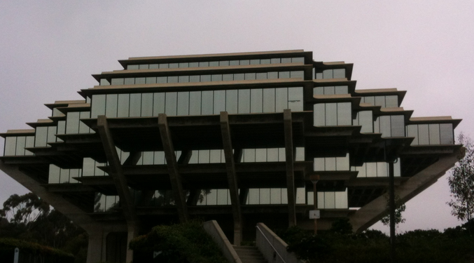
Single Property Category
37

Slide 38
Single Property Category
38

Slide 39
Categories Defined by Multiple Properties
UNIVERSITY OF CALIFORNIA, BERKELEY
SCHOOL OF INFORMATION
Categories based on multiple properties form a hierarchy
Each successive property differentiates the items in a category to create sub-categories
No more properties are needed if every item is in its own category or if the remaining differences are not important to us
For information resources, easily perceived properties are much less useful than ABOUTNESS
39

Slide 40
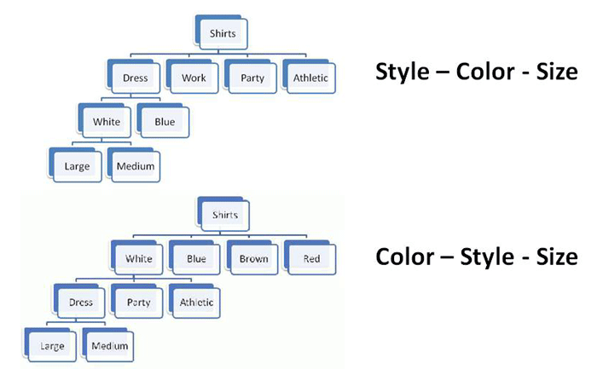
Property Order Determines the Category Hierarchy
40

Slide 41
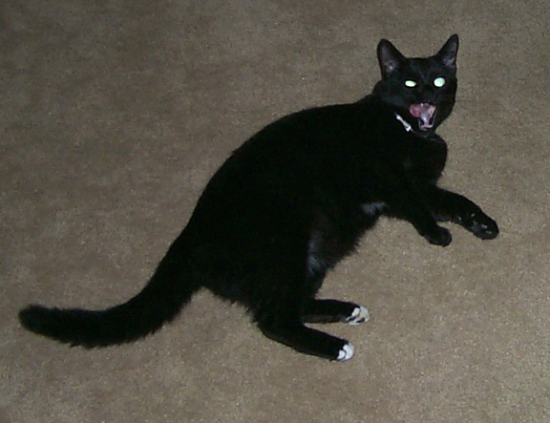
Category Hierarchies
UNIVERSITY OF CALIFORNIA, BERKELEY
SCHOOL OF INFORMATION
Categories can be organized into a hierarchy from the most general to the most specific
My cat can be described as
An animal
A mammal
A cat
An American Shorthair
Boris
41

Slide 42
Basic-Level Categories
UNIVERSITY OF CALIFORNIA, BERKELEY
SCHOOL OF INFORMATION
In the middle of category hierarchies are those that more "basic" because the within-category differences are smallest and the between-category differences are the largest
This means that perceptual, cognitive, and motor functions are "sharpest" at this level at identifying and thinking about category membership
These are the categories when Plato “carves nature at the joints”
42

Slide 43
Basic-Level Categories
UNIVERSITY OF CALIFORNIA, BERKELEY
SCHOOL OF INFORMATION
Members tend to have the same shape
They tend to "share parts"
The same motor movements are involved in interacting with them
43
Notes:
... (but recognizing that is a very hard problem for the visual system because there are an enormous number of views of any given object [size, lighting, color, viewing angle]); chairs vs furniture vs rocking chairs; cows vs animals vs jersey cows
Basic level categories are usually thought of as referring to things, but it also applies to processes, events... "making a purchase" is in the hierarchy with "shopping at supermarket" and "shopping in the vegetable aisle at the supermarket" - agreement that the middle level is more basic (even though there isn't the perceptual similarity to reinforce the category)
duality of process and payloads at that level of abstraction

Slide 44
The Classical View of Categories
UNIVERSITY OF CALIFORNIA, BERKELEY
SCHOOL OF INFORMATION
Some categories have clear boundaries defined by a small number of ESSENTIAL or necessary and sufficient properties
Necessary means that every instance must have the property to be in the category
Sufficient means that any instance that has the necessary properties is in the category
44

Slide 45
The Classical View of Categories
UNIVERSITY OF CALIFORNIA, BERKELEY
SCHOOL OF INFORMATION
All members of the category have equal status in the equivalence class
Example: A prime number is an integer divisible only by itself and 1
45

Slide 46
Wittgenstein
UNIVERSITY OF CALIFORNIA, BERKELEY
SCHOOL OF INFORMATION
Ludwig Wittgenstein (1889-1951) – "philosophy of ordinary language" - first to discuss problems with classical theory
Dismantles Frege in "Philosophische Untersuchungen"
Agrees with Frege that where the extensions have fixed characteristics or can be enumerated you can understand words by following the association to their extensions
But rebuts Frege with argument that there are no fixed extensions for most words
46

Slide 47
Wittgenstein's Rebuttal to Frege: Meaning is Use
UNIVERSITY OF CALIFORNIA, BERKELEY
SCHOOL OF INFORMATION
There may be defining features for typical instances
But there are no features that are necessary and sufficient for all examples of the category
Even when features can be identified, they change in different contexts and over time
Different instances vary substantially in how typical or representative they are of the category even though they share all the required features
47

Slide 48
Necessary and Sufficient Properties - Not!
UNIVERSITY OF CALIFORNIA, BERKELEY
SCHOOL OF INFORMATION
Wittgenstein's Counterexample is "Game"
No common properties are shared by all games
Some involve competition, others are cooperative
Some involve physical skill, others more mental skills, others luck
Some require equipment, others don't
Some involve teams, others are solitary
No fixed category boundary - we can extend game category to include video games, networked games, word games, mind games, …
48

Slide 49
Family Resemblances
UNIVERSITY OF CALIFORNIA, BERKELEY
SCHOOL OF INFORMATION
Instances of a category often share many features, but some instances might have properties that are not widely shared
These widely shared though not universal properties produce FAMILY RESEMBLANCES among the members
Categories based on family resemblance in $20,000 Pyramid game
49

Slide 50
Family Resemblance
Chen Family
Allan Bradley Power Supply Product Family
50
Notes:
scientific taxonomic categories are useful for many purposes, but not always. This "field guide" for identifying birds uses the features that are most visible when you're out birdwatching, namely the color and size, to identify them,

Slide 51
Characteristic Features
UNIVERSITY OF CALIFORNIA, BERKELEY
SCHOOL OF INFORMATION
Perceived degree of category membership has to do with which features help define the category
Members usually do not have ALL the necessary features, but have some subset
Those members that have more of the central features are seen as more central members
51

Slide 52
Gradience in Category Membership
UNIVERSITY OF CALIFORNIA, BERKELEY
SCHOOL OF INFORMATION
Not all members of a category are equally good examples
The perceived centrality or typicality of category membership depends on the extent to which the most characteristic properties are shared
"Someone says to me 'Show the children a game.' I teach them gaming with dice, and the other says 'I didn't mean that kind of game.' " (Wittgenstein)
52
Notes:
Graded typicality just doesn't fit in classical model

Slide 53
Gradience in Category Membership
Which bird is most typical of the category?
53
Notes:
scientific taxonomic categories are useful for many purposes, but not always. This "field guide" for identifying birds uses the features that are most visible when you're out birdwatching, namely the color and size, to identify them,

Slide 54
Similarity
UNIVERSITY OF CALIFORNIA, BERKELEY
SCHOOL OF INFORMATION
It is easy to say that we can create categories on the basis of resource similarity
But some people say that similarity is a meaningless and "mostly vacuous" concept because there must always be some unstated set of properties, and if we identify the properties and how they are used, a "similarity" mechanism has nothing to do
54

Slide 55
Theory-Based Categories
UNIVERSITY OF CALIFORNIA, BERKELEY
SCHOOL OF INFORMATION
Sometimes a category is defined because of a theory of causation or capability that explains why some collection of things go together
A good theory can "trump" similarity or family resemblance based on surface properties
Example: The category of "computer" is based on being able to compute, not on appearance
55

Slide 56
Goal-Derived Categories
UNIVERSITY OF CALIFORNIA, BERKELEY
SCHOOL OF INFORMATION
Imagine you are in a city about to be hit by a hurricane and you have 10 minutes to take any of your possessions and evacuate. How do you define the category of what to take?
You might have a set of properties, but they are not likely to be ones that are easy to define: irreplaceable, priceless, sentimentally valuable, etc.
They have no discernable properties in common
Barsalou, Lawrence W. "Ad hoe categories." Memory & cognition 11, no. 3 (1983): 211-227.
56

Slide 57
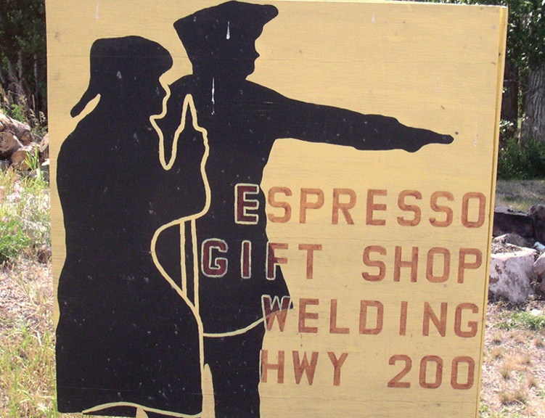
Goal-Derived Retail Category?
57

Slide 58
Summary: Why Study Categorization?
UNIVERSITY OF CALIFORNIA, BERKELEY
SCHOOL OF INFORMATION
Categorization is central to how we organize information and the world, and categories are involved whenever we communicate, analyze, predict, or classify
Whenever we design data structures, programming language class hierarchies, user or application interfaces, ...
Categorization is much messier than our computer systems and applications would like
But understanding how people (and each of us) categorize can help us design better systems and interfaces
58

Slide 59
Readings for Next Lecture
UNIVERSITY OF CALIFORNIA, BERKELEY
SCHOOL OF INFORMATION
TDO 7 through 7.2
Tavris, Carol. How Psychiatry Went Crazy. Wall Street Journal, 17 May 2013
Hoyt, Clark. Semantic minefields. New York Times, 15 May 2010.
Prewitt, Kenneth. Fix the Census’ Archaic Racial Categories. New York Times, 21 August 2013.
Rosenthal, Arnon, Len Seligman, and Scott Renner. “From semantic integration to semantics management: case studies and a way forward.” ACM SIGMOD Record 33, no. 4 (2004): 44-50.
59

