Slide 1
Plan for Today’s Lecture(s)
UNIVERSITY OF CALIFORNIA, BERKELEY
SCHOOL OF INFORMATION
XPath
The Architectural Perspective on Relationships
Structure between Resources
Link Architecture
Bibliometrics and Altmetrics
1

Slide 2
INFO 202 “Information Organization & Retrieval” Fall 2013
UNIVERSITY OF CALIFORNIA, BERKELEY
SCHOOL OF INFORMATION
Robert J. Glushko glushko@berkeley.edu
@rjglushko
8 October 2013 Lecture 12.6 – XPath

Slide 3
XPath (1)
UNIVERSITY OF CALIFORNIA, BERKELEY
SCHOOL OF INFORMATION
A standard way of addressing parts of XML documents
Defines the structures and patterns used by XML transformations, queries, and forms
Similar in concept to addressing files on the filesystem, i.e. at a shell or command prompt, but much more general and powerful
XPath lets you move in all sorts of different directions and multiple levels in a single step
3

Slide 4
XPath (2)
UNIVERSITY OF CALIFORNIA, BERKELEY
SCHOOL OF INFORMATION
Key idea is to view an XML document as a tree of information items called "nodes" - this is more abstract than thinking of it as a stream of marked-up text
XPath lets us select a set of matching candidate documents for retrieval that might be further analyzed for relevance
4

Slide 5
The Node Tree
UNIVERSITY OF CALIFORNIA, BERKELEY
SCHOOL OF INFORMATION
XPath describes the locations of addresses of parts of XML documents by navigating through the "node tree" along a "node axis"
There are seven types of nodes, corresponding to the different kinds of "stuff" in XML documents (most important : "element," "attribute," and "text")
There are thirteen different axes that specify different ways of following relationships among the nodes (the default is "child" -- look down the tree at the nodes directly linked as children)
5

Slide 6
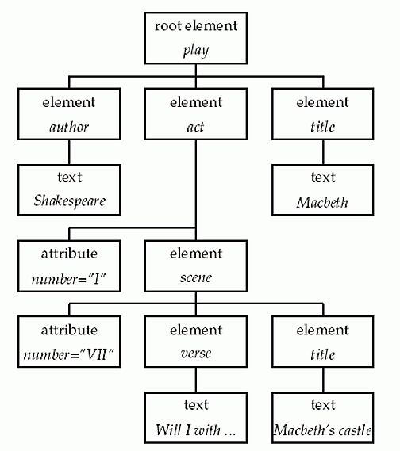
A Tree For A Shakespeare Play
Figure 10.2 From Manning (2008)

Slide 7
The Node Axes
UNIVERSITY OF CALIFORNIA, BERKELEY
SCHOOL OF INFORMATION
There are thirteen different axes that define different directions of "walking the node tree" depth-first starting from the context node;
Depth-first means visiting all the children recursively throughout the entire document, shown using the numbering of the nodes in the following graphs
The SELF Axis identifies the context node
Other nodes are defined relative to the context node
7

Slide 8
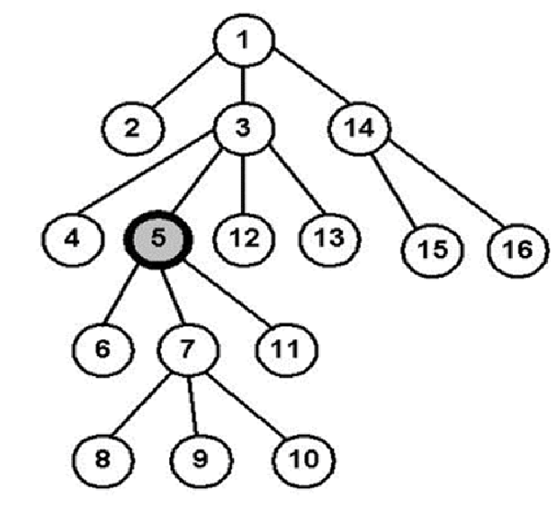
The SELF Axis
Identifies the context node

Slide 9
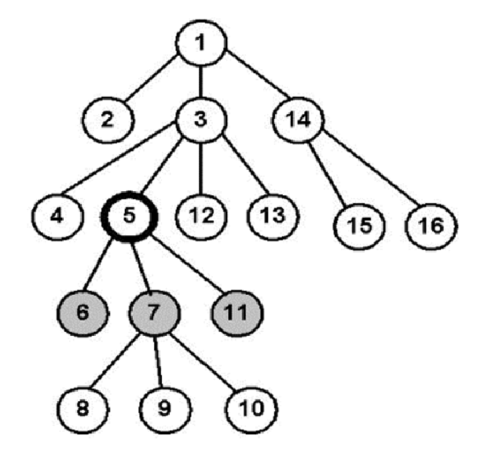
The CHILD Axis
Identifies the children of the context node

Slide 10
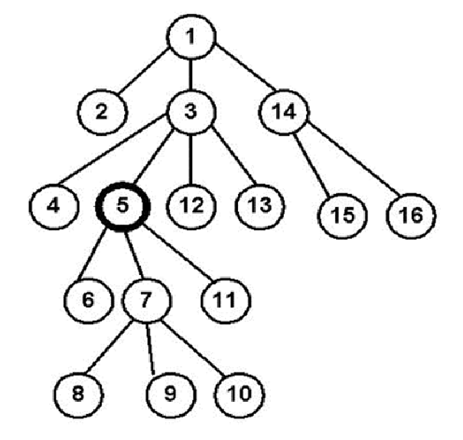
The ATTRIBUTE Axis
Identifies the attributes of the context node

Slide 11
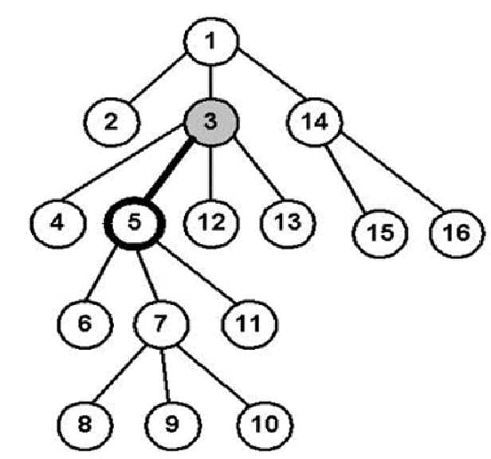
The PARENT Axis
Identifies the parent of the context node

Slide 12
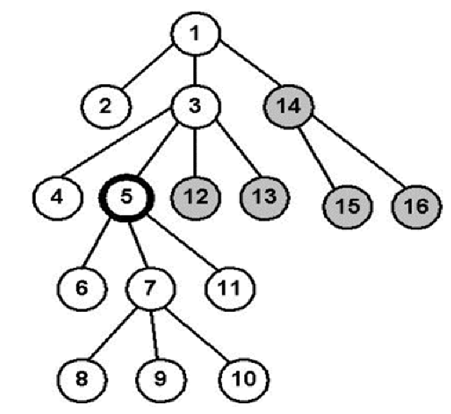
The FOLLOWING Axis
Identifies the nodes that follow the context node in document order, excluding its attributes and descrendants

Slide 13
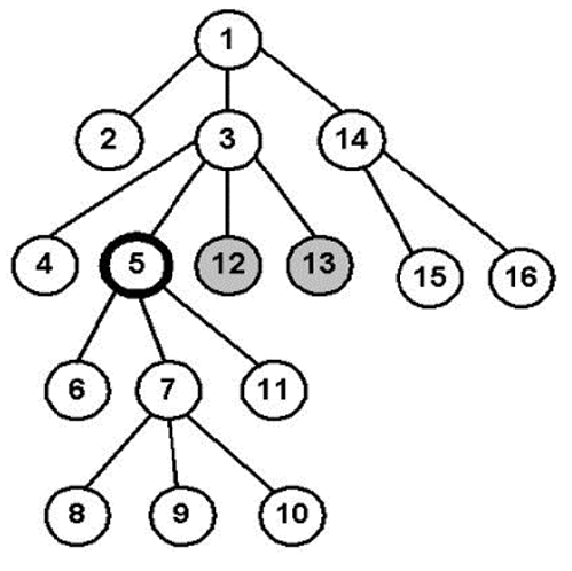
The FOLLOWING SIBLING Axis
Identifies the nodes that follow the context node in document order that have the same parent

Slide 14
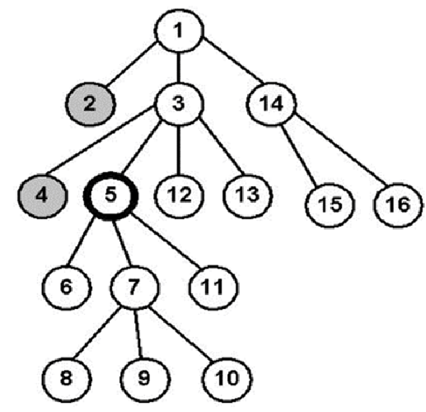
The PRECEDING Axis
Identifies the nodes that precede the context node in document order, excluding its attributes and ancestors

Slide 15
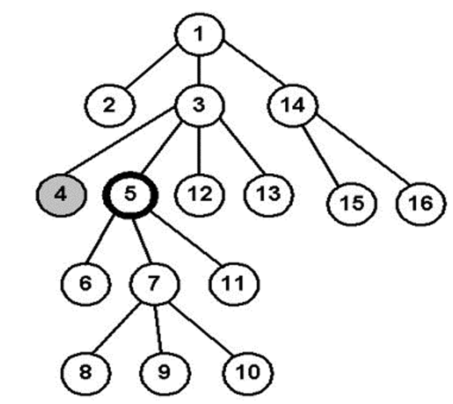
The PRECEDING SIBLING Axis
Identifies the nodes that precede the context node in document order that have the same parent

Slide 16
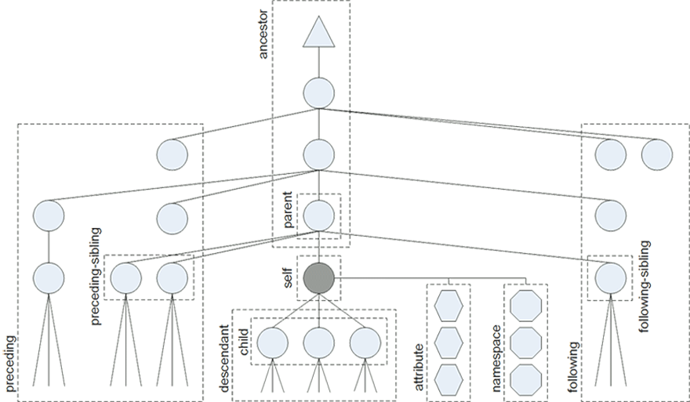
All the Node Axes

Slide 17
Path Expressions
UNIVERSITY OF CALIFORNIA, BERKELEY
SCHOOL OF INFORMATION
Each Path Expression consists of Location Steps separated by "/" that specify:
... the direction taken by the step (the "Axes")
...the type and number of nodes selected
... additional filters for selecting specific nodes ("Predicates")
// means start at the root of the tree
The Child access is the default
17

Slide 18
XPath Location Examples
UNIVERSITY OF CALIFORNIA, BERKELEY
SCHOOL OF INFORMATION
Find the slides in the lecture: //slide
Find their titles: //slide/title
Find the title of the first slide: //slide[1]/title
18

Slide 19
Path Expressions
UNIVERSITY OF CALIFORNIA, BERKELEY
SCHOOL OF INFORMATION
Each Path Expression consists of Location Steps separated by "/" that specify:
... the direction in which each step moves (the "Axes")
...the type and number of nodes selected by the step
... additional filters for selecting specific nodes ("Predicates")
19

Slide 20
Location Path Processing
UNIVERSITY OF CALIFORNIA, BERKELEY
SCHOOL OF INFORMATION
Start with a given context
For each location step:
Based on the axis, select the nodes on the axis
Reduce the set to the nodes that satisfy the node test
Apply the selection predicate(s) to further filter the node set
Take the remaining node set as the context for the next location step
20

Slide 21
Tree In, Selection Out
UNIVERSITY OF CALIFORNIA, BERKELEY
SCHOOL OF INFORMATION
XPath also has numerous arithmetic, logical, and string operators and many built-in functions
The result of the XPath evaluation is a selection
//img[not(@alt)] → select all images which have no alt attribute
count(//img) → return the number of images
/descendant::img[3]/@src → return the third image's src URI
21

Slide 22
INFO 202 “Information Organization & Retrieval” Fall 2013
UNIVERSITY OF CALIFORNIA, BERKELEY
SCHOOL OF INFORMATION
Robert J. Glushko glushko@berkeley.edu
@rjglushko
10 October 2013 Lecture 13.1 – The Architectural Perspective on Relationships

Slide 23
The Architectural Perspective: Degree or Arity
UNIVERSITY OF CALIFORNIA, BERKELEY
SCHOOL OF INFORMATION
The architectural perspective embodies Kent’s definition of “relation” as “A sequence of categories, that includes one thing from each category”
The DEGREE or ARITY of a relationship is the number of different "entity types" or "resource categories" in the relationship
Husband is-married-to Wife is BINARY
Person is-married-to Person is UNARY
23

Slide 24
The Architectural Perspective: Cardinality
UNIVERSITY OF CALIFORNIA, BERKELEY
SCHOOL OF INFORMATION
The CARDINALITY is the number of instances that can be associated with each entity type
Husband is-married-to Wife is ONE-TO-ONE, because husbands have only one wife and vice versa (in monogamous societies)
Father is-parent-of Child is ONE-TO-MANY
Homer is-parent-of Bart AND Lisa AND Maggie is one-to-three
24

Slide 25
Modeling Relationships as Binary Ones
UNIVERSITY OF CALIFORNIA, BERKELEY
SCHOOL OF INFORMATION
Relationships can always be modeled as binary ones, but this makes some relationships implicit that were explicit
Binary relationships are relationship "triples" with a "subject", "predicate," and "object"
With binary relationships the reason for the relationship can often be interpreted in both directions (one is the inverse of the other)
With triples we can combine relationships into a graph and "reason" over the set of relationships when they have common components
25

Slide 26
The Architectural Perspective: Directionality
UNIVERSITY OF CALIFORNIA, BERKELEY
SCHOOL OF INFORMATION
The DIRECTIONALITY of a relationship defines the order in which the arguments of the relationship are connected
A ONE-WAY or UNI-DIRECTIONAL relationship can be followed in only one direction
A BI-DIRECTIONAL one can be followed in both directions
All symmetric relationships are bi-directional, but not all bi-directional relationships are symmetric
26

Slide 27
The Architectural Perspective {and,or,vs.} the Structural Perspective
UNIVERSITY OF CALIFORNIA, BERKELEY
SCHOOL OF INFORMATION
The architectural perspective is abstract and prescriptive
It defines what kinds of relationships can be created
The structural perspective is concrete and descriptive
It says "this is what exists" and describes the actual patterns of association, arrangements, proximity, or connection between resources"
27

Slide 28
INFO 202 “Information Organization & Retrieval” Fall 2013
UNIVERSITY OF CALIFORNIA, BERKELEY
SCHOOL OF INFORMATION
Robert J. Glushko glushko@berkeley.edu
@rjglushko
10 October 2013 Lecture 13.2 – Introduction to Describing Structure Between Resources

Slide 29
Between-Resource Structure
UNIVERSITY OF CALIFORNIA, BERKELEY
SCHOOL OF INFORMATION
Links between printed or digital documents – citations, cross refs, notes
Links between web pages
Links – communication and information flows - between people, organizations, any other kind of interacting “actors” or resources – social networks
We can analyze all of these with some common concepts and abstractions, which we will introduce in as gentle a way as possible
29

Slide 30
Links Between Documents
UNIVERSITY OF CALIFORNIA, BERKELEY
SCHOOL OF INFORMATION
We can distinguish:
The starting point of the link (the ANCHOR)
The end point of the link (the DESTINATION)
How the starting point of the link is presented (the LINK MARKER)
How (if at all) the reason for the link is indicated (the LINK TYPE)
30

Slide 31
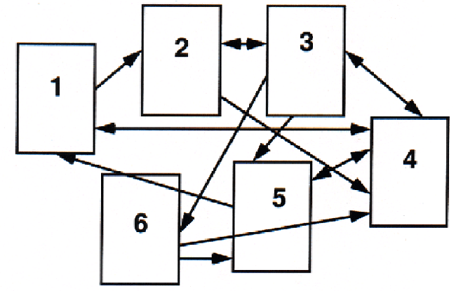
Link Network – Graphical View

Slide 32
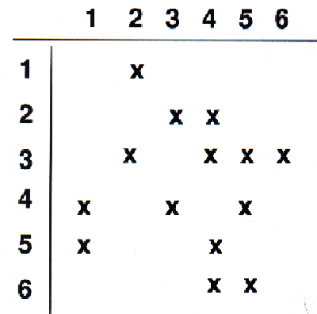
Link Network – Matrix View

Slide 33
Graph Theory
UNIVERSITY OF CALIFORNIA, BERKELEY
SCHOOL OF INFORMATION
We can apply graph theory to understanding relationships from a structural perspective
A GRAPH treats resources as VERTICES or NODES
The pairwise relationships between resources are represented by the EDGES that connect them
If the edges have an associated direction, this is a DIRECTED graph
A WEIGHT can be assigned to each edge if the relationship has a numerical aspect (distance, cost, time, etc.)
33

Slide 34
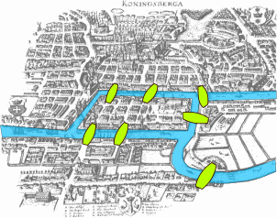
The Origins of Graph Theory (Euler 1735)
2 islands, 7 bridges – can you visit all 4 land masses without crossing any bridge more than once? Euler (1735) proved you couldn’t and invented much of graph theory to explain it
Euler’s Seven Bridges of Königsberg Problem
34

Slide 35
Computing the Properties of Graphs
UNIVERSITY OF CALIFORNIA, BERKELEY
SCHOOL OF INFORMATION
Reachability – is there a path between any two nodes in the graph?
Shortest path – if there are multiple paths between two nodes, which is the shortest?
Centrality – which nodes are the most connected or have the average shortest paths to the other nodes?
Subgraph discovery – are there sub-graphs that are completely contained in a larger graph?
35

Slide 36
Reachability and Transitive Closure
UNIVERSITY OF CALIFORNIA, BERKELEY
SCHOOL OF INFORMATION
The REACHABILITY property of a graph is "can you get there from here”
We can determine whether a path exists between any two nodes in a graph by calculating the transitive closure of the graph; the most commonly used approach is Warshall's algorithm
http://www.cs.sunysb.edu/~skiena/combinatorica/animations/graphpower.html
36

Slide 37
Shortest Path
UNIVERSITY OF CALIFORNIA, BERKELEY
SCHOOL OF INFORMATION
The shortest path between two nodes in a graph can be calculated using Dijkstra’s algorithm
The shortest path problem is ubiquitous and its solution has obvious value – travel, transportation, financial arbitrage, grocery shopping…
If the graph edges aren’t weighted and we only care about connectivity, we have the familiar “degrees of separation” situation
For mathematicians; for actors
37

Slide 38
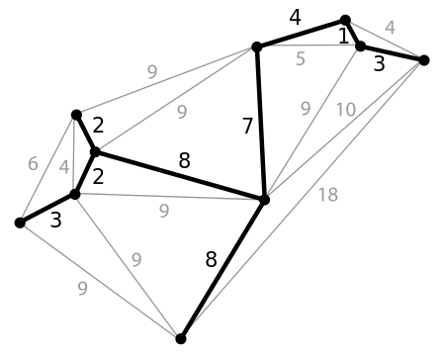
Minimum Spanning Tree
A spanning tree of a graph is a subgraph that is a tree that connects all the vertices – what’s the shortest one, and why would we care?
38

Slide 39
Moving Beyond “Reachability”
UNIVERSITY OF CALIFORNIA, BERKELEY
SCHOOL OF INFORMATION
We've been treating relationships in purely structural terms - is one thing connected to another - but we can refine that into two perspectives:
RELATIONAL analysis treats links as indicators of the amount of connectedness or the direction of flow between documents, people, groups, journals, disciplines, domains, organizations, or nations
EVALUATIVE analysis treats links as indicators of the level of quality, importance, influence or performance of documents, people, groups
39

Slide 40
Analysis of Large-Scale Social & Information Networks (Kleinberg)
UNIVERSITY OF CALIFORNIA, BERKELEY
SCHOOL OF INFORMATION
“The Web lets us observe, measure and analyse social interaction at a level of scale and resolution that was previously unimaginable, observing social phenomena that had previously remained essentially unrecorded and invisible”
Social social network firms exploit “triadic closure” – the increased tendency for two people to form a relationship when they people in common
People who are the boundaries of one’s social networks – “weak ties” – can be crucial sources of information
40

Slide 41
Analysis of Large-Scale Social & Information Networks (Kleinberg)
UNIVERSITY OF CALIFORNIA, BERKELEY
SCHOOL OF INFORMATION
Many social networks are directed graphs because of asymmetries in status, power, or values
Identifying “influencers” and predicting their influence is the billion dollar question for web-based social networks
If you liked this paper, you’ll love 203 next semester. If you didn’t like this paper, never mind
See Coursera course on Social Network Analysis
41

Slide 42
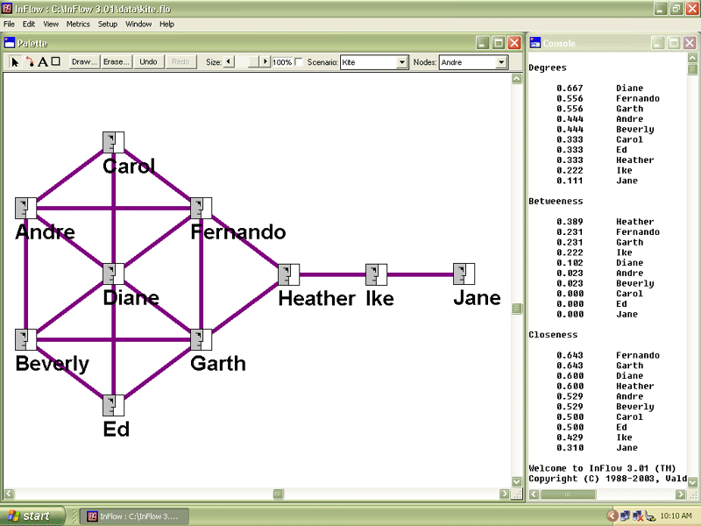
“Kite Network” Example from http://www.orgnet.com/sna.html
42

Slide 43
Measures of Centrality
UNIVERSITY OF CALIFORNIA, BERKELEY
SCHOOL OF INFORMATION
Degree Centrality – number of direct connections
Betweenness – a location in the network that interconnects different clusters
Closeness – low average path length
43

Slide 44
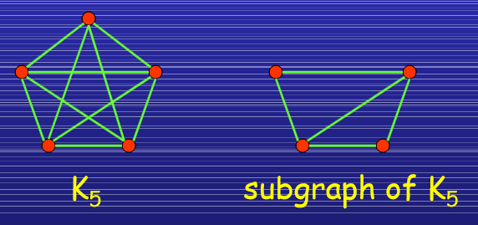
Subgraphs
In a social network setting, connection subgraphs can identify the few most likely paths of transmission for a disease (or rumor, or information-leak, or joke) or spot whether an individual has unexpected ties to any members of a list of individuals.
Faloutsos, Christos, Kevin S. McCurley, and Andrew Tomkins. "Connection subgraphs in social networks” 2004.
44

Slide 45
NSA’s Social Network Analysis
UNIVERSITY OF CALIFORNIA, BERKELEY
SCHOOL OF INFORMATION
The agency was authorized to conduct “large-scale graph analysis on very large sets of communications metadata without having to check foreignness” of every e-mail address, phone number or other identifier, the document said.
The agency can augment the communications data with material from public, commercial and other sources, including bank codes, insurance information, Facebook profiles, passenger manifests, voter registration rolls and GPS location information, as well as property records and unspecified tax data, according to the documents.
NSA Gathers Data on Social Connections of US Citizens.
NY Times 28 Sept 2013
45

Slide 47
UNIVERSITY OF CALIFORNIA, BERKELEY
SCHOOL OF INFORMATION
“The Web lets us observe, measure and analyse social interaction at a level of scale and resolution that was previously unimaginable, observing social phenomena that had previously remained essentially unrecorded and invisible”
47

Slide 48
INFO 202 “Information Organization & Retrieval” Fall 2013
UNIVERSITY OF CALIFORNIA, BERKELEY
SCHOOL OF INFORMATION
Robert J. Glushko glushko@berkeley.edu
@rjglushko
10 October 2013 Lecture 13.3 – Bibliometrics and Altmetrics

Slide 49
Citation Signals and Polarity (1)
UNIVERSITY OF CALIFORNIA, BERKELEY
SCHOOL OF INFORMATION
When one resource cites another there is often a lexical signal that indicates how a writer views the relationship of a citation to the text from which the citation is made
This concept comes from rhetoric and critical theory but is relevant to document engineering
Pedantic folks call this "genre of invocation" -- distinguishing things like "cite, mention, acknowledged”
49

Slide 50
Citation Signals and Polarity (2)
UNIVERSITY OF CALIFORNIA, BERKELEY
SCHOOL OF INFORMATION
A citation or link without a signal suggests by default that the citation supports the current text
Explicit signals that indicate positive polarity include "See," "See also," "See generally," and "Cf."
Signals that indicate negative polarity include "But see" and "Contra"
50

Slide 51
Bibilometrics (or "Scientometrics"): Structure of Scientific Citation
UNIVERSITY OF CALIFORNIA, BERKELEY
SCHOOL OF INFORMATION
Analysis of scientific citation began in the 1920s as a way to quantify the influence of specific documents or authors in terms of their "impact factor"
It can also identify "invisible colleges" of scientists whose citations are largely self-referential
It can recognize the emergence of new scientific disciplines
51

Slide 52
Some Problems for Citation Analysis
UNIVERSITY OF CALIFORNIA, BERKELEY
SCHOOL OF INFORMATION
People lie, are lazy, stupid, biased...
Most papers cite only a small proportion of the sources that influenced them
Secondary sources are cited more than primary ones, because people don't know the literature, and informal ones aren't cited
People cite their friends and themselves more than is justified
52

Slide 53
Altmetrics
UNIVERSITY OF CALIFORNIA, BERKELEY
SCHOOL OF INFORMATION
Measures based on total output are biased against young scholars; one of them proposed the H-Index as a better predictor of scientific impact
The “Altmetrics” movement is trying to make non-traditional contributions count for academic evaluations
Publishing in “open publications” – measuring downloading
Sharing “raw science” like datasets, code, and experimental designs
Blogging, microblogging, and comments or annotations on existing work
53

Slide 54
Adapting Citation Analysis to the Web
UNIVERSITY OF CALIFORNIA, BERKELEY
SCHOOL OF INFORMATION
The concepts and techniques of citation analysis seem applicable to the web since we can view it as a network of interlinked articles
But not everything applies because the web is different in numerous ways
We'll return to this issue with web search and structure-based retrieval
54

Slide 55
Readings for Next Lecture
UNIVERSITY OF CALIFORNIA, BERKELEY
SCHOOL OF INFORMATION
TDO 5.8, 8.4
Berners-Lee, Tim, James Hendler, and Ora Lassila. “The semantic web.” Scientific American 284, no. 5 (2001): 28-37.
Heath, Tom, and Christian Bizer. “Linked data: Evolving the web into a global data space.” Synthesis lectures on the semantic web: theory and technology 1, no. 1 (2011). Chapters 1 and 2, pages 1-29.
Byrne, Gillian, and Lisa Goddard. “The Strongest Link: Libraries and Linked Data.” D-Lib Magazine 16, no. 11/12 (2010).
55

