Slide 1
Plan for Today’s Lecture(s)
UNIVERSITY OF CALIFORNIA, BERKELEY
SCHOOL OF INFORMATION
Introduction to Multimedia Resource Description
“Professional” Metadata for Multimedia and Non-Text Resources
“Computational” Metadata for Multimedia and Non-Text Resources
“Contextual” Metadata
Resource Description for Music
1

Slide 2
INFO 202 “Information Organization & Retrieval” Fall 2013
UNIVERSITY OF CALIFORNIA, BERKELEY
SCHOOL OF INFORMATION
Robert J. Glushko glushko@berkeley.edu
@rjglushko
1 October 2013 Lecture 10.1 – Introduction to Describing Multimedia Resources

Slide 3
What is Multimedia?
UNIVERSITY OF CALIFORNIA, BERKELEY
SCHOOL OF INFORMATION
Media:
Text
Audio (speech, music, sound)
Graphics and Images
Moving Images
Multimedia -- Composed of more than one form of media
Time-based media -- Audio and video
3

Slide 4
Concepts and Relationships for Multimedia Resources
UNIVERSITY OF CALIFORNIA, BERKELEY
SCHOOL OF INFORMATION
playlist, album, queue
composite, collage, mix, remix
clip, sample, bite
remake, cover version
layout, presentation, performance
broad-/narrow-/simul-/tele-/web-/pod- cast
installation, environment
4

Slide 5
What's Different About Describing Multimedia?
UNIVERSITY OF CALIFORNIA, BERKELEY
SCHOOL OF INFORMATION
Sensory Gap
Semantic Gap
Proliferation Problem
5

Slide 6
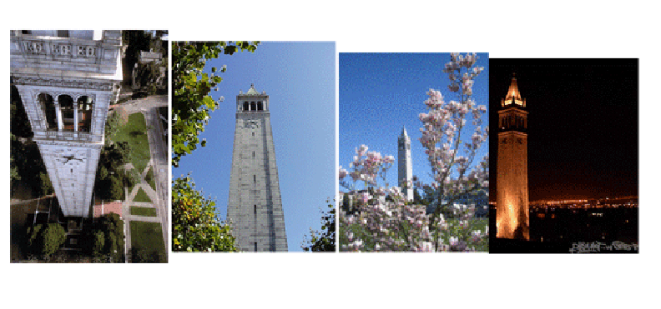
The Sensory Gap (1)

Slide 7
The Sensory Gap (2)
UNIVERSITY OF CALIFORNIA, BERKELEY
SCHOOL OF INFORMATION
There is a gap between an object and a computer's ability to sense and describe the object
An infinite number of different "signals“ can be produced by the same object
…And different objects can produce similar signals
Human perceptual machinery excels at recognizing when different "signal patterns" are the same object or when similar patterns are different ones
But the problem is difficult for computers
7

Slide 8
Don’t Blame the Computer
UNIVERSITY OF CALIFORNIA, BERKELEY
SCHOOL OF INFORMATION
It is asking a lot of the computer to reconstruct and recognize a 3D or 4D world from 2D (photos) or 3D (video) projections of it that lose massive amounts of information in the process
It is fairer to see the sensory gap as evidence of the incredible power of the human visual and cognitive systems to apply neural computation and knowledge to enable visual perception
8

Slide 9
The Semantic Gap
UNIVERSITY OF CALIFORNIA, BERKELEY
SCHOOL OF INFORMATION
Instruments, devices, and sensors encode data in formats that are optimized for efficient capture, storage, decoding, or other processing
This data is often limited to characteristics that involve coarse categorization and syntactic processing
The representation of the object can't be (easily) processed to understand what the object "means"
So there is a semantic gap between the descriptions that people assign and those that can be assigned by automated mechanisms
9

Slide 10
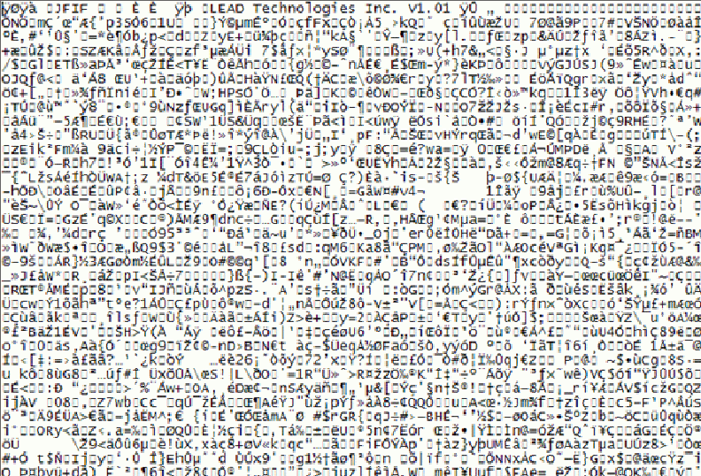
What’s this Picture About?

Slide 11
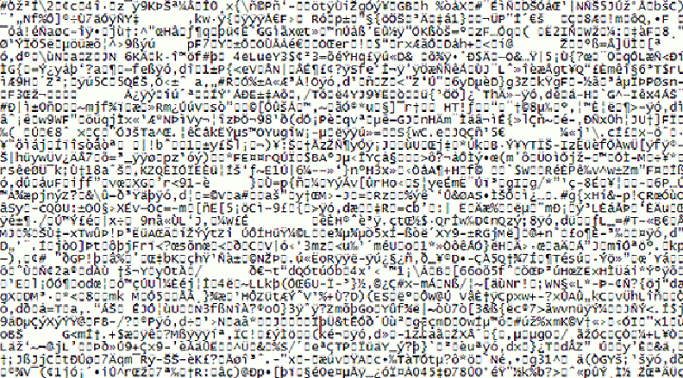
Name That Tune

Slide 12
Text has a Smaller Semantic Gap
<title>Concepts and Relationships for Multimedia "Documents"</title>
<list>
<item><p>playlist, album, queue</p></item>
<item><p>composite, collage, mix, remix</p></item>
<item><p>clip, sample, bite</p></item>
<item><p>remake, cover version</p></item>
<item><p>layout, presentation, performance</p></item>
<item><p>broad-/narrow-/simul-/tele-/web-/
pod- cast</p></item>
<item><p>installation, environment</p></item>
</list>

Slide 13
The Proliferation Problem (1)
UNIVERSITY OF CALIFORNIA, BERKELEY
SCHOOL OF INFORMATION
Digital cameras, video recorders, and smart phones have increased resolution and greater storage capacity every year
Non-professional consumers create very large collections of multimedia objects (20 B / year)
The average object has less value and doesn't justify much effort to organize and describe it
These “objects” include audio or video “snippets” that can stand alone
13

Slide 14
The Proliferation Problem (2)
UNIVERSITY OF CALIFORNIA, BERKELEY
SCHOOL OF INFORMATION
Without ways to manage collections of digital multimedia resources we lose the advantages of digital media
Many current approaches are insufficient, perhaps misguided, and certainly ignore a lot of what we already know
Great opportunity for innovation and invention, especially interdisciplinary approaches that combine technology and social considerations
14

Slide 15
Are these “Gaps” New Problems?
UNIVERSITY OF CALIFORNIA, BERKELEY
SCHOOL OF INFORMATION
Museums face some of the same or similar problems in describing art works and artifacts:
There may be many artifacts that represent the same "work" - this is like the "sensory" gap
The materials or medium in which the artifact is embodied don't convey semantics "on their surface" - this is the semantic gap
There may be so many artifacts of a particular type that some get only limited descriptions - this is like the proliferation problem
15

Slide 16
Just a Matter of Degree?

Slide 17
Some Problems May Be New
UNIVERSITY OF CALIFORNIA, BERKELEY
SCHOOL OF INFORMATION
The temporal structure of multimedia, especially video, mandates new descriptive vocabulary and new ways to identify meaningful components
Video and music meet emotional/psychological needs that are more complex than those for "documents" - so the descriptions of the latter have to be able to address these needs
People don't usually access or retrieve music or video "to satisfy information requirements“
17

Slide 18
INFO 202 “Information Organization & Retrieval” Fall 2013
UNIVERSITY OF CALIFORNIA, BERKELEY
SCHOOL OF INFORMATION
Robert J. Glushko glushko@berkeley.edu
@rjglushko
1 October 2013 Lecture 10.2 – “Professional” Metadata for Multimedia and Non-Text Resources

Slide 19
"Professional" Metadata for Multimedia and Non-textual Works
UNIVERSITY OF CALIFORNIA, BERKELEY
SCHOOL OF INFORMATION
Museum works and other non-text artifacts have long been described by professionals using structured metadata according to classification rules
The descriptions are often "layered" beginning with accessible properties with more analytic descriptions added for those objects that warrant them
19

Slide 20
"Panofsky's Three Levels of Meaning
UNIVERSITY OF CALIFORNIA, BERKELEY
SCHOOL OF INFORMATION
Description ("Preiconographic“ or “Primary”)
Identification ("Iconographic“ or “Secondary”)
Interpretation ("Iconologic“)
20

Slide 21
Description / “Preicongraphic” / Primary Level
UNIVERSITY OF CALIFORNIA, BERKELEY
SCHOOL OF INFORMATION
The "primary" or "natural" subject matter of a work
The generic elements or things depicted in, on, or by an object / image / art work
These would be recognizable by anyone, regardless of their expertise or training
21

Slide 22
Identification / “Icongraphic” / Secondary Level
UNIVERSITY OF CALIFORNIA, BERKELEY
SCHOOL OF INFORMATION
The name of the subject or thing depicted in the work
Can require research or fact assembly from sources of social and cultural knowledge
22

Slide 23
Interpretation / “Iconologic” Level
UNIVERSITY OF CALIFORNIA, BERKELEY
SCHOOL OF INFORMATION
The meaning or theme represented by the subject matter or iconography of the work
This meaning is often symbolic, and deeply grounded in the culture in which the work was created
Done by domain and methodology experts
23

Slide 24
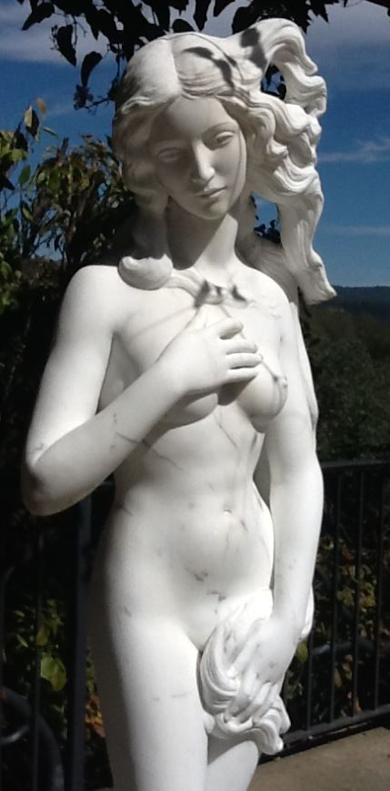
PRIMARY: Marble statue of nude woman standing on a seashell
SECONDARY: Statue made in 2005 by Lucio Carusi of Carrara, Italy, titled “Venus”, made of local marble
INTERPRETIVE: 3D transformation of 1486 painting by Italian painter Sondro Botticelli, titled “Birth of Venus,” now in the Uffizi Gallery in Florence. Carusi’s Venus is substantially slimmer in proportions because of changing notions of female beauty
(TDO Figure 4.5)
Panovsky’s 3-Level Scheme
24

Slide 25
Botticelli 1486
Carusi 2005
25

Slide 26
Getty Categories for the Description of Works of Art (CDWA)
UNIVERSITY OF CALIFORNIA, BERKELEY
SCHOOL OF INFORMATION
The CDWA is a massive metadata schema with 532 elements and sub-elements
Each element typically has a controlled vocabulary or recommends one (e.g, Art and Architecture Thesaurus)
There is a core set of 36 elements
CDWA-Lite is the XML specification for another simple subset of CDWA
26

Slide 27
CDWA’s First Question
You should have been able to guess the first question raised in the CDWA documentation
Section 1.1 of the CDWA (the top level element) is “Object/Work”
Works of art or architecture may be considered a single item, or they may be made up of many physical parts or arranged in separate physical groupings. It is necessary to define the particular work of art, architecture, or group of objects in question, whether it be a single painted canvas or an altarpiece made up of many panels…
UNIVERSITY OF CALIFORNIA, BERKELEY
SCHOOL OF INFORMATION
27

Slide 28
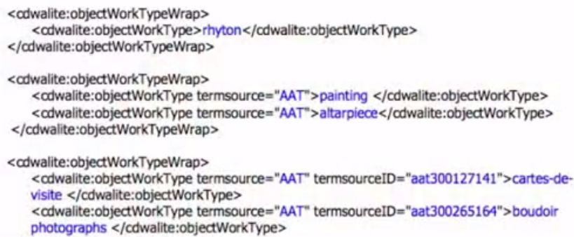
CDWA in XML - Examples
28

Slide 29
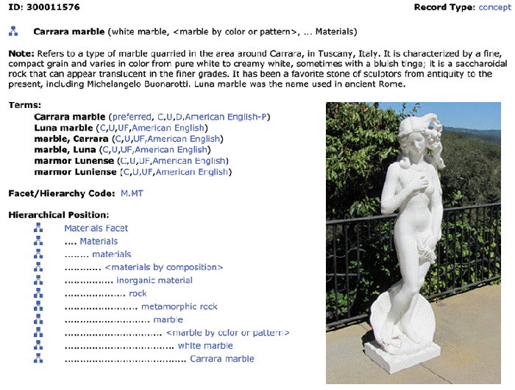
Art and Architecture Thesaurus
29

Slide 30
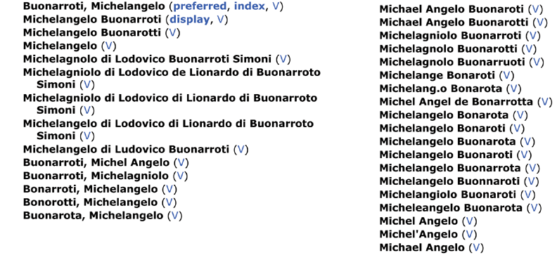
Union List of Artist Names
30

Slide 31
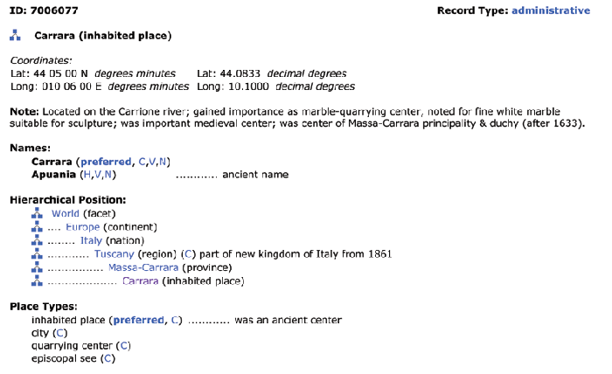
Thesaurus of Geographic Names
31

Slide 32
Metadata for Video
UNIVERSITY OF CALIFORNIA, BERKELEY
SCHOOL OF INFORMATION
Across types of video, the basics still apply
Name, network/channel or person uploading, episode, time, date, etc.
MPEG-7 standard defines the key elements
Digital broadcast TV is governed by an alphabet soup of standards (PSIP, PMCP, ATSC…)
Standards define what information about a program or a station shows up on your DVR’s channel guide
32

Slide 33
Professional Metadata-Making for Video
UNIVERSITY OF CALIFORNIA, BERKELEY
SCHOOL OF INFORMATION
When an ad pops up during a YouTube video, that’s not random
Advertisers want to be sure they (and we) can find people/characters drinking Pepsi, wearing Levi’s, etc. buy clothes worn in TV shows
NFL Films: Video loggers tag game footage with details from drop-down menus (team, date, yardage) and with keyword phrases like ‘funky fans,’ ‘torn uniform,’ ...’”
33

Slide 34
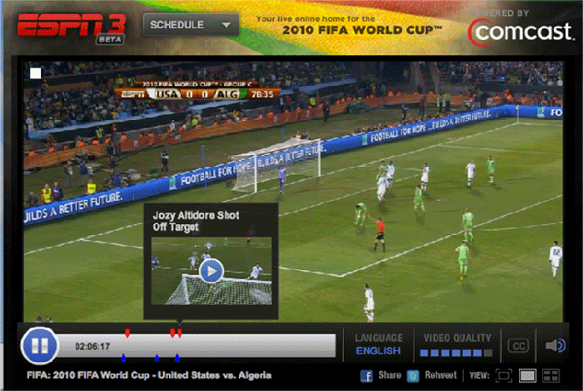
Metadata in/on Video
34

Slide 35
Comparing “Professional” Metadata with “Amateur" Metadata
UNIVERSITY OF CALIFORNIA, BERKELEY
SCHOOL OF INFORMATION
Flickr, YouTube, and other collections of multimedia works are characterized by non-standard classification schemes
There is no "professional" metadata to start with and build upon
Result 1: Unstructured tagging with little use of controlled vocabularies within each collection
Result 2: No standardization or interoperability across collections
35

Slide 36
INFO 202 “Information Organization & Retrieval” Fall 2013
UNIVERSITY OF CALIFORNIA, BERKELEY
SCHOOL OF INFORMATION
Robert J. Glushko glushko@berkeley.edu
@rjglushko
1 October 2013 Lecture 10.3 – “Computational” Metadata for Multimedia and Non-Text Resources

Slide 37
Bridging the Semantic Gap in Describing Images
UNIVERSITY OF CALIFORNIA, BERKELEY
SCHOOL OF INFORMATION
Bridging the gap means extracting features from multimedia content and finding ways to infer semantic-level descriptions from them
Some key questions: What features best support semantic inference? What inference techniques work the best? Can we exploit multi-modal or cross-modal information?
37

Slide 38
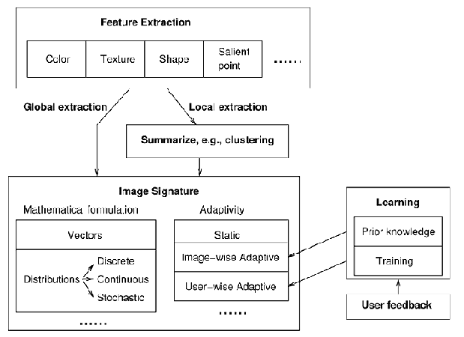
Creating an Image “Signature”
38

Slide 39
Computational Description of Images
UNIVERSITY OF CALIFORNIA, BERKELEY
SCHOOL OF INFORMATION
Shatford (as described by Christel) expanded Panovsky’s 3 levels to 10 to make finer distinctions about the amount of semantic information required (or extracted by computational means)
1. Type/technique
2. Global distribution
3. Local structure
4. Global composition
5. Generic objects
6. Generic scene
7. Specific objects
8. Specific scene
9. Abstract objects
10. Abstract scene
39

Slide 40
Query with Level 2 Description (low-level perceptual features)
Christel Figure 2.2: Example of syntactically correct matches of blue-green images to blue-green key, but with results spanning a variety of objects unlikely to be the true information targets for a user.
40

Slide 41
Video Analytics (1)
UNIVERSITY OF CALIFORNIA, BERKELEY
SCHOOL OF INFORMATION
Millions of video surveillance cameras are deployed worldwide
Most of their video feeds are not monitored by people in real time, so the cameras can't prevent crime, accidents, terrorist acts, etc. - the recordings have to be analyzed after the fact
41

Slide 42
Video Analytics (2)
UNIVERSITY OF CALIFORNIA, BERKELEY
SCHOOL OF INFORMATION
Three main R & D currents:
Detect, track, and classify events, especially "anomalous" ones
Exploit "camera networks" to combine multiple observations and perspectives to improve analysis
Improve real-time analysis, especially by exploiting application specific knowledge
“Lights, Camera, Data” story from WSJ
42

Slide 43
The Dark Side of Image Analysis
UNIVERSITY OF CALIFORNIA, BERKELEY
SCHOOL OF INFORMATION
What is the age and gender of this person?
Scene Tap uses cameras with facial detection software to scout bar scenes (http://scenetap.com/")
Facebook whacked for using face recognition sw
43

Slide 44
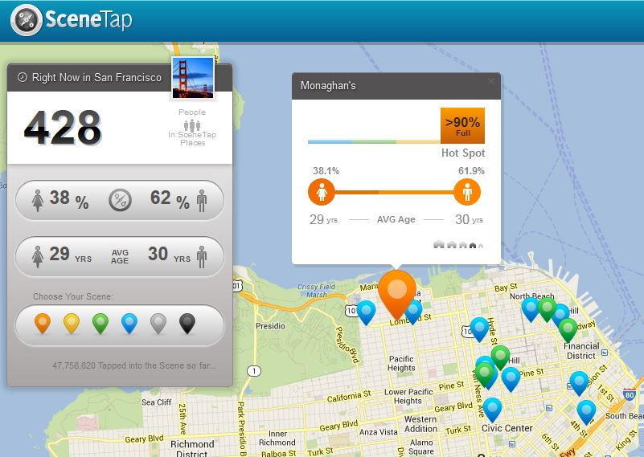
Scene Tap
See “San Francisco Hates Your Startup”
44

Slide 45
INFO 202 “Information Organization & Retrieval” Fall 2013
UNIVERSITY OF CALIFORNIA, BERKELEY
SCHOOL OF INFORMATION
Robert J. Glushko glushko@berkeley.edu
@rjglushko
1 October 2013 Lecture 10.4 – “Contextual” Metadata

Slide 46
Contextual Metadata
UNIVERSITY OF CALIFORNIA, BERKELEY
SCHOOL OF INFORMATION
Metadata about the context in which some content was "captured"
Location, time, other people or things present are basic elements, but there are many more
This kind of information has often been collected, but not usually analyzed and applied to description until afterwards
46

Slide 47
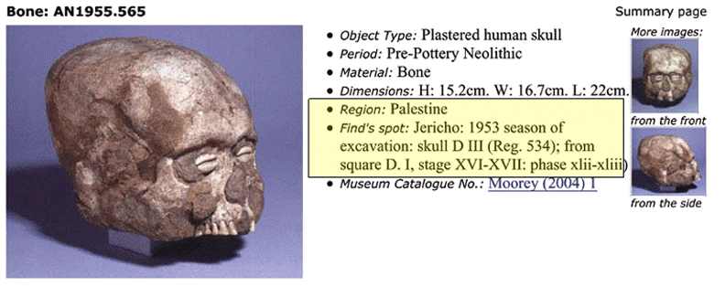
Non-Automated Contextual Metadata in Museum Catalog
47

Slide 48
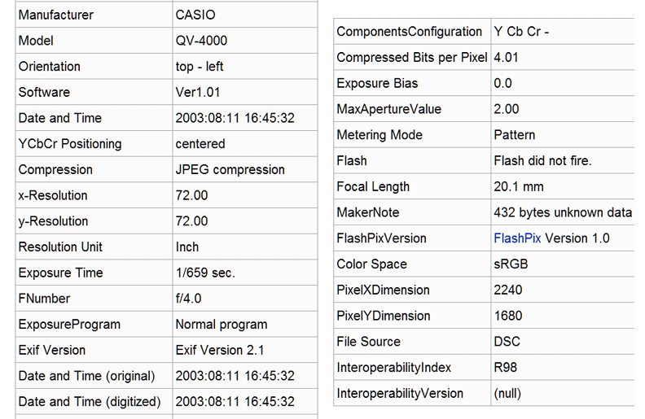
Automated Contextual Metadata in EXIF (Digital Camera)
48

Slide 49
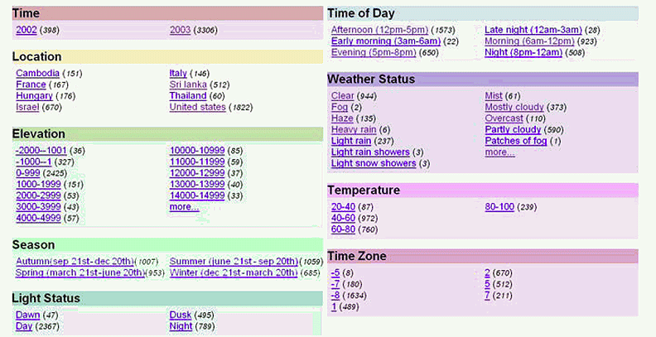
Augmenting EXIF (time) with Geo-Referenced Additional Resources
Naaman, Mor, et al. "Context data in geo-referenced digital photo collections.” 2004.
49

Slide 50
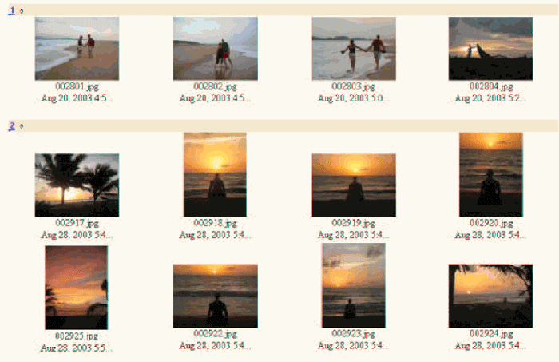
Using Contextual Metadata in Image Retrieval (Naaman et al)
50

Slide 51
INFO 202 “Information Organization & Retrieval” Fall 2013
UNIVERSITY OF CALIFORNIA, BERKELEY
SCHOOL OF INFORMATION
Ryan Baker
1 October 2013 Lecture 10.5 – Metadata for Music

Slide 52
Readings for Next Lecture
UNIVERSITY OF CALIFORNIA, BERKELEY
SCHOOL OF INFORMATION
TDO 5 through 5.4
Kent 4
Fellbaum, Chrisiane. Wordnet link.springer.com/chapter/10.1007%2F978-90-481-8847-5_10 (skip sections 10.12-10.15)
52

