Slide 1

Plan for Today’s Lecture(s)
UNIVERSITY OF CALIFORNIA, BERKELEY
SCHOOL OF INFORMATION
The Dublin Core
Metacrap
Tagging
Authority Control / Duplicate Detection
1

Slide 2
INFO 202
“Information Organization & Retrieval”
Fall 2013
UNIVERSITY OF CALIFORNIA, BERKELEY
SCHOOL OF INFORMATION
Robert J. Glushko
glushko@berkeley.edu
@rjglushko
26 September 2013
Lecture 9.1 – The Dublin Core

Slide 3
Dublin Core: Motivation
UNIVERSITY OF CALIFORNIA, BERKELEY
SCHOOL OF INFORMATION
When the web was just a few years old, professional “metadata-makers” were already concerned that web resources would be difficult to discover and identify because they lacked good descriptions
An international, cross-disciplinary group of professionals from librarianship, computer science, text encoding, the museum community, and other related fields convened in 1995 to propose a standard set of metadata elements for web pages
3

Slide 4
Dublin Core: Goals
UNIVERSITY OF CALIFORNIA, BERKELEY
SCHOOL OF INFORMATION
Simplicity: Must be usable by web page authors, because web scale defies description by professional metadata-makers
Broad semantics: Description elements must not require precise semantic distinctions that not everyone could or would want to make
Extensibility: Must be easy to extend when more precise semantic descriptions are needed
International: Element names need equivalents in all the languages used in web pages
4

Slide 5
Dublin Core
UNIVERSITY OF CALIFORNIA, BERKELEY
SCHOOL OF INFORMATION
Named after the place where it was created (but not where you think)
Widely used as the basis for more specialized models (because it is the “core” of all of them)
  See http://dublincore.org/documents/profile-guidelines/
  Example: PBCORE (used by PopUpArchive)
There are specifications of how to use it in numerous syntaxes (especially XML and RDF) and languages
5

Slide 6
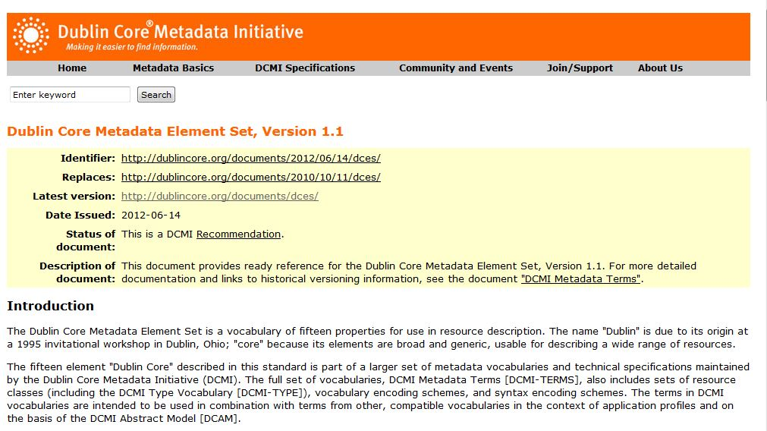
The Dublin Core

Slide 7
More than a Controlled Vocabulary
UNIVERSITY OF CALIFORNIA, BERKELEY
SCHOOL OF INFORMATION
A controlled vocabulary is a standardized set of terms (such as subject headings, names, classifications, etc.) assigned by organizers / cataloguers / indexers of resources
A metadata schema like the Dublin Core controls the kinds of assertions about resources that you can make in the first place
Controlled vocabularies can be very useful requirements or recommendations about the values that are contained in the assertions (the information content of the assertion)
7

Slide 8
Dublin Core: The Elements
UNIVERSITY OF CALIFORNIA, BERKELEY
SCHOOL OF INFORMATION
TITLE -- a name given to the resource
IDENTIFIER -- an unambiguous reference to the resource within a given context
SUBJECT -- the topic of the resource; key words or classification phrases
CREATOR -- an entity primarily responsible for making the resource
8

Slide 9
Dublin Core: The Elements
UNIVERSITY OF CALIFORNIA, BERKELEY
SCHOOL OF INFORMATION
CONTRIBUTOR -- An entity responsible for making contributions to the resource
PUBLISHER -- the entity primarily responsible for making the resource available
DATE -- a point or period of time associated with an event in the life cycle of the resource
FORMAT -- the file format, physical medium, or dimensions of the resource.
9

Slide 10
Dublin Core: The Elements
UNIVERSITY OF CALIFORNIA, BERKELEY
SCHOOL OF INFORMATION
DESCRIPTION -- an account of the resource; abstract, TOC, etc.
LANGUAGE -- a language of the resource
TYPE -- the nature or genre of the content of the resource
RIGHTS -- information about rights held in and over the resource
10

Slide 11
Dublin Core: The Elements
UNIVERSITY OF CALIFORNIA, BERKELEY
SCHOOL OF INFORMATION
SOURCE – a related resource from which the described resource is derived
RELATION -- a related resource
COVERAGE -- the spatial or temporal topic of the resource, relevant jurisdiction
11

Slide 12
Dublin Core “Content Model” is Unrestrictive
UNIVERSITY OF CALIFORNIA, BERKELEY
SCHOOL OF INFORMATION
All elements are optional
All elements are repeatable
Elements can be in any order
The model for each element has gotten more general over time… e.g., used to say “content of a resource”… where it now says “resource”
12

Slide 13
Hypothetical Metadata Description for 202 Course Home Page
<meta name=“author” content=“Robert J. Glushko”>
<meta name=“title” content=“I202 Information Organization and Retrieval”>
<meta name=“webmaster” content=“Fred Chasen”>
<meta name=“publisher” content=“UC Berkeley School of Information”>
<meta name=“date” content=“Fall 2013”>
13

Slide 14
“DublinCore-ized” Hypothetical Example for 202 Course Home Page
<meta name=“DC.creator” content=“Robert J. Glushko”>
<meta name=“DC.title” content=“I202 Information Organization and Retrieval”>
<meta name=“DC.contributor” content=“Fred Chasen”>
<meta name=“DC.publisher” content=“UC Berkeley School of Information”>
<meta name=“DC.date” content=“Fall 2013”>
14

Slide 15
Dublin Core in XML
UNIVERSITY OF CALIFORNIA, BERKELEY
SCHOOL OF INFORMATION
We can define the DC as an XML schema
This allows DC statements to be embedded in any XML document using a DC namespace
15

Slide 16
Dublin Core in XML as Separate Record
<?xml version=“1.0”?>
<metadata xmlns:dc=http://purl.org/dc/elements/1.1/>
<dc:creator>Robert J. Glushko</dc:creator>
<dc:title>I202 Information Organization and Retrieval </dc:title>
<dc:contributor>Fred Chasen</dc:contributor>
<dc:publisher>UC Berkeley School of Information</dc:publisher>
<dc:date>Fall 2013</dc:date>
</metadata>
16

Slide 17
Using the Dublin Core –
Pragmatics and Problems
UNIVERSITY OF CALIFORNIA, BERKELEY
SCHOOL OF INFORMATION
Some information may appear to belong in more than one metadata element“
There is potential semantic overlap between some elements
There will occasionally be some judgment required from the person assigning the metadata
17

Slide 18
INFO 202
“Information Organization & Retrieval”
Fall 2013
UNIVERSITY OF CALIFORNIA, BERKELEY
SCHOOL OF INFORMATION
Robert J. Glushko
glushko@berkeley.edu
@rjglushko
26 September 2013
Lecture 9.2– Metacrap

Slide 19
Cory Doctorow
UNIVERSITY OF CALIFORNIA, BERKELEY
SCHOOL OF INFORMATION
Cory Efram Doctorow (born July 17, 1971) is a Canadian-British blogger, journalist, and science fiction author who serves as co-editor of the weblog Boing Boing.
He is an activist in favour of liberalising copyright laws and a proponent of the Creative Commons organization, using some of their licenses for his books.
(from Wikipedia)
19

Slide 20
Metacrap
UNIVERSITY OF CALIFORNIA, BERKELEY
SCHOOL OF INFORMATION
"A world of exhaustive, reliable metadata would be a utopia. It's also a pipe-dream, founded on self-delusion, nerd hubris and hysterically inflated market opportunities”
People lie, are lazy, stupid, deluded, biased…
The vocabulary problem…
What is Doctorow's recommendation?
20

Slide 21
The HTML META Tag
UNIVERSITY OF CALIFORNIA, BERKELEY
SCHOOL OF INFORMATION
In 1994 (very early in Web history) a Computer Science graduate student proposed that HTML be revised to include a META tag
  "The META element can be used within the HEAD element to embed document metainformation not defined by other HTML elements. Such information can be extracted by servers/clients for use in identifying, indexing, and cataloging specialized document metainformation”
  (http://lists.w3.org/Archives/Public/www-html/1994Jun/0041.html)
21

Slide 22
What the W3C Imagined
UNIVERSITY OF CALIFORNIA, BERKELEY
SCHOOL OF INFORMATION
<META NAME="DESCRIPTION" CONTENT="accurate prose description">
<META NAME="KEYWORDS" CONTENT="useful comma-separated keywords">
22

Slide 23
INFO 202
“Information Organization & Retrieval”
Fall 2013
UNIVERSITY OF CALIFORNIA, BERKELEY
SCHOOL OF INFORMATION
Robert J. Glushko
glushko@berkeley.edu
@rjglushko
26 September 2013
Lecture 9.3 – Resource Tagging

Slide 24
Social Tagging - Overview
UNIVERSITY OF CALIFORNIA, BERKELEY
SCHOOL OF INFORMATION
Trant’s definition: “Publicly labeling or categorizing resources in a shared online environment”
The aggregated results of individual tags have been described as: collaborative, cooperative, distributed, dynamic, community-based, folksonomic, wikified, ethnoclassification, democratic, user-assigned, or user-generated
  Tag sharing (or visibility) creates additional value through network effects
24

Slide 25
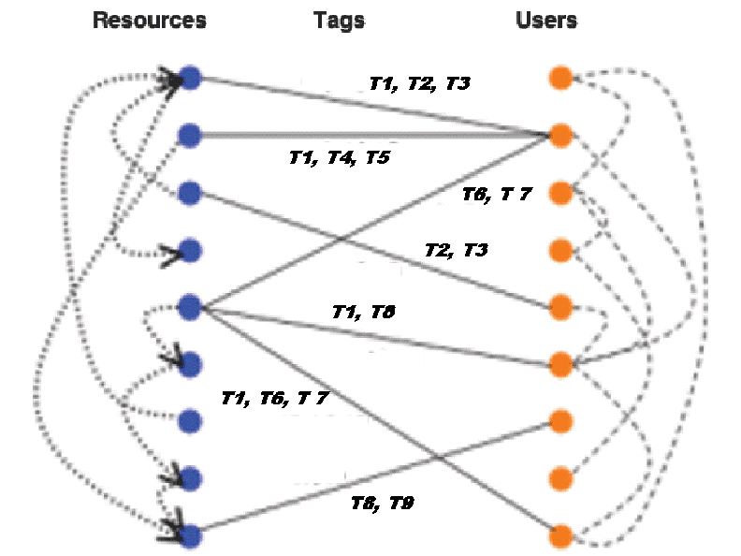
The Conceptual Model of Social Tagging
UNIVERSITY OF CALIFORNIA, BERKELEY
SCHOOL OF INFORMATION
25

Slide 26
Design Dimensions for Tagging Systems
UNIVERSITY OF CALIFORNIA, BERKELEY
SCHOOL OF INFORMATION
What can be tagged? (anything, photos, web resources, bibliographic resources…)
Tagging lexicography? (whitespace delimited string, phrases, normalization)
Who can tag? (self, permitted people, anyone)
Tagging support? (none, suggested, previous tags visible)
Aggregation model? (none, “bag”, labeled set)
26

Slide 27
Types of Tags
UNIVERSITY OF CALIFORNIA, BERKELEY
SCHOOL OF INFORMATION
Subject /Taxonomic or Keyword Tags (most common, but rarely from a controlled vocabulary)
Property or Attribute Tags ("red," "expensive“)
"Purpose" Tags (e.g, "toread" or "buythis" or "tagthis“)
Evaluative Tags ("interesting," "good)
27

Slide 28
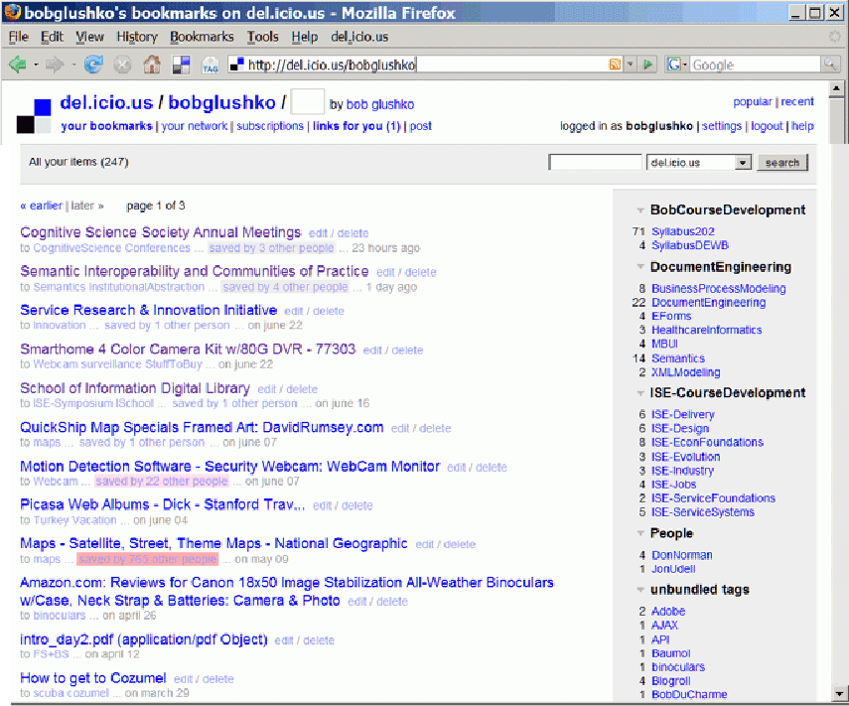
Delicious (2005)

Slide 29
Tagging Functionality / UIs for Tagging
UNIVERSITY OF CALIFORNIA, BERKELEY
SCHOOL OF INFORMATION
Context is recorded automatically
Share/Don't Share (or Private/Public): enable both personal organization and group organization
Tag suggestion (tagging precedents)
Tag organization into groups or categories
Batch uploading and tagging
Tag Visualization ("tag clouds")
29

Slide 30
Tag Quality / Correctness?
UNIVERSITY OF CALIFORNIA, BERKELEY
SCHOOL OF INFORMATION
When I first signed up for the popular bookmarking/tagging site “delicious” the instructions said:
  Tagging is intuitive
  A tag can be anything you want
  There are no wrong tags
30

Slide 31
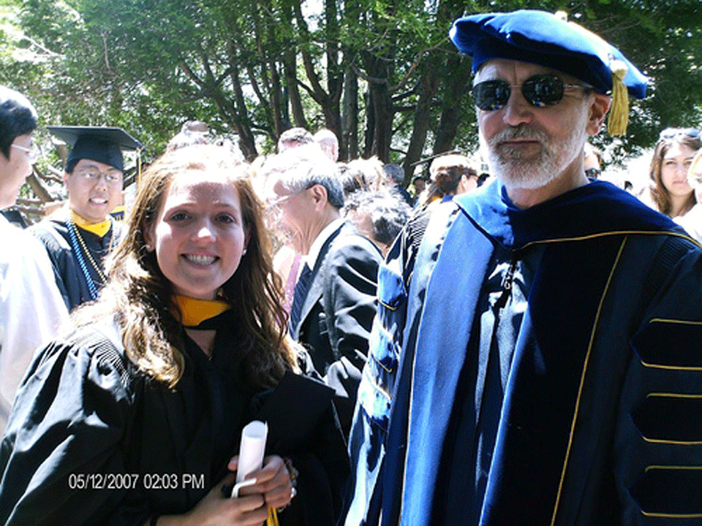
Tag Me “Stanford” “Hillary” “Obama”
UNIVERSITY OF CALIFORNIA, BERKELEY
SCHOOL OF INFORMATION
31

Slide 32
“Tag Soup”
UNIVERSITY OF CALIFORNIA, BERKELEY
SCHOOL OF INFORMATION
Users are free to assign any number of labels or tags they choose
No vocabulary control
No text processing to handle derivational and morphological variants
32

Slide 33
Responses to Tag Soup
UNIVERSITY OF CALIFORNIA, BERKELEY
SCHOOL OF INFORMATION
Some people consider the unstructured, uncontrolled nature of "tag soup" to be its great strength
Others adopt personal conventions to encode hierarchical and derivational relationships
Using multiple accounts for the same application for different purposes
“Tag bundles" to enable more hierarchy
33

Slide 34
Geotagging and Taxonomic Tagging
UNIVERSITY OF CALIFORNIA, BERKELEY
SCHOOL OF INFORMATION
Most tags don't come from controlled vocabularies, but geotagging and biological tagging are the exceptions that prove the rule
Map interfaces in flickr and google earth can be used for geotagging but any GPS will do - by convention 3 tags are used:
    geotagged
    geo:lat=latitude e.g. geo:lat=51.4989
    geo:lon=longitude e.g. geo:lon=-0.1786
34

Slide 35
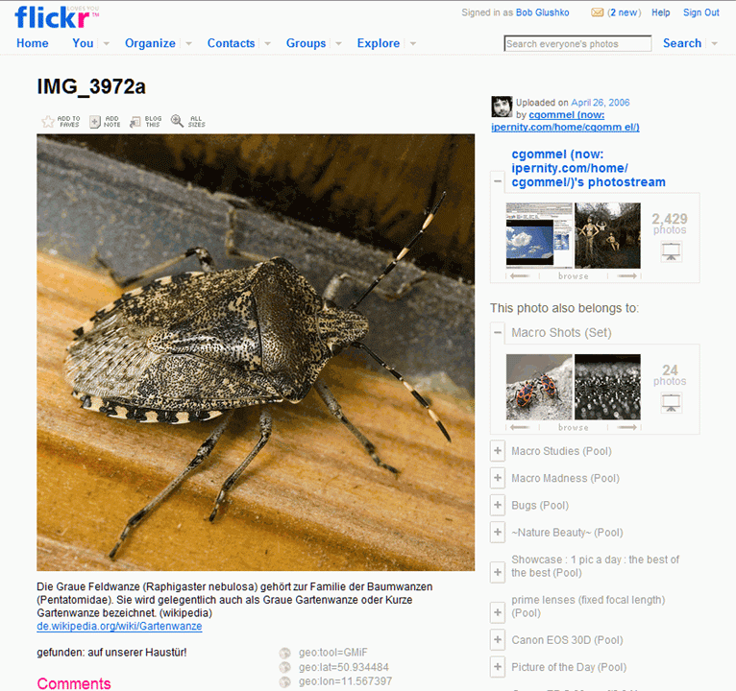
Combined Geo and
Bio Tagging

Slide 36
Tag Convergence
UNIVERSITY OF CALIFORNIA, BERKELEY
SCHOOL OF INFORMATION
Some systems (like del.icio.us) don't allow users to see the tags assigned by other users when they are tagging a resource
But once a user tags a resource, most systems reveal the tags applied by other users
If your tag(s) don't match, do you?
    Change your tag to adapt to the group norm
    Keep your tag to influence the group norm
    Add the group tag but keep yours as well
36

Slide 37
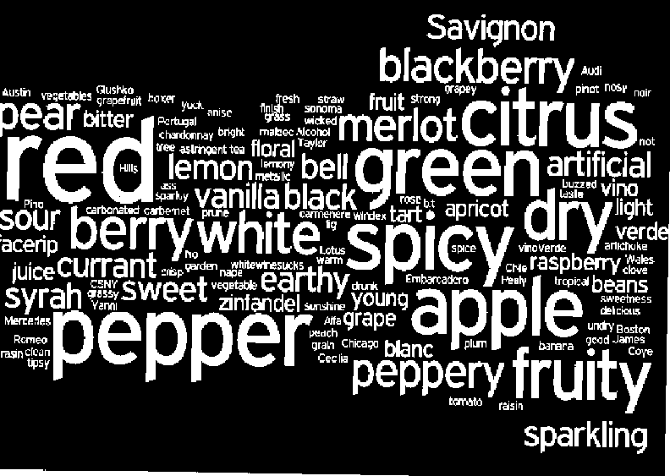
Tag Clouds

Slide 38
INFO 202
“Information Organization & Retrieval”
Fall 2013
UNIVERSITY OF CALIFORNIA, BERKELEY
SCHOOL OF INFORMATION
Robert J. Glushko
glushko@berkeley.edu
@rjglushko
26 September 2013
Lecture 9.4 – Authority Control
and Duplicate Detection

Slide 39
Variant Forms of Names
UNIVERSITY OF CALIFORNIA, BERKELEY
SCHOOL OF INFORMATION
A generic problem in resource description is dealing with variant name forms
  Same person (or resource) uses or is given different names
  Different people (or resources) use the same name
39

Slide 40
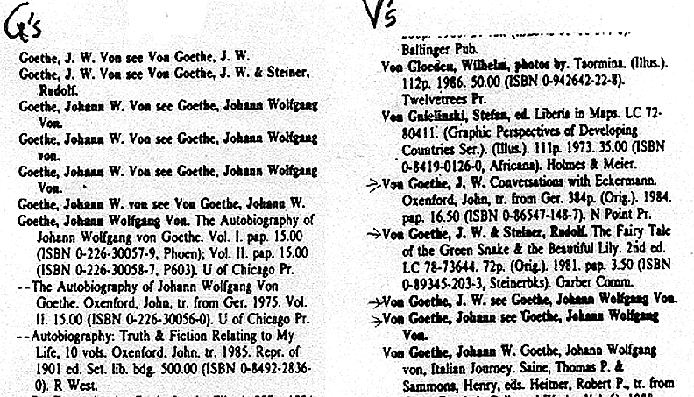
Different Forms of “Same” Author Name
40

Slide 41
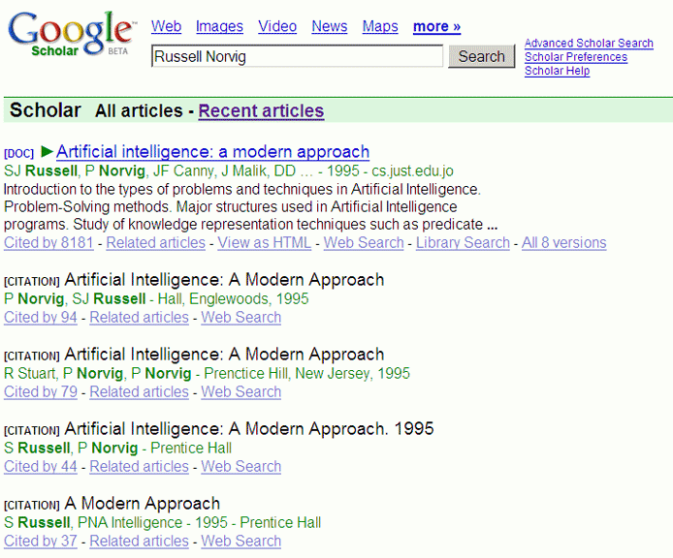
“Dirty” Citations for the Same Book
41

Slide 42
Different Forms of Institutional Name
42

Slide 43
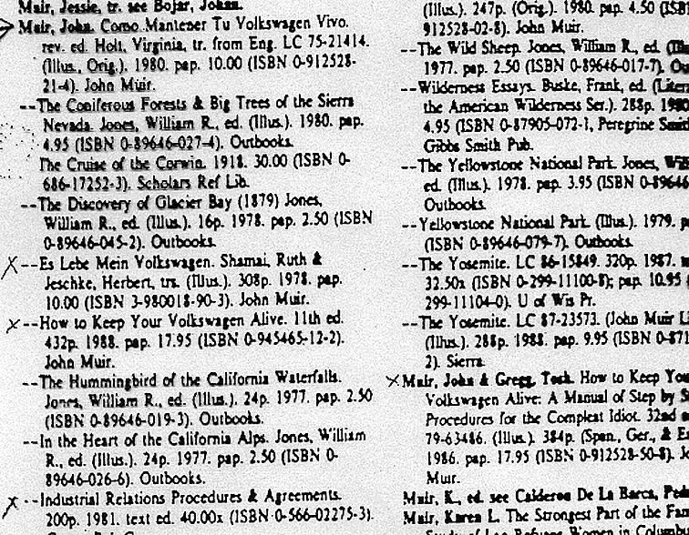
Same Name for Different Authors
43

Slide 44
Questions about Names
UNIVERSITY OF CALIFORNIA, BERKELEY
SCHOOL OF INFORMATION
How many names should be associated with a information object or resource?
Should one be designated as the preferred or authoritative form?
What references should be made from other possible forms of names that haven't been used?
44

Slide 45
Authority Control
UNIVERSITY OF CALIFORNIA, BERKELEY
SCHOOL OF INFORMATION
Authority control is concerned with creation and maintenance of a set of terms that have been chosen as the standard representatives for some resource based on some set of rules
The Library of Congress maintains an "authority file" (in MARC format) for the names of persons, corporate entities, geographic names of political entities, and titles of works
See http://www.loc.gov/marc/uma/ and http://authorities.loc.gov/
45

Slide 46
Normative Forms of Names
UNIVERSITY OF CALIFORNIA, BERKELEY
SCHOOL OF INFORMATION
When names appear in multiple forms, one form needs to be chosen; criteria include:
  Fullness (e.g., full names vs. initials only)
  Language of the name
  Spelling (choose predominant form)
  Entry element
    "Smith, John" not "John Smith"
    "Mao Zedong" or "Zedong, Mao" or "Mao Tse Tung" or ?
46

Slide 47
Naming Problems for Places
UNIVERSITY OF CALIFORNIA, BERKELEY
SCHOOL OF INFORMATION
Variant forms: St. Petersburg, Санкт Пербургскйй, Saint-Pétersbourg
Multiple names: Cluj, in Romania / Roumania / Rumania, is also called Klausenburg and Kolozsvar
Name changes: Bombay -> Mumbai.
Homographs:Vienna, VA, and Vienna, Austria; 50 Springfields
Anachronisms: No Germany before 1870
Vague, e.g. Midwest, Silicon Valley
Unstable boundaries: 19th century Poland; Balkans; USSR
47

Slide 48
Authoritative Place Names
UNIVERSITY OF CALIFORNIA, BERKELEY
SCHOOL OF INFORMATION
Places have latitude and longitude coordinates, so we can link places and spaces with a GAZETTEER
A gazetteer is a place name authority file that:
    Indicates what kinds of place: "Feature type"
    Objectively specifies latitude and longitude
    Disambiguates similar place names
    Brings variant names together
    Allows places to be displayed on maps
48

Slide 49
Code Sets
UNIVERSITY OF CALIFORNIA, BERKELEY
SCHOOL OF INFORMATION
Code sets are constrained sets of values that are often completely arbitrary but they are unambiguous and authoritative names
The ISO code sets for countries (3166), currencies (4217), quantities and units of measure (31) are very commonly used
Most organizations have internal code sets or business rules that implicitly define them
49

Slide 50
The Name Matching Problem
UNIVERSITY OF CALIFORNIA, BERKELEY
SCHOOL OF INFORMATION
Name matching" is the task of determining when two different strings denote the same person, object, or other named entity
It is ironic that this problem has many other names:
  Object consolidation
  Merge-purge
  Householding
  Fuzzy/approximate matching
  Co-reference resolution
  Duplicate detection
  Record linkage
50

Slide 51
Duplicate Detection vs. Exact Copies
51

Slide 52
Domains For The Name Matching Problem
UNIVERSITY OF CALIFORNIA, BERKELEY
SCHOOL OF INFORMATION
Customer relationship management
Direct mail
Law enforcement / counter-terrrorism
Demography / population statistics (e.g. census)
Computational biology
Data mining, signal processing, and image compression tasks in numerous application areas
52

Slide 53
Causes of Duplicate Names /
Why Name Matching is Hard
UNIVERSITY OF CALIFORNIA, BERKELEY
SCHOOL OF INFORMATION
Different data capture formats
Poor or mis-spellings (original, transcription, OCR, “autocorrection”)
Phonological -> orthographic alternatives (multiple ways to spell the same sound… which might not have been heard correctly)
Language transliteration ("Peking" or "Beijing")
Nicknames and variant forms
53

Slide 54
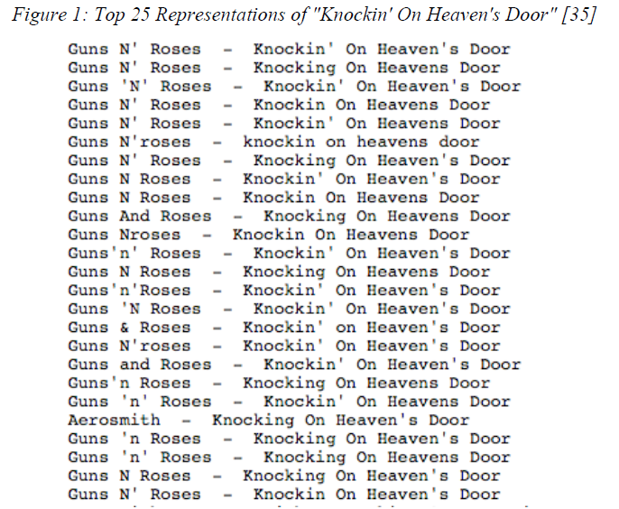
Naming the Same Song?
54

Slide 55
Causes of Duplicate Names /
Why Name Matching is Hard
UNIVERSITY OF CALIFORNIA, BERKELEY
SCHOOL OF INFORMATION
Name changes for people (http://www.famousnamechanges.net/)
Name changes for countries (http://www.nationsonline.org/oneworld/hist_country_names.htm)
(effectivity of names)
55

Slide 56
Causes of Duplicate Names /
Why Name Matching is Hard
UNIVERSITY OF CALIFORNIA, BERKELEY
SCHOOL OF INFORMATION
Name permutations and omissions (complex rules for language and culture apply http://en.wikipedia.org/wiki/Family_name
Definite descriptions and metonymy
56

Slide 57
Generic Approach to Name Matching
57

Slide 58
Computing Similarity between Names
UNIVERSITY OF CALIFORNIA, BERKELEY
SCHOOL OF INFORMATION
Measures of orthographic similarity
    "Edit distance" - how many insertions, deletions, or substitutions to turn one string into another
    Can be weighted using likelihood or word order considerations
Measuring pronunciation similarity
    "Hash" the names into phonetic encodings with fewer characters than original
    "Soundex" function is very commonly used http://www.searchforancestors.com/soundex.html
58

Slide 59
Operation Clean Data
UNIVERSITY OF CALIFORNIA, BERKELEY
SCHOOL OF INFORMATION
What were the symptoms or implications of "dirty" data in the British army's supply chains?
What were the primary causes of this "dirty" data?
Which data items were the focus of the data cleanup effort? Why?
What technologies or tools were used in the data cleanup effort?
59

Slide 60
Data Quality
UNIVERSITY OF CALIFORNIA, BERKELEY
SCHOOL OF INFORMATION
Data quality problems can have any combination of technological causes, process causes, or managerial causes
Does data have to be perfectly clean? Can it ever be?
How can your own actions contribute to data quality problems or to their resolution?
60

Slide 61
Principles and Processes for
Quality Information
UNIVERSITY OF CALIFORNIA, BERKELEY
SCHOOL OF INFORMATION
Prioritize the data items
Involve the data owners
  Find the data owners and the "headwaters“
  Validate at the time of capture or creation
  Set realistic goals for data quality
61

Slide 62
Readings for Next Lecture
UNIVERSITY OF CALIFORNIA, BERKELEY
SCHOOL OF INFORMATION
TDO 4.4
Harpring, Patricia. “The language of images: enhancing access to images by applying metadata schemas and structured vocabularies.”
Bailer, Werner et al., Multimedia Semantics: Use Case Scenarios.
Christel, Michael. Automated Metadata in Multimedia Information Systems, Chapter 2
62

