Slide 1

Plan for Today’s Lecture(s)
UNIVERSITY OF CALIFORNIA, BERKELEY
SCHOOL OF INFORMATION
Resources and Resource Identity over time
Intro to Resource Description
Resource Properties and Description
Creating Resource Descriptions
1

Slide 2
INFO 202
“Information Organization & Retrieval”
Fall 2013
UNIVERSITY OF CALIFORNIA, BERKELEY
SCHOOL OF INFORMATION
Robert J. Glushko
glushko@berkeley.edu
@rjglushko
19 September 2013
Lecture 6.4 – Resources and Resource Identity Over Time

Slide 3
Resources and Identity Over Time
UNIVERSITY OF CALIFORNIA, BERKELEY
SCHOOL OF INFORMATION
Organizing systems continually need to adapt and evolve in response to changes in content and context
Resources are created or added, and other ones are destroyed or culled
Resources might change in controlled ways or in uncontrolled ways
The organizing system might need automated or formal mechanisms for ensuring persistence and authenticity
3

Slide 4

Persistence
When you don’t want persistence:
“Reputation Management” “Mugshot Cleaner”
4

Slide 5

Authenticity
Buy the photo at Ustar.net , but consider http://www.fineartstitle.com
5

Slide 6
Authenticity in a Digital Environment – 1
UNIVERSITY OF CALIFORNIA, BERKELEY
SCHOOL OF INFORMATION
We often use judgments about the physical integrity of recorded information to stand in for a judgment about the integrity of the text
Digital resources have no independent physical manifestations or indications of usage that can provide evidence "about their fate in the world”
6

Slide 7
Authenticity in a Digital Environment – 2
UNIVERSITY OF CALIFORNIA, BERKELEY
SCHOOL OF INFORMATION
The "permeability" of digital environments makes it harder to ensure that resources have not been altered
Scholars trust technological solutions like time stamps. encryption, watermarks, and digital signatures; technologists are skeptical of them
In the digital world selecting for preservation has become a process of constant re-selection
7

Slide 8

Provenance
8

Slide 9
Effectivity
UNIVERSITY OF CALIFORNIA, BERKELEY
SCHOOL OF INFORMATION
Sec. 108. This title shall take effect on the first day of the sixth month which begins after the date of the enactment of this title, except that the amendments regarding sections 19(b)(7) and 19(b)(8)(D) of the Federal Reserve Act shall take effect on the date of enactment of this title.
http://www.fdic.gov/regulations/laws/rules/8000-2200.html
9

Slide 10
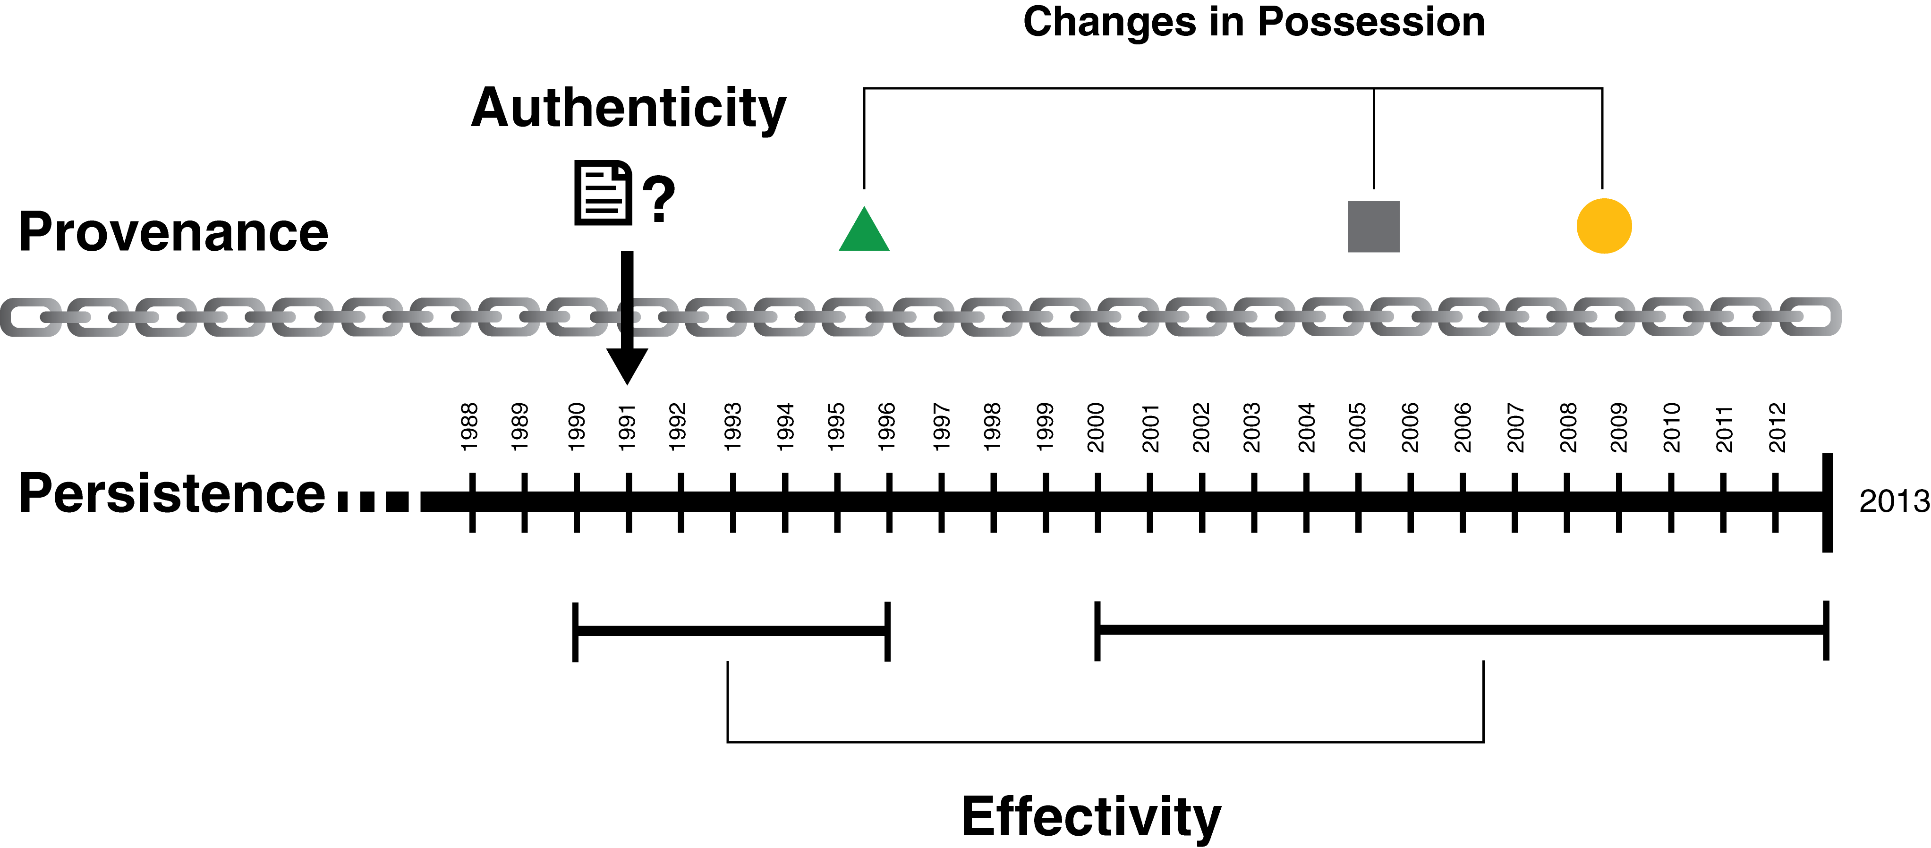
Putting it all Together (TDO Figure 3.6)
10

Slide 11
INFO 202
“Information Organization & Retrieval”
Fall 2013
UNIVERSITY OF CALIFORNIA, BERKELEY
SCHOOL OF INFORMATION
Robert J. Glushko
glushko@berkeley.edu
@rjglushko
19 September 2013
Lecture 7.1 – Introduction to
Resource Description

Slide 12
An Overview of Resource Description
UNIVERSITY OF CALIFORNIA, BERKELEY
SCHOOL OF INFORMATION
What is a resource description?
Why do we describe resources?
What resource properties should be described?
How are resource descriptions created?
What makes a good resource description?
12

Slide 13
What is a Resource Description?
UNIVERSITY OF CALIFORNIA, BERKELEY
SCHOOL OF INFORMATION
Information that is created intentionally and associated with a resource to enable it to be organized and interacted with
A resource description is also a resource from the perspective of any other resource that uses it, ad infinitum (which is why Resource Focus is an important issue)
A resource description is often a functional substitute for the resource it describes when the latter can’t be accessed or used
13

Slide 14
What is a Resource Description?
UNIVERSITY OF CALIFORNIA, BERKELEY
SCHOOL OF INFORMATION
Coyle cautions us:
    Resource descriptions developed on theoretical, religious, or philosophical principles may be intellectually pleasing, but are unlikely to get the job done
14

Slide 15
Why We Describe Resources
UNIVERSITY OF CALIFORNIA, BERKELEY
SCHOOL OF INFORMATION
We describe resources so we can refer to them, organize them, and interact with them
Each purpose might require different descriptions and different methods of using them
Different resource domains can have characteristic or standard resource descriptions (or description categories)
15

Slide 16
Why We Describe Resources
UNIVERSITY OF CALIFORNIA, BERKELEY
SCHOOL OF INFORMATION
But different types of resources must also have differentiating properties, otherwise there would be no reason to distinguish them as different types
We often combine descriptions... and we often compare them
But over time as a collection of resources grows and as requirements for interactions change, the reasons for describing resources will also change
16

Slide 17
Purposes and Description
UNIVERSITY OF CALIFORNIA, BERKELEY
SCHOOL OF INFORMATION
Selection: Descriptions enable discovery, assessment of fit to requirements, authentication, appraisal
Organizing: Tangible or perceivable properties for physical resources, "aboutness" for digital ones
Interaction Design: Organizing is the prerequisite for this purpose, which has been highlighted in LIS since 19th century
Maintenance: "Preservation Metadata" often emphasizes technological requirements to use resources
17

Slide 18
Objectives of Bibliographic Description
UNIVERSITY OF CALIFORNIA, BERKELEY
SCHOOL OF INFORMATION
Finding a resource that you know exists
Identifying a resource to make sure you have the one you were looking for
Selecting a resource from a set of candidates in a collection
Obtaining the resource if what you have at this point is just a resource description
18

Slide 19
Objectives of Bibliographic Description
UNIVERSITY OF CALIFORNIA, BERKELEY
SCHOOL OF INFORMATION
These four purposes and the information components needed in resource descriptions for satisfying them are systematized in LIS as the Functional Requirements for Bibliographic Records (FRBR)
…but the ideas apply more broadly to organizing systems: Tesco smartphone subway shopping in Korea
19

Slide 20
Complications
UNIVERSITY OF CALIFORNIA, BERKELEY
SCHOOL OF INFORMATION
The properties of resources that are easiest to describe are not always the most useful ones, especially for information resources
For non-text information resources this problem is magnified because the content is often in a semantically opaque format that cannot usefully be analyzed by people.
Business strategy and economics strongly influence the extent of resource description
But as bibliographic collections grow larger, we need more descriptions to satify the “frbr”
20

Slide 21
Process of Describing Resources
UNIVERSITY OF CALIFORNIA, BERKELEY
SCHOOL OF INFORMATION
Identify / scope the resources to be described
Determine the purposes or uses of the descriptions
Study the resource(s) to identify descriptive properties
Design the description vocabulary
Design the description form and implementation
Create the descriptions (either "by hand" or by some automated / computational process
Evaluate the descriptions
(TDO FIGURE 4-3)
21

Slide 22
Scoping and Description
UNIVERSITY OF CALIFORNIA, BERKELEY
SCHOOL OF INFORMATION
How explicit and thorough these 7 steps need to be depends on what we are calling "scope“
Do we know who the users are? Are the describers the users?
Do we have all the resources, a representative set, or just the first set ... do we know what else is coming?
22

Slide 23
Scoping and Description
UNIVERSITY OF CALIFORNIA, BERKELEY
SCHOOL OF INFORMATION
Sometimes we describe resource instances; sometimes we just describe the collection they are in
As a collection grows, the language for describing resources must become more rigorous, and descriptions created when the collection was small often require revision because they are no longer adequate for their intended purposes
23

Slide 24
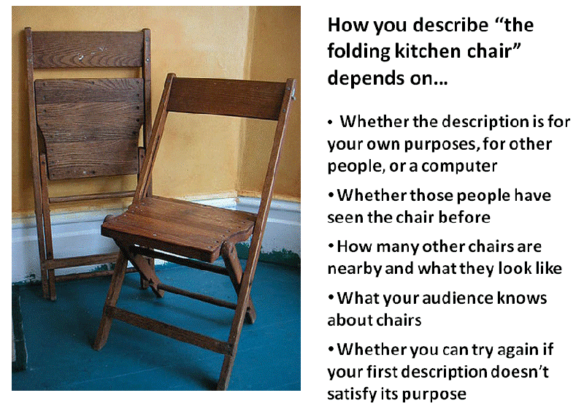
Kimra’ Kitchen Chair

Slide 25
INFO 202
“Information Organization & Retrieval”
Fall 2013
UNIVERSITY OF CALIFORNIA, BERKELEY
SCHOOL OF INFORMATION
Robert J. Glushko
glushko@berkeley.edu
@rjglushko
19 September 2013
Lecture 7.2 – Resource Properties
and Description

Slide 26
Classifying Resource Properties

Slide 27
Intrinsic Properties
UNIVERSITY OF CALIFORNIA, BERKELEY
SCHOOL OF INFORMATION
Intrinsic properties are inherent in a resource
Some are static, never changing their values
Others are dynamic, but they change “from the inside of the resource” not “from the outside” by actions or efforts of outside agents (like “developmental” properties – age, skill, experience)
Intrinsic properties can sometimes be used as an identifier - like a computed "signature" for a document or media object
27

Slide 28
Physical Properties
UNIVERSITY OF CALIFORNIA, BERKELEY
SCHOOL OF INFORMATION
Physical or perceptible properties are those "at the surface" that are immediately apparent
For "natural" things, these physical properties often make excellent descriptors because they intrinsic or inherent rather than assigned
They occur in consistent, predictable, and correlated combinations, which makes them reliable aids to identifying instances or types of things (the “joints of nature”
28

Slide 29

Distinctive Physical Properties
UNIVERSITY OF CALIFORNIA, BERKELEY
SCHOOL OF INFORMATION
29

Slide 30
Physical Properties
UNIVERSITY OF CALIFORNIA, BERKELEY
SCHOOL OF INFORMATION
For "manmade" things surface properties are less predictable ("innovation" enables the separation of form and function)
For "information" things in physical form the correlation between appearance and content varies across the Document Type Spectrum
For "born digital" resources the appearance is often extrinsic because it is assigned or associated (a style sheet, for example) instead of being an inherent part of the resource when it was created
30

Slide 31
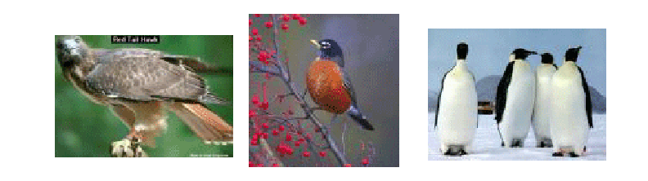
Which Properties Best Identify a Thing?
A Type of Thing?
UNIVERSITY OF CALIFORNIA, BERKELEY
SCHOOL OF INFORMATION
The properties best for identifying an instance might be those that aren't typical of its class
31

Slide 32
Extrinsic Properties
UNIVERSITY OF CALIFORNIA, BERKELEY
SCHOOL OF INFORMATION
Extrinsic properties are assigned to a resource rather than being inherent in it
Some extrinsic properties are static: assigned names or identifiers don’t usually change
Other extrinsic properties change often: the current location, popularity, price, etc. of a resource)
32

Slide 33
Cultural Properties
UNIVERSITY OF CALIFORNIA, BERKELEY
SCHOOL OF INFORMATION
Cultural properties are those that derive from conventional language use or culture and often involve analogy
Because they derive from knowledge of culture or language, they might be unintelligible to people who don't have the same perspective and experience
.. and they might lose their cultural salience
33

Slide 34
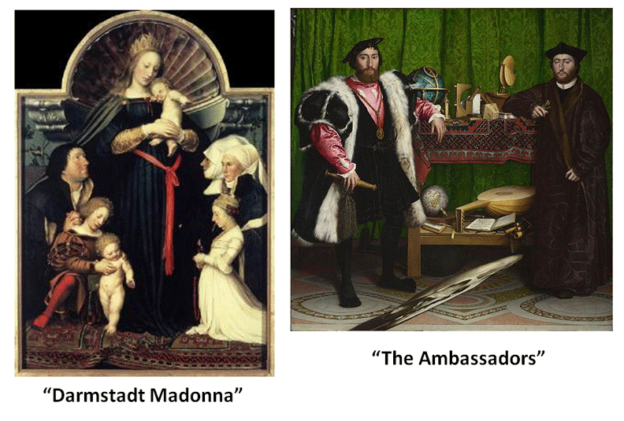
“Holbein” Carpets
More about Holbein and Henry VIII

Slide 35
Contextual Properties
UNIVERSITY OF CALIFORNIA, BERKELEY
SCHOOL OF INFORMATION
Contextual properties relate to the situation or context in which the thing being described exists
Dey et al (2001) define context as “any information that characterizes a situation related to the interactions between users, applications, and the surrounding environment.”
This open-ended definition implies many contextual properties that might be used in a description
Since context changes, context-based descriptors might be appropriate when assigned but not later; see "persistence" and "effectivity"
35

Slide 36
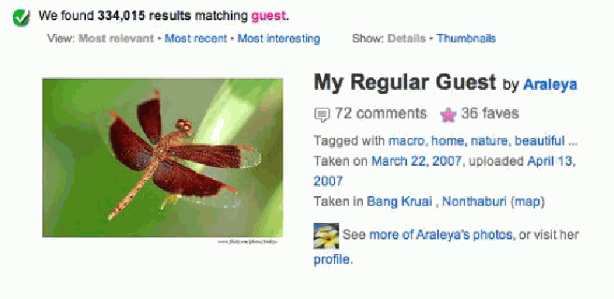
Contextual Description
== Private Language?
A "guest" tag makes sense to the photographer but no one else would use it to describe this photo if they don’t share the context

Slide 37
Structural Properties
UNIVERSITY OF CALIFORNIA, BERKELEY
SCHOOL OF INFORMATION
The internal and external structure of a thing can be a useful part of its description
  The number and arrangement of component parts (e.g, the number of chapters or pages in a book)
  The number and type of connections with other resources (e.g., the number of Facebook friends or Twitter followers)
37

Slide 38
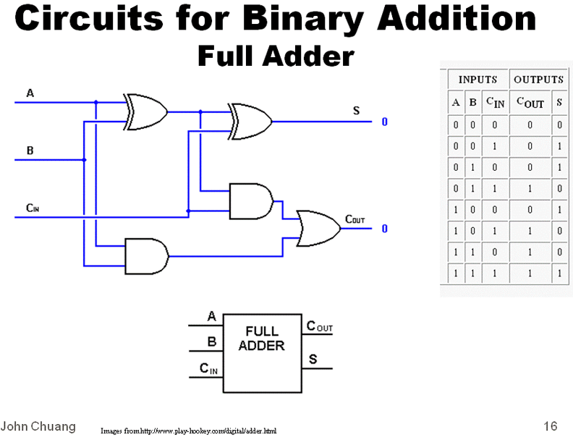
Meaning is Structure
Could you describe this without using structural concepts?

Slide 39
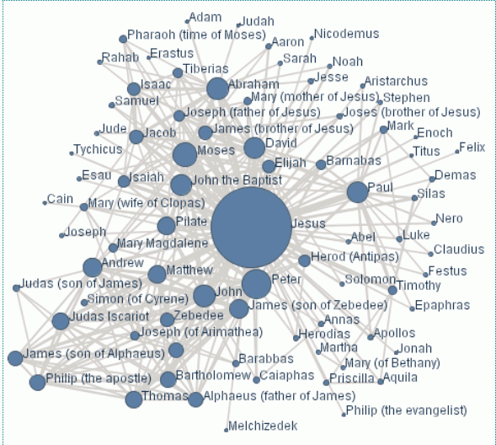
The Social Network of Jesus

Slide 40
Properties vs. Relationships
UNIVERSITY OF CALIFORNIA, BERKELEY
SCHOOL OF INFORMATION
But while we can express structure within and between resources as properties, there is “better language” for expressing this as RELATIONSHIPS
  Arrangement
  Proximity
  Connectivity
  Part-whole
  …
(See TDO Chapter 5)
40

Slide 41
Classifying Resource Properties

Slide 42
Principles of Kitchen Organization
UNIVERSITY OF CALIFORNIA, BERKELEY
SCHOOL OF INFORMATION
  Intrinsic static properties: If you store your pots, frying pans, and baking pans and nest each set by size
  Extrinsic static properties: A spice rack with the spices arranged in alphabetical order
  Intrinsic dynamic properties if you arrange your milk and other perishable goods by expiration date, a “useful life remaining” property that decreases to zero as the expiration date approaches
  Extrinsic dynamic properties if you put the most frequently used condiments or spices in the front of a refrigerator or pantry shelf.
42

Slide 43
Principles of Document Organization
UNIVERSITY OF CALIFORNIA, BERKELEY
SCHOOL OF INFORMATION
  Intrinsic static properties: Author, date published, words in the text
  Extrinsic static properties: ISBN, LOC Classifications
  Intrinsic dynamic properties: Effectivity (e.g., laws and regulations)
  Extrinsic dynamic properties: Links/citations to and from other documents
43

Slide 44
INFO 202
“Information Organization & Retrieval”
Fall 2013
UNIVERSITY OF CALIFORNIA, BERKELEY
SCHOOL OF INFORMATION
Robert J. Glushko
glushko@berkeley.edu
@rjglushko
19 September 2013
Lecture 7.3 – Creating Description Vocabularies
and Assigning Descriptions

Slide 45
Designing the Description Vocabulary
UNIVERSITY OF CALIFORNIA, BERKELEY
SCHOOL OF INFORMATION
  Good descriptions use terms that their intended users might use
  Good descriptions don't contain details that aren't necessary
  Good descriptions are created systematically and follow standards
45

Slide 46
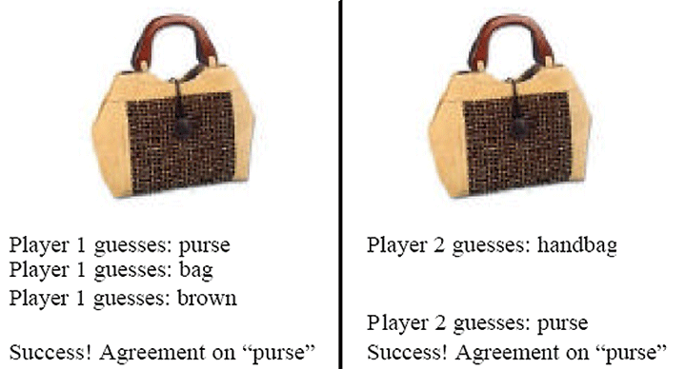
The Image Game:
Finding Good Descriptions

Slide 47
The Need for Controlled Vocabularies
UNIVERSITY OF CALIFORNIA, BERKELEY
SCHOOL OF INFORMATION
  The words people use to describe things or concepts are "embodied" in their context and experiences... so they are often different or even "bad" with respect to the words used by others
  These naturally-occurring words are an "uncontrolled vocabulary"
47

Slide 48
The Need for Controlled Vocabularies
UNIVERSITY OF CALIFORNIA, BERKELEY
SCHOOL OF INFORMATION
  Searches for resources using an uncontrolled vocabulary will not succeed when they fail to match resources described or indexed using a controlled vocabulary
  To agree on the words we use in descriptions will improve recall, but it means that we must use a subset of the words we would otherwise use
48

Slide 49
What is a Controlled Vocabulary?
UNIVERSITY OF CALIFORNIA, BERKELEY
SCHOOL OF INFORMATION
  A controlled vocabulary is a standardized set of terms (such as subject headings, names, classifications, etc.) assigned by organizers / cataloguers / indexers of resources
  A CV can be a content standard for the values used in (or as) descriptive elements
  A CV can be thought of as a fixed or closed dictionary in which everything must be defined using the same set of terms
49

Slide 50
Types of Controlled Vocabularies
UNIVERSITY OF CALIFORNIA, BERKELEY
SCHOOL OF INFORMATION
  Dictionaries
  Authoritative names
  Authority control for places and time periods
  Identifiers
  Code lists
  Subject heading lists (like the Library of Congress – LCSH)
  Thesauri
  Classification systems
50

Slide 51
Horizontal and Vertical Vocabularies
UNIVERSITY OF CALIFORNIA, BERKELEY
SCHOOL OF INFORMATION
  Horizontal
    Concepts that are common to all (or a large number) of domains
  Vertical
    Particular industry or vertical market
    Specialized product or process semantics
    Sometimes called “domain-specific languages”
51

Slide 52
“Dimensionality Reduction” in Descriptions
UNIVERSITY OF CALIFORNIA, BERKELEY
SCHOOL OF INFORMATION
  Creating a controlled vocabulary reduces the number of descriptive terms that are or can be assigned to something
  When achieved by computational techniques, "dimensionality reduction“ goes by names like "principle components analysis," "orthogonal decomposition," "latent semantic analysis," "factor analysis," and others
  These techniques analyze the correlations between descriptors and transform a large set into a smaller set of uncorrelated ones
52

Slide 53
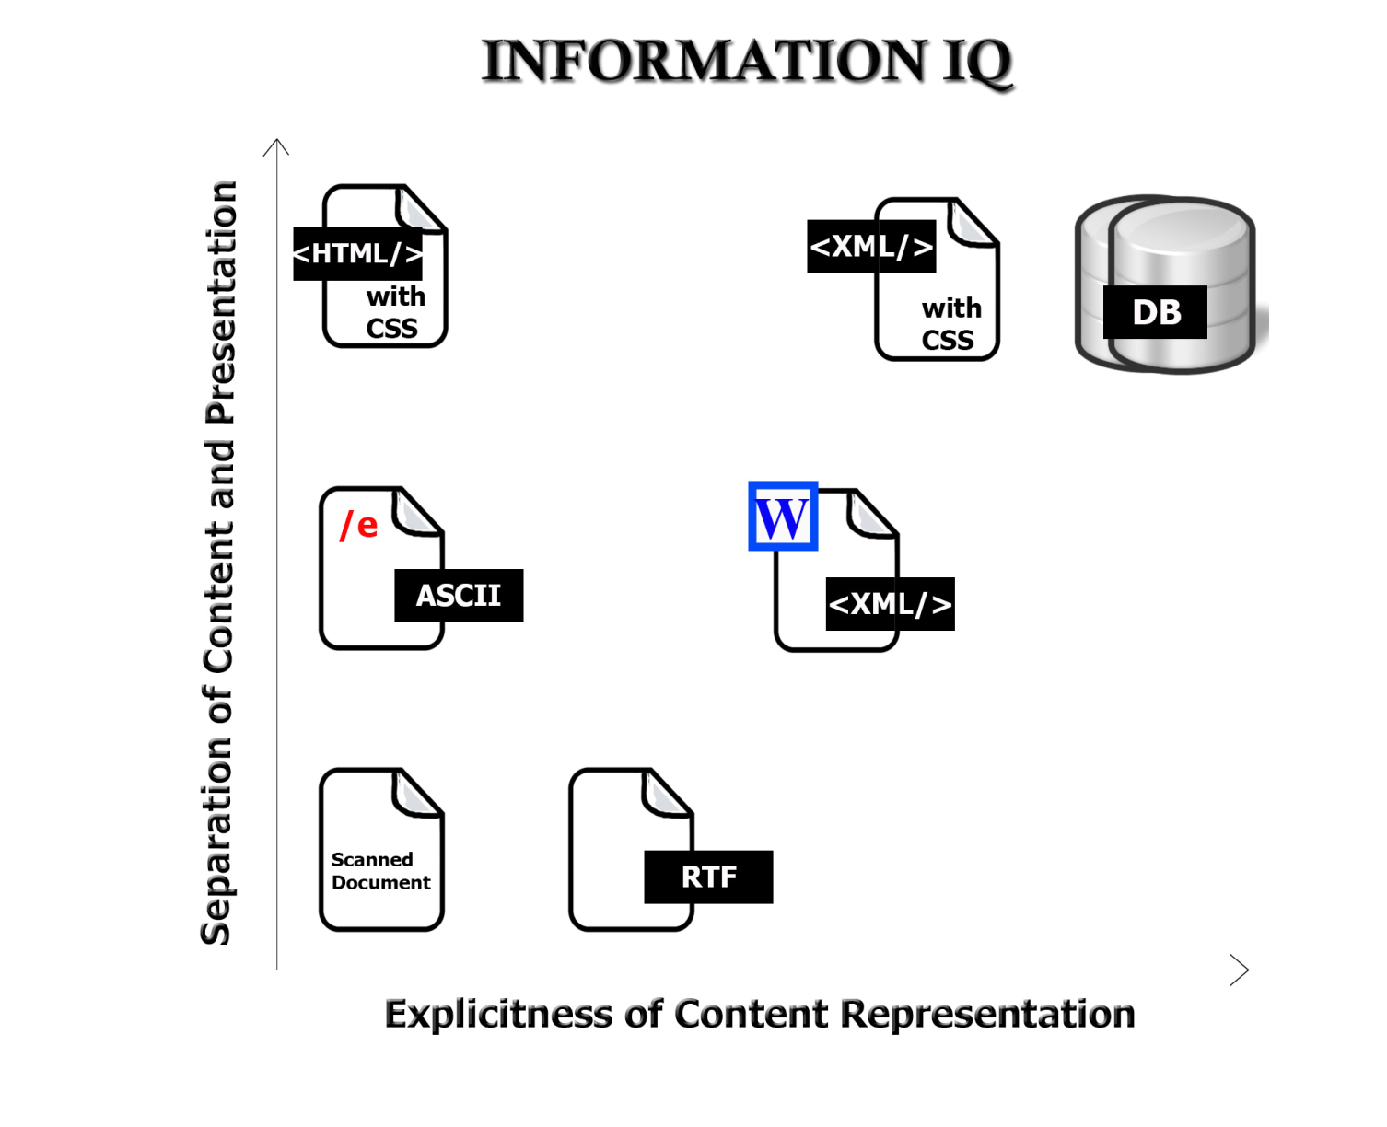
Description Form and Implementation: Format Matters!

Slide 54
Creating Resource Descriptions
UNIVERSITY OF CALIFORNIA, BERKELEY
SCHOOL OF INFORMATION
  By professionals: "Institutional" descriptions that follow standards
  By authors: Best knowledge of purpose and intended audience
  By users: Most variable, influenced by social purposes
  By automated processes: Most reliable, primarily technical / objective properties but semantic description capability is emerging
54

Slide 55
Evaluating Resource Descriptions
UNIVERSITY OF CALIFORNIA, BERKELEY
SCHOOL OF INFORMATION
  Quality should be evaluated with respect to intended purposes... but what if different stakeholders have different purposes?
  Creating resource descriptions can be costly; is it worth it? How and when measure the costs?
  Computational description is vastly less expensive, but is it good enough?
  How can we incent "community" or "crowdsourced" description to be of better quality?
55

Slide 56
Readings for Next Lecture
UNIVERSITY OF CALIFORNIA, BERKELEY
SCHOOL OF INFORMATION
Next lecture on XML (September 24) will be presented by Erik Wilde
Glushko and McGrath. Document Engineering. Chapter 2, XML Foundations
XML In a Nutshell, Ch 2 (as a reference guide and for assignment)
56

