Slide 1
INFO 202 “Information Organization & Retrieval” Fall 2013
UNIVERSITY OF CALIFORNIA, BERKELEY
SCHOOL OF INFORMATION
Robert J. Glushko glushko@berkeley.edu
@rjglushko
12 September 2013 Lecture 5.1 – Resources and Resource Identity

Slide 2
Plan for Today’s Lecture(s)
UNIVERSITY OF CALIFORNIA, BERKELEY
SCHOOL OF INFORMATION
Resources and resource identity
Four distinctions about resources
An introduction to conceptual modeling
2

Slide 3
What is a Resource?
UNIVERSITY OF CALIFORNIA, BERKELEY
SCHOOL OF INFORMATION
When you look at, refer to, or pick up a natural physical object, it usually seems that it is "one thing"
Many things have highly visible parts or internal structures, and we must consider whether to treat them as assemblies or aggregations of these separate things
For digital and computational resources, it is much harder to know how many parts we can or should identify
Once you've decided what to treat as a resource, you can create a name or identifier so you can refer to it
3

Slide 4
The Unit of Analysis
UNIVERSITY OF CALIFORNIA, BERKELEY
SCHOOL OF INFORMATION
Identifying the unit of analysis is a central problem in every intellectual or scientific discipline - and in every organizing system
But if the basic unit of an organizing system isn't usually very clear or naturally given to us, we need systematic methods for determining which resources will have separate identities and how they are related to each other
4

Slide 5
“Carving Nature at its Joints”
UNIVERSITY OF CALIFORNIA, BERKELEY
SCHOOL OF INFORMATION
Over 2000 years ago Plato (in Phaedrus) has Socrates arguing that species are distinguished by "carving nature at its joints" - where the natural differences between things are the largest or most salient or where there are few connections
"Joints" and the boundaries they create between things exist to some extent with physical resources and are manifested in their surface or perceptible properties
5

Slide 6
Carving Information at its Joints?
UNIVERSITY OF CALIFORNIA, BERKELEY
SCHOOL OF INFORMATION
When we deal with resources that are made of information, any "joints" are man-made and arbitrary
There might be indications "on the surface" that suggest the "joints" between information resources, but these represent design decisions, might be more structure or presentation oriented than content oriented distinctions, and are subject to cognitive interpretation
6

Slide 7
“Thing” vs “Type of Thing”
UNIVERSITY OF CALIFORNIA, BERKELEY
SCHOOL OF INFORMATION
Oops... we have been blurring the distinction between individual things or instances of things and classes of things
We often say that that two objects are the "same thing" when we mean they are the same "type of thing"
Identifying a resource as an instance is not the same as identifying the category or "equivalence class" to which it belongs
7

Slide 8
Two Aspects of “Thingness”
UNIVERSITY OF CALIFORNIA, BERKELEY
SCHOOL OF INFORMATION
Two separate aspects cut across the "thingness" distinctions:
Granularity
Abstraction
8

Slide 9
Granularity: Whole vs Parts
UNIVERSITY OF CALIFORNIA, BERKELEY
SCHOOL OF INFORMATION
Resources that are aggregates or composites of other resources, or that have internal structure, pose questions about the granularity of their "thingness"
We might need to organize and manage the granular resources, the composite resources, and the relationships between them - all at the same time
The "part things" can be identified at various levels of contexts/containers/collections in which they occur
The granularity of physical resources is more easily determined that for information resources
9

Slide 10
Red Car as 1 Resource
UNIVERSITY OF CALIFORNIA, BERKELEY
SCHOOL OF INFORMATION
10

Slide 11
Red Car : Not 1 Resource
UNIVERSITY OF CALIFORNIA, BERKELEY
SCHOOL OF INFORMATION
11

Slide 12
Abstraction - 1
UNIVERSITY OF CALIFORNIA, BERKELEY
SCHOOL OF INFORMATION
We can identify a resource as a unique instance or as a member of a class of resources
The size of this class - the number of resources that are treated as equivalent - is determined by the properties or characteristics we consider when we examine any instance
The choice of these properties depends on context and intent, so the same resource can be identified abstractly in some situations and very concretely in others
12

Slide 13
Abstraction - 2
UNIVERSITY OF CALIFORNIA, BERKELEY
SCHOOL OF INFORMATION
For tangible resources, there may be "natural" levels of abstraction (See Plato…)
For intangible resources, there aren't
13

Slide 14
The “Abstraction Hierarchy” of the “Work”
UNIVERSITY OF CALIFORNIA, BERKELEY
SCHOOL OF INFORMATION
WORK - an abstract entity; the distinct intellectual or artistic creation; it has no single material manifestation
EXPRESSION - the multiple realizations of a work in some particular medium or notation, where it can actually be perceived
MANIFESTATION - each of the formats of an expression that have the same appearance; but not necessarily the same implementation
ITEM - a single exemplar of a manifestation; if we distinguish this level it is because otherwise identical manifestations have some differentiation
14

Slide 15
What is Macbeth?
UNIVERSITY OF CALIFORNIA, BERKELEY
SCHOOL OF INFORMATION
15

Slide 16
The Equivalence Continuum (Tillett)
UNIVERSITY OF CALIFORNIA, BERKELEY
SCHOOL OF INFORMATION
16

Slide 17
INFO 202 “Information Organization & Retrieval” Fall 2013
UNIVERSITY OF CALIFORNIA, BERKELEY
SCHOOL OF INFORMATION
Robert J. Glushko glushko@berkeley.edu
@rjglushko
12 September 2013 Lecture 5.2 – Four Distinctions About Resources

Slide 18
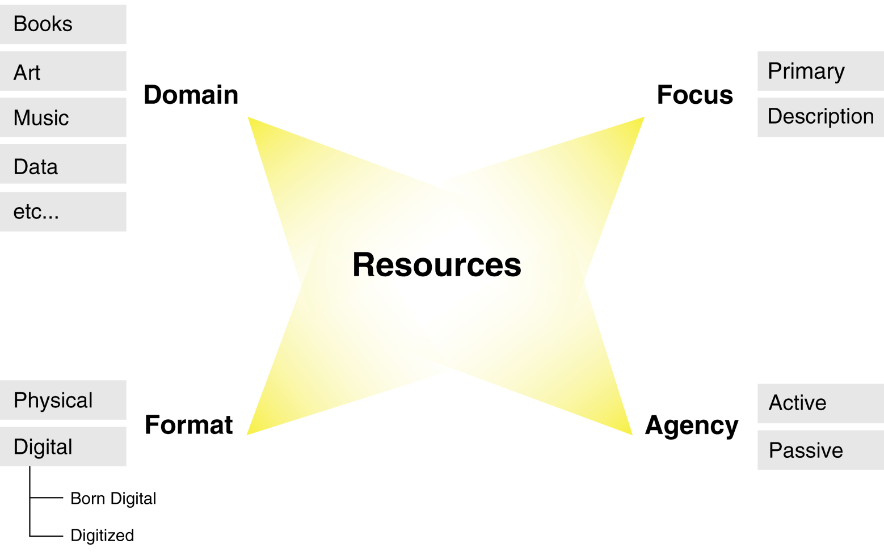
Four Distinctions About Resources
UNIVERSITY OF CALIFORNIA, BERKELEY
SCHOOL OF INFORMATION
18

Slide 19
Resource Domain
UNIVERSITY OF CALIFORNIA, BERKELEY
SCHOOL OF INFORMATION
Physical resources - often distinguished by material of composition and other visible properties
Bibliographic resources - traditional focus of library and information science; most commonly used cataloguing rules have 11 categories that don't cleanly distinguish semantics and formats
Information resources - the content of information-intensive artifacts and applications - "Document types"
19

Slide 20
Resource Format
UNIVERSITY OF CALIFORNIA, BERKELEY
SCHOOL OF INFORMATION
In Chapter 3 of TDO
Bits vs Atoms (Negroponte)
Three orders of order (Weinberger)
20

Slide 21
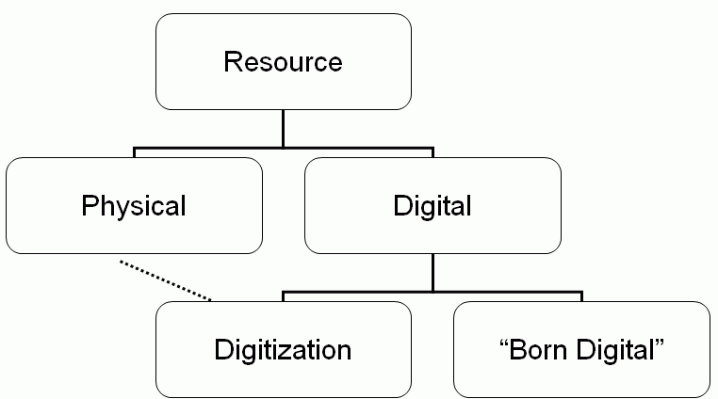
Resource Format in TDO
UNIVERSITY OF CALIFORNIA, BERKELEY
SCHOOL OF INFORMATION
21

Slide 22
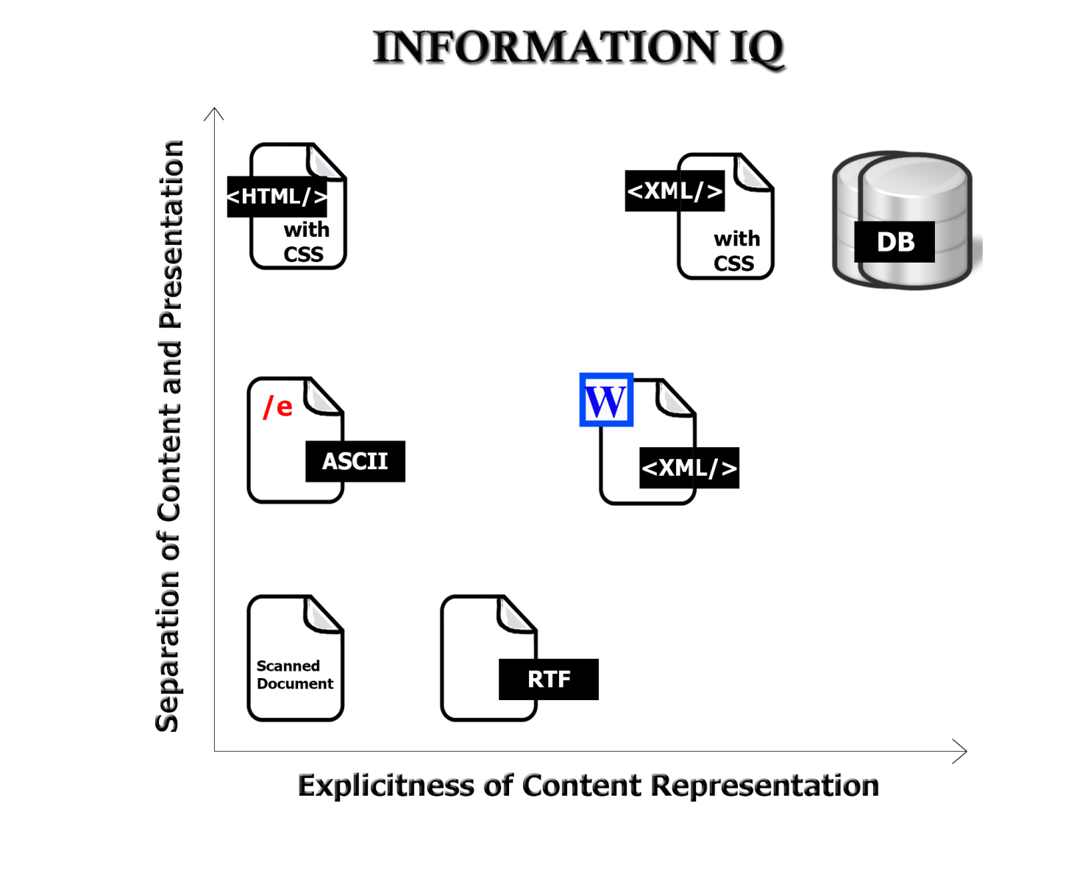
Format Matters!
UNIVERSITY OF CALIFORNIA, BERKELEY
SCHOOL OF INFORMATION
22

Slide 23
Bits vs Atoms (Negroponte)
UNIVERSITY OF CALIFORNIA, BERKELEY
SCHOOL OF INFORMATION
A contrast between information as "bits" and information as "atoms" was first expressed by Nicholas Negroponte of the MIT Media Lab (see Being Digital (1995)
Information encoded as bits can move several orders of magnitude faster than atoms can
It can be in many places at once (broadcasting, networking) unlike atoms that have to be in one place
...and there are many other ways in which bits and atoms differ
23

Slide 24
Movement of Bits != Movement of Atoms
UNIVERSITY OF CALIFORNIA, BERKELEY
SCHOOL OF INFORMATION
24

Slide 25
Three Orders of Order (Weinberger)
UNIVERSITY OF CALIFORNIA, BERKELEY
SCHOOL OF INFORMATION
An incremental extension of Negroponte's thinking is in Weinberger's Everything is Miscellaneous (2007)
First order: Organize physical things themselves
Second order: Organize physical surrogates of things
Third order: Organize digital surrogates of things, or digital things themselves
25

Slide 26
Resource Focus
UNIVERSITY OF CALIFORNIA, BERKELEY
SCHOOL OF INFORMATION
Any resource can have other resources associated with it, usually to describe it in some way to facilitate finding it, interacting with it, or interpreting it
So we can designate a resource as a primary one or as a description resource
Description resources are often called METADATA
26

Slide 27
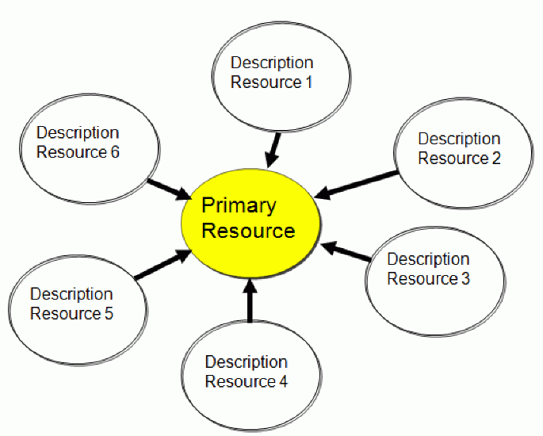
Description Resources
UNIVERSITY OF CALIFORNIA, BERKELEY
SCHOOL OF INFORMATION
27

Slide 28
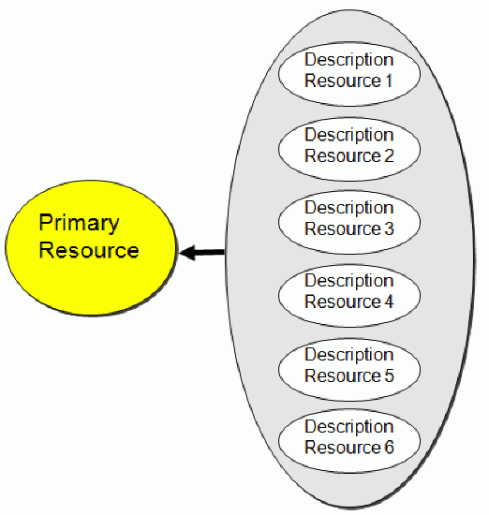
Aggregated Description Resources
UNIVERSITY OF CALIFORNIA, BERKELEY
SCHOOL OF INFORMATION
28

Slide 29
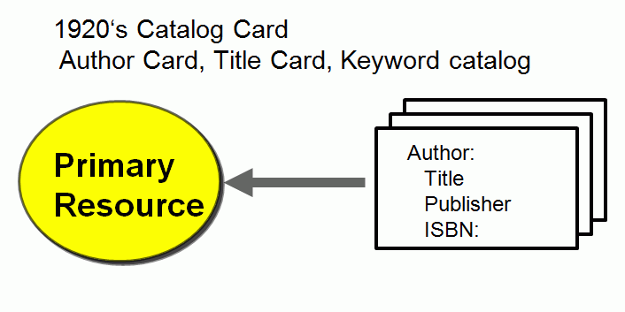
Bibliographic Description Resources - 1920
UNIVERSITY OF CALIFORNIA, BERKELEY
SCHOOL OF INFORMATION
29

Slide 30
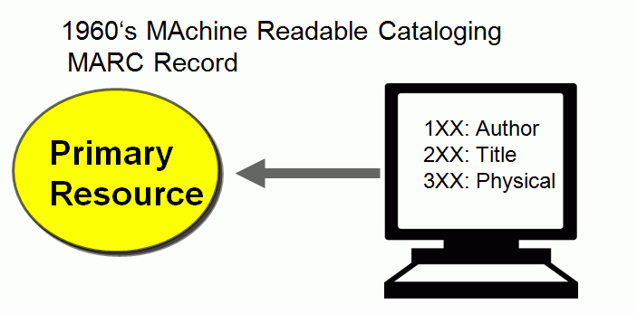
Bibliographic Description Resources - 1960
UNIVERSITY OF CALIFORNIA, BERKELEY
SCHOOL OF INFORMATION
30

Slide 31
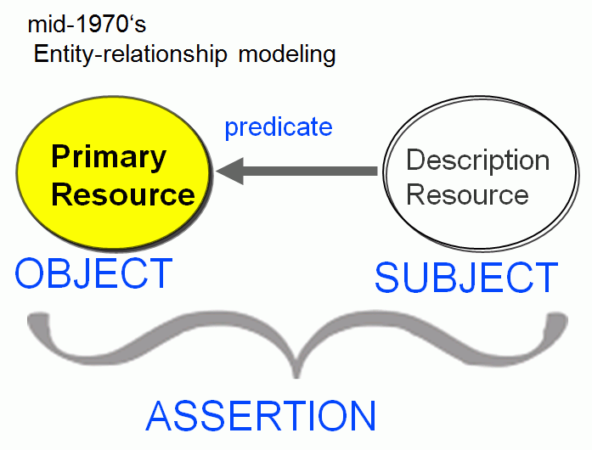
Resource Descriptions as “Triples”
UNIVERSITY OF CALIFORNIA, BERKELEY
SCHOOL OF INFORMATION
31

Slide 32
Resource Focus
UNIVERSITY OF CALIFORNIA, BERKELEY
SCHOOL OF INFORMATION
In the bibliographic domain the resource vs. description distinction is deeply embedded
It other domains it can be quite arbitrary and "focus" is an important decision
One person's data is another person's metadata -- and now substitute "process" for "person"
32

Slide 33
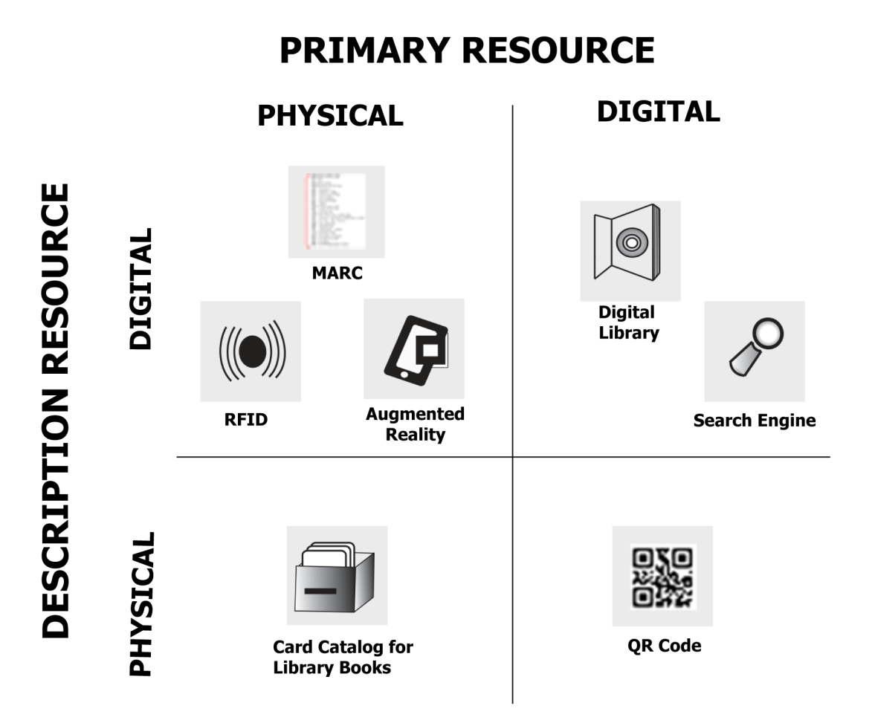
Format x Focus
UNIVERSITY OF CALIFORNIA, BERKELEY
SCHOOL OF INFORMATION
33

Slide 34
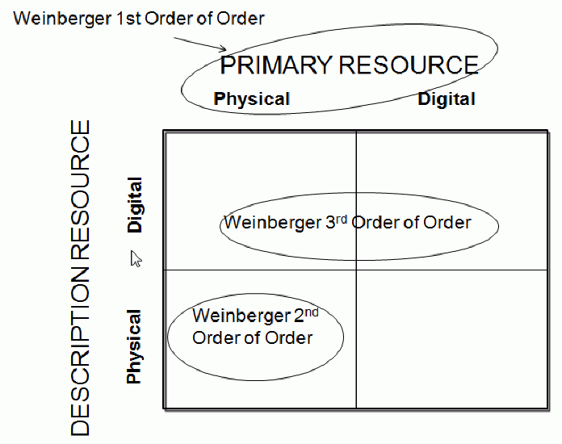
Format x Focus & Weinberger
UNIVERSITY OF CALIFORNIA, BERKELEY
SCHOOL OF INFORMATION
34

Slide 35
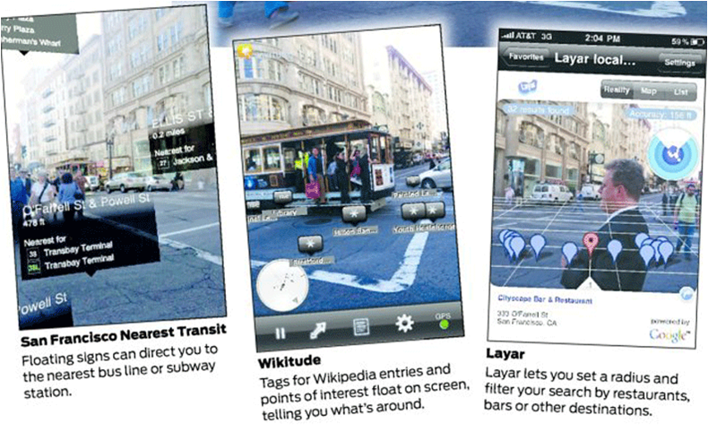
Augmented Reality – Overlay Digital on Physical
UNIVERSITY OF CALIFORNIA, BERKELEY
SCHOOL OF INFORMATION
35

Slide 36
QR Code – Connect Physical to Digital
UNIVERSITY OF CALIFORNIA, BERKELEY
SCHOOL OF INFORMATION
http://qrcode.kaywa.com/
36

Slide 37
Resource Agency
UNIVERSITY OF CALIFORNIA, BERKELEY
SCHOOL OF INFORMATION
Passive or operand resources ("nouns") must be acted upon or interacted with to produce an effect
Traditional organizing systems contain tangible and static resources that are "natural operands"
Active or operant resources ("verbs") create effects or value on their own, sometimes when then initiate interactions with operand resources.
Sensors, web-based services, information feeds are operant resources that often are combined to implement business processes or business models
37

Slide 38
Smart Things
UNIVERSITY OF CALIFORNIA, BERKELEY
SCHOOL OF INFORMATION
Sensors, RFID tags, GPS, other computation and communication built into physical objects (and phones) to identify them or their context
Technical challenges in sorting and identifying the objects in the "information torrent" especially when the objects exhibit some intentional or discretionary behavior
In an "Internet of Things" any object can have an IP address that uniquely identifies it
38

Slide 39
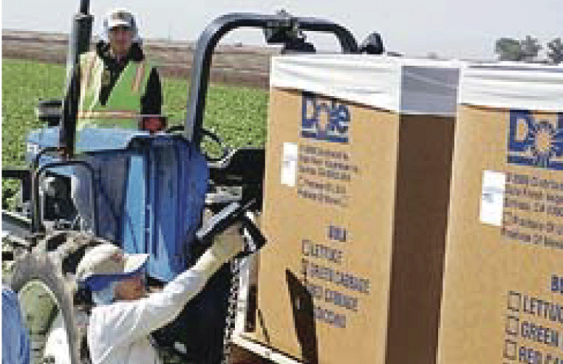
Tracking the Food Supply
UNIVERSITY OF CALIFORNIA, BERKELEY
SCHOOL OF INFORMATION
39

Slide 40
INFO 202 “Information Organization & Retrieval” Fall 2013
UNIVERSITY OF CALIFORNIA, BERKELEY
SCHOOL OF INFORMATION
Robert J. Glushko glushko@berkeley.edu
@rjglushko
12 September 2013 Lecture 5.3 – Introduction to Modeling

Slide 41
An Introduction to Modeling - 1
UNIVERSITY OF CALIFORNIA, BERKELEY
SCHOOL OF INFORMATION
Models are simplified descriptions of a subject that abstract from its complexity to emphasize some features or characteristics while intentionally de-emphasizing others
Models enable us to describe and communicate systems regardless of the specific domain or discipline that they represent
41

Slide 42
An Introduction to Modeling - 2
UNIVERSITY OF CALIFORNIA, BERKELEY
SCHOOL OF INFORMATION
A model can represent a human activity, a natural system, or a designed system
We can model structures – objects, their characteristics, their static relationships with each other like hierarchy, and reference
We can model functions, processes, behaviors – dynamic activities that create and affect structures
42

Slide 43
Recipes as Everyday Models
UNIVERSITY OF CALIFORNIA, BERKELEY
SCHOOL OF INFORMATION
A recipe describes both objects and structures (ingredients) and the processes (instructions) for creating a food dish
You can FOLLOW the recipe to create the dish
You can COMMUNICATE the recipe to someone else who can then create the same dish
You can use the recipe as a GUIDE FOR EXPERIMENTATION with the objects or the processes in the recipe to create alternative dishes
43

Slide 44
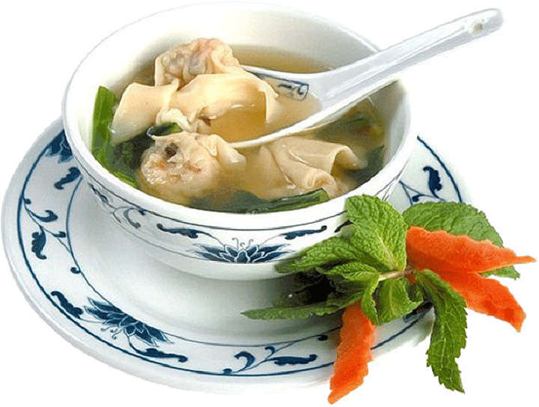
Not a Model of Wonton Soup
UNIVERSITY OF CALIFORNIA, BERKELEY
SCHOOL OF INFORMATION
44

Slide 45
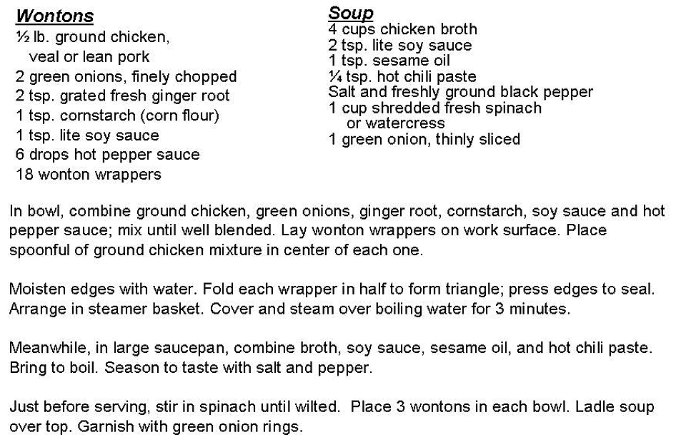
A Model of Wonton Soup
UNIVERSITY OF CALIFORNIA, BERKELEY
SCHOOL OF INFORMATION
45

Slide 46
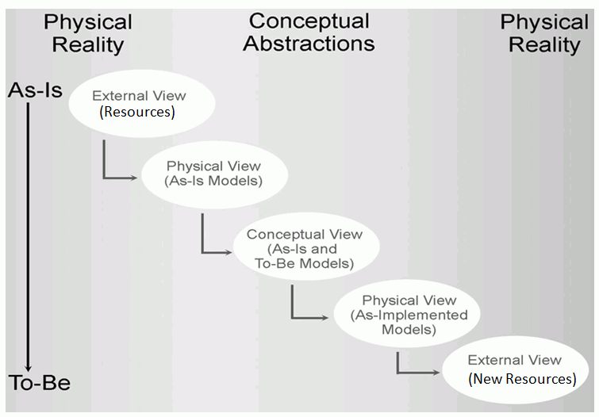
The Classical Modeling Approach
UNIVERSITY OF CALIFORNIA, BERKELEY
SCHOOL OF INFORMATION
46

Slide 47
Physical Modeling for Analysis - 1
UNIVERSITY OF CALIFORNIA, BERKELEY
SCHOOL OF INFORMATION
The primary purpose of modeling is to better understand some existing system or environment and its resources and to describe this understanding so it can be communicated
Models of things as they currently exist are Physical or As-Is models
This modeling activity is usually called "systems analysis" or simply "analysis"
A basic task of modeling for analysis is capturing the languages and practices of the people who work with the resources in the "real world"
47

Slide 48
Physical Modeling for Analysis - 2
UNIVERSITY OF CALIFORNIA, BERKELEY
SCHOOL OF INFORMATION
Any system (especially business and other institutionalized ones) has groups of stakeholders who do not fully understand the "big picture" – an analysis model can be used to prevent or repair misunderstandings
A physical model synthesizes different views or observations into a more complete or generic perspective that accurately accounts for all of them
48

Slide 49
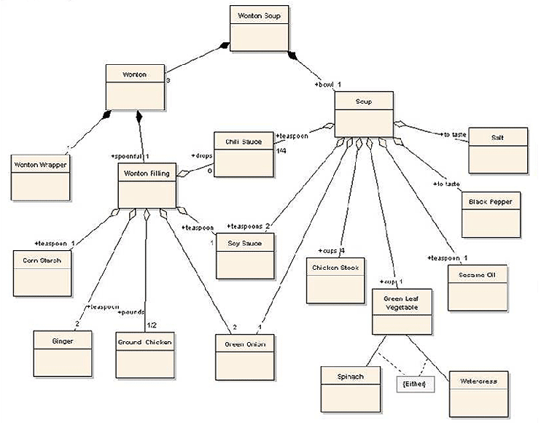
Physical View of Wonton Soup
UNIVERSITY OF CALIFORNIA, BERKELEY
SCHOOL OF INFORMATION
49

Slide 50
Conceptual Modeling for (Re-)Design - 1
UNIVERSITY OF CALIFORNIA, BERKELEY
SCHOOL OF INFORMATION
The next purpose of modeling is to assist in the design or re-design of a system or set of resources
This modeling activity is usually called "systems design" or simply "design"
Models of resources as they could be are Conceptual or To-Be models
Design abstracts away or generalizes from the technology and implementation details in the physical model to create a conceptual model
50

Slide 51
Conceptual Modeling for (Re-)Design - 2
UNIVERSITY OF CALIFORNIA, BERKELEY
SCHOOL OF INFORMATION
A conceptual model that is implementation-independent is often easier to talk about than one that is encoded in a specific technology context
When technologies change, the implementation model may change but the conceptual model won't.
When implementations in different technologies are based on the same conceptual models, they can more readily understood because of their common conceptual components.
51

Slide 52
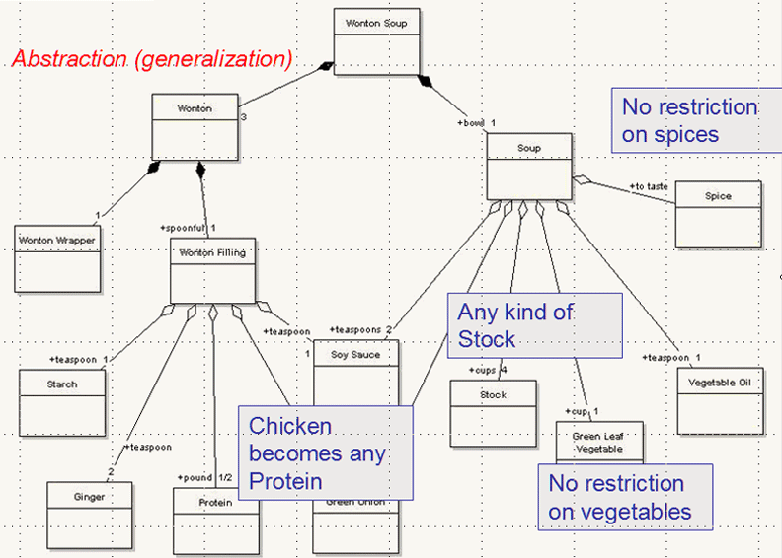
Conceptual View of Wonton Soup
UNIVERSITY OF CALIFORNIA, BERKELEY
SCHOOL OF INFORMATION
52

Slide 53
Using Conceptual Models
UNIVERSITY OF CALIFORNIA, BERKELEY
SCHOOL OF INFORMATION
Resources can be manipulated as conceptual components without impacting the real world that they describe, or in ways that are impossible in the real world
This encourages the re-use of common components via standardization, patterns and libraries
It facilitates the rationalization of components and the removal of redundancies and inefficiencies
53

Slide 54
The Modeling Gaps
UNIVERSITY OF CALIFORNIA, BERKELEY
SCHOOL OF INFORMATION
There is an essential difference or gap between the real world being modeled and any models of it, or else the models would serve no purpose
Likewise, there is always a gap between a physical model and a conceptual model, because an analysis model is often most useful when it isn't tied to specific or feasible implementations or technologies
But this means we can sometimes see what the current world looks like and what we would like it to be without being able to see how to get from one to the other
54

Slide 55
Implementing a Conceptual Model as a Physical One
UNIVERSITY OF CALIFORNIA, BERKELEY
SCHOOL OF INFORMATION
A model is purely theoretical until it is encoded in a technology that lets it operate in the real world again.
This is often a two-stage process: encoding conceptual models as physical ones, and then applying transformations to create resource instances with desired properties
When resources implemented in different technologies are generated or re-generated from models, they can more readily interoperate because of their common conceptual components
55

Slide 56
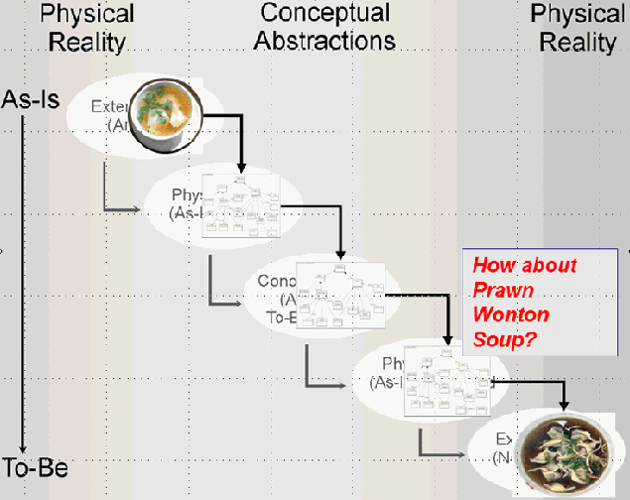
Applying the Conceptual Model
UNIVERSITY OF CALIFORNIA, BERKELEY
SCHOOL OF INFORMATION
56

Slide 57
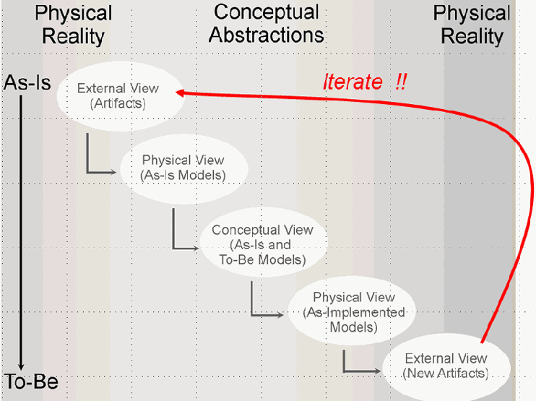
Iteration is Inevitable
UNIVERSITY OF CALIFORNIA, BERKELEY
SCHOOL OF INFORMATION
57

Slide 58
Adapting the Classical Modeling Approach to TDO – 1
UNIVERSITY OF CALIFORNIA, BERKELEY
SCHOOL OF INFORMATION
In an Organizing System context we can analyze a domain and analyze its resources and their processes or behaviors as we normally would
But taking an architectural perspective that distinguishes organizing principles from implementation means that we emphasize the information or intangible content of the resources
We only model those resources and their properties that are relevant to organizing them
58

Slide 59
Adapting the Classical Modeling Approach to TDO – 2
UNIVERSITY OF CALIFORNIA, BERKELEY
SCHOOL OF INFORMATION
In some Organizing System contexts we start with a collection of resources to organize
So we analyze the domain and the resources to determine appropriate properties to use in descriptions and organizing principles as we would in any other modeling activity
But sometimes we concurrently design the Organizing System and the resources it will contain
Systematic modeling of information components and documents to enable efficient reuse and transformation is essential
59

Slide 60
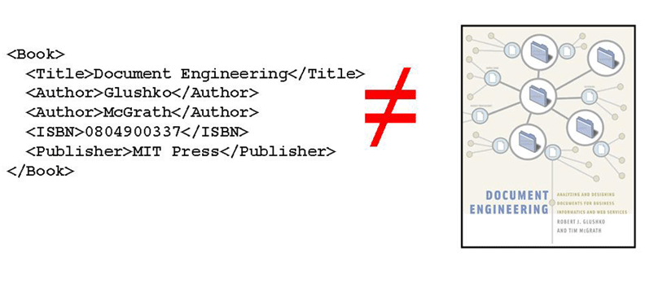
Model the Information, not the Things
UNIVERSITY OF CALIFORNIA, BERKELEY
SCHOOL OF INFORMATION
60

Slide 61
Readings for Next Lecture
UNIVERSITY OF CALIFORNIA, BERKELEY
SCHOOL OF INFORMATION
TDO 3.5, TDO 8.3.1 and 8.3.2
Gardiner www.wired.com/wiredscience/2013/05/sensors-listen-to-world/
Smith, Abby. “Authenticity in perspective”
Barbara Bazzanella, Stefano Bortoli, Paolo Bouquet, “Can Persistent Identifiers Be Cool? “
61

