Slide 1
Plan for Today’s Lecture(s)
UNIVERSITY OF CALIFORNIA, BERKELEY
SCHOOL OF INFORMATION
Identifying information components
Resource identifiers and names
Smart resources
1

Slide 2
INFO 202 “Information Organization & Retrieval” Fall 2013
UNIVERSITY OF CALIFORNIA, BERKELEY
SCHOOL OF INFORMATION
Robert J. Glushko glushko@berkeley.edu
@rjglushko
17 September 2013 Lecture 6.1 – Identifying Information Components; Document Analysis

Slide 3
Adapting the Classical Modeling Approach to TDO – 2
UNIVERSITY OF CALIFORNIA, BERKELEY
SCHOOL OF INFORMATION
In some Organizing System contexts we start with a collection of resources to organize
So we analyze the domain and the resources to determine appropriate properties to use in descriptions and organizing principles as we would in any other modeling activity
But sometimes we concurrently design the Organizing System and the resources it will contain
Systematic modeling of information components and documents to enable efficient reuse and transformation is essential
3

Slide 4
Information Components
UNIVERSITY OF CALIFORNIA, BERKELEY
SCHOOL OF INFORMATION
Information components - especially standardized ones - are semantic building blocks that can be assembled into different document types
A component architecture for information is essential to enable efficient reuse, integration and operation of information-intensive organizing systems
4

Slide 5
Identifying Information Components
UNIVERSITY OF CALIFORNIA, BERKELEY
SCHOOL OF INFORMATION
Any piece of information that can be addressed and manipulated by a person or process as a discrete entity
Any piece of information with a unique name or identifier
Any piece of information that is self-contained and comprehensible on its own
5

Slide 6
Separating Content from Structure and Presentation
UNIVERSITY OF CALIFORNIA, BERKELEY
SCHOOL OF INFORMATION
An essential goal of modeling is to separate what something means from its structure and presentation
We're expressing a distinction between information as conceptual or as content: and the physical container or medium, format, or technology in which the information is conveyed
Separating content from its structure and presentation is the most important principle of Information Architecture
6

Slide 7
Three Types of "Stuff“ or Kinds of Information
UNIVERSITY OF CALIFORNIA, BERKELEY
SCHOOL OF INFORMATION
Content - "what does it mean" information
Structure - "where is it" or "how it is organized or assembled" information
Presentation - "how does it look" or "how is it displayed" information
7

Slide 8
The Document Type Spectrum
UNIVERSITY OF CALIFORNIA, BERKELEY
SCHOOL OF INFORMATION
Figure 3.2 in TDO
8

Slide 9
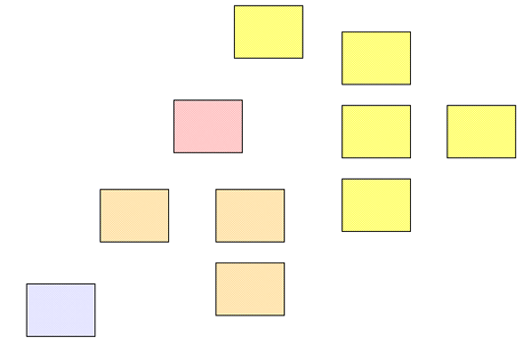
Content Components
UNIVERSITY OF CALIFORNIA, BERKELEY
SCHOOL OF INFORMATION
9

Slide 10
Structural Information
UNIVERSITY OF CALIFORNIA, BERKELEY
SCHOOL OF INFORMATION
Physical piece of a document or user interface (e.g. table, section, header, footer, panel, window)
Embodies the rules on how content components fit together, often hierarchical
Often driven by context of document use
Most applications and web sites are organized with a small set of structures
10

Slide 11
Applying Structure
UNIVERSITY OF CALIFORNIA, BERKELEY
SCHOOL OF INFORMATION
The structural components provide the hierarchical "skeleton" or "scaffold" into which the content components are arranged; the structure remains fixed when the content changes
Frequently a close relationship between structural and presentation items, especially in a paper document. This goes some way to explaining why document designers emphasize structural components
11

Slide 12
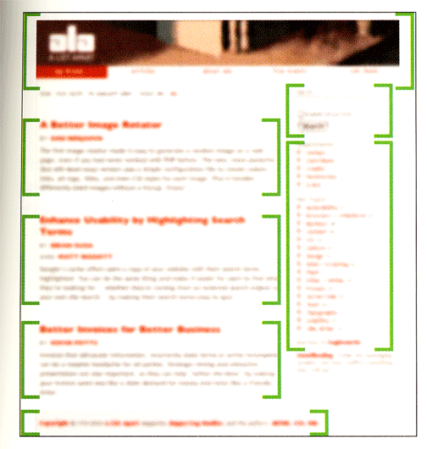
The Independence of Structure and Content

Slide 13
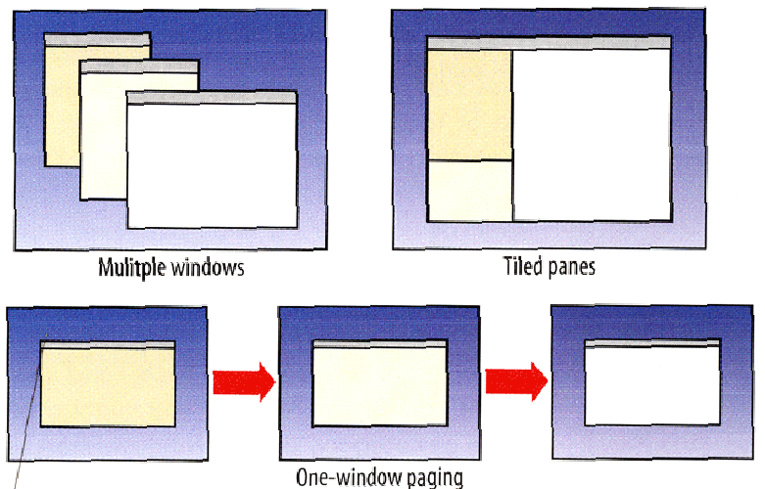
Different Physical Structures for Same Content Model

Slide 14
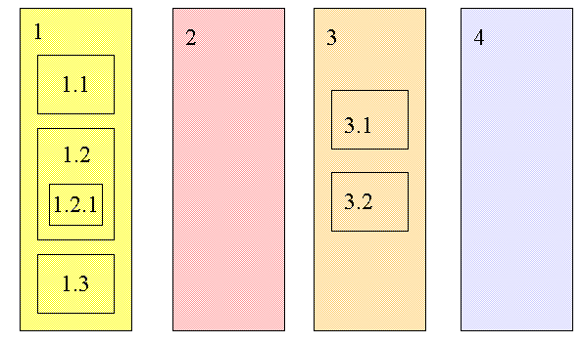
Structural Relationships Among Components Expressed as a Hierarchy

Slide 15
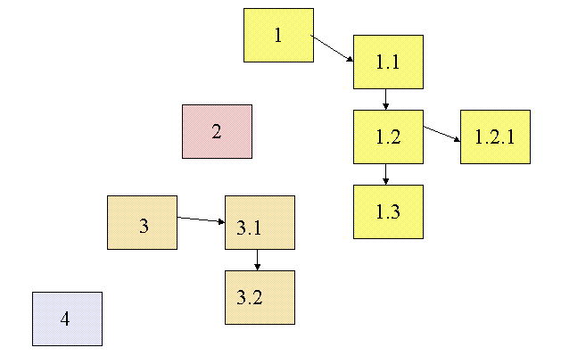
Structural Relationships Among Components Expressed as a Network

Slide 16
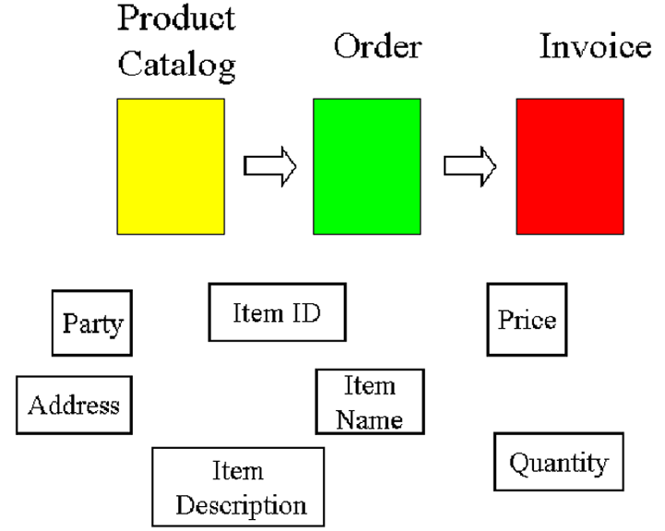
Component Architecture in Documents

Slide 17
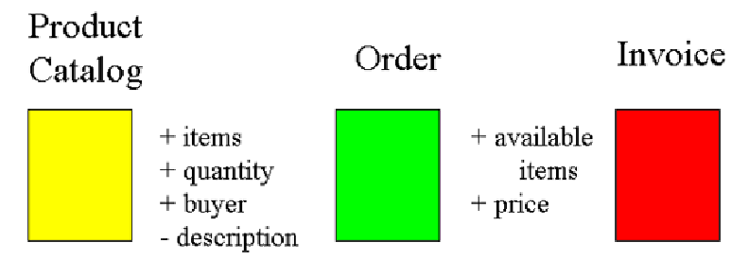
Overlapping Components as “Process Glue”

Slide 18
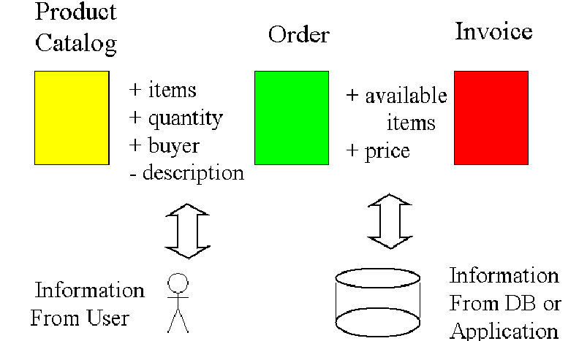
Component / Model-Driven Application Architecture

Slide 19
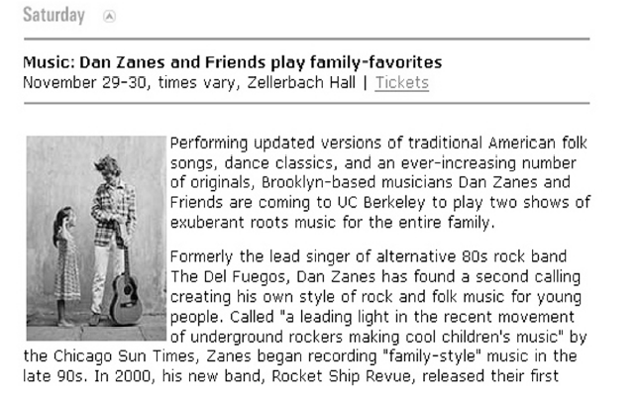
Document Analysis to Find Information Components
Figure 13.1 from Glushko & McGrath, Document Engineering

Slide 20
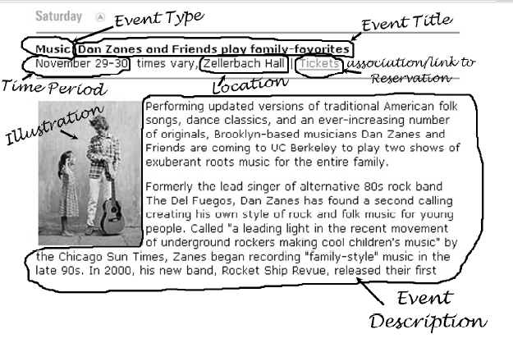
Figure 13.2 from Glushko & McGrath, Document Engineering

Slide 21
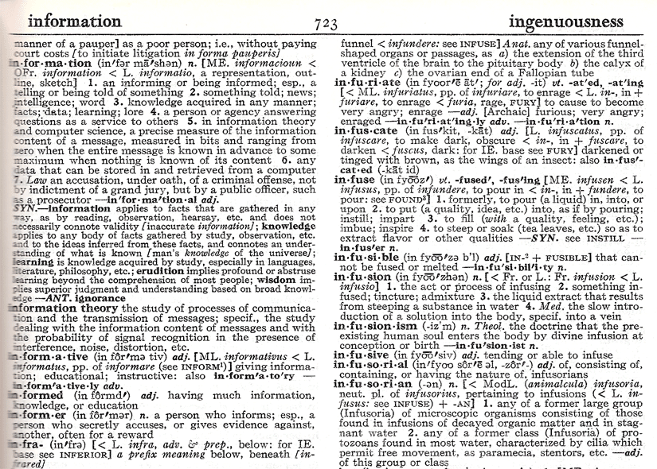
Webster’s Dictionary: What are the Information Components?

Slide 22
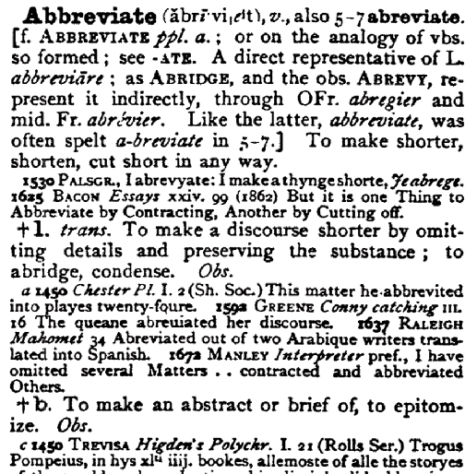
Oxford English Dictionary: What are the Information Components?

Slide 23
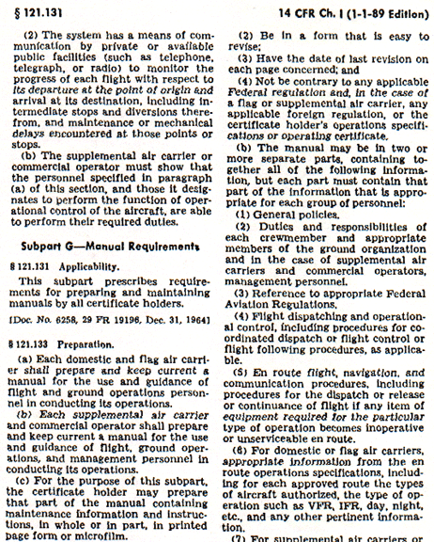
Regulation: What are the Information Components?

Slide 24
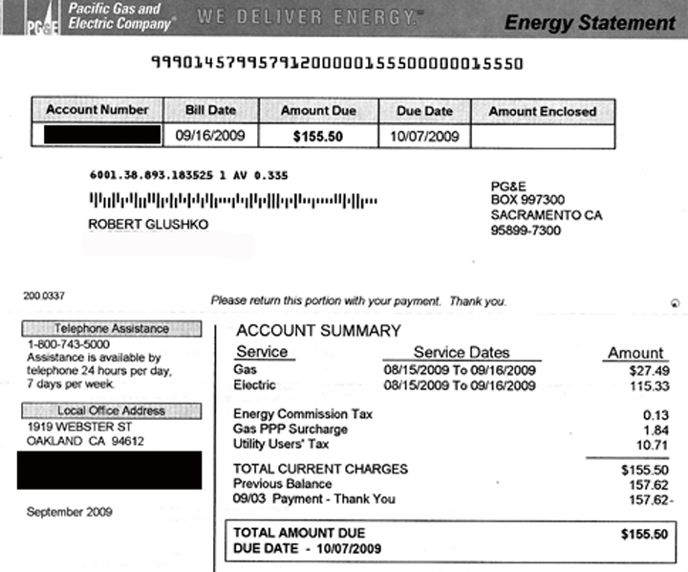
Utility Bill: What are the Information Components?

Slide 25
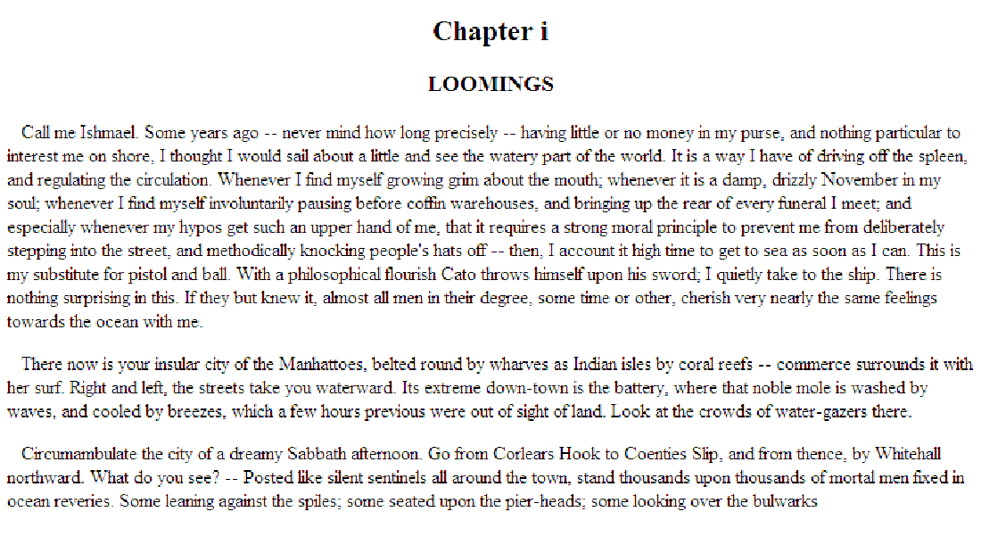
Moby Dick: How Many Information Components?

Slide 26
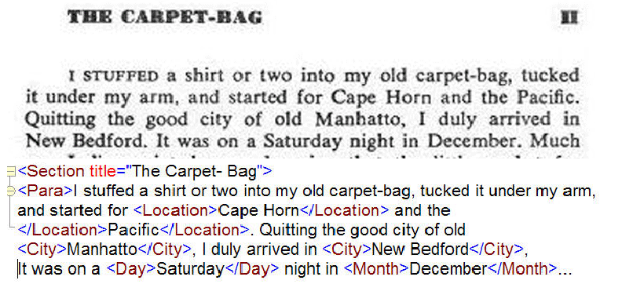
Marked-Up “Mixed Content” Moby

Slide 27
Marked-Up “Mixed Content” Moby

Slide 28
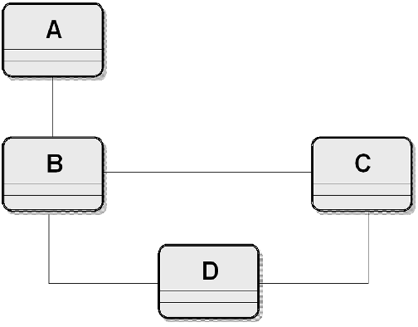
Document Component Model

Slide 29
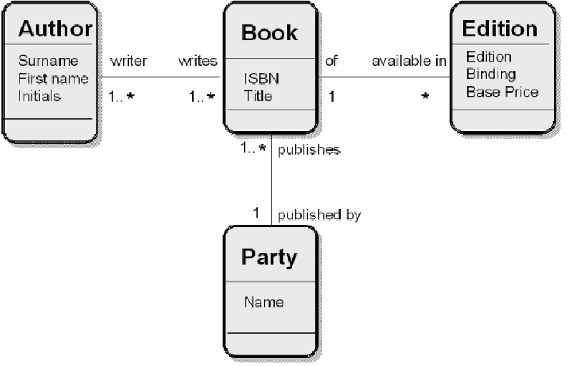
Example: Document Component Model

Slide 30
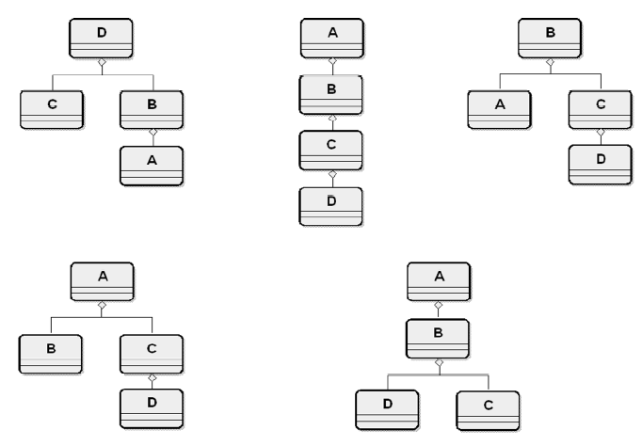
Different Document Assembly Models from Same Component Model

Slide 31
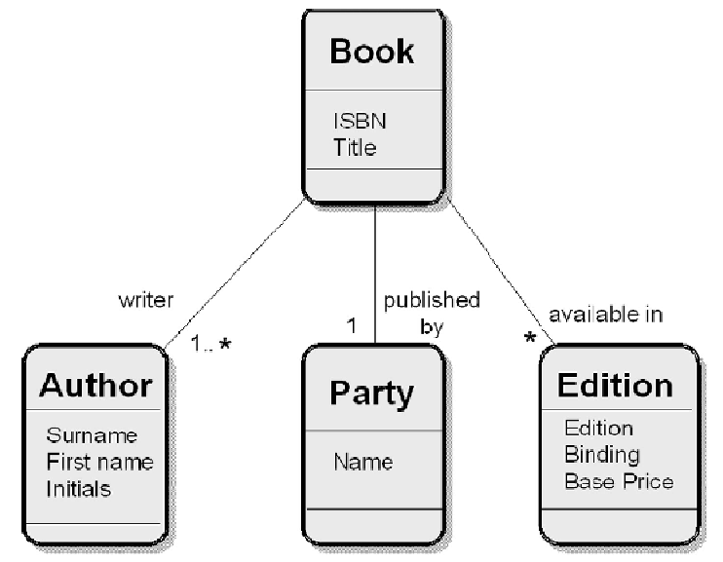
Assembly Model for “Library Catalog”

Slide 32
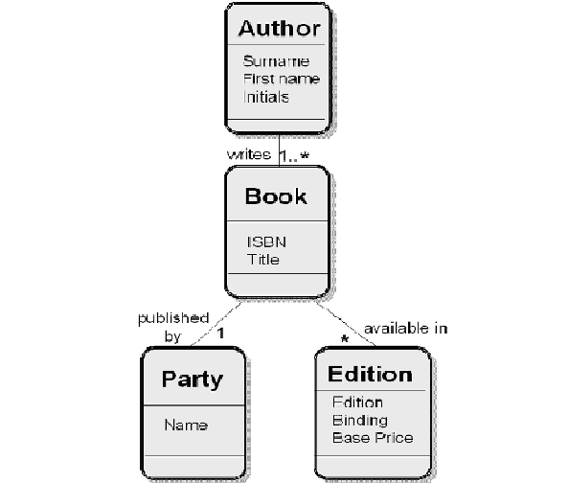
Assembly Model for “Author Catalog”

Slide 33
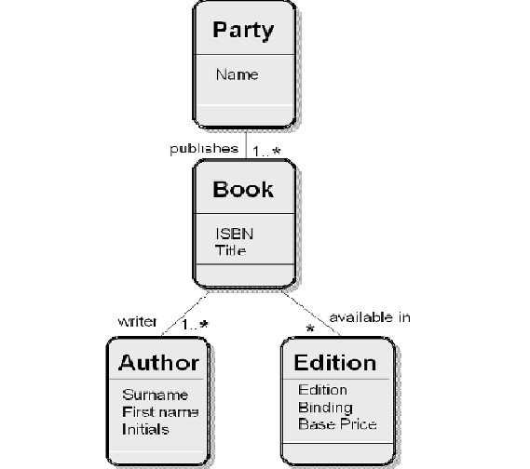
Assembly Model for “Publisher Catalog”

Slide 34
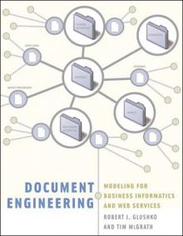
To Learn More about “Document Analysis” Read this Book

Slide 35
INFO 202 “Information Organization & Retrieval” Fall 2013
UNIVERSITY OF CALIFORNIA, BERKELEY
SCHOOL OF INFORMATION
Robert J. Glushko glushko@berkeley.edu
@rjglushko
17 September 2013 Lecture 6.2 – Names and Identifiers

Slide 36
What is a Name?
UNIVERSITY OF CALIFORNIA, BERKELEY
SCHOOL OF INFORMATION
A NAME is a label for some thing or some category that is used to distinguish one from another
Many surnames are literally resource descriptions
But most resource names do not convey properties of the resource
If a name is used to refer to some thing and is unique in some context it is an IDENTIFIER
36

Slide 37
Issues with Names and Naming – 1
UNIVERSITY OF CALIFORNIA, BERKELEY
SCHOOL OF INFORMATION
A specific resource or type or resource can often have multiple names; these are SYNONYMS or ALIASES
Different things can sometimes have the same names -- these are HOMOGRAPHS or POLYSEMES
What's a worse problem - synonymy or homography?
37

Slide 38
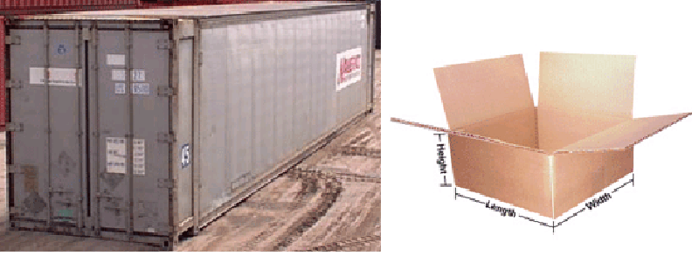
Both are “Shipping Containers”
UNIVERSITY OF CALIFORNIA, BERKELEY
SCHOOL OF INFORMATION
38

Slide 39
Issues with Names and Naming – 2
UNIVERSITY OF CALIFORNIA, BERKELEY
SCHOOL OF INFORMATION
False cognates
A name can have undesirable associations
A name can have assume impermanent attributes or associations (baby names over time)
Alphabetic ordering bias
Autogenerated names can't cross the "semantic gap”
39

Slide 40
The Vocabulary Problem
UNIVERSITY OF CALIFORNIA, BERKELEY
SCHOOL OF INFORMATION
People use a large variety of words for the same thing or concept
Most people - especially system designers - are surprised by this because they think their own word choices are “intuitive” or "natural“
The extreme variability of word selection is an inescapable fact that has its roots in the nature of language and categorization
40

Slide 41
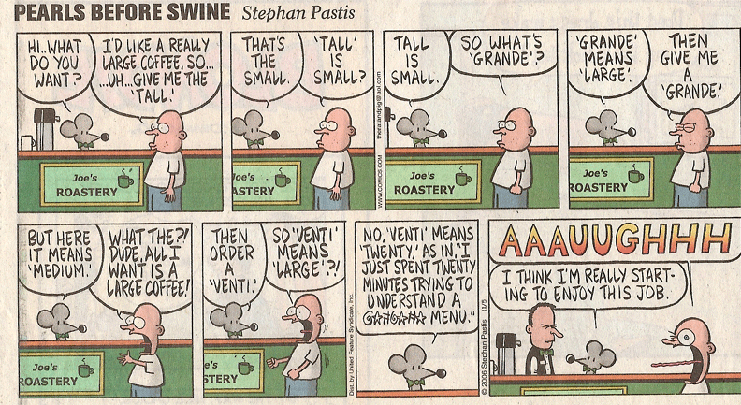
Everyday Example of the Vocabulary Problem
UNIVERSITY OF CALIFORNIA, BERKELEY
SCHOOL OF INFORMATION
41

Slide 42
Measuring the Vocabulary Problem
UNIVERSITY OF CALIFORNIA, BERKELEY
SCHOOL OF INFORMATION
Furnas et al. (1987) – classic paper in "statistical semantics” - 6 different experiments at assigning words to text editing functions, common objects, and categorization of household goods and recipes
Armchair " Method - Probability of two people coming up with the same term: 7, 8, 11, 12, 14, 18%
"Naming by Voting" -- Probability of someone using most popular word: 15, 21, 22, 28, 34, 36%
Select What I Intend" -- Probability that two people using the same term intend the same referent: 13, 15, 41, 52, 62, 73%
42

Slide 43
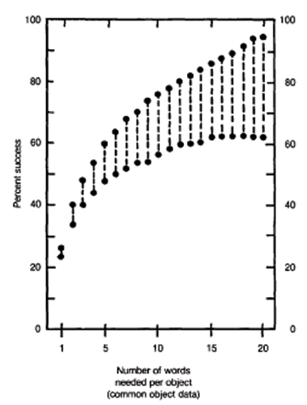
Does “Aliasing” Solve the Vocabulary Problem?

Slide 44
Identifiers - 1
UNIVERSITY OF CALIFORNIA, BERKELEY
SCHOOL OF INFORMATION
An identifier is a special type of name assigned in a controlled way and governed by rules that define possible values and naming conventions; "some person or organization asserts the relationship between the string and the thing” (Coyle, 2006, p. 428)
But the same resource can have more than one identifier
How many different identifiers can a person have?
What if the answer is “none”?
44

Slide 45
Identifiers - 2
UNIVERSITY OF CALIFORNIA, BERKELEY
SCHOOL OF INFORMATION
Identifiers are UNIQUE if they refer to one and only resource within some defined context or scope
Identifiers are PERSISTENT if they resolve to the same referent indefinitely, or as long as needed; but "persistence is a functions of organizations, not technology
Identifiers are UNSTRUCTURED or DUMB (as opposed to STRUCTURED or INTELLIGENT ) if they have no inherent meaning based on their values
Identifier schemes are designed to be STRUCTURED or INTELLIGENT but over time they often become less so
45

Slide 46
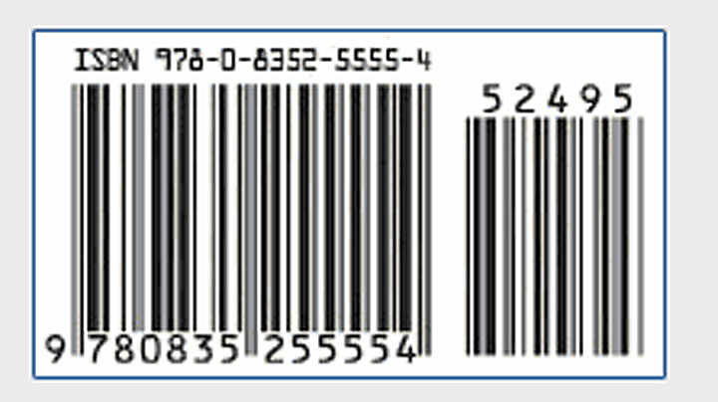
ISBN on Bar Code
UNIVERSITY OF CALIFORNIA, BERKELEY
SCHOOL OF INFORMATION
46

Slide 47
INFO 202 “Information Organization & Retrieval” Fall 2013
UNIVERSITY OF CALIFORNIA, BERKELEY
SCHOOL OF INFORMATION
Robert J. Glushko glushko@berkeley.edu
@rjglushko
17 September 2013 Lecture 6.3 – Smart Resources

Slide 48
“The Computer for the 21st Century”
UNIVERSITY OF CALIFORNIA, BERKELEY
SCHOOL OF INFORMATION
“The most profound technologies are those that disappear”
“Computers in light switches, thermostats, stereos and ovens help to activate the world”
“Doors open only to the right badge wearer, rooms greet people by name, telephone calls can be automatically forwarded to wherever the recipient may be, receptionists actually know where people are…”
48

Slide 49
“The Computer for the 21st Century”
UNIVERSITY OF CALIFORNIA, BERKELEY
SCHOOL OF INFORMATION
When almost every object either contains a computer or can have a tab attached to it, obtaining information will be trivial: "Who made that dress? Are there any more in the store? What was the name of the designer of that suit I liked last week?“
The computing environment knows the suit you looked at for a long time last week because it knows both of your locations, and, it can retroactively find the designer's name even if it did not interest you at the time.”
Mark Weiser, "The Computer for the 21st Century”
49

Slide 50
Active / Operant / Smart Resources
UNIVERSITY OF CALIFORNIA, BERKELEY
SCHOOL OF INFORMATION
“Smart” is a commonly used description of resources that can exploit sensing, computing, and communication capabilities
Virtually any product that uses electricity - toys, coffeemakers, cars, medical diagnostic machines - possesses inherent data processing capabilities. Each has a wealth of information about its current status, usage history, and performance
A “smart” resource with an IP address is said to be part of the “Internet of Things”
50

Slide 51
IBM Smarter Planet Initiative
http://www.ibm.com/smarterplanet

Slide 52
Classes of Smart Resource Applications
UNIVERSITY OF CALIFORNIA, BERKELEY
SCHOOL OF INFORMATION
Remote monitoring (of environments or products or people) via sensors that transmit data about their environment
Vendor-managed inventory ("remote monitoring" of retail shelf space)
Monitoring + capability upgrading
Remote monitoring + Interactive control
52

Slide 53
What Can a Sensor Sense?

Slide 54
Some Design Issues for Smart Sensing
UNIVERSITY OF CALIFORNIA, BERKELEY
SCHOOL OF INFORMATION
How is the information obtained from the environment?
Are the sensors in known locations, or is locating and arranging them a task in its own right?
How "smart" is the information communicated by the sensor?
What initiates the sending of context information to the recipient?
54

Slide 55
Dealing with the Data Torrent
UNIVERSITY OF CALIFORNIA, BERKELEY
SCHOOL OF INFORMATION
If low-level sensor information is being captured there can easily be too much of it, but making resources smarter so they can do local processing makes them vastly more expensive
How can sensors decide what are "significant' events in the torrent of data?
How does the information recipient process the sensor information?
55

Slide 56
Ad hoc Sensor Networks
UNIVERSITY OF CALIFORNIA, BERKELEY
SCHOOL OF INFORMATION
Dozens, hundreds, or even thousands of tiny, battery-powered computers, often called motes, can be scattered throughout the environment to collect sensor data
The Motes form an ad hoc network that relays the sensor data, to a specified destination for processing.
See http://www.xbow.com for some obvious applications
56

Slide 57
Context Awareness
UNIVERSITY OF CALIFORNIA, BERKELEY
SCHOOL OF INFORMATION
Where are you?
What are you doing, looking at, looking for?
Who are you with?
What’s it like there?
57

Slide 58
Location and Activity Tracking
UNIVERSITY OF CALIFORNIA, BERKELEY
SCHOOL OF INFORMATION
Objects are identified and "timestamped" in known locations - e.g., package / pallet tracking, Fastrak transponders to pay bridge tolls
Objects identify their location
Supply chain and Demand chain (information about demand for, use of products that moves in the opposite direction from the supply chain) - what potential customers want, when and where they become customers by buying something, how they use the products
Tagg - the Pet Tracker & LoJack
58

Slide 59
Remote Patient Monitoring
UNIVERSITY OF CALIFORNIA, BERKELEY
SCHOOL OF INFORMATION
Classic Commercial for "Lifecall”
Enabling "aging in place" with "assistive technology" can vastly improve the quality of life for old folks
Three kinds of services: assurance, support (compensation for impairment), and assessment (determining physical or cognitive status
59

Slide 60
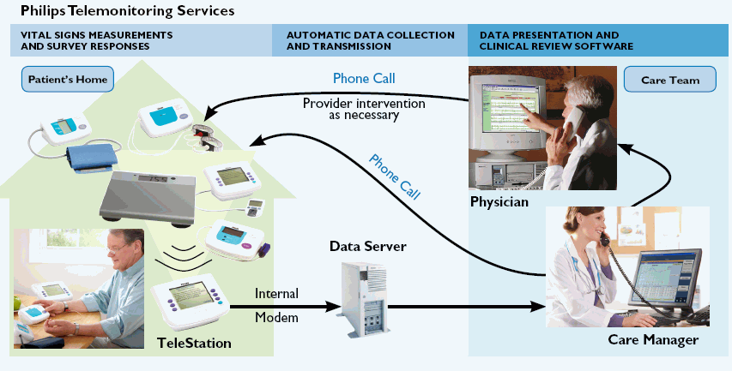
Remote Patient Monitoring
UNIVERSITY OF CALIFORNIA, BERKELEY
SCHOOL OF INFORMATION
See fitbit and whistle and NY Times 12 September 2013
60

Slide 61
Smart Transportation Systems
UNIVERSITY OF CALIFORNIA, BERKELEY
SCHOOL OF INFORMATION
Goal is to build a transportation system that will be more efficient, less polluting, and safer for better-informed drivers
"Personal navigation devices" (PNDs) have until recently been dedicated devices, often built into vehicles, but we're starting to see them as smart phone applications
61

Slide 62
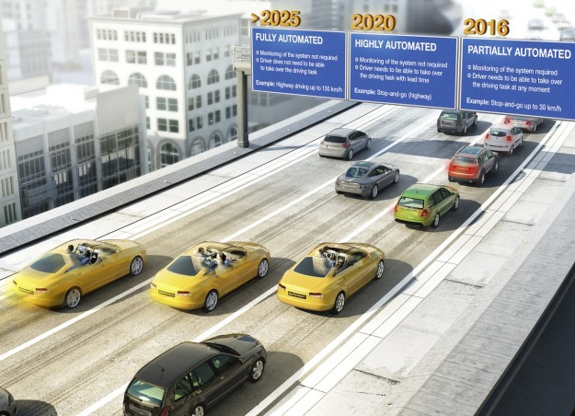
BMW’s Vision of Smart Cars
http://www.digitaltrends.com/cars/bmw-teams-with-continental-for-fully-autonomous-cars-by-2025/

Slide 63
Privacy as a Limiting Factor in Smart Resources
UNIVERSITY OF CALIFORNIA, BERKELEY
SCHOOL OF INFORMATION
A limiting factor on context-aware smart services might well be the willingness of people to allow service providers to use information about their current or previous contexts
Nevertheless, privacy or spam concerns or other worries about annoyances from commercial firms seem minor compared to potential abuses by governments.
63

Slide 64
Readings for Next Lecture
UNIVERSITY OF CALIFORNIA, BERKELEY
SCHOOL OF INFORMATION
TDO 4 up until 4.4; 4.5 Key Points
Coyle, Karen. Library Data in a Modern Context.
At kcoyle,net, follow the link that says ”Excerpt from Understanding the Semantic Web”
64

