Slide 1
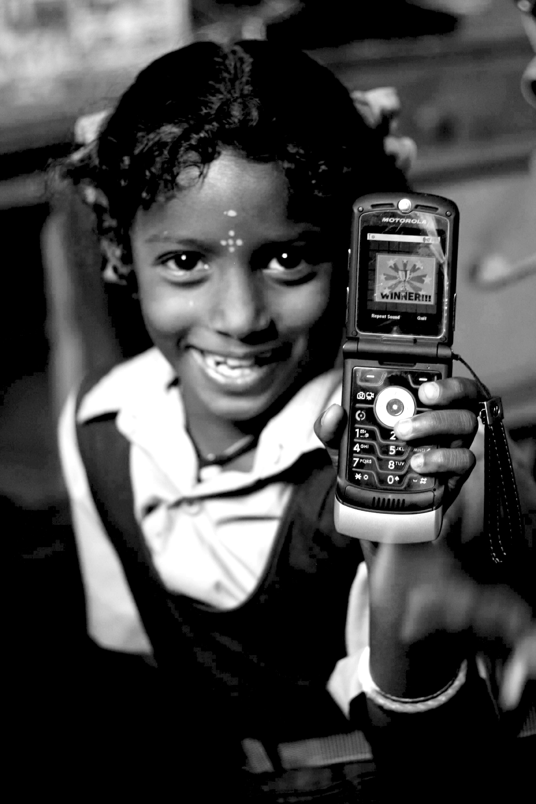
Thinking Big: Model, Projects, Critiques
05.29.12
Janaki Srinivasan
Neha Kumar

Slide 2
On Thursday (5/24)
Collected: Reading Response #1
Discussed: Technology & Poverty photo submissions
Technology: Hazards and determinism
Development: Evolution of ideas and models
Things to look for in a Technology and Development Project
Assigned: Groups + positions for Green Revolution debate

Slide 3
Administrivia
Anyone not on the class mailing list yet?
Any problem accessing readings and lecture slides online?
Comments on Reading Response 1
Check schedule to know what’s due each class
Course Reserves listed on About tab
Join Facebook Group: “I181 (Summer 2012)”

Slide 4
Outline for Today
Review of lessons learned last class
Thinking Big
Model
The case of Akosombo dam
Critiques
Break
The Green Revolution: Debate and discussion
Thursday’s Lecture

Slide 5
Review: ‘Technology’
as artifact and as ideology (Hazardous concept?)
The material form of a technology as shaped by social processes (see SCOT)
Relevant Social Groups
Interpretive Flexibility
Closure
Black-boxing
Guard against Technological Determinism!

Slide 6
Review: ‘Development’
A model of development
entity doing development
object of development
goals of development
preferred means of development
Role of technology?
Changes over six decades
Aid regime (1950s-1960s)
Basic needs (1970s)
Structural adjustment/ Washington consensus (1980s-1990s)
New Institutionalism (post 1990s)

Slide 7
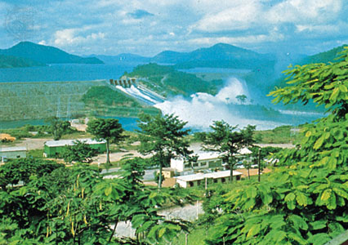
Characterizing Dam Projects
Large Scale
Capital-intensive
Infrastructure for Industrialization
Multiple uses: energy needs, irrigation, flood control

Slide 8
Financing Dam Projects
AID REGIME
BASIC NEEDS
STR. ADJ. + WASHINGTON CONSENSUS
NEW INSTITU-TIONALISM
1950
1960
1970
1980
1990
2000
Before 1980 – loans tied to particular projects
After 1980 – general loans to national governments tied to policy reforms (adjustment lending)

Slide 9
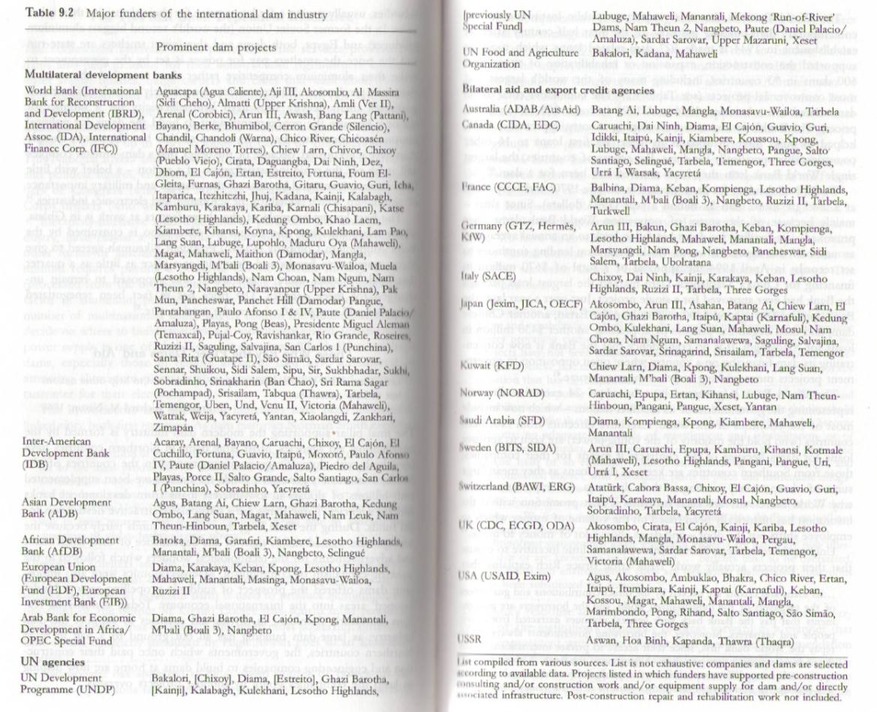
[dams and their funders – source Silenced Rivers: The Ecology and Politics of Large Dams, by Patrick McCully, 2001]

Slide 10
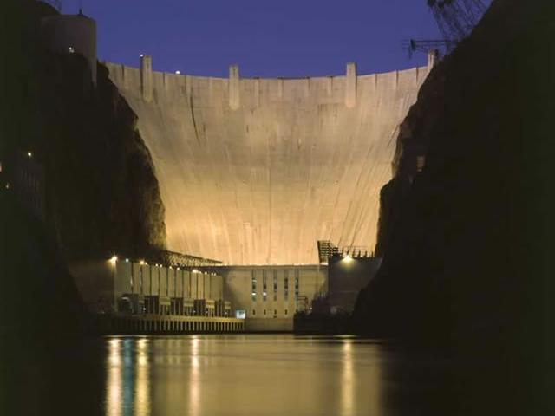
Dams As Monuments, Displays of Power
Notes:
Books that address this and related issues:
Adas, Machines as the Measure of Men
Nye, American Technology Sublime
Marvin, When Old Technologies Were New
Scott, Seeing Like a State

Slide 11
Odes to the Dam
“It is certainly one of the world’s wonders, that sweeping cliff of concrete, those impetuous elevators, the labyrinth of tunnels, the huge power stations. Everything about the dam is marked by the immense smooth efficient beauty that seems peculiarly American.”
- novelist Wallace Stenger
on the Hoover Dam

Slide 12
Odes to the Dam
“What a stupendous magnificent work – a work which only that nation can take up which has faith and boldness!... where thousands…of men have worked, have shed their blood and sweat and laid down their lives as well? Where can be a greater and holier place than this?...”
– Jawaharlal Nehru
first prime minister of India on the Bhakra Dam in Punjab

Slide 13
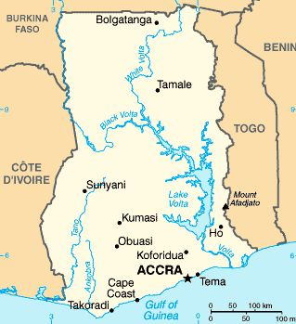
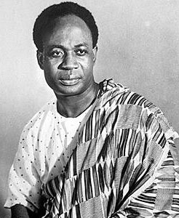
Akosombo Dam
Kwame Nkrumah,
first president of Ghana
Notes:
Source: http://media-2.web.britannica.com/eb-media/87/13587-004-BB82FE25.jpg
http://images.encarta.msn.com/xrefmedia/sharemed/targets/images/pho/t038/T038172A.jpg

Slide 14
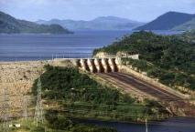
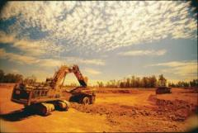
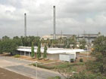
Nkrumah’s original vision
Akosombo:
Hydroelectric Dam
Water
Electricity
Awaso:
Bauxite Mine and Refinery
Tema:
Valco Aluminum Smelter
Bauxite
Alumina
Aluminum

Slide 15
World Bank Funding

Slide 16
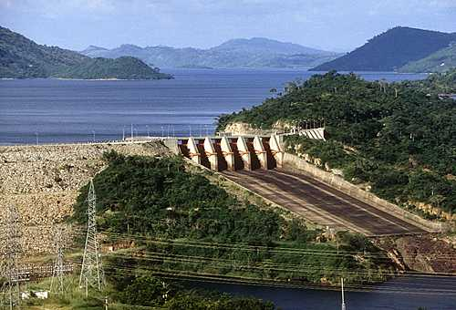
Other actors and the deal that was struck
Kaiser Corporation
finances the aluminum smelter
agrees to buy electricity from the dam
is given electricity at extremely low price to run the Volta Aluminum Company (VALCO) aluminum smelter at Tema.
Notes:
Source: http://media-2.web.britannica.com/eb-media/87/13587-004-BB82FE25.jpg

Slide 17
Social and Environmental Outcomes
Displacement of villages in Volta basin – 80,000 people
Creation of a fishing industry (40,000 tons annually)
Increase in Bihlarzia disease around the newly formed lake (unanticipated)
Contamination to water source from DDT sprayed to combat disease (unanticipated)

Slide 18
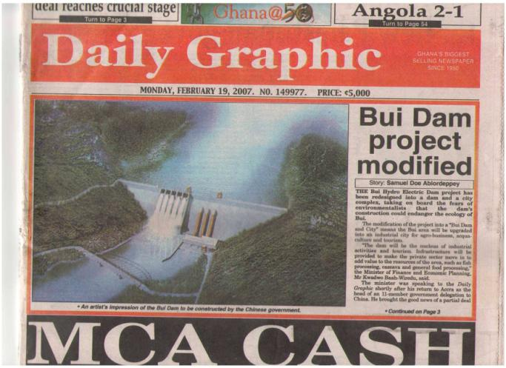
Akosombo Dam Today
Periodic droughts lead to rolling blackouts – demand has outstripped supply
Ghanaian Gov. eventually buys out Kaiser; Valco is now 100% state-owned
Recently revived interest in Bauxite mining and refinery
Smaller Bui dam to be built with investment from the Chinese government
Feb. 2007 news item about a new dam project in Ghana

Slide 19
Movement of People in the Wake of Industrialization
Rural to Urban Migration
To find work as industrial laborers
Development-Induced Displacement and Resettlement (DIDR)
When people have to move to make way for infrastructure development projects

Slide 20
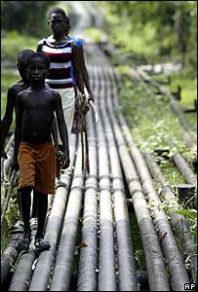
Direct vs. Indirect Costs and Benefits
Who is burdened with the projects costs and who reaps the rewards?
Who makes those decisions in the planning phases?
How do different groups benefit directly or indirectly from the project?
Where are the rural poor in this?
Scale Neutral?
Notes:
http://newsimg.bbc.co.uk/media/images/41318000/jpg/_41318252_pipes_ap_300.jpg

Slide 21
Modernization Paradigm/ Neoclassical Economic Growth Model
 | Akosombo Dam
Who is doing the development | World Bank, national government, Kaiser?
What/Who is being developed | The national economy
Proximate change (short-term) to be brought about | Electricity supply for factories, to sell to neighbors, self-sufficiency in power generation
The eventual outcome or development to accomplish | Industrialization of economy leading to growth and higher standard of living
Mechanism for bringing about this change | Building a hydroelectric dam with financial support from a consortium of international investors (USAID, Kaiser, etc.)

Slide 22
Summary
Dams as symbol and monument to progress and power
Direct vs. Indirect Costs and Benefits
The Issue of Scale
“I have been beginning to think that we are suffering from what we may call ‘disease of giganticism’…We want to show that we can build big dams and do big things…but the idea of having big undertakings and doing big tasks for the sake of showing that we can do big things is not a good outlook at all.”
Nehru in 1958

Slide 23
Rethinking Neoclassical Growth Models/ Modernization Paradigm
Rethinking the problem
How development discourse frame a problem/ object of development
Who does the framing?
With what motivations?

Slide 24
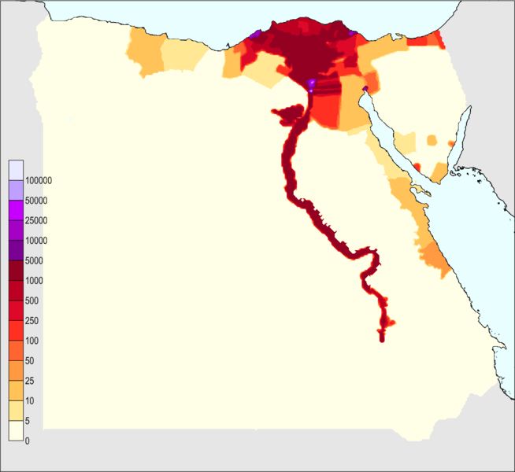
Mitchell’s Critique of Development Institutions (Egypt)
Picking apart the way development institutions frame
‘underdevelopment’ as natural
its solutions as technical
Alternate diagnosis?
Powerlessness and social inequality
Solution?
Population density per sq km. in Egypt (2010)

Slide 25
Rethinking Neoclassical Growth Models/ Modernization Paradigm
Rethinking the proposed solution
scale
distribution of costs and benefits (and who decides)
ecological considerations
Alternatives?
Appropriate technologies
Sustainable development
Participatory development
Social entrepreneurship?

Slide 26
Take a break!

Slide 27
Activity: Green Revolution Debate

Slide 28
On Thursday (5/31)
Lecture: “Thinking Small: Appropriate Technology, Participatory Development and Social Entrepreneurship”
Understand a few proposed alternatives to the mainstream neoclassical economic growth model/modernization paradigm
Due before class
Do the readings: Schumacher, Chambers, Prahalad, Fisher
Reading Response 2 based on Thinking Big and Thinking Small readings
Activity in class: Discussion of Assignment 1

