Slide 1
PMO, PSO, EPMO Discussion Successes and failures Lisa Bausell MBA, PMP

Slide 2
What problems are we trying to solve?
Each business unit doing “their” projects
Project selection by loudest voice
Project failure rate too high
Lack of consistency
Resources not coordinated
Project rollout not well planned

Slide 3
Services of a PMO
Data for project selection
Standards and metrics
Policies
Resource Management
Software
Time tracking
Cost tracking
TRANSPARENCY

Slide 4
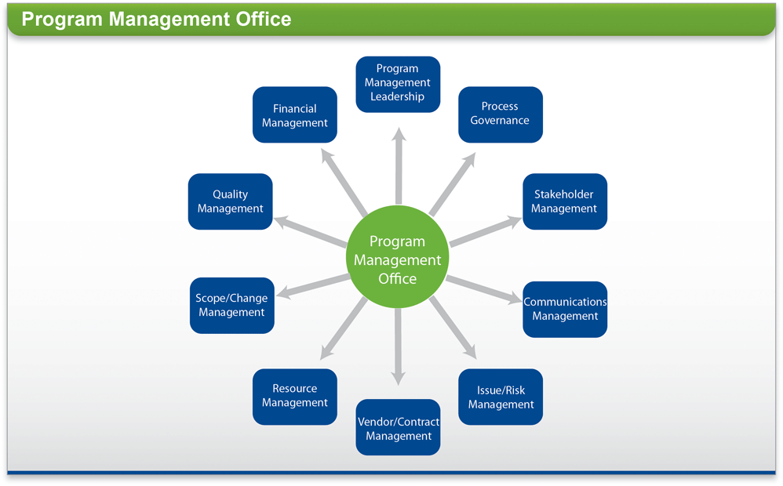
PMO Involvement

Slide 5
Definition
PSO
PMO
EPMO

Slide 6
Scope
Portfolio
Program
Project

Slide 7
Who are the customers of the PMO
Project Managers
Stakeholders
Sponsors
Executives
Department Managers

Slide 8
PMO – Keeper of the stats
Lessons learned
Trending
Find projects in trouble early
Executive decision making support
Resource planning (past, current, future)

Slide 9
Link to corporate strategy
Help to do the right projects and not just do project right
Strategic planning/project committees
Finance
IT
Business
HR
Link to CEO

Slide 10
PMO in action
Who do the PMs work for?
Who makes decisions of what projects to do?
Delivery of updates and news (PMO? PM’s?)

Slide 11
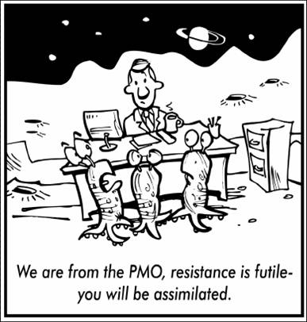
PMO Road to Failure

Slide 12
Problems
Perception ? Reality?
No buy-in
Bad for cowboys and cowgirls
Too much time needed to track
Cumbersome process holds up work
Neutralizes power

Slide 13
Case study, how not to start a PMO
Try to do too much at once
Bring in consultants to do all the planning
Plan for MONTHS and then implement everything
Don’t get participation from all levels
Go too slow or too fast

Slide 14
Success tips for PMO’s
Executive support
User support
PM’s need to see the benefit
Scope in line with organization
Show value immediately
Deliver news to different audiences in different ways
Continuous improvement!

Slide 15
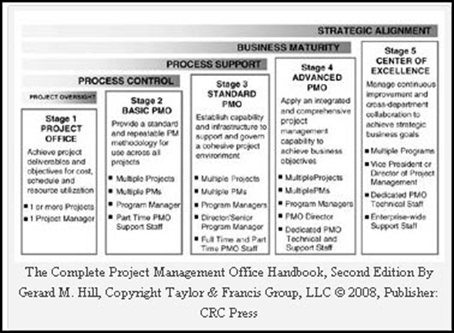
PMO Maturity

Slide 16
Questions?
Thank You

Slide 17
PMO, PSO, EPMO Discussion Successes and failures Lisa Bausell MBA, PMP

