Slide 1
Kanban in the Management of Projects
Glenn Ballard
April 18, 2013

Slide 2
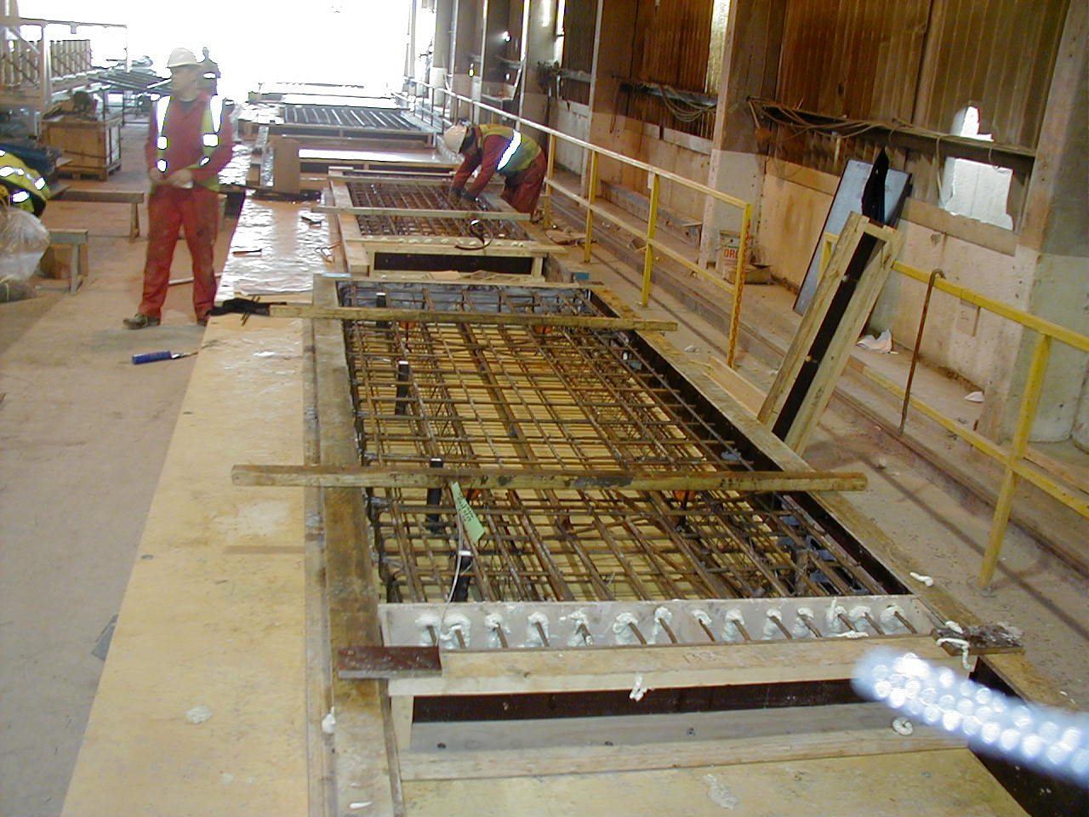

Slide 3
XYZ Production Cell: Shear Walls Process Chart

Slide 4
XYZ Production Cell: Shear Walls Current State Process Chart
Build up of inventories and cycle time in push systems

Slide 5
XYZ Production Cell: Shear Walls Future State Process Chart
Flow when you can, pull when you can’t, push when you must

Slide 6
Productivity Improvement in Shear Walls at Malling Precast
Previous Prep Week Target
Workers: 12 14 12
Output: 3.2 6 9
Productivity
Improvement: 281%

Slide 7
Malling Revenue

Slide 8
Key Points
Reducing cost in any part of a process helps only if the cost of the entire process is reduced.
Increased the per ton cost of reinforcing steel in order to reduce the quantity delivered…in order to reduce time spent looking for and handling materials…in order to free time for value-adding work…in order to increase capacity.
Increased the cost of carpentry services in order to make each production cell independent…in order to reduce waiting time…in order to …
We now had more capacity to produce precast products, but to use that capacity productively, we needed to have work flow evenly and predictably. Better coordination was achieved through pull and flow, which--together with a batch size of one--reduced cycle time. If we limit WIP in the system, cycle time reduction increases throughput (TH=WIP/CT).
Impact of process design on productivity
Almost tripled throughput and productivity by changing only the way work flowed through the production cell. No changes were made in technology, tools, skills, or work methods.

Slide 9
Kanban
Kanban is a tool for sending a pull signal to humans; in other words, a request. It can be a tag with preprinted information on it, it can be a bar-coded container, it can be a rule everyone knows to follow.

Slide 10
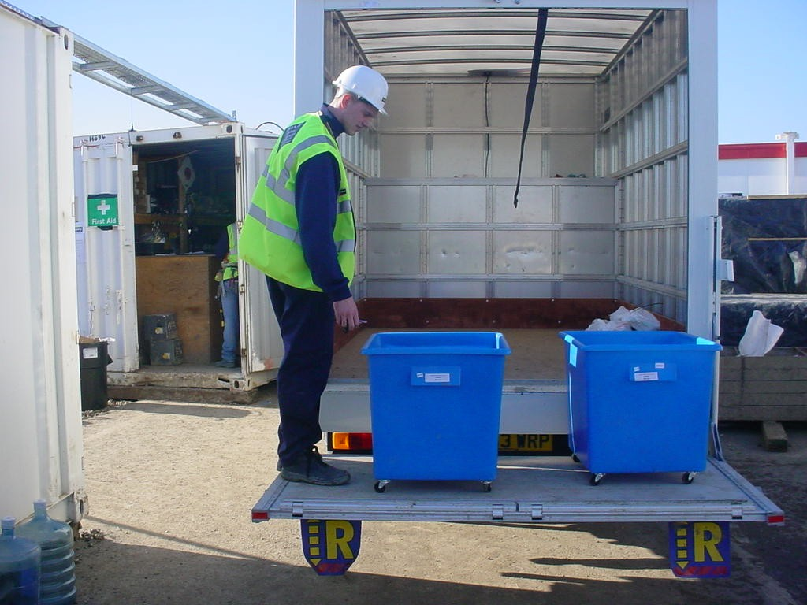
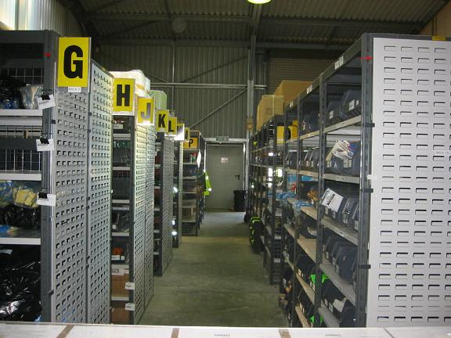
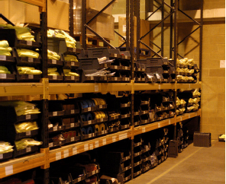
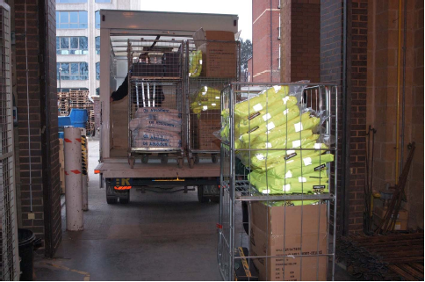

Slide 11
Kanban and Requests
A kanban is a predetermined request: ‘Send me a pound of #6 nails’ or ‘Can you have the soils report to me by Friday?’. Let’s look at how requests are determined.

Slide 12
Reliable Promising
1
Request
“Will You?”
Inquiry
PO
Negotiation
Accepted
Submitted
Clarification
&
Negotiation
Signed
Preparation
CUSTOMER
Conditions of
Satisfaction
&
Date of Completion
Conditions of Satisfaction
&
Completion Date
COMMIT
“I Promise I WILL”
4
Declare
Satisfaction
“Thank you”
2
PROVIDER
Assurance
Performance
3
Declare
Complete
“I’m Done”

Slide 13
Construction Weekly Work Plan
Research in 1990s found average PPC = 54%

Slide 14
Issue #1: How to increase the match between WILL and DID?
Only include in daily/weekly work plans tasks that are sound, sequenced, sized, and well defined.

Slide 15
Issue #2: How to make ready what SHOULD be done so it CAN be done?
Identify & Remove Constraints
Replan when constraints cannot be removed in time
Breakdown tasks into operations
Design new operations collaboratively

Slide 16
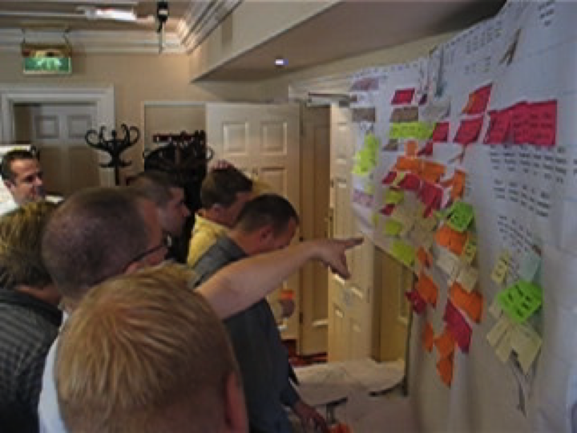
Issue #3: How to set goals and sequence tasks? How to decide what SHOULD be done when?

Slide 17
Last Planner Principles
Plan in greater detail as you get closer to doing the work.
Produce plans collaboratively with those who will do the work.
Reveal and remove constraints on planned tasks as a team.
Make reliable promises.
When promises are broken, find root causes and preventions—learn from those breakdowns.

Slide 18
Report from Sutter Health on Lean Project Delivery: Costs–Projects over $10M
22 ‘lean’ projects delivered since 2005
No projects over budget or schedule
No sacrifice of scope or quality
Cost at completion 3.4% under budget on average
Cost at completion approx. 15% under market on average
18

Slide 19
Eden Medical Center Replacement Hospital
$309M Project Budget
130 licensed beds, 223,000 SF
Completion: 3Q 2012
19

Slide 20
Performance – Eden Medical Center
Ahead of schedule and under budget
No compromise to space program or sustainability goals
Construction rework 15-80% less than trade baselines
Productivity 5-20% greater than trade baselines
Mechanical/Plumbing installed exactly to the model 99% of the time
Electrical installed exactly to the model 71% of the time
Framing installed exactly to the model 79% of the time
Fewer RFI’s, Change Orders and failed inspections than Sutter ‘legacy’ projects
‘Tool time’ significantly higher than industry standards
20

Slide 21
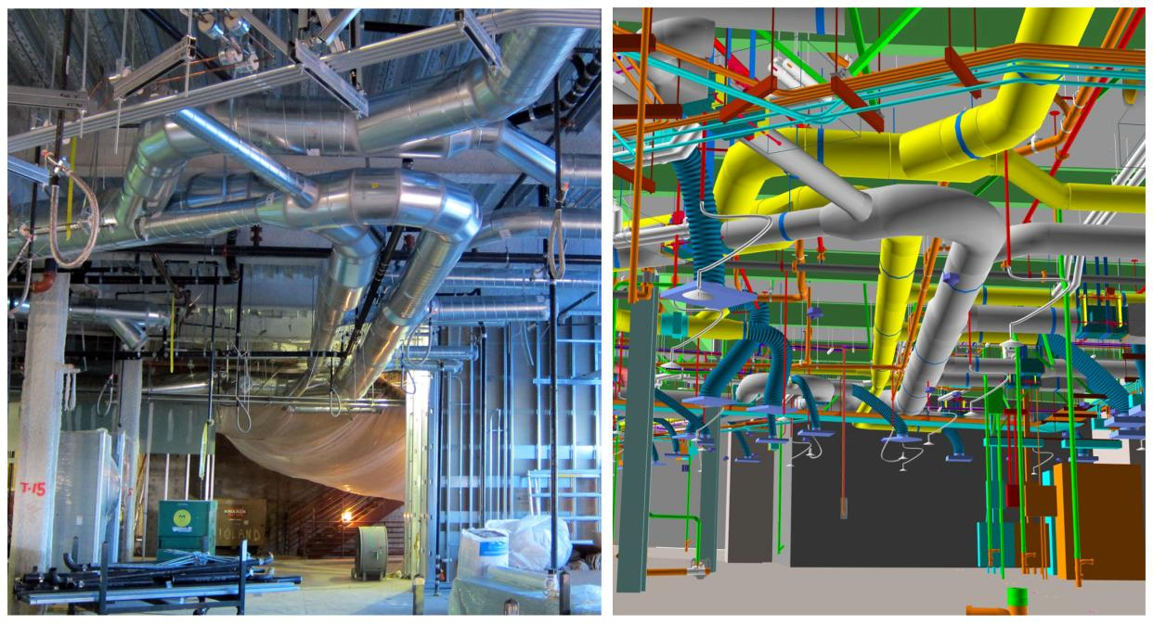
Eden Medical Center – adherence to the model
21

Slide 22
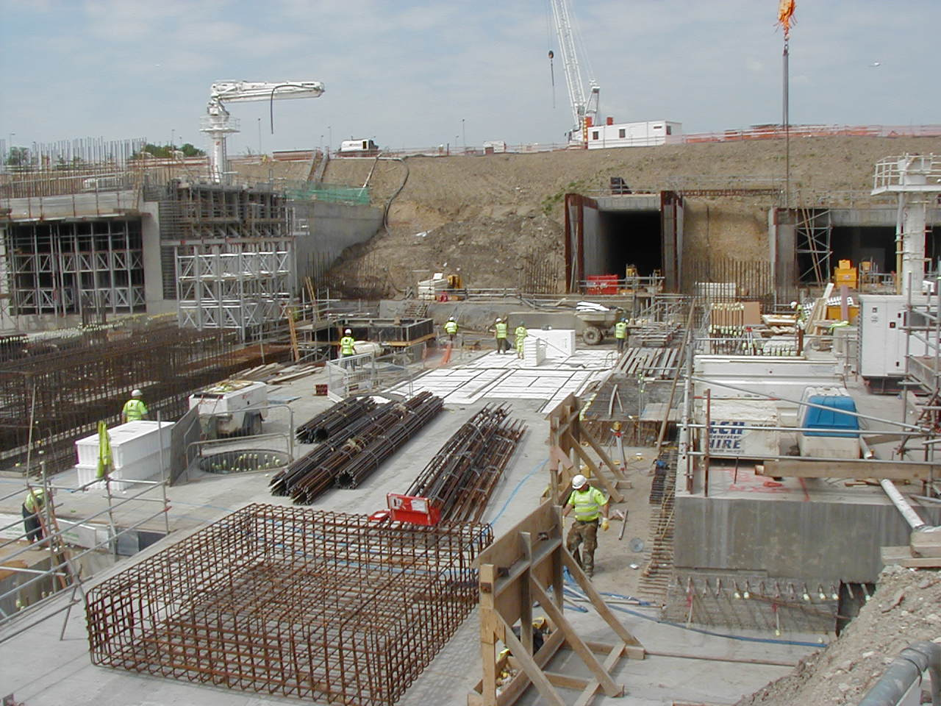
Terminal 5 Project, Heathrow Airport, London

Slide 23
Value Stream Mapping
Detailing of reinforced concrete structures

Slide 24
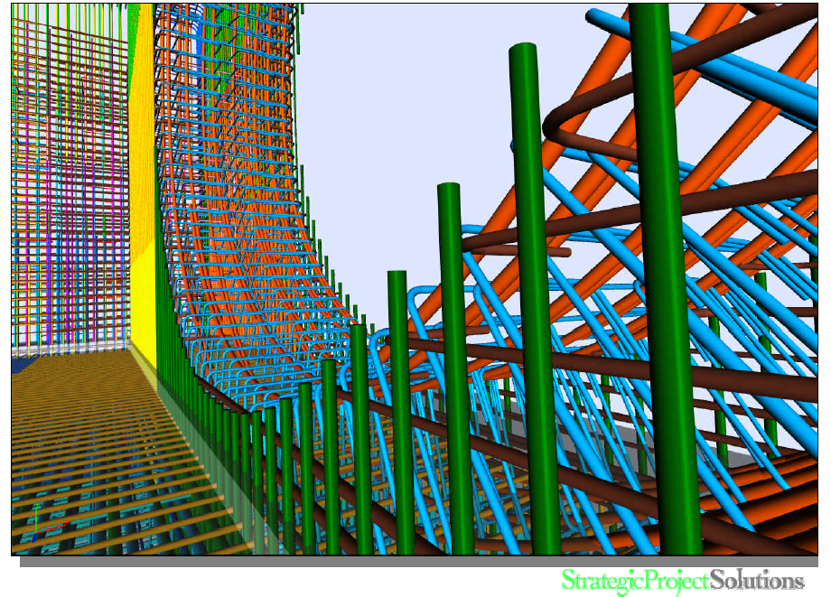

Slide 25
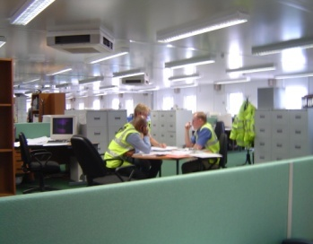
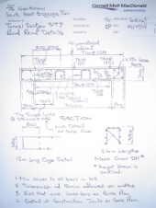
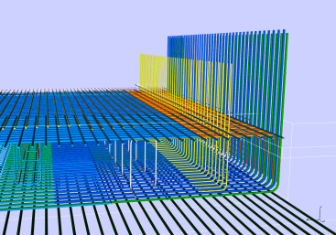
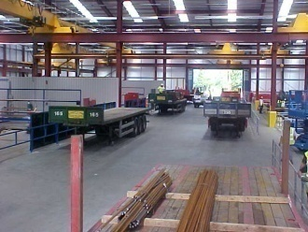
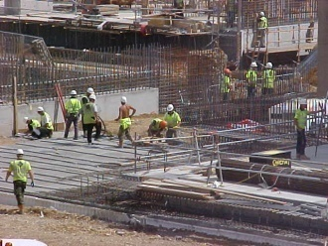
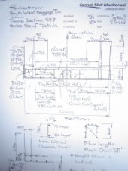
Lean Construction
Rebar Production Process + CONWIP Control
Pull
Engineering
Fabrication & Assembly
Installation
2 Days
1 Days
2 Days
ProjectFlow

Slide 26
Programme Improvement – Railbox East (Critical Path)
Results:
Compressed 9 month duration into 5.5 months
Railbox saving in steelfixing Ops £ 776,160 (19%)
Oct Nov Dec
Jan Feb Mar Apr
May Jun Jul Aug
Sep Oct Nov Dec
Start Enabling Works
09 Dec
24 Mar
Recovery Measures
Reduce Durations &
Overlap Activities
Start SRC Works
13 Jan
07 Apr
SRC Works
SRC Works
19 May
SRC Works Complete
Backfill
Form Piccex LC Compound
12 Sep 03
Anchor Milestone
Piccex Launch Chamber &
Compound F Available

Slide 27
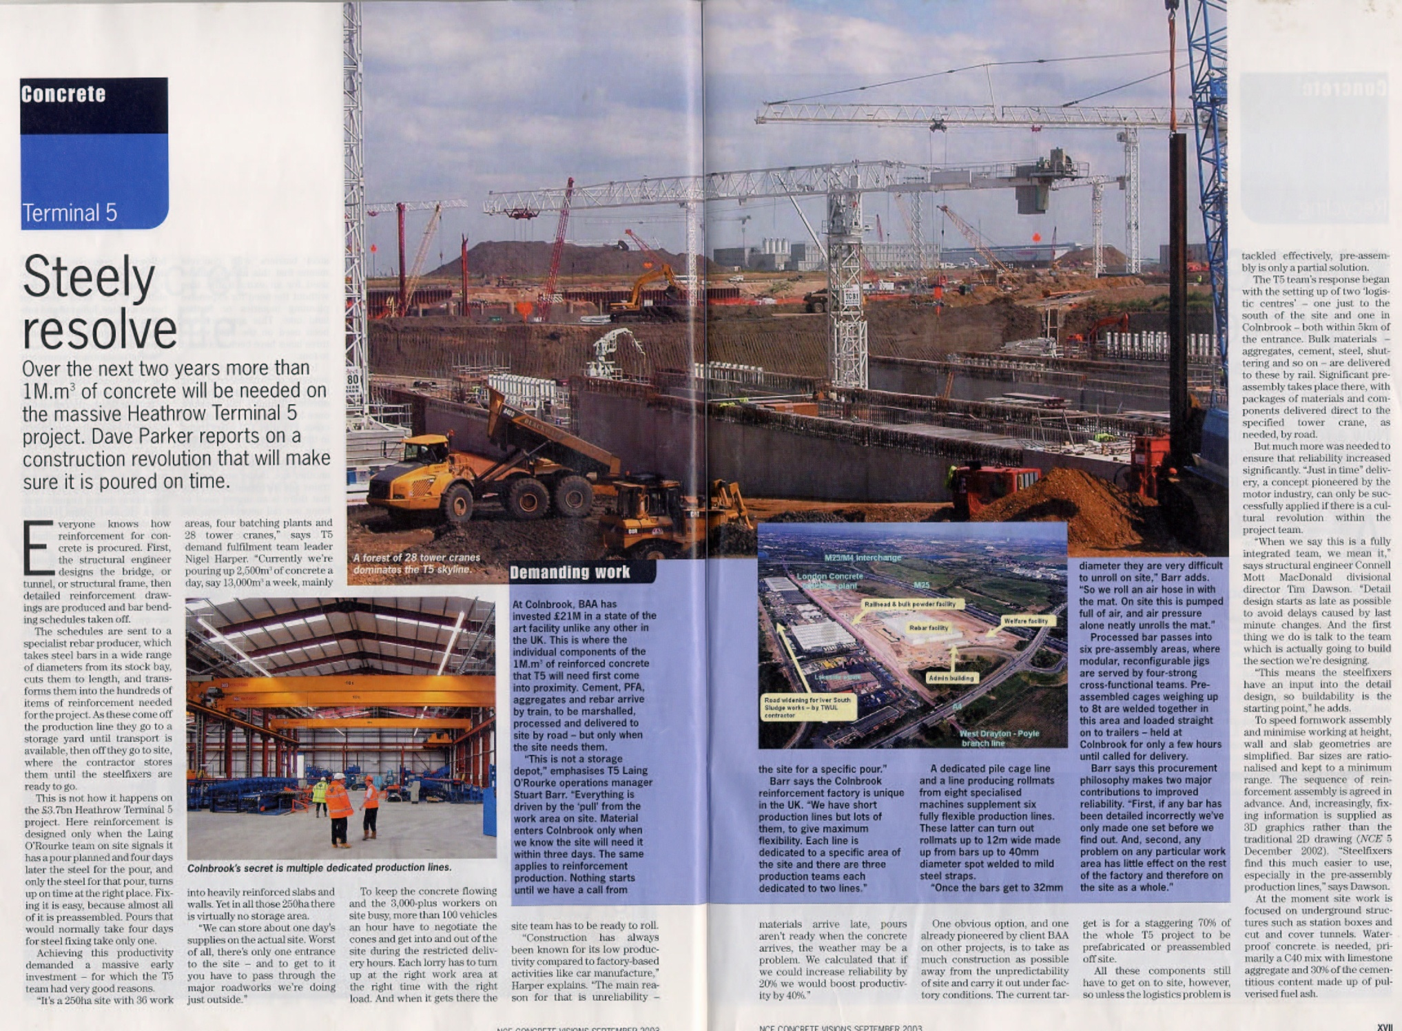
Results:
First major UK civil project in last 40 years to be delivered on time
$125 million cost savings in civil phase; 10% of contract value

Slide 28
Takeaways?
Questions?

