Slide 1
Lean Delivery:
The Future of Project Management
Nigel Blampied

Slide 2
What is Lean?
In humans and animals:
“containing little or no fat”
    - dictionary.com, merriam-webster.com
Concept in human language for millennia
Reduction of waist
In organizations:
Designing production systems to minimize waste and maximize value for the end customer.
Reduction of waste
Term adopted by John Krafcik in 1988 to describe the Toyota Production System
  Krafcik, JF (1988), "Triumph of the lean production system", Sloan Management Review, Vol 30 No1, pp41-52
Notes:
I used to weigh 64 pounds more than I do now
Experienced health problems
Doctor said to lose weight
Joined weightwatchers and lost 64 pounds
This has relevance to the definition of LEAN
Known since earliest time that people and animals become thin in times of famine
And fat when they eat a lot
Found in Hebrew scriptures
Joseph’s dream of 7 lean cattle and 7 fat cattle
Writer of Genesis did not invent these words
Lean production is a new use of an age-old word
Word has been in use in English for more than 1,000 years
The analogy is useful, although not perfect

Slide 3

How Humans and Animals become Lean
Diet and exercise
Again, known for millennia
Simple concept, but difficult to implement
Notes:
Difficult:
We know it, but nevertheless have an obesity epidemic
Worldwide health problem
I knew I was overweight throughout the 20 years that I was overweight
I lost weight because of fear I was afraid of having a stroke

Slide 4
How Organizations become Lean
Reduce the seven wastes (muda) - items that incur cost without adding value
  Transportation
  Inventory
  Motion
  Waiting
  Over-processing
  Over-production
  Defects
Reduce inconsistency / variation (mura)
Eliminate unreasonable demands (muri)

Slide 5
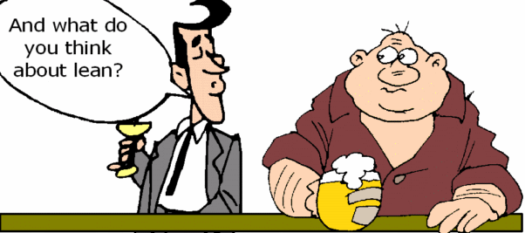
Lean in Organizations
Need to optimize the system (Reduction of one of the seven wastes might increase other wastes)
Zero waste is impossible, but it is always possible to do better
Notes:
“Zero waste” is used to refer to “zero landfill”.
The effort involved in reaching zero landfill outweighs the benefits
The world does not have a shortage of landfill space
In recycling and reusing the last pieces of material, one creates enormous effort that could be used more productively elsewhere
E.g., using carbon energy to reduce landfill
Hiring specialist contractors to get rid of last pieces of waste, who in turn produce landfill
Need a systems view
ISO 14040 Life-Cycle Assessment

Slide 6
Lean and Project Management
Modern Project Management
  The Triple Constraint
  PMBOK® Guide Third Edition, 2004, page 8:
    “Project managers often talk of a “triple constraint” - project scope, time and cost – in managing project requirements”
  No longer in Fourth Edition, 2008, and Fifth Edition, 2012

Slide 7
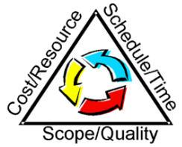
Triple Constraint
"Time, Budget, Scope: pick
any two" ‐ Greg Larman
sign at an automotive repair
shop:
  "We can do GOOD, QUICK and
  CHEAP work. You can have any two but not all three:
    GOOD QUICK work won't be CHEAP
    GOOD CHEAP work won't be QUICK
    QUICK CHEAP work won't be GOOD"

Slide 8
Lean rejects the Triple Constraint
One can be faster and better without increasing cost
How:
  People: training, mentoring, and hiring workers with different skills
  Adopting more efficient processes
  Using tools to increase productivity
Notes:
Note: not cheaper
Most clients want the best value for their budget, rather than a lower cost

Slide 9
People and Processes
People
Change adopted by management
Implemented through specialists - trainers, mentors, HR professionals (outside stimulus)
Processes
Sanctioned by management – create an environment that fosters systematic innovation
Developed and implemented by front-line workers
Works best when benchmarked with other similar operations (outside stimulus)
It is helpful to have training in process improvement techniques (outside stimulus)
Improvements are adopted by management

Slide 10
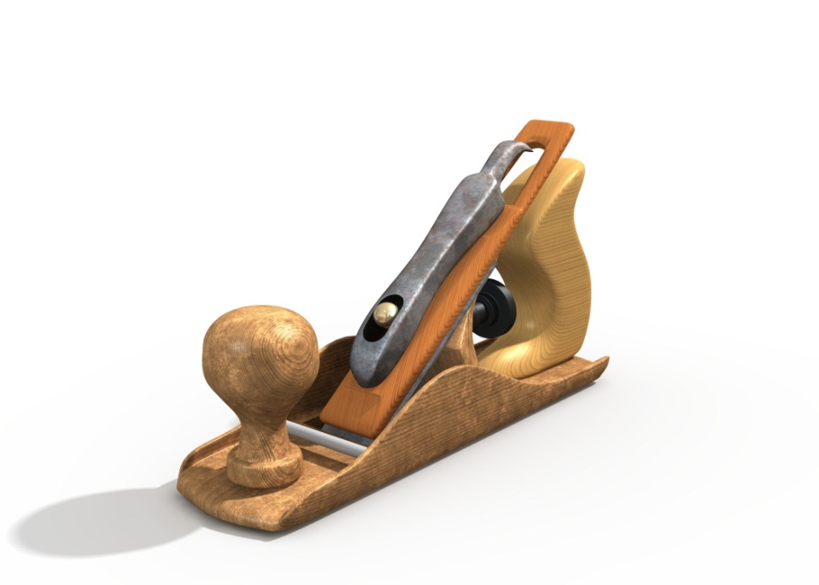
Tools
Tools
Approved by management
Most successful if benchmarked with other similar operations to find the best available tools (outside stimulus)

Slide 11
People, Processes and Tools Hierarchy
Adoption of new tools always requires some change in processes, but
  Process changes do not always require new tools
Process changes always require some people changes (training, mentoring, or hiring workers with different skills), but
  People changes do not always require new processes (e.g., training and hiring people to perform existing processes better)

Slide 12
People, Processes and Tools Impact
The greatest improvements in productivity come with new tools
Process changes can produce greater productivity improvement than what can be accomplished with people
  changes alone
In all cases, success is
not guaranteed

Slide 13







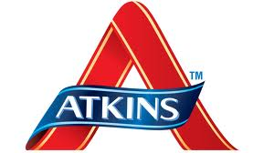




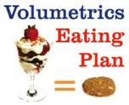



Some Lean Techniques in Humans
Notes:
All are variations of “Diet and Exercise”
All have overlapping features
Each technique has some unique features (often trade-marked / copyrighted / patented)
Each technique has worked for some people
For most people who try a technique, it fails
It is never too late to start, and no setback is an excuse to not try again
All work best if they include measurement
Every technique will become obsolete
Zero fat is undesirable

Slide 14
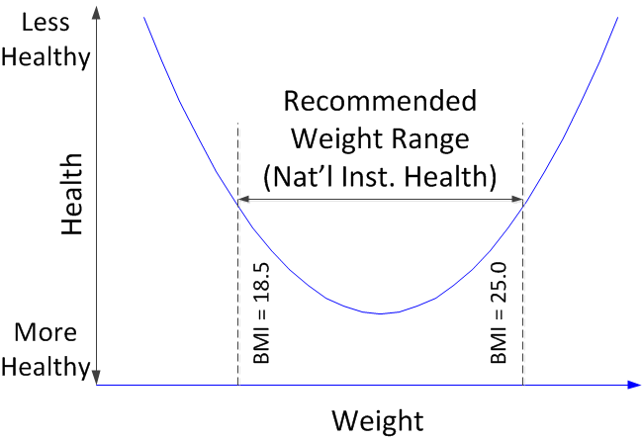
Lean Measurement in Humans
Notes:
BMI is new, developed 1972
(paper published in the July edition of 1972 in the Journal of Chronic Diseases by Ancel Keys)
Always known that heavy people and light people were less fit tha those with medium weight (hunters, farmers, soldiers)
18.5 and 25 limits adopted by NIH 1998

Slide 15
Some Lean Techniques in Organizations
5S
5 Whys
6Ms
7Ps
A3s
Agile
Analagous Estimates
Andon – call for help
Benchmarking
Bottom-Up Estimating
Brainstorming
Business Process Reengineering
CADD – 3D / 4D / 5D / 6D
Cause and Effect Diagrams
Checklists / Checksheets
Choosing by Advantages
Collocation
Continuous Improvement / Kaizen
Control Charts
Critical Chain
Critical Path Method
Design Structure Matrix
Earned Value Management
First run studies
Fishbone / Ishikawa Diagram
Flowcharts
Going to the source / Genchi Genbutsu
hansei - reflect on shortcomings and develop countermeasures
Histograms
Integrated Project Delivery
Intelligent use of machines / jidoka
inventive problem solving
Just in Time
Last Planner
Leads and Lags
Life Cycle Assessment / ISO 14040
Line of Balance
Overall equipment effectiveness
Off-site production
Parametric Estimates
Pareto Analysis
Plan-do-check-act
Precedence Diagrams
Pull systems / Kanban
Quality circles
Red-yellow-green progress reports
Responsibility Assignment Matrix
Risk Management
Rolling-Wave Planning / Progressive Elaboration
Root Cause Analysis / nemawashi
Scatter Diagrams
Scrum
Self-managed teams
Set-based design / Last responsible moment
Six Sigma
Spaghetti Plots
Standardizing tasks
Statistical Process Control
Supply Chain Participation
Takt units
Target Value Design
Theory of Constraints
Three-bin system
Three-point Estimates
Total productive maintenance
Trend Analysis
Value Analysis / Value Engineering
Value Stream Mapping
Visual control
Work Breakdown Structure
Work Structuring
Workload balancing / heijunka
Notes:
Some would switch “Agile” and “Lean”
OK, if “Agile” is defined as “elimination of waste”
Like lean, a re-use of an existing word
Agile is a word that has been used in English for more than 400 years
Dictionary definition of Agile is “quick and well-coordinated”
Agile Alliance (2001). "Manifesto for Agile Software Development".
Lean is no necessarily quick, and perhaps not well coordinated
In fact, some lean techniques slow down the early stages of projects

Slide 16
Lean in Projects
Most projects have iterative elements of work, which permits:
Test a technique, learn, and apply on future iterations, e.g.:
  Agile
  First run studies
  Last Planner
  Plan-do-check-act

Slide 17
Lean in Project Portfolios
For work that is not iterative (performed only once on any particular project), Lean techniques are applied across projects (i.e., apply lessons learned on one project to subsequent projects).

Slide 18
Three Eras of Project Management
Pre-Modern Project Management | Modern Project Management | Post-Modern Project Management / Lean
“It takes as long as it takes and it costs what it costs.” | “Generally recognized good practice” (PMBOK® Guide, 5th Ed., page 2) | Systematic elimination of waste / continuous improvement
Adapted from Gauthier and Ika, Project Management Journal, October 2012

Slide 19
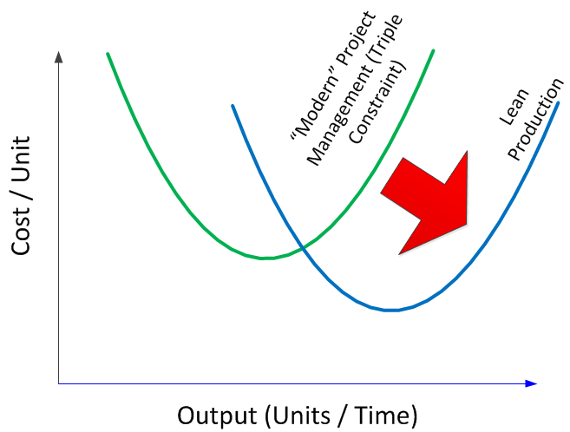
Lean Production Goal
Constant quality along production curve
Notes:
Limit is unknown

Slide 20
How Organizations become Lean
Reduce the seven wastes (muda) - items that incur cost without adding value
  Transportation
  Inventory
  Motion
  Waiting
  Over-processing
  Over-production
  Defects
Reduce inconsistency / variation (mura)
Eliminate unreasonable demands (muri)

