Slide 1
@SusannahFox @PewResearch #HA2014
Who uses social media?
What are some health-related examples?
Notes:
1

Slide 2
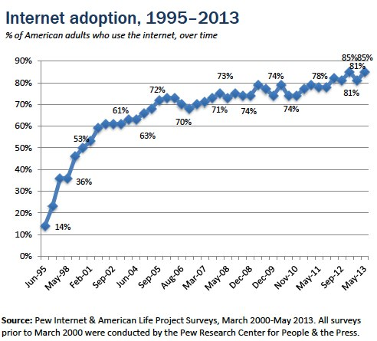
Let’s start with who has access in the U.S.

Slide 3
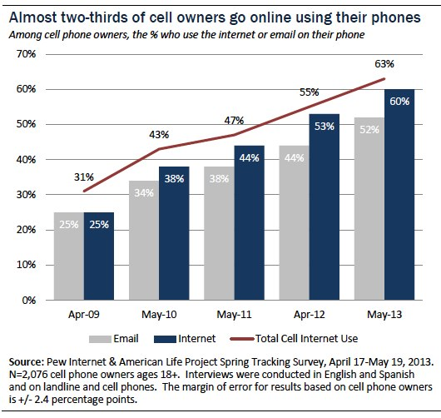
U.S.: 63% of cell phone owners use mobile internet
Notes:
Non-whites: Among those who use their phone to go online, six in ten Hispanics and 43% of African-Americans are cell-mostly internet users, compared with 27% of whites.
Young adults: Half of cell internet users ages 18-29 mostly use their cell phone to go online.
The less-educated: Some 45% of cell internet users with a high school diploma or less mostly use their phone to go online, compared with 21% of those with a college degree.
The less-affluent: Similarly, 45% of cell internet users living in households with an annual income of less than $30,000 mostly use their phone to go online, compared with 27% of those living in households with an annual income of $75,000 or more.

Slide 4
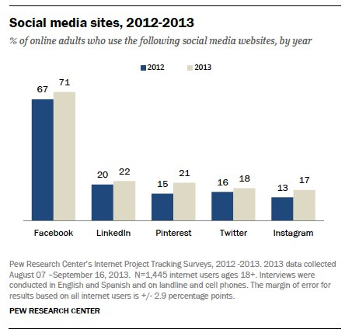

Slide 5
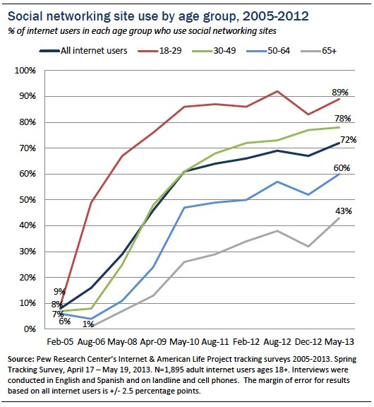
Notes:
This is just one example of how the online population falls out along demographic lines.

Slide 6
@SusannahFox @PewResearch #HA2014
Examples
Notes:
6

Slide 7
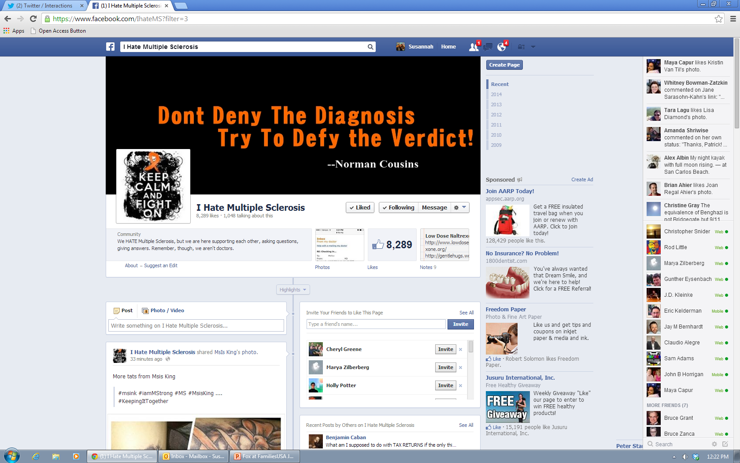
Facebook: 71% of internet users in the U.S., age 18+

Slide 8
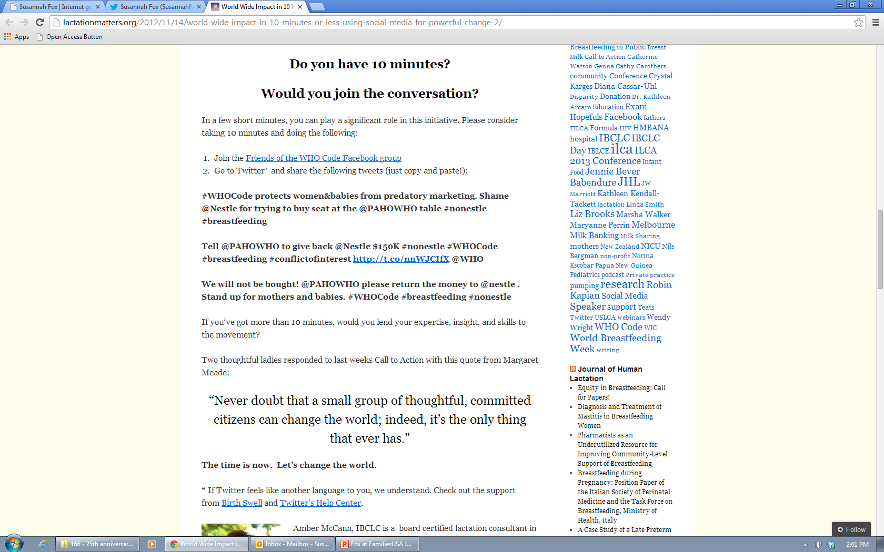
“Breastfeeding support and lactation are huge on SocMed, because that's where our #millenialmoms are!” - @HelenGrayIBCLC

Slide 9
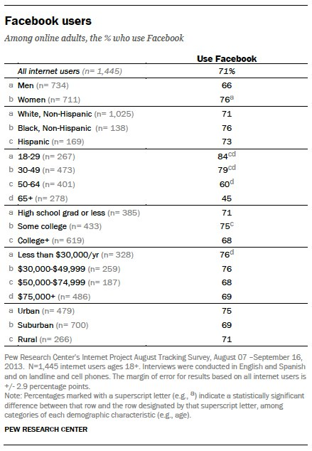
Notes:
See: http://www.pewinternet.org/Reports/2013/Social-Media-Update.aspx

Slide 10
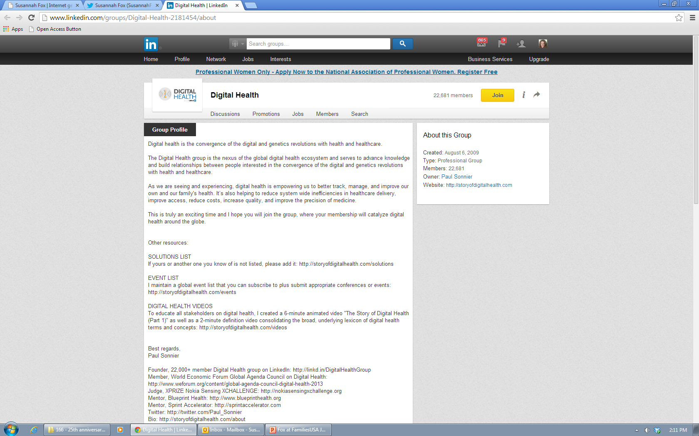
LinkedIn: 22% of internet users in the U.S., age 18+
Notes:
http://www.linkedin.com/groups/Digital-Health-2181454/about
22,000 members: http://www.linkedin.com/groups?groupDashboard=&gid=2181454

Slide 11
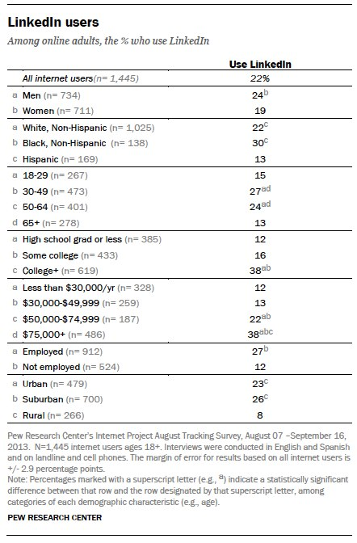

Slide 12
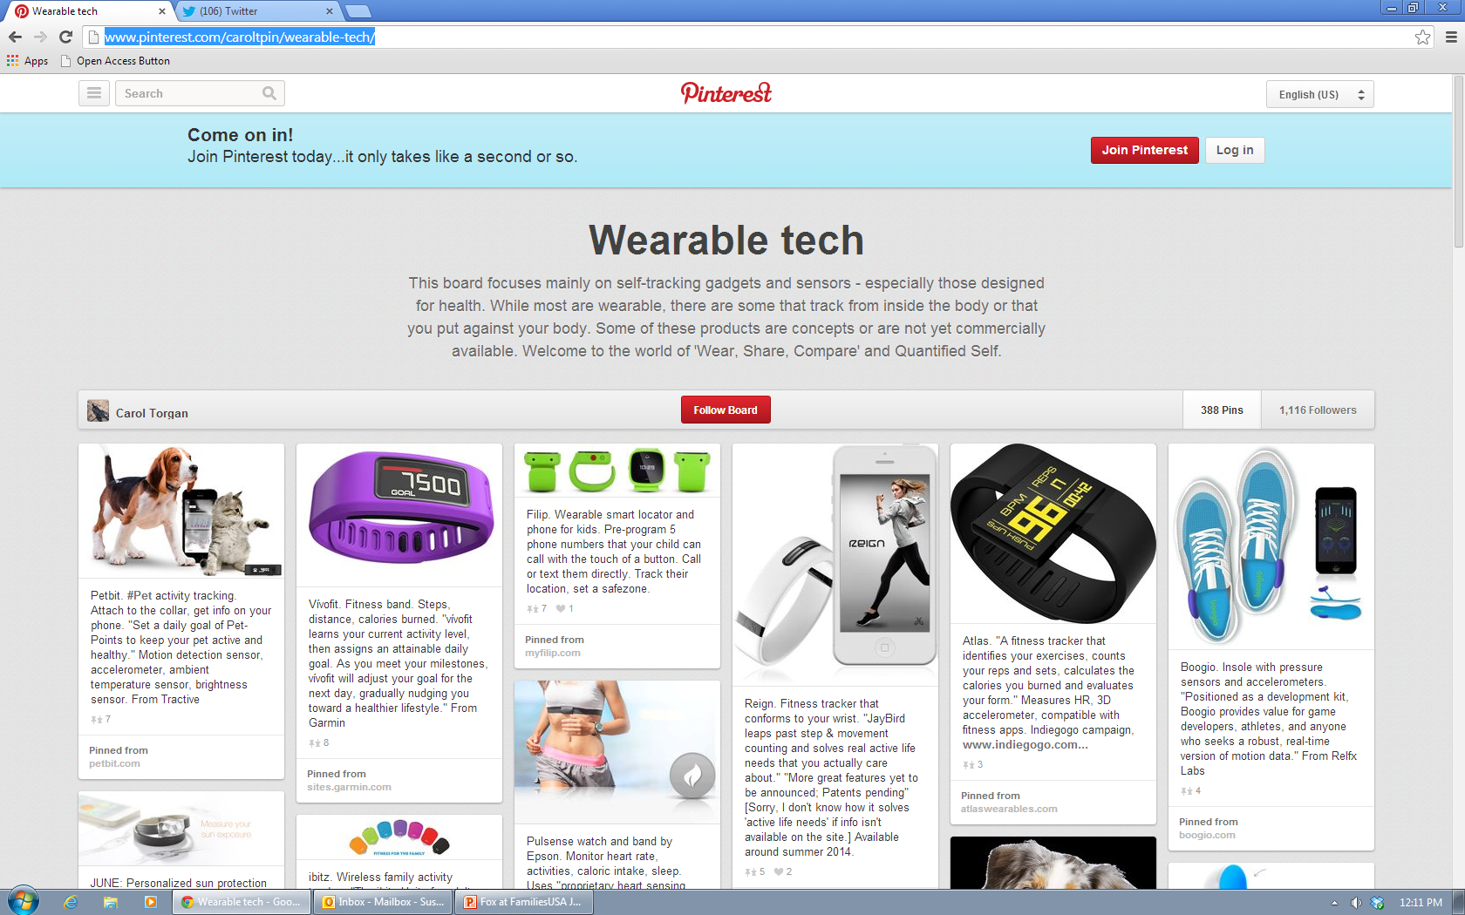
Pinterest: 21% of internet users in the U.S., age 18+
Notes:
3 Healthcare Users Who Get Pinterest Right - And What They Can Teach You, by Marie Ennis-O’Connor
http://healthworkscollective.com/marie-ennis-oconnor/145306/3-healthcare-users-who-got-pinterest-right-and-what-you-can-learn-them

Slide 13
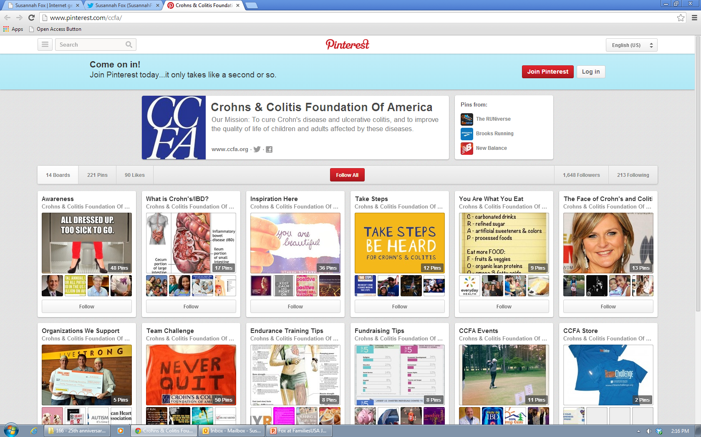
Pinterest: 21% of internet users in the U.S., age 18+

Slide 14
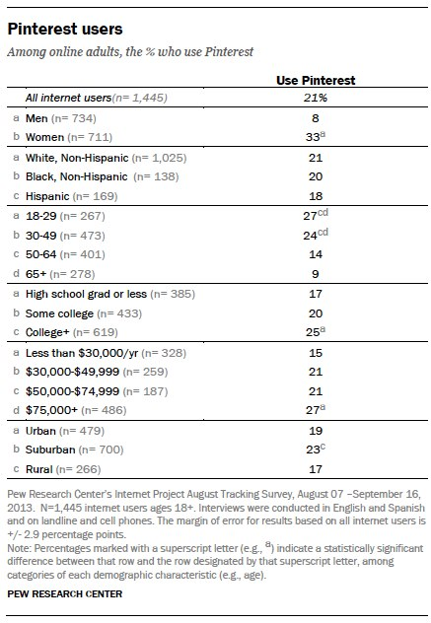

Slide 15
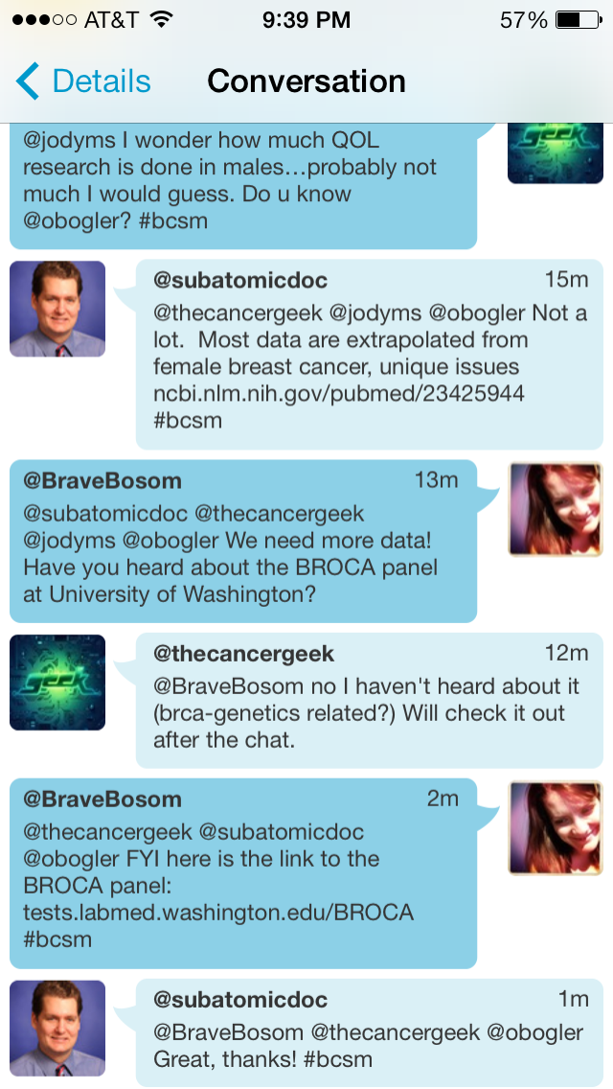
Twitter:
18% of internet users in the U.S., age 18+
Notes:
See also: http://blogs.bmj.com/bmj/2013/11/27/navjoyt-ladher-on-the-success-of-the-hellomynameis-campaign/
Or search Twitter for the hashtag: #hellomynameis

Slide 16
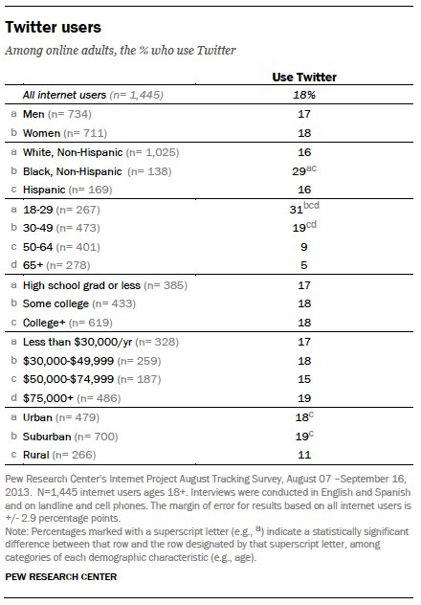

Slide 17
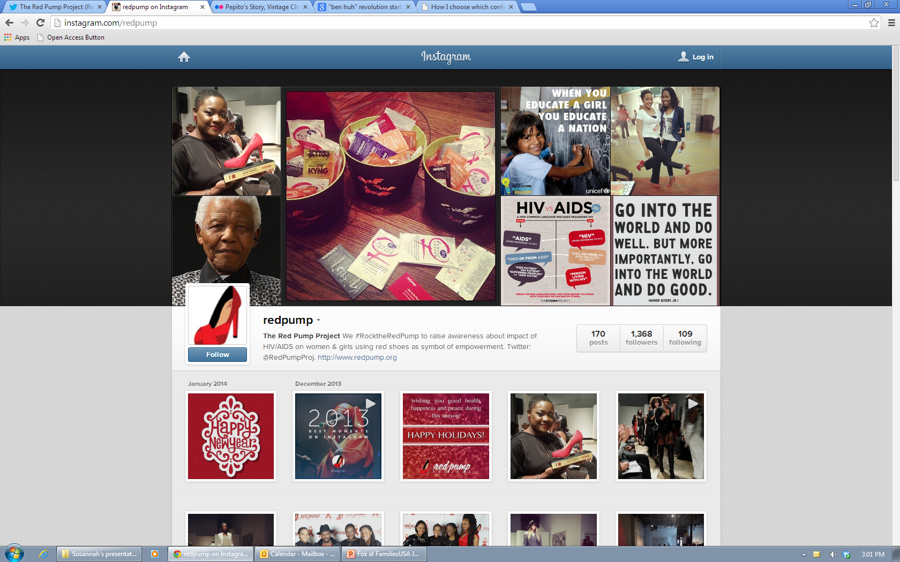
Instagram: 17% of internet users in the U.S., age 18+

Slide 18
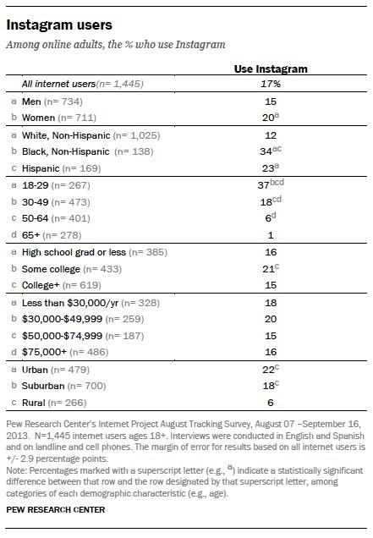

Slide 19
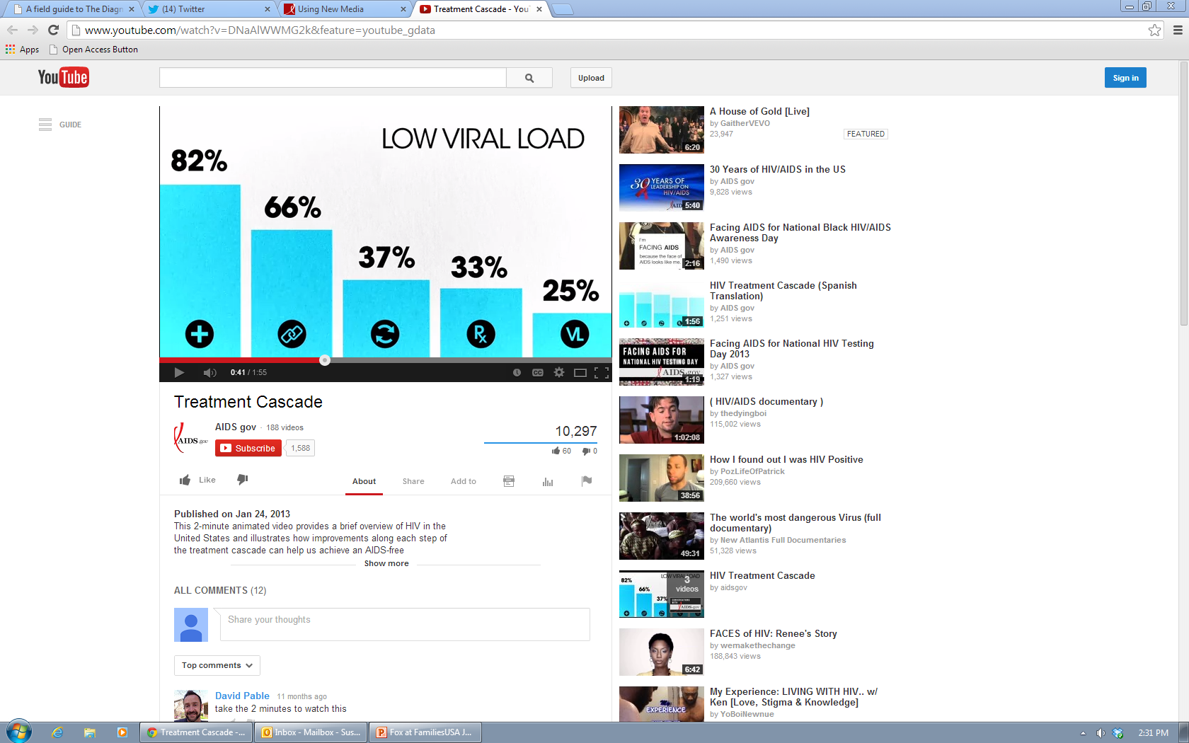
YouTube/Vimeo: 78% of internet users in the U.S., age 18+
Notes:
See also: http://aids.gov/using-new-media/new-media-basics/
And: http://www.pewinternet.org/Reports/2013/Online-Video.aspx

Slide 20
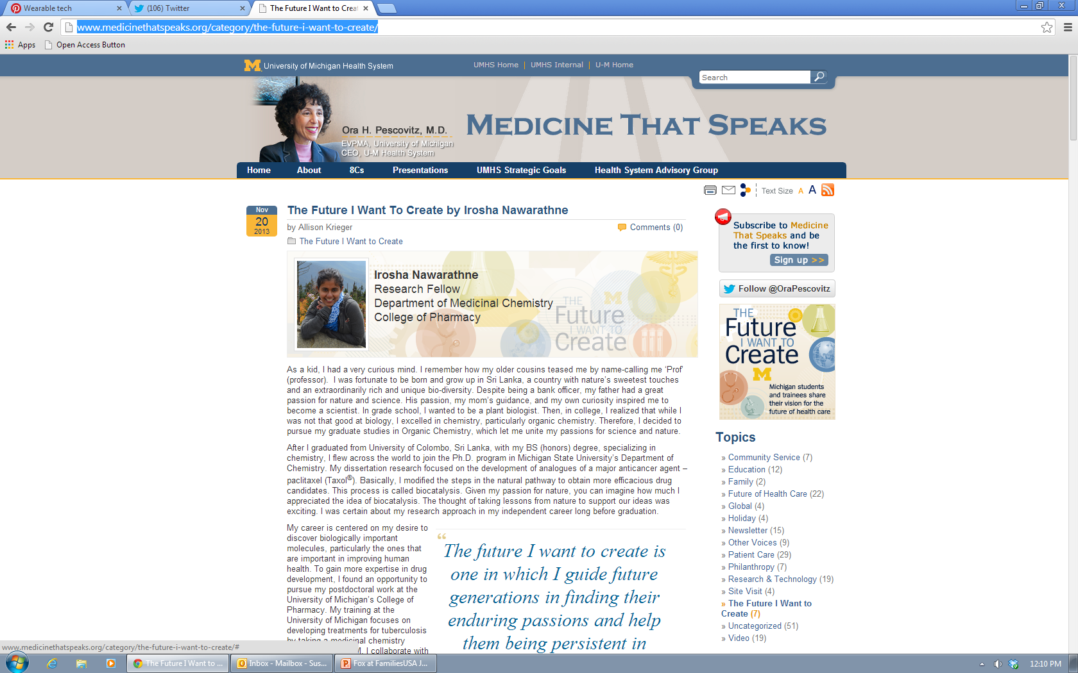
Blogs

Slide 21
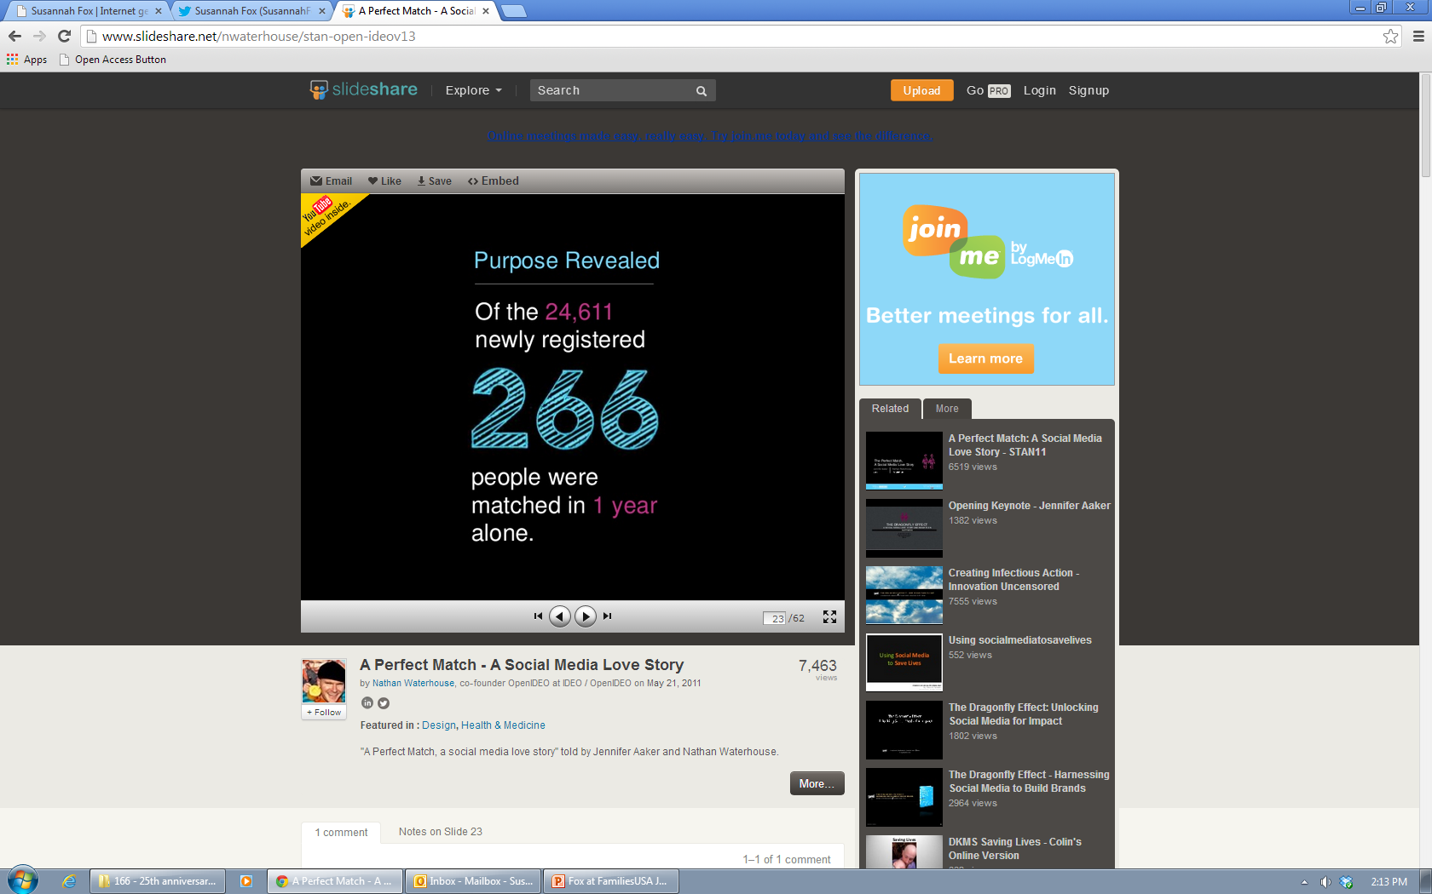
Slideshare

Slide 22
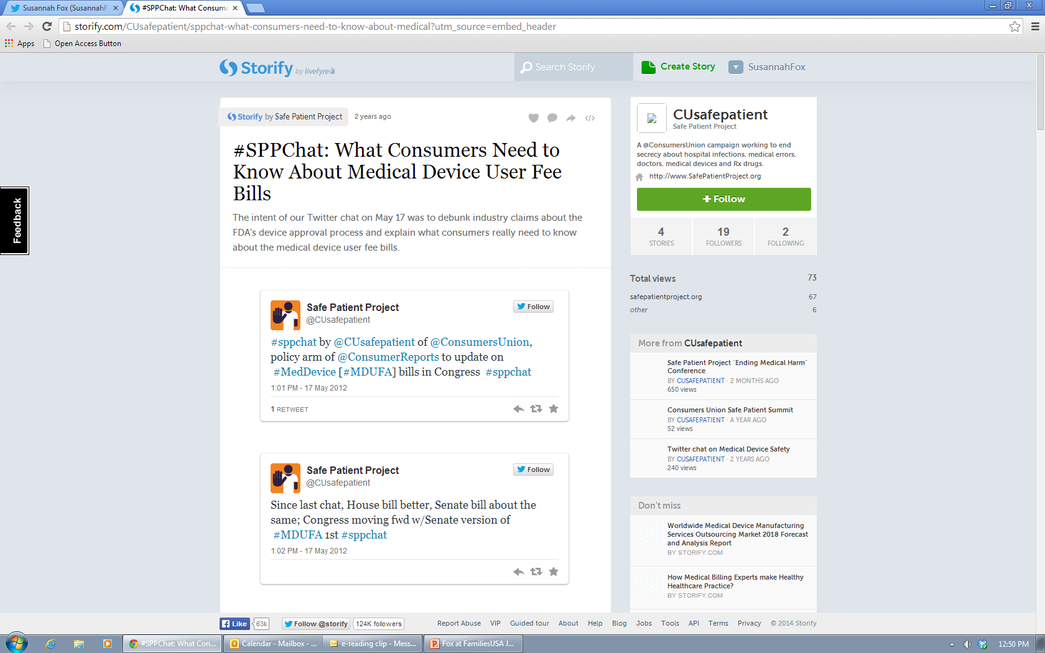
Storify

Slide 23
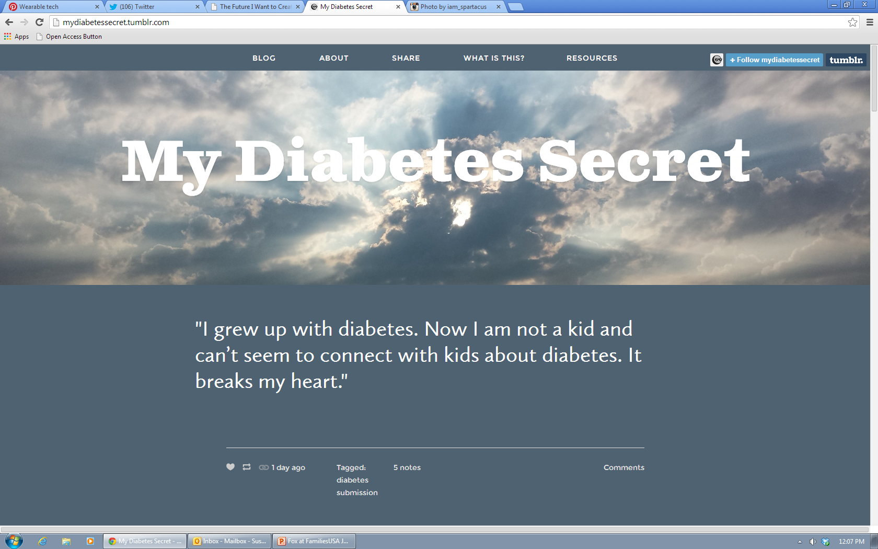
Tumblr

Slide 24
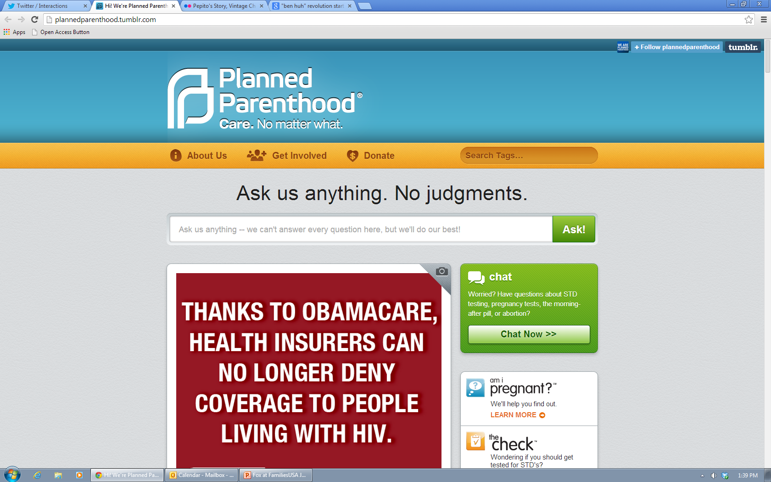
Tumblr

Slide 25
There are many other social tools to consider:
Google+
MySpace
Vine
Reddit
Foursquare
<your favorite which I didn’t mention>
More data: pewresearch.org

