Slide 1
SaleCloud
Arian Shams . Vimal Kini . Gaurav Shetti . Divya Karthikeyan
Mentor: Miguel Rios

Slide 2
Problem
Difficult to find todays hottest deals that people tweet about at some location
Project Scope
San Francisco

Slide 3
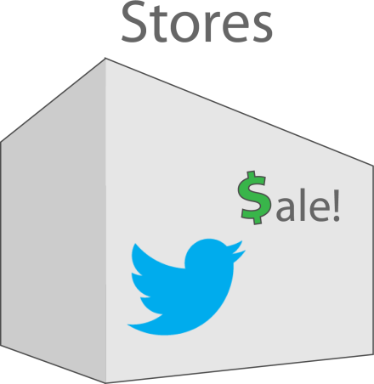
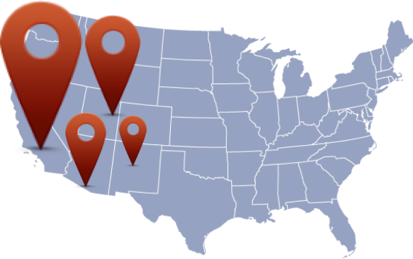
Idea

Slide 4
Demo
SaleCloud

Slide 5
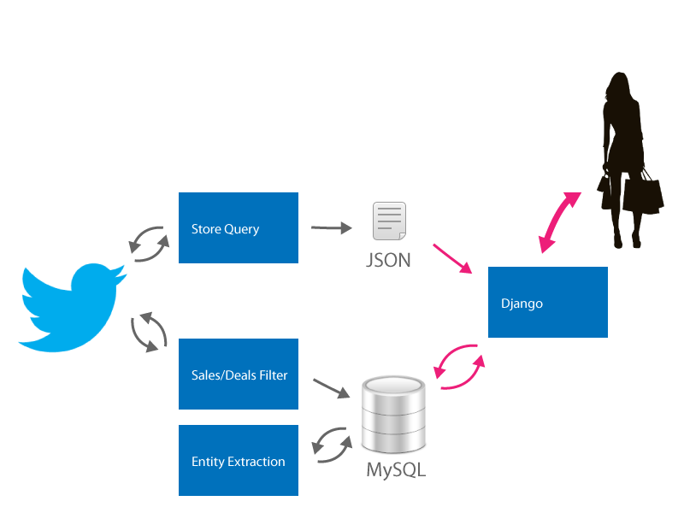
Architecture

Slide 6
Challenges
Identifying Sales/Deals Related Tweets
Extracting Entities
API Limitations & Tweepy
Time

Slide 7
Questions
?

