Slide 1
Sites
Parks – 3
ATMs – 4
Off the Grid event - 5
Notes:
ATMs … urban infrastructure, privacy and personal security in public spaces
Off the Grid event … the temporally fleeting, set up and break down of space
Parks … spaces of respite, negotiating technological intrusions?

Slide 2
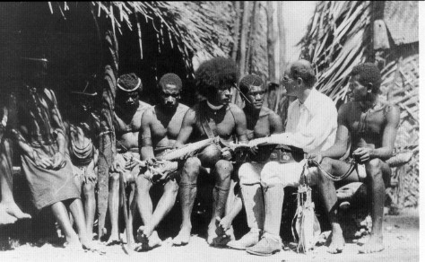
Ethnography
INFO 272. Qualitative Research Methods

Slide 3
Introduction
Participant-observation ≠ Ethnography
Classic Ethnographic Practice
Challenges to the Classic Model
Subjectivity, The Researcher as Research Instrument

Slide 4
Ethnography
not a ‘method’ or ‘procedure’ rather a methodological approach: combination of subject matter, epistemology, and practice
ethno [nation] + graphy [writing]

Slide 5
Ethnography – characterized by…
subject: the holistic study of people, culture, societies, social relations, social processes, behaviour in situ
method: some component of participant-observation
analysis and writing style: inductive analysis, use of ‘thick description’ and narrative, emic accounts

Slide 6
Ethnography – characterized by…
thick description
Keeping intact (holism)
‘You are there’ feeling
Not just observing action, understanding symbolic action, behavior and its meaning
Notes:
Extensive use of unaltered data
Interpretation and meaning (wink vs. blink)

Slide 7
a brief history...

Slide 8
Ethnography ala Malinowski
1922-1960s
Researchers Role:
scientific detachment
be neither preacher nor politician (Weber, “Science as a Vocation”)

Slide 9
Ethnography ala Malinowski
1922-1960s
Spatial Aspects of Field Work:
fieldwork: the study of distant cultures through total immersion in particular sites, participant-observation
assumed to take place in one distinct site (‘the field’)
Assumption that the site = focus of ‘whole culture’
Notes:
Gupta and Ferguson on the ‘assumption that the site = focus of the whole culture’

Slide 10
challenges to the model
1) Subject Matter
Chicago school (urban ethnography)
ethnographies of ‘the West’ and “studying up” (Marcus, 1986)
scientists and engineers (Latour, Traweek, Orr)
Notes:
What Clifford describes as the breakdown in “ethnographic authority”
the convergence of anthropology and sociology

Slide 11
challenges to the model
2) Spatial Aspects of the ‘Field Site’:
questioning cultural isolation and cultural ‘purity,’ ‘authenticity’ and whether it ever existed
ambiguous spatial terrain (cyberspace, media studies, transnationalism).
Marcus (1995) proposes multi-sited ethnography

Slide 12
challenges to the model
3) Researchers Role – Issue of Subjectivity
cultural research implicated in colonial practices – the politics of ‘objectivity’
The ‘subjects’ of research begin to talk back (negritude movement)
insights gained from examining subjectivity (Rosaldo reading)
Notes:
- Objectivity and ‘scientific approach’ as a rhetorical strategy for maintaining power/authority or serving the powerful. See Said, Orientalism or Rosaldo
Haraway calls this the ‘god trick’ and proposes ‘situated knowledge’
there was something to be gained by one’s presence in the fieldsite – that the researcher and the presence in the field could generate knowledge – not one that claimed a universal objectivity – but a “situated knowledge”

Slide 13
subjectivity
“the attempt to understand another life world using the self … as the instrument of knowing”
Sherry Ortner
Notes:
"Ethnography, of course, means many things. Minimally, however, it has always meant the attempt to understand another life world using the self -- or as much of it as possible -- as the instrument of knowing.”
Ortner, 1995, Resistance and the Problem of Ethnographic Refusal, Comparative Studies in Society and History 37(1) 173-193
So in other words the important thing here is to understand the role of the self in ethnography. One of the common critiques from people working in other methodological traditions is the ethnography is subjective or that the involvement of the ethnographer in the setting alters or produces a bias in that setting. Ortner’s quote indicates that subjectivity is not a problem in ethnography -- rather, it’s a method.

Slide 14
subjectivity, example 1
Emotion:
- Briggs, Never in Anger
Notes:
The big question is -- what is gained by the researcher as ‘research instrument?’

Slide 15
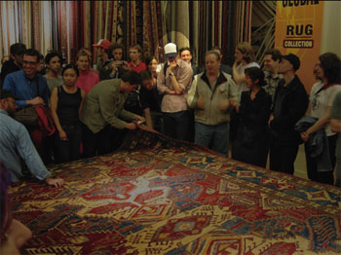
subjectivity, example 2
The Everyday, common sense (ethnomethodology):
Garfinkel
Notes:
“flash mobs”
Lest you conclude that ‘subjectivity’ and the researcher as research instrument is purely about the indeterminate, highly personal domain of emotion, belief, the ineffable – the case of ethnomethodology.

Slide 16
subjectivity, example 2
Frozen in Grand Central Station - http://www.youtube.com/watch?v=jwMj3PJDxuo

Slide 17
subjectivity
Forms of knowledge not easily attained through interviews:
Embodied
Tacit (what cannot be articulated)

Slide 18
For Tuesday
Discussion of your observation exercise

Slide 19
When is ethnography NOT ethnography
When there’s no context (holistic)
When there’s no empathetic understanding (emic)
When there is no symbolic understanding of action (thick description)
When there’s no situated participation (experience)
When you’re not prepared to be surprised (assumptions)
When there’s no interpretation/framework (models)
Notes:
i.e. “Voices of the Poor” – went in with the category of well-being and came out with the assertion that the ‘poor’ prefer well-being over material wealth

Slide 20
advantages/disadvantages
rich data, non-reductive
direct observation of events, practice rather than reliance only on second hand reports
understanding behaviour, tacit knowledge
extraordinarily time consuming, lots of waiting around, unpredictable
social isolation
extreme heterogeneity of data can be difficult to analyze, make sense of
commitment to inductive approach may lead to gaps in data
Notes:
direct observation of events (Becker links this to accuracy)

