Slide 1
INFO 202 “Information Organization & Retrieval” Fall 2013
Robert J. Glushko glushko@berkeley.edu
@rjglushko
12 December 2013 Lecture 30.1 – Course Review

Slide 2
IR Models
The core problems of information retrieval are finding relevant documents and ordering the found documents according to relevance
The IR model explains how these problems are solved:
...By specifying the representations of queries and documents in the collection being searched
...And the information used, and the calculations performed, that order the retrieved documents by relevance
(And optionally, the model provides mechanisms for using relevance feedback to improve precision and results ordering)

Slide 3
IR Models
BOOLEAN model -- representations are sets of index terms, set theory operations with Boolean algebra calculate relevance as binary
VECTOR models -- representations are vectors with non-binary weighted index terms, linear algebra operations yield continuous measure of relevance

Slide 4
IR Models
STRUCTURE models -- combine representations of terms with information about structures within documents (i.e., hierarchical organization) and between documents (i.e. hypertext links and other explicit relationships) to determine which parts of documents and which documents are most important and relevant
PROBABILISTIC models -- documents are represented by index terms, and the key assumption is that the terms are distributed differently in relevant and non relevant documents.

Slide 5
Dimensionality Reduction - A Very Informal Motivation
If every resource described as “big” is also described as “red,” and every “small” resource is also “green,” this correlation between color and size means that either of these properties is sufficient
With thousands of properties or descriptive terms, we need clever statistical analysis to choose the optimal descriptive terms
We can synthesize new “logical terms” based on the correlations
5

Slide 6
From Terms to Topics
The dimensionality of the space in the simple vector model is the number of different terms in it
But the "semantic dimensionality" of the space is the number of distinct topics represented in it
The number of topics is much lower than the number of terms
Documents can be similar in the topics they contain even if they have no words in common
6

Slide 7
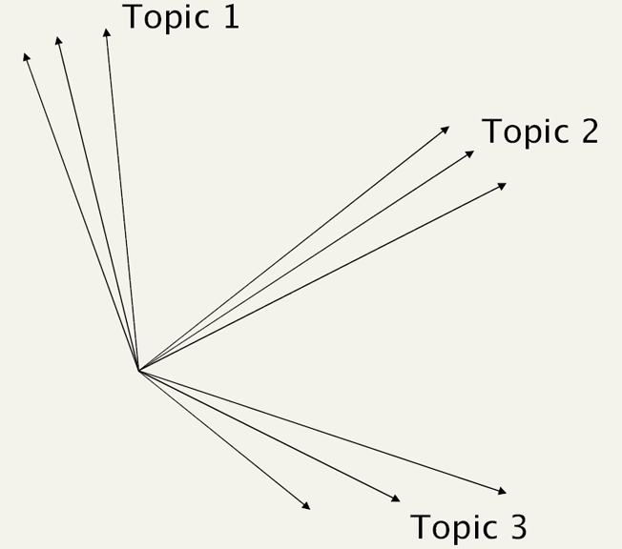
"Topic Space," Not "Term Space"
7

Slide 8
Relevance in the Boolean Model
Because terms are either present or absent, a document is either relevant or not relevant
Retrieved documents might be ordered (chronologically?) but not by relevance because there is logically no way to calculate it
But this is clearly flawed -- if a query is "a and b" the Boolean model retrieves only those documents that contain both of them, and treats documents that contain only a or only b as equally irrelevant
8

Slide 9
Relevance in other IR Models
Other IR models rank the retrieved documents in terms of their relevance to the query
This requires more refined methods of representing what documents are about
This enables more continuous methods of assessing relevance rather than all or none
9

Slide 10
Vector Model Retrieval and Ranking
So vector queries are fundamentally a form of "evidence accumulation" where the presence of more query terms in a document adds to its "score"
This score is not an exact measure of relevance with respect to the query, but it is vastly better than the all or none Boolean model!
10

Slide 11
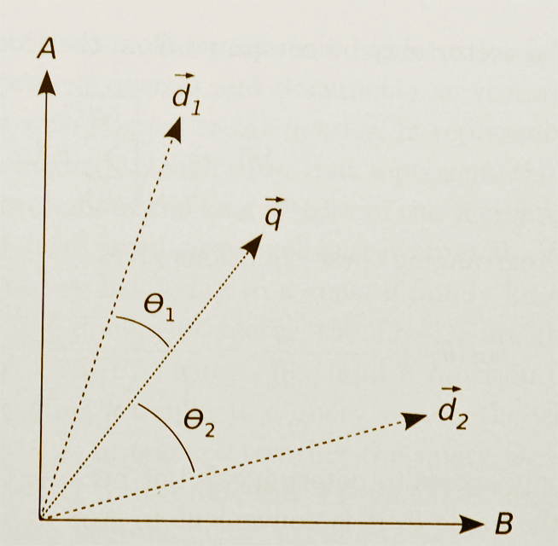
Similarity in Vector Models (Graphical Depiction)
11

Slide 12
IR Models and “Information Needs”
In classical IR, an "information need" is formulated as a query submitted to some information collection
"Documents" in the information collection are returned that "satisfy" the query
The "IR model" specifies how the queries and documents are represented and how "satisfaction" is calculated
"Satisfaction" can be an exact match, but more often the returned documents are ranked according to the statistical similarity between their representations and that of the query
12

Slide 13
Getting Beyond the “10 Blue Links”
IR systems locate relevant documents in response to a query, but the user must extract the actual answer to his or her question
This challenge has been described as “getting beyond the 10 blue links” – here are some of the ways to do that:
Semantic search
Structured data search
Structure / graph search
13

Slide 14
Crossing the Semantic Gap Through Computation
A consequence of the semantic gap for mulitimedia is that there are a very large number of low-level features that can be reliably identified
Any description using these features will be "sparse" - lots of missing values
Dimensionality reduction techniques can exploit correlations between low-level features
14

Slide 15
Natural Language Processing
Every NLP application needs to identify and classify the words, phrases, structures, documents in some context or domain
The earliest NLP applications were very narrow in scope, relying on “hand crafted” rules to implement the required knowledge
Today much NLP uses dictionaries, stemmers, grammars, and other language knowledge
But the statistics of co-occurrence / conditional probability yield many practical techniques for analyzing and generating language that make no use of “languageness”
15

Slide 16
Real World NLP Applications
Information extraction
Summarization
Auto-journalism (story generation)
Machine translation
Speech recognition and synthesis
Computational classification
Topic identification
Author identification
Spam detection
Sentiment analysis
Question answering, automated customer service, recommendations…
16

Slide 17
Computational Classification
Some classification tasks can't be done by people at the needed scale or speed
Some of the tasks can be done by computational approaches like N-gram analysis that are very simple yet very useful
Some tasks are inherently difficult and require techniques of “machine learning”, which are not simple

Slide 18
Text Classification Problems
Classification assigns objects in some domain to one of at least two classes or categories
words - determine part of speech
words - disambiguate polysemy
document retrieval - relevant/not relevant?
author identification - Shakespeare or not?
sentiment classification - positive or negative affect? urgent or not urgent?
language - English, Spanish, whatever?

Slide 19
Computational Classification
CLASSIFICATION assumes a system of categories and some labeled instances so we can train a system to assign new instances to the appropriate categories
In contrast, CLUSTERING techniques don't assume pre-existing categories - they create them (usually to maximize similarity within categories and maximize it between them)

Slide 20
Understanding Information Extraction
What type of structure is being extracted?
What is the unstructured source input?
What resources are available to guide the extraction?
What extraction techniques are employed?
What is the format of the extracted information?
(IE typically starts after tokenization, part-of-speech tagging, and phrase identification steps of text processing)

Slide 21
Sentiment Analysis
Sentiment analysis (aka "opinion mining") can be thought of a three-stage classification problem
Entity extraction to locate text of interest
Classifying texts as opinions or facts
Classifying the opinions according to polarity - positive vs. negative (or on some numerical scale)
This is challenging because these classes are really continuaa without sharp boundaries
...and because sarcasm, slang, cliches, and cultural norms obscure the content used to make the classification

Slide 22
The Organizing System Lifecycle
There is always a lifecycle, but there are times when its phases need to be more explicit and formal:
In institutional contexts
In information-intensive contexts
When traceability and impact analysis are necessary
Better to be more explicit and formal than absolutely necessary than vice versa
22

Slide 23
Defining and Scoping the Domain
Determining scope and scale
Nature and number of users
Expected lifetime
Physical and technological environment
Relationship to other organizing systems
23

Slide 24
Physical or Technological Environment
UNIVERSITY OF CALIFORNIA, BERKELEY
SCHOOL OF INFORMATION
There might be affordances that create possibilities
But there might be constraints that limit them
Estimating the ultimate size of a collection at the beginning of an organizing system’s lifecycle can reduce scaling issues related to storage space for the resources or for their descriptions (flashback to “warrant” goes here)
24

Slide 25
Requirements for Interactions
UNIVERSITY OF CALIFORNIA, BERKELEY
SCHOOL OF INFORMATION
All organizing systems have some common interactions, but most of the time we want to pay attention to the more resource-specific interactions that create the most value
The priorities of different interactions are often determined by decisions about intended users
An essential requirement is ensuring that the supported interactions can be discovered and invoked by their intended users
25

Slide 26
Requirements for Interactions
UNIVERSITY OF CALIFORNIA, BERKELEY
SCHOOL OF INFORMATION
For most organizing systems other than personal ones, the set of interactions that are implemented in an organizing system is strongly determined by business model considerations, funding levels, or other economic factors
Businesses differentiate themselves by the number and quality of the interactions they support with their resources
26

Slide 27
Requirements about Resource Description
UNIVERSITY OF CALIFORNIA, BERKELEY
SCHOOL OF INFORMATION
The most generic interactions use descriptions that can be associated with almost any type of resource, such as the name, creator, and date
Different types of resources must have differentiating properties, otherwise there would be no reason to distinguish them
27

Slide 28
Requirements about Resource Description
UNIVERSITY OF CALIFORNIA, BERKELEY
SCHOOL OF INFORMATION
Business strategy and economics strongly influence the extent of resource description and the use of technology for automatic description
The tradeoffs imposed by the extent and timing of resource description arise throughout the lifecycle, with the tradeoff between recall and precision being the most salient
28

Slide 29
Tradeoffs involving Description
UNIVERSITY OF CALIFORNIA, BERKELEY
SCHOOL OF INFORMATION
Someone designs or selects a structure for the description... or not
Someone determines the content of the description .. or not
How much structure or how detailed a description?
29

Slide 30
Tradeoffs involving Description
UNIVERSITY OF CALIFORNIA, BERKELEY
SCHOOL OF INFORMATION
Is it easier to create structured or unstructured descriptions?
If we want to combine information from many different authors or sources, what are the implications for description and organizing decisions?
Is it easier to combine information from different authors or sources if it is structured or unstructured?
30

Slide 31
The Fundamental Tradeoff in an Organizing System
UNIVERSITY OF CALIFORNIA, BERKELEY
SCHOOL OF INFORMATION
There is a tradeoff between the amount of work that goes into describing and organizing a collection of resources and the amount of work required to find and use them
The more effort we put into describing and organizing resources, the more effectively they can support interactions
The more effort we put into retrieving resources, the less they need to be organized first
31

Slide 32
The Fundamental Tradeoff in an Organizing System
UNIVERSITY OF CALIFORNIA, BERKELEY
SCHOOL OF INFORMATION
We need to think in terms of investment, allocation of costs and benefits between the describer/organizer and user
The allocation differs according to the relationship between them; who does the work and who gets the benefit?
32

Slide 33
The Course In One Slide
UNIVERSITY OF CALIFORNIA, BERKELEY
SCHOOL OF INFORMATION
To organize is to create capabilities by intentionally imposing order and structure
We organize things, we organize information, we organize information about things, and we organize information about information
If we think abstractly about these activities, we can see commonalities that outweigh their differences; We select, organize, interact with, and maintain resources
We organize resources as individuals, in informal association with other individuals, or as part of a more formal institutional or business context
We must recognize the profound impact of new technologies and their co-evolution with the nature of the organizing we do and the kinds of interactions that this organizing enables, but can't ignore the "classical" concepts and knowledge
33

Slide 34
Your Final Exam
UNIVERSITY OF CALIFORNIA, BERKELEY
SCHOOL OF INFORMATION
Tuesday December 17, 9-1 – Early Final
Wednesday December 18, 9-1 – FINAL EXAM
34

Slide 35
My Final Exam
UNIVERSITY OF CALIFORNIA, BERKELEY
SCHOOL OF INFORMATION
On the first day of class I said:
We deal with deep intellectual issues that have challenged philosophers and other deep thinkers for millennia
You must make the transition to studying information / content IN a discipline to studying information / content AS a discipline
You must learn to look past the presentation / rendition / technology reification / thinginess of information to see it more abstractly as structure and meaning
35

Slide 36
My Final Exam
UNIVERSITY OF CALIFORNIA, BERKELEY
SCHOOL OF INFORMATION
On the first day of class I said:
This course WILL change how you think about information
If it doesn't, it means that we have both failed this semester
36

Slide 37
This is NOT the end of 202
UNIVERSITY OF CALIFORNIA, BERKELEY
SCHOOL OF INFORMATION
It IS the end of the semester: 1500 pages, 10 assignments, 28 lectures, 12 section meetings…
But how you think and talk about information and organization has changed immensely
This transformation will shape the remainder of your ISchool experience and the rest of your personal and professional lives
Thank you for giving me the privilege of being along for the ride
Good luck on the final exam
37

