Slide 1
Plan for Today’s Lecture(s)
Getting beyond “10 blue links” (holdover)
Multi-platform and Mobile Information Retrieval
Using Context in Information Retrieval
Using Text and Non-Text Descriptions to Retrieve Non-Text Resources
Delphi
1

Slide 2
INFO 202 “Information Organization & Retrieval” Fall 2013
Robert J. Glushko glushko@berkeley.edu
@rjglushko
19 November 2013 Lecture 24.4 –Getting Beyond “10 Blue Links”

Slide 3
IR Models and “Information Needs”
In classical IR, an "information need" is formulated as a query submitted to some information collection
"Documents" in the information collection are returned that "satisfy" the query
The "IR model" specifies how the queries and documents are represented and how "satisfaction" is calculated
"Satisfaction" can be an exact match, but more often the returned documents are ranked according to the statistical similarity between their representations and that of the query
3

Slide 4
Changes in Information Needs
Web search initially emphasized discovery and “finding out about” --> retrieving a ranked list of relevant sites is appropriate for that information need
More recently, other types of information needs and queries are more common:
“navigational” - the user wants a specific page that they know exists (“UC Berkeley”)
“informational” - user wants an answer to a well-defined question (“Berkeley temperature”)
“transactional” - user wants to buy something and wants information about a product or service
4

Slide 5
“Navigation” with “Content Assembly”

Slide 6
Getting Beyond the “10 Blue Links”
IR systems locate relevant documents in response to a query, but the user must extract the actual answer to his or her question
This challenge has been described as “getting beyond the 10 blue links” – here are some of the ways to do that:
Semantic search
Structured data search
Structure / graph search
6

Slide 7
Getting Beyond the “10 Blue Links”
Search engines improve their responses to these kinds of queries not by improving relevance ranking but by becoming better at identifying user intent
“Identifying user intent” doesn’t require “understanding” the query or the retrieved documents, but it involves recognizing query patterns and matching them with document / data structures likely to contain the answers to the query
Structured data is most valuable when natural language processing techniques enable queries to be deconstructed, transformed, and joined to find information from more than one source
7

Slide 8
Structured Data
Structured data can be extracted from a wide variety of documents and Web sources depending on the consistency and predictability of structure, presentation, and content
Microformats, schema.org templates
“Info boxes” in Wikipedia and elsewhere
“Linked data” sources, other “knowledge bases”
8

Slide 13
Wolfram Alpha
Wolfram Alpha is a computational “answer engine” developed by Wolfram Research (and based on Mathematica, a widely-used computational toolkit)
It answers factual queries directly by computing the answer from externally sourced "curated” data from the “deep” web
It has substantial natural language capability
13

Slide 14
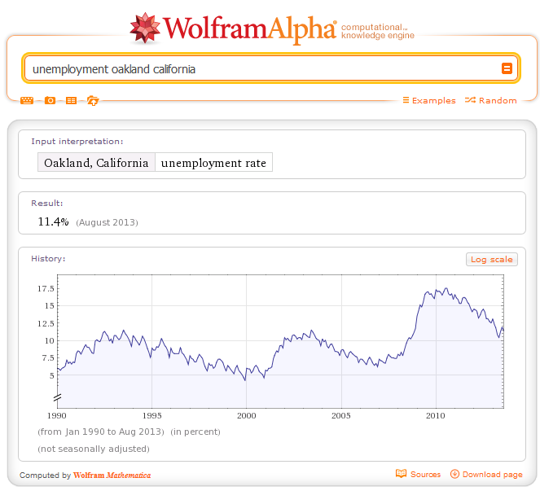
Smarter Search!

Slide 15
(Compare to…)

Slide 16
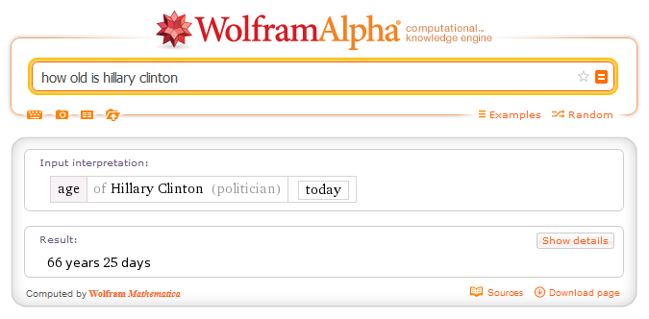
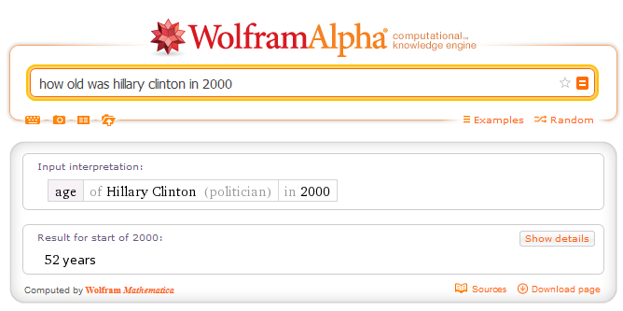
Smarter Search!

Slide 17
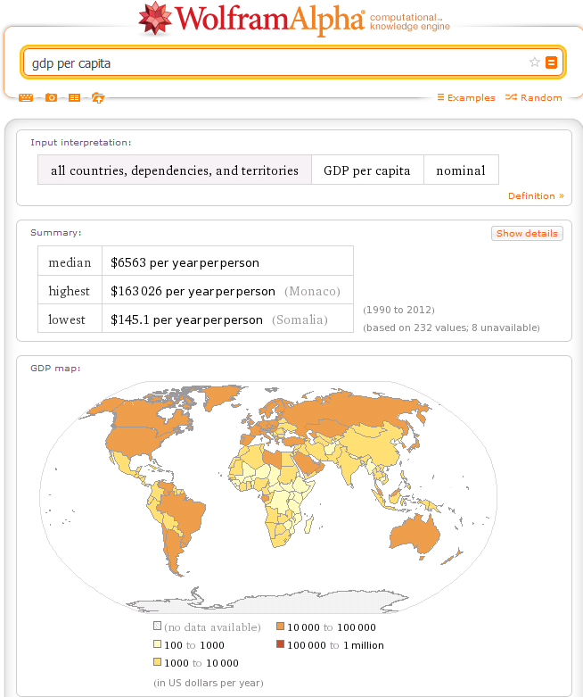
Smarter Search!
What is the fifteenth highest country by GDP per capita?
AND WHAT’S COMING NEXT FROM WOLFRAM IS TRULY MIND-BOGGLING – A PROGRAMMING LANGUAGE THAT CONTAINS ALL THE KNOWLEDGE BUILT INTO WOLFRAM ALPHA!

Slide 18
Facebook Graph Search
Searches the information created by the billion users of Facebook
Queries consist of multiple phrases that map to different parts of the structured data in profiles
Locations
Time
Objects (that are mentioned, tagged, liked…)
Results are based on content matches constrained by the relationships between a user and the people in his or her social network
18

Slide 19
INFO 202 “Information Organization & Retrieval” Fall 2013
Robert J. Glushko glushko@berkeley.edu
@rjglushko
21 November 2013 Lecture 25.1 – Multi-platform and Mobile IR

Slide 20
Multi-platform and Mobile Information Retrieval
How are queries affected?
How are user interfaces affected?
How are query results affected?
20

Slide 22
The Multi-{Device, Platform} Design Imperative
Many people routinely use more than one platform or device for different services, but this can create expectations about using the same service on different platforms
(How) can a service provider offer the "same" service on multiple platforms or devices?
22

Slide 23
The Mobile "Phone" Platform
The mobile phone was invented in the 1970s, but widespread commercial use didn't begin until the 1990s; SMS was added in 1991
Today, many times more people in the world use mobile phones than personal computers
There are several hundred models of mobile phones on the market today-
A rapidly growing percentage of "phones" are multifunction devices with substantial computing capability
23

Slide 24
The Simplest Mobile IR Services
On even the "dumbest" phones a query and response can be performed using an SMS search service)
But since your dumb phone doesn't know its location, you have to explicitly localize your query or you'll not get the results you want for many queries
24

Slide 25
Comparing Devices / Platforms
Devices and platforms differ on many different capability dimensions
Computing power
Storage capacity
Portability
Display size and resolution
Multimedia processing
Bandwidth
GPS capability
…
25

Slide 26
Comparing Devices / Platforms
These capabilities are not always correlated and bundled into devices in the same combinations (for both technical and business reasons)
--> user interface design tradeoffs across devices
26

Slide 27
Smart Phone Capability Checklist
Wi-fi
Touchscreen
Keypad
Music (MP3) playback
Audio recording
Video (MP4) playback
Video recording
Camera
GPS (possibly with navigation)
Bluetooth
USB
Memory card reader
Alarms
FM Radio
Picture calling
Video calling
...
An application developer community

Slide 28
User Interfaces on Mobile Devices
Mobile devices lack full-size keyboards; entering text-based queries can be tedious
But mobile devices have input capabilities that larger computers lack
Voice recognition (e.g., SIRI)
Audio processing capability of mobile phone to create content-based query (e.g., Shazam)
Image or bar/QR code processing to identify resources
28

Slide 29
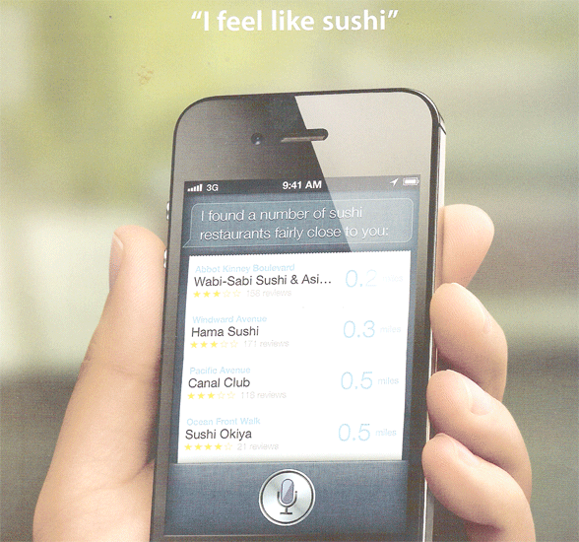
Voice Input with SIRI
29

Slide 30
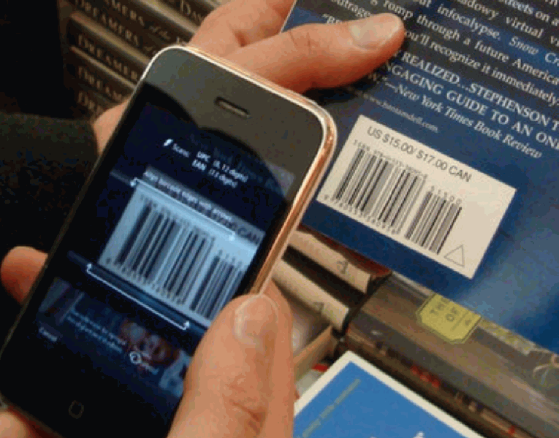
Bar Code Input
30

Slide 31
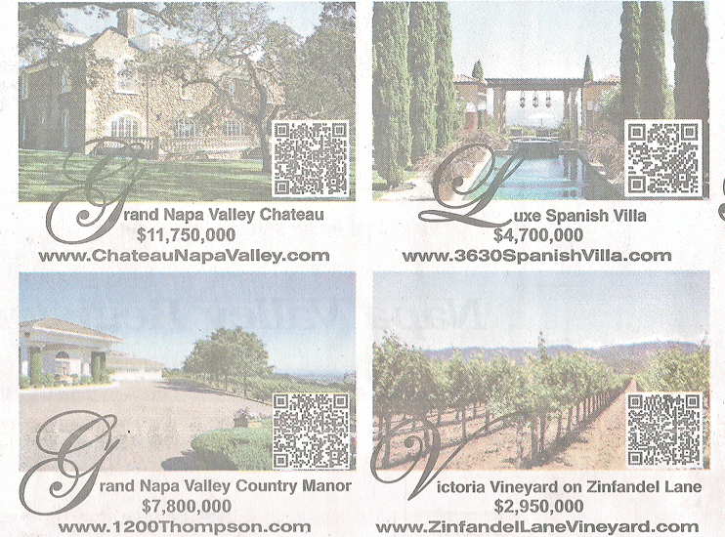
QR Code Input
31

Slide 32
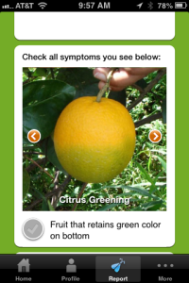
Photo Input - “Save Our Citris”
View images of diseased fruit and then take photos of lemons and oranges and send them in to US Dept. of Agriculture for a (sometimes automated) analysis
32

Slide 33
The Simplest Mobile IR Service on a Smart Phone
A search service on a smart phone can use just one piece of information - current location - to personalize or adapt the outputs
Many providers assume local search for "weather" and many other domains that are location-based
For other services that have local providers (restaurant, transportation, etc.) many "Local Search" functions list only "nearby" results pinpointed on a local map
33

Slide 34
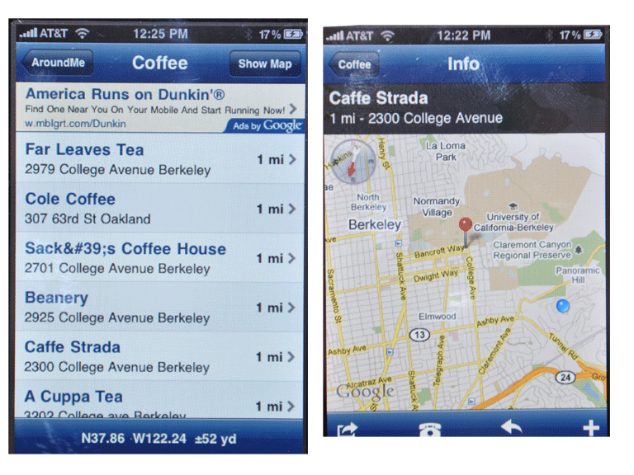
Search Results as List & Map ("Around Me")
34

Slide 35
Presenting Results for Mobile Queries
Mobile phones have smaller screens than non-mobile computers so conventional search results presentation won't work as well
But information about location makes for more precise results, so results set is smaller
Display limits imply reformatted and abbreviated text content
35

Slide 36
Presenting Results for Mobile Queries
Bandwidth limits might imply transcoding to lower quality images, audio, or video content
Channel translation the right solution in some contexts; voice synthesis instead of text display
Maps are natural UI elements because most mobile services are location-based
36

Slide 37
INFO 202 “Information Organization & Retrieval” Fall 2013
Robert J. Glushko glushko@berkeley.edu
@rjglushko
21 November 2013 Lecture 25.2 – Using Context in Information Retrieval

Slide 38
Defining "Context Awareness"
If devices can exploit emerging technologies
to infer the current activity state of the user
and the characteristics of the environment
they can then intelligently manage both the information content
and the means of information distribution
38

Slide 39
Design Issues for Context-Awareness
What information is defined as the "context" ?
How is the information sensed or obtained from the environment?
When is the context information obtained?
Is this information always collected in the same place, or is locating and arranging the sensors or collection points a task in its own right?
What initiates the sending of context information to the service?
39

Slide 40
Design Issues for Context-Awareness
How "smart" is the information when the service receives it?
Is the contextual information shared with other contexts and services?
How does the service process the information it obtains?
40

Slide 41
Context Awareness: Substituting Information for Interaction
Context awareness means a system or service doesn't need to ask:
Where are you?
What are you doing, looking at, looking for?
Who are you with?
What's it like there?
And the service can eliminate irrelevant information from its responses
41

Slide 42
INFO 202 “Information Organization & Retrieval” Fall 2013
Robert J. Glushko glushko@berkeley.edu
@rjglushko
21 November 2013 Lecture 25.3 – Using Text and Non-text Descriptions to Retrieve Non-text Resources

Slide 43
Describing Non-Text With Text - By People
People can always assign names and other textual metadata to non-text objects
Professional cataloguers of "museum objects," images/paintings and other "cultural works" often use the Getty CDWA or CDWA-Lite
ID3 tags on MP3 audio files contain a very limited amount of song metadata
MPEG-7 is the newest, most standard, and most complicated specification for "semantic" image and video metadata
43

Slide 44
Describing Non-Text With Text - Automated
Other textual metadata can be assigned by the devices or mechanisms that created the non-text objects (e.g.EXIF (Exchangeable Image File Format) is used in digital cameras )
But this level of description isn't what most people want to use when they search for non-text resources
44

Slide 45
Exploiting Multi-Modal Information
Video often has audio content and text transcriptions
Correlations or anomalies with these different content types can be exploited "semi-automatically"
Text overlays (captions) can be used to identify people or places in videos
Location information (e.g, GPS) attached to images or video can be used to infer content descriptions
45

Slide 46
Exploiting Multi-Modal Information
Distinguish speech from non-speech sounds; attempt speech recognition for the former
Excited speech, crowd noise suggest important events
Multi-modal annotation visualization as user interface
46

Slide 47
Crossing the Semantic Gap Through Computation
A consequence of the semantic gap for mulitimedia is that there are a very large number of low-level features that can be reliably identified
Any description using these features will be "sparse" - lots of missing values
Dimensionality reduction techniques can exploit correlations between low-level features
47

Slide 48
"A Music Search Engine Built upon Audio-based and Web-based Similarity Measures"
Use "artist" / "album" / "title" metadata in ID3 tags as search terms to find web content about a song (excluding the lyrics)
Create a tf/idf "document vector" for each song from the terms located in the web content
Compute 19 different audio characteristics from each song
48

Slide 49
"A Music Search Engine Built upon Audio-based and Web-based Similarity Measures"
Use audio characteristics to reduce the dimensionality of the document vector
Queries using the descriptive terms can rank order songs by acoustic similarity
49

Slide 50
Ignoring the Semantic Gap in Search
But maybe we don't need to cross the semantic gap to have effective multimedia IR
We can use low-level features that can be extracted automatically to index the multimedia collection and then extract the same ones from a multimedia query
Shazam uses audio "fingerprinting" for identification: (try Test Song)
Midomi uses different features to enable query by humming (broader “equivalence class”)
50

Slide 51
INFO 202 “Information Organization & Retrieval” Fall 2013
Robert J. Glushko glushko@berkeley.edu
@rjglushko
21 November 2013 Lecture 25.4 – Delphi

Slide 52
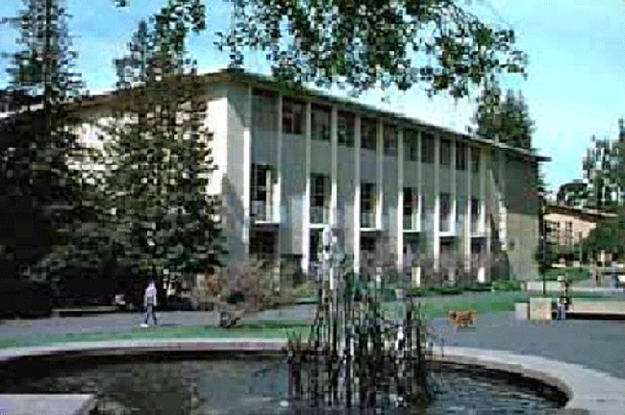
"The Delphi Toolkit: Enabling Semantic Search in Museum Collections"
52

Slide 53
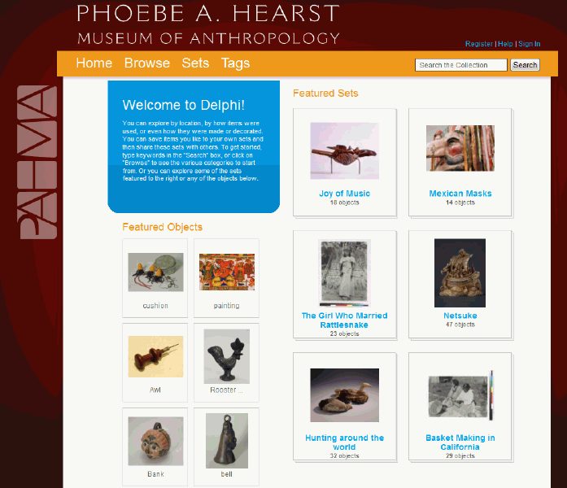
Delphi Home Page
53

Slide 54
Motivation for Delphi
The Museum of Anthropology (founded in 1901 by Phoebe Apperson Hearst) has an estimated 2-3 million objects in its collection
While the museum is relatively well known among researchers, a small public exhibition space (relative to the total collection size) means that the public has no clue about the richness of the collection
The Museum uses a collection management system (TMS) with roughly over 600,000 records describing the entire collection
54

Slide 55
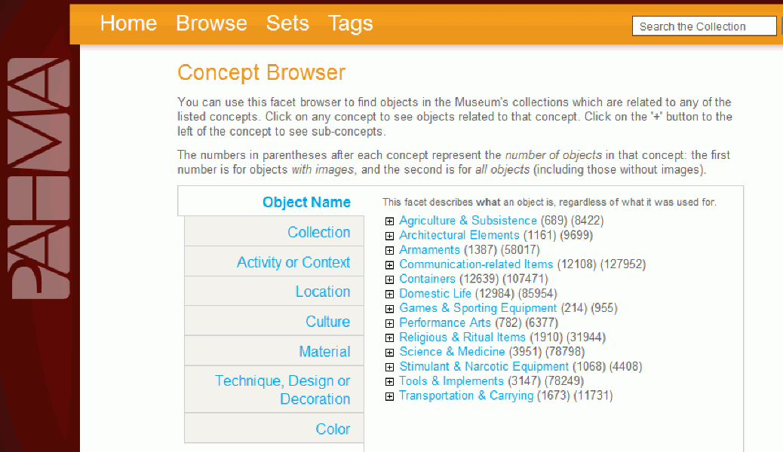
Delphi Faceted Browsing
55

Slide 56
What Delphi Does
Uses NLP techniques to enhance "scientific anthropological" metadata and descriptions of objects
Organizes the metadata and descriptions into an ontology
Ontology facets generate a dynamic searching and browsing UI
Supports personal user organization and annotation of the collections by allowing visitors to create sets and tag individual items
56

Slide 57
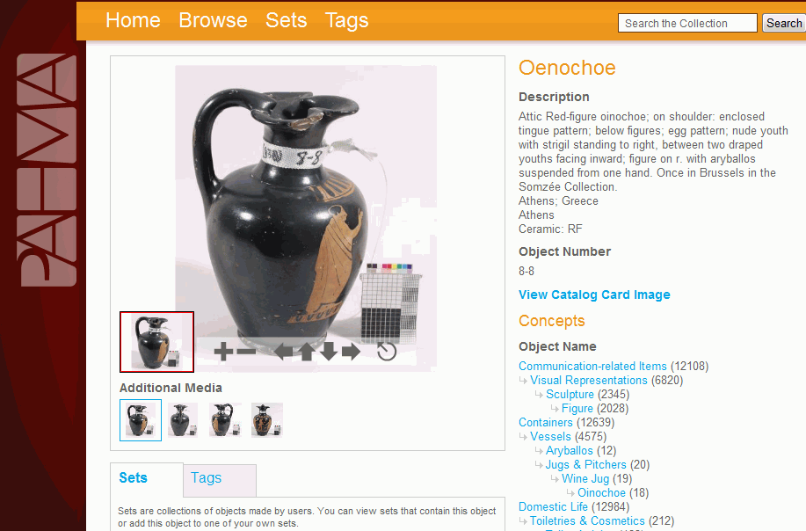
Delphi Resource
57

Slide 58
Readings for Next Lecture
TDO 6.5, 7.6
Li, Jiexun, Rong Zheng, and Hsinchun Chen. “From fingerprint to writeprint.” Communications of the ACM 49, no. 4 (2006): 76-82. dl.acm.org/citation.cfm?id=1121951
Blanzieri, Enrico, and Anton Bryl. “A survey of learning-based techniques of email spam filtering.” Artificial Intelligence Review 29, no. 1 (2008): 63-92. (Section 3, 67-75). link.springer.com/article/10.1007/s10462-009-9109-6
Linden, Greg, Brent Smith, and Jeremy York. “Amazon. com recommendations: Item-to-item collaborative filtering.” Internet Computing, IEEE 7, no. 1 (2003): 76-80.
58

