Slide 1

INFO 202
“Information Organization & Retrieval”
Fall 2013
UNIVERSITY OF CALIFORNIA, BERKELEY
SCHOOL OF INFORMATION
Robert J. Glushko
glushko@berkeley.edu
@rjglushko
5 November 2013
Lecture 20 – Midterm Review

Slide 2
The Course In One Slide
UNIVERSITY OF CALIFORNIA, BERKELEY
SCHOOL OF INFORMATION
To organize is to create capabilities by intentionally imposing order and structure
We organize things, we organize information, we organize information about things, and we organize information about information
If we think abstractly about these activities, we can see commonalities that outweigh their differences; We select, organize, interact with, and maintain resources
We organize resources as individuals, in informal association with other individuals, or as part of a more formal institutional or business context
We must recognize the profound impact of new technologies and their co-evolution with the nature of the organizing we do and the kinds of interactions that this organizing enables, but can't ignore the "classical" concepts and knowledge
2

Slide 3
Organizing Principles [1]
UNIVERSITY OF CALIFORNIA, BERKELEY
SCHOOL OF INFORMATION
ORGANIZING PRINCIPLES use properties or DESCRIPTIONS that are associated with the resources; organizing and describing resources are inherently interconnected activities
Almost any property of a resource might be used as a basis for an organizing principle, and multiple properties are often used simultaneously
The principles can also use collection-level properties
3

Slide 4
Organizing Principles [3]
UNIVERSITY OF CALIFORNIA, BERKELEY
SCHOOL OF INFORMATION
Other typical arrangements are based on ownership, origin, taxonomic, or “taskonomic” properties (usage frequency, correlated usage)
Any resource with a orderable name or identifier can have alphabetic or numeric ordering
Any resource with an associated date (creation, acquisition) can have chronological ordering
Principles should be expressed logically in a way that doesn’t assume an implementation
4

Slide 5
Why We Describe Resources
UNIVERSITY OF CALIFORNIA, BERKELEY
SCHOOL OF INFORMATION
We describe resources so we can refer to them, organize them, and interact with them
Each purpose might require different descriptions and different methods of using them
Different resource domains can have characteristic or standard resource descriptions (or description categories)
5

Slide 6
Categories are “Equivalence Classes”
UNIVERSITY OF CALIFORNIA, BERKELEY
SCHOOL OF INFORMATION
Categories are sets or groups of resources or abstract entities that are treated the same
This almost never means that every instance of the category is identical
It only means that for some purpose we treat them in the same way
6

Slide 7
Categories are Models
UNIVERSITY OF CALIFORNIA, BERKELEY
SCHOOL OF INFORMATION
Defining categories as equivalence classes in this way should remind you of this definition:
  Models are simplified descriptions of a subject that abstract from its complexity to emphasize some features or characteristics while intentionally de-emphasizing others
Categories are COGNITIVE and LINGUISTIC MODELS for applying prior knowledge
7

Slide 8
Principles for Creating Categories
UNIVERSITY OF CALIFORNIA, BERKELEY
SCHOOL OF INFORMATION
Enumeration
Single Properties
Multiple Properties
Family Resemblance
Similarity
Theory-Based
Goal-Derived
8

Slide 9
Distinguishing Categorization and Classification (1)
UNIVERSITY OF CALIFORNIA, BERKELEY
SCHOOL OF INFORMATION
Categories are EQUIVALENCE CLASSES - sets of resources, processes, and events that we treat the same
A Classification (noun) is a SYSTEM OF CATEGORIES, ordered according to a PRE-DETERMINED SET OF PRINCIPLES and used to organize a collection of resources
Classification (verb) is the process of systematically assigning resources to intentional (often institutional) categories in a classification system
9

Slide 10
Classification Schemes
UNIVERSITY OF CALIFORNIA, BERKELEY
SCHOOL OF INFORMATION
A HIERARCHICAL or TAXONOMIC scheme emerges when multiple resource properties are used by organizing principles; each property creates another level
A scheme can be both HIERARCHICAL and ENUMERATIVE at the lowest level where resources are categorized
A FACETED classification scheme uses multiple resource properties, but does not require every resource to have a value for every property and allows the properties to be considered in any order
10

Slide 11
Principles Embodied in the
Classification Scheme
UNIVERSITY OF CALIFORNIA, BERKELEY
SCHOOL OF INFORMATION
Warrant: What is the justification for the choice of categories and their names?
    Literary Warrant: Classify only the resources we have?
    Scientific Warrant: Use expert categories and names
    Use Warrant: Use categories and names from “ordinary” people
Breadth and depth of classification hierarchy
Degree of enumerativeness
11

Slide 12
Classification and Standardization (1)
UNIVERSITY OF CALIFORNIA, BERKELEY
SCHOOL OF INFORMATION
Classifications and standards both impose order on resources
They both distinguish, explicitly or implicitly, between standard / appropriate / effective and nonstandard / inappropriate / ineffective ways of creating organizing, and using resources
But this does not imply that a standard is a good one or that the best one will win a "standards war"
12

Slide 13
Description is Challenging
UNIVERSITY OF CALIFORNIA, BERKELEY
SCHOOL OF INFORMATION
People use different words for the same things, and the same words for different things - what would a "good" description be like, and how can it be created?
Describing and organizing always (explicitly or implicitly) takes place in some context
The context shapes which resource properties are important and the organizing principles that use those properties, introducing bias
13

Slide 14
The Vocabulary Problem
UNIVERSITY OF CALIFORNIA, BERKELEY
SCHOOL OF INFORMATION
People use a large variety of words for the same thing or concept
Most people - especially system designers - are surprised by this because they think their own word choices are “intuitive” or "natural“
The extreme variability of word selection is an inescapable fact that has its roots in the nature of language and categorization
14

Slide 15
More than a Controlled Vocabulary
UNIVERSITY OF CALIFORNIA, BERKELEY
SCHOOL OF INFORMATION
A controlled vocabulary is a standardized set of terms (such as subject headings, names, classifications, etc.) assigned by organizers / cataloguers / indexers of resources
A metadata schema like the Dublin Core controls the kinds of assertions about resources that you can make in the first place
Controlled vocabularies can be very useful requirements or recommendations about the values that are contained in the assertions (the information content of the assertion)
15

Slide 16
Implications for Vocabulary Design
UNIVERSITY OF CALIFORNIA, BERKELEY
SCHOOL OF INFORMATION
  Choosing vocabulary terms, and precisely defining their semantics, is essential but impossible to do perfectly
  Your vocabulary must express what YOU intend, so you "look inward" -- analyze how you think about a domain
  You want others to understand what you mean, so you need to "look outward" -- analyze the terms used by your users, competitors, or subject matter experts
  You should reuse other vocabularies or thesauri if they exist, especially for any "horizontal" components, to improve transformability and interoperability
  But these three approaches may suggest different terms
16

Slide 17
Complications
UNIVERSITY OF CALIFORNIA, BERKELEY
SCHOOL OF INFORMATION
The properties of resources that are easiest to describe are not always the most useful ones, especially for information resources
For non-text information resources this problem is magnified because the content is often in a semantically opaque format that cannot usefully be analyzed by people.
Business strategy and economics strongly influence the extent of resource description
But as bibliographic collections grow larger, we need more descriptions to satify the “frbr”
17

Slide 18
The Vision of the Semantic Web (1)
UNIVERSITY OF CALIFORNIA, BERKELEY
SCHOOL OF INFORMATION
In a classic 2001 paper Sir Tim Berners-Lee says:
The Web can reach its full potential only if … data can be shared and processed by automated tools as well as by people...
The Semantic Web will bring structure to the meaningful content of Web pages...
For the Web to scale, tomorrow's programs must be able to share and process data even when these programs have been designed totally independently.
18

Slide 19
There Are No Modeling Shortcuts
UNIVERSITY OF CALIFORNIA, BERKELEY
SCHOOL OF INFORMATION
You might think that "modeling" means "writing a schema given a set of instances" or "inferring a schema from a single instance" (like you can with the "autogenerate" function in many XML editors)
But schemas developed without a stage of conceptual design (other than very simple ones) are rarely very useful because they are too closely tied to the particular instances used, which may not be representative
Sometimes schemas went through a stage of conceptual design but once the schemas are implemented the conceptual information isn't available to allow users to evaluate suitability
19

Slide 20
To Summarize…
UNIVERSITY OF CALIFORNIA, BERKELEY
SCHOOL OF INFORMATION
The original vision of the Semantic Web emphasized the creation of ontologies that robustly described the semantics of particular domains or contexts
Lots of research was spawned by this vision, but the high bar of formal semantics and automated agents undoubtedly deterred “regular” people and firms from adopting it
Semantic authoring can’t take off without tools that are simple to use as tools for designing and creating HTML pages
20

Slide 21
What's Different About Describing Multimedia?
UNIVERSITY OF CALIFORNIA, BERKELEY
SCHOOL OF INFORMATION
Sensory Gap
Semantic Gap
Proliferation Problem
21

Slide 22
Are these “Gaps” New Problems?
UNIVERSITY OF CALIFORNIA, BERKELEY
SCHOOL OF INFORMATION
Museums face some of the same or similar problems in describing art works and artifacts:
  There may be many artifacts that represent the same "work" - this is like the "sensory" gap
  The materials or medium in which the artifact is embodied don't convey semantics "on their surface" - this is the semantic gap
  There may be so many artifacts of a particular type that some get only limited descriptions - this is like the proliferation problem
22

Slide 23
Some Problems May Be New
UNIVERSITY OF CALIFORNIA, BERKELEY
SCHOOL OF INFORMATION
The temporal structure of multimedia, especially video, mandates new descriptive vocabulary and new ways to identify meaningful components
Video and music meet emotional/psychological needs that are more complex than those for "documents" - so the descriptions of the latter have to be able to address these needs
People don't usually access or retrieve music or video "to satisfy information requirements“
23

Slide 24
Classifying Resource Properties

Slide 25
“Thing” vs “Type of Thing”
UNIVERSITY OF CALIFORNIA, BERKELEY
SCHOOL OF INFORMATION
Oops... we have been blurring the distinction between individual things or instances of things and classes of things
We often say that that two objects are the "same thing" when we mean they are the same "type of thing"
Identifying a resource as an instance is not the same as identifying the category or "equivalence class" to which it belongs
25

Slide 26
Two Aspects of “Thingness”
UNIVERSITY OF CALIFORNIA, BERKELEY
SCHOOL OF INFORMATION
Two separate aspects cut across the "thingness" distinctions:
    Granularity
    Abstraction
26

Slide 27
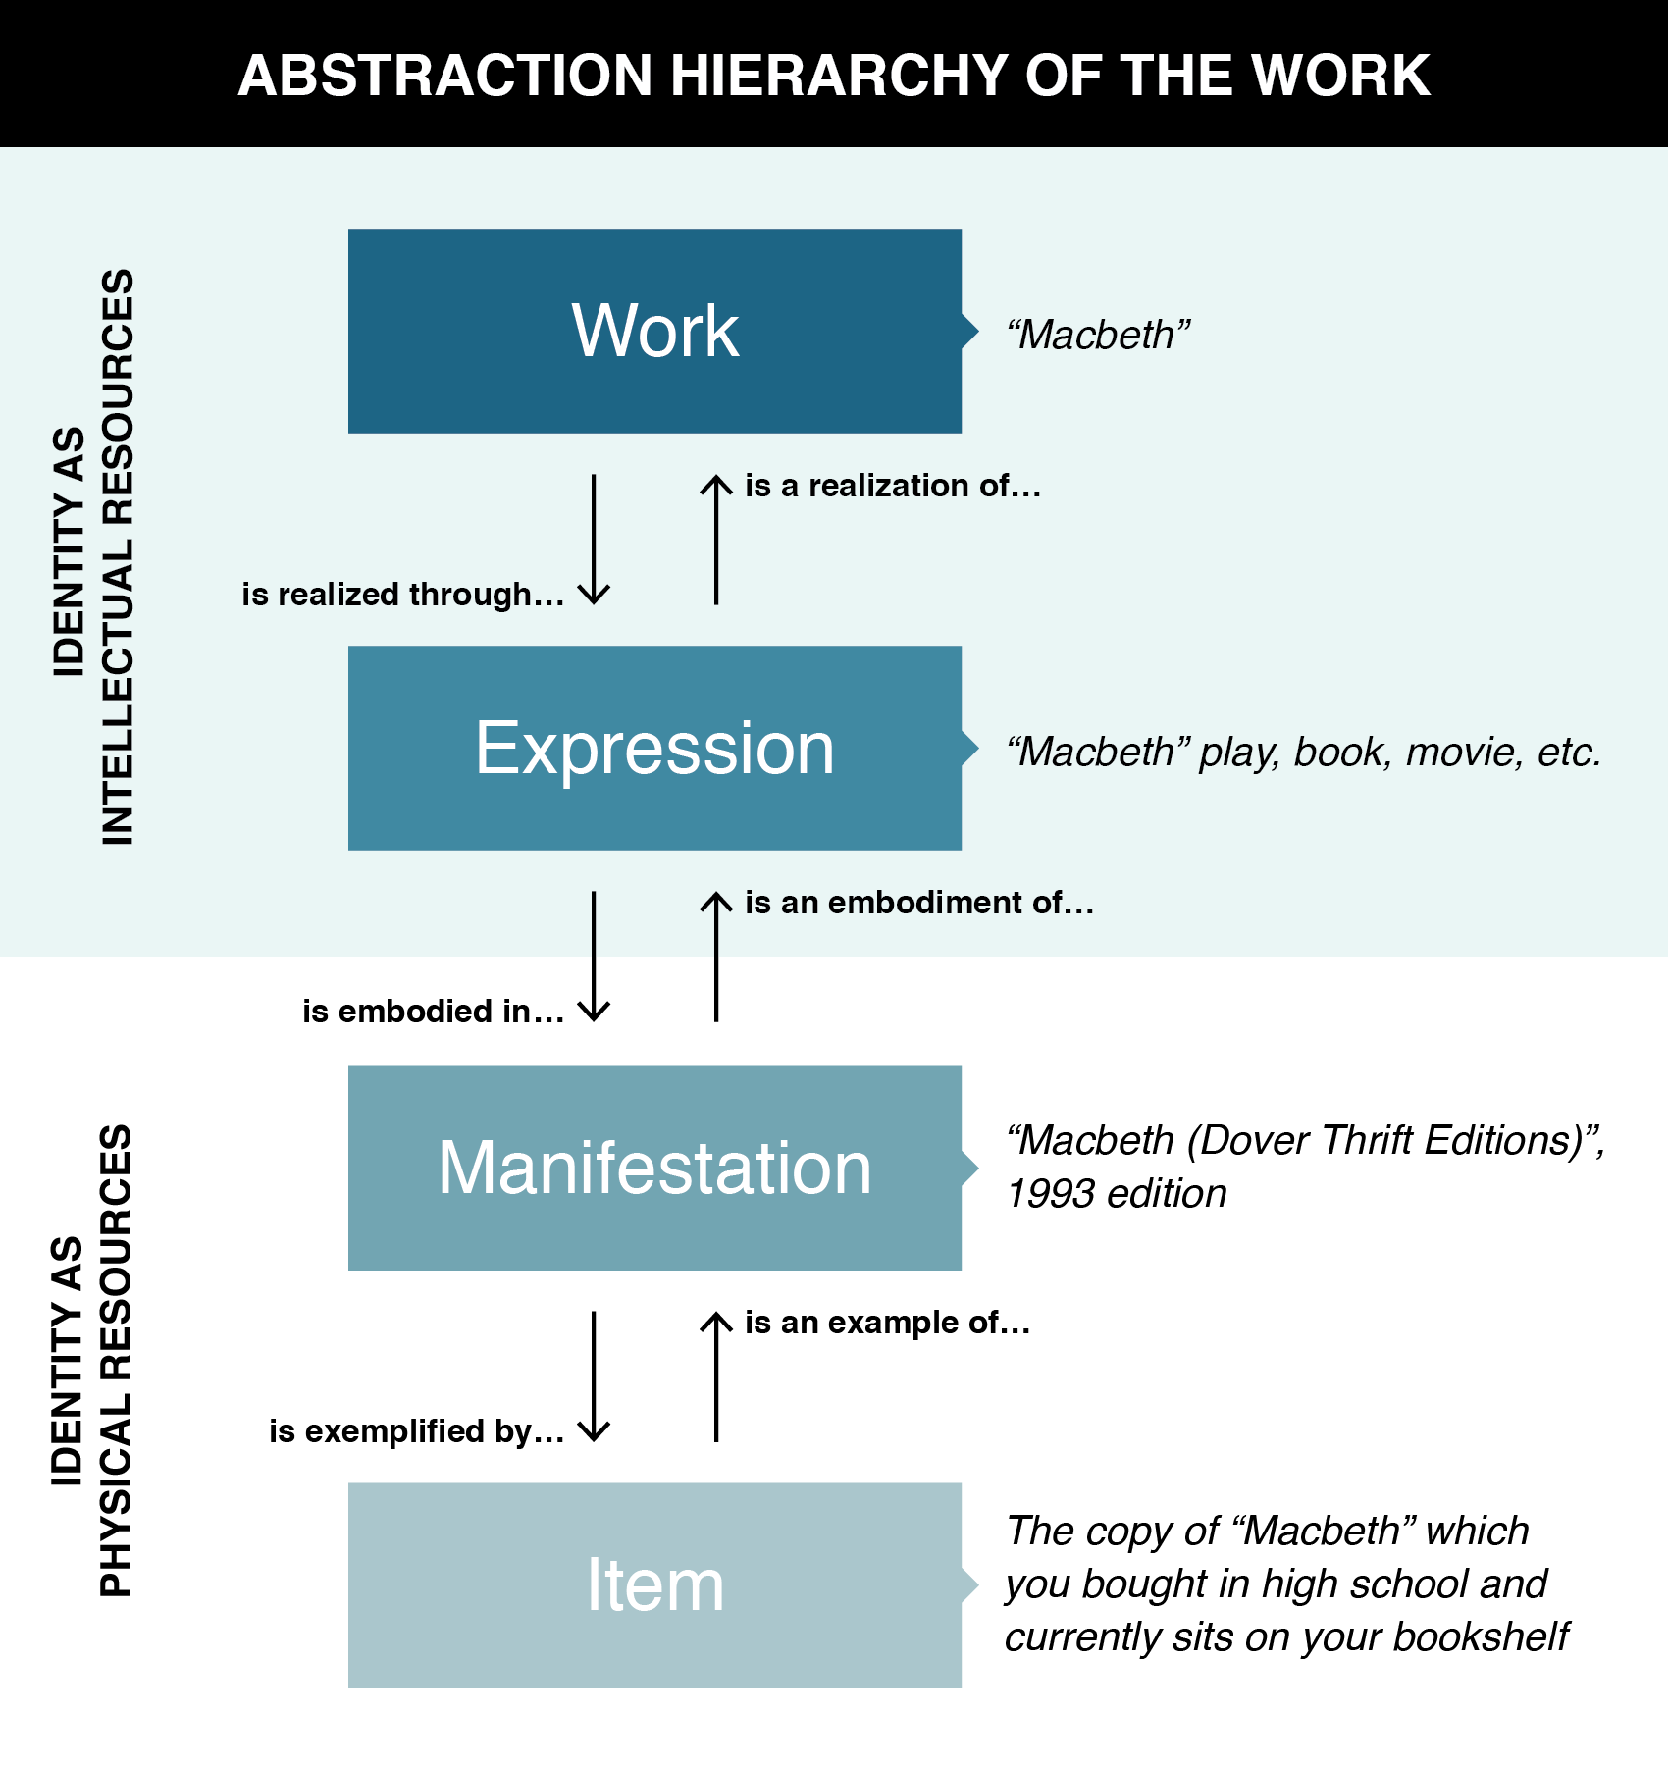
Instances vs. Types

Slide 28

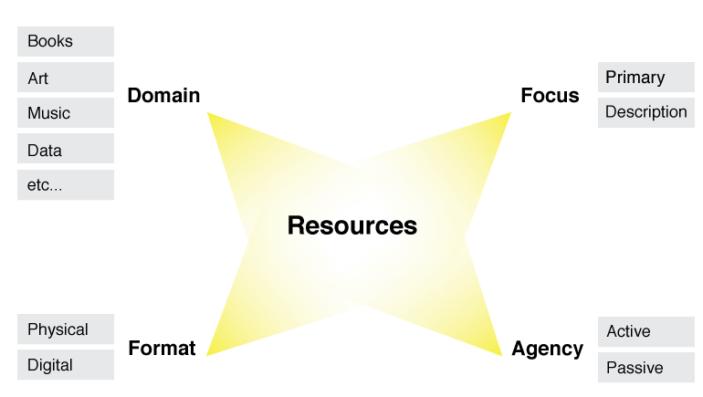
Design Choices & Patterns for Resources
UNIVERSITY OF CALIFORNIA, BERKELEY
SCHOOL OF INFORMATION
28

Slide 29
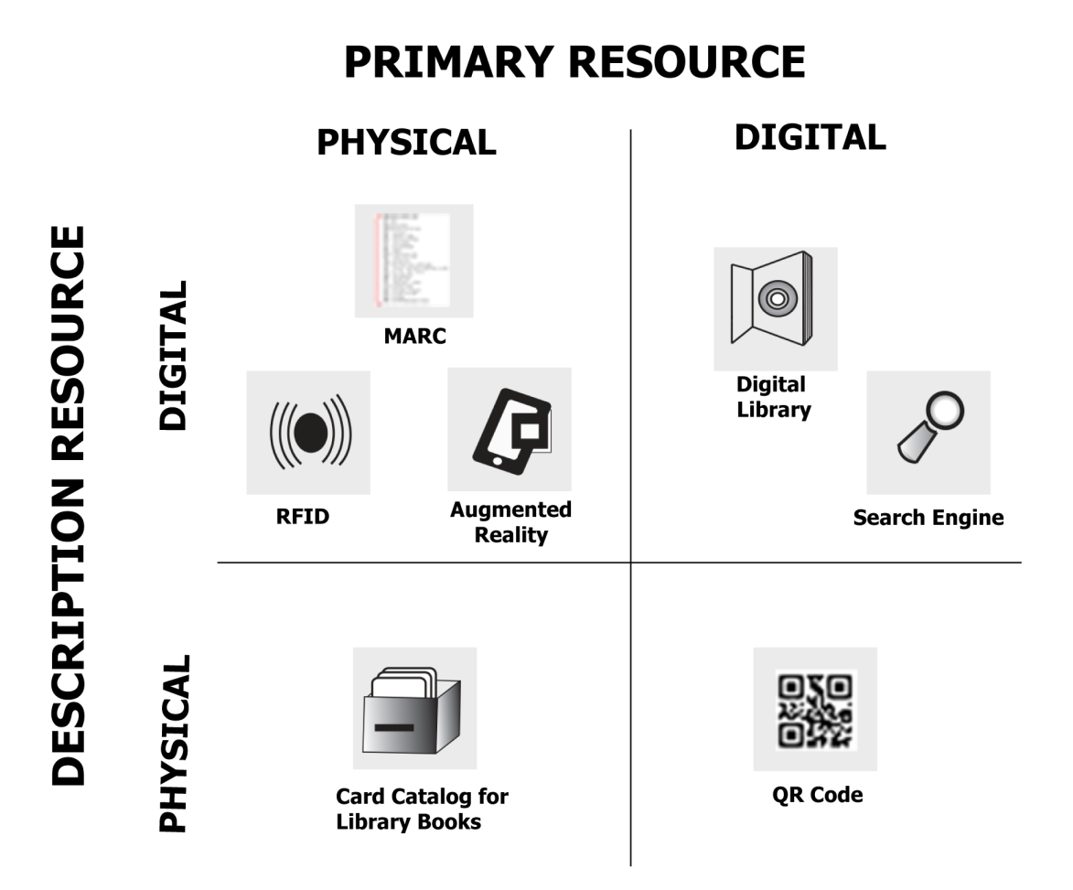
Format x Focus
UNIVERSITY OF CALIFORNIA, BERKELEY
SCHOOL OF INFORMATION
29

Slide 30
Interactions –The Why of Organizing Systems
UNIVERSITY OF CALIFORNIA, BERKELEY
SCHOOL OF INFORMATION
INTERACTIONS include any activity, function, or service supported by or enabled with respect to the resources in a collection or with respect the collection as a whole
Interactions can include access, reuse, copying, transforming, translating, comparing, combining… anything that a person or process can do with the resources…
30

Slide 31
Interactions
UNIVERSITY OF CALIFORNIA, BERKELEY
SCHOOL OF INFORMATION
Some interactions can be enabled with any type of resource, while others are tied to resource types
Interaction can be direct, mediated or indirect, or limited to interactions with resource copies or descriptions
The supported interactions depend on the nature and extent of the resource descriptions and arrangement
Different principles, or different implementations of the same organizing principles, determine the efficiency or effectiveness of the interactions
31

Slide 32
Interaction and Value Creation
Interactions differ in the absolute and relative amounts of physical manipulation, interpersonal or empathetic contact, and symbolic manipulation or information exchange involved in the interaction
Physical Object Manipulation
Symbolic Manipulation
Interpersonal Interaction
Apte, U. and Mason, R. Global Disaggregation of
Information-Intensive Services. Management Science (1995).
32

Slide 33
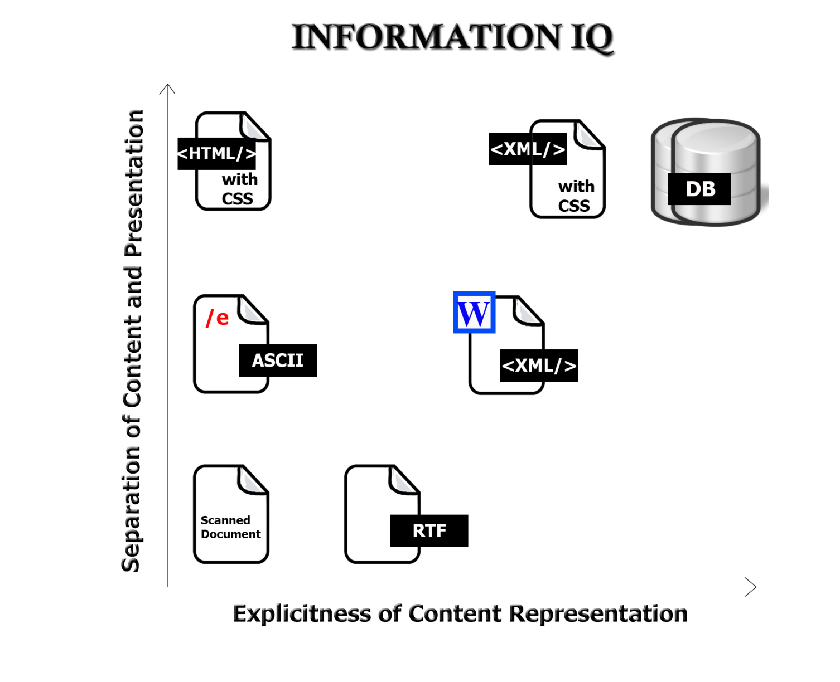
Value Creation with “Smart” Resources
The variety and functions of interactions with digital resources are determined by the amount of structure and semantics represented in their digital encoding, in the descriptions associated with the resources, or by the intelligence of the
computational processes applied to them
33

Slide 34
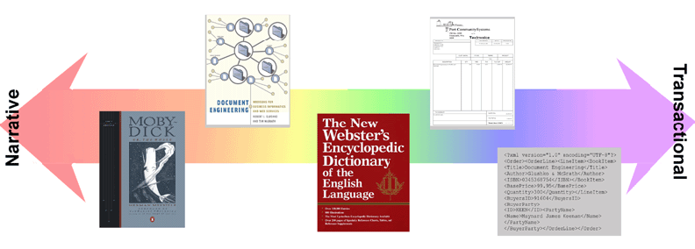
The Document Type Spectrum
UNIVERSITY OF CALIFORNIA, BERKELEY
SCHOOL OF INFORMATION
From Glushko & McGrath, DOCUMENT ENGINEERING, MIT Press 2005
34

Slide 35
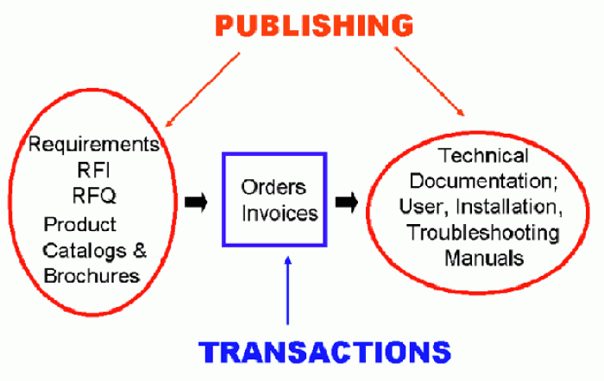
Mixing Data and Documents

Slide 36
Five Perspectives on Relationships (1)
UNIVERSITY OF CALIFORNIA, BERKELEY
SCHOOL OF INFORMATION
SEMANTIC: the meaning of the association
LEXICAL: how the conceptual description of a relationship is expressed using words in a specific language
STRUCTURAL: analyzes the patterns of association, arrangement, proximity, or connection between resources
36

Slide 37
Five Perspectives on Relationships (1)
UNIVERSITY OF CALIFORNIA, BERKELEY
SCHOOL OF INFORMATION
ARCHITECTURAL: emphasizes the number and abstraction level of the components of a relationship, which together characterize its complexity
IMPLEMENTATION: how the relationship is implemented in a particular notation and syntax and the manner in which relationships are arranged and stored in some technology environment.
37

Slide 38
Defining "Relationship"
UNIVERSITY OF CALIFORNIA, BERKELEY
SCHOOL OF INFORMATION
“An association among several things, with that association having a particular significance”
“Relationships are the stuff out of which information is made”
The reason is an important part of the relationship
Multiple relationships can exist among the same objects, so the order of the objects matters
38

Slide 39
The Structural Perspective on Relationships
UNIVERSITY OF CALIFORNIA, BERKELEY
SCHOOL OF INFORMATION
Analyzing the association, arrangement, proximity, or connection between resources without primary concern for their meaning or the origin of these relationships
Sometimes structure is all we know...and sometimes we ignore what we know about relationship semantics to focus on the generic aspect of structural connectivity
39

Slide 40
Internal and External Structure
UNIVERSITY OF CALIFORNIA, BERKELEY
SCHOOL OF INFORMATION
Resources can have INTERNAL structure as well as EXTERNAL structure that connects them to other resources
We often make arbitrary decisions about how the granularity with which we describe the internal structure of a resource
The boundaries we impose to identify resources determines whether some structure is internal or external with respect to them
40

Slide 41
The Architectural Perspective {and,or,vs.} the Structural Perspective
UNIVERSITY OF CALIFORNIA, BERKELEY
SCHOOL OF INFORMATION
The architectural perspective is abstract and prescriptive
    It defines what kinds of relationships can be created
The structural perspective is concrete and descriptive one
    It says "this is what exists" and describes the actual patterns of association, arrangements, proximity, or connection between resources"
41

Slide 42
Computing the Properties of Graphs
UNIVERSITY OF CALIFORNIA, BERKELEY
SCHOOL OF INFORMATION
Reachability – is there a path between any two nodes in the graph?
Shortest path – if there are multiple paths between two nodes, which is the shortest?
Centrality – which nodes are the most connected or have the average shortest paths to the other nodes?
Subgraph discovery – are there sub-graphs that are completely contained in a larger graph?
42

Slide 43
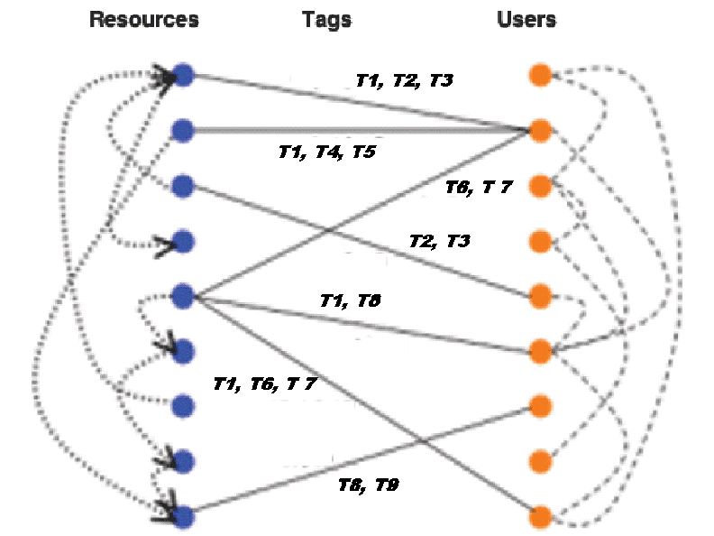
The Conceptual Model of Social Tagging
UNIVERSITY OF CALIFORNIA, BERKELEY
SCHOOL OF INFORMATION
43

