Slide 1
Plan for Today’s Lecture(s)
UNIVERSITY OF CALIFORNIA, BERKELEY
SCHOOL OF INFORMATION
Taskonomic Classification (runover from 10/24)
Introduction to Interactions
Affordances and Interactions
Interactions in “Memory Institutions”
1

Slide 2
INFO 202 “Information Organization & Retrieval” Fall 2013
UNIVERSITY OF CALIFORNIA, BERKELEY
SCHOOL OF INFORMATION
Robert J. Glushko glushko@berkeley.edu
@rjglushko
24 October 2013 Lecture 17.3 – Taskonomic Classification

Slide 3
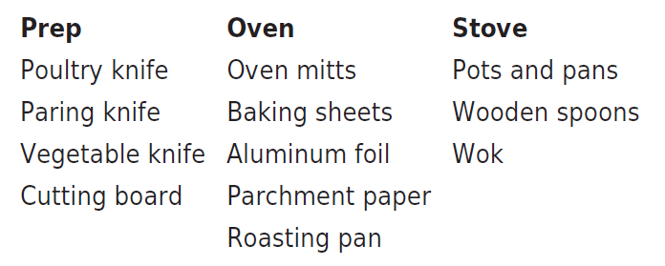
Taskonomy
UNIVERSITY OF CALIFORNIA, BERKELEY
SCHOOL OF INFORMATION
In contrast to "taxonomy" - an approach to organization based on similarity of content or characteristics - a "taskonomy" organizes on the basis of purpose or "activity structure“
A COOK’S TASKONOMY (Figure 7.1 in TDO)
3

Slide 4
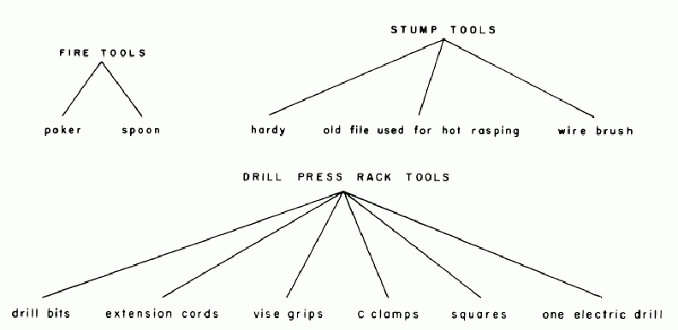
The Blacksmith’s Taxonomy
Janet W. D. Dougherty and Charles M. Keller, "Taskonomy: A Practical Approach to Knowledge Structures," American Ethnologist, Vol. 9, No. 4, Symbolism and Cognition II (Nov., 1982), pp. 763-774
4

Slide 5
“Distributed Cognition”
UNIVERSITY OF CALIFORNIA, BERKELEY
SCHOOL OF INFORMATION
"Distributed cognition" is a "dialect" of cognitive science that views cognitive activity as not just something that takes place within the mind of a single person a some moment in time; it is:
Distributed across the members of a social or goal-oriented group
Distributed and coordinated between people and the technology and artifacts they create and use
Hollan, Hutchins, & Kirsh, "Distributed Cognition: Toward a New Foundation for Human-Computer Interaction Research," ACM TOCHI, 2000
5

Slide 6
“The Intelligent Use of Space”
UNIVERSITY OF CALIFORNIA, BERKELEY
SCHOOL OF INFORMATION
"Whether we are aware of it or not, we are constantly organizing and reorganizing our workplace to enhance performance"
"The physics of the world is such that at times the histories of use are perceptually available to us in ways that support the tasks we are doing"
"When space is used well, it reduces the time and memory demands of our tasks... to simplify choice, to simplify perception, and simplify internal computation”
Kirsh, David. "The intelligent use of space." Artificial intelligence 73, no. 1 (1995): 31-68.
6

Slide 7
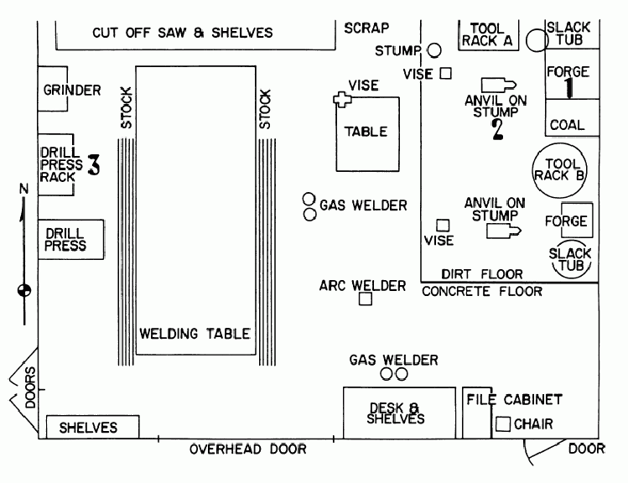
The Blacksmith’s Use of Space
7

Slide 8
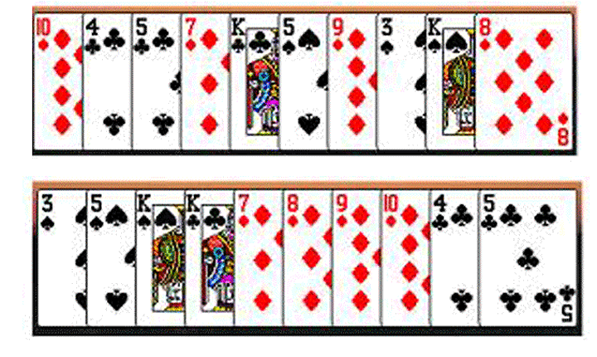
Task-Based Card Sorting
“When space is used well, it reduces the time and memory demands of our tasks... to simplify choice, to simplify perception, and simplify internal computation“ –
David Kirsh on “Cognitive Overload”
8

Slide 9
INFO 202 “Information Organization & Retrieval” Fall 2013
UNIVERSITY OF CALIFORNIA, BERKELEY
SCHOOL OF INFORMATION
Robert J. Glushko glushko@berkeley.edu
@rjglushko
29 October 2013 Lecture 18.1 – Interactions in Organizing Systems

Slide 10
Interactions –The Why of Organizing Systems
UNIVERSITY OF CALIFORNIA, BERKELEY
SCHOOL OF INFORMATION
INTERACTIONS include any activity, function, or service supported by or enabled with respect to the resources in a collection or with respect the collection as a whole
The interaction of ACCESS is fundamental in any collection of resources –why would you collect and organize resources you didn’t expect to access in the future?
10

Slide 11
Classifying Interactions
UNIVERSITY OF CALIFORNIA, BERKELEY
SCHOOL OF INFORMATION
Type of resource involved (physical or digital)
How value is created
Generality (generic to domain or resource-specific)
“Property layer” involved (properties of individual resources, properties of collections)
Extent of mediation (none, partial, complete)
Initiative (by user, by resource, mixed initiative)
11

Slide 12
Classifying Interactions
UNIVERSITY OF CALIFORNIA, BERKELEY
SCHOOL OF INFORMATION
Implementation technology or algorithm (person to person, self-service, mechanical, IR, machine learning, NLP,...)
Impact on the resources or collection (unchanged, translated, transformed, consumed, destroyed)? Are new resources created as a result of the interaction?
12

Slide 13
Interaction and Value Creation
Interactions differ in the absolute and relative amounts of physical manipulation, interpersonal or empathetic contact, and symbolic manipulation or information exchange involved in the interaction
Physical Object Manipulation
Symbolic Manipulation
Interpersonal Interaction
Apte, U. and Mason, R. Global Disaggregation of Information-Intensive Services. Management Science (1995).
13

Slide 14
Value Creation with Physical Resources
UNIVERSITY OF CALIFORNIA, BERKELEY
SCHOOL OF INFORMATION
Physical manipulation is often the intrinsic type of interaction with physical resources
The resource might have to be handled or directly perceived in order to interact with it
Physical manipulation and interpersonal contact might be required to interact with information resources in physical form like printed books in libraries or music in CDs or albums
Interactions involving physical resources often emphasize generic aesthetic or emotional goals
14

Slide 15
Value Creation with Digital Resources
UNIVERSITY OF CALIFORNIA, BERKELEY
SCHOOL OF INFORMATION
With digital resources, neither physical manipulation nor interpersonal contact is required for interactions
The essence of the interaction is information exchange or symbolic manipulation of the information contained in the resource
By replacing interactions that involve people and physical resources with symbolic ones, organizing systems can lower their costs without reducing user satisfaction (automation, self-service, outsourcing…)
15

Slide 16
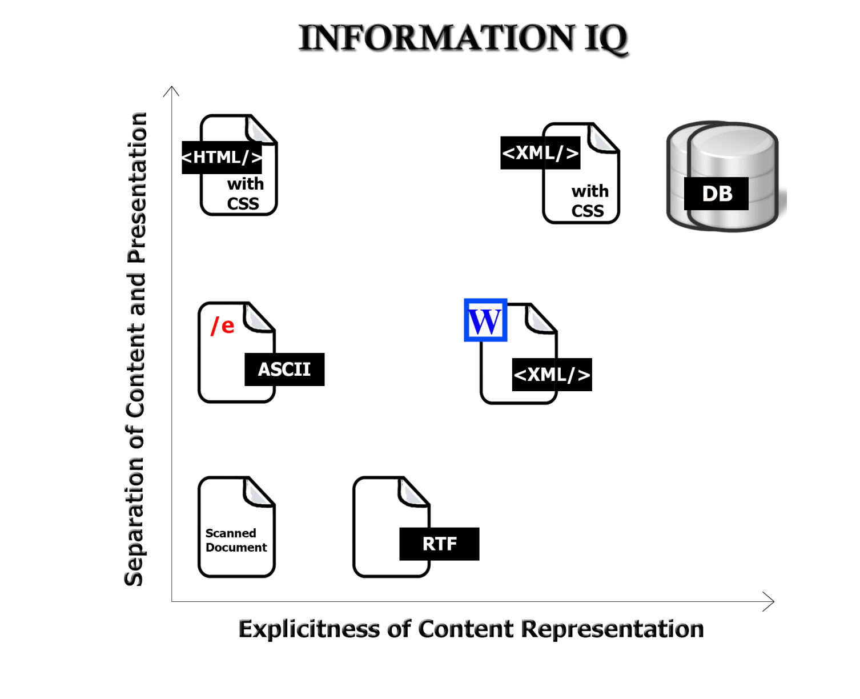
Value Creation with “Smart” Resources
The variety and functions of interactions with digital resources are determined by the amount of structure and semantics represented in their digital encoding, in the descriptions associated with the resources, or by the intelligence of the
computational processes applied to them
16

Slide 17
Disaggregation of Symbolic Interaction and Other Impacts of Technology
Robotics,
Remote
manipulation?
Information can augment interpersonal and physical interactions, and can also replace them
Symbolic
Manipulation
(Part 2)
Symbolic Manipulation
(Part 1)
Telepresence?
17

Slide 18
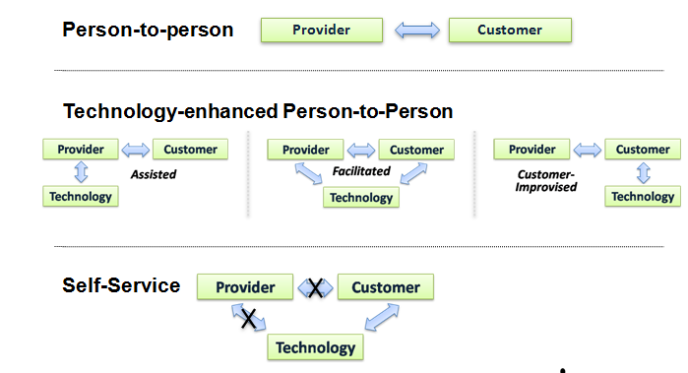
A Continuum of Technology Support in Interactions
18

Slide 19
Substituting Information for Interaction
UNIVERSITY OF CALIFORNIA, BERKELEY
SCHOOL OF INFORMATION
A “smart resource” or organizing system that can capture, manage, integrate and retrieve information about the customer / user and prior interactions can substitute information for interaction
A hotel clerk with a CRM database doesn’t need to ask for your room preferences; Amazon doesn’t need to ask you about what type of books you like
Design implication: hidden computational services are interchangeable with customer-facing “touch points”
19

Slide 20
Generic and Domain-Specific Interactions
UNIVERSITY OF CALIFORNIA, BERKELEY
SCHOOL OF INFORMATION
Some interactions can be enabled with any type of resource, while others are tied to resource types
The supported interactions depend on the nature and extent of the resource descriptions and arrangement
Different principles, or different implementations of the same organizing principles, determine the efficiency or effectiveness of the interactions
20

Slide 21
The Most Generic Interactions
UNIVERSITY OF CALIFORNIA, BERKELEY
SCHOOL OF INFORMATION
Finding a resource that you know exists
Identifying a resource to make sure you have the one you were looking for
Selecting a resource from a set of candidates in a collection
Obtaining the resource if what you have at this point is just a resource description
21

Slide 22
Direct vs Mediated Interactions
UNIVERSITY OF CALIFORNIA, BERKELEY
SCHOOL OF INFORMATION
Interactions with a resource can be direct, mediated or indirect, or limited to interactions with resource copies or descriptions
Many of the interactions with individual physical resources seem unmediated when they take place
This means we don't always realize the role of additional descriptions or organization in supporting or improving interactions
22

Slide 23
Patterns of “Interaction Initiation”
UNIVERSITY OF CALIFORNIA, BERKELEY
SCHOOL OF INFORMATION
A) Where can I buy a notebook computer?
B) Here's my catalog of notebook computers.
A) I'd like to order this one.
B) OK.
B) And here's your invoice.
A) OK.
A) When will the computer arrive?
B) By next Tuesday.
B) Here's my complete catalog, in case you're interested in other products.
23

Slide 24
Interaction Patterns
UNIVERSITY OF CALIFORNIA, BERKELEY
SCHOOL OF INFORMATION
The ebXML standards activity defined a set of “transaction patterns” for describing business processes that we use to understand interactions in organizing systems
The patterns differ in how the interaction is initiated, whether it makes any assumptions about prior interactions, and whether it creates obligations for future interactions
24

Slide 25
Interaction Patterns
A) Where can I buy a notebook computer?
B) Here's my catalog of notebook computers.
Query/response pattern – no assumption of prior interaction, no dependence on identity of requestor
A) I'd like to order this one.
B) OK.
Commercial transaction – creates an obligation to perform
25

Slide 26
Interaction Patterns
B) And here's your invoice.
Notification – initiated by the system, follows up on prior interaction and thus depends on identity of the original requestor
A) When will the computer arrive?
B) By next Tuesday.
Request/ confirm – based on a prior interaction
B) Here's my complete catalog, in case you're interested in other products
Information distribution – initiated by the system but no dependence on prior interaction
26

Slide 27
INFO 202 “Information Organization & Retrieval” Fall 2013
UNIVERSITY OF CALIFORNIA, BERKELEY
SCHOOL OF INFORMATION
Robert J. Glushko glushko@berkeley.edu
@rjglushko
29 October 2013 Lecture 18.2 – Affordances and Interactions

Slide 28
“The Design of Everyday Things” (new edition Nov 2013)
UNIVERSITY OF CALIFORNIA, BERKELEY
SCHOOL OF INFORMATION
“intentional arrangement of resources and the interactions they support? – that’s what design does” (Don Norman)
Design must convey the essence of a device’s operation
The way it works
The possible actions that can be taken
Just what it is doing at any particular moment
28

Slide 29
Affordances (1)
UNIVERSITY OF CALIFORNIA, BERKELEY
SCHOOL OF INFORMATION
For physical resources, many potential interactions are inherent in their AFFORDANCES – perceptible and actionable properties that determine what can be done with them (given some capabilities of the entities interacting with them)
Affordances can also be analyzed as constraints that limit what can be done with a resource
Creating affordances is often the purpose of design
29

Slide 30
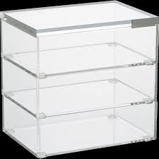
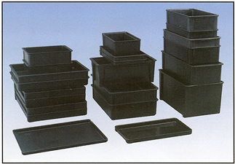
Easily Perceivable Affordances
30

Slide 31
Affordances (2)
UNIVERSITY OF CALIFORNIA, BERKELEY
SCHOOL OF INFORMATION
Many organizing systems use the readily perceived properties that create affordances as the basis for resource selection, arrangement, and interaction design
(this is especially true with “taskonomic” classification)
But not every affordance makes sense as an organizing principle, and not every affordance is related to a useful interaction
31

Slide 32
Not every Affordance is Related to a Useful Interaction
In graphical, screen-based interfaces, all that the designer has available is control over perceived affordances. The computer system … affords pointing, touching, looking, and clicking on every pixel of the display screen. Most of this affordance is of no value. Thus, if the display does not have a touch-sensitive screen, the screen still affords touching, but it has no result on the computer system.
Norman, Donald. "Affordances and design”
32

Slide 33
Design to Support Interaction (1)
UNIVERSITY OF CALIFORNIA, BERKELEY
SCHOOL OF INFORMATION
With physical resources, good design makes it easy to distinguish between parts and properties that are functional and those that are decorative or otherwise non-functional
With digital and computational resources, it is often impossible to discern capability in the “presentation layer”
So designing the interactions isn't sufficient; we must also make them discoverable and comprehensible
33

Slide 34
Design to Support Interaction (2)
UNIVERSITY OF CALIFORNIA, BERKELEY
SCHOOL OF INFORMATION
Many interactions with physical and digital resources are invoked and performed using controls or other “user interface elements”
These controls and UI elements have affordances too, and good design makes it easy to see how to use them
Does the arrangement of the controls map well to the arrangement of the resources they control?
If the resources belong to logical groups or categories, does the arrangement of the controls reflect them?
34

Slide 35
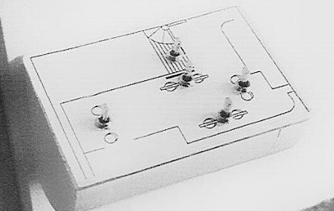
AFTER: Switches arranged to match room layout
BEFORE: Array of 6 light switches
Donald Norman, The Design of Everyday Things

Slide 36
Beer tap handles used to distinguish identical knobs in control room of a nuclear power plant
Donald Norman, The Design of Everyday Things

Slide 37
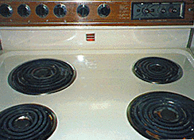
Good and Bad Mappings
UNIVERSITY OF CALIFORNIA, BERKELEY
SCHOOL OF INFORMATION
37

Slide 38
INFO 202 “Information Organization & Retrieval” Fall 2013
UNIVERSITY OF CALIFORNIA, BERKELEY
SCHOOL OF INFORMATION
Robert J. Glushko glushko@berkeley.edu
@rjglushko
29 October 2013 Lecture 18.3 – Designed Interactions

Slide 39
Designed Interactions (1)
UNIVERSITY OF CALIFORNIA, BERKELEY
SCHOOL OF INFORMATION
The interactions that are “afforded” should be distinguished from “designed interactions” that are made possible by intentional acts of description, arrangement, or technological mediation
For example, when a book is checked out of a library it might be read, translated, summarized, criticized, or otherwise used — but none of these interactions are directly designed into the library
A digital library, however, might design in support for translation, summarization, annotation, and other services
39

Slide 40
Designed Interactions (2)
UNIVERSITY OF CALIFORNIA, BERKELEY
SCHOOL OF INFORMATION
Different principles, or different implementations of the same organizing principles, determine the efficiency or effectiveness of designed interactions
Choices about descriptions and organizing principles involve tradeoffs to determine which interactions are efficient, possible, difficult, or impossible
40

Slide 41
Interactions with Digital and Computerized Resources (1)
We often can’t perceive the designed interactions with digital and computerized resources, because their capabilities are internally implemented rather than inherent in perceptible surface properties or file names
Sonicator
41

Slide 42
Interactions with Digital and Computerized Resources (2)
Even when we see some indications of potential interactions we can't directly understand or compare their capability
42

Slide 43
Classifying Interactions by Resource Property Layers
UNIVERSITY OF CALIFORNIA, BERKELEY
SCHOOL OF INFORMATION
The resource properties that enable interactions can be distinguished in three layers:
Properties of individual resources
Properties of resource collections
Derived or computed properties
43

Slide 44
Properties of Individual Physical Resources
44

Slide 45
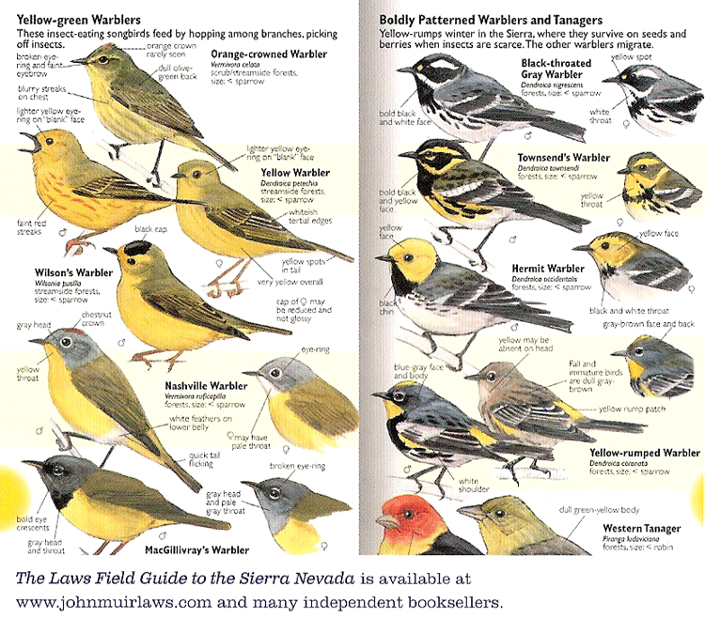
Different Properties Needed for Different Interactions
45

Slide 46
Organizing Books by Color
UNIVERSITY OF CALIFORNIA, BERKELEY
SCHOOL OF INFORMATION
Trading aesthetics for scalability in organization and retrieval
Photo by See-ming Lee (http://www.flickr.com/photos/seeminglee/4556156477) Creative Commons CC BY-SA 2.0 license
46

Slide 47
Properties of Individual Information Resources
<Book> <Title>Moby Dick</Title> <Author>Melville</Author> <PublicationYear>1851</PublicationYear> <Category>Fiction</Category> </Book>
47

Slide 48
Derived or Computed Properties
UNIVERSITY OF CALIFORNIA, BERKELEY
SCHOOL OF INFORMATION
For individual resources: image or audio signatures, sentiment analysis, summaries
For collections: inter-item similarity, inter-item relationships/links, discriminating terms (inverse document frequency), statistically improbable phrases, principle components/factor analysis/LSI
48

Slide 49
Properties of Resource Collections
UNIVERSITY OF CALIFORNIA, BERKELEY
SCHOOL OF INFORMATION
Statistics like the average age, size, usage of the resources
For documents with text content, statistics like term distributions
49

Slide 50
INFO 202 “Information Organization & Retrieval” Fall 2013
UNIVERSITY OF CALIFORNIA, BERKELEY
SCHOOL OF INFORMATION
Robert J. Glushko glushko@berkeley.edu
@rjglushko
29 October 2013 Lecture 18.3 – Interactions in “Memory Institutions” and their Convergence

Slide 51
The Baseline: Distinctiveness
UNIVERSITY OF CALIFORNIA, BERKELEY
SCHOOL OF INFORMATION
Libraries, museums, and archives have traditionally been distinguished on the basis of resource types, organizing principles, interaction repertoires, user communities, and access policies
Furthermore, the broad categories of libraries and museums can be subdivided into scores of finer types
Curriculum models still support traditional definitions of the roles, functions, and audiences of each type of organizing system
51

Slide 52
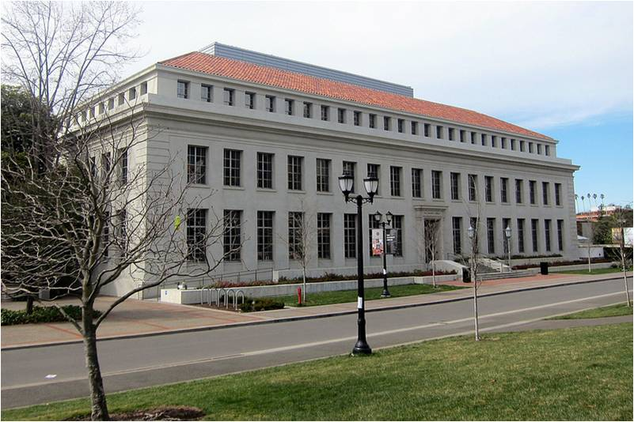
Libraries
52

Slide 53
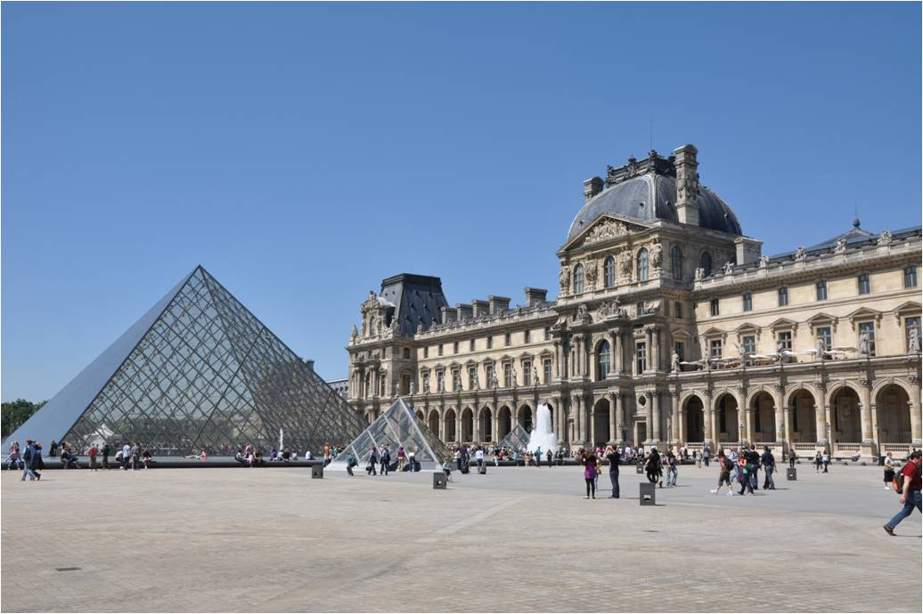
Museums
53

Slide 54
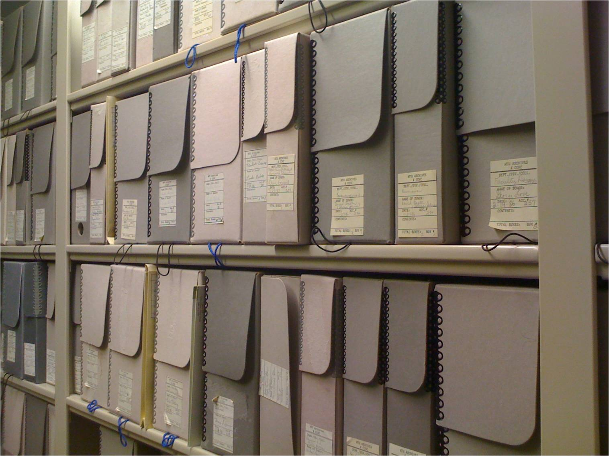
Archives
54

Slide 55
Emerging Convergence
UNIVERSITY OF CALIFORNIA, BERKELEY
SCHOOL OF INFORMATION
The web has put vast amounts of resources online and changed default behaviors with respect to resource discovery and access
Dealing with the web as a common challenge (or opportunity)
Common need to reposition toward less formal interactions and purposes
Effective digitization
Common platforms, governance
55

Slide 56
Emerging Convergence
UNIVERSITY OF CALIFORNIA, BERKELEY
SCHOOL OF INFORMATION
These commonalities have not historically been dominant features in the self-characterization of libraries, museums, and archives, they are increasingly important to their sustainability
While the traditions and historical areas of expertise in archives, libraries, and museums may differ, the new challenges facing all collecting cultural institutions are best addressed in concert, in an inter-disciplinary forum that explores multiple solutions and takes advantage of many skills
56

Slide 57
Readings for Next Lecture
UNIVERSITY OF CALIFORNIA, BERKELEY
SCHOOL OF INFORMATION
Schwarzman, A., Hur, H., Pai, S., and Glass, C. XML-centric workflow offers benefits to scholarly publishers. people.ischool.berkeley.edu/~glushko/202/Schwarzman-XML-CentricWorkflow.pdf
Baron, Richard J., Elizabeth L. Fabens, Melissa Schiffman, and Erica Wolf. “Electronic health records: just around the corner? Or over the cliff?.” Annals of internal medicine 143, no. 3 (2005): 222-226. annals.org/article.aspx?articleid=718641
Brunnermeier, Smita B., and Sheila A. Martin. “Interoperability costs in the US automotive supply chain.” Supply Chain Management: An International Journal 7, no. 2 (2002): 71-82.
57

