Slide 1
Plan for Today’s Lecture(s)
UNIVERSITY OF CALIFORNIA, BERKELEY
SCHOOL OF INFORMATION
MITRE Reference Model for Understanding and Comparing Standards (holdover from 10/22)
Bibliographic Classification
Faceted Classification
Taskonomic Classification
1

Slide 2
INFO 202 “Information Organization & Retrieval” Fall 2013
UNIVERSITY OF CALIFORNIA, BERKELEY
SCHOOL OF INFORMATION
Robert J. Glushko glushko@berkeley.edu
@rjglushko
22 October 2013 Lecture 16.4 – MITRE Reference Model for Understanding and Comparing Standards

Slide 3
MITRE Reference Model for Understanding and Comparing Standards
UNIVERSITY OF CALIFORNIA, BERKELEY
SCHOOL OF INFORMATION
"We need to proactively produce new areas of useful semantic agreement, and not simply document correspondences among existing systems"
"An approach to semantics management must tolerate organizational realities that are often ignored“
Rosenthal, A., Seligman, L., and Renner, S. 2004. From semantic integration to semantics management: case studies and a way forward. SIGMOD Rec. 33, 4 (Dec. 2004), 44-50
3

Slide 4
Lessons From Standards Making: The "Person-Concept" Tradeoff
UNIVERSITY OF CALIFORNIA, BERKELEY
SCHOOL OF INFORMATION
Semantic agreement comes at a cost driven by the number of people who require a shared understanding, and by the number of concepts they must all understand
So a small set of people can agree on a complex standard, or a large set of people can agree on a simple one
…especially when participants are just trying to agree on how to describe pre-existing shared concepts rather than having to define them first
4

Slide 5
Lessons from Standards Making: Incentives and Disincentives
UNIVERSITY OF CALIFORNIA, BERKELEY
SCHOOL OF INFORMATION
Approaches that require perfect coordination and altruism are of no practical interest
Disincentives to agree on semantics arise if agreement means that someone has to change an implementation and pay the cost of doing so
Model-driven development tools that generate needed software artifacts (e.g., system and user interfaces) from specifications can encourage standards adoption by reducing the transition costs
5

Slide 6
MITRE Reference Model for Comparing Standards: Data Objects
UNIVERSITY OF CALIFORNIA, BERKELEY
SCHOOL OF INFORMATION
What is the semantic granularity of the concepts being standardized?
Is there also a standard for how the concepts are encoding in some syntactic or physical representation?
Does the standard also specify "instance sets" or possible values for each data element concept?
6

Slide 7
MITRE Reference Model for Comparing Standards: Structures
UNIVERSITY OF CALIFORNIA, BERKELEY
SCHOOL OF INFORMATION
In addition to standards for data objects, are there standards for schemas or "document architectures" that structurally organize them?
Are there standards for the instances or interchange formats used by publishers/producers or expected by subscribers/consumers?
7

Slide 8
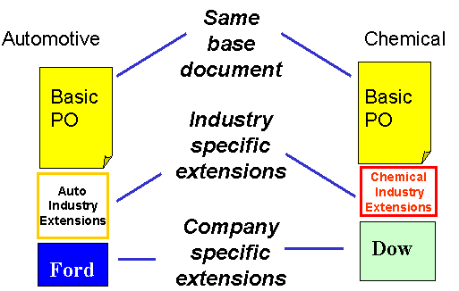
Horizontal and Vertical Document Components
8

Slide 9
The Universal Business Language (UBL)
UNIVERSITY OF CALIFORNIA, BERKELEY
SCHOOL OF INFORMATION
Over 100 document types built using core components and a common architecture/metamodel needed for supply chains (European) and International Trade (Asia and US), collaborative planning, forecasting, and replenishment; vendor managed inventory; intermodal freight management; and utility billing
These document types use a library of XML schemas for reusable aggregate data components such as "Address," "Item," and "Payment“
9

Slide 10
MITRE Reference Model for Comparing Standards: Community Characteristics
UNIVERSITY OF CALIFORNIA, BERKELEY
SCHOOL OF INFORMATION
Is there a primary stakeholder with decision making authority, or is authority distributed?
What are participants' obligations to support the standard?
Do the participants already share an understand of the domain to be standardized?
10

Slide 11
Lessons from Standards Making: Enterprise Data Standards
UNIVERSITY OF CALIFORNIA, BERKELEY
SCHOOL OF INFORMATION
Standards-making can be successful when a "single authority exercises effective control over the system requirements, funding, the developers, and the users"
But a very large enterprise cannot hope to construct a single data model (or even a single-set of universally understood concept definitions) for all the data it requires
11

Slide 12
Lessons from Standards Making: "Communities of Interest"
UNIVERSITY OF CALIFORNIA, BERKELEY
SCHOOL OF INFORMATION
Standards making is best organized around naturally formed communities of interest rather than "org chart" organizations
Different types of communities might be needed to develop, deploy, and maintain a standard
12

Slide 13
INFO 202 “Information Organization & Retrieval” Fall 2013
UNIVERSITY OF CALIFORNIA, BERKELEY
SCHOOL OF INFORMATION
Robert J. Glushko glushko@berkeley.edu
@rjglushko
24 October 2013 Lecture 17.1 – Bibliographic Classification

Slide 14
Bibliographic Classification
UNIVERSITY OF CALIFORNIA, BERKELEY
SCHOOL OF INFORMATION
Much of our thinking about classification systems comes from the bibliographic domain, which is distinctive because of:
Scale, complexity, and degree of standardization
Standards and rules for classification
Legacy of physical arrangement, user access, circulation
14

Slide 15
Dewey Decimal Classification
UNIVERSITY OF CALIFORNIA, BERKELEY
SCHOOL OF INFORMATION
Started in 1876, the DDC is the most widely used classification system in the world, especially in public libraries
Easy to use to locate resources in libraries because of its numerical notation
The DDC is proprietary and must be licensed from OCLC in Dublin OH
15

Slide 16
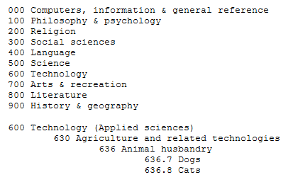
Dewey Decimal Classification
16

Slide 17
Dewey Decimal Classification
UNIVERSITY OF CALIFORNIA, BERKELEY
SCHOOL OF INFORMATION
The DDC is divided into ten main classes, which together cover the entire world of knowledge. Each main class is further divided into ten divisions, and each division into ten sections
Melvil Dewey wanted to develop a universal classification, but it was done in the context of the library of Amherst College, which introduced significant bias because of the contents of its collection and school’s religious orientation at the time
17

Slide 18
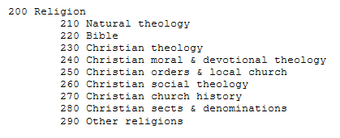
DDC on Religion
Dewey Religion Browser hides the Christian bias
18

Slide 19
DDC and the “One and Only One Place” Rule
UNIVERSITY OF CALIFORNIA, BERKELEY
SCHOOL OF INFORMATION
The title is often a clue to the subject, but should never be the only thing analyzed
A work is classed in the discipline for which it is intended, rather than the discipline from which the work derives
Works dealing with multiple subjects are classed with the subject being acted upon
Class a work multiple on subjects with the one receiving fuller treatment.
If two subjects are equal, class the work using the one that comes first in the DDC
19

Slide 20
Library of Congress Classification
UNIVERSITY OF CALIFORNIA, BERKELEY
SCHOOL OF INFORMATION
The US Library of Congress was established in 1800 with a very practical focus, with no intent to devise an organizing scheme that could be used elsewhere
It got off to a bad start when the British burned it down (along with the White House) during the “War of 1812” in 1814
The library was restarted with Thomas Jefferson’s personal library, which broadened its scope, influenced the subsequent LCC scheme
20

Slide 21
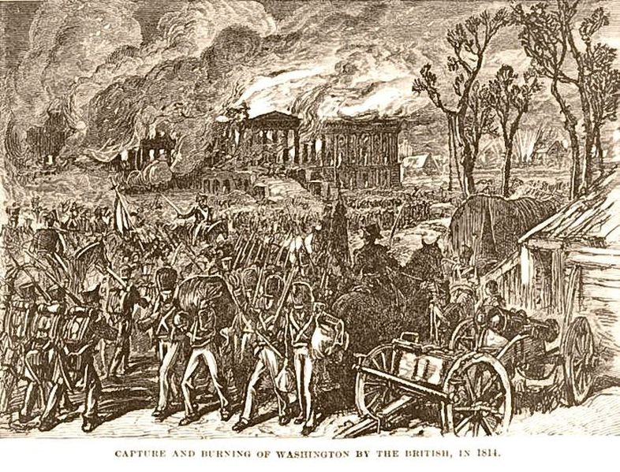
British Burn the White House (1814)
21

Slide 22
An Important Distinction
UNIVERSITY OF CALIFORNIA, BERKELEY
SCHOOL OF INFORMATION
The LCC is not the same as the LCSH, the controlled vocabulary for subject description
The LCSH is used to describe individual resources
The LCC positions them in a collection
These two activities are distinguished in LIS education and practice
In non-library organizing contexts, describing resources and organizing them are much more intertwined activities
22

Slide 23
Library of Congress Classification
UNIVERSITY OF CALIFORNIA, BERKELEY
SCHOOL OF INFORMATION
The LCC has 21 top level categories, identified by (arbitrary?) letters instead of numbers like the DCC
Each top level category is further divided, and then once again… a very deep system that makes it practical but not theoretically grounded
The LCC is biased toward the US and toward the needs of a national government, and definitely shows its age
23

Slide 24
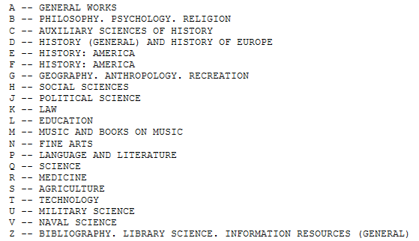
Library of Congress Classification
24

Slide 25
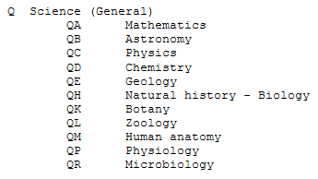
Where’s Computer Science?
25

Slide 26
BISAC
UNIVERSITY OF CALIFORNIA, BERKELEY
SCHOOL OF INFORMATION
The Book Industry Standards Advisory Committee Classification (BISAC) differs substantially in intent and design from the DDC and LCC schemes
BISAC is developed by the Book Industry Study Group, an organization with a business efficiency focus (logistics, marketing)
BISAC is used by publishers to suggest how a book should be classified in physical and online bookstores, so its categories are biased toward common language usage and popular culture
26

Slide 27
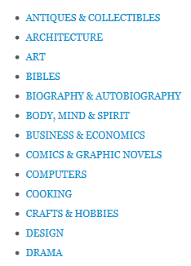
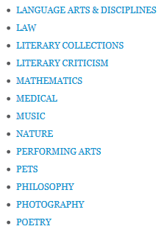
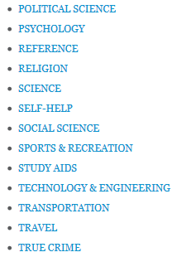
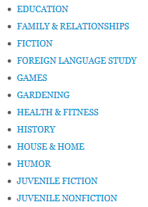
Top Level BISAC Categories
27

Slide 28
The “Dewey Dilemma”
UNIVERSITY OF CALIFORNIA, BERKELEY
SCHOOL OF INFORMATION
Some new public libraries are adopting BISAC rather than DDC; their patrons like this (“Use Warrant”) but traditional librarians see this as heresy and selling out to commercial interests
“The books everywhere, but especially in the children’s room, have been shelved, labeled, and organized in a way that makes me feel less like a moron and more empowered to find what I’m looking for on my own.”
28

Slide 29
INFO 202 “Information Organization & Retrieval” Fall 2013
UNIVERSITY OF CALIFORNIA, BERKELEY
SCHOOL OF INFORMATION
Robert J. Glushko glushko@berkeley.edu
@rjglushko
24 October 2013 Lecture 17.2 – Faceted Classification

Slide 30
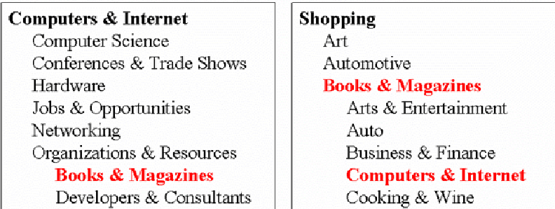
The Need For Multiple Classifications
UNIVERSITY OF CALIFORNIA, BERKELEY
SCHOOL OF INFORMATION
30

Slide 31
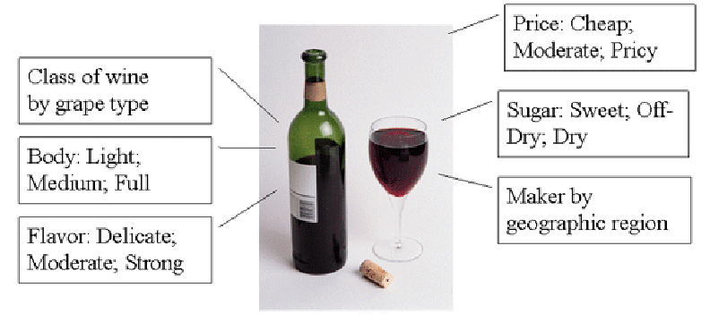
Wine Classifications
31

Slide 32
Faceted Classification
UNIVERSITY OF CALIFORNIA, BERKELEY
SCHOOL OF INFORMATION
FACETS are an alternative to hierarchical classification that overcome many of its limitations
Instead of creating a deep category hierarchy, facets create multi-dimensional categories that are (defined or generated) through grammatical (composition or combination) from the (characteristics or dimensions or relations) in the domain
Facets divide a domain or subject into "homogeneous" or "semantically cohesive" categories of manageable size
32

Slide 33
Facets as a Controlled Vocabulary
UNIVERSITY OF CALIFORNIA, BERKELEY
SCHOOL OF INFORMATION
The relationships between the facets enable a small CONTROLLED VOCABULARY to generate:
Many structured descriptions
That are complex, but formally structured
That enable us to describe things we don't have words for
33

Slide 34
Marti Hearst and Faceted UIs
UNIVERSITY OF CALIFORNIA, BERKELEY
SCHOOL OF INFORMATION
Professor Marti Hearst did much of the fundamental research on faceted user interfaces for search and navigation in large resource collections
Section 8.6 of “Search User Interfaces”
"Faceted metadata for image search and browsing." In Proceedings of the SIGCHI conference on Human factors in computing systems, pp. 401-408. ACM, 2003.
34

Slide 35
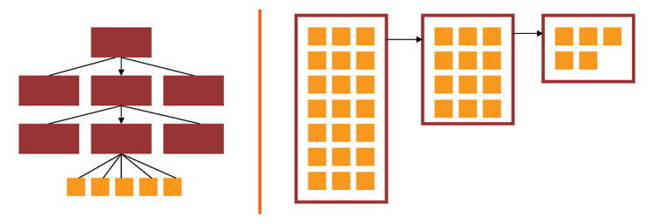
Facets and User Interfaces
Sequential category selection, results only at leaf nodes
Each selection yields results, subsequent selections refine the results set
35

Slide 36
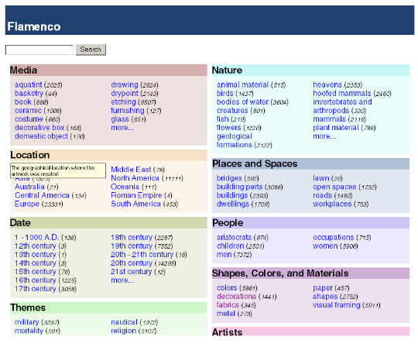
Facets in “Flamenco”
Figure 1 of “Faceted Metadata for Image Search and Browsing”
36

Slide 37
Some Live Examples
UNIVERSITY OF CALIFORNIA, BERKELEY
SCHOOL OF INFORMATION
Epicurious
CDW
Hearst Museum
37

Slide 38
Faceted Classification - Condorcet
38

Slide 39
Faceted Classification - Rangananthan
UNIVERSITY OF CALIFORNIA, BERKELEY
SCHOOL OF INFORMATION
S. R. Ranganathan, a Hindu mathematician working as a librarian, introduced facets to information science in the early 20th century
Ranganathan felt it was his desire and dharma to describe the entire universe of ideas using a single system of classification and notation that:
Systematically describes, in detail, the contents of complex documents discussing compound subjects
Codifies those descriptions into a sequenced numerical form
39

Slide 40
Ranganathan's Colon Classification (PMEST)
UNIVERSITY OF CALIFORNIA, BERKELEY
SCHOOL OF INFORMATION
5 universal facets applied in fixed order to all things:
P (ersonality) - the type of thing
M (atter) - the constituent material of the thing
E (nergy) - the action or activity of the thing
S (pace) - where the thing occurs
T (ime) - when things occur
L,45;421:6;253:f.44'N5
Medicine,Lungs;Tuberculosis:Treatment;Xray :Research.India'1950
40

Slide 41
Facets in the Library of Congress Subject Headings
UNIVERSITY OF CALIFORNIA, BERKELEY
SCHOOL OF INFORMATION
LCSH uses facets for Topic, Place, Time, and Form (but they can be ordered in a variety of ways)
(Topic Main Heading - Place - Topic - Time - Form)
Art criticism - France - Paris - History - Nineteenth Century - Bibliography
(Topic Main Heading - Topic - Place - Time - Form)
Art - Censorship - Europe - Twentieth Century - Exhibitions
41

Slide 42
Designing a Faceted Classification (TDO 7.4.4)
UNIVERSITY OF CALIFORNIA, BERKELEY
SCHOOL OF INFORMATION
Collect examples that need to be classified
Identify candidates for facets and subfacets by analyzing the examples
Order foci within facets
Determine grammar for ordering and combining facets and subfacets
Create new facets and subfacets where needed
Test classification scheme on new examples
Iterate and refine throughout
42

Slide 43
Types of Facets
UNIVERSITY OF CALIFORNIA, BERKELEY
SCHOOL OF INFORMATION
Enumerative -- a set of mutually exclusive possible values
Boolean -- yes or no on some dimension
Hierarchical or taxonomic -- organize the instances by logical containment
Spectrum -- numerical attributes on some range, with min and max
43

Slide 44
Choosing Facets
UNIVERSITY OF CALIFORNIA, BERKELEY
SCHOOL OF INFORMATION
ORTHOGONALITY - facets are independent dimensions
SEMANTIC BALANCE - top level facets are the most important semantic dimensions of the domain; values within facets are at equal semantic level
COVERAGE - all current instances can be classified
SCALABILITY - future instances can be classified
OBJECTIVITY - instances can be objectively classified; might also be called CONCRETENESS
NOT IDIOSYNCRATIC - facet semantics should be "mainstream" or "normative" and not rely on clever, fanciful or metaphoric interpretation
44

Slide 45
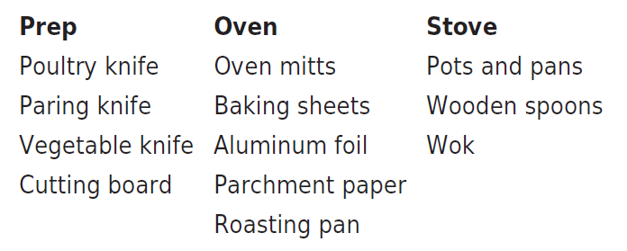
Taskonomy
UNIVERSITY OF CALIFORNIA, BERKELEY
SCHOOL OF INFORMATION
In contrast to "taxonomy" - an approach to organization based on similarity of content or characteristics - a "taskonomy" organizes on the basis of purpose or "activity structure“
A COOK’S TASKONOMY (Figure 7.1 in TDO)
45

Slide 46
“Distributed Cognition”
UNIVERSITY OF CALIFORNIA, BERKELEY
SCHOOL OF INFORMATION
"Distributed cognition" is a "dialect" of cognitive science that views cognitive activity as not just something that takes place within the mind of a single person a some moment in time; it is:
Distributed across the members of a social or goal-oriented group
Distributed and coordinated between people and the technology and artifacts they create and use
Hollan, Hutchins, & Kirsh, "Distributed Cognition: Toward a New Foundation for Human-Computer Interaction Research," ACM TOCHI, 2000
46

Slide 47
“The Intelligent Use of Space”
UNIVERSITY OF CALIFORNIA, BERKELEY
SCHOOL OF INFORMATION
"Whether we are aware of it or not, we are constantly organizing and reorganizing our workplace to enhance performance"
"The physics of the world is such that at times the histories of use are perceptually available to us in ways that support the tasks we are doing"
"When space is used well, it reduces the time and memory demands of our tasks... to simplify choice, to simplify perception, and simplify internal computation”
Kirsh, David. "The intelligent use of space." Artificial intelligence 73, no. 1 (1995): 31-68.
47

Slide 48
Readings for Next Lecture
UNIVERSITY OF CALIFORNIA, BERKELEY
SCHOOL OF INFORMATION
TDO 9 through 9.3
Trant, Jennifer. “Emerging convergence? Thoughts on museums, archives, libraries, and professional training.” Museum Management and Curatorship 24, no. 4 (2009): 369-387
Williams, Ashley. “User-centered design, activity-centered design, and goal-directed design: a review of three methods for designing web applications.” In Proceedings of the 27th ACM international conference on Design of communication, pp. 1-8. ACM, 2009.
48

