Slide 1
Plan for Today’s Lecture(s)
UNIVERSITY OF CALIFORNIA, BERKELEY
SCHOOL OF INFORMATION
The Semantic Web
RDF and other Semantic Web Technologies
Linked Data
SemWeb and Linked Data and Libraries
1

Slide 2
INFO 202 “Information Organization & Retrieval” Fall 2013
UNIVERSITY OF CALIFORNIA, BERKELEY
SCHOOL OF INFORMATION
Robert J. Glushko glushko@berkeley.edu
@rjglushko
15 October 2013 Lecture 14.1 – The Semantic Web

Slide 3
Why the Web Wasn’t Born Semantic
UNIVERSITY OF CALIFORNIA, BERKELEY
SCHOOL OF INFORMATION
Around 1990, when the Web was being imagined by TBL, SGML (precursor of XML) was increasingly being used to define structured document models for publishing etc.
TBL consciously chose to create HTML as a specific and simple document language rather than take on the generality, expressive power, and complexity that SGML would have meant (and he was criticized by the “experts” for doing so)
This tradeoff enabled the Web to take off because it made it vastly easier to create web pages and software for serving and processing them
But this made the Web work “for eyes only” rather than make it work “for machines”, especially those doing business
3

Slide 4
The Vision of the Semantic Web (1)
UNIVERSITY OF CALIFORNIA, BERKELEY
SCHOOL OF INFORMATION
In a classic 2001 paper Sir Tim Berners-Lee says:
The Web can reach its full potential only if … data can be shared and processed by automated tools as well as by people...
The Semantic Web will bring structure to the meaningful content of Web pages...
For the Web to scale, tomorrow's programs must be able to share and process data even when these programs have been designed totally independently.
4

Slide 5
The Vision of the Semantic Web (2)
UNIVERSITY OF CALIFORNIA, BERKELEY
SCHOOL OF INFORMATION
Services and agents can advertise their function by registering in directories
The service is described in a way that lets other agents discover the function offered and understand how to use it, terms and conditions, invocations…
Service discovery enables agents to delegate tasks to create the overall "value chain" in which subassemblies of information are passed from one agent to another
5

Slide 6
The Semantic Web Scenario (1)
UNIVERSITY OF CALIFORNIA, BERKELEY
SCHOOL OF INFORMATION
Lucy and Pete, 2 adult children trying to help out Mom with a medical appointment
"...Lucy instructed her Semantic Web agent through her handheld Web browser. The agent promptly retrieved information about Mom's prescribed treatment from the doctor's agent, looked up several lists of providers, and checked for the ones in-plan for Mom's insurance within a 20-mile radius of her home and with a rating of excellent or very good on trusted rating services”
6

Slide 7
The Semantic Web Scenario (2)
UNIVERSITY OF CALIFORNIA, BERKELEY
SCHOOL OF INFORMATION
... trying to find a match between available appointment times and Pete's and Lucy's busy schedules...
…but Pete didn't like the agent's plan
… He set his own agent to redo the search with stricter preferences about location and time
7

Slide 8
Making the (Existing) Web More Semantic
UNIVERSITY OF CALIFORNIA, BERKELEY
SCHOOL OF INFORMATION
Convert existing Web page content to semantic markup
Annotate existing Web page content with semantic metadata
8

Slide 9
Making the (New) Web More Semantic
UNIVERSITY OF CALIFORNIA, BERKELEY
SCHOOL OF INFORMATION
Create new web page content with semantic content and semantic metadata
Create new pages or resources that are designed from the outset to be "meta-pages" that facilitate semantic processing of all the other metadata
9

Slide 10
Extracting “Semantic” Markup
UNIVERSITY OF CALIFORNIA, BERKELEY
SCHOOL OF INFORMATION
if the content is semi-structured (e.g,, a news feed that uses a "story template" for its stories, with mixed content "semantic islands" in the text, NLP and "data mining" techniques can often extract some limited semantics -- like tagging for people, place names, product names - these usually start with "named entity recognition”
10

Slide 11
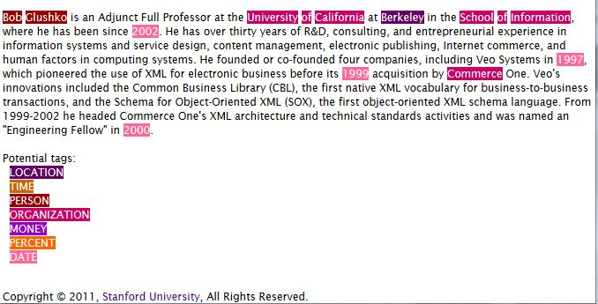
Stanford Named Entity Tagger
Demo using text from Robert J. Glushko’s Home Page at Berkeley

Slide 12
Semantic Annotation
UNIVERSITY OF CALIFORNIA, BERKELEY
SCHOOL OF INFORMATION
Annotation" generally means "semantics applied to a document or information resource by a person" -- rather than by NLP
Someone other than the author can sometimes figure out the author's intent and context if:
they both belong to the same narrow organization, "community of interest" or "social network"
there are "extraction," "summarization," and other text processing tools that can help them
12

Slide 13
Semantic Authoring
UNIVERSITY OF CALIFORNIA, BERKELEY
SCHOOL OF INFORMATION
But even when an author is creating his own semantically-encoded content or annotation ...
How are semantic descriptors chosen?
What do those descriptors mean?
Can others trust what the author does?
13

Slide 14
Semantic Authoring: The 2001 Vision (1)
UNIVERSITY OF CALIFORNIA, BERKELEY
SCHOOL OF INFORMATION
“The clinic's web page will have more than just keywords; it will have computer-processable information about when specific doctors take appointments"
"These semantics were encoded into the Web page when the clinic's office manager (who never took Comp Sci 101) massaged it into shape using off-the-shelf software for writing Semantic Web pages along with resources listed on the Physical Therapy Association's site”
14

Slide 15
Semantic Authoring: The 2001 Vision (2)
UNIVERSITY OF CALIFORNIA, BERKELEY
SCHOOL OF INFORMATION
What might the office manager have learned in Comp Sci 101 (or INFO 202) that is now somehow unnecessary?
What use is the Physical Therapy Association site?
What specifically is the "off-the-shelf" software going to do?
15

Slide 16
Semantic Authoring: Today’s Reality
UNIVERSITY OF CALIFORNIA, BERKELEY
SCHOOL OF INFORMATION
Many current semantic web tools still require expertise in semantic technologies and web standards (e.g., Protégé )
SWAT project underway to put a natural language front end to semantic authoring
Refining and inferring from a verbal description
More likely to succeed are applications that aim lower, not trying to encode all the latent semantics in a document or web page
16

Slide 17
Semantic Templating with Microformats
UNIVERSITY OF CALIFORNIA, BERKELEY
SCHOOL OF INFORMATION
Microformats make the web "semantic light" by embedding content annotation into web pages
Microformats currently exist for personal contact information, events, and a few other small chunks of structured data
Wikis and blogs have templates to encourage the creation of more structured and semantically-annotated content (mention a movie, get schema.org/movie)
Wikipedia has thousands of templates and "infoboxes" that encourage the creation of factual information in a uniform format
17

Slide 18
To Summarize…
UNIVERSITY OF CALIFORNIA, BERKELEY
SCHOOL OF INFORMATION
The original vision of the Semantic Web emphasized the creation of ontologies that robustly described the semantics of particular domains or contexts
Lots of research was spawned by this vision, but the high bar of formal semantics and automated agents undoubtedly deterred “regular” people and firms from adopting it
Semantic authoring can’t take off without tools that are simple to use as tools for designing and creating HTML pages
18

Slide 19
INFO 202 “Information Organization & Retrieval” Fall 2013
UNIVERSITY OF CALIFORNIA, BERKELEY
SCHOOL OF INFORMATION
Robert J. Glushko glushko@berkeley.edu
@rjglushko
15 October 2013 Lecture 14.2 – RDF and other Semantic Web Technologies

Slide 20
Technologies for the Semantic Web
UNIVERSITY OF CALIFORNIA, BERKELEY
SCHOOL OF INFORMATION
XML
RDF and RDFa
Ontology languages
20

Slide 21
XML is a Good Start
UNIVERSITY OF CALIFORNIA, BERKELEY
SCHOOL OF INFORMATION
You can use XML to create a content-oriented vocabulary rather than the presentation-oriented one in HTML
XML schemas allow you to specify structural, occurrence, and datatyping constraints for instances that must conform to them
You can use XML namespaces to reuse XML constructs across a set of related document types
21

Slide 22
XML Alone is NOT Sufficient
UNIVERSITY OF CALIFORNIA, BERKELEY
SCHOOL OF INFORMATION
But the semantics associated with XML constructs are NOT explicitly represented in the instance or the schema
Element and attribute names, container structures, etc. can suggest semantics to people, but not in a way that is “computable”
What is the meaning of?
<quantity>5</quantity>
<price>100</price>
22

Slide 23
Resource Description Framework (RDF)
UNIVERSITY OF CALIFORNIA, BERKELEY
SCHOOL OF INFORMATION
The Resource Description Framework (RDF) is a graph-based model for making computer-processable statements about web resources and their relationships to each other
RDF can be used to encode metadata, the usual sort of information about an information resource, like its title, author, creation date, etc.
23

Slide 24
Resource Description Framework (RDF)
UNIVERSITY OF CALIFORNIA, BERKELEY
SCHOOL OF INFORMATION
In the context of RDF and the web, however, “resource” means something more specific: a resource is anything that has been given a Uniform Resource Identifier (URI)
So RDF can be used to represent information about anything that can be IDENTIFIED on the Web, not just published or retrieved on it
This broader idea about Web resource makes it a general mechanism for organizing and integrating information
24

Slide 25
RDF Data Model -- The Conceptual View
UNIVERSITY OF CALIFORNIA, BERKELEY
SCHOOL OF INFORMATION
A general way to represent information about something is in three parts:
The thing (or resource) being described
The specific property of the thing
The value of the property
The data model is usually stated as Statement -> (Subject, Predicate, Object) but there are many other ways to say it
Statement (Student, attends, University)
25

Slide 26
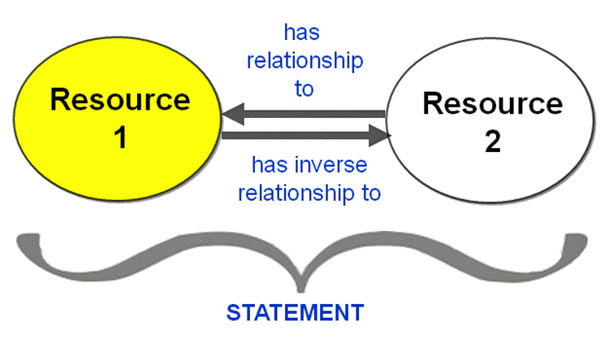
Statements About Resources

Slide 27
The Relationship is also a “Resource” with a Unique Identifier
Resource

Slide 28
Statements as Interconnecting Building Blocks
UNIVERSITY OF CALIFORNIA, BERKELEY
SCHOOL OF INFORMATION
Because each resource is uniquely identified, statements that involve the same resource can be interconnected
28

Slide 29
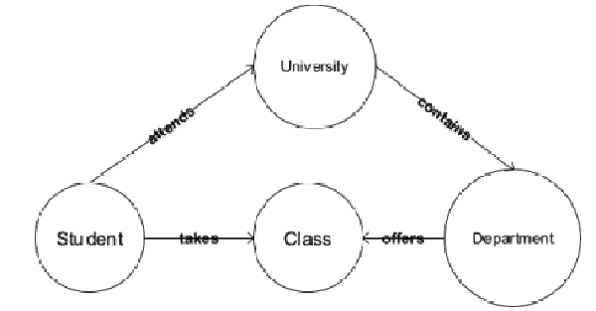
Interconnected Statements Create a Graph
These are statements about resource types that are part of the conceptual model of a domain

Slide 30
Some Statements About Instances
UNIVERSITY OF CALIFORNIA, BERKELEY
SCHOOL OF INFORMATION
John Doe attends UC Berkeley
John Doe takes 202
Jane Smith attends UC Berkeley
Jane Smith takes 202
Jane Smith takes 290-1
30

Slide 31
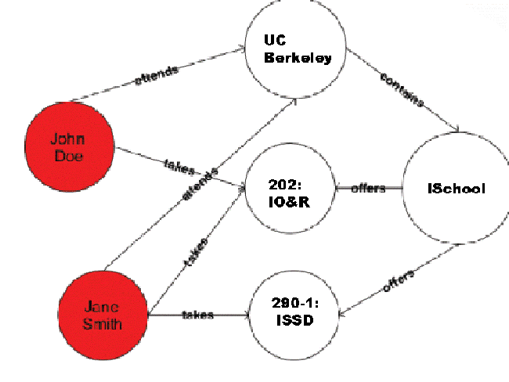
Graphical Representation

Slide 32
Can We Make These Inferences?
UNIVERSITY OF CALIFORNIA, BERKELEY
SCHOOL OF INFORMATION
John Doe takes classes at the ISchool
202 is offered by UC Berkeley
Jane Smith is a classmate of John Doe
32

Slide 33
RDF Syntax – Simplified Implementation View
UNIVERSITY OF CALIFORNIA, BERKELEY
SCHOOL OF INFORMATION
RDF is a conceptual model that must be “serialized” into some specific data syntax
<Description> describes a resource
Attributes or elements contained in <Description> are properties of the resource
Their content is the value of the property
33

Slide 34
RDF Description Example
(from Heath & Bizer p. 18)
Two RDF triples in the description
This URI is a person
The person is named Dave Smith

Slide 35
RDFa
UNIVERSITY OF CALIFORNIA, BERKELEY
SCHOOL OF INFORMATION
RDFa is a second serialization syntax for RDF
RDFa uses attributes (hence the "a") to embed RDF statements into XHTML elements
So instead of using RDF in standalone documents, or using the RDF namespace to embed statements in other XML documents, RDFa lets you embed these statements into XHTML instances
Very useful in situations where data publishers can’t change publishing technology from HTML to XML but could change templates
35

Slide 36
RDFa {and,or,vs} Microformats
UNIVERSITY OF CALIFORNIA, BERKELEY
SCHOOL OF INFORMATION
This makes RDFa like microformats in that you can add some new attributes to an HTML document
But unlike microformats that are pre-defined for specific types of data, RDFa can be used to say anything about anything
But the greater expressiveness of RDFa comes at a cost – harder to use
36

Slide 37
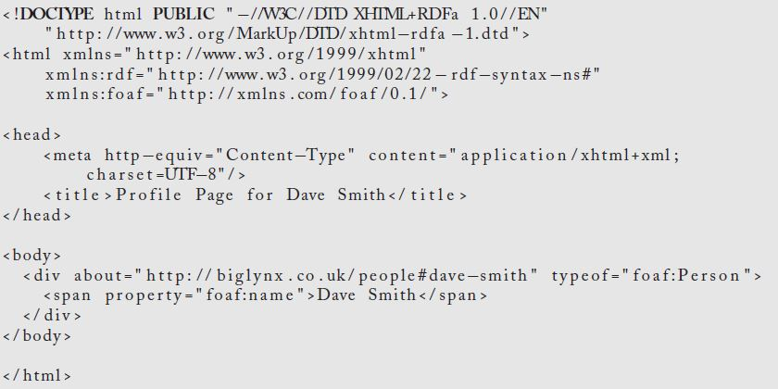
RDFa Description Example
(from Heath & Bizer p. 19)

Slide 38
The Need for Ontologies (1)
UNIVERSITY OF CALIFORNIA, BERKELEY
SCHOOL OF INFORMATION
Suppose we have RDF statements:
(Bob Glushko, teaches, INFO202)
(Information System & Service Design, is-taught-by, Dr. Robert J. Glushko)
No RDF processor can link these into a graph and make the inference that both classes are taught by the same person unless…
38

Slide 39
The Need for Ontologies (2)
UNIVERSITY OF CALIFORNIA, BERKELEY
SCHOOL OF INFORMATION
An ontology could define:
"Bob Glushko" and "Dr. Robert J. Glushko" to be the same person
"teaches" and "is-taught-by" to be inverse relationships
39

Slide 40
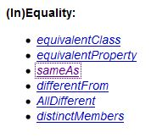
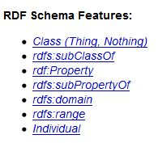
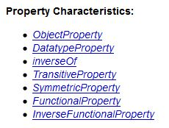
Ontology assertions on the Web are expressed using the OWL language
40

Slide 41
Identity, Authority, Truthiness
UNIVERSITY OF CALIFORNIA, BERKELEY
SCHOOL OF INFORMATION
The assertion that "Bob Glushko" and "Dr. Robert J. Glushko" is the same person enables statements about either to be interconnected
But if anyone can make assertions, how do we know whether they are correct? What authorities should we trust?
(Barack Obama, has birthplace, Hawaii)
(Barack Obama, has birthplace, Kenya)
“Defining a new URI somewhere on the Web” isn’t the same as "defining a new concept”
41

Slide 42
INFO 202 “Information Organization & Retrieval” Fall 2013
UNIVERSITY OF CALIFORNIA, BERKELEY
SCHOOL OF INFORMATION
Robert J. Glushko glushko@berkeley.edu
@rjglushko
15 October 2013 Lecture 14.3 – Linked Data

Slide 43
Linked Data
UNIVERSITY OF CALIFORNIA, BERKELEY
SCHOOL OF INFORMATION
“Linked Data” is a reframing of basic Web principles reframed for the Semantic Web
instead of links as relationships in hypertext documents written in HTML, links are between arbitrary resources described by RDF
Use URIs to identify everything
Use HTTP URIs so that they can be de-referenced
When someone looks up a URI, provide useful information, including additional links
43

Slide 44
From AI to BI (Erik Wilde)
UNIVERSITY OF CALIFORNIA, BERKELEY
SCHOOL OF INFORMATION
Erik Wilde nicely characterized the shift from the “Semantic Web” to “Linked Data” as “From AI to BI”
Semantic Web is mainly about data and ontologies; its starting point was Artifiicial Intelligence(AI) efforts like CYC
Linked Data changes the focus to real-world entities, linking data and making data discoverable; this is the Business Intelligence (BI) design pattern (ETL)
44

Slide 45
ETL – Extract, Transform, Load
UNIVERSITY OF CALIFORNIA, BERKELEY
SCHOOL OF INFORMATION
You EXTRACT some data from your repository
You can TRANSFORM its native data model into RDF by using custom-defined mappings into a data model that is standard (enough) to be used by the “outside world”
The RDF “triple store” can then be LOADED into the “Linked Data Cloud”
This might be a one time conversion of your data into RDF
A better way would be to create a linked data service that responds to requests from web agents, and then transforming those requests into queries that can be handled by a “live” triple store
45

Slide 46
Libraries & Semantic Web / Linked Data : Opportunity
UNIVERSITY OF CALIFORNIA, BERKELEY
SCHOOL OF INFORMATION
Libraries have a very long history in trying to systematize and catalog the world's knowledge
Library data tends to be high quality when created and it is managed and maintained by people who keep it that way
This should make library data a key trusted resource about people, publications, and organizations that could be used to improve the quality of non-library data
The Web is increasingly the first source that people search, and the library needs to interconnect with it or it will be ignored
46

Slide 47
Authoritative Library Information
UNIVERSITY OF CALIFORNIA, BERKELEY
SCHOOL OF INFORMATION
Subject headings
Authoritative names
Classification
If each of the terms in these vocabularies is identified by a URI, it would be easy to detect or prevent conflicts
47

Slide 48
Libraries & Semantic Web / Linked Data
UNIVERSITY OF CALIFORNIA, BERKELEY
SCHOOL OF INFORMATION
"Libraries could collaboratively develop a large shared knowledgebase that could act as a library "linking hub". The linking hub would expose a network of tightly linked information from publishers, aggregators, book and journal vendors, subject authorities, name authorities, and other libraries"
48

Slide 49
Libraries & Semantic Web / Linked Data : Obstacles
UNIVERSITY OF CALIFORNIA, BERKELEY
SCHOOL OF INFORMATION
However, libraries have had a deeply engrained model of how it is supposed to be done, by a few heavyweight and fairly centralized organizations, and many are reluctant to interconnecting their resources to the open and uncontrolled web
In particular, the conceptual foundations for library data assume it will be created by professional people for people
"The struggle to accommodate technological change with data created using the old rules is clearly not optimal, and hinders the ability of libraries to create innovative services“
49

Slide 50
Libraries & Semantic Web / Linked Data : Progress
UNIVERSITY OF CALIFORNIA, BERKELEY
SCHOOL OF INFORMATION
It hasn’t been quick, but the library world seems to be adapting to the decentralized and heterogeneous world view of the Semantic Web and Linked Data
A Bibliographic Framework for the Digital Age, Library of Congress “Manifesto” (10/31/11)
Library of Congress Linked Data Service
50

Slide 51
Readings for Next Lecture
UNIVERSITY OF CALIFORNIA, BERKELEY
SCHOOL OF INFORMATION
TDO 6
Glushko, Robert J., Paul P. Maglio, Teenie Matlock, and Lawrence W. Barsalou. “Categorization in the wild.”
51

