Slide 1
Plan for Today’s Lecture(s)
UNIVERSITY OF CALIFORNIA, BERKELEY
SCHOOL OF INFORMATION
The Structural Perspective on Relationships
Internal Structure in Documents
Motivating “Document Engineering”
The Document Engineering Method
“Heavyweight” vs. “Lightweight” Modeling
1

Slide 2
INFO 202 “Information Organization & Retrieval” Fall 2013
UNIVERSITY OF CALIFORNIA, BERKELEY
SCHOOL OF INFORMATION
Robert J. Glushko glushko@berkeley.edu
@rjglushko
8 October 2013 Lecture 12.1 – The Structural Perspective on Relationships

Slide 3
The Structural Perspective on Relationships
UNIVERSITY OF CALIFORNIA, BERKELEY
SCHOOL OF INFORMATION
Analyzing the association, arrangement, proximity, or connection between resources without primary concern for their meaning or the origin of these relationships
Sometimes structure is all we know...and sometimes we ignore what we know about relationship semantics to focus on the generic aspect of structural connectivity
3

Slide 4
Internal and External Structure
UNIVERSITY OF CALIFORNIA, BERKELEY
SCHOOL OF INFORMATION
Resources can have INTERNAL structure as well as EXTERNAL structure that connects them to other resources
We often make arbitrary decisions about how the granularity with which we describe the internal structure of a resource
The boundaries we impose to identify resources determines whether some structure is internal or external with respect to them
4

Slide 5
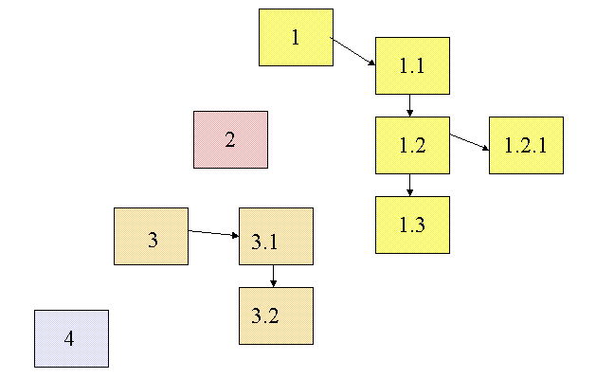
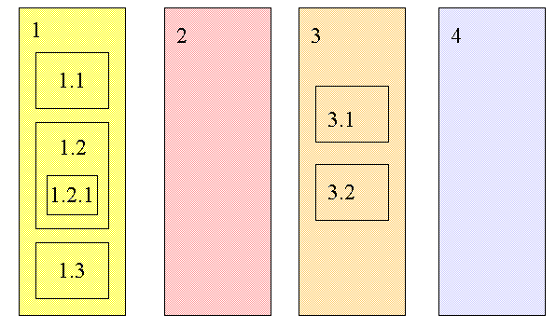
Changing Resource Boundaries Changes External to Internal Structure

Slide 6
Intentional Structure
UNIVERSITY OF CALIFORNIA, BERKELEY
SCHOOL OF INFORMATION
In organizing systems we focus on INTENTIONAL structure created by people or computational agents programmed by people
If structure isn’t intentional, we can’t reuse or recreate the organizing system with our own efforts
6

Slide 7
Structure, But Not Intentional
Photo by B. Rosen (http://www.flickr.com/photos/rosengrant/2966470172/) CC BY-ND 2.0

Slide 8
Making Implicit Structure Explicit
UNIVERSITY OF CALIFORNIA, BERKELEY
SCHOOL OF INFORMATION
Some organizing principles impose very little structure and the structure might be implicit
co-location / pile of resources used together
arrangement by frequency of use
Coordinate systems enable absolute description of location, or we can use relative descriptions
in, on, above, below, in front of, behind…
Statistical techniques can make explicit the structure implied by frequency distribution or correlations between properties of resources
8

Slide 9
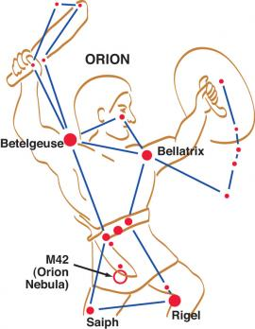
Sometimes Implicit Structure is Apparent… but not Organized
Orion’s Belt: Alnitak (736 LY), Alnilam (1340LY), Mintaka (915 LY)

Slide 10
INFO 202 “Information Organization & Retrieval” Fall 2013
UNIVERSITY OF CALIFORNIA, BERKELEY
SCHOOL OF INFORMATION
Robert J. Glushko glushko@berkeley.edu
@rjglushko
8 October 2013 Lecture 12.2 – Internal Structure in Documents

Slide 11
The Document Type Spectrum

Slide 12
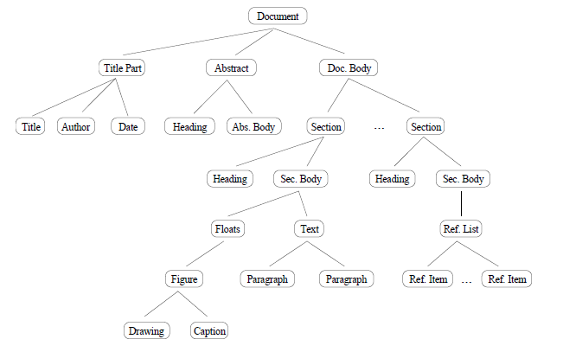
Structure in Narrative Document Types
NARRATIVE documents typically have relatively little internal structure, and that usually varies across instances of the same document type
Figure 1 in Summers, Kristen. "Toward a taxonomy of logical document structures (1995)
12

Slide 13
The Exception that Proves the Rule
UNIVERSITY OF CALIFORNIA, BERKELEY
SCHOOL OF INFORMATION
There are some notable exceptions for specialized narrative document types like "theatrical play" where there are highly conventional structural divisions and associated presentation rules
Or should we say that the specialized use cases or context of use for plays requires us to impose more structure than most narrative document types need
13

Slide 14
The Exception that Proves the Rule
UNIVERSITY OF CALIFORNIA, BERKELEY
SCHOOL OF INFORMATION
<play> <author>Shakespeare</author> <title>Macbeth</title> <act number="I“> <scene number="VII"> <title>Macbeth's castle</title> <verse>Will I with wine and wassail...</verse>… </scene>… </act>… </play>
14

Slide 15
Structure in Hybrid Document Types
UNIVERSITY OF CALIFORNIA, BERKELEY
SCHOOL OF INFORMATION
HYBRID document types are often called "semi-structured“ because they have more structure than narrative ones but less than fully-structured transactional ones
The extent of explicit structure (“mixed content”) in semi-structured document types is an important design decision
15

Slide 16
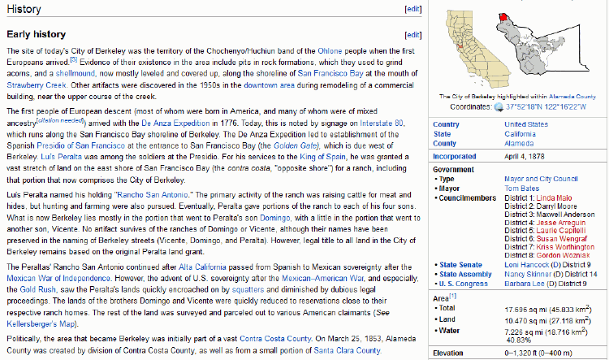
Encyclopedia: Semi-Structured Document Type

Slide 17
Structure in Transactional Documents
UNIVERSITY OF CALIFORNIA, BERKELEY
SCHOOL OF INFORMATION
TRANSACTIONAL documents are completely and regularly structured because they contain many specific information components that are distinguished by their content type
These components are often organized in aggregate structures that can occur many times in the same document because they are typically created by repeated automated processes
For example, an invoice might contain a long list of purchases, each of which identifies a buyer, an item, a quantity, and a total price
17

Slide 18
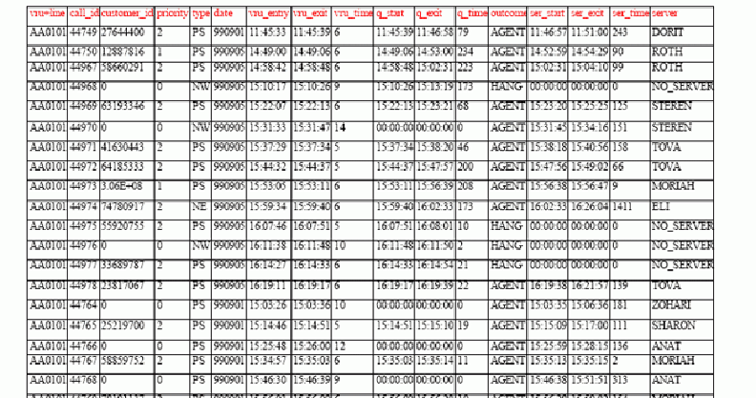
Call Center Log Transactional Document Type

Slide 19
The Structure of a Web Page
UNIVERSITY OF CALIFORNIA, BERKELEY
SCHOOL OF INFORMATION
Conceptually convenient to think of a web page as a unitary object with a unique identifier
But individual web pages are highly structured
Static internal structure is encoded in the markup of the web page
As HTML
As XHTML
As XHTML, with additional XML vocabularies identified by namespace
19

Slide 20
The Structure of a Web Page
UNIVERSITY OF CALIFORNIA, BERKELEY
SCHOOL OF INFORMATION
Scripts can be used to generate or modify content when the page is loaded or when a user interacts with it
Dynamic web pages might have a static structure into which content is "poured" or the structure might also be generated dynamically
There may be hyperlinks within a web page, like a table of contents to facilitate navigation within a long page that would otherwise require lots of scrolling
20

Slide 21
INFO 202 “Information Organization & Retrieval” Fall 2013
UNIVERSITY OF CALIFORNIA, BERKELEY
SCHOOL OF INFORMATION
Robert J. Glushko glushko@berkeley.edu
@rjglushko
8 October 2013 Lecture 12.3 – Motivating
“Document Engineering”

Slide 22
Documents vs. Data
UNIVERSITY OF CALIFORNIA, BERKELEY
SCHOOL OF INFORMATION
Many people have contrasted "documents" and "data" and concluded that documents and data cannot be understood and handled with the same terminology, techniques, and tools.
This document vs. data distinction is embedded and reinforced in textbooks, technology, and product marketing
22

Slide 23
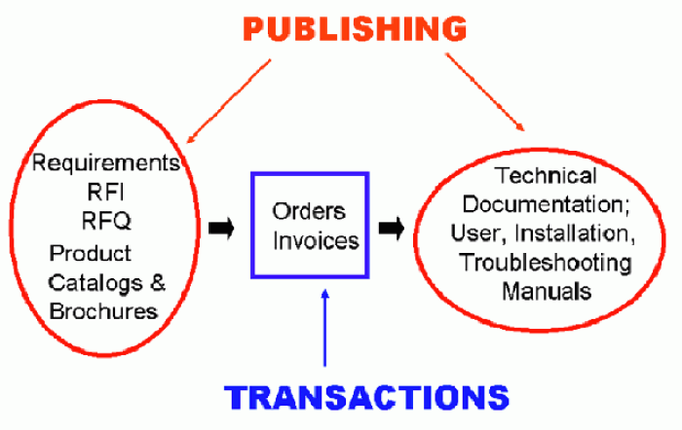
Mixing Data and Documents

Slide 24
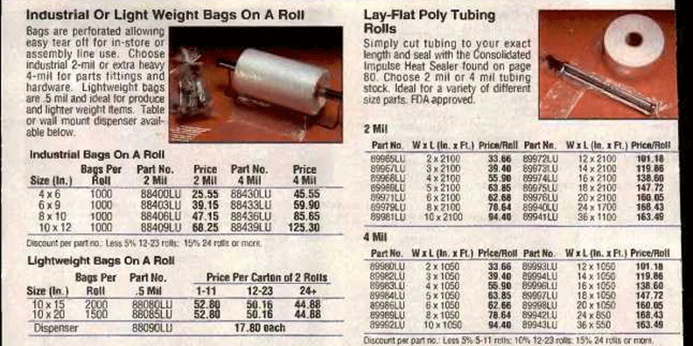
Catalog: Database That Contains Documents

Slide 25
Encyclopedia: Document that Contains Databases

Slide 26
Document Analysis
UNIVERSITY OF CALIFORNIA, BERKELEY
SCHOOL OF INFORMATION
Documents are Artifacts or Renditions that combine content, structure and appearance
The goal of document analysis is a model of a document's content and structure that is separate from its presentational characteristics
The optimal prescriptive schema for a set of documents is one that best satisfies the requirements of current and prospective users for carrying out specific tasks with new instances
Finally, one or more stylesheets can be used to assign formatting or rendering characteristics in a consistent manner to any valid document
26

Slide 27
“Document Analysis” Methodology
UNIVERSITY OF CALIFORNIA, BERKELEY
SCHOOL OF INFORMATION
Heritage: publishing, literary analysis, graphical design
Scope: One document type at a time
Reuse focus: identify "boilerplate" content and repeating structural elements
Heuristic rather than formal techniques
Canonical textbook: Maler and Andaloussi. Developing SGML DTDs: From Text to Model to Markup (1996)
27

Slide 28
Data-Centric Analysis
UNIVERSITY OF CALIFORNIA, BERKELEY
SCHOOL OF INFORMATION
Goal is to understand and describe the properties and relationships between information components or objects
This understanding is represented in conceptual models that organize the components efficiently to support a broad range of contexts or applications
The conceptual model is also typically called a schema, but this is generally meant to be a "database schema" rather than a "document schema"
28

Slide 29
“Data Modeling” Methodology
UNIVERSITY OF CALIFORNIA, BERKELEY
SCHOOL OF INFORMATION
Heritage: philosophy, linguistics, systems analysis
Scope: multiple interrelated document types
Reuse focus: identify the overlapping content in transformationally- or derivationally-related document types
Prescriptive and formal approach (e.g., schema normalization)
Canonical textbook: C. J. Date, An Introduction to Database Systems (8 editions since 1980).
29

Slide 30
The Document Type Spectrum: A Continuum
UNIVERSITY OF CALIFORNIA, BERKELEY
SCHOOL OF INFORMATION
There is systematic and continuous variation in document instances and types and there is no clear boundary between “documents” and “data”
But the traditional tools, terminology, and techniques for analyzing documents and data have made it into a chasm
How do we cross the chasm?
30

Slide 31
INFO 202 “Information Organization & Retrieval” Fall 2013
UNIVERSITY OF CALIFORNIA, BERKELEY
SCHOOL OF INFORMATION
Robert J. Glushko glushko@berkeley.edu
@rjglushko
8 October 2013 Lecture 12.4 – The “Document Engineering” Method

Slide 32
Crossing the Chasm with “Document Engineering”
UNIVERSITY OF CALIFORNIA, BERKELEY
SCHOOL OF INFORMATION
The emerging discipline of Document Engineering unifies the document analysis and data modeling disciplines
Document Engineering supports the specification, design, and implementation of the narrative and transactional documents needed in document-centric applications
It is a synthesis of information and systems analysis, business process modeling, content management, and distributed computing
Document Engineering requires and reinforces patterns of information description and exchange from the perspective of business models, business processes, and information systems and services design
32

Slide 33
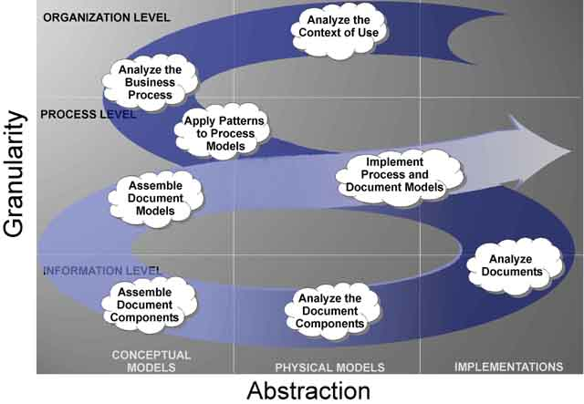
The Document Engineering Approach

Slide 34
Document Engineering’s Key Ideas
UNIVERSITY OF CALIFORNIA, BERKELEY
SCHOOL OF INFORMATION
Document Engineering harmonizes the terminology of document analysis and data modeling and emphasizes what they have in common rather than highlighting their differences:
Identifying the presentational, content, and structural components
Eliminating synonymy and homonymy
Identifying and organizing the "good" content components
Assembling hierarchical document models to organize components to meet requirements for a specific context
34

Slide 35
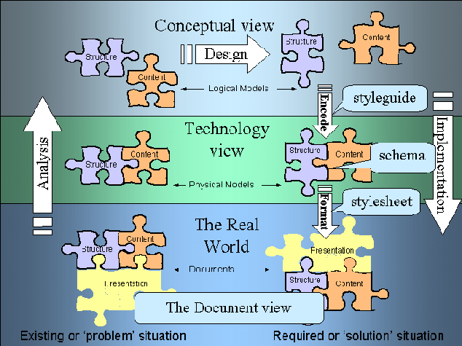
The Document Engineering Approach

Slide 36
From Physical to Conceptual Models (1)
UNIVERSITY OF CALIFORNIA, BERKELEY
SCHOOL OF INFORMATION
When we analyze information sources: interviews, documents, sets of data whatever - our goal is to identify and describe the "significant things" or the "information components" and their characteristics or attributes
If you conduct an interview your source will naturally talk about information components as abstract pieces of information
But when you analyze documents the information components aren't as immediately apparent because they are contained in structures and rendered in some presentation
36

Slide 37
From Physical to Conceptual Models (2)
UNIVERSITY OF CALIFORNIA, BERKELEY
SCHOOL OF INFORMATION
So we have to remove the presentational information and dis-assemble the structural information to find the content information that is our highest priority
As we take away presentation and structure, we are abstracting away or generalizing from a physical implementation and creating our first conceptual or logical model of the information components
37

Slide 38
Finding the Right Documents to Analyze (1)
UNIVERSITY OF CALIFORNIA, BERKELEY
SCHOOL OF INFORMATION
Identifying all the potentially relevant documents or information sources is inherently an iterative task
We locate documents, which may refer or link to other documents, and we locate people who work with the documents, who may refer or link to other documents or people
If there are lots of documents of a particular type, we have to be concerned about representiveness and selection biases
38

Slide 39
Finding the Right Documents to Analyze (2)
UNIVERSITY OF CALIFORNIA, BERKELEY
SCHOOL OF INFORMATION
Avoid the temptation to assume that job titles and formal organizational structure reflect what people actually do
Likewise, avoid the temptation to assume that the names given to documents fit the people, tasks, and organizations in which we locate them
Regardless of its title, make sure a document is being used before you conclude it is important
39

Slide 40
Extracting Presentation Rules
UNIVERSITY OF CALIFORNIA, BERKELEY
SCHOOL OF INFORMATION
Presentation affects structure and content by applying transformation rules to them
To understand the structure and content we must identify and record what the rules of the transformation were
Explicit transform rules can be encoded in templates, stylesheets or source code
40

Slide 41
Sometimes Rules Can’t be Extracted
UNIVERSITY OF CALIFORNIA, BERKELEY
SCHOOL OF INFORMATION
No access to source formats or source code
Rules may be inaccessible in source formats ("override" formatting in word processors instead of style tags)
Rules don't exist or are inconsistently followed (author has "fontitis" with "ransom note" presentation style)
41

Slide 42
“Ransom Note” or “Fontitis” Style

Slide 43
Using Correlations or Conventions
UNIVERSITY OF CALIFORNIA, BERKELEY
SCHOOL OF INFORMATION
Color, pitch, other perceptual dimensions can be correlated with semantic distinctions
Type size is correlated with structural hierarchy
Content types can have characteristic layouts or text attributes
Adjacency can suggest a semantic relationship, like that between figure and caption
Presentation order is sometimes semantically significant
43

Slide 44
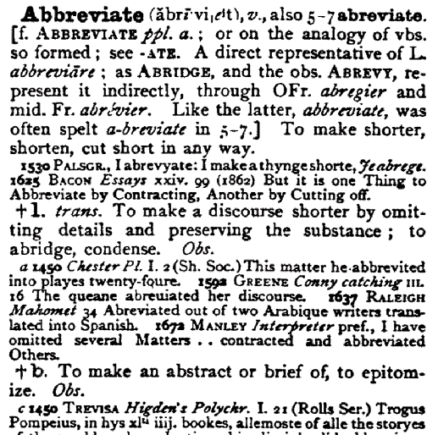
Presentation that Conveys Semantics

Slide 45
Presentation that Hides Content Components
UNIVERSITY OF CALIFORNIA, BERKELEY
SCHOOL OF INFORMATION
Address: Line 1: ________________ Line 2: _________________ City: ____________ State: ________ ZipCode: _________
“Line 1" and “Line 2" are presentation labels that are not useful for any purpose other than printing out an address label
They are not content components; they are hiding content components like "number" and "street”
45

Slide 46
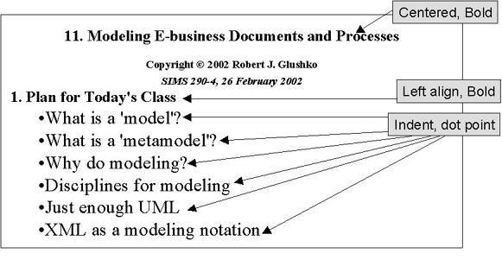
Presentation View of Lecture Slide

Slide 47
Structural Information
UNIVERSITY OF CALIFORNIA, BERKELEY
SCHOOL OF INFORMATION
Removing the presentation components allows us to focus on the two remaining types, Structure and Content.
Structure is the physical or logical arrangement of components. Paragraphs, titles, sections, footnotes, tables, "parts" in a form, are all structural components.
The structural components provide the hierarchical "skeleton" or "scaffold" into which the content components are arranged
47

Slide 48
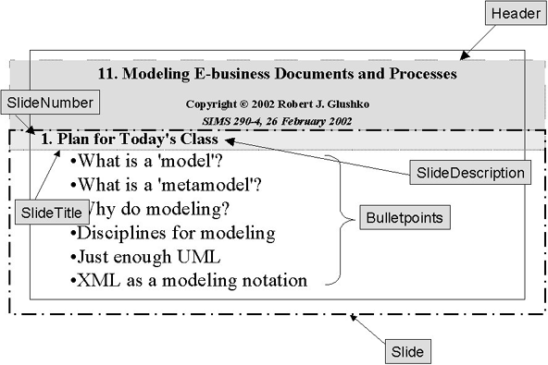
Structural View of Lecture Slide

Slide 49
Content Components
UNIVERSITY OF CALIFORNIA, BERKELEY
SCHOOL OF INFORMATION
The search for “meaning” in our document analysis ends up with the content.
Content components are the "nouns" in our documents or sets of data – things like "topic," "summary," "name," "address," "price"
49

Slide 50
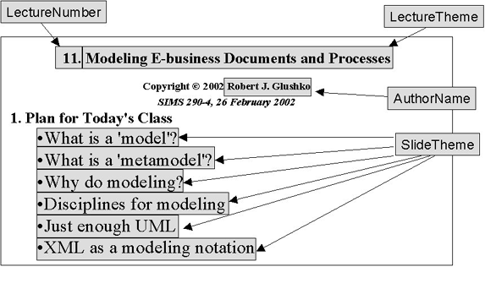
Content View of Lecture Slide

Slide 51
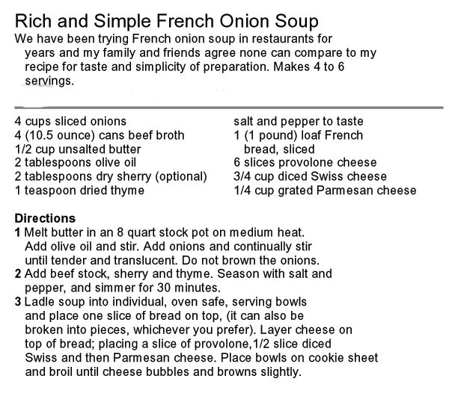
Deconstruct into Presentation, Structure, and Content

Slide 52
Generated or Derived Components
UNIVERSITY OF CALIFORNIA, BERKELEY
SCHOOL OF INFORMATION
"Table of Contents," "Permuted Index," and list of figures, tables, or other types of components can usually be generated or derived from other components and are not components in their own right
Similarly, if “TotalPrice" is "Quantity" x "UnitPrice" we might only want the latter two components in our model since collecting that first one separately could lead to data integrity problems
52

Slide 53
Harvesting and Consolidation
UNIVERSITY OF CALIFORNIA, BERKELEY
SCHOOL OF INFORMATION
Harvesting – Create a set of candidate content components by extracting them from the information sources while removing presentation and structure
Consolidation– Identify synonyms and homonyms among the candidate content components, assigning a unique name to each unique meaning as part of a controlled vocabulary
53

Slide 54
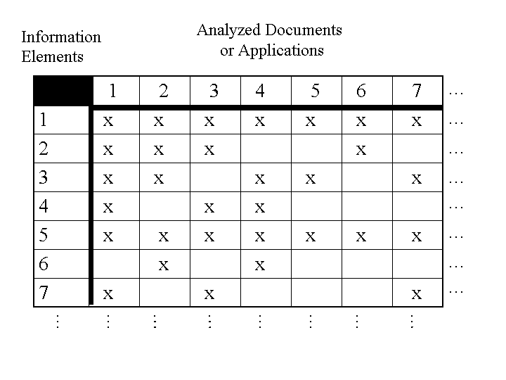
Harvesting Components from Multiple Sources

Slide 55
The Simplest Information Component Model
UNIVERSITY OF CALIFORNIA, BERKELEY
SCHOOL OF INFORMATION
The simplest or minimal information component model is a glossary – a list of the words used to describe or name the "things of significance" and what they mean
This simple data model is augmented as attributes or characteristics of the significant things are identified and recorded
The model is further developed as relationships or associations or links between the "significant things" are identified and recorded
55

Slide 56
Information About Candidate Components
UNIVERSITY OF CALIFORNIA, BERKELEY
SCHOOL OF INFORMATION
What attributes about each type of content might we record in our analysis?
Names/synonyms/homonyms (what it is called) and Identifiers
Definition (what it "means")
Optionality, Cardinality (occurrence rules)
Data Type (text, numbers, date, video) and possible values, code sets, defaults
Relationships/Associations
???
56

Slide 57
Analyzing "Possible Values"
UNIVERSITY OF CALIFORNIA, BERKELEY
SCHOOL OF INFORMATION
It is critical to capture any rules governing the possible values for a component
Sometimes possible values are conventional, fixed, and span the entire semantic range for some domain (days of week, AM/PM)
Determine who can control the value sets (internal [Manufacturer part #s] vs external [Bar codes, AAT])
Patterns like regular expressions are often useful but not sufficient for validation
And if the set of possible values isn't well motivated, fix it in your component design
57

Slide 58
Consolidating the Harvest
UNIVERSITY OF CALIFORNIA, BERKELEY
SCHOOL OF INFORMATION
We can begin our consolidation with the candidate components from any of the information sources, but we recommend using the one you believe is the most authoritative or that yielded the most components
The goal is to combine components that are synonyms (different names for the same meaning) and to distinguish any homonyms (same names for different meanings)
It is desirable for a set of components to enable one and only one way to describe something
58

Slide 59
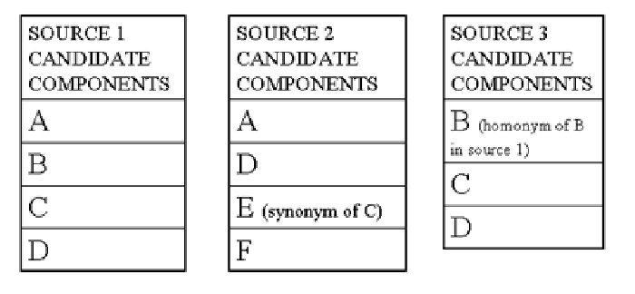
Merging Candidate Components

Slide 60
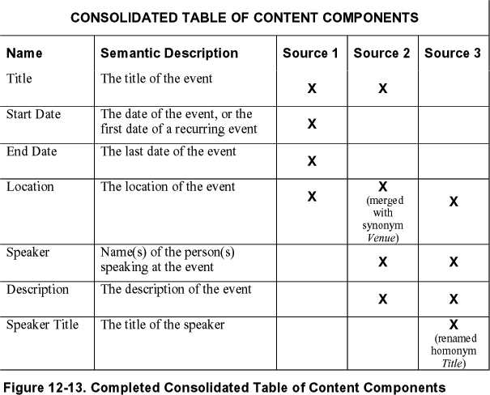
Consolidating Candidate Components

Slide 61
INFO 202 “Information Organization & Retrieval” Fall 2013
UNIVERSITY OF CALIFORNIA, BERKELEY
SCHOOL OF INFORMATION
Robert J. Glushko glushko@berkeley.edu
@rjglushko
8 October 2013 Lecture 12.5 – “Heavyweight” vs. “Lightweight” Modeling

Slide 62
Modeling Methodologies
UNIVERSITY OF CALIFORNIA, BERKELEY
SCHOOL OF INFORMATION
When we create a model we follow – implicitly or explicitly – a modeling methodology, the steps or techniques for analysis, design, and implementation
Methodologies can be formal, prescriptive, step-by-step, documented with artifacts at each step, and auditable
Or they can be the opposite: informal, ad hoc, "seat of the pants" with no trace other than the final model artifact itself
62

Slide 63
Heavyweight vs. Lightweight Modeling (1)
UNIVERSITY OF CALIFORNIA, BERKELEY
SCHOOL OF INFORMATION
At one end of the modeling continuum, “heavyweight” methods are based on consensus requirements that are identified and then satisfied in the most robust way possible
These "heavyweight" approaches are expensive to follow but the models are credible and prescriptive and enable “traceability” of analysis and design decisions
Examples of standards organizations that follow heavyweight methods: OASIS, W3C
63

Slide 64
Heavyweight vs. Lightweight Modeling (1)
UNIVERSITY OF CALIFORNIA, BERKELEY
SCHOOL OF INFORMATION
At the extreme “lightweight” end of the modeling continuum, document models tend to be inductive, descriptive, and “as is”
They codify simple and commonly used information models (like “microformats”)
Schema.org contains a somewhat larger set of information models and they appear to have been created more systematically - but this is a proprietary effort with little transparency
64

Slide 65
There Are No Modeling Shortcuts
UNIVERSITY OF CALIFORNIA, BERKELEY
SCHOOL OF INFORMATION
You might think that "modeling" means "writing a schema given a set of instances" or "inferring a schema from a single instance" (like you can with the "autogenerate" function in many XML editors)
But schemas developed without a stage of conceptual design (other than very simple ones) are rarely very useful because they are too closely tied to the particular instances used, which may not be representative
Sometimes schemas went through a stage of conceptual design but once the schemas are implemented the conceptual information isn't available to allow users to evaluate suitability
65

Slide 66
Readings for Next Lecture
UNIVERSITY OF CALIFORNIA, BERKELEY
SCHOOL OF INFORMATION
TDO 8.2.1.6
Graph Theory. Wikipedia. en.wikipedia.org/wiki/Graph_theory
Kleinberg, Jon. “Analysis of large-scale social and information networks.” Philosophical Transactions of the Royal Society A: Mathematical, Physical and Engineering Sciences 371, no. 1987 (2013). rsta.royalsocietypublishing.org/content/371/1987/20120378.short
Krebs, V. Social Network Analysis: A Brief Introduction www.orgnet.com/sna.html
MacRoberts, Michael H., and Barbara R. MacRoberts. “Problems of citation analysis.” Scientometrics 36, no. 3 (1996): 435-444. (just the 12 problems… skim or skip “one paper: two philosophies”)
66

