Slide 1
Plan for Today’s Lecture(s)
UNIVERSITY OF CALIFORNIA, BERKELEY
SCHOOL OF INFORMATION
Introduction to Relationships and Structures
Semantic Perspective
Lexical Perspective
1
Notes:
Before I forget – those of you invited to the first “lunch with bob’ – meeting out front of South hall at 12:35. I expect do another one of these in a few weeks, another after the midterm, working my way through the classs.
Another announcement – midterm exam is about one month away – I asked my TAs to encourage you to self-organize into groups for note sharing and studying… how’s that coming along? Who is in a study group?
3rd announcement – some of you were a little upset about your grades on the last assignment… We have a way for you to feel better. The last assignment is optional and if you do it you can toss out your lowest grade on required assignments. So if you had a bad and didn’t do as well as you wanted to , you can fix it.
Show the “I get 202” curves…
Now on to the lecture. This is an important lecture because it is introducing lots of vocabulary you need when you talk about organizing
You probably are familiar with most of the concepts here, but my goal in chapter 5 was to be ruthlessly systematic and thorough in presenting them.

Slide 2
INFO 202 “Information Organization & Retrieval” Fall 2013
UNIVERSITY OF CALIFORNIA, BERKELEY
SCHOOL OF INFORMATION
Robert J. Glushko glushko@berkeley.edu
@rjglushko
3 October 2013 Lecture 11.1 – Introduction to Relationships and Structures
Notes:
An organizing system can make use of existing relationships among resources, or it can create relationships by applying organizing principles to arrange the resources.
Organizing systems for digital resources or digital description resources are the most likely to rely on explicit relationships to enable interactions with the resources.
goal of chapter 5 is to give you a "controlled vocabulary" for talking about relationships, or perhaps better said as 5 different vocabularies because there are 5 different perspectives on relationships

Slide 3
Defining "Relationship"
UNIVERSITY OF CALIFORNIA, BERKELEY
SCHOOL OF INFORMATION
“An association among several things, with that association having a particular significance”
“Relationships are the stuff out of which information is made”
The reason is an important part of the relationship
Multiple relationships can exist among the same objects, so the order of the objects matters
3
Notes:
(from William Kent, "Data and Reality")
"An association among several things, with that association having a particular significance"
Just identifying the resources involved is not enough because several different relationships can exist among the same resources; the same person can be your brother, your employer, and your landlord.
"Relationships are the stuff out of which information is made"
The reason is an important part of the relationship
Multiple relationships can exist among the same objects, so the order of the objects matters
the person who is your employer gives a paycheck to you, not vice versa.
here

Slide 4
Relationship != Relation
UNIVERSITY OF CALIFORNIA, BERKELEY
SCHOOL OF INFORMATION
In mathematics and computer science a “relation” is a set of ordered elements (“tuples”) of equal degree
A binary relation is a set of element pairs, a ternary relation is a set of 3-tuples, and so on.
The elements in each tuple are “related” but they do not need to have any “significant association” or “relationship” among them
4

Slide 5
Five Perspectives on Relationships (1)
UNIVERSITY OF CALIFORNIA, BERKELEY
SCHOOL OF INFORMATION
SEMANTIC: the meaning of the association
LEXICAL: how the conceptual description of a relationship is expressed using words in a specific language
STRUCTURAL: analyzes the patterns of association, arrangement, proximity, or connection between resources
5
Notes:
In graph theory – basically about structural description – a “graph is a collection of vertices and a collection of pairs of vertices, called edges”
Sounds a lot like “relation” where the degree of the relation, the number of ordered elements, is 2

Slide 6
Five Perspectives on Relationships (1)
UNIVERSITY OF CALIFORNIA, BERKELEY
SCHOOL OF INFORMATION
ARCHITECTURAL: emphasizes the number and abstraction level of the components of a relationship, which together characterize its complexity
IMPLEMENTATION: how the relationship is implemented in a particular notation and syntax and the manner in which relationships are arranged and stored in some technology environment.
6
Notes:
structural and architectural perspective are closest to the meaning of "relation" above

Slide 7
INFO 202 “Information Organization & Retrieval” Fall 2013
UNIVERSITY OF CALIFORNIA, BERKELEY
SCHOOL OF INFORMATION
Robert J. Glushko glushko@berkeley.edu
@rjglushko
3 October 2013 Lecture 11.2 – The Semantic Perspective on Relationships
Notes:
Those of who studied linguistics or semantics are going to like this lecture. and also those of you who like Kent

Slide 8
The Semantic Perspective on Relationships
UNIVERSITY OF CALIFORNIA, BERKELEY
SCHOOL OF INFORMATION
The essence of relationships; why the resources are related
Relies on or expresses information that is not directly available from perception
“Homer is married to Marge" is a semantic assertion; "Homer is standing next to Marge" is not
It is difficult to define what a relationship means in a non-circular way that doesn't rely on lots of undefined relationships...
8

Slide 9
Making Sense (1)
Notes:
There are nine combinations implied here. Which of these combinations make sense? STOP -AND FIGURE THIS OUT
There are at least 7 sensible combinations... but as many as 11 "meanings if you let "star" be a person:
How do we know?
"saw" and "with" have very different interpretations depending on the words they are with because they "relate" differently
understanding these relationships and making these interpretations requires a lot of knowledge about the world
And even those combinations that make sense can have multiple interpretations (I used a telescope to see a man, I saw a man who has a telescope)

Slide 10
Making Sense (2)
UNIVERSITY OF CALIFORNIA, BERKELEY
SCHOOL OF INFORMATION
Draw a diagram that represents these assertions:
"Mary and Sue are sisters“
"Sally and Martha are mothers”
Now try:
“Bob saw the plane flying over Denver”
“Bob saw the mountains flying over Denver”
10
Notes:
Did you think that Mary and Sue are siblings, sisters of each other?
MOM has two kids, mary and Sue
Vs MOM1 has two daughters, one of whom is Mary; MOM2 has two daughters, one of whom is Sue
Sally is a mom, has a child; martha is a mom, has a child.
Did you think that Sally might be Martha's mother, or vice versa? why did you interpret sister and mother differently?

Slide 11
Language and Meaning
UNIVERSITY OF CALIFORNIA, BERKELEY
SCHOOL OF INFORMATION
Words and sentence structure only hint at meaning
Meaning is constructed not just from the literal language used, but from all the clues or cues in the context of use -- common knowledge, assumptions, previous discourse, the present situation, and inferences from all of these
11
Notes:
we could do this all day but I hope you get the point
Words and sentence structure only hint at meaning
Meaning is constructed not just from the literal language used, but from all the clues or cues in the context of use -- common knowledge, assumptions, previous discourse, the present situation, and inferences from all of these
The relationships between things differ in these different contexts
How much does this representation need to express about "context" and "common knowledge" to distinguish which meaning is intended?
See endnote 257: When in the operating room, the surgeon used a knife to cut the ….; vs When in the restaurant, the surgeon used a knife to cut the …
I phrased this question this way so that we can answer it from either the perspective of a person or a "natural language processor" that might be a computer
Let's see if we can not just push the problem around here by introducing the notion of context
or other automated mechanisms

Slide 12
Specifying Semantic Relationships
UNIVERSITY OF CALIFORNIA, BERKELEY
SCHOOL OF INFORMATION
"A sequence of categories, that includes one thing from each category“ (Kent)
Predicate/Argument Syntax:
is-married-to (Homer Simpson, Marge Simpson)
Subject / Predicate / Argument Syntax:
Homer Simpson => is-married-to => Marge Simpson
12
Notes:
"A sequence of categories, that includes one thing from each category"
maybe not how you would have defined it, and if you don't quite understand it this way hang on and we'll talk about this some more when we talk about the architectural perspective (the "degree" of a relationship)
Predicate/Argument Syntax:
is-married-to (Homer Simpson, Marge Simpson)
A common way to specify a semantic relationship is as a predicate with one or more arguments. In many relationships the predicate is an action or association that involves multiple participants that must be of particular types, and the arguments define the different roles of the participants
Subject / Predicate / Argument Syntax:
Homer Simpson => is-married-to => Marge Simpson
The sequence and role are explicitly distinguished is this form of expression

Slide 13
The Semantics of "Inclusion"
UNIVERSITY OF CALIFORNIA, BERKELEY
SCHOOL OF INFORMATION
One class or type of resources logically contains another; predicate is usually is-a or "is-a-type-of"
A set of interconnected class inclusion relationships defines a HIERARCHY or TAXONOMY
An inclusion relationship between an instance and a class -- assigning an instance to a class - is CLASSIFICATION
13
Notes:
Ch6 is about definiing classes of resources – categorization; ch 7 is about assigning resources to a category; classification – not the same

Slide 14
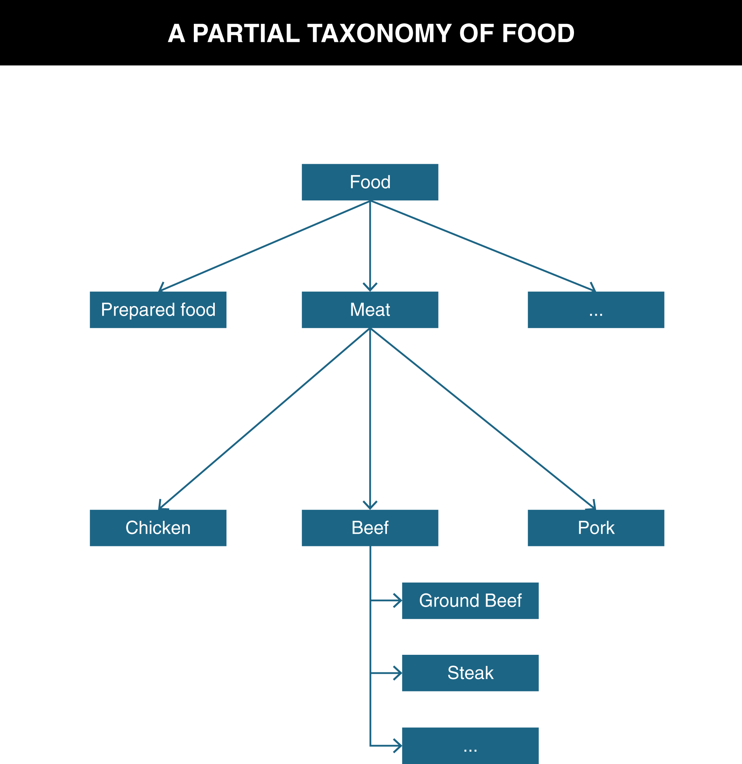
TDO Figure 5.1

Slide 15
Part-Whole or Meronymic Inclusion
UNIVERSITY OF CALIFORNIA, BERKELEY
SCHOOL OF INFORMATION
A resource class or instance physically, topologically, or temporally contains another
The engine is part of the car
The Napa Valley is part of Northern California
Extra time is part of a football match
expressed using “is-part-of,” “is-partly,” or with other similar predicate expressions
15
Notes:
First sentence packs a whole of stuff into just a few words… make sure you understand some of the contrasts

Slide 16
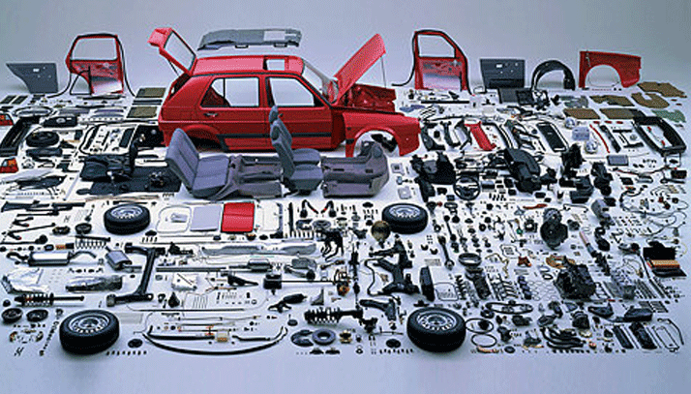
Part-Whole Relationship (Component-Object)
Notes:
But this stuff is very conceptual – I have been trying to find non gratuitous pictures to break up the text slides but I just don’t know what might help

Slide 17
The Semantics of “Attribution”
UNIVERSITY OF CALIFORNIA, BERKELEY
SCHOOL OF INFORMATION
In contrast to inclusion expressions that state relationships between resources, attribution relationships assert or assign values to properties for a particular resource
Attribution can be thought of as a binary relationship whose predicate has a single argument:
Martin the Gecko => is-small
"Title" : "Moby Dick“
Or with two arguments:
Martin => has-size => small
17
Notes:
In contrast to inclusion expressions that state relationships between resources, attribution relationships assert or assign values to properties for a particular resource
Attribution can be thought of as a binary relationship whose predicate has a single argument:
Martin the Gecko => is-small
"Title" : "Moby Dick"
http://www.geico.com/about/commercials/ -- do the Chicago or California one
Or with two arguments:
Martin => has-size => small

Slide 18
Properties of Semantic Relationships: Symmetry (1)
UNIVERSITY OF CALIFORNIA, BERKELEY
SCHOOL OF INFORMATION
SYMMETRY: the order in which the arguments of a binary relationship doesn't matter
Homer Simpson => is-married-to => Marge Simpson
Marge Simpson => is-married-to => Homer Simpson
18

Slide 19
Properties of Semantic Relationships: Symmetry (2)
UNIVERSITY OF CALIFORNIA, BERKELEY
SCHOOL OF INFORMATION
Relationships that are symmetric are also called BI-DIRECTIONAL
ASYMMETRIC relationships are those where the order of the arguments matters
Homer Simpson => is-parent-of => Bart Simpson
19

Slide 20
Properties of Semantic Relationships: Transitivity (1)
UNIVERSITY OF CALIFORNIA, BERKELEY
SCHOOL OF INFORMATION
TRANSITIVITY: if X and Y have a relationship, and Y and Z have the same relationship, then X also has the relationship with Z
Homer Simpson => is-taller-than => Bart Simpson
Bart Simpson => is-taller-than => Maggie Simpson
IMPLIES THAT
Homer Simpson => is-taller-than => Maggie Simpson
20

Slide 21
Properties of Semantic Relationships: Transitivity (2)
UNIVERSITY OF CALIFORNIA, BERKELEY
SCHOOL OF INFORMATION
Any relationship based on inclusion or ordering is transitive
Ordering includes numerical, alphabetic, and chronological relationships as well as those that imply qualitative or quantitative measurement
21

Slide 22
Properties of Semantic Relationships: Equivalence
UNIVERSITY OF CALIFORNIA, BERKELEY
SCHOOL OF INFORMATION
Any relationship that is both symmetric and transitive is an EQUIVALENCE relationship
We often need to assert that a particular class or property has the same meaning as another class or property or that it is generally substitutable for it
22

Slide 23
Properties of Semantic Relationships: Inverse
UNIVERSITY OF CALIFORNIA, BERKELEY
SCHOOL OF INFORMATION
For asymmetric relationships, it is often useful to be explicit about the meaning of the relationship when the order of the arguments in the relationship is reversed
The resulting relationship is called the INVERSE or the converse of the first relationship
23
Notes:
Lots of interesting analysis – kinship domain in particular – when you have inverse relationships whether there are words for both of them – “lexicalization of inverse”
Is parent of – is child of
But is top of - ??? When something is on top of something (like the top book in a stack), there is no word that uniquely picks out the thing that first resource is on top of…
More about lexicalization in a few minutes

Slide 24
Ontology
UNIVERSITY OF CALIFORNIA, BERKELEY
SCHOOL OF INFORMATION
An ontology defines the concepts and terms used to describe and represent some domain or area of knowledge
To fully understand a domain you need to know class and part-whole inclusion, attribution, equivalence, and many other relationships about and between the resources it contains
Class inclusion relationships can form a kind of backbone or framework to which other kinds of relationships attach, creating a network of relationships
24

Slide 25
Analyzing the Definition of Ontology
UNIVERSITY OF CALIFORNIA, BERKELEY
SCHOOL OF INFORMATION
The word ontology has been used to describe artifacts with different degrees of structure that differ:
... according to how precisely the terms are defined
... according to how precisely the relationships among them are expressed
So the simplest ontology is a dictionary
A thesaurus is a somewhat more complex ontology
More complete ontologies are expressed using formal logic-based language
25
Notes:
By itself, a dictionary won't be sufficient to solve the problem posed at the beginning of the lecture, but it will help
We saw the AAT in the previous lecture where it showed how terms like cararra marble fit into a term hierarchy. And which terms are preferred (rock vs stone)
… but I didn’t dwell on these issues then

Slide 26
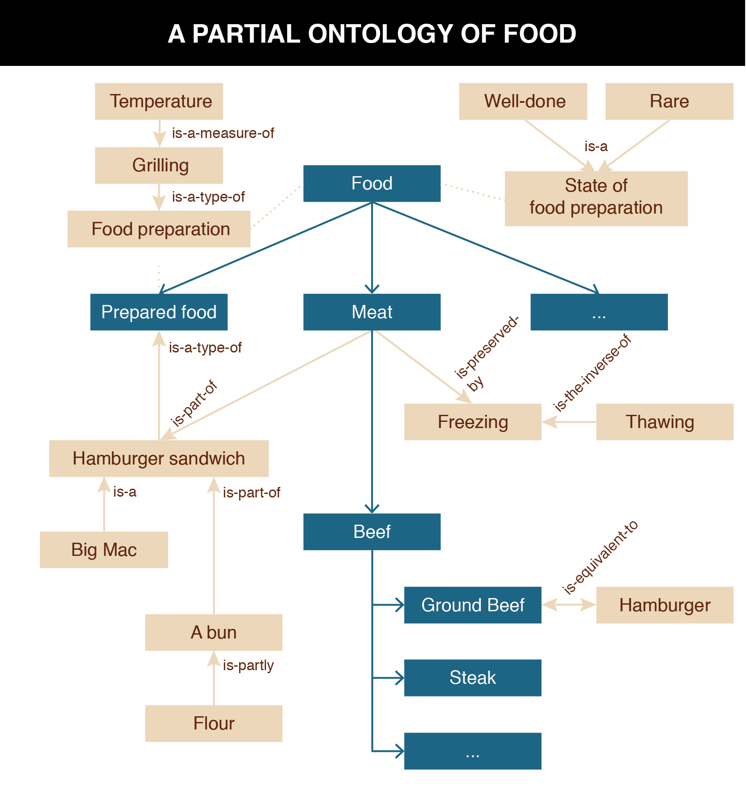
TDO Figure 5.2

Slide 27
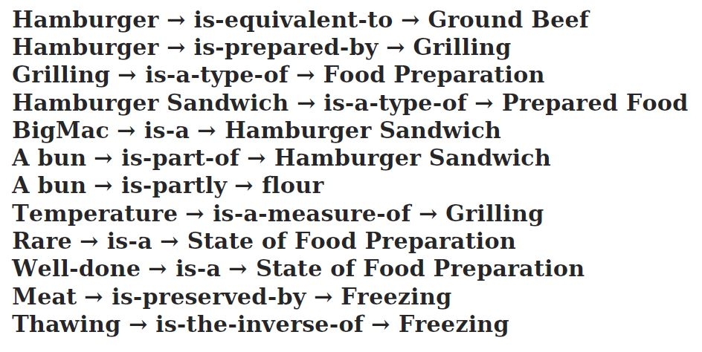
Ontological Assertions That Annotate the Food Taxonomy

Slide 28
Ontologies and the “Vocabulary Problem”
UNIVERSITY OF CALIFORNIA, BERKELEY
SCHOOL OF INFORMATION
The Artificial Intelligence solution (for computers) to the vocabulary problem is to give an information system all the knowledge -- including "commonsense" -- that is needed to interpret every user's expressions in every context
A great deal of work in AI has been dedicated to building knowledge bases to support language understanding, reasoning, problem solving applications
The most famous / infamous effort is the Cyc project (http://www.cyc.com)
28
Notes:
millions of dollars of taxpayer money to fund Artificial Intelligence starting in the 1970s, but these were with toy problems. In early 1980s several of the leading thinkers in AI (Doug Lenat, Marvin Minsky, Ed Feigenbaum, Alan Kay) concluded that AI needs a great deal of "world knowledge" that would have to be created by people. Cyc started in 1984.. And they've been working on it ever since

Slide 29
Cyc – Formalized Commonsense Knowledge
UNIVERSITY OF CALIFORNIA, BERKELEY
SCHOOL OF INFORMATION
Cyc knows a few hundred thousand basic concepts and a few million human-entered assertions about the world -- "facts, rules of thumb, and heuristics for reasoning about the objects and events of everyday life“
The Cyc knowledge base consists of terms and assertions that relate those terms
This kind of common sense is a pre-requisite for computers to achieve anything approaching human competence on natural language processing tasks (once you get outside of narrow, constrained domains)
How will Cyc change the world in the next 10 years?
29
Notes:
Some of this is very general knowledge: causes precede effects. Most of it is very specific, like the relative sizes of different objects, how long people live...

Slide 30
SNOMED
UNIVERSITY OF CALIFORNIA, BERKELEY
SCHOOL OF INFORMATION
Systematized Nomenclature of Medical-Clinical Terms, http://www.ihtsdo.org/snomed-ct/
Important aid in accurately recording "healthcare encounters" to improve communication and interoperability among information systems, especially electronic health records
Contains over 300,000 concepts and formal definitions, organized in several different hierarchies to enable terms to be located and interrelated from different perspectives
30
Notes:
think for a bit about different ways or hierarchies or "conceptual roots" you might use to organize medical and clinical terms.
If you don't where to start, here's two of them: by body part or anatomy to which the terms refer, or to drugs that are involved.
Topography -- Anatomic terms
Morphology -- Changes found in cells, tissues and organs
Living organisms -- Bacteria and viruses
Function -- Signs and symptoms
Diagnosis -- Diagnostic terms
Procedure -- Administrative, diagnostic and therapeutic procedures
Physical agents, forces, activities -- Devices and activities associated with the disease
Social context -- Social conditions and important relationships in medicine (like mother)

Slide 31
INFO 202 “Information Organization & Retrieval” Fall 2013
UNIVERSITY OF CALIFORNIA, BERKELEY
SCHOOL OF INFORMATION
Robert J. Glushko glushko@berkeley.edu
@rjglushko
3 October 2013 Lecture 11.3 – Lexical Perspective on Relationships

Slide 32
The Lexical Perspective on Relationships
UNIVERSITY OF CALIFORNIA, BERKELEY
SCHOOL OF INFORMATION
A prototypical word is the minimal "meaning bearing" element of language
Words express concepts and relationships, but not all concepts and relationships have words for them (are "lexicalized")
These "lexical gaps" differ from language to language
Whereas "conceptual gaps" -- the things we can't think of -- may be innate and universal
32
Notes:
A prototypical word is the minimal "meaning bearing" element of language
first oversimplification - compound terms like "polar bear" or "sea horse" might be represented as two words in the sense that there is white space in the middle but they are best treated as a single unit of meaning because what they mean isn't decomposable into the meaning of the two parts
Words express concepts and relationships, but not all concepts and relationships have words for them (are "lexicalized")
we don't have a word for "all the stuff you'd take from your home if the fire was coming in 10 minutes" but we just created a concept for it
These "lexical gaps" differ from language to language
Chinglish play about poorly translated Chinese to English because not words in Chinese for some common English phrases
Whorfian Hypothesis - lexical repertoire of a language constrains what you can think about; this is too strong a claim. Discredited – but the weaker claim that different languages make speakers attend to different details or aspects of experience is pretty well accepted – this is called linguistic relativitly – more in chapter 6 on categorization
Languages differ a great deal in the words they contain and also in more fundamental
ways that they require speakers or writers to attend to details about the
world or aspects of experience that another language allows them to ignore. (this is called linguisitic relativity – chapter 6 on categories)
Whereas "conceptual gaps" -- the things we can't think of -- may be innate and universal
things we can't perceive or experience, for example, like the pull of gravity
sort of a backwards argument, but making it on the basis that once a concept is expressed in one language it can be translated into other languages

Slide 33
Linguistic Relativity in Iceland
Notes:
Took this photo in the Rejkavik airport a couple of years ago. Highly recommend Iceland. If you ever have to go to scandinavia fastest way is sfo-sea-ice-

Slide 34
Relationships Among Words / Relationships Among Concepts
UNIVERSITY OF CALIFORNIA, BERKELEY
SCHOOL OF INFORMATION
Representing the relationships among words is a task for linguistics and cognitive science
In contrast, representing the relationships among concepts is a task for computer science (e.g., ontologies like Cyc)
Understanding both kinds of relationships is essential for designers of organizing systems
34
Notes:
And as we saw in Wordnet, you can do both at the same time more or less

Slide 35
Relations Among Words
UNIVERSITY OF CALIFORNIA, BERKELEY
SCHOOL OF INFORMATION
Hyponymy/Hyperonymy
Metonymy
Synonymy
Polysemy
Antonymy
35

Slide 36
Hyponymy/Hyperonymy
UNIVERSITY OF CALIFORNIA, BERKELEY
SCHOOL OF INFORMATION
When words encode IS-A or inclusion relationships, the word for the more specific class is the HYPONYM and the other is the HYPERNYM
So there can be a "lexical hierarchy" that represents the "semantic hierarchy"
Often used to situate "basic categories" with respect to superordinate and subordinate categories
36

Slide 37
Hyponymy/Hyperonymy
UNIVERSITY OF CALIFORNIA, BERKELEY
SCHOOL OF INFORMATION
A is a hyponym of B if A is a type of B
A robin is a hyponym of bird
A is a hypernym of B if B is a type of A
An animal is a hypernym of bird
37

Slide 38
A Formula for Definitions
UNIVERSITY OF CALIFORNIA, BERKELEY
SCHOOL OF INFORMATION
hyponym = {adjective+} hypernym {distinguishing clause+}
Robin = Migratory BIRD with clear melodious song, a reddish breast, gray or black upper plumage
Doesn't mention every characteristic of hyponym, only those needed to distinguish from other hyponyms
38
Notes:
Here's something that would have been really nice to know a few days ago when you were defining the terms in your vocabulary, but you'll appreciate it more now. It will improve your work if you apply this idea because it will improve your semantic precision and so people using your vocabulary will understand it much better.

Slide 39
Metonymy
UNIVERSITY OF CALIFORNIA, BERKELEY
SCHOOL OF INFORMATION
The lexical representation of or analogy to part-whole or meronymic relationships
Using one aspect of something to stand for the whole
"Bank" as building stands for the institution of the "bank"
"The White House released new budget figures today"
39
Notes:
"The ham sandwich wants his check"
Take a look at that blonde

Slide 40
Synonymy
UNIVERSITY OF CALIFORNIA, BERKELEY
SCHOOL OF INFORMATION
Synonyms are different word forms that can express the same concept
cat, feline, Siamese cat
Absolute synonyms that can always substitute for each other probably don't exist
Propositional synonyms are those where substituting one for another isn’t likely to change the truth value of the statement
40
Notes:
Absolute substitutability is an extremely hard test to pass, except for acronyms
or compound terms like “USA,” “United States,” and “United States of America”
that are completely substitutable.
{weep, sob, cry}-- differ in scale or degree
"brave" implies physical, "courageous" implies moral
Lisa Simpson plays the {violin, fiddle}
Fellbaum in Wordet article: "Substitution of a synset member by another does not change the truth value of the context, though one synonym may be stylistically more felicitous than another in some contexts."

Slide 41
Polysemy
UNIVERSITY OF CALIFORNIA, BERKELEY
SCHOOL OF INFORMATION
Many "word forms" (particular spelling patterns) are polysemous with multiple senses established in the language -- they are semantically ambiguous
- That dog has floppy ears - She has a good ear for jazz.
"bank" (financial) has related senses:
- a building (the bank on Shattuck) - specific financial firm (Wells Fargo) - where money is kept (abstract notion) - where anything of value is kept (more abstract)
41
Notes:
"established in the language" important to note to contrast with ("coerced" polysemy, perhaps in poetry or some other atypical context)
"you can take that to the bank" means "it has a high probability of happening or being true"

Slide 42
Polysemy vs Homonymy
UNIVERSITY OF CALIFORNIA, BERKELEY
SCHOOL OF INFORMATION
A HOMOGRAPH is a word with multiple senses that are not conceptually related
- bank (financial sense) - bank (river sense)
But what looks like homography may be polysemy from a historical perspective
- mole (an animal that digs holes; an infiltrating spy)
HOMOPHONES are words with the same pronunciation but different spellings and meanings
- to, two, too; might, mite; clawed, claude
42
Notes:
But bank also has meanings that have nothing to do with money or value – so it is polysemous but also homonymous
Two kinds of homonyms:
A HOMOGRAPH is a word with multiple senses, but for which the different senses are not conceptually related
bank (financial sense)
bank (river sense)
But what appears to be homography may be polysemy from a historical perspective...and native speakers sometimes disagree about whether two senses are polysemous or homonymous
mole (a small animal that digs underground)
mole (a spy who infiltrates an organization)
HOMOPHONES are words with the same pronunciation but different spellings and meanings
to, two, too; might, mite; clawed, claude,

Slide 43
Antonymy
UNIVERSITY OF CALIFORNIA, BERKELEY
SCHOOL OF INFORMATION
Antonyms are lexical opposites
Some are inherently binary “true antonyms”
dead / alive, true / false, on / off
Others are "graded"
long / short, hot / cold
Markedness: if one member of a pair is more restricted in its contexts it can stand out psychologically
long is unmarked, short is marked
43
Notes:
Many antonymous relations can be reliably detected by looking for co-occurrence in large text collections. (Justeson & Katz, 91) - that is, big-little and large-small are good antonym pairs, but large-little are not, and we can tell that because the first two pairs are more likely to appear in same or nearby sentences than the last pair.

Slide 44
Thesauri
UNIVERSITY OF CALIFORNIA, BERKELEY
SCHOOL OF INFORMATION
A THESAURUS is a tool for finding the "right" or "good" terms of a controlled vocabulary
It is a collection of vocabulary terms annotated with lexical relationships to indicate terms that are:
Preferred (UF "used for")
Broader (BT "broader term")
Narrower (NT "narrower term")
Related (RT "related term" or "see also")
USE in a thesaurus refers the reader from a variant term to a preferred term; the inverse of UF
44
Notes:
With all that as background and foundation, now we can talk precisely about thesauri and other kinds of "machinery" or "mechanisms" for creating controlled vocabularies and more formal or rigorous representations of whatever meaning is
This means that a word is synonymous or equivalent to the "UF" term, but "better" in some way

Slide 45
Examples from Food Domain (TDO 5.4.2)
UNIVERSITY OF CALIFORNIA, BERKELEY
SCHOOL OF INFORMATION
Food BT Meat
Beef NT Meat
Food UF Sustenance, Nourishment
Food RT Cooking, Dining, Cuisine
Victuals USE Food
45
Notes:
With all that as background and foundation, now we can talk precisely about thesauri and other kinds of "machinery" or "mechanisms" for creating controlled vocabularies and more formal or rigorous representations of whatever meaning is
This means that a word is synonymous or equivalent to the "UF" term, but "better" in some way
Do you know how to pronounce the word in the last example
victuals
c.1300, vitaylle (singular), from Anglo-Fr. and O.Fr. vitaille, from L.L. victualia "provisions," noun use of plural of victualis "of nourishment," from victus "livelihood, food, sustenance," from base of vivere "to live" (see vital). Spelling altered early 16c. to conform with Latin, but pronunciation remains "vittles."

Slide 46
WordNet
UNIVERSITY OF CALIFORNIA, BERKELEY
SCHOOL OF INFORMATION
Another "ontological resource" -- a "semantic dictionary" - started in 1985 by George Miller and others at Princeton's Cognitive Science program
over 100,000 nouns in 80,000 “synonym sets”
11000 verbs in 13000 synsets
Instead of using spelling as the primary organizing principle for words, it uses their semantic properties and relationships
Designed as a network to capture the idea that words and concepts are an interrelated system
46
Notes:
Fellbaum: "All noun synsets ultimately descend from a single root, entity. The next layer comprises three synsets: physical entity, abstract entity, and thing. Below these, we find the synsets object, living thing, causal agent, matter, physical process, substance, psychological feature, attribute, group, relation, communication, measure, quantity, amount, and otherworld."

Slide 47
Using WordNet
UNIVERSITY OF CALIFORNIA, BERKELEY
SCHOOL OF INFORMATION
The WordNet database is freely downloadable from http://wordnet.princeton.edu/
http://www.synonym.com/ is easier to work with
The Visual Thesaurus is a commercial product that uses WordNet (http://www.visualthesaurus.com)
WordNet is very commonly used in natural language processing research and applications
Most important automated use of WordNet is in sense disambiguation, identifying a sense based on contexts in which it occurs
47

Slide 48
Implications for Vocabulary Design
UNIVERSITY OF CALIFORNIA, BERKELEY
SCHOOL OF INFORMATION
Choosing vocabulary terms, and precisely defining their semantics, is essential but impossible to do perfectly
Your vocabulary must express what YOU intend, so you "look inward" -- analyze how you think about a domain
You want others to understand what you mean, so you need to "look outward" -- analyze the terms used by your users, competitors, or subject matter experts
You should reuse other vocabularies or thesauri if they exist, especially for any "horizontal" components, to improve transformability and interoperability
But these three approaches may suggest different terms
48

Slide 49
Readings for Next Lecture
UNIVERSITY OF CALIFORNIA, BERKELEY
SCHOOL OF INFORMATION
rest of TDO 5
TDO 8 through 8.2.1.5
Glushko, Robert J. – “Modeling Methods and Artifacts for Crossing the Data/Document Divide”, people.ischool.berkeley.edu/~glushko/glushko_files/GlushkoXML2005.pdf
www.oasis-open.org/org
Getting started with schema.org schema.org/docs/gs.html
49

