Slide 1
INFO 202 “Information Organization & Retrieval” Fall 2013
UNIVERSITY OF CALIFORNIA, BERKELEY
SCHOOL OF INFORMATION
Robert J. Glushko glushko@berkeley.edu
@rjglushko
10 September 2013 Lecture 4.1 – Search in Organizing Systems

Slide 2
Search in Organizing Systems
UNIVERSITY OF CALIFORNIA, BERKELEY
SCHOOL OF INFORMATION
People often search for resources – especially information resources - that let them make better decisions or act more effectively
"Search" is not a single type of interaction; because of the range of information finding requirements that users have, it is better to view it as a class or continuum of interactions that need to be supported
We can caricature two endpoints on a continuum of reasons for searching and what they're searching for
They search for answers to specific questions
They search to "find out about"
2

Slide 3
Models of the Search Process
UNIVERSITY OF CALIFORNIA, BERKELEY
SCHOOL OF INFORMATION
Are the concepts and design guidance that emerged from the first 100 years of library and information science still relevant?
Classical model
More recent models
Iterative models - IR as problem-solving dialog
"Berry picking"
Information Foraging
3

Slide 4
The Classical Model
UNIVERSITY OF CALIFORNIA, BERKELEY
SCHOOL OF INFORMATION
Assumes a "go to the library and use the IR system" to search specialized bibliographic collections – resource descriptions, not resource content
Often required a trained searcher as an intermediary actually doing the search (e.g., reference librarian) because UIs were complex
4

Slide 5
Depiction of Classical Search
UNIVERSITY OF CALIFORNIA, BERKELEY
SCHOOL OF INFORMATION
5

Slide 6
Search Processing – Generic Model (1)
UNIVERSITY OF CALIFORNIA, BERKELEY
SCHOOL OF INFORMATION
The user translates an information need or question(s) into a QUERY
The query expresses the information need in a format or as a set of descriptive features that the system can handle
The processable representation of these features make up the INDEX or INDICES
6

Slide 7
Search Processing – Generic Model (2)
UNIVERSITY OF CALIFORNIA, BERKELEY
SCHOOL OF INFORMATION
The system matches the descriptive features in the query against the features that describe the "documents" (or pointers to documents) stored by the system
Documents are retrieved when the degree of the match exceeds some measure of similarity
The system presents the retrieved documents according to the measure of similarity
The user assesses the RELEVANCE of the documents
7

Slide 8
Problems With the Classical Model
UNIVERSITY OF CALIFORNIA, BERKELEY
SCHOOL OF INFORMATION
People don't just search "formal" information sources
Users learn during the search process
They refine their original queries and generate new ones
They might change their preferences for recall and precision
8

Slide 9
Understanding Recall and Precision
UNIVERSITY OF CALIFORNIA, BERKELEY
SCHOOL OF INFORMATION
9

Slide 10
High Recall with Low Precision
UNIVERSITY OF CALIFORNIA, BERKELEY
SCHOOL OF INFORMATION
10

Slide 11
Low Recall with High Precision
UNIVERSITY OF CALIFORNIA, BERKELEY
SCHOOL OF INFORMATION
11

Slide 12
High Recall with High Precision
UNIVERSITY OF CALIFORNIA, BERKELEY
SCHOOL OF INFORMATION
12

Slide 13
Search as Problem Solving, Iterative Model
UNIVERSITY OF CALIFORNIA, BERKELEY
SCHOOL OF INFORMATION
“Information-seeking is a special case of problem solving. It includes recognizing and interpreting the information problem, establishing a plan of search, conducting the search, evaluating the results, and if necessary, iterating through the process again.”
Hearst Figure 3.1
13

Slide 14
Search as Dialog
UNIVERSITY OF CALIFORNIA, BERKELEY
SCHOOL OF INFORMATION
14

Slide 15
Iterative Models of Search
UNIVERSITY OF CALIFORNIA, BERKELEY
SCHOOL OF INFORMATION
IR is an active process of Finding Out About
It involves making hypotheses, evaluating whether process is on a useful path, proceeding forward (and backward)
Users can recognize elements of a useful answer, even when incomplete
Questions and understanding changes as the process continues
15

Slide 16
The “Berry Picking” Model
UNIVERSITY OF CALIFORNIA, BERKELEY
SCHOOL OF INFORMATION
Hearst Figure 3.3
16

Slide 17
Berry Picking
UNIVERSITY OF CALIFORNIA, BERKELEY
SCHOOL OF INFORMATION
Interesting information is scattered like berries among bushes
New information may yield new ideas and new directions
The information need Is not satisfied by a single, final retrieved set - it is satisfied by a series of selections and bits of information found along the way
So the information need, the query, and the search strategies co-evolve over time
17

Slide 18
Traditional Library Search Strategies (Bates 1999)
UNIVERSITY OF CALIFORNIA, BERKELEY
SCHOOL OF INFORMATION
Footnote Chasing
Citation Searching
Journal Run
Area scanning
Subject searches (in bibliographies, abstracting and indexing services)
Author searches
How do these apply to search of web resources?
18

Slide 19
Carnivores and Infovores
UNIVERSITY OF CALIFORNIA, BERKELEY
SCHOOL OF INFORMATION
19

Slide 20
Information Foraging
UNIVERSITY OF CALIFORNIA, BERKELEY
SCHOOL OF INFORMATION
A more recent and rigorous theory about the search process called INFORMATION FORAGING was proposed by Peter Pirolli and Stuart Card (2007 book)
Uses concepts of foraging theory from evolutionary biology to analyze the cost structure of search and select the highest value strategy
How do predators decide which prey to hunt? == How does an "inforvore" choose which information resources to pursue?
Animals adapt their search strategies == Inforvores also adapt search tactics, and modify their own information environments and information organization to make their searches more productive
20

Slide 21
Information Foraging
UNIVERSITY OF CALIFORNIA, BERKELEY
SCHOOL OF INFORMATION
Are you more likely to launch a web search or walk to the library to find some information?
Where are the "meaty" information resources more likely to be found?
What takes more effort?
Foraging theory holds that animals use "scent" to assess the likely value of a food source and to determine the direction to hunt. What are the "scents" for information resources?
21

Slide 22
INFO 202 “Information Organization & Retrieval” Fall 2013
UNIVERSITY OF CALIFORNIA, BERKELEY
SCHOOL OF INFORMATION
Robert J. Glushko glushko@berkeley.edu
@rjglushko
10 September 2013 Lecture 4.2 – Information Architecture and Organizing Systems

Slide 23
"Information Architecture" and Organizing Systems
UNIVERSITY OF CALIFORNIA, BERKELEY
SCHOOL OF INFORMATION
An architecture describes a system's components (or "building blocks") and their relationships with each other
This gives an "architected" system an explicit model, in contrast with systems that are implemented incrementally without a master plan
Abstract patterns of information content or organization are sometimes called architectures, which means that IA and Organizing Systems could have very similar definitions:
"IA is designing an abstract and effective organization of information and then exposing that organization to facilitate navigation and information use"
23

Slide 24
A Definition of Information Architecture
UNIVERSITY OF CALIFORNIA, BERKELEY
SCHOOL OF INFORMATION
24

Slide 25
A Definition of Information Architecture in User Interface Design
UNIVERSITY OF CALIFORNIA, BERKELEY
SCHOOL OF INFORMATION
25

Slide 26
Information Visualization
UNIVERSITY OF CALIFORNIA, BERKELEY
SCHOOL OF INFORMATION
Information visualization is the depiction of information using spatial and graphical conventions
IV most often involves computer-based, interactive visual representations to exploit human perceptual and cognitive capabilities for perceiving and understanding more information than can be obtained from textual displays
Two primary goals for IV:
Information Producer Goals: To explain, illustrate, and communicate
Information Consumer Goals: To facilitate analysis, exploration, and discovery
26

Slide 27
Info Vis for Business Intelligence (1)
UNIVERSITY OF CALIFORNIA, BERKELEY
SCHOOL OF INFORMATION
See also http://support.sas.com/rnd/datavisualization/dashboards/, http://robslink.com/SAS/dashboards/aaaindex.htm
27

Slide 28
IV for Business Intelligence (2)
UNIVERSITY OF CALIFORNIA, BERKELEY
SCHOOL OF INFORMATION
GE Health "Infoscape" http://visualization.geblogs.com/visualization/network/
28

Slide 29
Info Vis as a Design Specialty for Organizing Systems
UNIVERSITY OF CALIFORNIA, BERKELEY
SCHOOL OF INFORMATION
Information Visualization can also be defined as a subspecialty of "designing the interactions in an organizing system"
Like IA, Info Vis pays careful attention to content models and structural relationships
Like UI design, Info Vis seeks to apply interaction structure and presentations to the underlying information
But Info Vis often succeeds by transcending or ignoring the underlying information models and instead applying creative transformations to them
29

Slide 30
A More Typical Definition of IA
UNIVERSITY OF CALIFORNIA, BERKELEY
SCHOOL OF INFORMATION
30

Slide 31
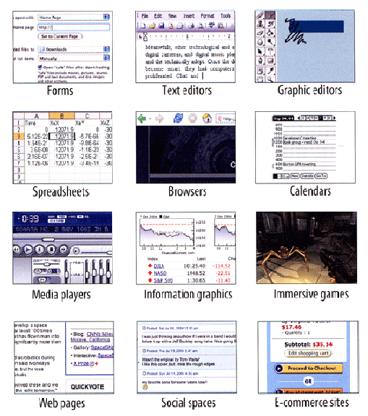
User Interface Design Idioms
UNIVERSITY OF CALIFORNIA, BERKELEY
SCHOOL OF INFORMATION
Tidwell, Jenifer.
Designing Interfaces: Patterns for Effective Interaction Design
www.amazon.com/dp/1449379702
31

Slide 32
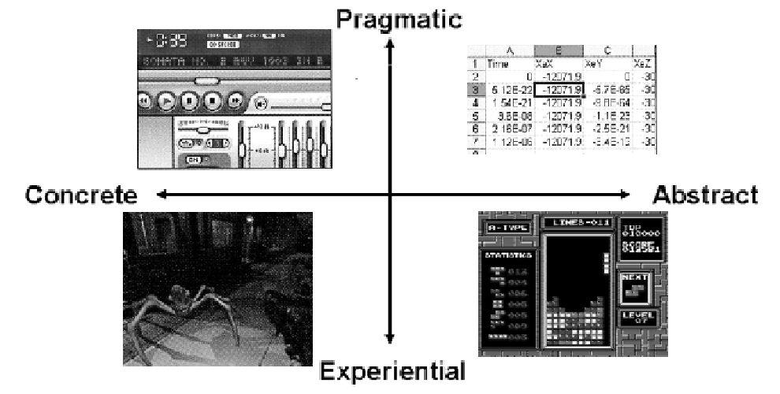
Where Is IA Most Important in UI Design?
UNIVERSITY OF CALIFORNIA, BERKELEY
SCHOOL OF INFORMATION
32

Slide 33
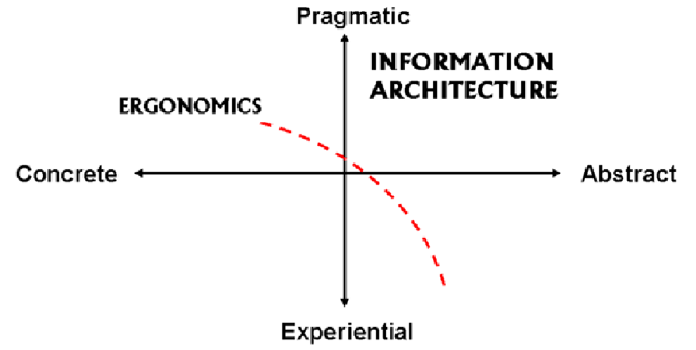
Narrowing the Scope of IA
UNIVERSITY OF CALIFORNIA, BERKELEY
SCHOOL OF INFORMATION
33

Slide 34
IA is Now Compatible with Organizing Systems
UNIVERSITY OF CALIFORNIA, BERKELEY
SCHOOL OF INFORMATION
Applications in the IA region involve information that is explicitly organized according to rules or constraints
The applications present, collect, and manipulate information according to these rules or constraints
For "Transactional" applications the rules are encoded in document type and process models from some domain
Many "Visualization" applications operate on document and data models from multiple domains and apply additional structural and presentational models (or "metaphors") to them
34

Slide 35
Finally, the “Polar Bear” Book
UNIVERSITY OF CALIFORNIA, BERKELEY
SCHOOL OF INFORMATION
"Exact organization schemes are relatively easy to design and maintain because there is little intellectual work involved in assigning items to categories"
Alphabetical - Arrange resources according to the spelling of their names or identifiers
Chronological - Arrange resources according to some time-related property or descriptor
Geographical - Arrange resources according to location information
35

Slide 36
Are These Organizing Schemes Truly Objective and Exact?
UNIVERSITY OF CALIFORNIA, BERKELEY
SCHOOL OF INFORMATION
Are these resources "Cars" or "Automobiles" -> changes the alphabetical ordering
Is "Van Gogh" a "V" name or a "G" name -> changes the alphabetical ordering
Geopolitical effectivity: “What country do you live in?” – depends on when you ask (See TDO note 187)
36

Slide 37
Are These Organizing Schemes Truly Ambiguous and Subjective?
UNIVERSITY OF CALIFORNIA, BERKELEY
SCHOOL OF INFORMATION
Topic (see Google News, algorithmic assignment of stories to topics)
Task (maybe ambiguous for information resources, but not so much for physical ones)
Audience (data mining or discrete choice modeling to identify customer segments)
Metaphor
37

Slide 38
Things I Agree with in the Polar Bear Book
UNIVERSITY OF CALIFORNIA, BERKELEY
SCHOOL OF INFORMATION
In most situations, there is an ongoing need for classifying new items and for modifying the organization scheme
In designing a topical organization scheme, you are defining the universe of content (both present and future) that users will expect to find
Using multiple schemes together while presenting them separately enables flexibility without causing confusion
38

Slide 39
INFO 202 “Information Organization & Retrieval” Fall 2013
UNIVERSITY OF CALIFORNIA, BERKELEY
SCHOOL OF INFORMATION
Robert J. Glushko glushko@berkeley.edu
@rjglushko
10 September 2013 Lecture 4.3 – Social Tagging

Slide 40
Social Tagging - Overview
UNIVERSITY OF CALIFORNIA, BERKELEY
SCHOOL OF INFORMATION
Trant’s definition: “Publicly labeling or categorizing resources in a shared online environment”
The aggregated results of individual tags have been described as: collaborative, cooperative, distributed, dynamic, community-based, folksonomic, wikified, ethnoclassification, democratic, user-assigned, or user-generated
Tag sharing (or visibility) creates additional value through network effects
40

Slide 41
Why People Tag
UNIVERSITY OF CALIFORNIA, BERKELEY
SCHOOL OF INFORMATION
To organize resources for personal use
Content-based description
Task-based description
To enable sharing and communication to known audiences
To express opinions
To entertain
41

Slide 42
Tagging and the “Long Tail”
UNIVERSITY OF CALIFORNIA, BERKELEY
SCHOOL OF INFORMATION
Interest in tagging and folksonomy derives in part from the information discovery needs of the ‘long tail”
Digitization/webification enables infrequently needed or accessed resources to remain available… if they can be found
Resources in the “long tail” are also hard to “re-find” because of their lack of prominence in large collections; tagging is a mechanism for individuals to create personal collections of “stuff they’ve seen”, enabling them to “keep found things found”
42

Slide 43
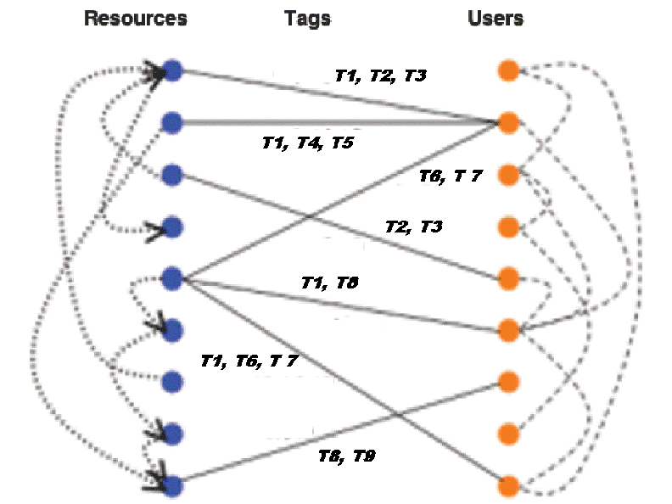
The Conceptual Model of Social Tagging
UNIVERSITY OF CALIFORNIA, BERKELEY
SCHOOL OF INFORMATION
43

Slide 44
The Conceptual Model
UNIVERSITY OF CALIFORNIA, BERKELEY
SCHOOL OF INFORMATION
Three kinds of relationships:
between resources (the links)
between people and resources (the tags people apply to resources)
between people (some pre-existing, some because they share the same relationships to the resources
Links between items can be inferred from links between people
Links between people can be inferred from links between resources
we'll talk more about that in the context of "collaborative filtering" or "recommender systems" later this semester
“Categorizing” is probably in this definition because of the prominence of “folksonomy” in discussions of tagging
Because “folksonomy” is a blend of “folk” and “taxonomy” and the latter is a system of categories
Tag sharing (or visibility) creates additional value through network effects
44

Slide 45
Tagging Vs. Categorizing
UNIVERSITY OF CALIFORNIA, BERKELEY
SCHOOL OF INFORMATION
“Categorizing” is probably in Trant’s definition because of the prominence of “folksonomy” in discussions of tagging
Because “folksonomy” is a blend of “folk” and “taxonomy” and the latter is a system of categories
But “labeling” and “categorizing” aren’t synonyms
Tagging describes resources, but this isn’t the same as assigning them to categories
Most tagging implementations don’t impose a pre-existing set of tags, so there is no category system
45

Slide 46
Design Dimensions for Tagging Systems
UNIVERSITY OF CALIFORNIA, BERKELEY
SCHOOL OF INFORMATION
What can be tagged? (anything, photos, web resources, bibliographic resources…)
Tagging lexicography? (whitespace delimited string, phrases, normalization)
Who can tag? (self, permitted people, anyone)
Tagging support? (none, suggested, previous tags visible)
Aggregation model? (none, “bag”, labeled set)
46

Slide 47
Assigned Readings for Next Lecture
UNIVERSITY OF CALIFORNIA, BERKELEY
SCHOOL OF INFORMATION
TDO 3.1-3.4, 3.6
Kent Preface and Chapter 1
47

