Slide 1
INFO 202 “Information Organization & Retrieval” Fall 2013
UNIVERSITY OF CALIFORNIA, BERKELEY
SCHOOL OF INFORMATION
Robert J. Glushko glushko@berkeley.edu
@rjglushko
5 September 2013 Lecture 3.1 – Activities in Organizing Systems

Slide 2
The Activities in Organizing Systems
UNIVERSITY OF CALIFORNIA, BERKELEY
SCHOOL OF INFORMATION
2

Slide 3
The Activities in Organizing Systems
UNIVERSITY OF CALIFORNIA, BERKELEY
SCHOOL OF INFORMATION
We can identify four activities in the lifecycle of every organizing system:
Selecting resources
Organizing resources
Supporting resource-based interactions and services
Maintaining resources
3

Slide 4
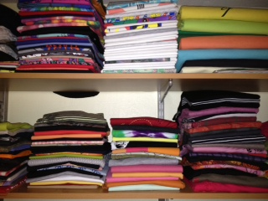
Closet Organizing Systems
UNIVERSITY OF CALIFORNIA, BERKELEY
SCHOOL OF INFORMATION
4

Slide 5
For Your Closet Organizing System…
UNIVERSITY OF CALIFORNIA, BERKELEY
SCHOOL OF INFORMATION
Selecting: Should I hang up my sweaters in the closet or put them in a drawer?
Organizing: Should I sort my shirts by color, sleeve type, or season?
Supporting Interactions: Do I need separate places for laundry or dry cleaning?
Maintaining: Should I toss out my clothes based only on stains and tears, based on how long I’ve owned them, or based on whether I’m tired of them?
5

Slide 6
Stop and Reflect…
UNIVERSITY OF CALIFORNIA, BERKELEY
SCHOOL OF INFORMATION
Does the definition of “Organizing System” apply to all of the types of collections, documents, and information services we’ve seen?
What are the consequences of using abstract terms like “resource,” “interaction,” and “maintenance” instead of more specific and domain-specific terms?
Collection development, Appraisal vs. Selecting
Acquisition, Accession, Ingesting vs. Adding to Collection
Cataloging, Indexing vs. Organizing
Curation, Governance vs. Maintenance …
6

Slide 7
And Your Closet Has “Interfaces” But They’re Not Listed Here
UNIVERSITY OF CALIFORNIA, BERKELEY
SCHOOL OF INFORMATION
ProgrammableWeb.com
7

Slide 8
Stop and Reflect Again…
UNIVERSITY OF CALIFORNIA, BERKELEY
SCHOOL OF INFORMATION
Why are there FOUR activities and not 3 or 5 or some other number?
Why are the activities given generic names?
8

Slide 9
What about “Creating” Resources?
UNIVERSITY OF CALIFORNIA, BERKELEY
SCHOOL OF INFORMATION
Does "intentional arrangement" imply the existence of resources?
Can "intentional arrangement" be a pre-requisite for resource creation?
9

Slide 10
INFO 202 “Information Organization & Retrieval” Fall 2013
UNIVERSITY OF CALIFORNIA, BERKELEY
SCHOOL OF INFORMATION
Robert J. Glushko glushko@berkeley.edu
@rjglushko
5 September 2013 Lecture 3.2 – Selection in Organizing Systems

Slide 11
Selecting Resources
UNIVERSITY OF CALIFORNIA, BERKELEY
SCHOOL OF INFORMATION
SELECTION is the process by which resources are identified, evaluated, and added to a collection
Selection is by definition an intentional process
Selection methods and criteria vary across domains (as do the words that describe them); these can be subjective or objective
11

Slide 12
Selecting {and,or,vs.} Organizing
UNIVERSITY OF CALIFORNIA, BERKELEY
SCHOOL OF INFORMATION
SELECT everything and keep it all --> often defaults to weak organizing principles
Selection PRECEDES Organizing --> Unique or rare resources are naturally evaluated one-at-a-time
Selection and Organizing are more CONCURRENT --> homogeneous or predictable resources
Selection FOLLOWS Organizing --> Resources created according to schema
12

Slide 13
Selection Principles
UNIVERSITY OF CALIFORNIA, BERKELEY
SCHOOL OF INFORMATION
Utility or relevance
Intrinsic value
Scarcity or uniqueness
To support social or symbolic goals
… many others
13

Slide 14
“Path Dependence”
UNIVERSITY OF CALIFORNIA, BERKELEY
SCHOOL OF INFORMATION
Does the selection principle apply to each candidate resource in isolation?
... or does the selection decision consider the items already in the collection?
... or does the selection decision consider possible future selections?
14

Slide 15
Selection in Different Domains
UNIVERSITY OF CALIFORNIA, BERKELEY
SCHOOL OF INFORMATION
Libraries select, collect, organize, conserve, preserve and provide access to information on behalf of a community of users
Museum collections, especially of special or rare items, bring status or prestige whether or not the items have any contemporary use
In "work systems" or "business models" selection is very task dependent and highly data-intensive
15

Slide 16
“My Life Bits”
UNIVERSITY OF CALIFORNIA, BERKELEY
SCHOOL OF INFORMATION
In 1998 Gordon Bell (MSFT research) began digitally recording as much of his life as possible
Articles, books, cards, CDs, letters, memos, papers, photos, pictures, presentations, home movies, videotaped lectures, and voice recordings...
Printed resources were scanned
Everything he did on his computer was captured
He wore a "sensecam" that took photos and logged biometric and ambient data
Little or no concurrent organization but "The more that is captured, the more correlation is possible to help find things“
2009 Book: Your Life, Uploaded http://totalrecallbook.com/about-the-book/
16

Slide 17
The SenseCam
UNIVERSITY OF CALIFORNIA, BERKELEY
SCHOOL OF INFORMATION
17

Slide 18
Digitization and Selection
UNIVERSITY OF CALIFORNIA, BERKELEY
SCHOOL OF INFORMATION
Digitization separates selection from storage concerns because access need not imply actual "holding" of the resources
Digital capture and copying of photos, videos, music and documents reduces their distinctiveness
The "digital torrent" of scientific and sensor data makes collection easy and selection more important
18

Slide 19
Selection on the Web
UNIVERSITY OF CALIFORNIA, BERKELEY
SCHOOL OF INFORMATION
The web has no centralized and authoritative directory or catalog
The web can be treated as a combination of a very large number of domain- or topic-specific resource collections that are created by individuals or identified by computational analysis
19

Slide 20
INFO 202 “Information Organization & Retrieval” Fall 2013
UNIVERSITY OF CALIFORNIA, BERKELEY
SCHOOL OF INFORMATION
Robert J. Glushko glushko@berkeley.edu
@rjglushko
5 September 2013 Lecture 3.3 – Organizing in Organizing Systems

Slide 21
Organizing Resources
UNIVERSITY OF CALIFORNIA, BERKELEY
SCHOOL OF INFORMATION
Almost any property of resources can be used to organize them, but the most appropriate or effective properties differ across resource types and tasks
Are you organizing the resources you have, or do you need to create an organizing system that can apply to resources that you have not yet collected or that might not even exist yet?
Selection is easier if there are clear organizing principles because they establish specifications or locations for the resources to be collected
21

Slide 22
Matching Organizing Principles to Resource Types and Interactions
UNIVERSITY OF CALIFORNIA, BERKELEY
SCHOOL OF INFORMATION
Almost any property of resources can be used to organize them, but the most appropriate or effective properties differ across resource types and tasks
22

Slide 23
Resource Organization in Libraries
UNIVERSITY OF CALIFORNIA, BERKELEY
SCHOOL OF INFORMATION
Bibliographic classification
We’ll discuss this a lot in chapter 4 on Resource Description and chapter 7 on classification
23

Slide 24
Resource Organization in Corporate Knowledge Management
UNIVERSITY OF CALIFORNIA, BERKELEY
SCHOOL OF INFORMATION
Corporate or specialized libraries are narrowly focused organizing systems that support the knowledge management and reuse needs of a particular group of experts
They need a narrower and deeper system that will often have proprietary aspects
Access control mechanisms are often implicit in the organizing system
24

Slide 25
Resource Organization in Museums
UNIVERSITY OF CALIFORNIA, BERKELEY
SCHOOL OF INFORMATION
Museum collections often have a very distinctive or idiosyncratic character because many of them began as or grew through the acquisition of private collections
Because non-text objects are more semantically opaque than text ones, there is greater need for description resources or metadata
25

Slide 26
Resource Organization in Archives
UNIVERSITY OF CALIFORNIA, BERKELEY
SCHOOL OF INFORMATION
Archives often collect sets of documents ("fonds") that have themselves been previously organized as a result of their generation and use
This "original order" embodies the implicit or explicit organizing system of the person or entity that created the documents
As a result, archival documents are often kept in this original order
The "provenance" is an important set of information about the documents and influences how much they can be trusted
26

Slide 27
“Respect pour les fonds” in Museums
UNIVERSITY OF CALIFORNIA, BERKELEY
SCHOOL OF INFORMATION
The “fonds” principle of archives sometimes has an analogy in museums, when the museum is housed in a building donated by the original collector and the resources are kept in their original locations
This is the Frick Museum in Pittsburgh; see also TDO case study about Barnes Collection (10.5.2)
27

Slide 28
Digitization and Organization
UNIVERSITY OF CALIFORNIA, BERKELEY
SCHOOL OF INFORMATION
For digital resources the distinction between primary resources and description resources is less clear and less important because they are often organized and stored together
Being apply to apply "computational organization" in search engines or other NLP applications reduces the need for organization work by people
28

Slide 29
Webification and Organization
UNIVERSITY OF CALIFORNIA, BERKELEY
SCHOOL OF INFORMATION
Can we define a logical or technical boundary around a collection of web resources?
What are the implications of doing so?
29

Slide 30
INFO 202 “Information Organization & Retrieval” Fall 2013
UNIVERSITY OF CALIFORNIA, BERKELEY
SCHOOL OF INFORMATION
Robert J. Glushko glushko@berkeley.edu
@rjglushko
5 September 2013 Lecture 3.4 – Interaction Design in Organizing Systems

Slide 31
Interactions in Organizing Systems
UNIVERSITY OF CALIFORNIA, BERKELEY
SCHOOL OF INFORMATION
INTERACTIONS include any activity, function, or service supported by or enabled with respect to the resources in a collection or with respect the collection as a whole
ACCESS is the fundamental interaction in all organizing systems – you wouldn’t organize anything you didn’t expect to access again – but most organizing systems have additional interactions to make access more efficient and to create additional value with the resources
31

Slide 32
The Four Big Ones for Libraries…
UNIVERSITY OF CALIFORNIA, BERKELEY
SCHOOL OF INFORMATION
FINDING resources
IDENTIFYING resources to confirm that that a found resource is the intended one by distinguishing it from similar ones
SELECTING a resource from a collection when more than one might seem to fit the search criteria
OBTAINING the resource if it isn’t immediately available
32

Slide 33
Designing Resource-Based Interactions
UNIVERSITY OF CALIFORNIA, BERKELEY
SCHOOL OF INFORMATION
Important distinction between interactions that are directly afforded by the resources from those that must be designed
The nature of interactions depends on how we identify and define "resource"
Selecting and organizing have no purpose if you don't allow interactions to the resource (to the appropriate "agents")
Who we consider "appropriate" differs a great deal; contrast libraries, museums, archives, scientific and business data
33

Slide 34
Mediated Interactions (in Paris)
UNIVERSITY OF CALIFORNIA, BERKELEY
SCHOOL OF INFORMATION
34

Slide 35
Digitization and Interactions
UNIVERSITY OF CALIFORNIA, BERKELEY
SCHOOL OF INFORMATION
The variety and functions of interactions with digital resources are determined by the amount of structure and semantics in their encoding
Interactions can also be supported with digital resources that describe or are otherwise associated with the primary or original digital resource
Access controls for the interactions involving digital resources can be very precisely defined and enforced
35

Slide 36
The Document Type Spectrum
UNIVERSITY OF CALIFORNIA, BERKELEY
SCHOOL OF INFORMATION
From Glushko & McGrath, DOCUMENT ENGINEERING, MIT Press 2005
36

Slide 37
Organizing System Types & the DTS
UNIVERSITY OF CALIFORNIA, BERKELEY
SCHOOL OF INFORMATION
37

Slide 38
Information Retrieval Models & the DTS
UNIVERSITY OF CALIFORNIA, BERKELEY
SCHOOL OF INFORMATION
38

Slide 39
INFO 202 “Information Organization & Retrieval” Fall 2013
UNIVERSITY OF CALIFORNIA, BERKELEY
SCHOOL OF INFORMATION
Robert J. Glushko glushko@berkeley.edu
@rjglushko
5 September 2013 Lecture 3.5 – Maintenance in Organizing Systems

Slide 40
Maintaining Resources
UNIVERSITY OF CALIFORNIA, BERKELEY
SCHOOL OF INFORMATION
Maintaining includes any activity whose purpose is to ensure that a resource will be available at some future time for use or reuse
We can predict future use for some kinds of resources but not for others
Note that the intended future "user" of a resource might be a computational process or service
For many kinds of resources, you need to preserve more than the "primary resource" for it to have future use
Maintenance has many synonyms or near-synonyms across domains: Preservation, curation, governance, storage…
40

Slide 41
Preservation
UNIVERSITY OF CALIFORNIA, BERKELEY
SCHOOL OF INFORMATION
Preservation of physical resources requires that they be kept in conditions that prevent their deterioration
It might also include actions to improve access or to restore the resource
Preservation of digital copies might seem easier, but other issues arise:
How many copies do we need to ensure preservation?
Do we care about which copy is the original?
How do we prevent or at least detect tampering?
Preservation (or "non-preservation") might be required by law or regulation
41

Slide 42
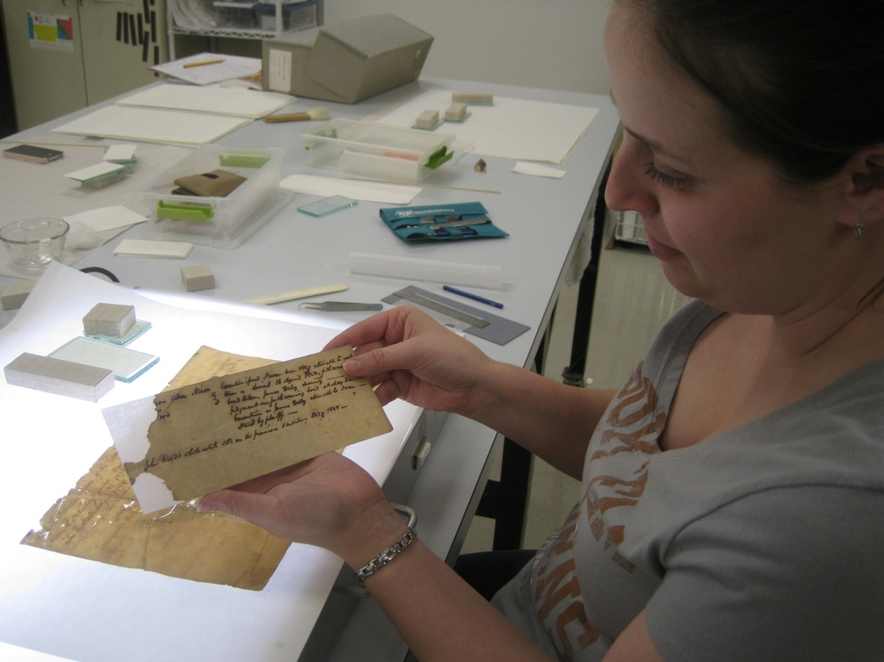
Restoration
UNIVERSITY OF CALIFORNIA, BERKELEY
SCHOOL OF INFORMATION
Using a light table to see the tears and losses in a 19th century document
Repairing a similar document with conservation tissue and wheat starch paste
42

Slide 43
Records Management
UNIVERSITY OF CALIFORNIA, BERKELEY
SCHOOL OF INFORMATION
“Records management” and “compliance” are old terms but the concerns about what information a government or business needs to preserve are very important today
Retention requirements
Non-retention requirements
Access control
Prohibitions about keeping personally identifiable information
Purging requirements and authority
43

Slide 44
Backing Up Your Computer
UNIVERSITY OF CALIFORNIA, BERKELEY
SCHOOL OF INFORMATION
44

Slide 45
Curation
UNIVERSITY OF CALIFORNIA, BERKELEY
SCHOOL OF INFORMATION
CURATION a common term for maintenance activities in "memory institutions“
It includes work to improve access (through better organization or description) or to restore / transform the resource
Curation decisions are often on an item-by-item basis, or for a set of closely related ones
Some people call "Crowdsourcing" and similar activities "community curation" but professional curators deprecate this usage
45

Slide 46
Cook and the "Contribution Revolution"
UNIVERSITY OF CALIFORNIA, BERKELEY
SCHOOL OF INFORMATION
Scott Cook, "The Contribution Revolution: Letting Volunteers Build Your Business", Harvard Business Review, October 2008
Much design thinking focuses on individual customers or users treated as independent actors or whose interactions with each other are not viewed as important
More recently, designers of information systems and services have started to notice and exploit the collective actions of people who implicitly or explicitly contribute content or preference information
Putting a "user contribution system“ into place to encourage and exploit this work is challenging (hard to get incentives right)
46

Slide 47
Cook’s “Contribution Taxonomy”
UNIVERSITY OF CALIFORNIA, BERKELEY
SCHOOL OF INFORMATION
47

Slide 48
Governance
UNIVERSITY OF CALIFORNIA, BERKELEY
SCHOOL OF INFORMATION
GOVERNANCE and Curation overlap, but the former term is more associated with corporate or enterprise data management and focuses more on policy than on process
Governance often has an economic basis or metaphor at its foundation
"IT Governance" has broad scope, applying to the management of the complete technological environment in which information resources are maintained
48

Slide 49
Assigned Readings for Next Lecture
UNIVERSITY OF CALIFORNIA, BERKELEY
SCHOOL OF INFORMATION
Hearst, Marti. Search User Interfaces, 2009. Chapter 3 through 3.4
Trant, Jennifer. “Studying social tagging and folksonomy: A review and framework.” Journal of Digital Information 10, no. 1 (2009).
Morville, Peter and Rosenfeld, Louis – “Information Architecture for the World Wide Web, Third Edition”, Sections 5.3 and 5.4
Berman, Francine, and Vint Cerf. “Who Will Pay for Public Access to Research Data?.” Science 341, no. 6146 (2013): 616-617.
Keller, Erasing History in the Internet Era, NY Times 28 April 2013
49

