Slide 1
INFO 202 “Information Organization & Retrieval” Fall 2013
UNIVERSITY OF CALIFORNIA, BERKELEY
SCHOOL OF INFORMATION
Robert J. Glushko glushko@berkeley.edu
@rjglushko
29 August 2013 Lecture 1.1 – Course Introduction

Slide 2
Outline
Course Introduction
Motivating the “Organizing System”
Design Dimensions and Frameworks for Organizing Systems
TDO as a Book and as eBooks; Customization & Collaboration Experiments
Course Administrivia

Slide 3
Catalog Description of INFO 202
UNIVERSITY OF CALIFORNIA, BERKELEY
SCHOOL OF INFORMATION
Three hours of lecture per week. Organization, representation, and access to information. Categorization, indexing, and content analysis. Data structures. Design and maintenance of databases, indexes, classification schemes, and thesauri. Use of codes, formats, and standards. Analysis and evaluation of search and navigation techniques.
3

Slide 4
The Course I’m Teaching (2013)
UNIVERSITY OF CALIFORNIA, BERKELEY
SCHOOL OF INFORMATION
“Organizing” is a fundamental activity in many disciplines, most notably library and information science, computer science, informatics, information architecture, law, economics, and business, but these disciplines don't agree very much in how they approach and describe problems of organizing and in what they seek at their solutions. In addition, information is just one type of resource to organize: we organize things, we organize information, we organize information about things, and we organize information about information. This course takes an abstract and trans-disciplinary approach that unifies these diverse perspectives and contexts of organizing.
4

Slide 5
Introductions
UNIVERSITY OF CALIFORNIA, BERKELEY
SCHOOL OF INFORMATION
Bob Glushko
The 5 Teaching Assistants (Class of 2013):
Ryan Baker
Fred Chasen
Sandra Helsley
Lisa Jervis
Colin MacArthur
The Students
5

Slide 6
Why This Course Exists
UNIVERSITY OF CALIFORNIA, BERKELEY
SCHOOL OF INFORMATION
INFO 202 has been the "gateway course" in this program since the day it began
The course builds the foundation for much of your I School experience
It introduces the intellectual foundations and vocabulary for students with heterogeneous backgrounds
6

Slide 7
Why This Course Is Challenging and Essential
UNIVERSITY OF CALIFORNIA, BERKELEY
SCHOOL OF INFORMATION
We deal with deep intellectual issues that have challenged philosophers and other deep thinkers for millennia
You must making the transition to studying information and its organization IN a discipline to studying information and its organization AS a discipline
You must learn to look past the presentation / rendition / technology reification / thinginess of information and organizing to see it more abstractly as meaning and structure
The diversity of perspectives and backgrounds in your class will be one of the challenges in this course
7

Slide 8
The Course In One Slide
UNIVERSITY OF CALIFORNIA, BERKELEY
SCHOOL OF INFORMATION
To organize is to create capabilities by intentionally imposing order and structure
We organize things, we organize information, we organize information about things, and we organize information about information
If we think abstractly about these activities, we can see commonalities that outweigh their differences; We select, organize, interact with, and maintain resources
We organize resources as individuals, in informal association with other individuals, or as part of a more formal institutional or business context
We must recognize the profound impact of new technologies and their co-evolution with the nature of the organizing we do and the kinds of interactions that this organizing enables, but can't ignore the "classical" concepts and knowledge
8

Slide 9
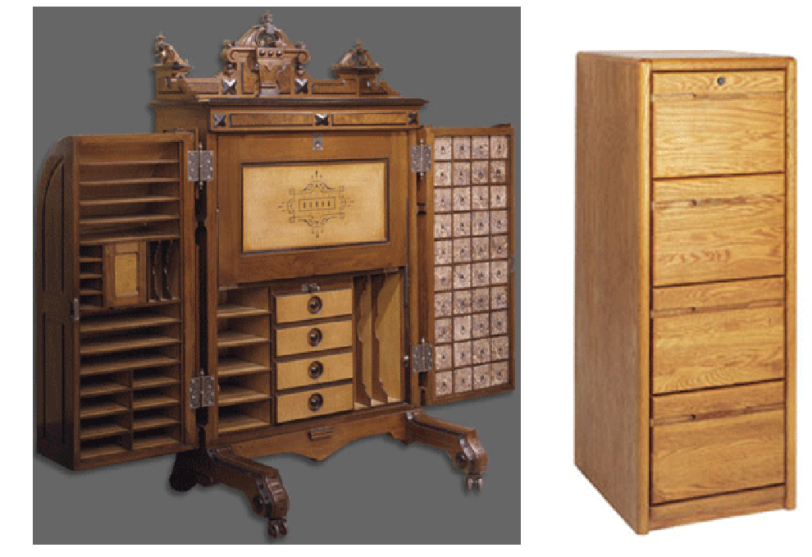
Co-Evolution of Technology and Organization
UNIVERSITY OF CALIFORNIA, BERKELEY
SCHOOL OF INFORMATION
9

Slide 10
INFO 202 “Information Organization & Retrieval” Fall 2013
UNIVERSITY OF CALIFORNIA, BERKELEY
SCHOOL OF INFORMATION
Robert J. Glushko glushko@berkeley.edu
@rjglushko
29 August 2013 Lecture 1.2 – Motivating the “Organizing System”

Slide 11
We Organize…
UNIVERSITY OF CALIFORNIA, BERKELEY
SCHOOL OF INFORMATION
Things
Information
Information about Things
Information about Information about {Things, Information}
…
11

Slide 12
We Organize…
UNIVERSITY OF CALIFORNIA, BERKELEY
SCHOOL OF INFORMATION
Libraries, museums, business information systems, scientific data… and other institutional resource collections
Different types of documents – from narrative to transactional – which have characteristic content, structures, and presentations
Personal information and artifacts of all kinds in our kitchens, closets, personal computers, smartphones…
12

Slide 13
But There is No Discipline
UNIVERSITY OF CALIFORNIA, BERKELEY
SCHOOL OF INFORMATION
“Organizing” is a fundamental activity in many disciplines, most notably library and information science, computer science, informatics, information architecture, law, economics, and business
But these disciplines have only limited agreement in how they approach and describe problems of organizing and in what they seek as their solutions
These differences obscure the common activities of selecting, describing, organizing, and maintaining resources
Interdependent concerns are treated separately as related to “organization” and “retrieval”
13

Slide 14
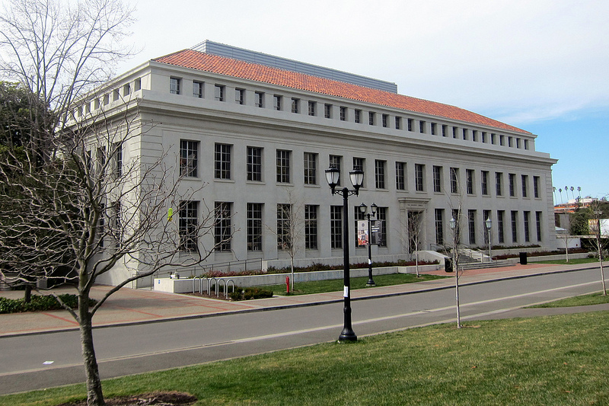
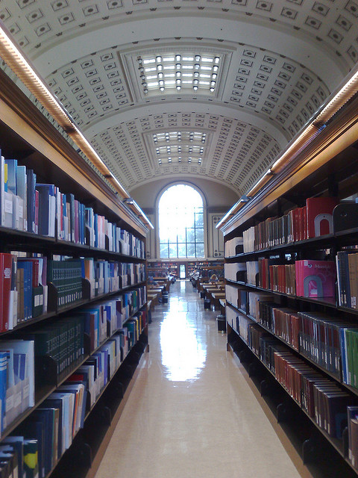
Library
UNIVERSITY OF CALIFORNIA, BERKELEY
SCHOOL OF INFORMATION
Photo by Wally Goebetz http://www.flickr.com/photos/wallyg/6977666395/
Bancroft Library, UC Berkeley
Photo by George Oates http://www.flickr.com/photos/george/
14

Slide 15
Museum
UNIVERSITY OF CALIFORNIA, BERKELEY
SCHOOL OF INFORMATION
Louvre, Paris – with Mona
Photos by Bob Glushko
15

Slide 16
Archive
UNIVERSITY OF CALIFORNIA, BERKELEY
SCHOOL OF INFORMATION
16

Slide 17
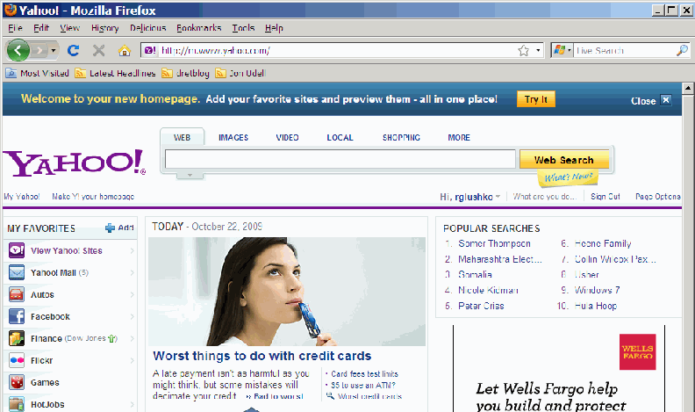
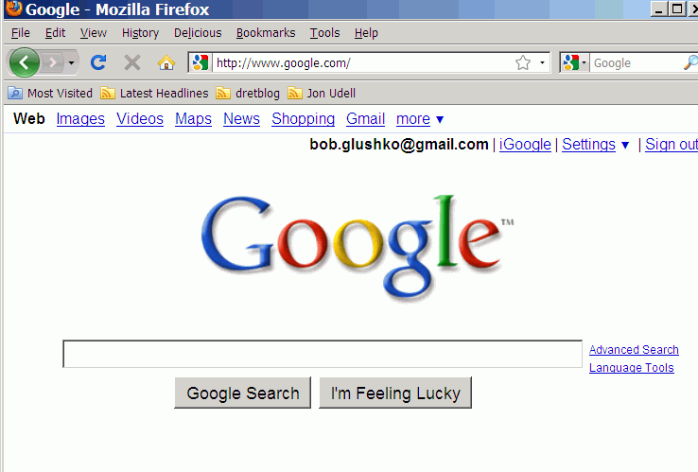
The Web & Digital Libraries
UNIVERSITY OF CALIFORNIA, BERKELEY
SCHOOL OF INFORMATION
17

Slide 18
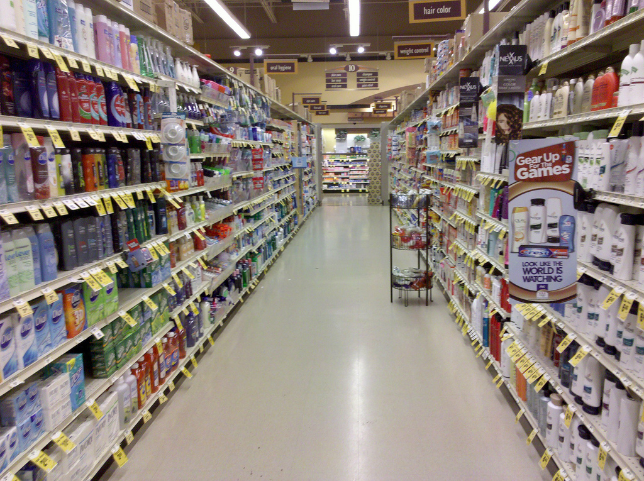
Retail Store
UNIVERSITY OF CALIFORNIA, BERKELEY
SCHOOL OF INFORMATION
18

Slide 19
Web Retail Store
UNIVERSITY OF CALIFORNIA, BERKELEY
SCHOOL OF INFORMATION
19

Slide 20
Document Collection
UNIVERSITY OF CALIFORNIA, BERKELEY
SCHOOL OF INFORMATION
20

Slide 21
Music Collection
UNIVERSITY OF CALIFORNIA, BERKELEY
SCHOOL OF INFORMATION
21

Slide 22
Stamp Collection
UNIVERSITY OF CALIFORNIA, BERKELEY
SCHOOL OF INFORMATION
22

Slide 23
Vineyards
UNIVERSITY OF CALIFORNIA, BERKELEY
SCHOOL OF INFORMATION
23

Slide 24
Motivating the Concept of “Organizing System”
UNIVERSITY OF CALIFORNIA, BERKELEY
SCHOOL OF INFORMATION
We can emphasize how all of these domains and types of collections differ… or we can emphasize what they have in common
They are all “Organizing Systems”
A collection of resources
Intentionally arranged
To enable some set of interactions
24

Slide 25
INFO 202 “Information Organization & Retrieval” Fall 2013
UNIVERSITY OF CALIFORNIA, BERKELEY
SCHOOL OF INFORMATION
Robert J. Glushko glushko@berkeley.edu
@rjglushko
29 August 2013 Lecture 1.3 – Definitions and Frameworks for Organizing Systems

Slide 26
The “Organizing System”
UNIVERSITY OF CALIFORNIA, BERKELEY
SCHOOL OF INFORMATION
26

Slide 27
The Organizing System [1]
UNIVERSITY OF CALIFORNIA, BERKELEY
SCHOOL OF INFORMATION
RESOURCES are “anything of value that can support goal-oriented activity”
A COLLECTION is a group of resources that have been selected for some purpose
27

Slide 28
Resources in the Library:
UNIVERSITY OF CALIFORNIA, BERKELEY
SCHOOL OF INFORMATION
Resources On the Web: Universal Resource Identifiers (URIs)
28

Slide 29
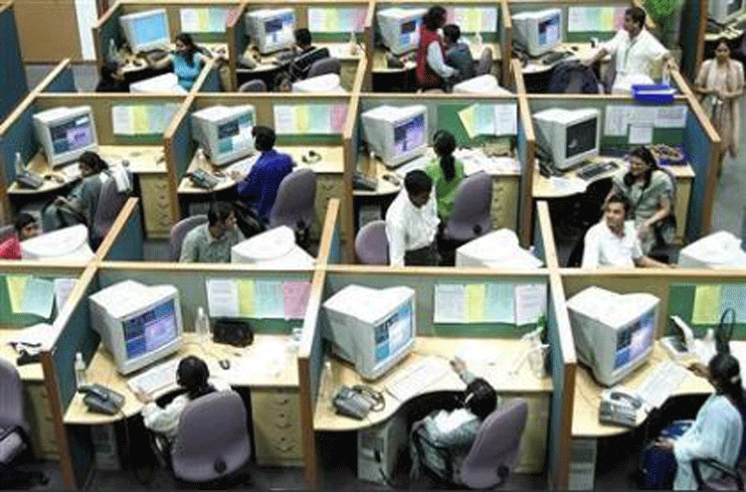
Human Resources
UNIVERSITY OF CALIFORNIA, BERKELEY
SCHOOL OF INFORMATION
29

Slide 30
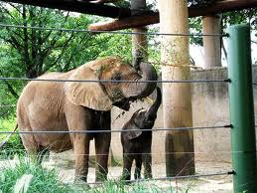
Resources in the Zoo…
UNIVERSITY OF CALIFORNIA, BERKELEY
SCHOOL OF INFORMATION
30

Slide 31
The Organizing System [2]
UNIVERSITY OF CALIFORNIA, BERKELEY
SCHOOL OF INFORMATION
INTENTIONAL ARRANGEMENT captures the idea that the system requires explicit or implicit acts of organization by AGENTS – human or computational ones
These arrangements follow or embody one or more ORGANIZING PRINCIPLES, ideally expressed in an implementation-neutral way
31

Slide 32
Not An Organizing System
UNIVERSITY OF CALIFORNIA, BERKELEY
SCHOOL OF INFORMATION
Resources are arranged, but not intentionally
Photo by B. Rosen (http://www.flickr.com/photos/rosengrant/2966470172/) Creative Commons CC BY-ND 2.0
32

Slide 33
Organizing Principles [1]
UNIVERSITY OF CALIFORNIA, BERKELEY
SCHOOL OF INFORMATION
ORGANIZING PRINCIPLES use properties or DESCRIPTIONS that are associated with the resources; organizing and describing resources are inherently interconnected activities
Almost any property of a resource might be used as a basis for an organizing principle, and multiple properties are often used simultaneously
The principles can also use collection-level properties
33

Slide 34
Organizing Principles [2]
UNIVERSITY OF CALIFORNIA, BERKELEY
SCHOOL OF INFORMATION
The simplest organizing principle is co-location, “bringing like things together”
For physical resources the properties that “make things go together” are often perceptual, material ones, or task-oriented ones
For information resources the properties are often semantic ones
34

Slide 35
Organizing Spices by Cuisine
UNIVERSITY OF CALIFORNIA, BERKELEY
SCHOOL OF INFORMATION
35

Slide 36
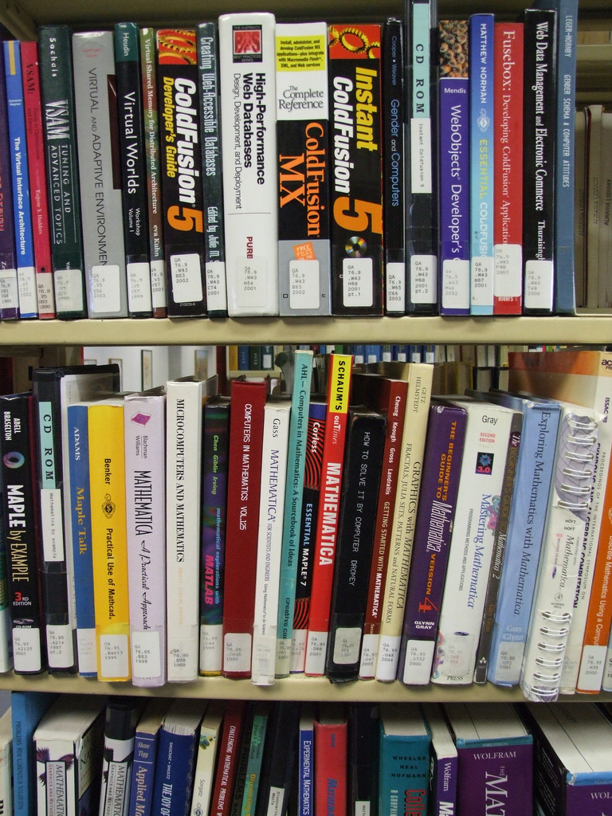
Organizing Books
By Content
(LOC Classification)
Photo by Jeffrey Beall (http://www.flickr.com/photos/denverjeffrey/304220561) Creative Commons CC BY-ND 2.0

Slide 37
Organizing Principles [3]
UNIVERSITY OF CALIFORNIA, BERKELEY
SCHOOL OF INFORMATION
Other typical arrangements are based on ownership, origin, taxonomic, or “taskonomic” properties (usage frequency, correlated usage)
Any resource with a orderable name or identifier can have alphabetic or numeric ordering
Any resource with an associated date (creation, acquisition) can have chronological ordering
Principles should be expressed logically in a way that doesn’t assume an implementation
37

Slide 38
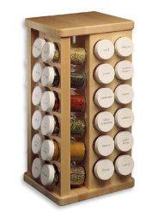
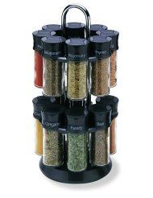
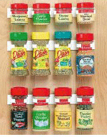
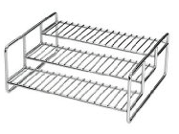
Principles don’t Specify Implementation: “Organize Spices Alphabetically”
UNIVERSITY OF CALIFORNIA, BERKELEY
SCHOOL OF INFORMATION
38

Slide 39
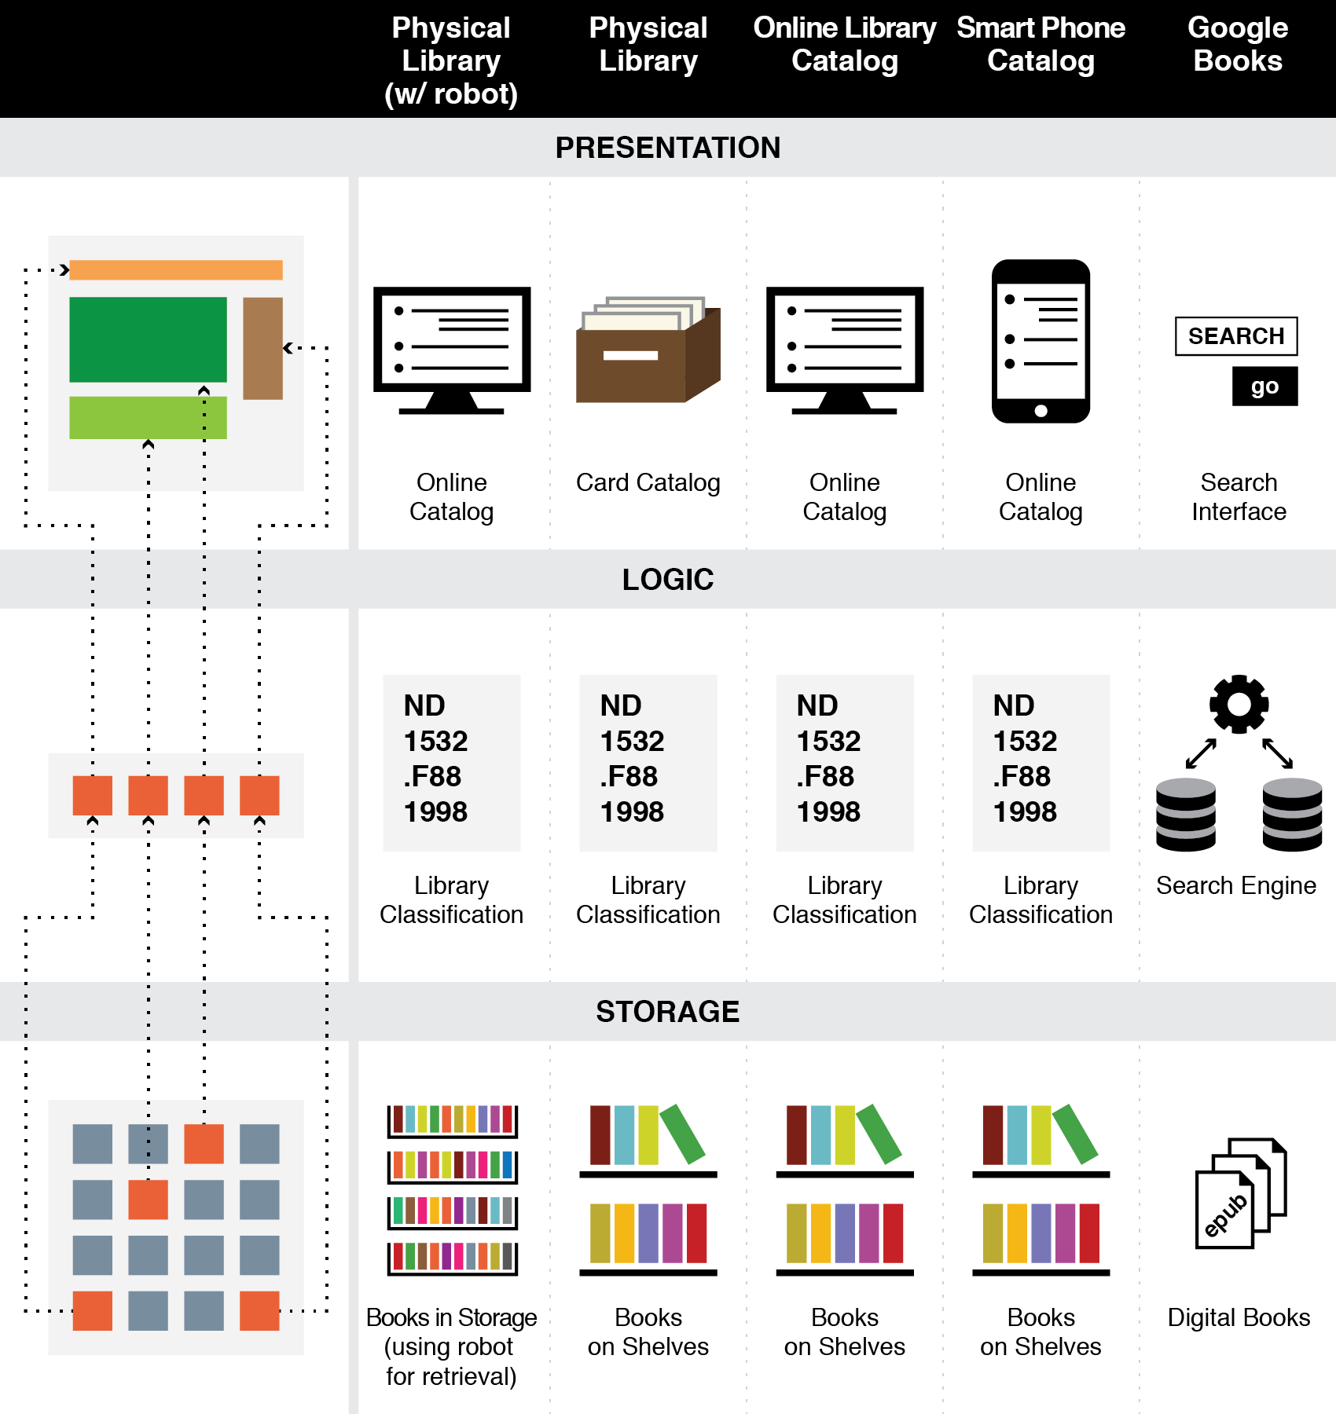
The Three-Tier Architecture
Organizing Principles are logically separated from Implementation and Presentation Tiers

Slide 40
Description is Challenging
UNIVERSITY OF CALIFORNIA, BERKELEY
SCHOOL OF INFORMATION
People use different words for the same things, and the same words for different things - what would a "good" description be like, and how can it be created?
Describing and organizing always (explicitly or implicitly) takes place in some context
The context shapes which resource properties are important and the organizing principles that use those properties, introducing bias
40

Slide 41
The Vocabulary Problem
UNIVERSITY OF CALIFORNIA, BERKELEY
SCHOOL OF INFORMATION
41

Slide 42
Specifying Meaning
UNIVERSITY OF CALIFORNIA, BERKELEY
SCHOOL OF INFORMATION
By Reference or Enumeration
Definition
Definition in a controlled vocabulary
Data types
Metadata
Metamodels
Formal assertions
Ontologies and thesauri
42

Slide 43
Understanding “Food” (TDO Fig. 5.2)
UNIVERSITY OF CALIFORNIA, BERKELEY
SCHOOL OF INFORMATION
43

Slide 44
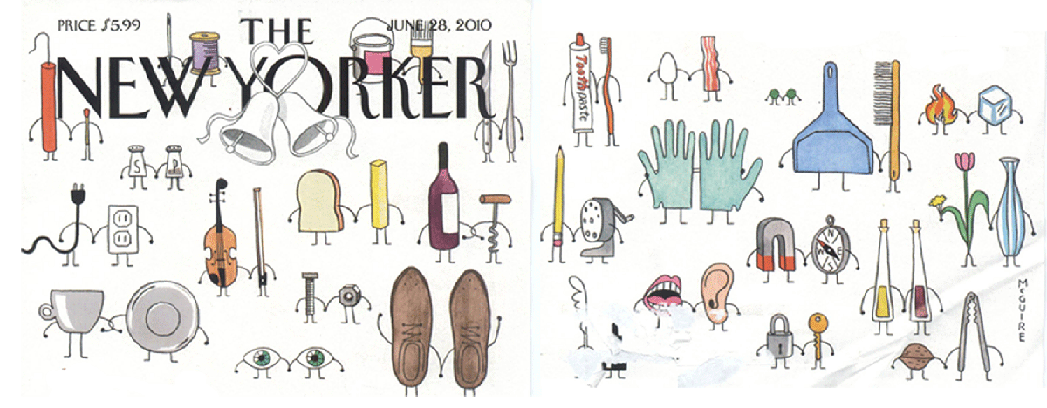
Relationships
UNIVERSITY OF CALIFORNIA, BERKELEY
SCHOOL OF INFORMATION
5 Perspectives: Semantic, Lexical, Structural, Architectural, and Implementation
44

Slide 45
Creating Categories to Enable Classification
UNIVERSITY OF CALIFORNIA, BERKELEY
SCHOOL OF INFORMATION
45

Slide 46
The 5 Dimensions of an Organizing System
UNIVERSITY OF CALIFORNIA, BERKELEY
SCHOOL OF INFORMATION
What Is Being Organized?
Why Is It Being Organized?
How Much Is It Being Organized?
When Is It Being Organized?
Who (or What) is Organizing It?
46

Slide 47
Summary
UNIVERSITY OF CALIFORNIA, BERKELEY
SCHOOL OF INFORMATION
The concept of Organizing System unifies a vast body of design and analysis practice from many disciplines
Thinking in terms of design dimensions overcomes the limitations and inertia of the traditional categories
It is a generative, forward-looking approach that encourages and accommodates innovation while preserving conventional theory and practice as design patterns
It enables intelligent conversations between people who didn’t have much common language before
47

Slide 48
INFO 202 “Information Organization & Retrieval” Fall 2013
UNIVERSITY OF CALIFORNIA, BERKELEY
SCHOOL OF INFORMATION
Robert J. Glushko glushko@berkeley.edu
@rjglushko
29 August 2013 Lecture 1.4 – TDO as Book and EBook

Slide 49
TDO
“The Discipline of Organizing” was published by MIT Press in May 2013 simultaneously in several different formats:
As a traditional printed book
As an ebook in epub2 and mobi formats
Read how we did this in in Section 10.7.4.

Slide 50
The Breadth vs. Depth Challenge
UNIVERSITY OF CALIFORNIA, BERKELEY
SCHOOL OF INFORMATION
A BROAD textbook for a multidisciplinary field represents all the disciplines that contribute to it
A DEEP textbook treats all the disciplines with appropriate rigor and nuance
Can a textbook be deep and broad at the same time?
50

Slide 51
Supplemental Content in Books
UNIVERSITY OF CALIFORNIA, BERKELEY
SCHOOL OF INFORMATION
Tables, figures, illustrations
Sidebars
Footnotes, endnotes, glossary entries
Bibliographic references
Appendices
Commentaries and reviews
Case studies
Temporal and interactive content
51

Slide 52
Selective Inclusion of Supplemental Content
UNIVERSITY OF CALIFORNIA, BERKELEY
SCHOOL OF INFORMATION
The simplest mechanism for a personalized reading experience
A reader can get the content and (logically) include it in the “text stream” at his current location
Example: with footnotes and endnotes, visual or hypertextual inclusion is an optional act by the reader
52

Slide 53
Making Supplemental Content “Intelligent”
UNIVERSITY OF CALIFORNIA, BERKELEY
SCHOOL OF INFORMATION
Supplemental content can be tagged or typed by discipline, target audience, or a contextual category
This added information enables the selective inclusion of the supplemental content in the main content stream
An innovative way to control the breadth vs depth challenge
53

Slide 54
Tagged Endnotes in TDO
UNIVERSITY OF CALIFORNIA, BERKELEY
SCHOOL OF INFORMATION
Over 20% of the content in TDO has been factored out of the core and converted to endnotes tagged by discipline
In the initial print and ebook versions of TDO, there are 6 categories of endnotes
Citation
Library and Information Science
Computing
Cognitive Science
Law
Business
This makes depth into a choice rather than a distraction or confusion
54

Slide 55
Breaking News for Fall 2013
UNIVERSITY OF CALIFORNIA, BERKELEY
SCHOOL OF INFORMATION
We have just finished an “enhanced academic edition” with 25 new photos, a “quiz mode,” and a more refined classification system for endnotes
Now includes Museum, Archive, Web, Linguistics, Philosophy
Several 2013 students have built epub.js to enable ebooks to be read in a browser
Enhanced TDO in a browser is being integrated with the Hypothes.is open annotation system, which we hope to use for communication, class participation, and assignments
Research project, possible collaboration with North Carolina Ischool …
If you opt-in to the research project, you can use enhanced TDO in a browser
55

Slide 56
Tagged Endnotes
56

Slide 57
INFO 202 “Information Organization & Retrieval” Fall 2013
UNIVERSITY OF CALIFORNIA, BERKELEY
SCHOOL OF INFORMATION
Robert J. Glushko glushko@berkeley.edu
@rjglushko
29 August 2013 Lecture 1.5 – Course Administrivia

Slide 58
Outline
UNIVERSITY OF CALIFORNIA, BERKELEY
SCHOOL OF INFORMATION
Tour of the syllabus
Class participation
Sections
Assignments
Exams
Grading, Admonitions, Administrivia
Readings for Next Time
58

Slide 59
A Tour of the Syllabus
UNIVERSITY OF CALIFORNIA, BERKELEY
SCHOOL OF INFORMATION
TDO was written to implement my model of how best to teach this course, so the syllabus follows the book
But because TDO is targeted broadly at the ISchools, we need additional texts and readings
REQUIRED BOOK: William Kent. Data and Reality, 3rd Edition
RECOMMENDED BOOK: Christopher D. Manning, Prabhakar Raghavan, and Hinrich Schütze. Introduction to Information Retrieval (2008)
RECOMMENDED BOOK: Marti Hearst. Search User Interfaces (September 2009)
Readings come from library science, computer science, cognitive science, linguistics, philosophy, systems analysis, information architecture, business case studies
59

Slide 60
Class Participation
UNIVERSITY OF CALIFORNIA, BERKELEY
SCHOOL OF INFORMATION
You are expected to have read the assigned readings before the class meets
You are expected to participate in class, in section, and in online contexts to demonstrate your reading and reflection… and there’s a wide “participation spectrum”
Some of you come from academic settings where classroom discussion and questioning of the instructor or other students is highly deprecated… but not here
Everyone will need to demonstrate some participation in all three contexts, but we will allow you to distribute your participation according to your personal preferences
60

Slide 61
Sections
UNIVERSITY OF CALIFORNIA, BERKELEY
SCHOOL OF INFORMATION
Are critically important because this class is just too big to allow the needed discussion
Sections will present and review the assignments, help you prepare for exams, and otherwise keep you on track in a very challenging course
Your section will become your tribe of fellow ISchoolers
Your TA is your pragmatic and spiritual guide to understanding the Ischool and 202
61

Slide 62
Assignments, Exams, Grading
UNIVERSITY OF CALIFORNIA, BERKELEY
SCHOOL OF INFORMATION
10 required and 1 optional assignment (30% of overall course grade)
Midterm exam on 7 November, covers course through 31 October (20%)
Final exam 17 December (35%)
Class participation (15%)
62

Slide 63
Academic Integrity
UNIVERSITY OF CALIFORNIA, BERKELEY
SCHOOL OF INFORMATION
Unless otherwise instructed, homework assignments are to be completed independently and materials submitted as homework should be the result of your own work.
The midterm and final exams are "open book," meaning that you can refer during the exam to the instructor's lecture notes, your notes, and anything in the course syllabus. But this is because you will be never be tested on simple facts, definitions, or anything else you can locate in a text somewhere. To copy text or ideas from another source without appropriate reference is PLAGIARISM and will result in a failing grade for your assignment and usually further disciplinary action.
63

Slide 64
Other Class Policies and Expectations
UNIVERSITY OF CALIFORNIA, BERKELEY
SCHOOL OF INFORMATION
Your computer and other devices you might use for reading and writing are essential tools and you can use them in the classroom. But if you decide you want to use Facebook or other applications rather than paying attention in class, you should leave... and you might even be asked to leave by the instructor.
Likewise, if your phone rings during class you will be asked to leave the classroom to answer it and will not be invited back.
64

Slide 65
Assigned Readings for Next Lecture
UNIVERSITY OF CALIFORNIA, BERKELEY
SCHOOL OF INFORMATION
Bush, Vannevar. “As We May Think”
Borges, Jorge Luis. "The library of Babel”
Homann et al. "Flexible value structures in banking”
Siegal , Nina.”Masterworks for one and all”
Wakabayashi, D. “Japanese Farms Look to the ‘Cloud’”
Kharif , Olga. “Retailers enlist the smartphone to encourage shopping”
Yang, Sarah. “Help wanted: Public needed to uncover clues in natural history collections”
65

