Slide 1
P2PTrainer Logo Progression
Kay Ashaolu
INFO 198 Final Presentation

Slide 2
Original Logo Issues
Did not contain“P2PTrainer” name
“P2P” is highlighted
Could be seen as two people running or one person with a shadow

Slide 3
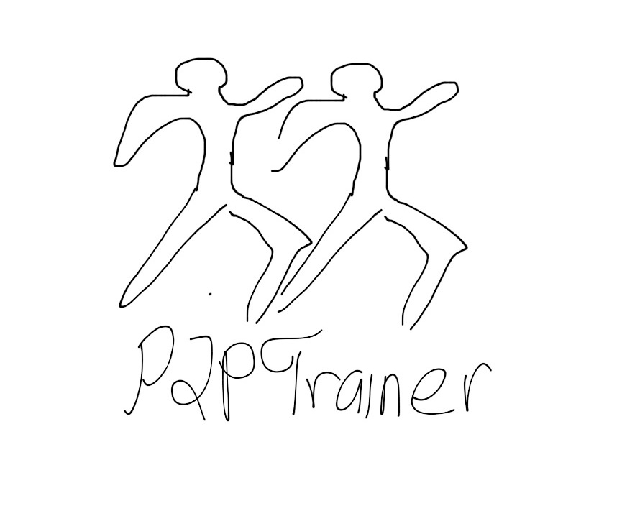
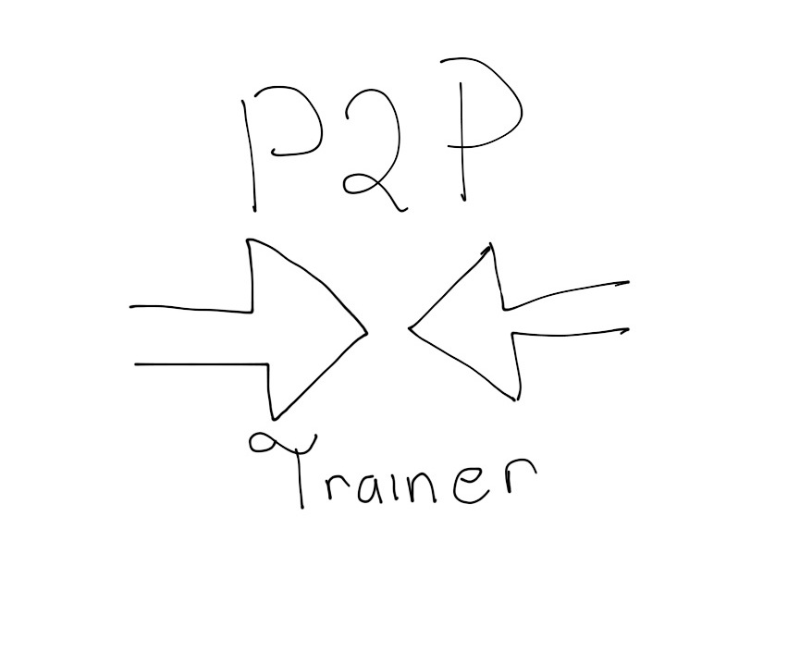
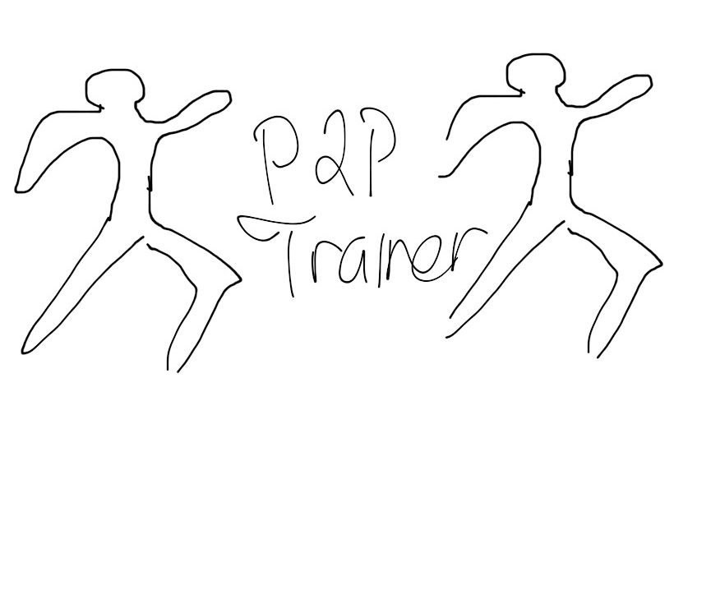
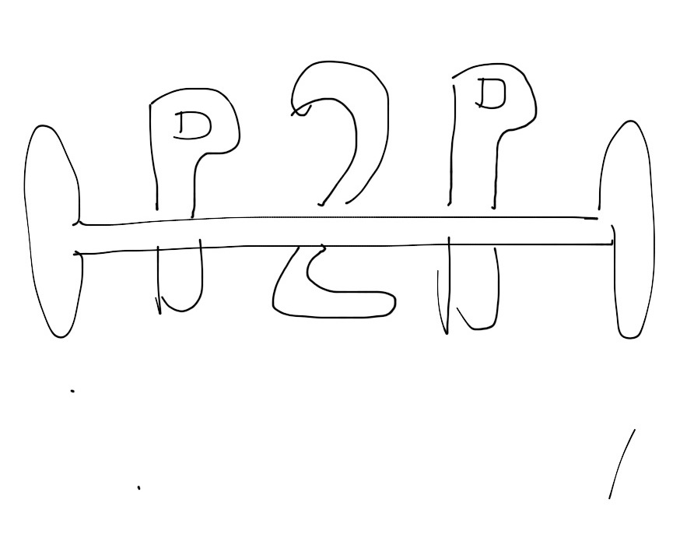
Initial concepts

Slide 4
Enhanced Concepts

Slide 5
Final Logo

