Slide 1
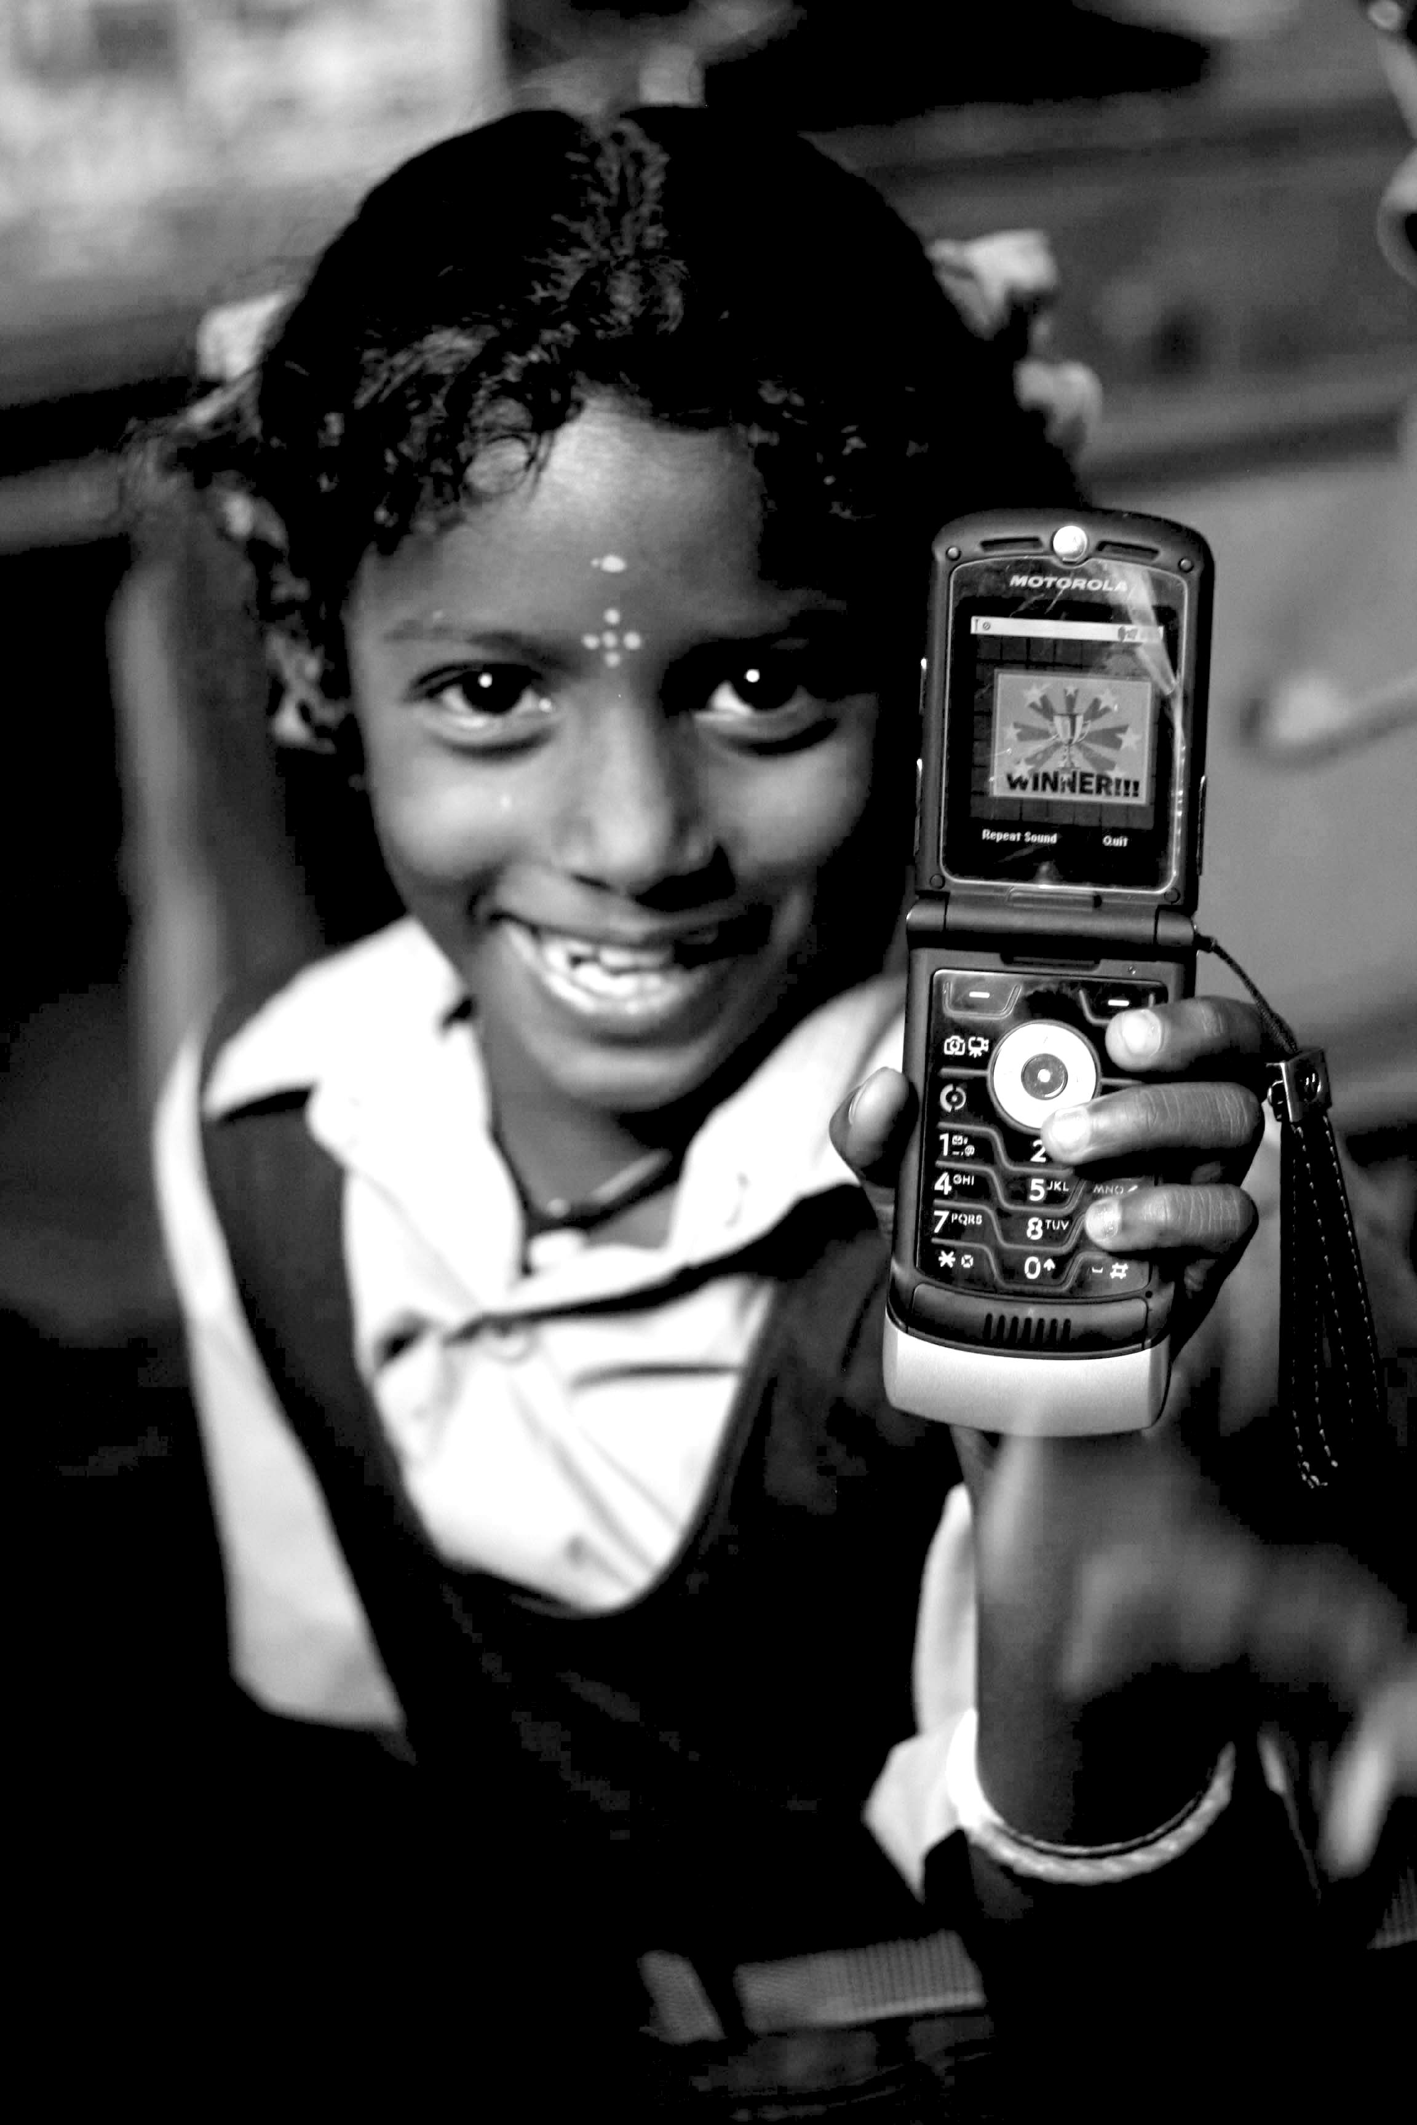
Information Society & Digital Divide
06.05.12
Janaki Srinivasan
Neha Kumar

Slide 2
On Thursday (5/31)
Green Revolution (Review)
Appropriate Technology
Break
Participatory Development
Activity: Discussion of Assignment 1

Slide 3
Administrivia
In Progress: Assignment #1
Graded: Reading Response #1
Soon: Reading Response #1 Answer Key + Reading Response #2
Join: Facebook Group “I181 (Summer 2012)”

Slide 4
Outline for Today
Social Entrepreneurship
Information Society
Break
Digital Divide
Case Study: One Laptop Per Child
Activity: Observing at Sproul

Slide 5
Back to the Timeline
AID REGIME
BASIC NEEDS
STR. ADJ. + WASHINGTON CONSENSUS
NEW INSTITU-TIONALISM
1950
1960
1970
1980
1990
2000
Social Entrepreneurship?

Slide 6
Social Entrepreneurship
View 1: Poor as market
View 2: Emphasizes creativity, ‘giving back’ while engaging market pressures

Slide 7
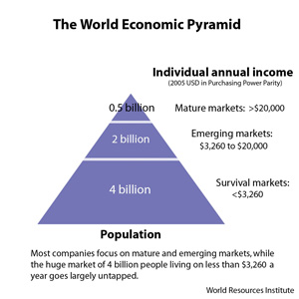
Bottom of the Pyramid Perspective
Poverty premium
Myths about the poor
MNCs and their constant search for new markets
Profit margins vs. market size
“enabling dignity and choice through markets”
Prahalad, C.K., and A. Hammond. (2002). “Serving the World’s Poor, Profitably.” Harvard Business Review, Vol. 80, No. 9, p. 48-57.

Slide 8
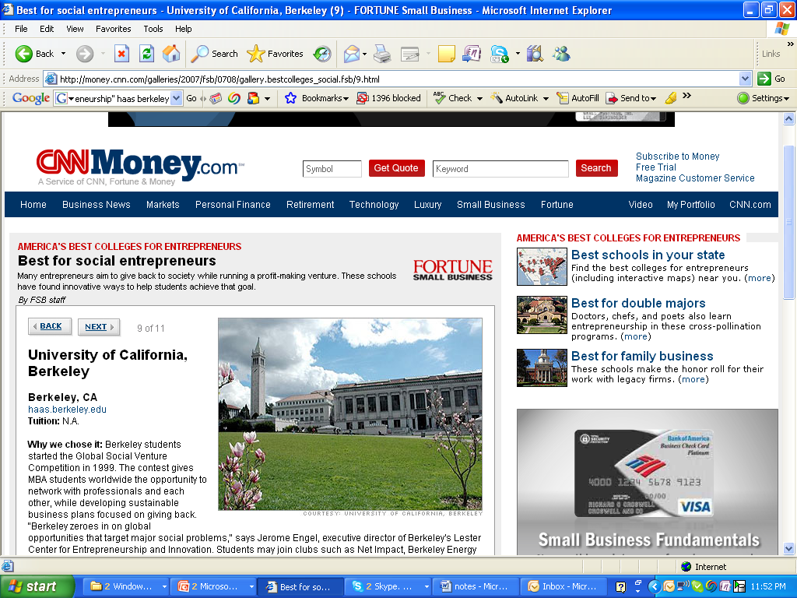
Giving Back while Engaging Market Pressures

Slide 9
Recent Shifts in Development Thinking and Practice
Government aid agencies undergo cuts and criticism
Renewed emphasis on measurement and accountability
Possibility of self-sustaining and even profitable ventures that target poverty

Slide 10
Privatization of Aid
Alternatives to Government- Administered Aid
Corporate foundations (Bill and Melinda Gates foundation, Google foundation)
Private Investors
NGOs and Social Entrepreneurship Organizations (Ashoka, Skoll)

Slide 11
Corporate Foundations
Private funding for development work is not new
What is the distinction between the foundation and the business?
is dedicated to bringing innovations in health and learning to the global community.
aspires to use the power of information and technology to address the global challenges of our age: climate change, poverty and emerging disease

Slide 12
Social Entrepreneurship
Problem solving
Emphasis on innovating - changing the system (rather than optimizing)
Acting through implementation (rather than lobbying or protesting)
vs. traditional entrepreneurship
vs. social service provision
vs. social activism
For more on Social Entrepreneurship, see Bornstein, D. (2007). “The Light in my Head Went On.” in How to Change the World: Social Entrepreneurs and the Power of New Ideas. Oxford University Press. (p. 21-40)

Slide 13
Social Entrepreneurship
Notes:
Source: “social entrepreneurship: the case for definition” Martin & Osberg – Stanford Social Innovation Review

Slide 14
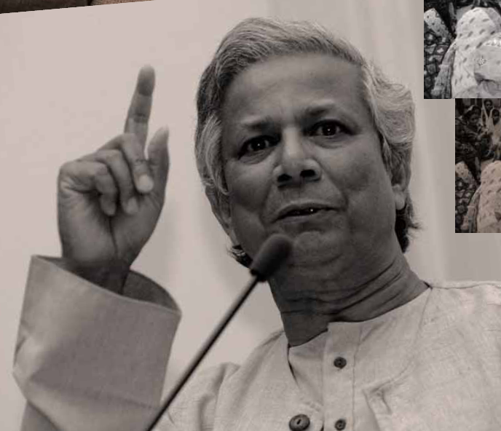
Social Entrepreneurs (as Heroes)
emphasizing their personal qualities (creative thinking, determination)
fighting against the stasis of both government and market domination of big business
The heroic individual: Muhammed Yunus, Grameen Foundation
Notes:
The entrepreneurial personality? Something innate, inborn, unique. This is quite different from the ‘participatory development’ approached that considered anyone capable of analyzing and acting upon their situation to improve it.

Slide 15
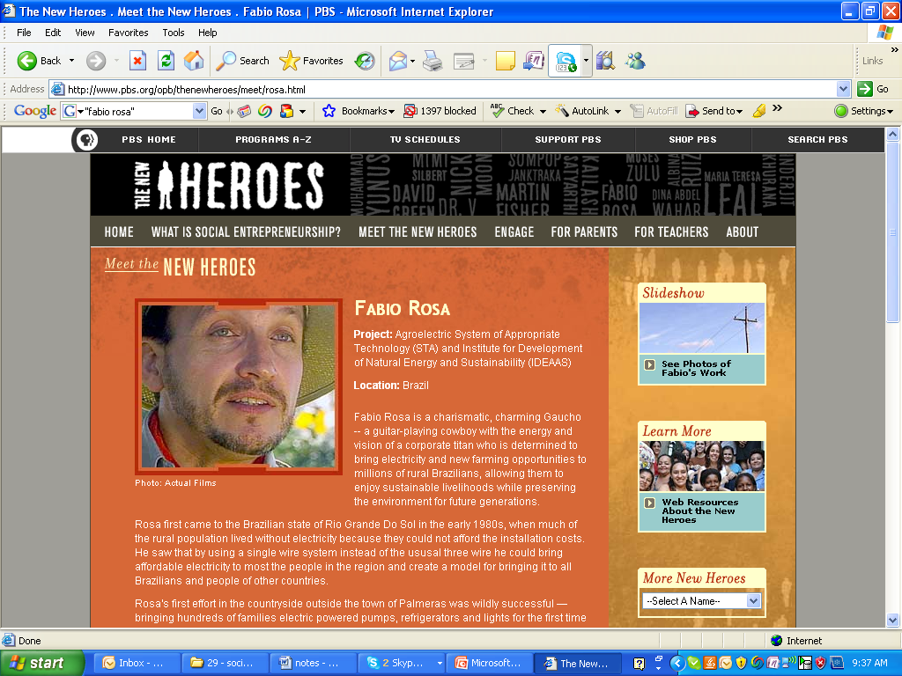

Slide 16
Another Bottom-Up Approach?
Participatory Development | Social Entrepreneurship
Means | Ends
Carried out by the Group | Championed by a tireless individual
‘Socio-cultural animator’ | Entrepreneur
The targeted community are key collaborators | Does not explicitly identify what relationship with targeted community ought to be

Slide 17
Information Society

Slide 18
Eras defined by (technological) innovations
The First Industrial Revolution (18th century) – spinning Jenny, steam engine, transport
The Post-Industrial Society
Information revolution?
The Information Economy
The Second Industrial Revolution (from around 1850) – steel and electricity
The Network Society
The Atomic Age?
Adam Smith
Karl Marx
Daniel Bell
Alvin Toffler
M.U. Porat
Fritz Machlup
Manuel Castells
Notes:
First, there was the agricultural revolution. Then came the two industrial revolutions. And finally now, are we in the midst of an information revolution? Many theorists talk of an information age or society and these discussions implicitly seem to recognize an information revolution. Webster mentions many of these theories. We will take a look at the 6 categories of theories he describes in a bit. But before that, a quick look at some of the influential theories describing the information age.

Slide 19
Post-Industrial Society (Bell)
Defined by: occupational change, an increase in employment in the service sector. [Daniel Bell, The Coming of Post-Industrial Society]
Decline of manufacturing employment (shifted offshore) and rise of service sector and white-collar employment.
A concept that alludes to, but is prior to the way we currently conceptualize information, prior to IT innovations.

Slide 20
Network Society (Castells)
Defined by: “a new technological paradigm, centered around micro-electronics-based, information/communication technologies, and genetic engineering.”
This new age is characterized by the spread of networks linking people, institutions, countries. Increasing integration of global affairs.
Network as causal agent, but also decentralization results in broader empowerment.

Slide 21
Characterizing Information Societies
By technological innovation (Toffler, Negroponte)
By occupational change (Bell, Castells)
By economic value (Machlup, Porat)
By information flows (Castells)
By the expansion of symbols and signs (Poster)
By theoretical knowledge (Stehr, Giddens)
Notes:
Webster describes 6 ways in which info societies have been theorized. By tech innovation
By occupational change- Castells, Bell. These talk about the increase in informational workers
By economic value: more of the ceonomy is dependent on information work than agriculture/manufacturing etc.
By info flows: increasingly, the world is about the flow of information around it. Places are characterized by how well they are linked in a network of information flows.
Culural: or culture now includes interpreting a much wider range of symbols,whether in movies, hoardings, txt messages etc.
Webster points to problems in all these ways. He says he supports a 6th way of characterizing which is about how society now is dependent theoretical knowledge.

Slide 22
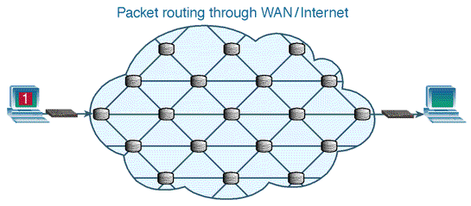
Information Societies
What is information to Info Society theorists?
Influence of Information Theory (a field of applied mathematics)
“the fundamental problem of communication is that of reproducing at one point, either exactly or approximately, a message selected at another point.”
– Claude Shannon, Bell Labs 1948
Notes:
http://www.teach-ict.com/technology_explained/packet_switching/packet.switching.gif
One thing to notice in these info society theories is what each means by information. Second, do they see information as something that has meaning or not.

Slide 23
Information Societies: Criticism
Ignores issues of information quality
More of something (quantitative increase) doesn’t necessarily yield a changing social order (qualitative change
Info-determinism in play?
Centrality of information in society is not new
all societies place central importance on information (Castells, Giddens, Darnton!)

Slide 24
The UN and the Information Society
How is the concept employed by development practitioners?

Slide 25
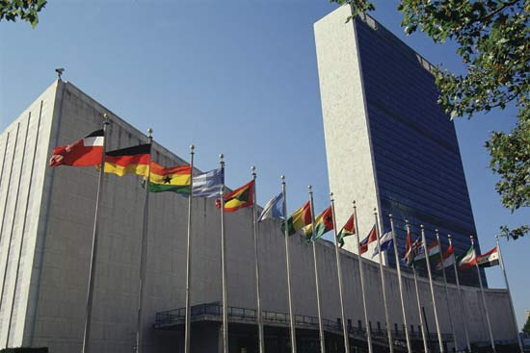
UN World Summits
Earth Summit on Environment and Development (Rio de Janeiro, 1992)
World Conference on Human Rights (Vienna, 1993)
International Conference on Women (Beijing, 1995)
World Summit on the Information Society (Geneva 2003 to Tunis, Tunisia 2005)
Summits serve to launch certain terms/concepts into the global Development lexicon

Slide 26
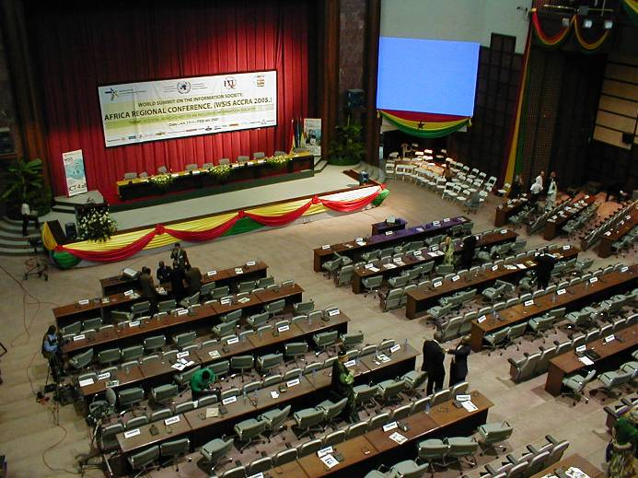
World Summit on the Info Society
“The digital revolution, fired by the engines of ICTs, has fundamentally changed the way people think, behave, communicate, work and earn their livelihood…”
“our common desire and commitment to build a people-centred, inclusive and development-oriented Information Society…”
From the WSIS website
WSIS Africa regional conference, Accra Conference Center February 2005

Slide 27
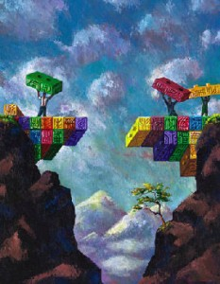
The Digital Divide
Notes:
When we think about the digital divide, the most common way of thinking about it is that it’s a demarcation – a line that we draw between the haves and have-nots. …is generally the difference in percentage of individuals with access to digital technologies. And it often correlates with gender, race, geographic location, caste, class, education level, and/or income.

Slide 28
Not One But Many
Rich, educated, powerful vs. not
Linguistic and cultural
Rich nations vs. poor
Emergence of the digerati

Slide 29
Redefining ‘Access’
Using the Internet anywhere
Using the Internet at home
Using the Internet at home with a high-speed connection

Slide 30
Leapfrogging
Assumes that there are a series of developmental steps generally taken in a particular order. Leap-frogging is an act of skipping over one of these steps.
The idea that ICTs allow nations to skip over an Industrialization phase that never happened despite the efforts of the 1950s and 60s.
Why Developing Regions, Why Now?
The burden of existing infrastructure (as in affluent nations) can block the uptake of better, competing innovations and/or prevents adoption among users
ICTs have advantageous properties – 1) low polluting 2) low capital investment

Slide 31
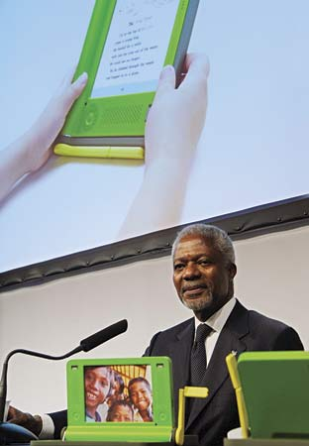
Leapfrogging
“This (information) technology is far less capital-intensive than old industrial technology, and therefore may enable poor countries to leapfrog some of the long and painful stages of development that others had to go through. …many developing countries are already showing the way...” – Kofi Annan at the G77 South Summit (Havana, Cuba)

Slide 32
Doubts
ICT is not one thing – questions about the sensibility of grouping various objects by common technological base (in this case the microchip)
Information Treated as Homogeneous
Lessons of the past forgotten? – the appropriate technologies movement. Emulation of the West vs. local relevance.
Digital Divide trains our attention on the negative space
Notes:
“looks through rather than at the object at hand” - Larkin

Slide 33
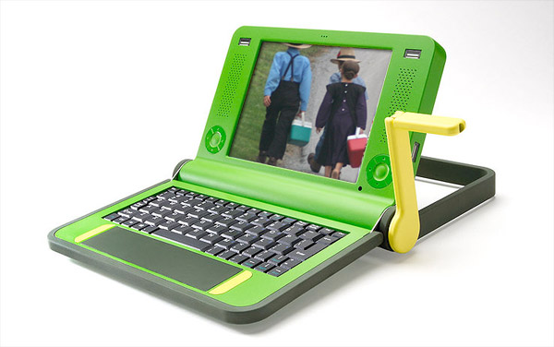

Slide 34
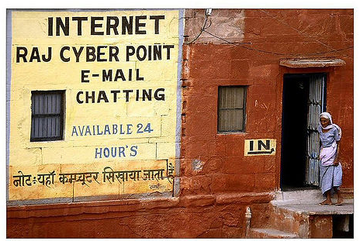
Approaches to Resource Scarcity
Notes:
Public access – pay per use. Adapt existing machines, but multi-user set-up
Low-cost computers – new machines, single-user model

Slide 35
About the OLPC
Targets the individual child
Embodies the constructionist theory of learning [Papert, Kay]

Slide 36
Arguments FOR
“Traditional education has failed in these locations. Incremental increases will not solve the problem.”
“Laptops increase interest in traditional schooling.”

Slide 37
Design Goals
Design for Ruggedness
Design for Repair and Maintainability
Design for Scarcity

Slide 38
Design Issues
What parts of a conventional laptop consume the most electricity?
What parts of a laptop present pollution and toxicity concerns?
What parts of a laptop are most likely to fail?

Slide 39
PROBLEM | OLPC SOLUTION
Bright sunlight | Dual-mode display
Dust, dirt, rough roads… | Enclosed keyboard, cooling system without vents, solid state memory
Lack of infrastructure (limited electricity and repair/maintenance) | Built in surge-protector, human-power generation, components consume less energy, easy to take apart
Low-income levels – among the citizenry and small education budgets | Easy to take apart and replace parts. Low-cost overall ($100 target).

Slide 40
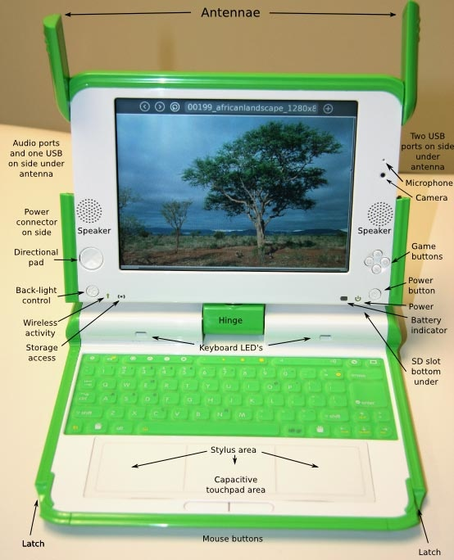

Slide 41
Dual-Mode Display
In Black-and-White mode, is reflective
In color mode, uses a backlight
In the future, e-ink maybe?

Slide 42
Dust, Dirt, Heat, Children
Ports covered by WiFi antennae
No gaps in keyboard
Constrained cooling system
Flash memory

Slide 43
Power Issues
Human power option
Longer lasting battery
Built-in surge protection

Slide 44
Maintenance
Designed for easy disassembly and replacement of parts
Does not require trained service people

Slide 45
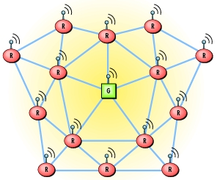
Mesh Networking
Peer-to-peer OLPC connections
Serve as routers
On 24x7

Slide 46
Deployment

Slide 47
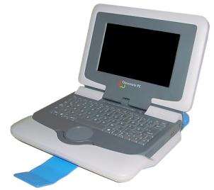
Distribution
Intel’s classmate PC
Aiming at Economies of Scale
Distributed through governments (ministry of education) to bypass markups from the supply chain.
No country has committed to the 1 million minimum (max order is 202,000 in Uruguay)
OLPC
Notes:
[source ]

Slide 48
Appropriate Technology
Philosophy | Rule
Self-sufficiency - no dependence on imports or production of exports (to avoid large-scale conflict) | Artifacts built and maintained using local materials and skills. Capital investment is minimal.
Restrained consumption - no tax on natural resources (to avoid small-scale conflict) | Energy efficient, conservation-oriented
Development in place - bring workplaces to where people are living (rather than moving them) | Decentralized, a multitude of small versions rather than one BIG thing
People need creative and meaningful work. | Tools that facilitate entrepreneurship?

Slide 49
Distribution Woes
Since 2006:
India opts out – ministry spokesperson says –
“India must not allow itself to be used for experimentation with children in this area… It would be impossible to justify an expenditure of this scale on a debatable scheme when public funds continue to be in inadequate supply for well-established needs listed in different policy documents.”
The Intel Controversy
Plagued by weak sales
Microsoft decision, selling out the Open Source principle?

Slide 50
Distribution: New Tactics
Americans can purchase OLPC devices for $399
OLPC Corps in Africa – distribute/guide/train
OLPC as part of a class curriculum

Slide 51
analysis

Slide 52
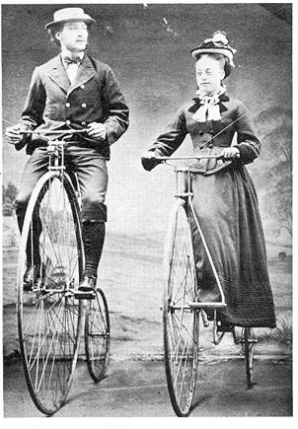
Lessons from SCOT
Different Relevant Social Groups can have divergent views.
Tech development is a drawn-out and socially embedded process.

Slide 53
Remember these?
Technological Determinism – what is the story that is told about the origins of this artifact/system/process?
Relevant Social Groups – What groups have a stake in the development, diffusion, and use of the technology in question?
Interpretive Flexibility – Are there differences of opinion about whether the technology is ‘working’or not? What priorities, concerns, interests are revealed by these different interpretations?
Closure – Was there a debate about the technology that was resolved? How was it resolved?
Black-boxing – What elements of infrastructure are being overlooked? What are the necessary components to keep this system functional?

Slide 54
Appropriate Technology?
YES
NO
Self-sufficiency: Designed for local serviceability
Conserves power
Compatible with the physical, economic environment
Economies of scale, one size fits all – BIG is beautiful
Does not improve livelihoods
Not a simple object

Slide 55
Models of Development
 | OLPC
What/Who is being developed
Proximate change (short-term) to be brought about
The eventual outcome or development to accomplish
Mechanism for bringing about this change

Slide 56
Models of Development
 | OLPC
What/Who is being developed | Kids (elementary school age) [not schools, teachers]
Proximate change (short-term) to be brought about | Smarter, more creative, problem-solving children
The more distant outcome/development to accomplish | Possibly a better more-educated labor force? A new generation that can solve the countries’ problems in unique ways?
Mechanism for bringing about this change | Distribution of a special kind of inexpensive, durable laptop with software that will bring about this evolution/education of children

Slide 57
Further Reading
OLPC news: http://www.olpcnews.com/
OLPC website: http://laptop.org/
OLPC wiki:http://wiki.laptop.org/go/The_OLPC_Wiki
Other Readings: Alan Kay, Seymour Papert, and Nicholas Negroponte’s Being Digital; Oppenheimer’s The Flickering Mind; Easterly’s The White Man’s Burden

Slide 58
On Thursday (5/7)
Lecture: Making Technologies Accessible
Guest Lecture by Christo Sims
Due: Readings (Corbett, Gee, Cockburn, Kuriyan and Kitner)
Due: Reading Response 3
Time to work on Assignment 1

