Slide 1
Technology
and
Poverty

Slide 2
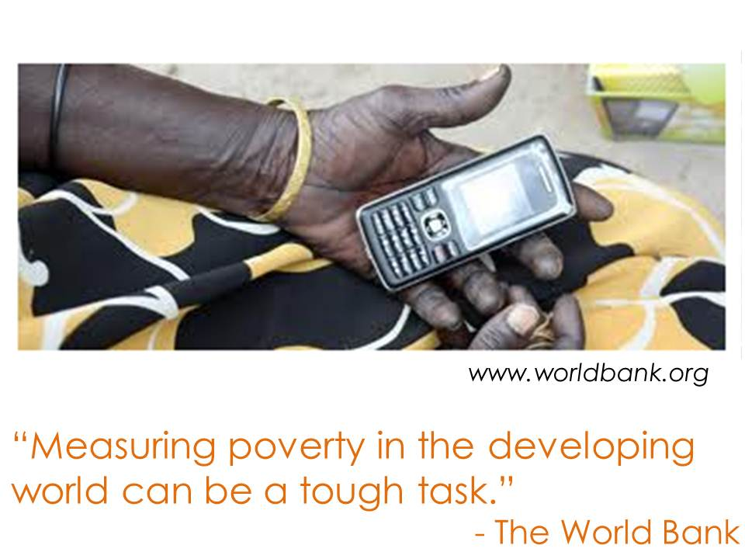
Notes:
Alejandra

Slide 3
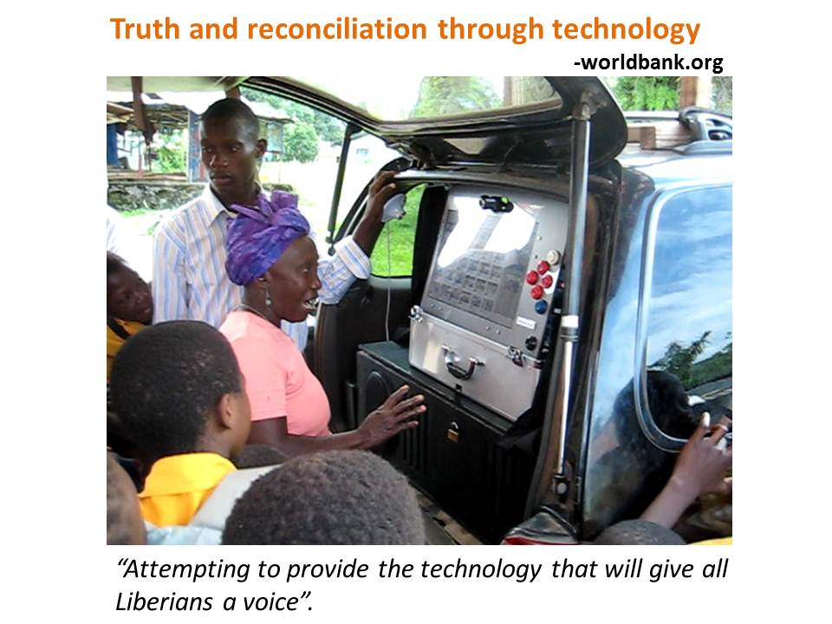
Notes:
Nelda

Slide 4
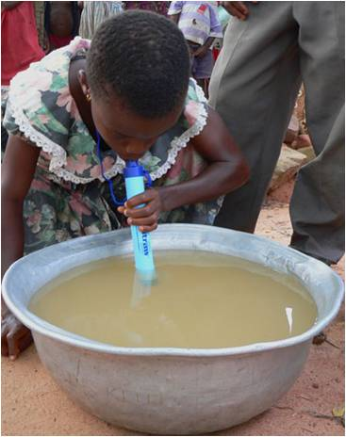
Technology allows poor people to have easier access to vital needs - a life straw.
Notes:
Rogelio

Slide 5
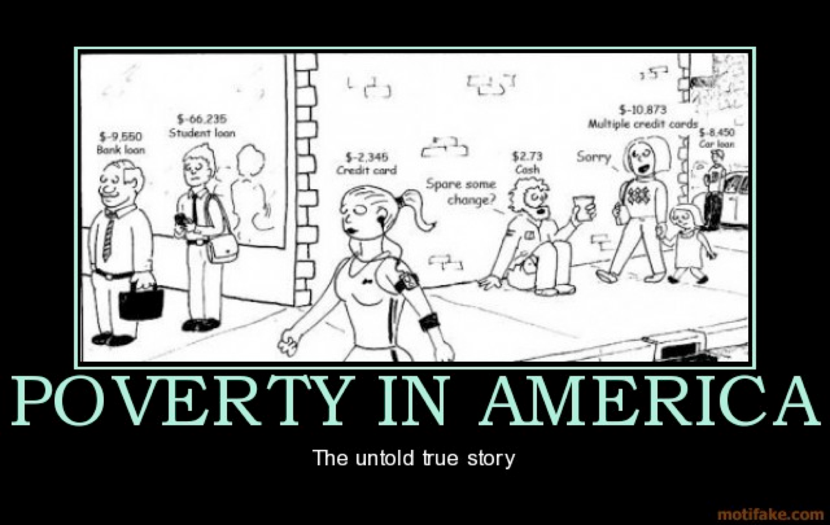
Developed Country
Notes:
Perrie

Slide 6
Developing Country
Sanjit "Bunker" Roy has found a better way to solve poverty: train
women as engineers so they can transform their villages

Slide 7
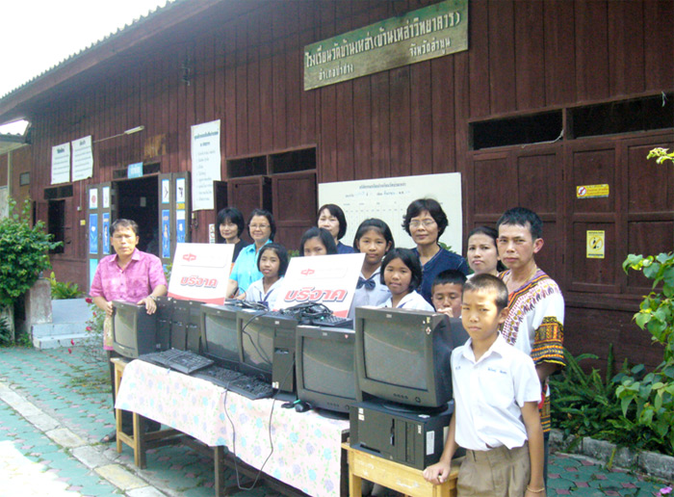
Wat Ban Lao Elementary School in Thailand was donated some computers by Chuo Senko
Company. These computers, which are too expensive for the school and students to purchase,
can help the students there understand the world better. This is how technology could help
to alleviate the poverty.
Notes:
Yiwen Luo

Slide 8
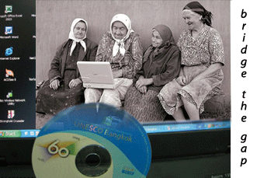
http://ccit333.wikispaces.com/Digital+Divide
This image symbolizes in my view two aspects:
Women – of all ages! – have an important role for the reduction of poverty and especially for the equal distribution of household income. Technology therefore needs to be available for all kinds of users, not only for the young high potentials.
Computers are not only means for communication or game machines, but also calculation machines (!). The use of computers is therefore not only important to connect people to each other, but will also help them, for example, to establish a business plan for the start of a small business, this, as well, very important for women in poorer regions of the world.
Notes:
Caterine

Slide 9

ONE LITER OF LIGHT: A SIMPLE SOLUTION TO A BIG PROBLEM
Notes:
Jesha

Slide 10
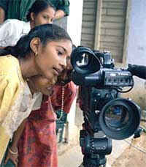
Poor people always have few opportunities to
get access to the latest technology. This
prevents the poor to adopt the technologies
that will improve their livelihoods.
Notes:
Liu Qinglai

Slide 11
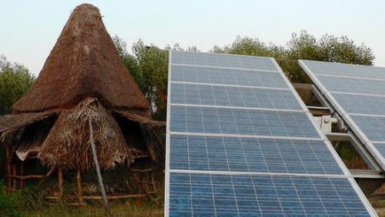
Poor rural use solar power generation technology
Notes:
Sunyi

Slide 12
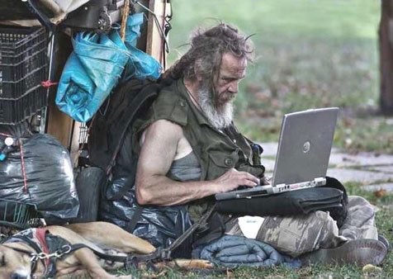
Contrast
Notes:
Sarahi

Slide 13
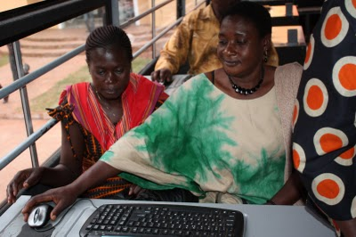
This picture shows the free computers and the internet education in the slums.
Technology plays an important role on the reduction of poverty; technology has
enabled the population to contribute to the world economy as producers of
knowledge, information and services.
Notes:
92824 Teng

Slide 14
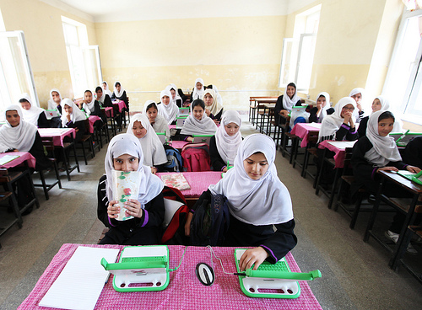
This is a picture of students in Kabul using One Laptop Per Child’s tablet computer.
We can see with technology develops, computers which are low-cost can be produced
and people who cannot afford a normal PC or IPAD can have similar experience now.
Also more children around the world will have a better chance at self-empowering,
computer-based learning.
Notes:
Alex – Yuzhe Zhang

Slide 15
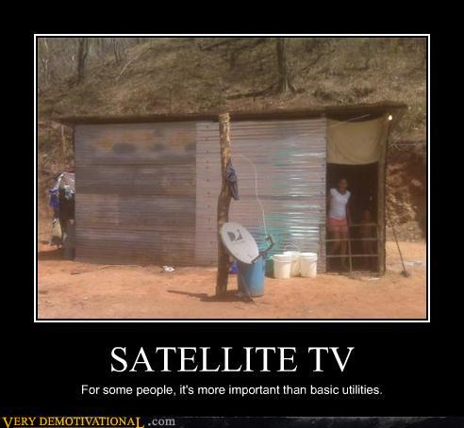
Notes:
eeweng

Slide 16
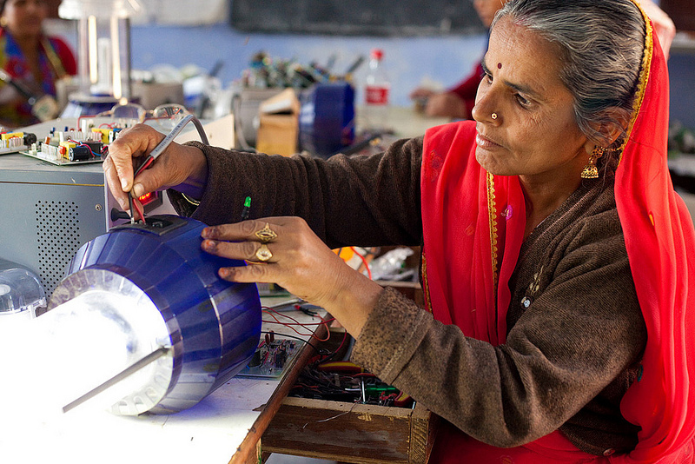
Tilonia India, Barefoot College -
From September 2011 to the following March, women travelled from across Africa, from countries like Uganda Liberia and South Sudan, to take part in training to become solar engineers.
Each was selected or nominated by her local community and supported by a variety of local and international organisations, and in some cases, their governments. Their trainers, who mostly speak Hindi, must cut across linguistic and cultural barriers using gestures and signs.
Notes:
bianca

Slide 17
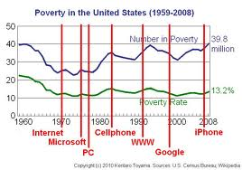
The technology is incredible, but the intent is not there.
Notes:
elisa

Slide 18
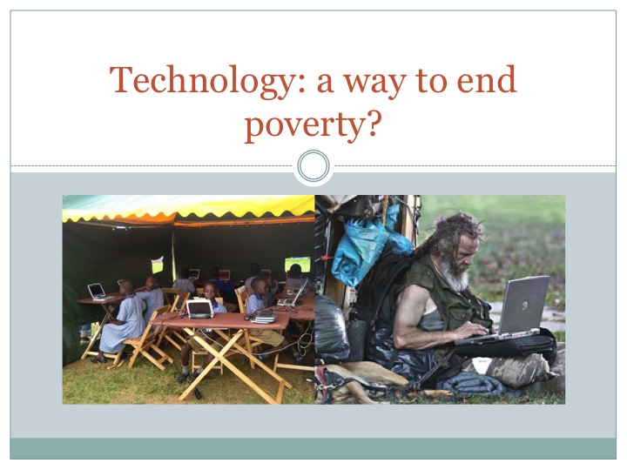
Notes:
daniela

Slide 19

Notes:
melissa

Slide 20
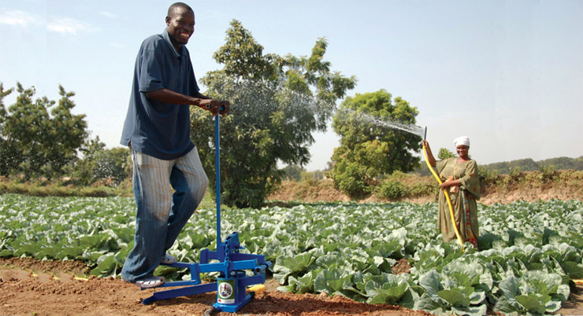
The Super MoneyMaker Pressure Pump was launched in October 1998, in
response to a demand by farmers for a pump that can push water uphill as
well as simply pulling it up from the source. This means it is suitable
for use on steeply sloping land where the water source may be at the
bottom.
Notes:
frankie

Slide 21

While there are much highways with cars, symbolizing forms of technology,
there is also poverty, in this case, refers to the homeless.
Notes:
Tang wan xuan

Slide 22
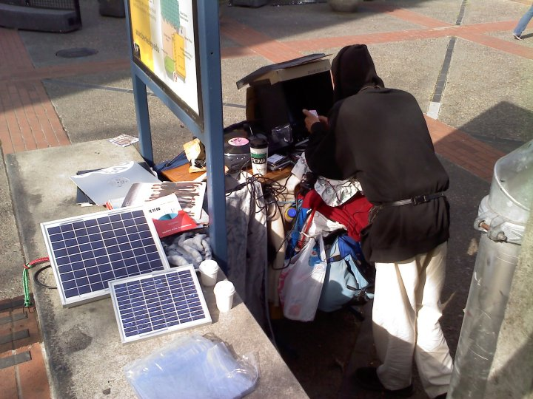
DJ Homeless
Notes:
marc

Slide 23

Though there are a lot of people who are in poverty,
I think technology sometimes can be a way to solve the
problem and save the poor.
Notes:
weiwei

Slide 24
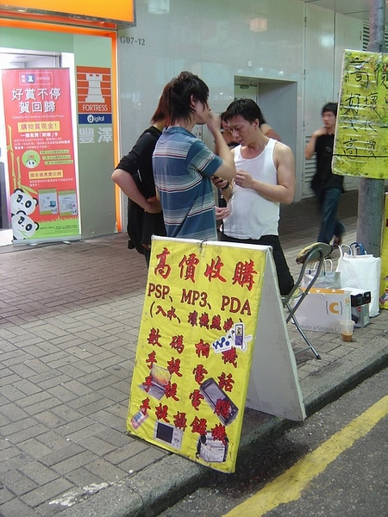
Used Phone Dealer in Hong Kong
Notes:
happy

Slide 25
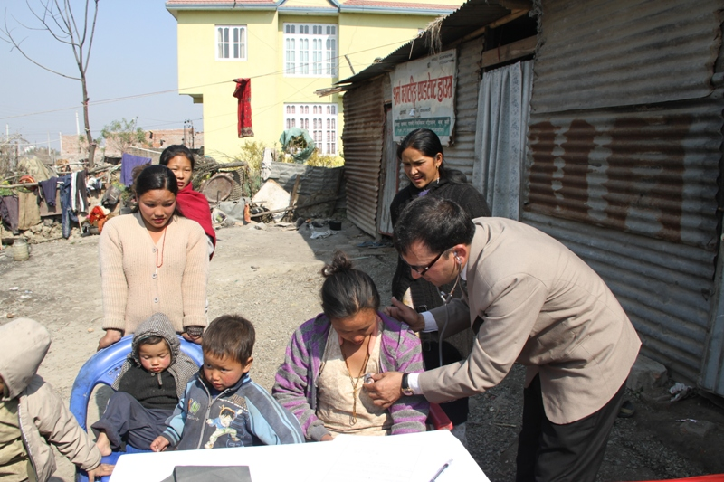
Providing better health services for waste workers: Dr. Acharya checking a young mother.
Notes:
liu

Slide 26
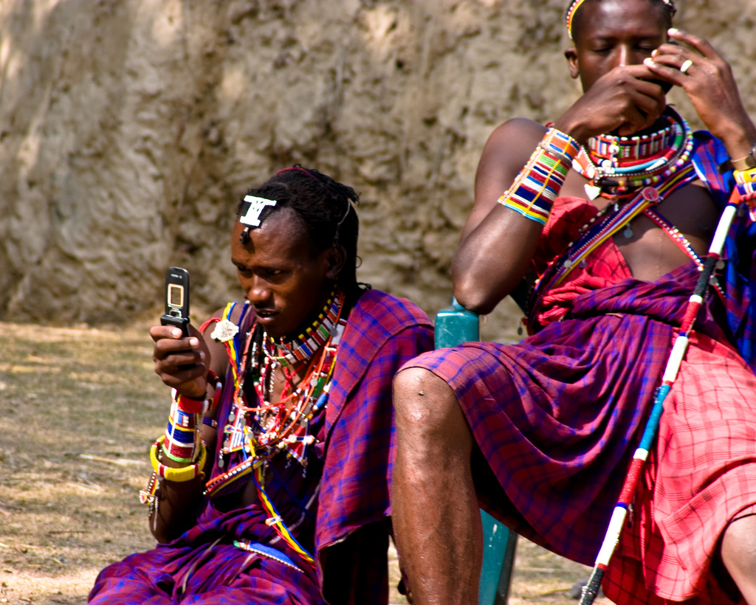
Africa is currently the second biggest market for mobile in the world.
Notes:
Jing Li

Slide 27
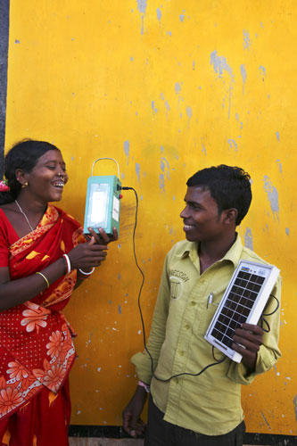
In the India east remote village, solar energy lamps are supported to develop.
Government taught the poor and illiterate to use the solar energy generator instead of kerosene.
Notes:
Zhang meng

Slide 28
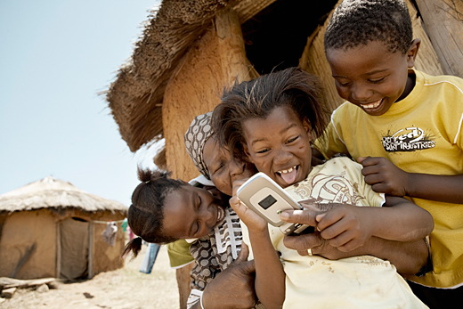
This picture shows some poor children are playing with a telephone and laughing happily. The impact of technology on these children is very important. When they know that the technology is so amazing and useful, they will try to know more and want to get more, and these will become their motivation to get out of poverty.
Notes:
huiying

