Slide 1
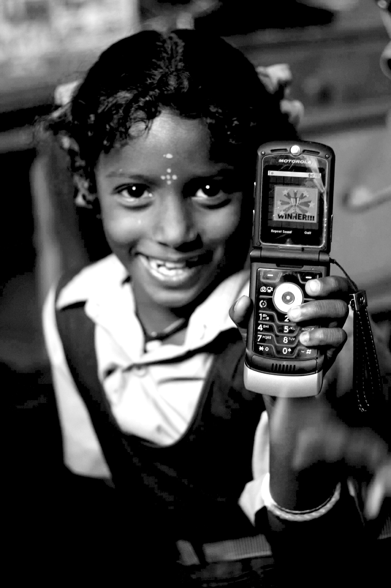
Citizen Media
06.19.12
Janaki Srinivasan
Neha Kumar

Slide 2
On Thursday (6/14)
Presentations!

Slide 3
Administrivia
Grading: Assignment #1
Graded: Reading Response #1, #2, #3
Soon: Reading Response #4
In Progress: Assignment #2

Slide 4
Outline for Today
Presentations for South Africa
Break
Discussion of Assignment #1
Citizen Media
Activity: Community Radio Show

Slide 5
Assignment #1
Micro Analysis: 10
Macro Analysis: 10
Connections between Micro and Macro: 5
Presentation: 5
Grades:
25-30: A+, 19-24: A, 13-18: A-, 7-12: B+, 1-6: B
Notes:
And within each, we are looking for depth of analysis and understanding.

Slide 6
Assignment #1-Feedback
Sources and citation practices, especially macro-analysis
Wikipedia
PBS country websites?
Staying close to the narrative for micro-analysis
Of incomes, but also of intangibles?
Individual costs and benefits
Making connections between macro and micro picture
Technology?
Documents as technology?
Notes:
Intangibles
Mark Mathabane’s father’s humiliation at being beaten in front of his kids
Biu’s desire to not depend on anyone
Min’s growing authority and voice in her family- contrary to a traditional age-based hierarchy, a desire to see the world
Crossing Over- spending on graves, on the fiesta in spite of the lil income they had
Indv, costs and benefits
The income from migration vs. working conditions+missing home
Missing home vs. freedom from some traditions in the new land
Biu- the love for being pregnant/having children vs. being unable to keep them alive
Macro-micro connections
How people’s trajectories diverge as a consequence of macro policy /circumstances + indv values and agency
Hukou system- how consequential to Min?
Apartheid policies- how shaped Mark’s life?
Plantation work/colonisation/patriarchy- how affected Biu’s and Tonieta’s lives?
Nafta- how affected migrant’s lives?
Imp of documents
The pass in SA
Papers to be a legitimate worker in Brazil
Regn card/ over 18- in china
Legal migration papers- Mexico

Slide 7
Design Goals
Design for Ruggedness
Design for Repair and Maintainability
Design for Scarcity
Notes:
Design for Ruggedness (environmental context)
Design for Repair and Maintainability
Design for Scarcity
Build a Better Laptop!

Slide 8
About the OLPC
Targets the individual child
Embodies the constructionist theory of learning [Papert, Kay]
Notes:
Targets the individual child (raising various equity issues)
Embodies A Theory of Learning – constructionist learning (Papert, Kay) -- Through exploring rich tools, children can teach themselves. Children with laptops, “swim like fish, play them like pianos.”

Slide 9
Arguments FOR
“Traditional education has failed in these locations. Incremental increases will not solve the problem.”
“Laptops increase interest in traditional schooling.”
Notes:
Traditional education has failed in these locations - incremental increases (more teachers, more books, “more of the same”) will not solve the problem.
Laptops increase interest in traditional schooling (Negroponte observes in Cambodia)

Slide 10
Design Issues
What parts of a conventional laptop consume the most electricity?
What parts of a laptop present pollution and toxicity concerns?
What parts of a laptop are most likely to fail?

Slide 11
PROBLEM | OLPC SOLUTION
Bright sunlight | Dual-mode display
Dust, dirt, rough roads… | Enclosed keyboard, cooling system without vents, solid state memory
Lack of infrastructure (limited electricity and repair/maintenance) | Built in surge-protector, human-power generation, components consume less energy, easy to take apart
Low-income levels – among the citizenry and small education budgets | Easy to take apart and replace parts. Low-cost overall ($100 target).

Slide 12
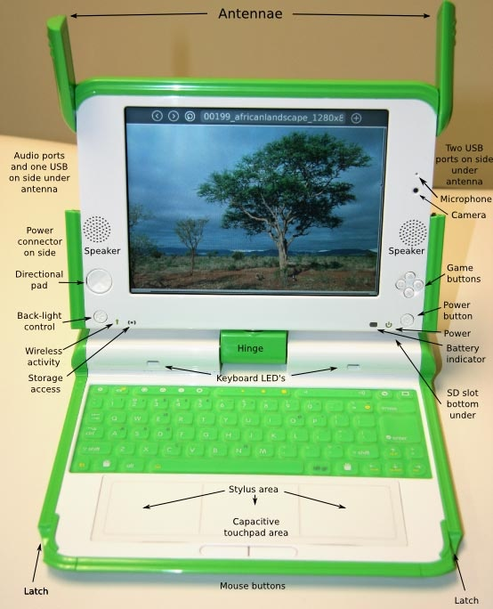

Slide 13
Dual-Mode Display
In Black-and-White mode, is reflective
In color mode, uses a backlight
In the future, e-ink maybe?

Slide 14
Dust, Dirt, Heat, Children
Ports covered by WiFi antennae
No gaps in keyboard
Constrained cooling system
Flash memory
Notes:
The ports are covered by WiFi antennae, no gaps in keyboard – there is a constrained cooling system to prevent dust and dirt from getting in. Flash memory to protect against dropping

Slide 15
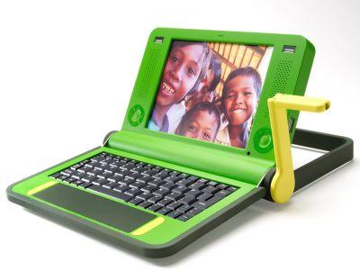
Power Issues
Human power option
Longer lasting battery
Built-in surge protection
Notes:
Human power option (so far unfulfilled)
Longer-lasting battery – 2000 battery (recharging) cycles as opposed to the typical 500 (accomplished?)
Built in surge protection - designed to cope with low-quality power (spikes from AC generators)

Slide 16
Maintenance
Designed for easy disassembly and replacement of parts
Does not require trained service people
Notes:
A very compact design makes conventional laptops extremely difficult to disassemble requiring an infrastructure of trained service people
OLPC is designed for easy disassembly and replacement of parts

Slide 17
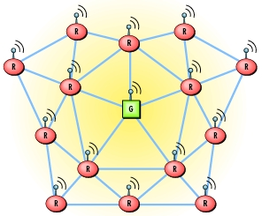
Mesh Networking
Peer-to-peer OLPC connections
Serve as routers
On 24x7
Notes:
If one OLPC is connected to the Internet any other OLPCs in range will be able to connect peer-to-peer
OLPCs do double duty as routers
Switched off when battery life gets low otherwise on 24 hours a day
Power issues?
image source: http://machinedesign.com/ContentItem/61196/IndustrialSensingthewirelessway.aspx

Slide 18
Deployment

Slide 19
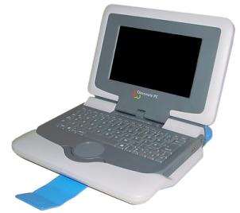
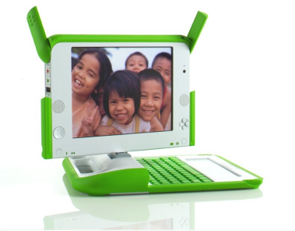
Distribution
Aiming at Economies of Scale
Distributed through governments (ministry of education) to bypass markups from the supply chain.
No country has committed to the 1 million minimum (max. order is 202,000 in Uruguay)
Intel’s classmate PC
OLPC
Notes:
[source ]

Slide 20
Appropriate Technology
Philosophy | Rule
Self-sufficiency - no dependence on imports or production of exports (to avoid large-scale conflict) | Artifacts built and maintained using local materials and skills. Capital investment is minimal.
Restrained consumption - no tax on natural resources (to avoid small-scale conflict) | Energy efficient, conservation-oriented
Development in place - bring workplaces to where people are living (rather than moving them) | Decentralized, a multitude of small versions rather than one BIG thing
People need creative and meaningful work. | Tools that facilitate entrepreneurship?
Notes:
Although originally the ideal seemed to be tools to support ‘craft’ rather than automation.

Slide 21
Distribution Woes
Since 2006:
India opts out – ministry spokesperson says –
“India must not allow itself to be used for experimentation with children in this area… It would be impossible to justify an expenditure of this scale on a debatable scheme when public funds continue to be in inadequate supply for well-established needs listed in different policy documents.”
The Intel Controversy
Plagued by weak sales
Microsoft decision, selling out the Open Source principle?
Notes:
Ultimately the number of laptops out there is well below the target set by the team – way below. It hasn’t been easy to get governments to commit.
India notably opts out of the program with some sharp words. Libya commits to 1.2 million, but scales back considerably. Then switches to Intel’s classmate PC.
Intel Classmate PCs, by contrast, sold at a significantly higher price (around $350) and through sales offices, the ordinary supply chain approach.
the Intel controversy – briefly partnered in 2007 – Intel contributed several million dollars and they were going to collaborate on an OLPC with an intel chip inside – but went separate ways shortly thereafter. Negroponte suggested that Intel was selling their own laptop (the Classmate PC) at below cost – a conspiracy to prevent the OLPC from getting into the hands of children. Even seen as an attempt to destroy the whole market. See 60 minutes about that.
Intel salespeople were doing side by side comparisons of the devices, trying to convince government officials to buy the Classmate PC instead of the OLPC. But also claiming that having Intel people inside the OLPC organization meant they knew that the OLPC project was in trouble.
Intel says that OLPC was asking them to stop selling Classmate PCs and to stop all dealing with any low-cost laptop maker. The Intel spokesperson said they believed that there was no single way to get laptops into the hands of poor children.

Slide 22
Distribution: New Tactics
Americans can purchase OLPC devices for $399
OLPC Corps in Africa – distribute/guide/train
OLPC as part of a class curriculum
Notes:
Americans can purchase OLPC devices for $399, keep one and the other is given to a child in a developing region (80,000 distributed)
OLPC Corps in Africa – not only distribute but guide and train
OLPC as part of curriculum / classroom

Slide 23
analysis

Slide 24
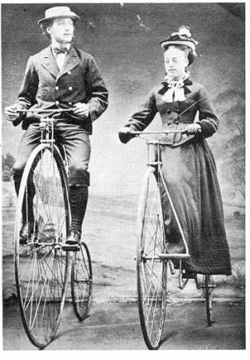
Lessons from SCOT
Different Relevant Social Groups can have divergent views.
Tech development is a drawn-out and socially embedded process.
Notes:
Here we have lots of relevant social groups, although only a few are being treated as legitimate. One possibly is children in poor, resource-scarce communities (though they aren’t really consulted). Ministries of education is another (have to be convinced to shell out the money). But also teachers, parents (concerned citizens!) marginalized (initially) from the project.
Two: the more normal process of tech development is this continual refinement, piece by piece, a negotiation between local social groups - their interests and the developers’. Negroponte presents a caricatured view of how technology succeeds and takes hold – that simply doesn’t map to much of the history of tech development. For him, it is designed, planned, perfected and then unleashed upon a user population. “the days of pilot projects are over” he asserts in his TED talk

Slide 25
Remember these?
Technological Determinism – what is the story that is told about the origins of this artifact/system/process?
Relevant Social Groups – What groups have a stake in the development, diffusion, and use of the technology in question?
Interpretive Flexibility – Are there differences of opinion about whether the technology is ‘working’or not? What priorities, concerns, interests are revealed by these different interpretations?
Closure – Was there a debate about the technology that was resolved? How was it resolved?
Black-boxing – What elements of infrastructure are being overlooked? What are the necessary components to keep this system functional?
Notes:
Technological determinism – is it described as the latest item in the inevitable march towards progress? Is it considered to be a product of science? Does it originate in a U.S. laboratory or a village in India?
Relevant social groups – defining one group as distinct from another can be tricky. For example in the lecture on the Green Revolution – one thing we will consider for sure is the way that different farmers form separate social groups. Farmers with 1-2 acres are one relevant social group -- farmers with 10+ acres are another. A mistake to treat all farmers as a single relevant social group. You can bet there are some differences of opinion about whether these modern farming practices are working or non-working technologies. In this way we can address questions of equity in access to a technology. The same technology can impoverish some while enriching others. How does that happen?

Slide 26
Appropriate Technology?
YES
NO
Self-sufficiency: Designed for local serviceability
Conserves power
Compatible with the physical, economic environment
Economies of scale, one size fits all – BIG is beautiful
Does not improve livelihoods
Not a simple object
Notes:
In what ways is the OLPC an appropriate tech? In what ways is it not?
In Peru, that made a full order of laptops (not a pilot) “students who once said they expected to be farmers like their parents are now dreaming of becoming lawyers, accountants, or engineers” from a Business Week article on the OLPC.
The technology comes to them - where they are (does not force mass migration as a dam or factory would) - but does it promote development ‘in place?’
Also it’s not simple. It uses microprocessors - one of the least simple technologies in existence, typically not made of materials that are provisioned locally. Maintenance and repair issues can also be difficult.

Slide 27
Models of Development
 | OLPC
What/Who is being developed
Proximate change (short-term) to be brought about
The eventual outcome or development to accomplish
Mechanism for bringing about this change
Notes:
Ask (1) what/who is being developed, the unit (2) what proximate change is to be brought about – smarter, more adaptable, creative, problem-solving children through laptops? (3) the (possibly) more distant outcome – a better educated labor force one day? A new generation that can solve the countries problems in unique ways? (4) the mechanism for bringing about this change – a laptop distribution program.

Slide 28
Models of Development
 | OLPC
What/Who is being developed | Kids (elementary school age) [not schools, teachers]
Proximate change (short-term) to be brought about | Smarter, more creative, problem-solving children
The more distant outcome/development to accomplish | Possibly a better more-educated labor force? A new generation that can solve the countries’ problems in unique ways?
Mechanism for bringing about this change | Distribution of a special kind of inexpensive, durable laptop with software that will bring about this evolution/education of children
Notes:
Characterizations: technologically-determinist. One size fits all. De-centralized.

Slide 29
Further Reading
OLPC news: http://www.olpcnews.com/
OLPC website: http://laptop.org/
OLPC wiki:http://wiki.laptop.org/go/The_OLPC_Wiki
Other Readings: Alan Kay, Seymour Papert, and Nicholas Negroponte’s Being Digital; Oppenheimer’s The Flickering Mind; Easterly’s The White Man’s Burden

Slide 30
Take a break!

Slide 31
Assignment 2 - Outline
General Topic
Expected sources to draw from
What questions (2-3 max) will you address in your paper?
What primary argument or claim do you expect to make in your final paper?

