Slide 1
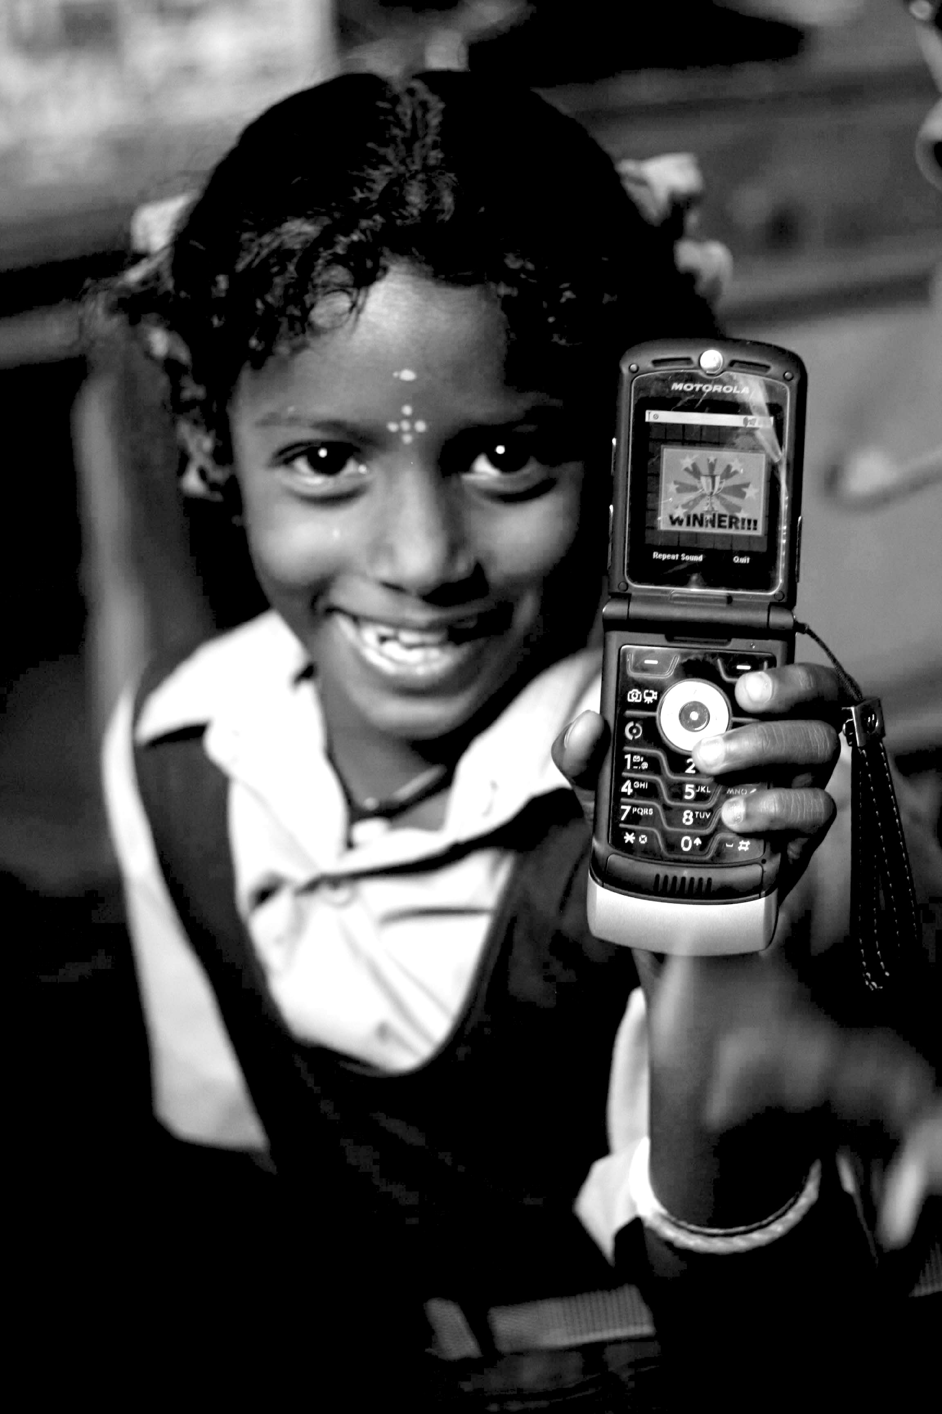
Bridging the ‘Digital Divide’: Public Access Models
06.07.12
Janaki Srinivasan
Neha Kumar

Slide 2
On Tuesday (6/5)
Social Entrepreneurship
Information Society
Break
Digital Divide
Case Study: One Laptop Per Child
Activity: Observation and Interview exercise at Sproul Plaza

Slide 3
Administrivia
In Progress: Assignment #1
Graded: Reading Response #2, Green Revolution debate
Due today: Reading Response #3

Slide 4
Outline for Today
Guest Lecture by Christo Sims on the use of digital technologies in a school in NYC
Break
Gender and class in accessing digital technologies in public access projects
Discussion of Sproul Plaza activity
Time to work on Assignment 1

Slide 5
Bridging the Digital Divide
What is the end-goal?
Improvements in socio-economic conditions
Improvements in the realms of governance, education, health…
What are the means?
Providing access to ICTs
What is meant by ‘access’?
What is included in ‘ICTs’?
Notes:
“looks through rather than at the object at hand” - Larkin

Slide 6
Ways to think about ‘Access to ICTs’
Hard infrastructure (fiber optic, copper, wireless, etc)
‘Soft’ infrastructure (government policy)
Business models (to lower cost, ensure ongoing feasibility)
Connecting Devices (MultiMouse, OLPC, desktop PC, shared access computing)
Socio-cultural dimensions (specifically as they relate to gender and class)
Notes:
caste and the MultiMouse

Slide 7
Thinking about Access and Use
Those who have used a technology (at least once) vs. those who never have
Those for who can get to and pay for technology (though some may choose not to use it)
Frequency of use and whether this is equitable between groups
Quality of use and actual benefits (perhaps frequency doesn’t reflect this?)
Notes:
recall in the beginning of the semester I highlighted this as a particular challenge (quality of use vs. actual benefits)

Slide 8
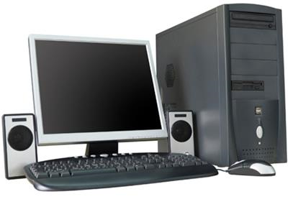
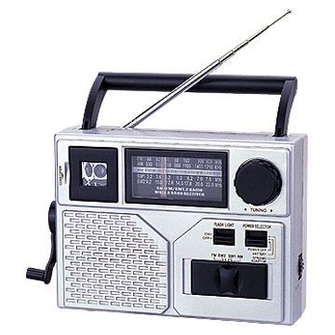
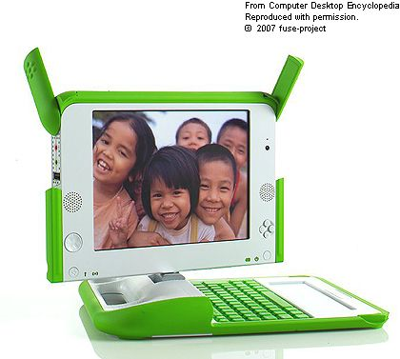
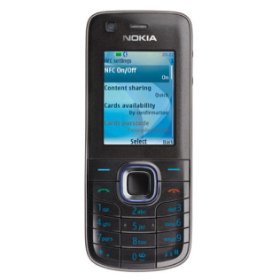
Thinking about ICTs (Connecting Devices)
Form factor (physical dimensions (size) and hardware configuration)
Input/output mechanisms (i.e. voice vs. text, keyboard vs. keypad vs. touchscreen)
Repurposed vs. Custom device (desktop computer vs. One Laptop Per Child device)
Notes:
Photo source: NY times

Slide 9
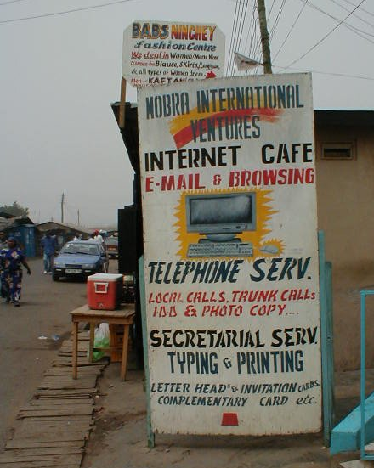
Connecting Devices in Resource-Constrained Circumstances
Low-cost devices
Build cheaper devices
Maintain single-user model
Shared Access devices
Build/ adapt devices to
Support multiple users simultaneously
Public Access or Pay Per Use
Use existing devices
Single user at a time, but used by many users over time

Slide 10
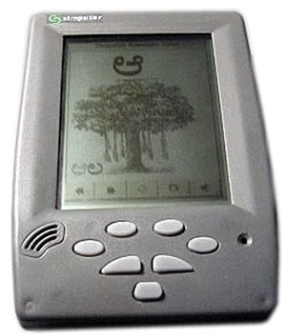
Low Cost Connecting Devices
OLPC
Simputer
Recent interest in Internet via Mobile Phones

Slide 11
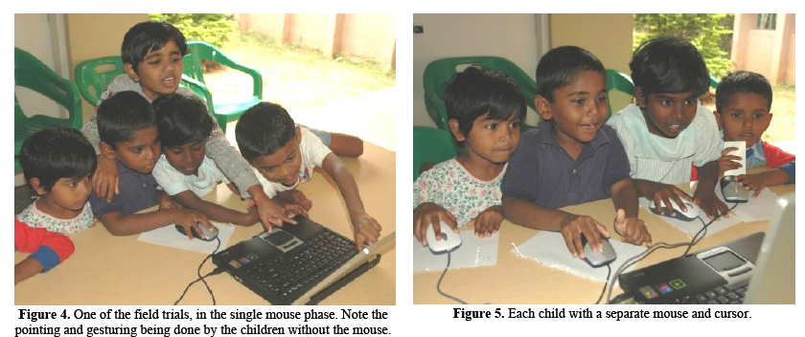
MultiPoint Project
“Multiple Mice for Computers in Education in Developing Countries,“ by Pawar, Pal, and Toyama
Also see http://research.microsoft.com/en-us/um/india/projects/multipoint/multipoint.htm
Notes:
from “Multiple Mice for Computers in Education in Developing Countries,“ by Pawar, Pal, and Toyama

Slide 12
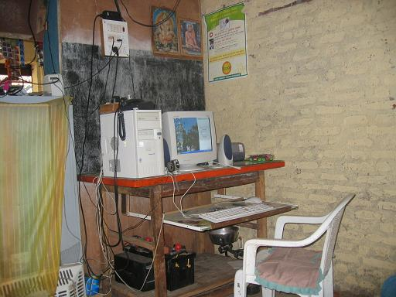
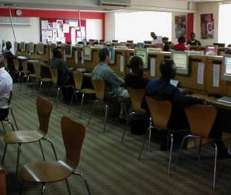
Public Access Facilities: Terms
Kiosks – a single computer set up with access to the Internet and other services.
Telecenters – multiple computers w/ Internet access. Often donor or govt. funded and bundled with other services/resources.
Internet cafes – multiple computers w/ Internet access. A private, entrepreneurial venture.

Slide 13
Public Access Facilities: A Range
Funding Model and ‘financial sustainability’
government or donor programs vs. for-profit
Content and services on offer
special purpose vs. open-ended access
Sharing Model
‘timesharing’ (pay per use) vs. using simultaneously (as in a computer classroom)
Day-to-day operation and intermediaries
entrepreneurs or salaried operators
degree of involvement in users’ activities
Notes:
(what about when uses are oriented towards ‘development’ or where there is misuse/abuse?)

Slide 14
Mapping the Range
Internet cafes (worldwide)
Broad, open-ended content & services
Akshaya (India)
ITCP (Egypt)
n-Logue (India)
PC-Baangs
(South Korea)
e-Choupals (India - grain/ soybean marketing)
Bhoomi (India - land records)
Narrow content & services
Government funded
Private-public partnership (franchise)
Privately funded

Slide 15
The Example of E-governance
“…the process of enabling transactions between concerned groups and the government…using ICTs, to improve the efficiency, transparency, accountability and effectiveness of a government.”
Transparency and Accountability – eliminating ambiguity, more oversight by citizens through national distribution
Efficiency – government processes carried out without time and expense of travel, centralization to reduce duplicated efforts
Empowerment – remote citizens can have their voices heard by central government
Notes:
Quote from where?

Slide 16
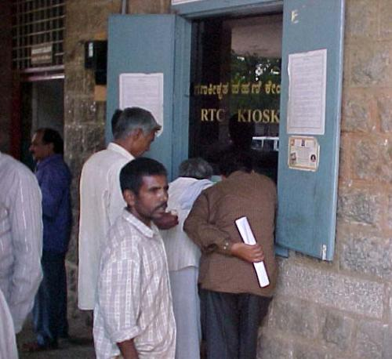
Handling Land Records with Bhoomi
The goal was transparency, improved efficiency, accountability in government processes.
The result was an increase in bribes and delay in amount of time it takes to access or alter land records.
http://www.bhoomi.kar.nic.in/Bhoomi/Walk_through/Images/details.jpg
Notes:
http://www.bhoomi.kar.nic.in/Bhoomi/Walk_through/Images/details.jpg

Slide 17
The Bhoomi Land Records Project: Success or Failure?
Shift from dealing with land records at village level to higher taluk level.
Old process eliminated entirely.
Shift away from nearby access to land records, ability to negotiate with village officials
Which had worked well for small-scale, rural landowners
Shift to centralized record-keeping, formal documentation to aid in informed decision-making.
Worked for large-scale landowners and agro-business
Why did the project fail?
Who did it fail for?

Slide 18
Ways to think about ‘Access to ICTs’
Hard infrastructure (fiber optic, copper, wireless, etc)
‘Soft’ infrastructure (government policy)
Business models (to lower cost, ensure ongoing feasibility)
Connecting Devices (MultiMouse, OLPC, desktop PC, shared access computing)
Socio-cultural dimensions (specifically gender and class)
Notes:
caste and the MultiMouse

Slide 19
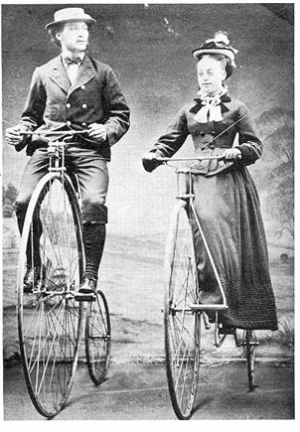
Remember the Bicycle Case Study
Accommodating social norms?
Or challenging them?
Women and bicycles in the 19th Century
Notes:
Recall from our lecture early in the semester

Slide 20
Gender in Public Access Kiosks
Women kiosk users in Kuriyan and Kitner (2009)
Heterogeneous
by income group
urban vs. rural
Expectations of women, permitted behavior, duties at home.
Matters of motivation, aspiration, and relevance
Access and use of technology shaped by gender!

Slide 21
Gender in Public Access Kiosks
But does accessing and using this technology also shape perceptions of gender?
The case of women kiosk operators (KOs)
Changes how they ‘see’ bureaucrats, experts etc.
Awareness of schemes, techniques, who’s who
Increased frequency of interaction
But also how the village community ‘sees’ them
status in community: “girl with the computer,” role model
status in family: income, negotiating housework times
Notes:
diversity
learning by doing
coping, dealing, negotiating
“girl with the computer”
“girl for certificates”
KO as an aspiration
finances
housework
involvement
resources to draw on
Dilemmas

Slide 22
Next class (6/12)
Guest Lecture by Elisa Oreglia on User Appropriation
Due: Readings (Burrell, possibly some more?)
Time to discuss Assignment 1

