Slide 1
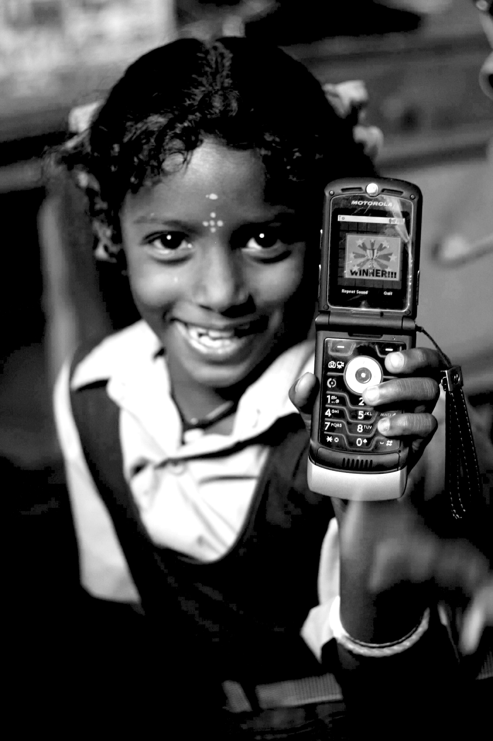
Thinking Small
05.31.12
Janaki Srinivasan
Neha Kumar

Slide 2
On Tuesday (5/29)
Thinking Big
Model
Case of Akosombo Dam
Critiques
Activity: Green Revolution Debate

Slide 3
Administrivia
Due: Reading Response #2
Back: Reading Response #1
Join Facebook Group

Slide 4
Outline for Today
Green Revolution (Review)
Appropriate Technology
Break
Participatory Development
Social Entrepreneurship
Activity: Discussion of Assignment 1
Tuesday’s Lecture

Slide 5
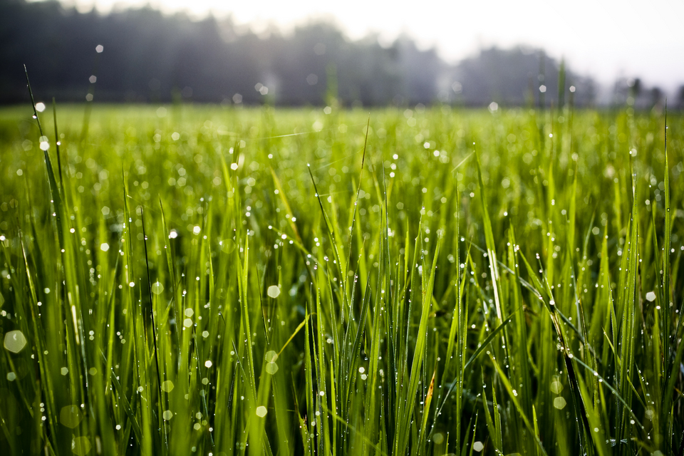
Green Revolution: For or Against?

Slide 6
Feedback
Define your stance.
Be careful with the T, D, and P words.
Credit your sources.
Understand causation vs. correlation.
See both sides.
Notes:
A few points that I made then that I’d like to repeat –
1. define your stance! Don’t use the term “development” loosely, define it. When you use the words T, P, D, understand what they mean!
2. Credit your sources, and this serves two objectives – 1. it makes your claims more credible, 2. it also transfers the blame to someone else ☺.
3. Know the difference between causation and correlation.
4. But if there is one lesson we would definitely want you to take away from this course, especially, is to be able to see both sides. To understand that different views of development have different pros and cons, and that a technology can be seen as both positive and negative, e.g. with Bijker’s bicycle example.

Slide 7
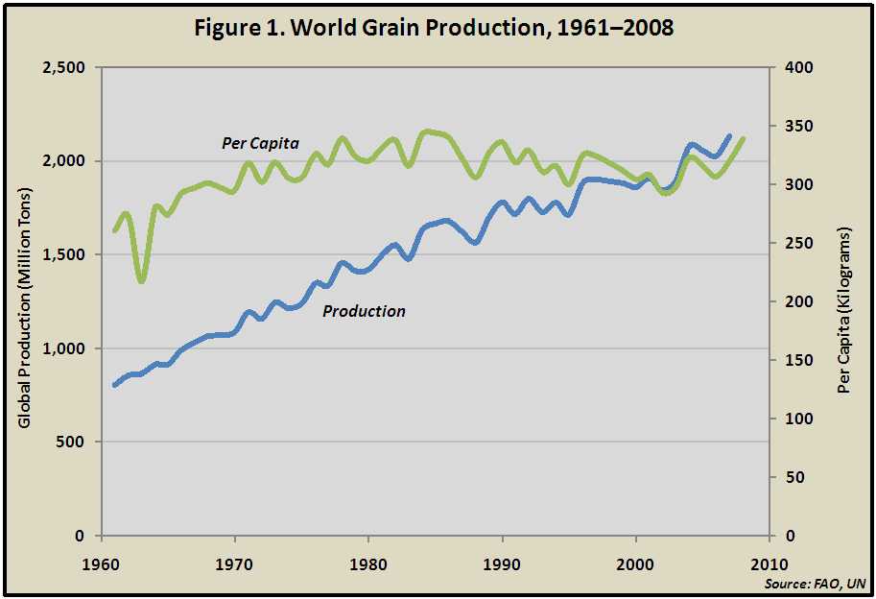
Productivity Trends
Productivity did increase in India - 10 million tons of wheat (1960) to 73 million tons (2006)
But today -productivity gains are slowing down (and at times lagging population growth)
Notes:
Source for graph: Vital Signs, World Watch Institute

Slide 8
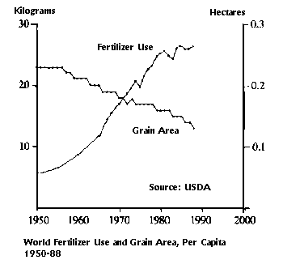
Inputs: Fertilizer and Soil Fertility
More fertilizer needed to produce the same yields as before
Causes: soil erosion and decline in soil fertility

Slide 9
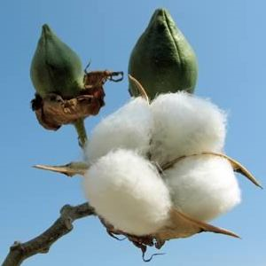
Inputs: Seeds
Bt cotton (2002 – present) a good comparison to earlier 1960s era Green Rev (focused on food supply – rice & wheat)
Beyond food self-sufficiency: cash crop not a food crop
Introduced without extensive institutional support (ag. extension, institutional loans)

Slide 10
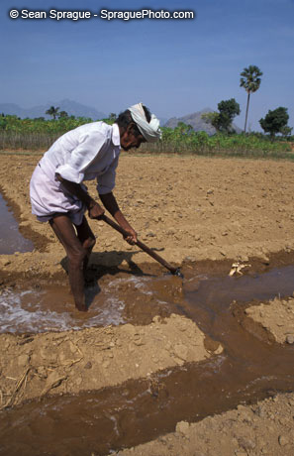
Inputs: Irrigation and Water Supply
Water tables dropping 1 meter per year in Punjab
Boreholes, debt, and suicide
Irrigation also has an impact on soil quality – in some regions leads to salinization or water-logging

Slide 11
Farmers Enmeshed in Global Markets
…over which they have little control
Seed and input suppliers - rising cost of oil (recently in 2007) means rising cost of fertilizers
Taking out loans to pay for seeds and inputs (sometimes at very high interest rates) leading to debt
National policies change in India - decreasing support for agriculture, decline of institutional loans, subsidies for fertilizers (except urea) are eliminated in 1992

Slide 12
Other Consequences
Pollution from pesticides and fertilizers
Departure of the self-sufficient farm

Slide 13
Modernization Paradigm/ Neoclassical Economic Growth Model
 | Green Revolution
Who is doing the development
What/Who is being developed
Proximate change (short-term) to be brought about
The eventual outcome or development to accomplish
Mechanism for bringing about this change

Slide 14
Remember these?
Technological Determinism – what is the story that is told about the origins of this artifact/system/process?
Relevant Social Groups – What groups have a stake in the development, diffusion, and use of the technology in question?
Interpretive Flexibility – Are there differences of opinion about whether the technology is ‘working’or not? What priorities, concerns, interests are revealed by these different interpretations?
Closure – Was there a debate about the technology that was resolved? How was it resolved?
Black-boxing – What elements of infrastructure are being overlooked? What are the necessary components to keep this system functional?

Slide 15
Why the Green Revolution?
The chance to think about equity
Tremendous global impact
Enough time has passed

Slide 16
Green Revolution 2.0
How would you advise today’s efforts to accomplish a new Green Revolution?
Notes:
Thoughts? 5-min exercise.

Slide 17
The Problem of Scale
Large projects have large-scale impact…
but the unanticipated consequences are also large-scale.
Poor countries depend on foreign partners for necessary resources.
Centralized projects compel mass movement.

Slide 18
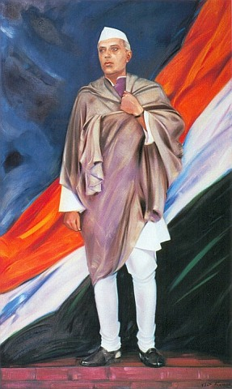
1954: “What a stupendous magnificent work – a work which only that nation can take up which has faith and boldness!...it has become the symbol of a nation’s will to march forward with strength, determination and courage…As I walked around the [dam] site I thought that these days the biggest temple and mosque and gurdwara is the place where man works for the good of mankind…”
1958: “I have been beginning to think that we are suffering from what we may call ‘disease of giganticism’…We want to show that we can build big dams and do big things…but the idea of having big undertakings and doing big tasks for the sake of showing that we can do big things is not a good outlook at all.”
Notes:
http://en.wikipedia.org/wiki/Image:S.Roerich_%22Shri_Jawaharlal_Nehru%22_1943.jpg
1954: Upon visiting the Nangal Canal in Punjab and construction site of the Bhakra dam
1958: At the annual meeting of the Central Board of Irrigation and Power.

Slide 19
Appropriate Technology
“What can be done to bring health to economic life outside the big cities, in the small towns and villages which still contain – in most cases – 80 to 90 per cent of the total population?”

Slide 20
Schumacher critiques…
Forms of work and the effect they have on workers (as facilitated by mechanization)
Emphasis by economists on increased consumption as indication of improved well-being
This leads to competition and overconsumption of natural resources generating small-scale local conflict.
Societies become enmeshed in global markets and large-scale conflict.

Slide 21
A Philosophy of T & D
Technological non-determinism
Can be employed to a multitude of ends (not just boosting productivity)
Can be directed by human interests
Small is Beautiful
“small-scale operations, no matter how numerous, are always less likely to be harmful to the natural environment than large-scale ones…the greatest danger invariably arises from the ruthless application, on a vast scale, of partial knowledge.”

Slide 22
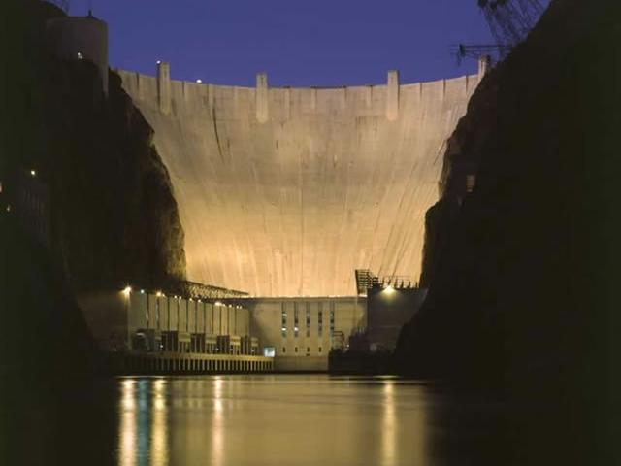
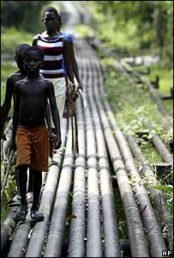
A Philosophy of T & D
Direct vs. Indirect Benefit

Slide 23
Intermediate vs. Appropriate
The term technology has cachet.
Intermediate
Between what and what?
Appropriate supplants “Intermediate”
But what is inappropriate?

Slide 24
How to build an AT
Philosophy | Rule
Self-sufficiency - no dependence on imports or production of exports (to avoid large-scale conflict) | Artifacts built and maintained using local materials and skills. Capital investment is minimal.
Restrained consumption - no tax on natural resources (to avoid small-scale conflict) | Energy efficient, conservation-oriented
Development in place - bring workplaces to where people are living (rather than moving them) | Decentralized, a multitude of small versions rather than one BIG thing
People need creative and meaningful work. | ???

Slide 25
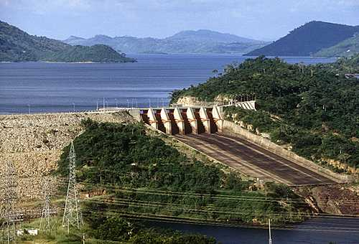
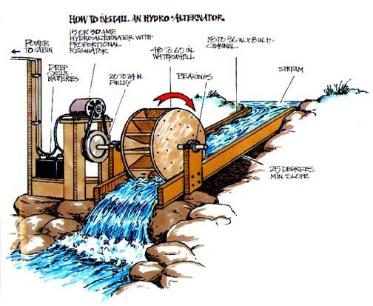
Philosophy to Artifacts
micro-hydro power
[Akosombo Dam Capacity: 900 MW]
[Micro-Hydro
Capacity: ~100 KW]

Slide 26
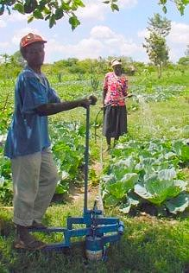
Philosophy to Artifacts
KickStart NGO
Treadle operated pump pulls water from a well and sprays it out of a hose - for irrigating small farms
59,000 pumps in use in Kenya, Tanzania and Mali by 2006
Notes:
http://www.kickstart.org/tech/technologies/micro-irrigation.html

Slide 27
Philosophy to Artifacts
Agriculture and aquaculture: fertilizers, irrigation, crop drying, preservation, storage
Water supply and sanitation: water pumps, water tanks, water filtration and treatment, water reuse, latrines
Energy: improved cookstoves, wind energy, solar energy, biogas
Housing: alternative construction materials
Notes:
Applications where AT are being useful

Slide 28
Criticism
Is rural life being romanticized? Is AT motivated by Westerners’ disillusionment with their own modern, urban lives?
Produced for the poor, but not with the poor (participatory approaches emerge separately).
Band-aids for much larger social, structural problems
The challenge of distributing technology was (and is) underestimated.
Does appropriate have to mean “simple?”

Slide 29
AT Today
See Fisher paper on “Income is Development”.
Business models, fiscal pragmatism, leveraging supply chains
Evaluation and quantification of impact
Not necessarily strict reliance on local materials (self-sufficiency)
Specialized and skilled manufacturing of AT technologies (often in factories)

Slide 30
Sustainable Development
Short-term productivity gains come with rapid depletion of resources that puts future production in jeopardy.
Boosting yields isn’t enough. We must also consider how to manage natural resources to ensure future productivity.
Brundtland Report (1987) stresses the need for sustainable development.

Slide 31
Take a break!

Slide 32
Mainstream Development Models
AID REGIME
BASIC NEEDS
STR. ADJ. + WASHINGTON CONSENSUS
NEW INSTITU-TIONALISM
1950
1960
1970
1980
1990
2000
Akosombo Dam (industrial productivity)
Green Revolution (agricultural productivity)

Slide 33
Rethinking the Mainstream Models of ‘Doing Development’
Critiques of the neoclassical growth model/ modernization paradigm
Scale
Environmental degradation
Who defines the problem and the solution?
Alternative frameworks
Appropriate technologies
Sustainable development
People-centered development
Social entrepreneurship?

Slide 34
Rethinking the Mainstream Models of ‘Doing Development’
Critiques of the neoclassical growth model/ modernization paradigm
Scale
Environmental degradation
Who defines the problem and the solution?
Alternative frameworks
Appropriate technologies
Sustainable development
People-centered development
Social entrepreneurship?

Slide 35
Characterizing Models of Development
Other ways of characterizing a model of development:
single vs. multi-dimensional (GDP vs. Millennium Development Goals)
technologically deterministic = technology with direct causality generates economic growth or development
centralized vs. de-centralized
participatory/people-centered = bottom-up, consultative
market-based = improving efficiency of markets or against markets

Slide 36
The ‘object’ of development
National economy (neoclassical economic growth models)
National government and other institutions (new institutionalist approach)
……………….…..…
Families, households, or individuals (people-centered approach)

Slide 37
Chronology of Bottom-up Approaches
From Schumacher
To Chambers ‘Participatory Rural Appraisal’
To Action Research
‘Ethnographic Action Research’ on ICTs
Differences
role of researcher vs. ‘subject’
how is the perspective of the poor engaged?
Commonality
use of qualitative methods

Slide 38
Appropriate Technology (1970s)
Small is Beautiful as prescription for alternate path of technology development
A pro-poor, bottom-up, direct approach
But
makes assertions about the needs of people in developing regions without consulting them

Slide 39
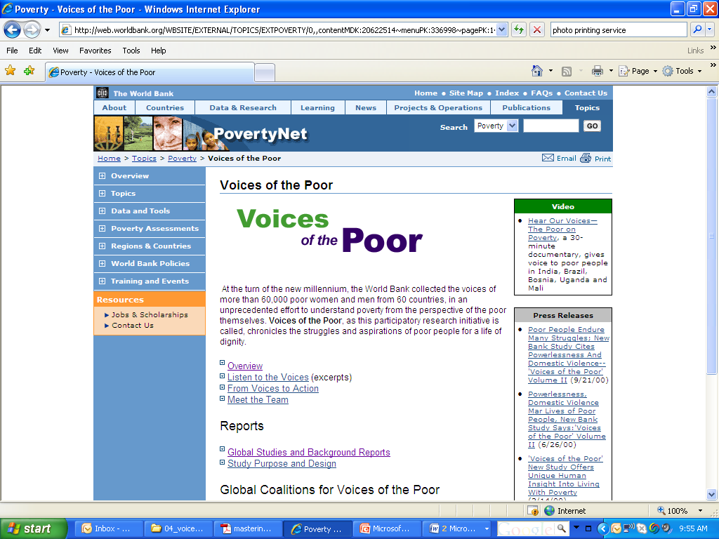
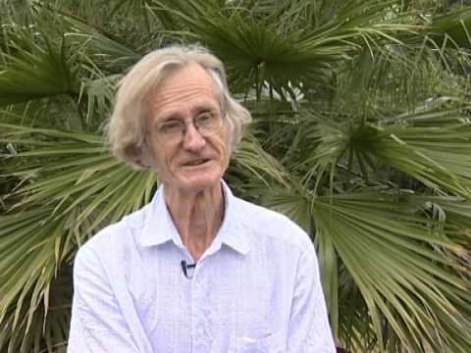
Participatory Development -Chambers (1990s)

Slide 40
Participatory Development -Chambers (1990s)
Data Collection
Emphasis on consultation
“the basic human right of poor people to conduct their own analysis.”
Data should be shared
rather than extracted

Slide 41
Who Collects the Data?
Rapid Rural Appraisal | Participatory Rural Appraisal
Data collected by outsiders | Data collaboratively collected. – ‘handing over the stick’
Data elicited and extracted | Data owned and shared locally
Information used for external researchers agenda | Part of process of ‘empowerment’

Slide 42
What Metrics are Calculated?
In an Institutional perspectives
From single variable definition:
Low per-capita GDP, $1 a day income
To multi-variable definition:
The UN’s Human Development Index (HDI) adds adult literacy and life expectancy to national income statistics in 1990
Female literacy and mortality added to the HDI in 1991
Millennium Development Goals
but still the emphasis is on numeric measurement and cross-national comparison

Slide 43
“Whose Reality Counts?”
How are variations accounted for?
“the realities of poor people are local, complex, diverse and dynamic”
How are priorities set?
“one may speculate on what topics the poor and powerless would commission papers if they could convene conferences and summits”
“what matters most to [the poor] often differs from what outsiders assume, is not always easy to measure, and may not be measurable at all”

Slide 44
Chambers’ Findings: Alternate Priorities
Social inferiority
Isolation
Physical Weakness
Vulnerability
Seasonal Deprivation
Powerlessness
Humiliation

Slide 45
Alternate Solutions?
Chambers suggests focusing on the priorities set by the poor can yield new and inexpensive ideas for programs/solutions:
Postponing school fee payments
(seasonal deprivation)
Training health care staff in ‘customer service’
(social inferiority)
Providing food-for-work to workers who do road repair (during periods of seasonal deprivation)
Notes:
Alternative approach yields alternative solutions

Slide 46
Emic Accounts and the Sociological Imagination (for Assignment 1!)
Emic accounts = an account from the actor’s point of view. How the poor describe poverty and its causes in their own terms.
Sociological imagination - “to understand the larger historical scene in terms of its meaning for the inner life and the external career of a variety of individuals.” (Sociologist C. Wright Mills).

Slide 47
Action Research (1970s and 80s)
Critique of scholarly research
Not engaged with practice
Action Research
Findings fed immediately into social action
Agenda of researcher and group being studied must match!
Action
Research
See Tacchi, Slater, and Hearn (2003). Ethnographic Action Research, Chapter 3. Action Research and ICTs

Slide 48
Summary of Bottom-up Approaches of ‘Doing’ Development
 | Bottom-up, poor-first | Consultation with the poor | Research by the poor | Actions, solutions by the poor
Schumacher | ☑ | □ | □ | □
Chambers – PRA | ☑ | ☑ | ☑ | □
Action Research | ☑ | ☑ | ☑ | ☑

Slide 49
Back to the Timeline
AID REGIME
BASIC NEEDS
STR. ADJ. + WASHINGTON CONSENSUS
NEW INSTITU-TIONALISM
1950
1960
1970
1980
1990
2000
Social Entrepreneurship?

Slide 50
Your first assignment
Step 1. Form groups of 4 people – pick a book (excerpts on email):
Factory Girls: From Village to City in a Changing China, Leslie T. Chang
Crossing Over: A Mexican Family on the Migrant Trail, Ruben Martinez
Kaffir Boy: The True Story of a Black Youth’s Coming of Age in Apartheid South Africa, Mark Mathabane
Death Without Weeping: The Violence of Everyday Life in Brazil, Nancy Scheper-Hughes

Slide 51
On Tuesday (6/5)
Lecture: “Digital Divide and Information Society”
Diverse meanings of terms
Due before class
Do the readings: Webster, Keniston
Try to think of ideas about the digital divide in the models of technology and development that we have talked about
Activity in class
We will head to Sproul Plaza for an observation exercise!

