Slide 1
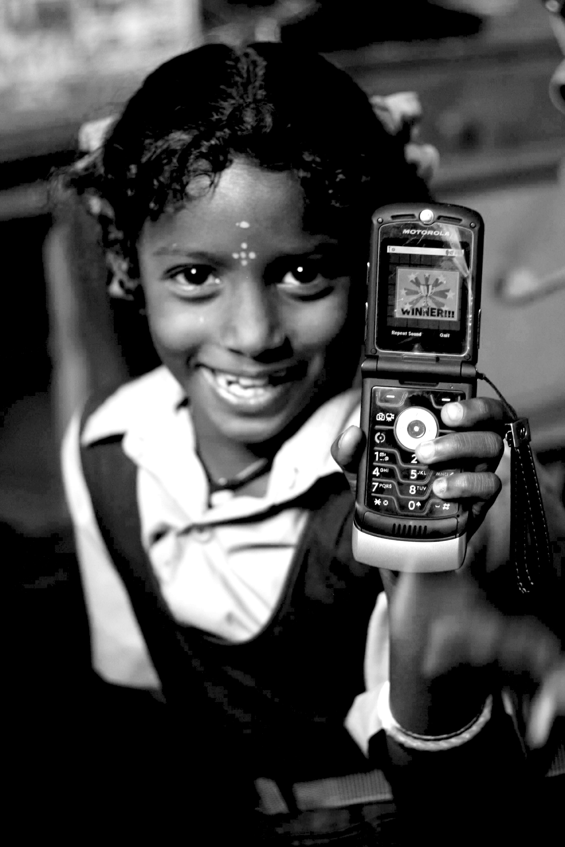
Technology & Development
05.24.12
Janaki Srinivasan
Neha Kumar

Slide 2
On Tuesday (5/22)
Technology & Poverty: in the News
Technology & Poverty: a Historical Perspective
About the Course
Break
Introductions
TED Talk
Thursday’s Lecture

Slide 3
Administrivia
Office Hours
Janaki: Thursday 1.30-2.30 [211 South Hall]
Neha: Tuesday 9-10 [211 South Hall]
Mailing List
Readings Online
Facebook Group

Slide 4
Outline for Today
Due: Reading Response #1
Technology & Poverty: Photo Exercise
Technology
Break
Development
Case Study: The Green Revolution
Tuesday’s Lecture

Slide 5
Technology and Society

Slide 8
The Origins of ‘Technology’
1600s: A discourse or treatise on an art or arts
1800s: A kind of book
1900: Mechanic arts

Slide 9
Technology Fills the Void
“a concept of a form of power (of progress) that far exceeded…the relatively limited capacity of the merely useful (or mechanic or practical or industrial) arts to generate social change.”

Slide 10
Notes:
To elucidate this point, Marx picks up the example of the railroad – which was both a material and social artifact. The operation of the railroad required various different components – not just the machine – the engine, but also stations, bridges, tunnels – a corporate business org with a large capital investment, specialized technical knowledge, engineers, firemen, brakemen, conductors, and also laws for standardization of track gauges and time zones. Here we see an example of a technology that was much more than just a thing.

Slide 11
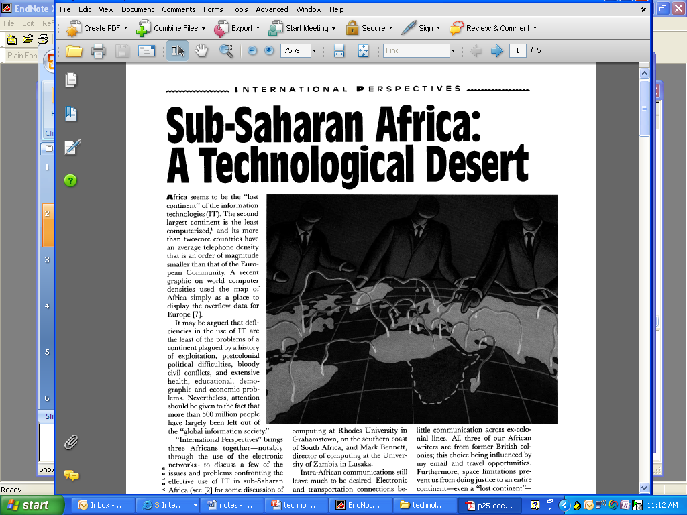
A technological desert
[Source: Communications of the ACM, 1993]

Slide 12
A Hazardous Concept?
“Technology is changing the way we live.”
“Our inventions are wont to be pretty toys, which distract our attention from serious things. They are but improved means to an unimproved end.”
- Thoreau

Slide 13
Technological Determinism
“The question we are interested in … concerns the effect of technology in determining the nature of the socioeconomic order.”
- How does technology evolve in the sequence it does?
- How does technology affect social relationships?

Slide 14
Stages of Technical Conquest
“…one cannot move to the age of the hydro-electric plant before one has mastered the steam-mill, nor to the nuclear power age until one has lived through that of electricity.”

Slide 15
Technology’s Influence on Society
Composition of the Labor Force
Hierarchical Organization of Work

Slide 16
Technological Determinism
‘hard’ tech determinism: technology impacts society as an external force with direct causal effects
‘soft’ tech determinism: “artifacts have politics” [Winner] - technology does matter

Slide 17
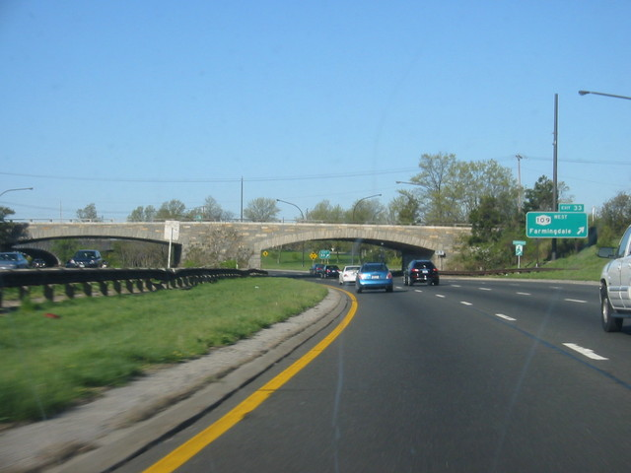
Do Artifacts have Politics?
Notes:
What we see here is an overpass. There are 200 or so such overpasses in Long Island that were built by Robert Moses in the 20s to 70s, to have a particular social effect. They were built to discourage buses on these parkways, so that only automobile-owners – who were white and richer – would be able to use his parkways. One consequence was to limit access of racial minorities and low-income groups to Jones Beach, Moses’s widely acclaimed public park. Years after Moses is gone, these bridges continue to shape the city. Winner’s argument is that technologies are inherently political, and choosing these technologies is choosing a particular form of political life.

Slide 18
Winner says…
Machines/structures/systems embody forms of power and authority.
Technologies matter. They outlast lives and social prejudices that gave them form.
The consequences produced by a technical arrangement may be intentional or unintentional.

Slide 19
Now, sentences to avoid…
“Many countries do not have the same potential for growth as other countries due to the lack of technology.”
“Technology allows for the spread of knowledge which in return will contribute to the growth and development of a country.”
“If everyone was technologically advanced, they would have no problems finding jobs.”
“It is known that the Internet is a very powerful tool and has proven to be very successful for many nations.”
Notes:
What you need to be conscious of is making a claim that the technology has causality and can – all by itself – create social change, alleviate poverty, generate economic growth.

Slide 20
Social Construction of Technology (SCOT)
Relevant Social Groups
Interpretive Flexibility
Closure
Notes:
We now look at SCOT - a different way of looking at technology. Instead of looking at tech as an autonomous, external force, SCOT believes that the society is directly involved in making technology what it is. SCOT has a vocabulary and model for thinking about how technology is embedded in society that I would like to cover here, to help you in the case studies we will look at.
RSG: These include all those who are involved in the design and use of a technology – affected in some way by the presence of this new artifact (could include non-users).
IF: Individuals or groups may interpret an artifact in different ways. What is a “working” tech for one may be a “non-working” tech for another. Even though the object is the same, the technical properties are the same, the interpretations and uses may be very different.
Closure: This refers to the way in which technologies become mundane, taken-for-granted, and invisible. It is where RSGs come to a point of agreement over the evolving configuration of an artifact. The debate dies down. There may be periods of great activity of debate about a particular technology. When it’s being developed, or when it comes into the market. Or when some kind of event, like the Bhopal disaster, takes place.

Slide 21
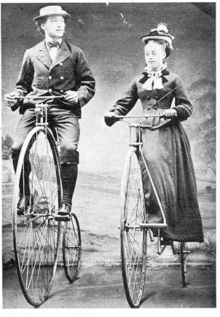
The History of the Bicycle
Athletic Young Men
Concerned Community Members
High- Wheeled Bicycle
Notes:
The high-wheeled Ordinary bicycle is patented in 1870. The front wheel diameter of the bicycle changes over the history of the bicycle. Why such a large front wheel? No gearing system, pedals attached to the front wheel, desire early on to use the bicycles for racing. In order to go fast the wheel diameter had to become bigger. BUT In order to reach the pedals the seat had to be shifted forward so the center of gravity shifted way forward as well. Also sitting high over the wheel made the ride smoother. It had many problems, was tiring, difficult to get on and off, hard to keep balanced. There were safety issues. Two relevant social groups include athletic young men who rode the bikes and enjoyed the risk factor. For them it was a macho bicycle. Another group was concerned community members who saw the bikes as a threat and nuisance to non-users, pedestrians see it as an unsafe bicycle. Different groups had different views about whether this technology was a ‘working’ technology. Eventually new bicycles, permutations on the design with incremental improvements, are designed to address safety problems.
Finally the invention of pneumatic tires in 1891 reconciled both groups. It was meant to create a smoother ride, but it also allowed the bicycle to travel much more quickly – it appealed to the athletic young men as a racing bicycle. It was also much safer, the pneumatic tires improved control of the bicycle and reduced crashes. The concerned community members saw it as a safe bicycle. It becomes referred to as a “Safety bicycle.” The result is that the technology reaches a state of closure where the debates die down and the object becomes a mundane element of everyday life. An indication of this closure is that with time this bicycle with pneumatic tires is referred to as a “bicycle” in publications (rather than a ‘safety’ bicycle).
The conclusion to draw from this is, for one thing, that the design of a technology – its material properties - is not only determined by designers, but can also be influenced by users. They do so by making decisions about whether to purchase the product, by writing critical editorials in the newspaper. The relevant social groups have a number of ways to make their concerns and interests known and serving to influence the material form.

Slide 22
Black-Boxing
The tendency for a technology to become a stand-in for the larger system its existence relies on.
A problem to look out for in the context of ‘technology for poverty-alleviation’ projects. Blindness to the supporting infrastructure leads to fatal flaws in ‘technology transfer’projects.
Notes:
This is another STS concept to keep around and is related to ‘closure’ and the way technology fades into the background. A side effect of a functioning system (one where the debates have died down) is that we have a difficult time seeing all that it is composed of. It becomes reduced to the single thing.
Breakdowns make the Broader System Visible. It is only in the circumstance of a breakdown (by which I don’t necessarily mean a technical breakdown) when we can see the other components – i.e. to use a computer how many of you think about the electricity supply and how important it is for it to be maintained at a stable voltage – that fluctuations are hard on equipment and reduce their life span. You might think about this in a thunderstorm. You would certainly think about it in a country like Ghana where the electricity may go off suddenly and where you have to contend with power surges that can blow fuses and irreparably destroy fragile electronics.

Slide 23
Terms to Remember
Relevant Social Groups
Interpretive flexibility
Closure
Black-Boxing
Technological Determinism

Slide 24
Applying them to Case Studies
Technological Determinism – what is the story that is told about the origins of this artifact/system/process?
Relevant Social Groups – What groups have a stake in the development, diffusion, and use of the technology in question?
Interpretive Flexibility – Are there differences of opinion about whether the technology is ‘working’or not? What priorities, concerns, interests are revealed by these different interpretations?
Closure – Was there a debate about the technology that was resolved? How was it resolved?
Black-boxing – What elements of infrastructure are being overlooked? What are the necessary components to keep this system functional?
Notes:
Technological determinism – is it described as the latest item in the inevitable march towards progress? Is it considered to be a product of science? Does it originate in a U.S. laboratory or a village in India?
Relevant social groups – defining one group as distinct from another can be tricky. For example in the lecture on the Green Revolution – one thing we will consider for sure is the way that different farmers form separate social groups. Farmers with 1-2 acres are one relevant social group -- farmers with 10+ acres are another. A mistake to treat all farmers as a single relevant social group. You can bet there are some differences of opinion about whether these modern farming practices are working or non-working technologies. In this way we can address questions of equity in access to a technology. The same technology can impoverish some while enriching others. How does that happen?

Slide 25
What We Learned
The material form of a technology is shaped by social processes (see SCOT).
Certain kinds of technologies seem to entail an implicit commitment to certain political orderings.
Whether the term ‘technology’ is applied to a particular artifact is not determined solely by its material properties but reflects systems of valuation and various social factors. The set of artifacts referred to with this term also changes over time.
Fixating on what is newest and most ‘technological’ may mean overlooking genuine but more mundane possibilities for promoting social progress (a ‘hazard’ of the term).
Efforts to address poverty have historically involved reclaiming the power of this term, expanding it to refer to a broader range of artifacts and ideas (i.e. “appropriate technologies” or “indigenous technologies”).

Slide 26
Take a break!

Slide 27
A brief history of development

Slide 28
Models of Development
Are associated with
an entity ‘doing development’
Aid agencies? Corporations?
an ‘object’ being developed
Poor people? National economy?
a targeted ‘outcome’
Jobs? GDP growth?
a ‘means’ to realize that outcome
Technology?

Slide 29
Institutions ‘doing development’
A Typology
International (multilateral) Aid Agencies: UNDP, World Bank, IMF
National (bilateral) Aid Agencies: USAID, IDRC (Canada), DFID (UK), DANIDA. Increasingly - India, China, as well as Muslim organizations.
A proliferation of NGOs/Non-Profits in recent years and a shift in emphasis to realizing development through these orgs.
Corporations, foundations
Academia?
Institutions define poverty in order to act not simply to understand

Slide 30
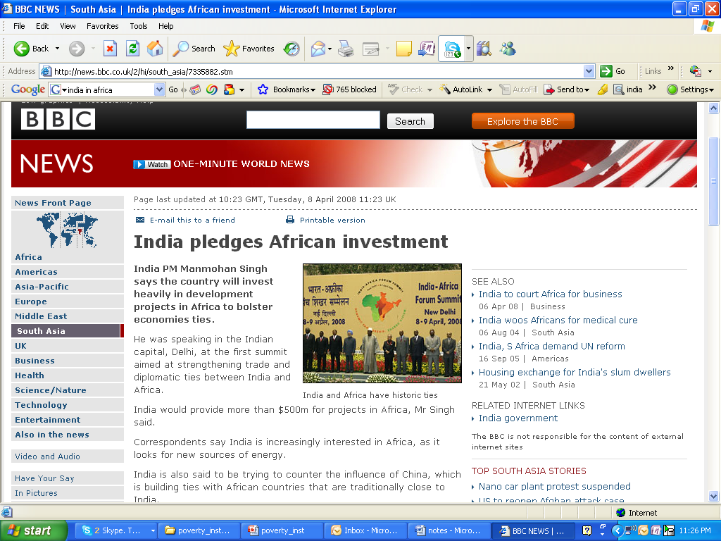

Slide 31
Dominant Models of Development
AID REGIME
BASIC NEEDS
STR. ADJ. + WASHINGTON CONSENSUS
NEW INSTITU-TIONALISM
1950
1960
1970
1980
1990
2000

Slide 32
Aid regime
Economic rationale for aid*
Investment (esp. in more machines) soaks up surplus labor, leads to increased production and to growth of economy (desirable).
Investment proportional to growth: Harrod-Domar model
Growth leads to savings and, in turn, to investments.
But poor countries are limited in how much they can save and thereby invest.
Leads to a financing gap (=required investment minus actual savings)
Aid is used to address this financing gap
*Read Easterly (2002) for more on aid

Slide 33
Aid regime
Political rationale for aid*
The Communist scare
Soviet willingness to “extract large forced savings”->output production superior to the US : what if newly independent ‘Third World’ countries were attracted to this model?
Rostow’s theory of Stages of Economic Growth (Modernization theory) as a way to demonstrate superiority of US model
Poor countries were stuck in a low-level economic equilibrium, required investment to boost their economy and to“takeoff into self-sustained growth”
This investment was to be provided with US foreign aid
Read Easterly (2002) for more on political rationale for aid
and Rostow (1960) for modernization theory

Slide 34
Aid -> Investment in machines -> Growth?
Why it didn’t work that way
Aid didn’t go 1:1 into investment
Investment didn’t go 1:1 into growth
More machines not= more productivity
Led to unsustainable debt
Source: Easterly The Elusive Quest for Growth

Slide 35
Structural adjustments and Washington Consensus (also known as Neoliberal Reform)
Aid formula had failed, a Debt crisis was on hand
Neoliberal view: Governments were the cause of this failure and had to get out of the way
Reagan-Thatcher Era (1980-96) – looking beyond the lack of physical capital to policy reform
The Washington Consensus: a packet of policy reforms emphasizing privatization, trade liberalization
Applied through ‘structural adjustment’ – aid tied to this set of policy reforms principally to remove the obstructions of national government on free competition in markets
Criticism
Technology?

Slide 36
But something major was missing…
Don’t the national government and related institutions play a role in facilitating economic growth? In education, health care, enforcement of law and property rights?
The AIDS epidemic – neoliberal reforms do nothing to confront, contain such a public health emergency
Shift towards new institutionalism - key institutions must be in place for durable economic progress to take place

Slide 37
Dominant Models and Visions of Development
Aid regime (1950s-60s) based on neoclassical theory of economic growth = aid for investment, capital for industrialization (Revisit in “Thinking Big” lecture next week)
Basic needs (1970s) = investments to raise the productivity of the poor
Structural Adjustment and the Washington Consensus (1980s and 1990s) = aid tied to policy changes, liberalization, reduction of government, opening up to global trade
New institutionalism (post 1990s) = the government matters after all – social welfare role, to ensure functioning markets and to provide health/education thus keeping the labor force productive

Slide 38
Only Models of Development?
AID REGIME
BASIC NEEDS
STR. ADJ. + WASHINGTON CONSENSUS
NEW INSTITU-TIONALISM
1950
1960
1970
1980
1990
2000

Slide 39
Rethinking Development: two major paradigms*
Neoclassical Economics & Modernization Theory
Linear path to modern model of the West (capitalist industrialization + liberal democracy)
Technology’s Role: Push to change from simple and traditional techniques to the application of scientific knowledge.
Marxist Economics & Dependency Theory
Growth of developed world only possible at the expense of developing regions. Aid is exploitative and paternalistic. Inequalities intensify. The imperialist project continued.
Technology's Role: Expanding the market for Western innovations – industrial equipment, fertilizers and pesticides, etc.
*Read Thomas (2000) for more on differences between the two
Rostow (1960) and Easterly (2002) for rise and decline of development economics and Modernization theory
Frank (1966) for Dependency Theory

Slide 40
Rethinking Development: Multidimensionality
Capabilities Approach = change in per capita GDP is not development; development is the generation of political, economic, social freedoms (Revisit Sen’s capabilities approach in last lecture)
Sustainable Development (late 1980s) = growth but with more careful resource management and environmental preservation to ensure long-term continuation [Bruntland report] (Revisit in “Thinking Small” lecture)
UN’s Millennium Development Goals (MDGs) = aid is tied to targeting and accomplishing MDGs (instead of the policies of the Washington Consensus)

Slide 41
Millennium Development Goals
End Poverty and Hunger
Universal Education
Gender Equality
Child Health
Maternal Health
Combat HIV/AIDS
Environmental sustainability
Global partnership

Slide 42
Characterizing Models of Development
Some other ways of characterizing a model of development:
single vs. multi-dimensional (GDP vs. Millennium Development Goals) [examples in optional readings Easterly and Sen]
technologically deterministic = technology with direct causality generates economic growth or development
centralized vs. de-centralized [we will read Schumacher]
participatory/people-centered = bottom-up, consultative [Re-read Thomas, we will also read Chambers]
market-based = improving efficiency of markets [we will read Jensen’s study of mobile phones among fishermen in Kerala] or against markets [examples in Thomas]

Slide 43
Revisiting Models of Development
Models of Development involve
an entity ‘doing development’
Aid agencies? Corporations?
an ‘object’ being developed
Poor people? National economy?
a targeted ‘outcome’
Jobs? GDP growth?
a ‘means’ to realize that outcome
Technology?

Slide 44
Models of Development in Technology Projects
 | Akosombo Dam (next class) | Green revolution (today+next class)
Who is doing the development?
What/Who is being developed
Proximate change (short-term) to be brought about
The eventual outcome or development to accomplish
Mechanism for bringing about this change

Slide 45
What We Learned
A model of development involves an entity doing the development, an object of development, long and short-term goals of development, as well as a preferred means of development. All of these elements have experienced changes in the past 6 decades
Shift away from the national economy as the sole object of development. Recognition of the role that the state, institutions play in facilitating economic growth.
Poverty is defined by institutions in order to act and to reach certain goals. Over time within these institutions poverty has increasingly come to be understood as a multi-dimensional phenomenon.
Technology (defined as physical capital, machines for industrial production) – has been an important means of development in many models

Slide 46
Further Reading
W. W. Rostow, The Stages of Economic Growth: A Non-Communist Manifesto
Andre Gunder Frank. 1966. ‘The Development of Underdevelopment »
John Williamson. 1990. “What Washington Means by Policy Reform” (The Washington Consensus)
William Easterly. 2002. The Elusive Quest for Growth: Economists Adventures and Misadventures in the Tropics
Amartya Sen. 2000. Development As Freedom.

Slide 47
On Tuesday (5/29)
Lecture: “Thinking Big: Models, Projects and Critiques”
Understand the push for industrialization in greater detail
Examine the working of the Akosombo Dam project, Ghana
Read a critique of how development projects are framed
Due before class
Do the readings: Smillie, Arp and Baumgärtel, Mitchell
Try to think of the Akosombo dam in terms of the table we discussed today
Activity in class
Green Revolution debate
Notes:
This lecture will discuss the push towards industrialization in many developing regions after independence. This emphasis followed from economic growth models that saw capital investment as the key to realizing economic growth with the presumption that improved social conditions would follow.

Slide 48
Activity
Debate on 5/29
Topic: “Did the Green Revolution lead to development?”
Whichever position you take, you will start by defining what you mean by development!
Preparation for debate (next 30 minutes in class + before next class)
Team assignment
Research the Green Revolution
Prepare a 3-5 minute position piece for debate

