Slide 1
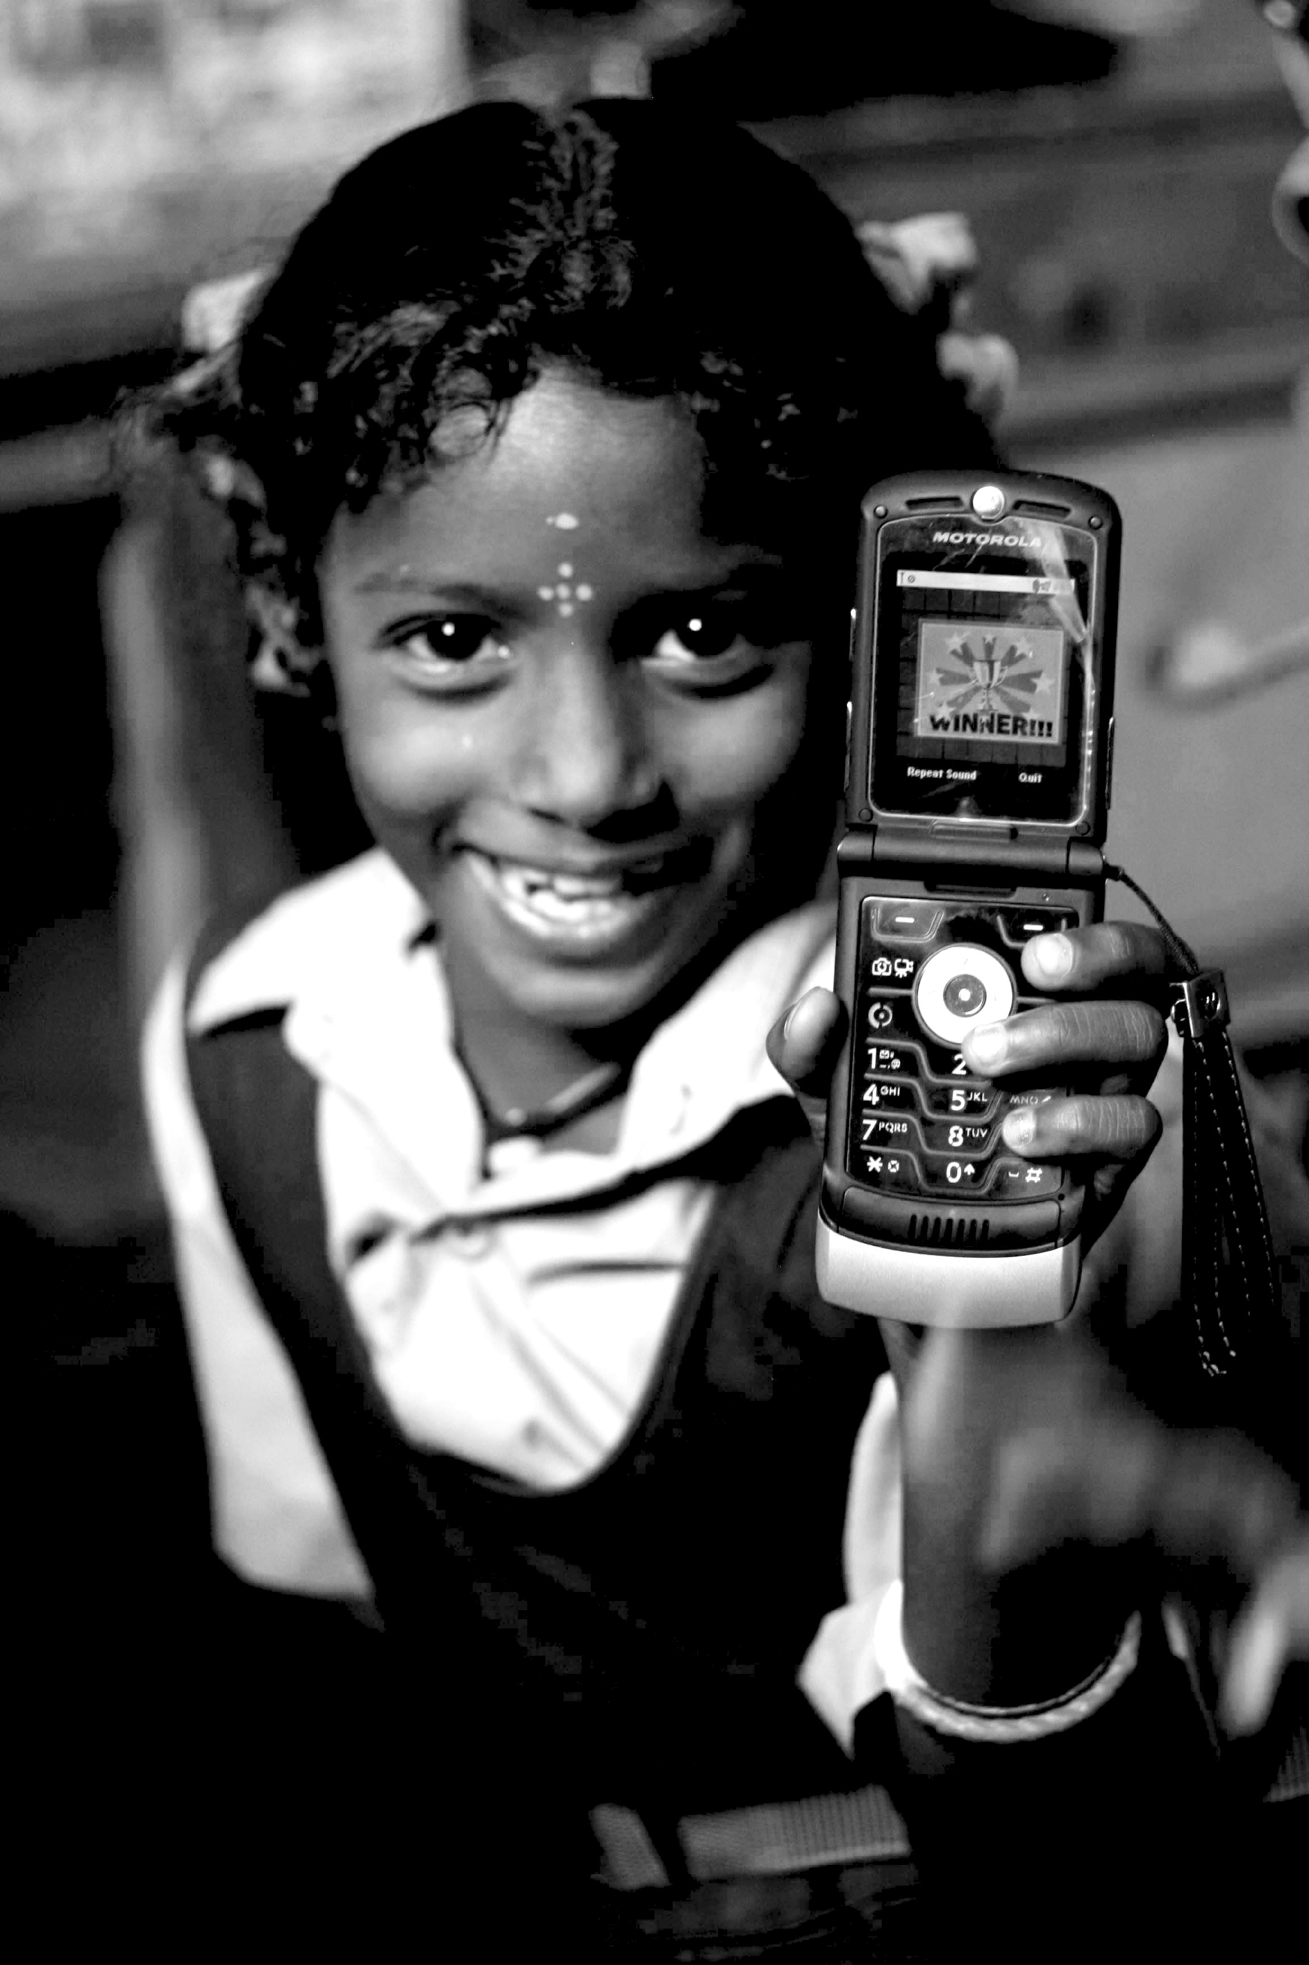
Technology &
Poverty
I181
Janaki Srinivasan
Neha Kumar

Slide 2
Outline for Today
Grades
Review of key questions from Class 1
Our attempts to answer these
Your attempts to answer these

Slide 3
Grades!
Class Participation: 5
Activities: 10
  Technology and Poverty photograph: 2
    2 if submitted, 0 if not
  Green Revolution: 4
    Your scores have been doubled!
  Sproul Plaza: 2
    2 if submitted, 0 if not
  Community Radio: 2
Reading Responses: 15 overall, 5 each
  √- = 2
  √ = 4
  √+ = 5
Assignment 1: 30
Assignment 2: 40
  To pass: 60

Slide 4
The Key Questions
What’s the history of the idea that technology can help alleviate poverty, bring about development?
What models of development, definitions of technology, and metrics of poverty did such ideas give rise to?
How do “the poor” describe their lives and use these technologies?

Slide 5
Back to the beginning

Slide 6
The Key Questions
What’s the history of the idea that technology can help alleviate poverty, bring about development?
What models of development, definitions of technology, and metrics of poverty did such ideas give rise to?
How do “the poor” describe their lives and use these technologies?

Slide 7
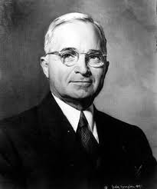
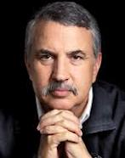
History of an Idea
?
?
1949
2005

Slide 8
Technology and Development in 1949
Truman's Inaugural Address (January 20, 1949)
“The material resources which we can afford to use for assistance of other peoples are limited. But our imponderable resources in technical knowledge are constantly growing and are inexhaustible. I believe that we should make available to peace-loving peoples the benefits of our store of technical knowledge in order to help them realize their aspirations for a better life. And, in cooperation with other nations, we should foster capital investment in areas needing development.”
“Greater production is the key to prosperity and peace. And the key to greater production is a wider and more vigorous application of modern scientific and technical knowledge.”
Text available: http://www.trumanlibrary.org/whistlestop/50yr_archive/inagural20jan1949.htm

Slide 9
Technology and Development in 2005
Friedman tells us:
Technology has made the World
“Flat”

Slide 10

Questions for Truman and Friedman
(and for us!)
Does technology determine
social, economic, political change?
Notes:
The idea of technological determinism

Slide 11
How does technology operate
in a world
that is NOT flat?
Source: Richard Florida’s “The World is Spiky,” Atlantic Monthly, October 2005.

Slide 12
The Key Questions
What’s the history of the idea that technology can help alleviate poverty, bring about development?
What models of development, definitions of technology, and metrics of poverty did such ideas give rise to?
How do “the poor” describe their lives and use these technologies?

Slide 13
Technology: Review
As artifact and as ideology (‘hazardous’ concept?)
The material form of a technology as shaped by social processes (see SCOT)
  Relevant Social Groups
  Interpretive Flexibility
  Closure
  Black-boxing
Guard against Technological Determinism!

Slide 14
Development: Review
Paradigms of Development
  Neoclassical Economics & Modernization Theory
  Marxist Economics & Dependency Theory
Models and Metrics of Development from the Dominant Paradigm
Changes in Metrics and Models over six decades
    Aid regime (1950s-1960s)
    Basic needs (1970s)
    Structural adjustment/ Washington consensus (1980s-1990s)
    New Institutionalism (post 1990s)

Slide 15
Development:
Two paradigms*
Neoclassical Economics & Modernization Theory
  Linear path to modern model of the West (capitalist industrialization + liberal democracy)
  Technology’s Role: Push to change from simple and traditional techniques to the application of scientific knowledge.
Marxist Economics & Dependency Theory
  Growth of developed world only possible at the expense of developing regions. Aid is exploitative and paternalistic. Inequalities intensify. The imperialist project continued.
  Technology's Role: Expanding the market for Western innovations – industrial equipment, fertilizers and pesticides, etc.
  *Read Thomas (2000) for more on differences between the two
  Rostow (1960) and Easterly (2002) for rise and decline of development economics and Modernization theory
  Frank (1966) for Dependency Theory

Slide 16
Dominant Models of Development
AID REGIME
BASIC NEEDS
STR. ADJ. + WASHINGTON CONSENSUS
NEW INSTITU-TIONALISM
1950
1960
1970
1980
1990
2000

Slide 17
Changing Models of Development
Aid regime (1950s-60s) based on neoclassical theory of economic growth = aid for investment, capital for industrialization
Basic needs (1970s) = investments to raise the productivity of the poor
Structural Adjustment and the Washington Consensus (1980s and 1990s) = aid tied to policy changes, liberalization, reduction of government, opening up to global trade
New institutionalism (post 1990s) = the government matters after all – social welfare role, to ensure functioning markets and to provide health/education thus keeping the labor force productive

Slide 18
Changing Metrics too?
From GDP-centric definitions
To
  Capabilities Approach = change in per capita GDP is not development; development is the generation of political, economic, social freedoms (Sen’s capabilities approach in today’s reading)
  Sustainable Development (late 1980s) = growth but with more careful resource management and environmental preservation to ensure long-term continuation (Bruntland report)
  UN’s Millennium Development Goals (MDGs) = aid is tied to targeting and accomplishing the multi-dimensional MDGs
Notes:
(instead of the policies of the Washington Consensus)

Slide 19
Model of Development as
Framework for Analysis
A model of development
  entity doing development
  object of development
  goals of development
  preferred means of development
    Role of technology?
Notes:
We have learnt now, of course that there’s more of interest in a development project in practice, than the rows of this framework.
Its costs and benefits are not unforrmly distributed: important to understand this distribution and these variations
Nor are the costs and benefits in practice the same as what project designers imagined: important to understand how the project technologies and goals are appropriated and subverted by the communities targeted

Slide 20
Thinking Big in Industrialization
 | Akosombo Dam
Who is doing the development | World Bank, national government, Kaiser?
What/Who is being developed | The national economy
Proximate change (short-term) to be brought about | Electricity supply for factories, to sell to neighbors, self-sufficiency in power generation
The eventual outcome or development to accomplish | Industrialization of economy leading to growth and higher standard of living
Mechanism for bringing about this change | Building a hydroelectric dam with financial support from a consortium of international investors (USAID, Kaiser, etc.)
Notes:
Costs: borne by displaced villagers
Benefits: for urban areas where employment went up, electrification
Unexpected costs-with new diseases

Slide 21
Thinking Big in Agriculture
 | Green Revolution
Who is doing the development
What/Who is being developed
Proximate change (short-term) to be brought about
The eventual outcome or development to accomplish
Mechanism for bringing about this change

Slide 22
Re-Thinking BIG
Rethinking
  scale
  distribution of costs and benefits (and who decides)
  ecological considerations
Alternatives?
  Appropriate technologies
  Sustainable development
  Participatory development
    Social entrepreneurship?

Slide 23
Appropriate Technology
“What can be done to bring health to economic life outside the big cities, in the small towns and villages which still contain – in most cases – 80 to 90 per cent of the total population?”

Slide 24
Sustainable Development
Short-term productivity gains come with rapid depletion of resources that puts future production in jeopardy.
Boosting yields isn’t enough. We must also consider how to manage natural resources to ensure future productivity.
Brundtland Report (1987) stresses the need for sustainable development.

Slide 25
Participatory Development -Chambers (1990s)
Data Collection for Needs Assessment
  Emphasis on consultation
    “the basic human right of poor people to conduct their own analysis.”
  Data should be shared
    rather than extracted

Slide 26
“Whose Reality Counts?”
How are variations accounted for?
  “the realities of poor people are local, complex, diverse and dynamic”
How are priorities set?
  “one may speculate on what topics the poor and powerless would commission papers if they could convene conferences and summits”
  “what matters most to [the poor] often differs from what outsiders assume, is not always easy to measure, and may not be measurable at all”

Slide 27
Just another Bottom-Up Approach?
Participatory Development | Social Entrepreneurship
Means | Ends
Carried out by the Group | Championed by a tireless individual
‘Socio-cultural animator’ | Entrepreneur
The targeted community are key collaborators | Does not explicitly identify what relationship with targeted community ought to be
Notes:
View 1: Poor as market
View 2: Emphasizes creativity, ‘giving back’ while engaging market pressures

Slide 28
Enter
Information Age and
Digital Technologies
Notes:
As Models of Development changed and stabilized, what was happening with Technological Innovations. What was changing with the technologies that dev agencies were willing to fund, people were willing to adopt

Slide 29
Eras defined by (technological) innovations
The First Industrial Revolution (18th century) – spinning Jenny, steam engine, transport
The Post-Industrial Society
Information revolution?
The Information Economy
The Second Industrial Revolution (from around 1850) – steel and electricity
The Network Society
The Atomic Age?
Adam Smith
Karl Marx
Daniel Bell
Alvin Toffler
M.U. Porat
Fritz Machlup
Manuel Castells
Notes:
First, there was the agricultural revolution. Then came the two industrial revolutions. And finally now, are we in the midst of an information revolution? Many theorists talk of an information age or society and these discussions implicitly seem to recognize an information revolution. Webster mentions many of these theories. We will take a look at the 6 categories of theories he describes in a bit. But before that, a quick look at some of the influential theories describing the information age.

Slide 30
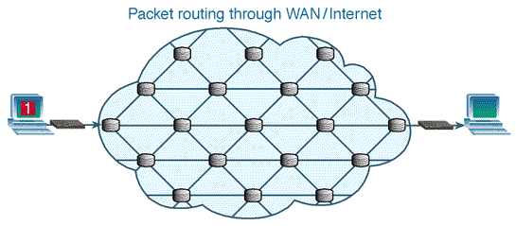
Information Societies
What is information to Info Society theorists?
Influence of Information Theory (a field of applied mathematics)
  “the fundamental problem of communication is that of reproducing at one point, either exactly or approximately, a message selected at another point.”
  – Claude Shannon, Bell Labs 1948
Notes:
http://www.teach-ict.com/technology_explained/packet_switching/packet.switching.gif
One thing to notice in these info society theories is what each means by information. Second, do they see information as something that has meaning or not.

Slide 31
Information Societies: Criticism
  Ignores issues of information quality
  More of something (quantitative increase) doesn’t necessarily yield a changing social order (qualitative change
  Info-determinism in play?
  Centrality of information in society is not new
    all societies place central importance on information (Castells, Giddens, Darnton!)

Slide 32
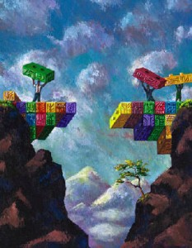
The Digital Divide
Notes:
When we think about Development in an information society, when we think about the technologies involved in bringing about development in this society, the issue of a digital divide comes up. The most common way of thinking about it is that it’s a demarcation – a line that we draw between the haves and have-nots. …is generally the difference in percentage of individuals with access to digital technologies. And it often correlates with gender, race, geographic location, caste, class, education level, and/or income.

Slide 33
Not One But Many
Rich, educated, powerful vs. not
Linguistic and cultural
Rich nations vs. poor
Emergence of the digerati
Notes:
Keniston.

Slide 34
Bridging the Divide
What is the end-goal?
  Improvements in socio-economic conditions
  Improvements in the realms of governance, education, health…
What are the means?
  Providing access to ICTs
    What is meant by ‘access’?
    What is included in ‘ICTs’?
Notes:
“looks through rather than at the object at hand” - Larkin

Slide 35
Dimensions of Accessing ICTs
Hard infrastructure (fiber optic, copper, wireless, etc)
‘Soft’ infrastructure (government policy)
Business models (to lower cost, ensure ongoing feasibility)
Connecting Devices (MultiMouse, OLPC, desktop PC) and access models (individual or shared access)
Socio-cultural dimensions (specifically as they relate to gender and class)
Notes:
caste and the MultiMouse

Slide 36
A Divide between
‘Haves’ and ‘Have-nots’…?
Those who have used a technology (at least once) vs. those who never have
Those who can get to and pay for technology (though some may choose not to use it)
Frequency of use and whether this is equitable between groups
Quality of use and actual benefits (perhaps frequency doesn’t reflect this?)
Or a Spectrum of Access and Use?

Slide 37
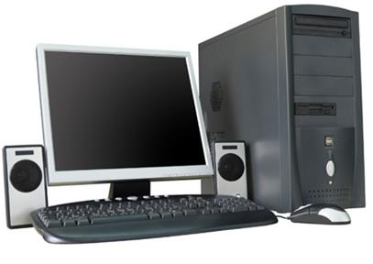
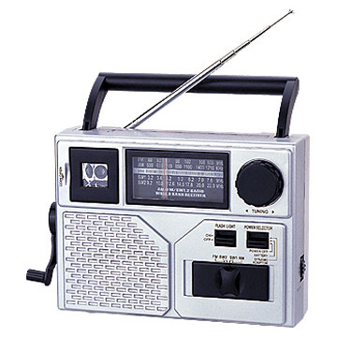
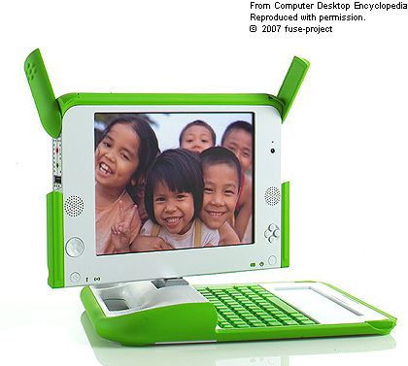
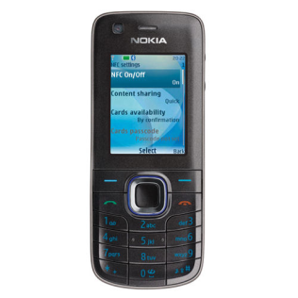
‘ICT’: Single Technology?
Form factor (physical dimensions (size) and hardware configuration)
Input/output mechanisms (i.e. voice vs. text, keyboard vs. keypad vs. touchscreen)
Repurposed vs. Custom device (desktop computer vs. One Laptop Per Child device)
Or a Range of Connecting Devices?
Notes:
Photo source: NY times

Slide 38
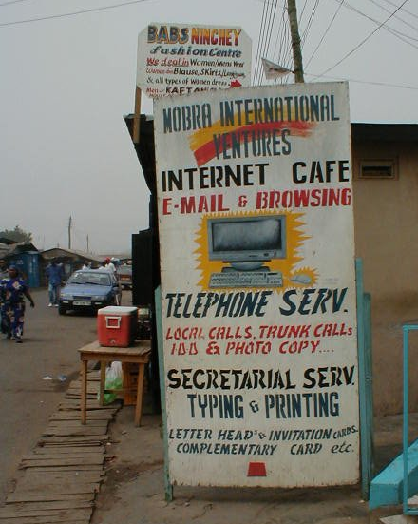
Making Connecting Devices Accessible
Low-cost devices
  OLPC
Shared Access devices
  Multimouse
Public Access or Pay Per Use
  Kiosks

Slide 39
Towards Development?
Notes:
The ones we looked at in this class

Slide 40
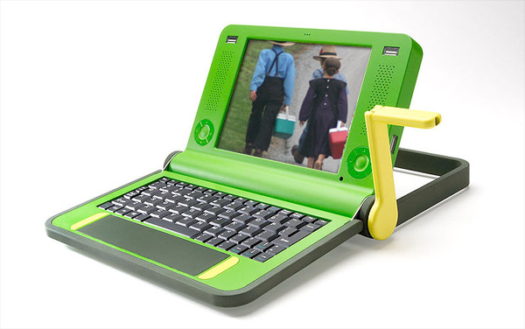
OLPC
 | OLPC
What/Who is being developed | Kids (elementary school age) [not schools, teachers]
Proximate change (short-term) to be brought about | Smarter, more creative, problem-solving children
The more distant outcome/development to accomplish | Possibly a better more-educated labor force? A new generation that can solve the countries’ problems in unique ways?
Mechanism for bringing about this change | Distribution of a special kind of inexpensive, durable laptop with software that will bring about this evolution/education of children

Slide 41
Quest to Learn
 | Q to L
What/Who is being developed | Middle graders in NYC
Proximate change (short-term) to be brought about | Learn Better
The more distant outcome/development to accomplish | Smarter, more creative, problem-solving children for a digital age
Mechanism for bringing about this change | Gaming-centric School Curriculum

Slide 42
Public Access Village Kiosks
 | Kiosks
What/Who is being developed | Village Residents
Proximate change (short-term) to be brought about | Ready access to Information
The more distant outcome/development to accomplish | Better functioning market, government (with e-governance services)
Mechanism for bringing about this change | Information Provision using ICTs in kiosks
Notes:
But of course, we saw in the case of Bhoomi’- a land records project and SARI, another e-gov kiosk project that this worked differently. Costs and benefits went to different parts of a community. In Bhoomi, large farmers and large real estate agents benefitted through the availability of digitised records. Small-scale farmers and those with disputes on their land or shaky land tenure had less recourse to local-level officials now and were in danger of losing their land as the land mafia found it easier to buy up disputed land.
If the costs and benefits were not equally distributed in Bhoomi, I n the SARI case, besides that, the benefits were not even what the project envisioned: information provision did not turn out to be the most useful consequence

Slide 43
Community Radio
 | Our Voices
What/Who is being developed
Proximate change (short-term) to be brought about
The more distant outcome/development to accomplish
Mechanism for bringing about this change

Slide 44
Citizen Media
 | CGNet Swara
What/Who is being developed
Proximate change (short-term) to be brought about
The more distant outcome/development to accomplish
Mechanism for bringing about this change

Slide 45
Citizen Media
 | Acopio, Mobileworks…
What/Who is being developed
Proximate change (short-term) to be brought about
The more distant outcome/development to accomplish
Mechanism for bringing about this change

Slide 46
The Key Questions
What’s the history of the idea that technology can help alleviate poverty, bring about development?
What models of development, definitions of technology, and metrics of poverty did such ideas give rise to?
How do “the poor” describe their lives and use these technologies?

Slide 47
Appropriation of Technology
Notes:
By the user.

Slide 48
Mobile Use in China

Slide 49
Mobile Use in India

Slide 50
Your attempt at these questions?
What’s the history of the idea that technology can help alleviate poverty, bring about development?
  Possibly in Assignment 1
What models of development, definitions of technology, and metrics of poverty did such ideas give rise to?
  Green Revolution debate, Assignment 1
How do “the poor” describe their lives and use these technologies?
  Assignment 1 and 2

Slide 51
Our Objectives?
Notes:
I guess we’ll find out ☺.

Slide 52
Technology beyond Instrumentalism
Technology
as shaped by the social, political, and economic
as a powerful ideological concept (as ‘hazardous’)
as meaning something more to poor populations than a ‘solution’ to their ‘poverty’

Slide 53
Poverty beyond Metrics
Poverty
as having no universal, uncontested definition or metrics
as relational, rather than about an absolute lack of assets
not just as described by institutional perspectives and metrics
BUT also as described by the diverse people who experience it

Slide 54
Access beyond Developmentalism
Needs beyond the Material
Worth Adding to the List?
Notes:
We already saw with many of our examples, esp. Elisa and Neha’s cases how technology is appropriated, often in ways much beyond what technology designers imagined, but also beyond or in conflict with what the designers of a development project imagined as the useor benefits of a project or technology.Remember the debates about development or entertainment?
Liang takes this much further. He says that when we talk about ineuality or equality in a society, we should not be focusing only on material needs in the first place.
We need to look beyond the material needs of the poor. Of course those are important, but what about their intellectual lives? What if it’s their intellectual lives that the use of digital technologies address. He uses the example of a project called cyber mohalla (locality) in Delhi where working class young adults have used digital technologies to write, blog, create broadsheets, videos about their everyday lives in Delhi. He says this has had fundamentally consequences for their lives- but not always in addressing their material needs. It ahs instead addressed their intellectual needs.
So, perhaps worth adding “access beyond Developmentalism” or “needs beyond the material” to our list?

Slide 55
Did we succeed?
Notes:
I guess we’ll find out ☺.

Slide 56
Thank you!
Notes:
To our many guest speakers, to Jenna Burrell. To each other. But most of all, to all of you. When we read your essays or responses, we have sometimes between frustrated, but mostly, it’s been an immense pleasure to watch all of you grapple with ideas, reach your own conclusions. Thank you for giving us that opportunity an that joy. Hope it has been worth your time!

