Slide 1
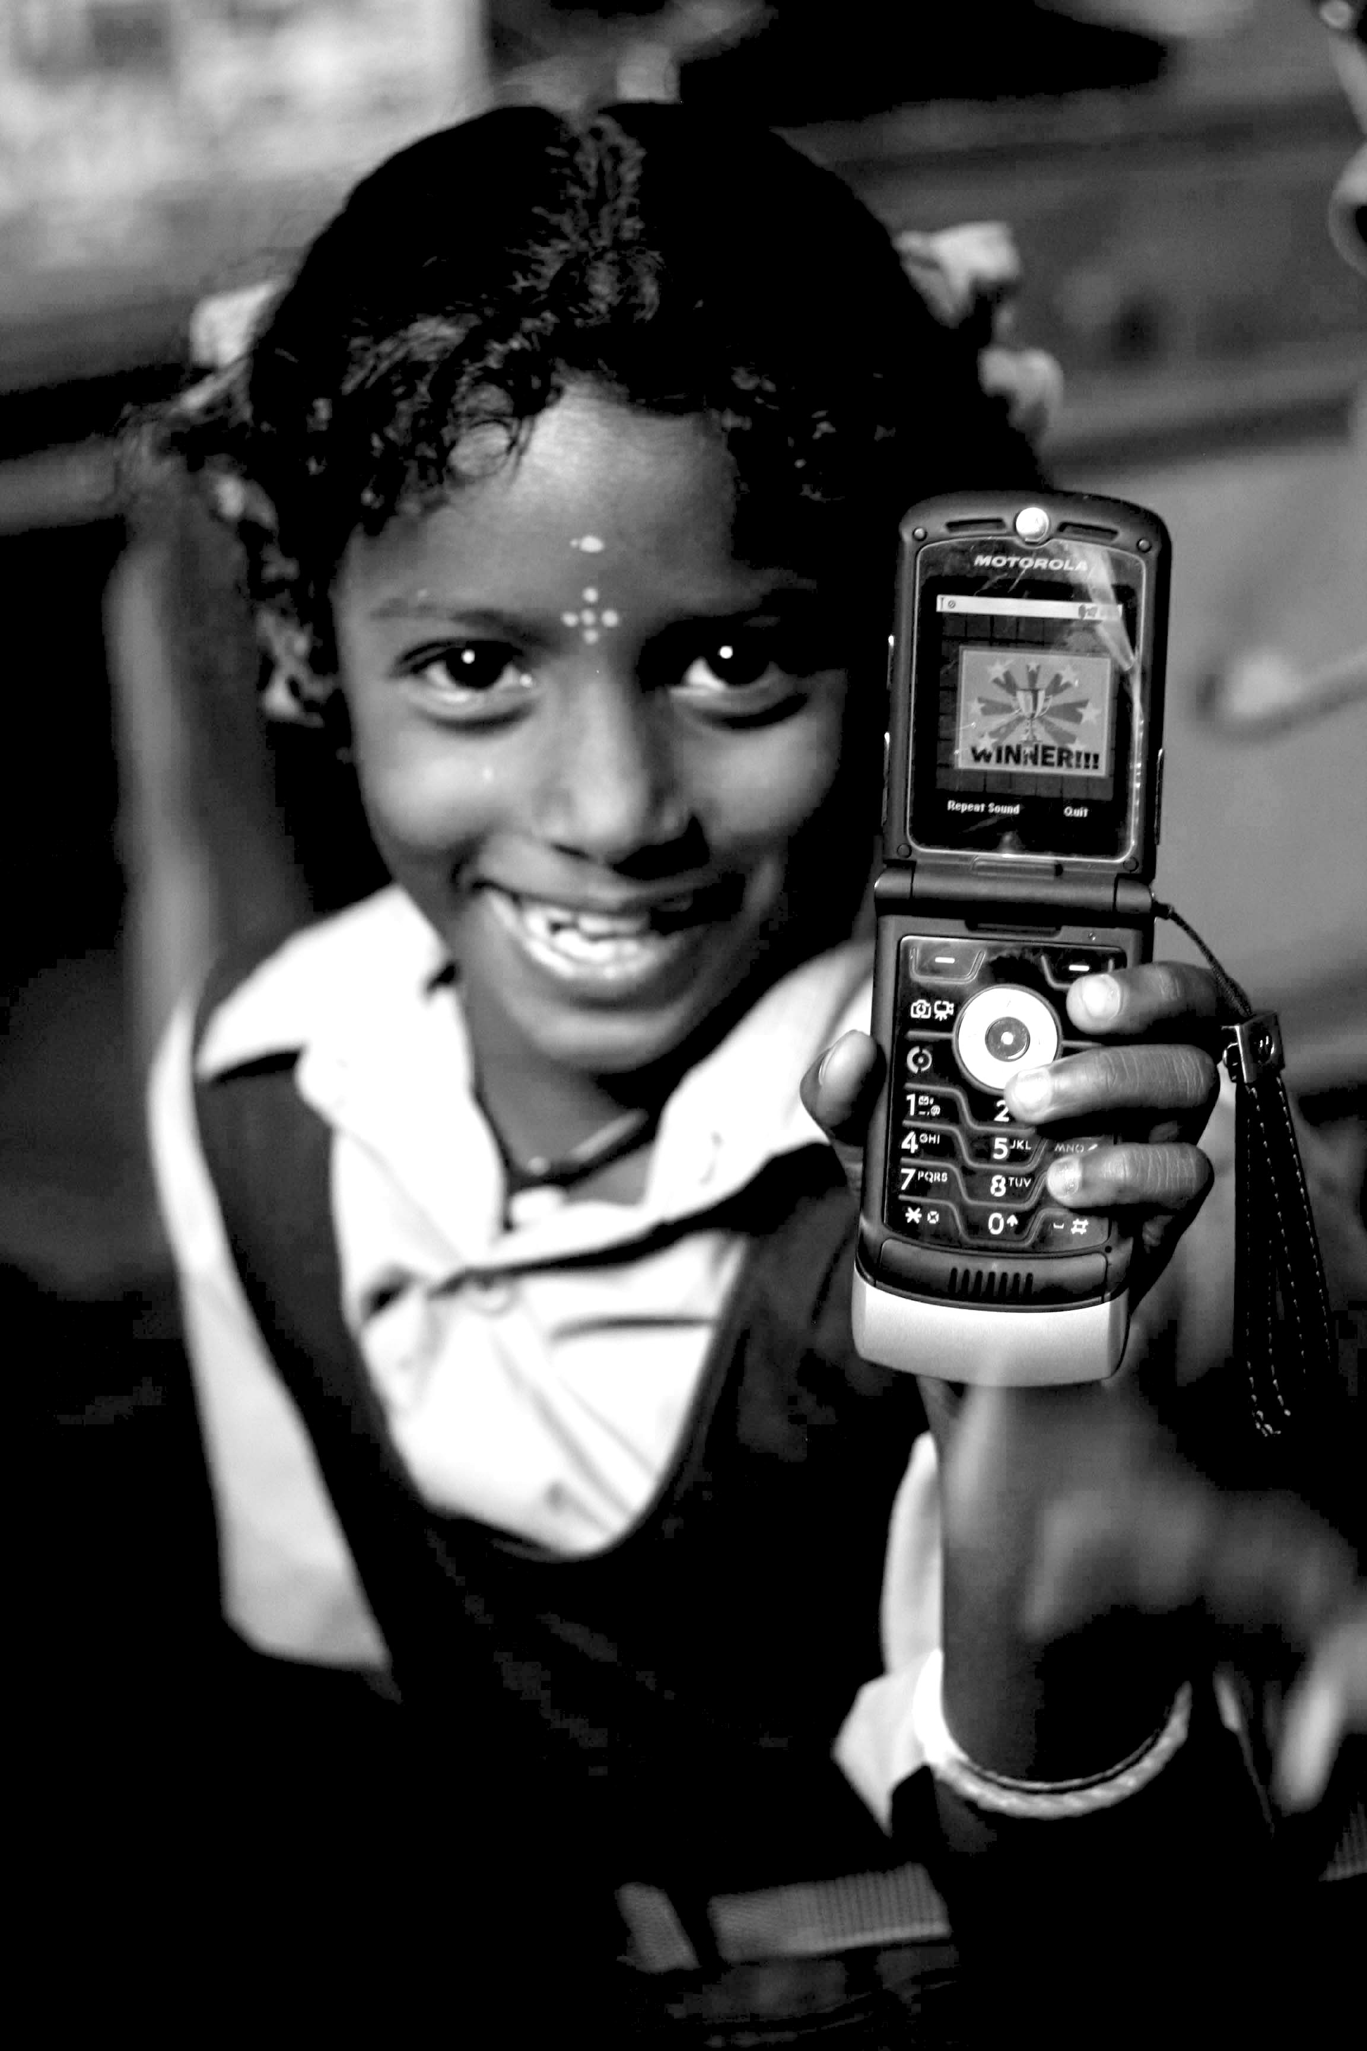
Technology & Poverty
I181
Janaki Srinivasan
Neha Kumar

Slide 2
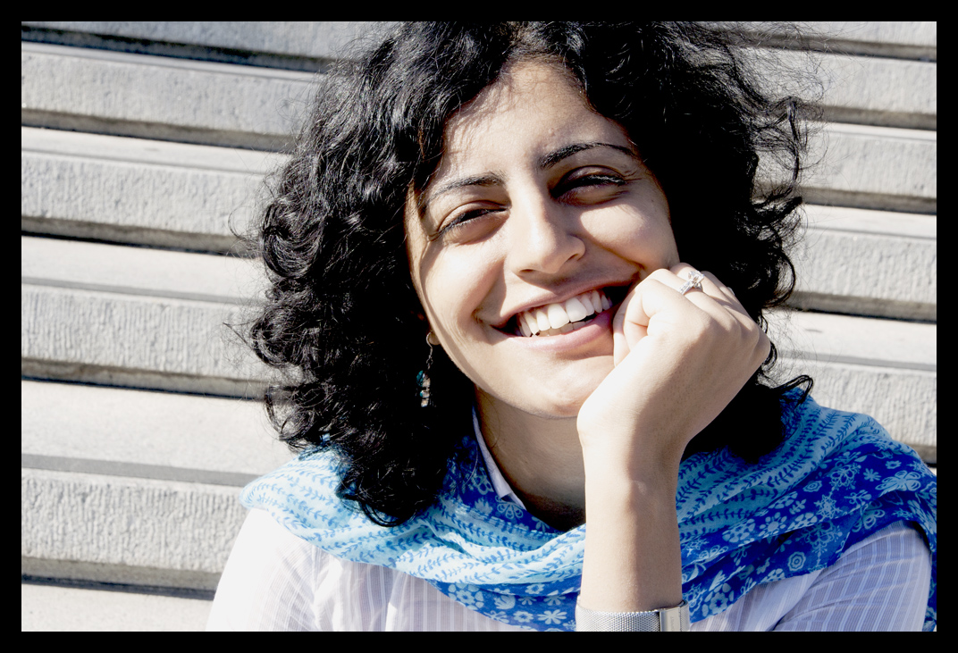
Course Instructors
Janaki Srinivasan
Research interests and regions: political economy of development, access to government information, e-governance, Information and Communication Technologies and Development (ICTD), India
Neha Kumar
Research interests and regions: mobile phones, entertainment media, social media, piracy, user-centered design, India

Slide 3
Outline for Today
Technology & Poverty: in the News
Technology & Poverty: a Historical Perspective
About the Course
Break
Introductions
TED Talk
Thursday’s Lecture

Slide 4
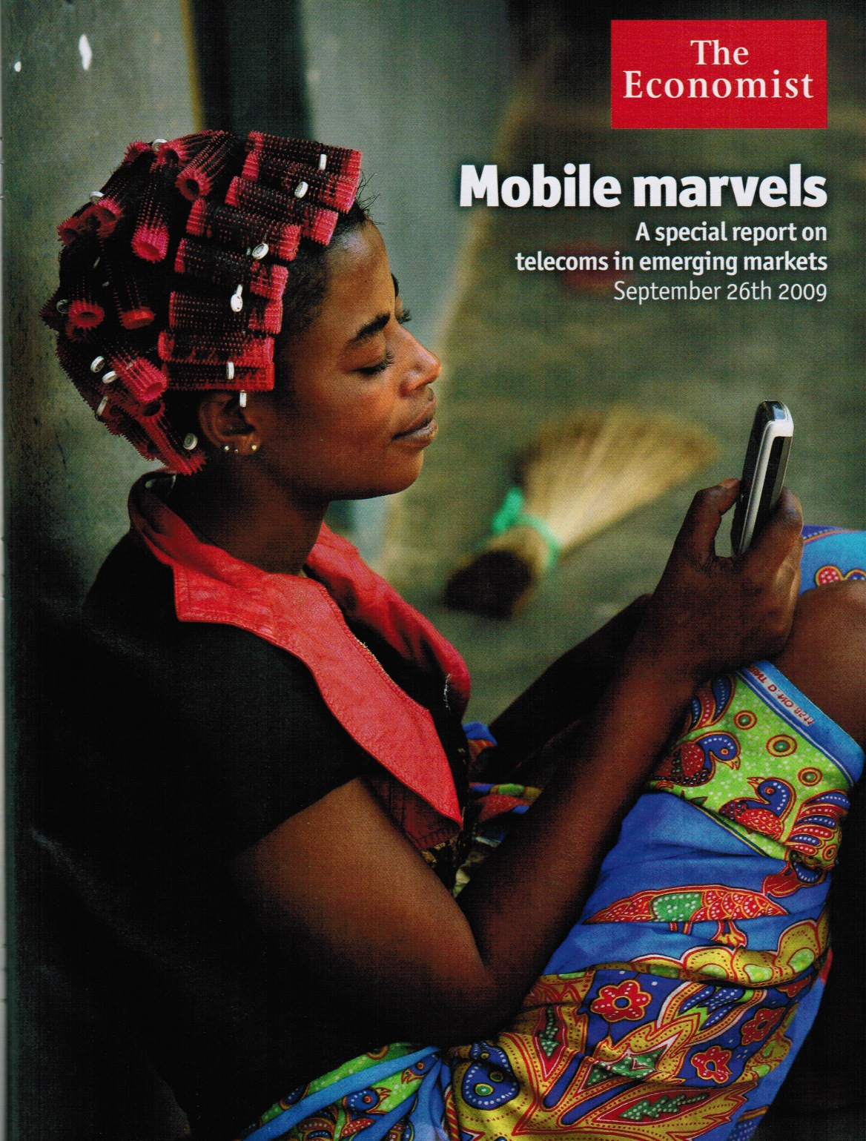
[image from the Economist]

Slide 5
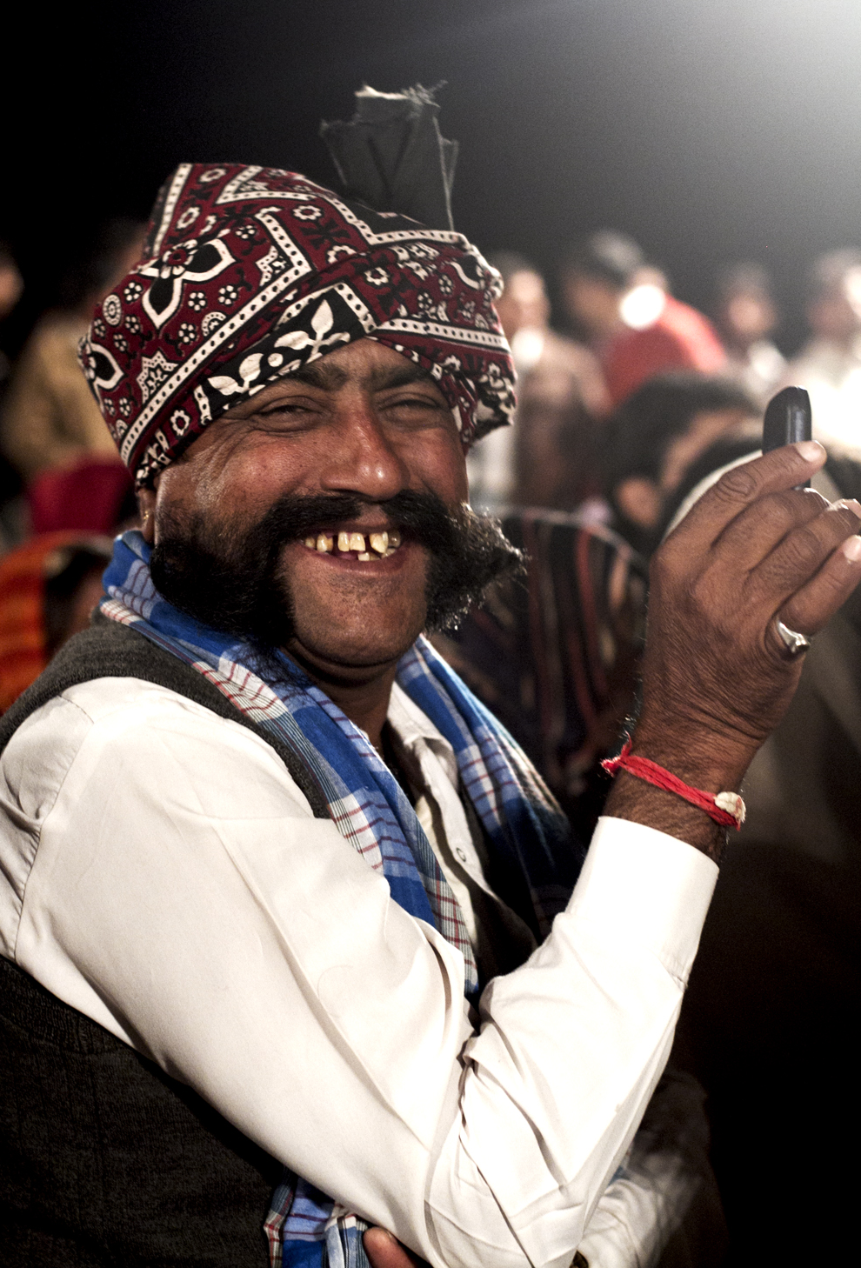
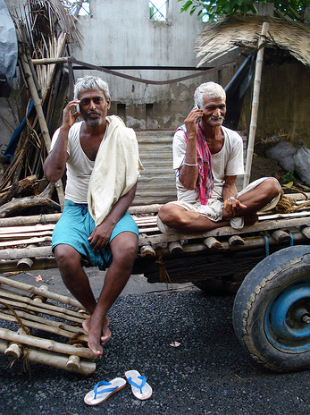
Diffusion of Technology

Slide 6
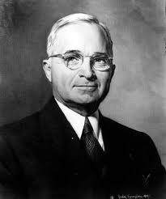
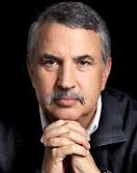
History of an Idea
?
?
1949
2005

Slide 7
Technology and Development in 1949
Truman's Inaugural Address, delivered January 20, 1949
“The material resources which we can afford to use for assistance of other peoples are limited. But our imponderable resources in technical knowledge are constantly growing and are inexhaustible. I believe that we should make available to peace-loving peoples the benefits of our store of technical knowledge in order to help them realize their aspirations for a better life. And, in cooperation with other nations, we should foster capital investment in areas needing development.”
“Greater production is the key to prosperity and peace. And the key to greater production is a wider and more vigorous application of modern scientific and technical knowledge.”
Text available: http://www.trumanlibrary.org/whistlestop/50yr_archive/inagural20jan1949.htm

Slide 8
“the world is flat…”
or is it?

Slide 9
Your Highnesses, as Catholic Christians, and princes who love and promote the holy Christian faith, and are enemies of the doctrine of Mahomet, and of all idolatry and heresy, determined to send me, Christopher Columbus, to the above-mentioned countries of India, to see the said princes, people, and territories, and to learn their disposition and the proper method of converting them to our holy faith; and furthermore directed that I should not proceed by land to the East, as is customary, but by a Westerly route, in which direction we have hitherto no certain evidence that anyone has gone.
Entry from the journal of Christopher Columbus on his voyage of 1492

Slide 10
“Columbus accidentally ran into America but thought he had discovered part of India. I actually found India and thought many of the people I met there were Americans. Some had actually taken American names, and others were doing great imitations of American accents at call centers and American business techniques at software labs.”
“Columbus reported to his king and queen that the world was round,
and he went down in history as the man who first made this discovery. I
returned home and shared my discovery only with my wife, and only in
a whisper.”
"Honey," I confided, "I think the world is flat."

Slide 11
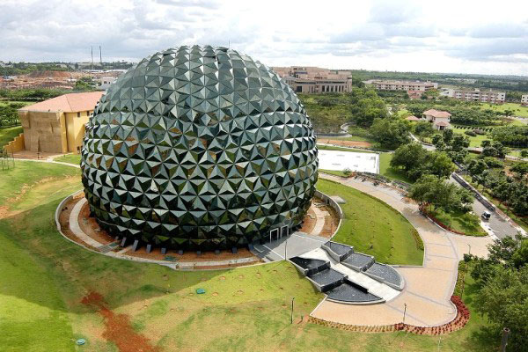
infosys (bangalore, india)

Slide 12
"We could be sitting here, somebody from New York, London, Boston, San Francisco, all live. And maybe the implementation is in Singapore, so the Singapore person could also be live here ... That's globalization.”
Nandan Nilekani (Ex-CEO, Infosys Technologies)

Slide 13
"What happened over the last [few] years is that there was a massive investment in technology, especially in the bubble era, when hundreds of millions of dollars were invested in putting broadband connectivity around the world, undersea cables, all those things.”
“Tom, the playing field is being leveled.”
Nandan Nilekani (Ex-CEO, Infosys Technologies)

Slide 14
“My God, he’s telling me the world is flat.”

Slide 15
globalization 1.0

Slide 16
globalization 2.0

Slide 17
globalization 3.0
“Globalization 3.0 makes it possible for so many more people to plug and play, and you are going to see every color of the human rainbow take part.”

Slide 18
“Wages and rents in Bangalore are less than one-fifth what they are in those Western capitals.”
“In addition to being able to pay an analyst in Bangalore about $15,000 in total compensation, as opposed to $80,000 in New York or London, Reuters has found that its India employees tend to be financially literate and highly motivated as well. “
“These call center jobs are low-wage, low-prestige jobs in America, but when shifted to India they become high-wage, high-prestige jobs.”

Slide 19
“Work gets done where it can be done most effectively and efficiently. That ultimately helps the New Londons, New Bedfords and New Yorks of this world even more than it helps the Bangalores and Shenzhens. It helps because it frees up people and capital to do different, more sophisticated work, and it helps because it gives an opportunity to produce tile end product more cheaply, benefiting customers even as it helps the corporation.”

Slide 20
the world is flat

Slide 21
is the world flat?

Slide 22
Questions for Truman and Friedman (and for this course!)
Does technology determine
social, economic, political change?

Slide 23
How does technology operate
in a world
that is NOT flat?
Source: Richard Florida’s “The World is Spiky,” Atlantic Monthly, October 2005.

Slide 24
Key Questions for this Course
What’s the history of the idea that technology can help alleviate poverty, bring about development?
What models of development, definitions of technology, and metrics of poverty did such ideas give rise to?
How do “the poor” describe their lives and use these technologies?

Slide 25
Technology beyond Instrumentalism
Technology
as shaped by the social, political, and economic
as a powerful ideological concept (as ‘hazardous’)
as meaning something more to poor populations than a ‘solution’ to their ‘poverty’

Slide 26
Poverty beyond Metrics
Poverty
as having no universal, uncontested definition or metrics
as relational, rather than about an absolute lack of assets
not just as described by institutional perspectives and metrics
BUT also as described by the diverse people who experience it

Slide 27
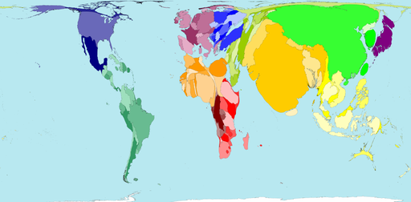
Is this our world?
developing countries." Hania Zlotnik, 2005
The size of each territory shows the relative proportion of the world's population living there.
The size of each territory shows the relative proportion of the world's population living there.
From Worldmapper.org, based on figures from 2002.

Slide 28
Or is this?
It’s all about the metrics, honey!

Slide 29
Course Themes
What is Technology? What is Poverty?
Evolution of theories and models of development and poverty alleviation(1950s-2000s)
Role of technology
Role of social structure and user agency
Digital Divide and Information Society

Slide 30
Course Themes (contd.)
Access to technology and user appropriation of technology
Personal computers and the internet
Community radio
Mobile phones
Technology in health, education, governance
Revisiting Technology & Poverty

Slide 31
Course Organization
Lectures and Guest Speakers
Readings and Case Studies
In-class Activities
Assignments
Reading responses (up to 4)
Assignment 1: Poverty as diversely experienced
Assignment 2: Analysis of a technology project
Course website
http://blogs.ischool.berkeley.edu/i181su12/

Slide 32
Administrivia
Submissions
Mailing List
Grades
Class Participation + Readings: 30%
Assignment 1: 30%
Assignment 2: 40%
Academic Honesty
Laptops

Slide 33
Take a break!

Slide 34
Introductions
Find a friend.
Get to know them.
Introduce them to us.

Slide 35
Homework
Share an image that speaks to you of Technology & Poverty.

Slide 36
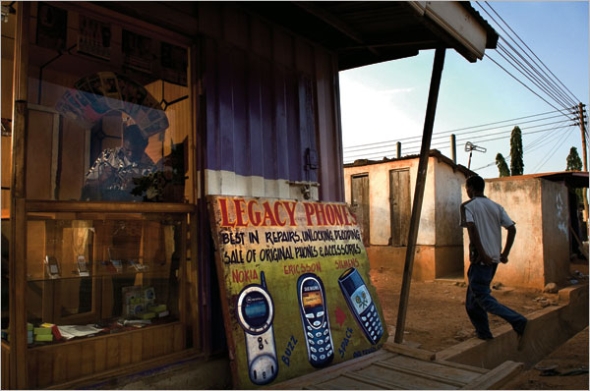
“Selling to the other three billion”
Find an image that speaks to you of “Technology & Poverty”
Source: www.nytimes.com

Slide 37
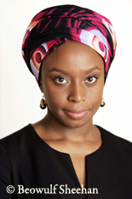
The Danger of a Single Story
“The single story creates stereotypes, and the problem with stereotypes is not that they are untrue, but that they are incomplete. They make one story become the only story.”
Nigerian author Chimamanda Adichie
at TEDGlobal 2009
http://www.ted.com/talks/chimamanda_adichie_the_danger_of_a_single_story.html

Slide 38
On Thursday (5/24)
Themes for discussion
What is technology?
What is development?
Due before class
Do the readings: Marx, Heilbroner, Thomas
Email reading response #1
Photos due Wednesday at midnight
Activities in class
Discussion of photos
Discussion of readings and themes

